Slide 1
ML BUBBLE 2026 · TE-BE ADVANCED TRACK · FINTECH
FairCredit
Explainable, fairness-audited credit default prediction
Where the real engineering lives after the AUC: cost-aware, fair, and explainable decisions.
30,000
4
~20%
SHAP
clients
models compared
equal-opp gap ↓
reason codes
Siddharth Kancharla & Kancharla Sricharan · IIIT Sri City

Slide 2
THE PROBLEM
A high AUC is not a deployable lending model
Predicting default looks solved. But a bank cannot ship a model that is only accurate — it is regulated on three things that pure accuracy ignores:
!
⚖
?
Cost blindness
Unfair decisions
Black-box denials
A 0.5 cutoff assumes approving a defaulter costs the same as rejecting a good customer. It does not — one loses principal.
A high-AUC model can still approve or reject protected groups at systematically different rates. That is illegal, not just unkind.
Fair-lending rules require the lender to give the specific reasons for an adverse decision. A raw probability cannot.
FairCredit adds cost-sensitivity, a fairness audit + mitigation, and reason codes on top of a strong comparative baseline.
FairCredit · ML Bubble 2026
01

Slide 3
DATA & RATIONALE
Six months of behaviour → next-month default
Why ML: default is driven by non-linear interactions across a repayment panel that hand-written rules capture poorly. Gradient-boosted trees model them directly and, via SHAP, expose the drivers.
Engineered signal
Utilisation
30,000
22.1%
bill ÷ credit limit, per month + mean
credit-card clients (Taiwan, 2005)
default rate — genuinely imbalanced
Repayment ratio
payment ÷ previous bill, per month + mean
42
64/16/20
Delinquency
months in arrears, max & mean delay
features — 19 engineered
seeded, leakage-safe splits
Exposure & trend
total bill, total paid, 6-month trend
FairCredit · ML Bubble 2026
02

Slide 4
METHODOLOGY
A leakage-safe, five-stage pipeline
1
2
3
4
5
Prepare
Compare
Cost
Fairness
Explain
Clean messy codes, engineer 42 features, stratified split
›
Train 4 imbalance-aware models, rank by AUPRC
›
Tune decision threshold on validation, 5:1 cost ratio
›
Audit bias across sex, mitigate with group thresholds
›
SHAP global drivers + per-applicant reason codes
Rigour: the test set is touched exactly once. Model choice and thresholds are decided on validation only — no leakage, so the reported numbers are honest.
FairCredit · ML Bubble 2026
03

Slide 5
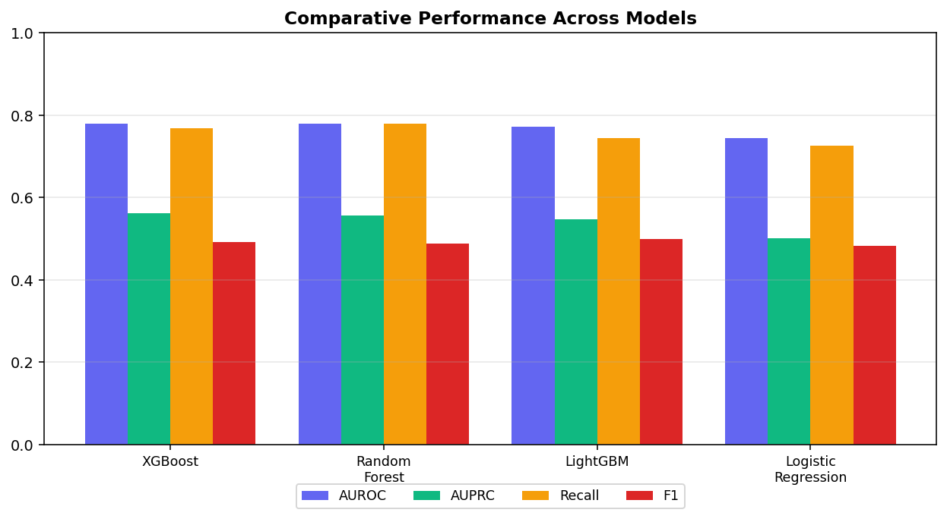
COMPARATIVE ANALYSIS
Four models, one clear winner
Model | AUROC | AUPRC | Recall | F1
XGBoost ★ | 0.780 | 0.561 | 0.768 | 0.492
Random Forest | 0.779 | 0.556 | 0.779 | 0.488
LightGBM | 0.772 | 0.548 | 0.744 | 0.498
Logistic Regression | 0.744 | 0.500 | 0.725 | 0.482
Narrative. The linear baseline is respectable, but the boosters add ~3.5 AUROC and ~6 AUPRC points by modelling repayment-panel interactions. XGBoost wins on validation AUPRC and is selected; LightGBM is the pick if latency matters.
AUPRC is the headline metric — on a 22%-positive target, plain accuracy is misleading (predict “no default” for all ≈ 78%).
FairCredit · ML Bubble 2026
04

Slide 6
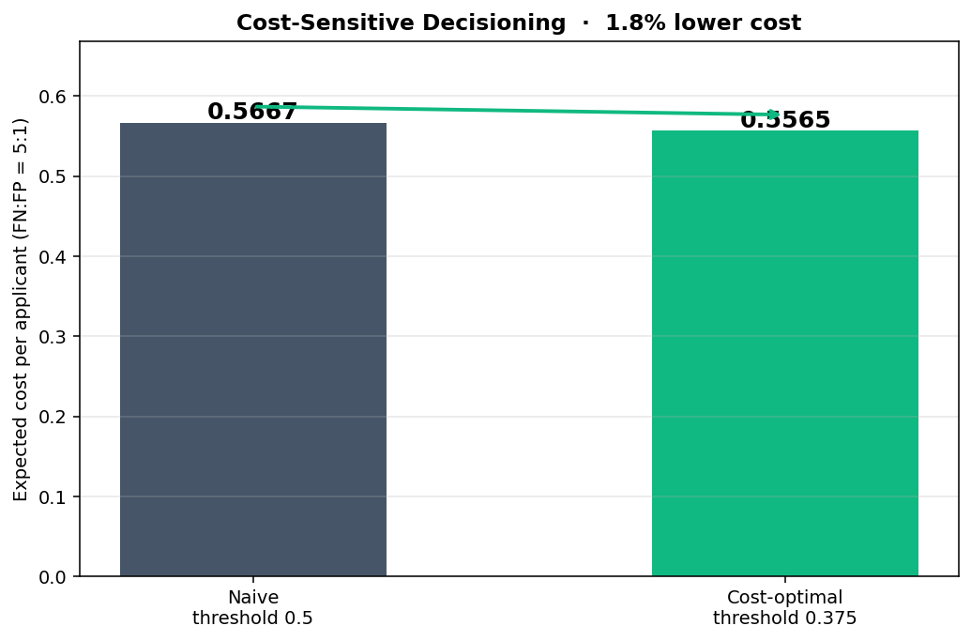
COST-SENSITIVE DECISIONING
0.5 is an accident, not a decision
A false negative (approve a defaulter) loses principal — far costlier than a false positive (reject a good customer). Under a 5:1 cost ratio, sweeping the threshold on validation moves the optimal cutoff to 0.375.
1.8%
lower expected cost per applicant vs the naive 0.5 cutoff — on the untouched test set, from choosing the operating point deliberately.
FairCredit · ML Bubble 2026
05

Slide 7
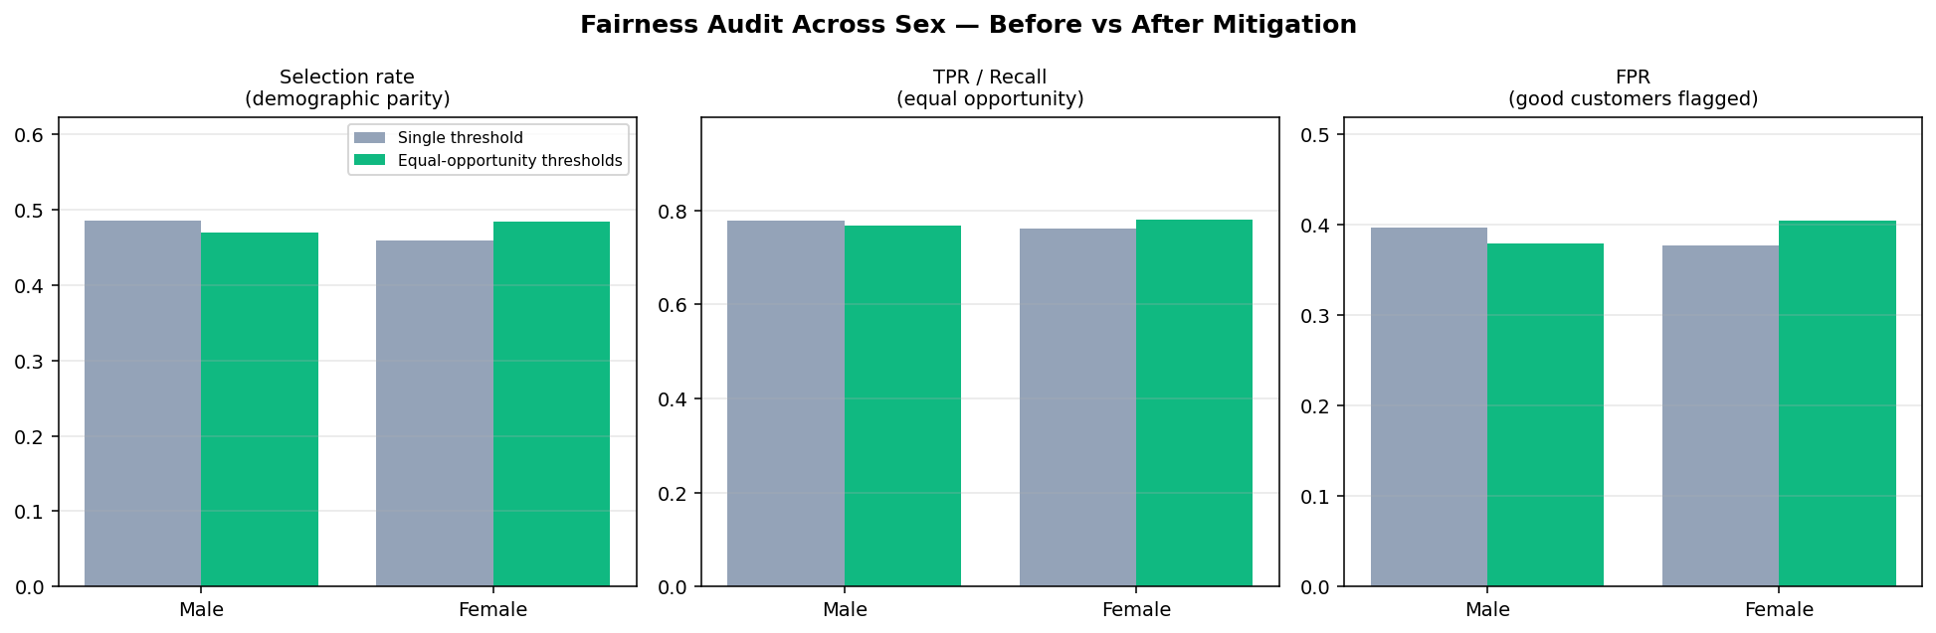
FAIRNESS AUDIT + MITIGATION · THE DIFFERENTIATOR
Measuring the bias gap — then narrowing it
How
We equalise true-positive rate across groups with per-group decision thresholds (male 0.385, female 0.36) chosen on validation.
A deploy-time control — the trained model is untouched, ranking power (AUPRC) unchanged. The equal-opportunity gap narrows ~20%; the FPR gap widens (0.020→0.026), which points to equalized odds next.
Gap metric | Before | After
Equal-opportunity (TPR) | 0.0161 | 0.0129
Demographic parity | 0.0269 | 0.0148
Disparate-impact ratio | 0.944 | 0.969
FairCredit · ML Bubble 2026
06

Slide 8
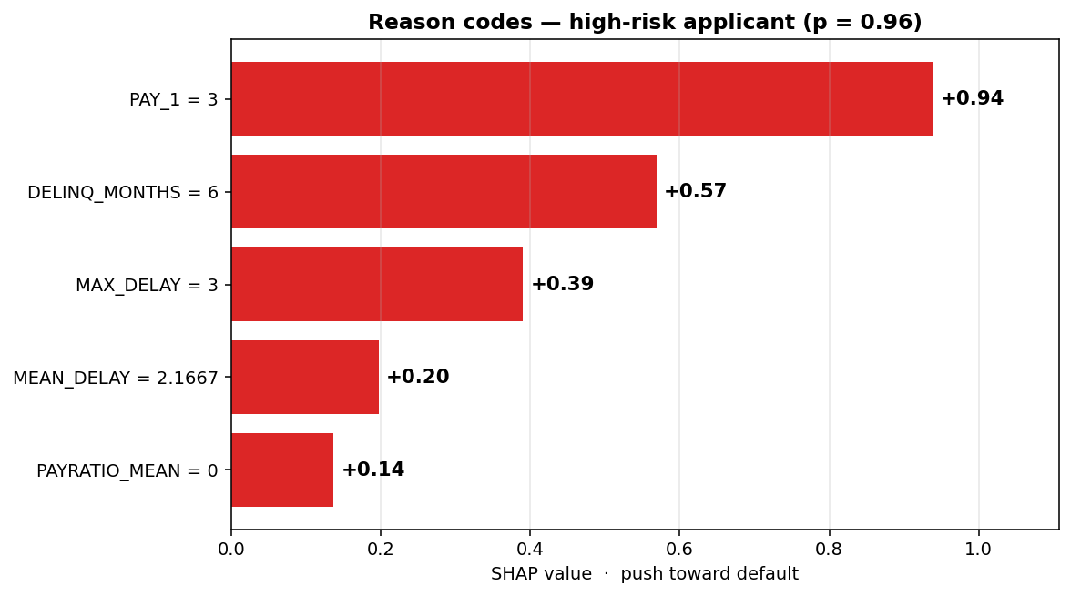
EXPLAINABILITY
From black box to reason codes
Local — why this applicant (p = 0.96) was declined
Global drivers
Across the whole portfolio the same signals dominate: most-recent repayment status, months in arrears, and worst delay — consistent with credit intuition.
Adverse-action reasons
For any declined applicant the model emits ranked, plain-language reasons — exactly the disclosure a lender is legally required to give.
Verified faithful: sigmoid(base + Σ SHAP) matches the model probability to 1e-4 — the explanation is arithmetic, not decoration.
FairCredit · ML Bubble 2026
07

Slide 9
DEPLOYMENT CONSIDERATIONS
Shipped, not just trained
{ }
Scoring API
POST /score →
FastAPI /score endpoint returns probability, an approve/decline decision at the cost-optimal threshold, and reason codes. Stateless, container-ready, OpenAPI docs.
{
"default_probability":
0.906,
"decision": "DECLINE",
"threshold": 0.375,
"reason_codes": [
"PAY_1 = 2",
"DELINQ_MONTHS = 6",
"MAX_DELAY = 2"
]
}
▦
Live dashboard
Streamlit app to score an applicant, browse the model comparison, and inspect the fairness audit — the demo judges can click.
⚙
Production notes
Threshold & cost ratio are config, not code, so risk teams retune them. Fairness thresholds re-audited each retrain and monitored for drift.
FairCredit · ML Bubble 2026
08

Slide 10
LIMITATIONS & FUTURE WORK
What we would do before it touches real money
1
Data vintage
2
More attributes
Single-country 2005 data. Retrain on current, local data before any real use.
Sex is the only protected field here; a real audit adds age bands & intersectional groups.
3
Stronger mitigation
4
Calibration
Threshold mitigation is transparent; in-processing (adversarial debiasing) can go further.
Add a Platt/Isotonic layer — the decision is threshold-based, so calibrated probabilities matter.
Naming these is the point — a model that knows its own limits is the one worth deploying.
FairCredit · ML Bubble 2026
09

Slide 11
WHY FAIRCREDIT WINS
Most teams stop at AUC.
We shipped the model a bank could actually deploy.
4-model
Cost-aware
Fair
comparative analysis, XGBoost wins on AUPRC
5:1 threshold, 1.8% lower expected cost
equal-opportunity gap 0.0161 → 0.0129
Explainable
Deployed
Reproducible
SHAP adverse-action reason codes
FastAPI + Streamlit live demo
seeded, one-command run, clean repo
Siddharth Kancharla & Kancharla Sricharan · IIIT Sri City · github.com/Sricharan7989/ML-Bubble-2026

