Slide 1
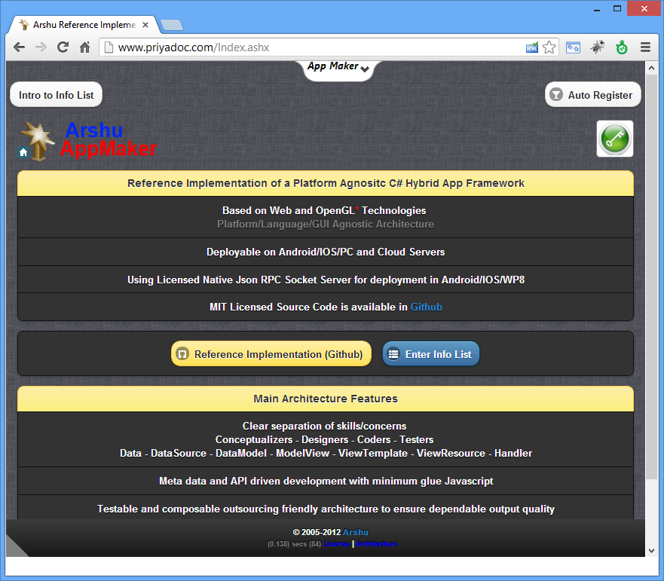
Auto Register
Click App Maker Menu to show Auto Register Button
Click to View Auto Register Button
Click to view License & Architecture

Slide 2
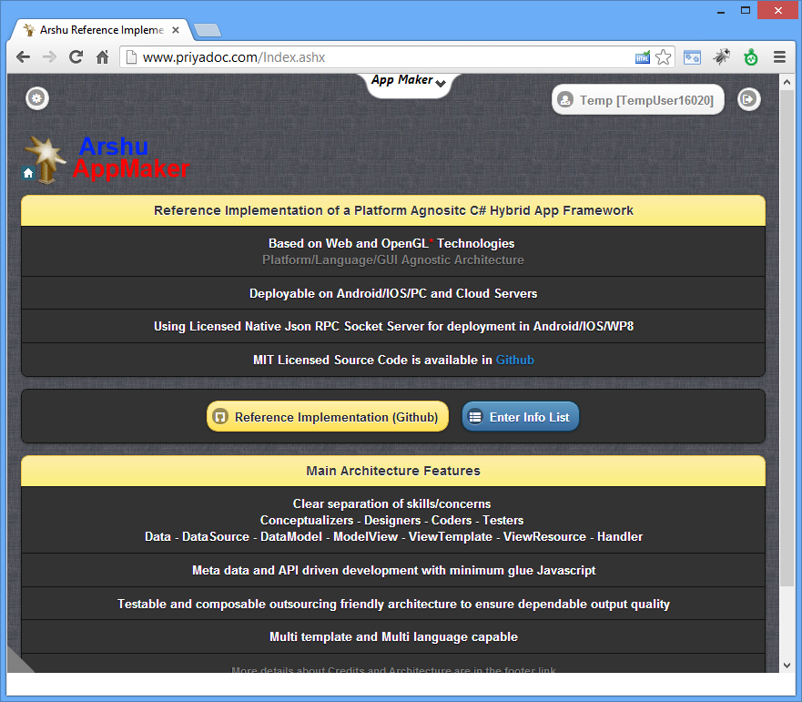
Top Action Menu – Guest Role Based
Click to View Action Menu
Setting
User Details
Log Off

Slide 3
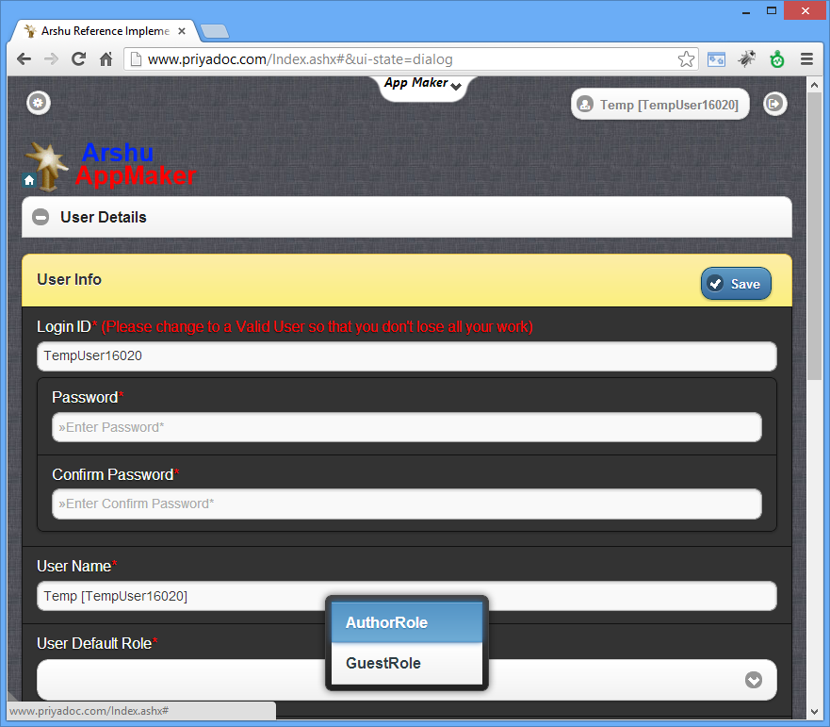
Enable Author Role
Click to View User Details
Change Role and Click Save
Change Role and Click Save

Slide 4
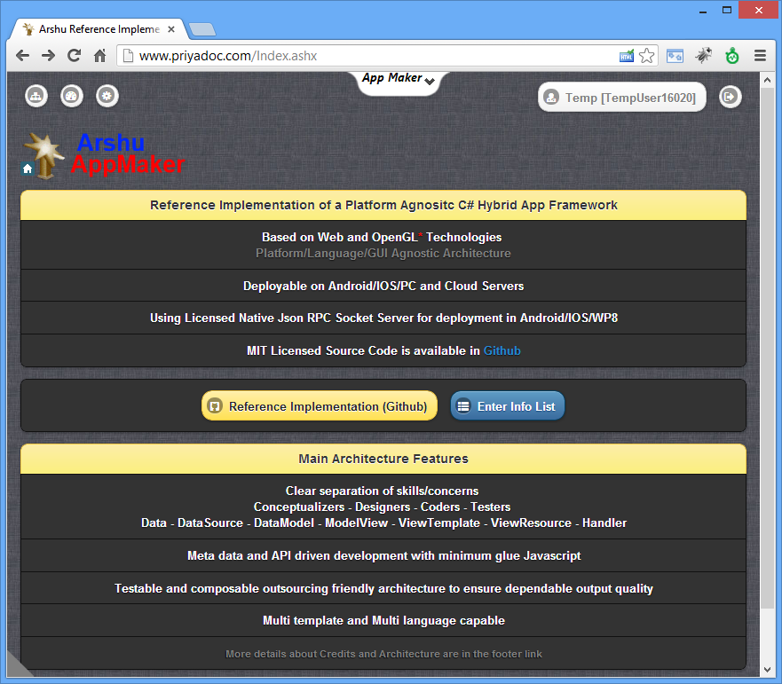
Top Action Menu – Author Role Enabled
Tracking
User Details
API
Log Off

Slide 5
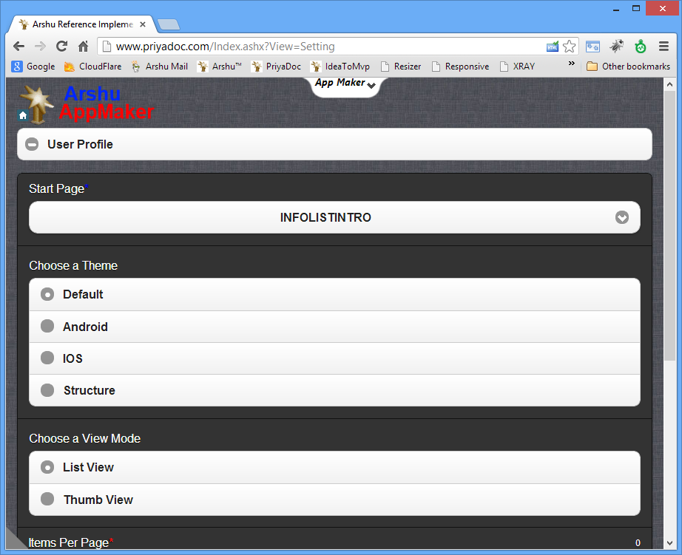
User Profile Setting

Slide 6
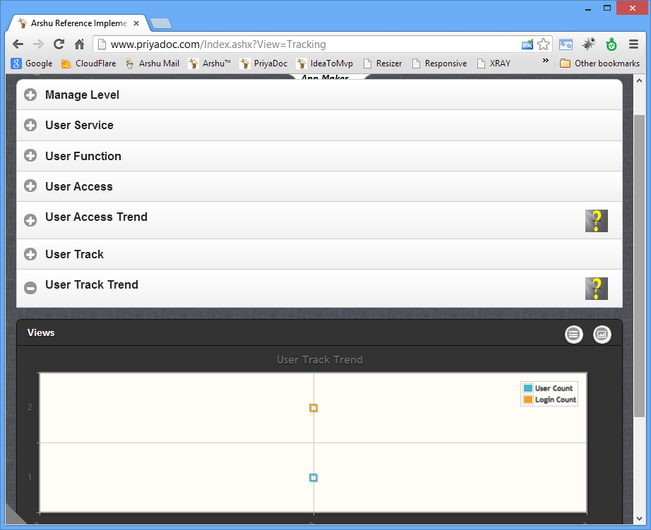
Tracking View (For Demo Only)

Slide 7
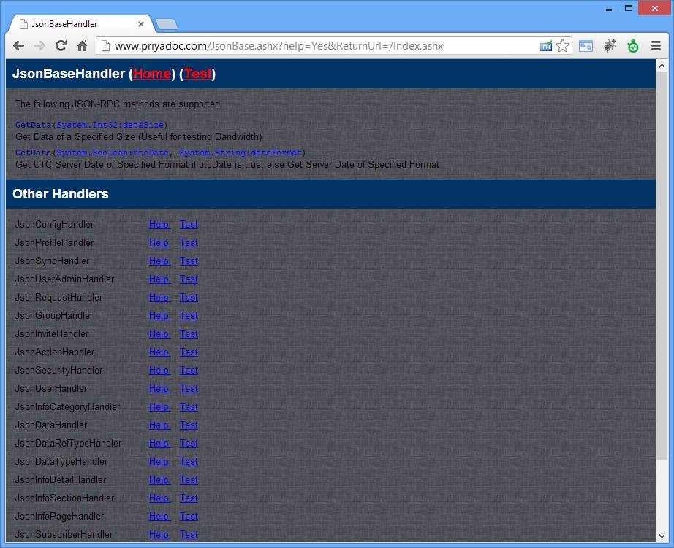
Service API (For Demo Only)

