Slide 1
Ai anywhere RPA-BOT
Powered by UI-PATH

Slide 2
Team members
TEAM NAME: AI ANYWHERE
TEAM MEMBERS
SRIDATTA SAI
SRAVANTI CHINTA

Slide 3
CONTENTS
A GLANCE OF OUR PROJECT
ABOUT MY PROJECT
USE CASE DESCRIPTION
SOLUTION/APPROACH
TECHNOLOGY/TOOL/CLOUD/STACK
SCREENS
VIDEO DEMOS
CHALLENGES FACED
POSSIBLE IMPROVEMENTS
ALTERNATE FILES
WHY OUR TEAM SHOULD BE BEST?
CHALLENGES BEING SOLVED

Slide 4

a glance of my bot
Our bot is purely RPA based Bot. The bot is based on the main concept RPA. Credit analysis is the method by which one calculates the creditworthiness of a business or organization or an individual. This bot is very helpful to most of the businesses in the credit analysis or issuing loans to customers or dealing with decision making situations to issue loans to customers. So Commercial Credit Risk – Credit Analysis is our use case in this RPA theme.

Slide 5
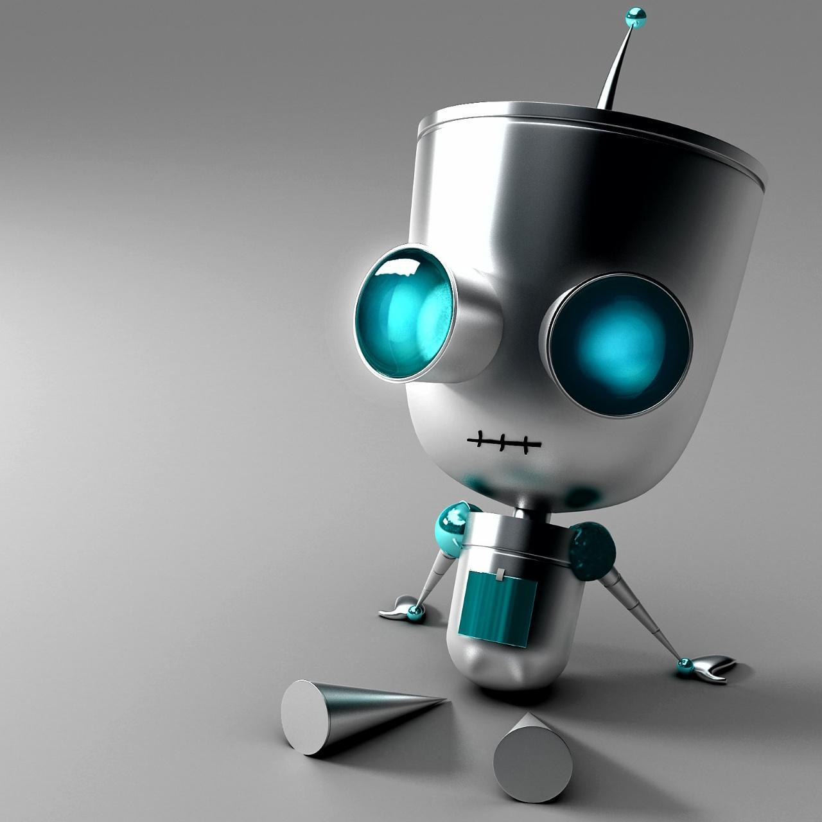
Presenting you Ai anywhere rpa- Bot

Slide 6
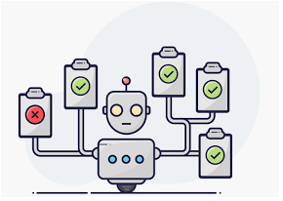
ABOUT MY rpa-BOT
Our bot is purely RPA based Bot. The bot is based on the main concept RPA. Credit analysis is the method by which one calculates the creditworthiness of a business or organization or an individual. This bot is very helpful to most of the businesses in the credit analysis or issuing loans to customers or dealing with decision making situations to issue loans to customers. So Commercial Credit Risk – Credit Analysis is our use case in this RPA theme.

Slide 7
USE CASE DESCRIPTION
My bot is unique because-
This RPA-bot maximizes the user's readability and understand ability by doing the innovative tasks which attracts a lot of people. In a way this can be used to gain more users.
The bot is based on the main concept RPA. This bot is main dealing with the concept of Commercial Credit Risk – Credit Analysis. Which is mainly useful for commercial businesses such as banks, insurance companies etc. The fundamental goal of our application is Credit Analysis which is the method by which one calculates the creditworthiness of a business or organization or an individual.

Slide 8
Use case description
Here we are taking an important task which most of banks are working is loan generation we are automating this task using RPA to decide whether to issue a loan or not to the customer.
Many of the banks are facing more issues when doing this task manually. Yes it is possible to do this task when there is less number of customers .But present situation is not that we should automate the task to achieve the best results in dealing with Issuing loans to the customers.
Here we are taking data received in multiple spreadsheets and PDF files.
The task of updating the customer details is manual. User has to copy the data from the spreadsheet and create 6 templates and a final master template based on the data.
Making this bot is quite economic and its a good way of presenting.

Slide 9
SOLUTION/APPROACH
Coming with the solution here we are using RPA, Automation Anywhere , UI Path. We are going to explain each one and where we have used it in the bot.
RPA
Robotics Process Automation(RPA) allows organizations to automate task just like a human being was doing them across application and systems. Robotic automation interacts with the existing IT architecture with no complex system integration required.
We have used it to present the solution to automate the process.
UI path
Automation is the technology by which a process or procedure is performed with minimal human assistance.
It is a RPA software. It helps organizations to automate processes efficiently. It can be downloaded from https://www.uipath.com/

Slide 10
SOLUTION/APPROACH
UI PATH
Many enterprises are adopting digital methods for their operation because they understood that future lies in routine operation being fully automated. Speed of execution and accuracy are the two biggest advantages of digitization.
Ui Path is a Robotic process automation tool used for Windows desktop automation. It is founded in the year 2005 by the Romanian entrepreneurs Daniel Dines and Marius Tirca.
We have used to present our solution we need a software to automate our solution we need to use some tool and one of the best too we used is UI-Path

Slide 11
SOLUTION/APPROACH
Automation Anywhere
Automation Anywhere is one of the popular RPA vendors offering powerful & user-friendly RPA capabilities to automate any complex tasks. It is one of the "Revolutionary Technology" that changes the way the enterprise operates.
Automation Anywhere allows organizations to automate the processes which are performed by the humans. It is a Web-Based Management System which uses a Control Room to run the Automated Tasks.
Automation Anywhere Architecture has 3 primary components
Control Room
Bot Creator
Bot Runner

Slide 12
steps to execute
Install the free trail versions of any UI PATH community or Automation Anywhere community.
Open Automation Anywhere client/UI Path client from the windows start menu and click on it .
Give required information i.e credentials to open the dashboard of community.
Select file menu open file and traverse through our folder and open the templates named tempa and later template b and later template c and template d and lastly Master.
Run the templates and see the output generation files clearly .
Finally after executing all the templates ,go through the RPA folder and open the Master.csv file which is final o/p file.

Slide 13

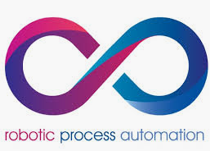

Technology /tools/cloud used
Robotics Process Automation(RPA) allows organizations to automate task just like a human being was doing them across application and systems. Robotic automation interacts with the existing IT architecture with no complex system integration required.
Ui Path is a Robotic process automation tool used for Windows desktop automation. It is founded in the year 2005 by the Romanian entrepreneurs Daniel Dines and Marius Tirca.
Automation Anywhere is one of the popular RPA vendors offering powerful & user-friendly RPA capabilities to automate any complex tasks. It is one of the "Revolutionary Technology" that changes the way the enterprise operates.

Slide 14
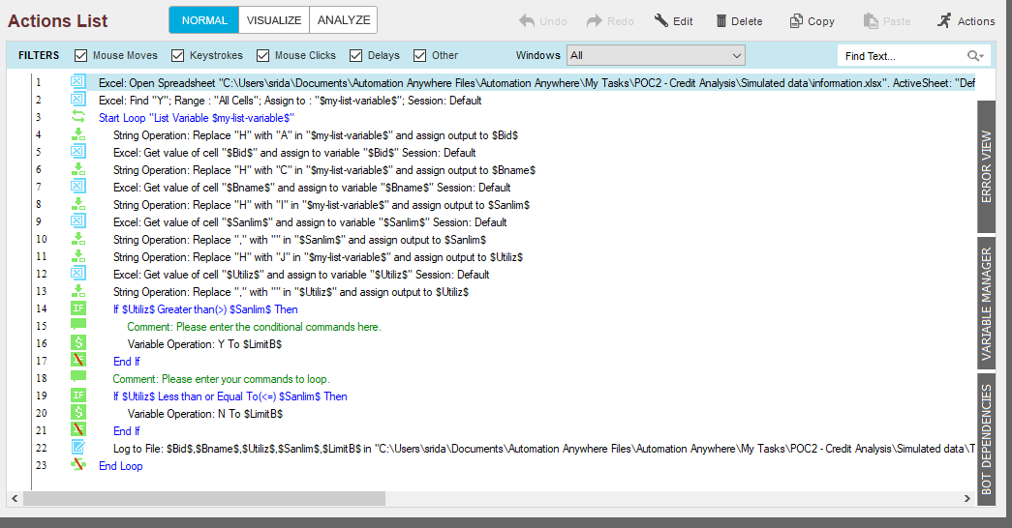
SCREENS OF MY rpa BOT-temp a

Slide 15
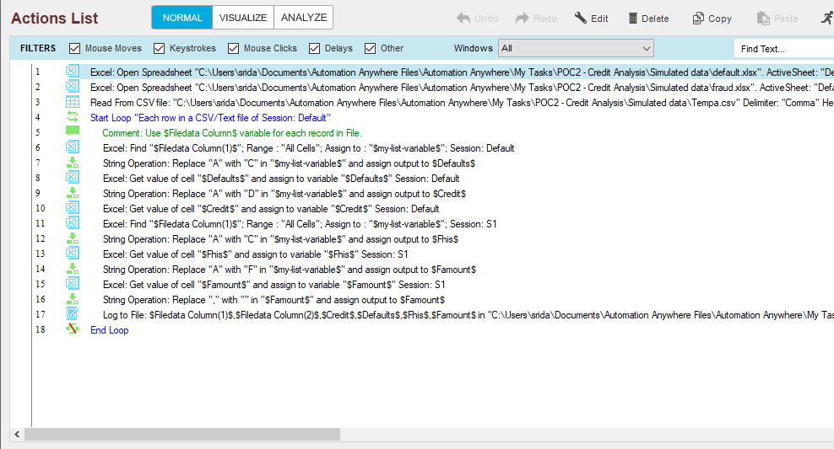
SCREENS OF MY BOT temp b

Slide 16
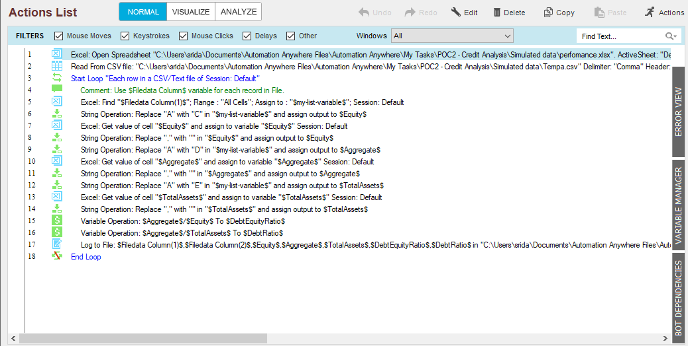
SCREENS OF MY BOT temp c

Slide 17
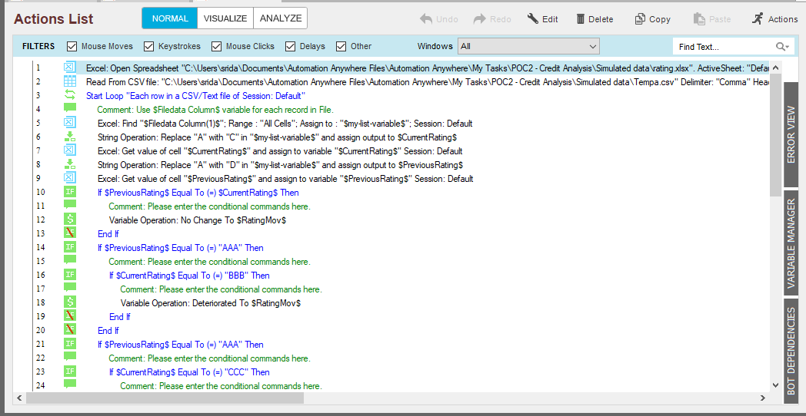
SCREENS OF MY BOT temp d

Slide 18
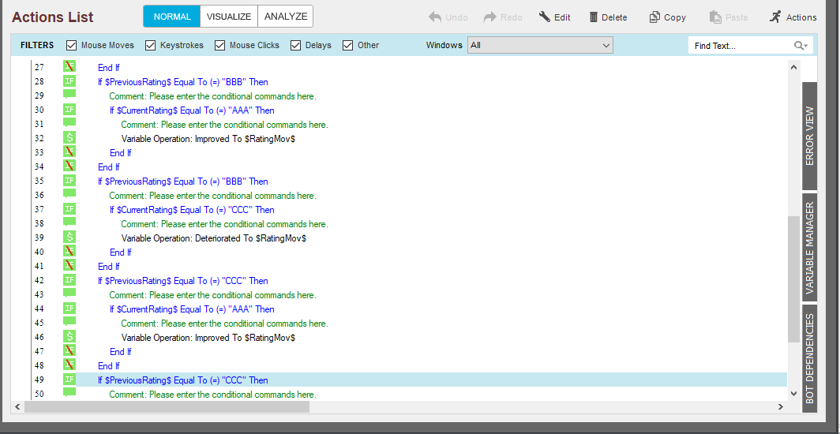
SCREENS OF MY BOT temp d

Slide 19
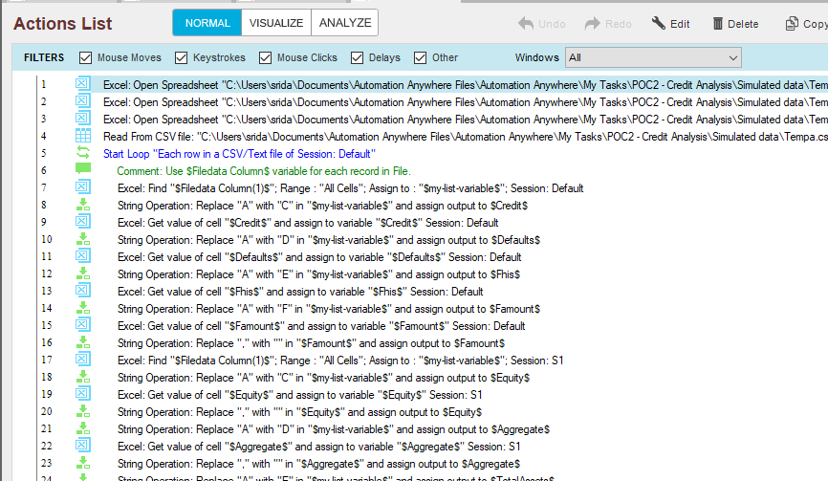
SCREENS OF MY BOT master template

Slide 20
video demos
Please check in the VIDEOS folder

Slide 21
Challenges faced
Regarding UI Path there are very few blogs, it was completely a new concept to us.
We were not new to automation ,but new to automation in Ui path.
Had a hard time with creating a task in UI path/Automation A. Making a this type of bot with UI path/AA was more a difficult task.
Regarding our learning and use case selection is one most important task , there are no proper tutorial for both editions. Its really difficult for a newbie, unexperienced. We had to sit studying books for doing best.

Slide 22
Possible Improvements
Our next use case to implement is More interesting use case is it is more innovative regarding RPA in Instagram.
Adding more features to the Bot for better user satisfaction.

Slide 23
Associated attachments/ files
Here we developed AI ANYWHERE RPA Bot using RPA,UI PATH,AUTOMATION ANYWHERE etc.
You can find two different folders in the folder TechgigChatbot2019 ,where the code folder contains FULL SOURCE CODE files which is used for evaluation , finally there is Video Demo folder which contains 3 videos demos used for Evaluation.
CODE FOLDER------------All code scripts
VIDEOS FOLDER----------VIDEO DEMOS

Slide 24
Why our team is the best!
We think that our team should be selected because even though our bot still needs improvement but the features it provides are fascinating ones. The use case is really helpful to the end users and it is something unique. We aim to provide a bot which is useful for the bigger mass. We will always look forward to improve our bot and provide more better services

Slide 25

Gratitude towards Techgig
We would like to thank Techgig for organising such competitions and giving opportunity to exhibit our talent. We have learnt many new things ,We learnt ML ,We learnt RPA, UI –PATH ,We learned many other technologies and the most important we learned team work . We learned to work with new technology, We learned to bring things in real life model. Our experience with Techgig is very good. Being a Student from a Non IIT , its difficult to get a job in a reputed company. But now we believe that college wont matter, until Techgig will conduct such competitions . We heartily thank Techgig and We are happy to be a part of code gladiators 2019.

Slide 26
THANKING YOU
BY Sri DATTA SAI AND SRAVANTI CHINTA

