Slide 1
Food Delivery Cost and Profitability Analysis
Presented By:
Sridevi Polkam
22401024
MBA ( Data Analytics)

Slide 2
Outline of Presentation
01
Introduction
05
Findings
02
Objectives
06
Suggestions
03
Data Collection
04
Data Analysis

Slide 3
Introduction
Food Delivery Cost and Profitability Analysis involves examining all the costs associated with delivering food orders, from direct expenses like delivery fees and packaging to indirect expenses like discounts offered to customers and commission fees paid by restaurants.
The food delivery service is facing challenges in achieving profitability across its operations and it seeks to understand the dynamics of its cost structure and profitability to identify strategic opportunities for improvement.
By juxtaposing these costs against the revenue generated (primarily through order values and commission fees)
The analysis aims to provide insights into how profitable the food delivery service is on a per-order basis.

Slide 4
Objectives of the Study
Cost Analysis: Identify major cost components, including direct and indirect costs.
Profitability Evaluation: Assess individual and overall profitability by examining commission fees vs. total costs.
Strategic Recommendations: Propose strategies to reduce costs and optimize commission/discount rates for improved profitability.
Impact Simulation: Forecast the financial impact of recommended strategies and how they could transform losses into profits.

Slide 5
DATA COLLECTION
The Data is sourced from Unified Mentor.
Libraries used for Analysis are:
Pandas
Datetime
matplotlib.pyplot

Slide 6
Data Description
Order ID: Unique identifier for each order.
Customer ID: Unique identifier for each customer.
Restaurant ID: Unique identifier for each restaurant.
Order Date and Time: Date and time when the order was placed.
Delivery Date and Time: Date and time when the delivery was made.
Order Value: Total value of the order.
Delivery Fee: Fee associated with the delivery.
Payment Method: The method used for payment (e.g., Credit Card, Digital Wallet, Cash on Delivery).
Discounts and Offers: Any discounts or offers applied to the order.
Commission Fee: Fee charged as a commission.
Payment Processing Fee: The fee associated with processing the payment.
Refunds/Chargebacks: Any refunds or chargebacks associated with the order.

Slide 7
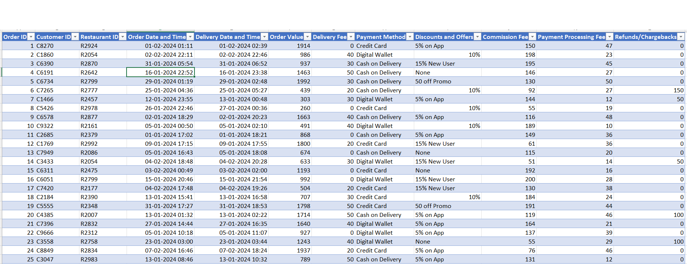
DATASET
No. of samples = 1000
No. of Columns = 1000
No. of Rows =12

Slide 8
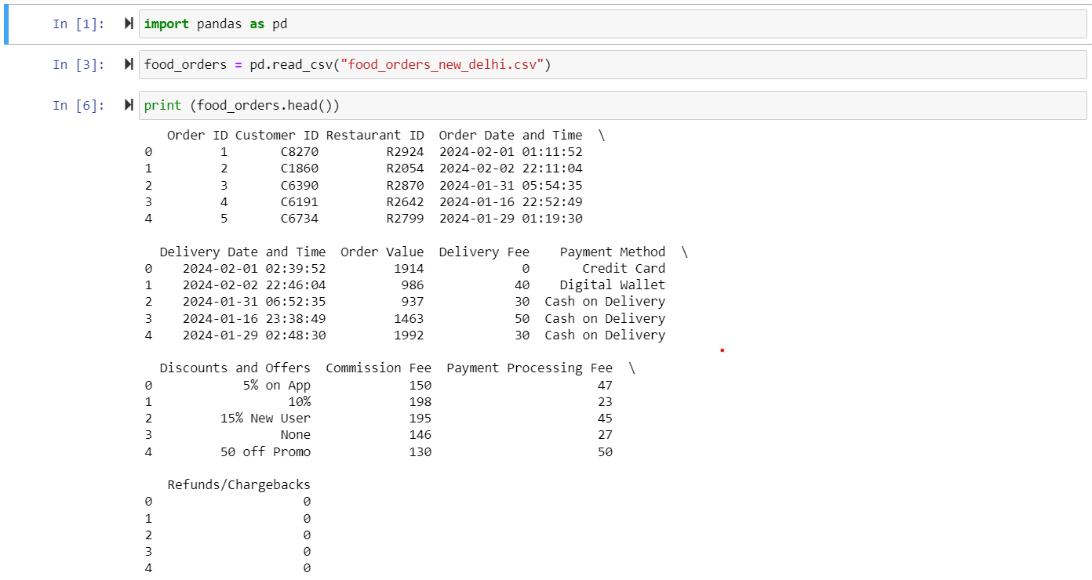
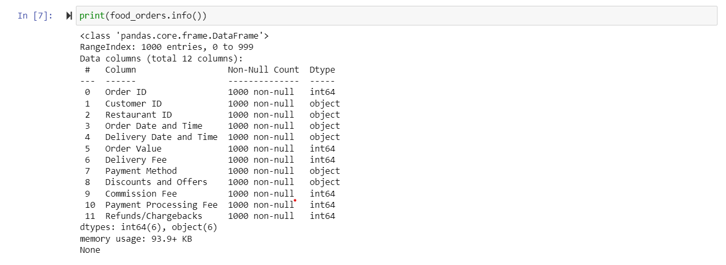
Data Wrangling

Slide 9
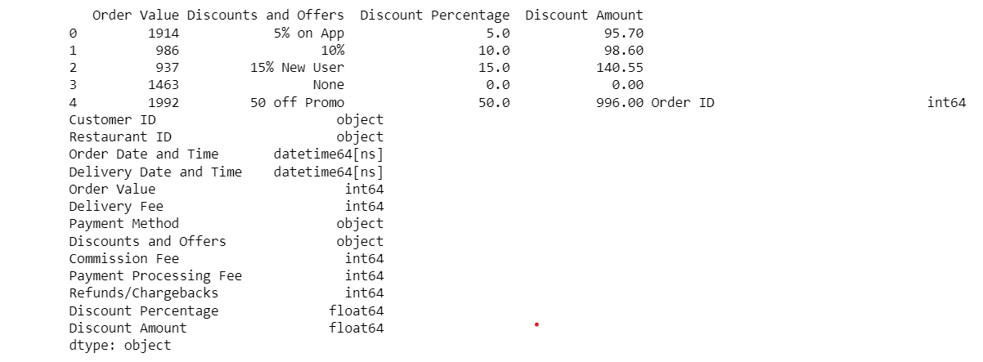
Convert Date and Time columns to Datetime
Extracting and calculating Discount Amount

Slide 10
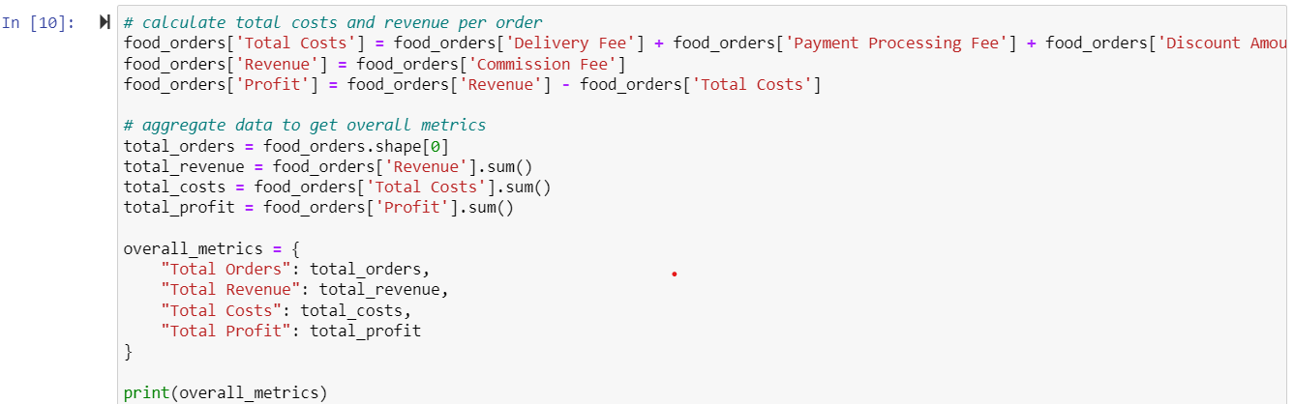
cost and profitability analysis
Output :

Slide 11

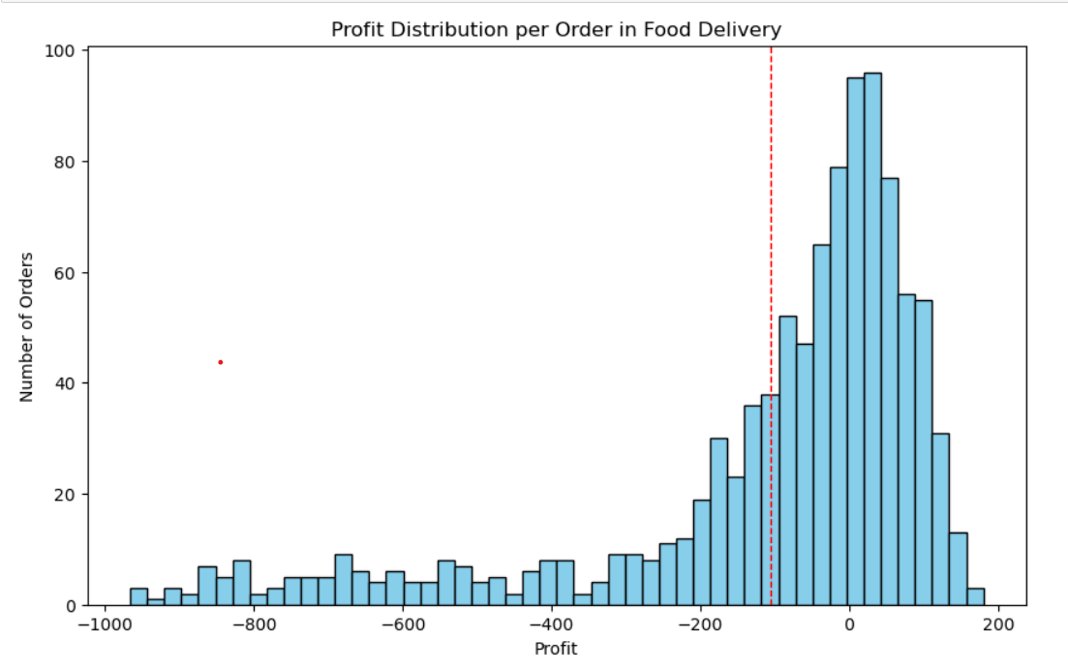
Distribution of profitable and unprofitable orders
The histogram shows a wide distribution of profit per order, with a noticeable number of orders resulting in a loss (profits below 0).
The red dashed line indicates the average profit, which is in the negative territory, highlighting the overall loss-making situation.

Slide 12

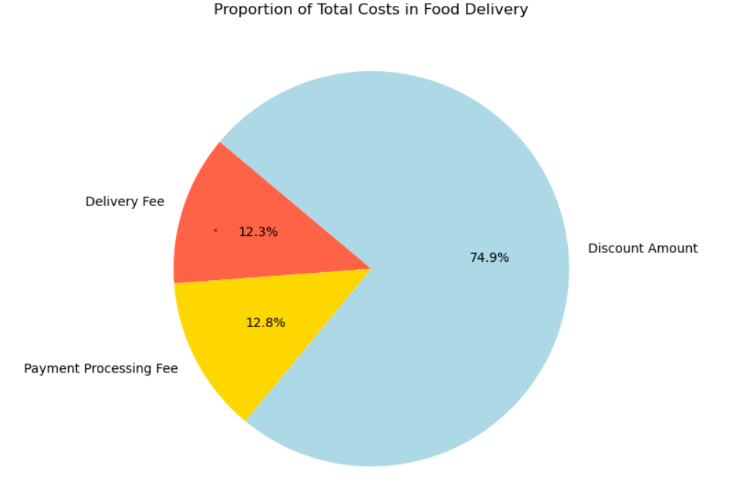
Visualizing the proportion of Total Costs
The pie chart illustrates the breakdown of total costs into delivery fees, payment processing fees, and discount amounts.
Delivery fees : 12.3%
Payment processing fees : 12.8%
Discount Amount : 74.9%

Slide 13

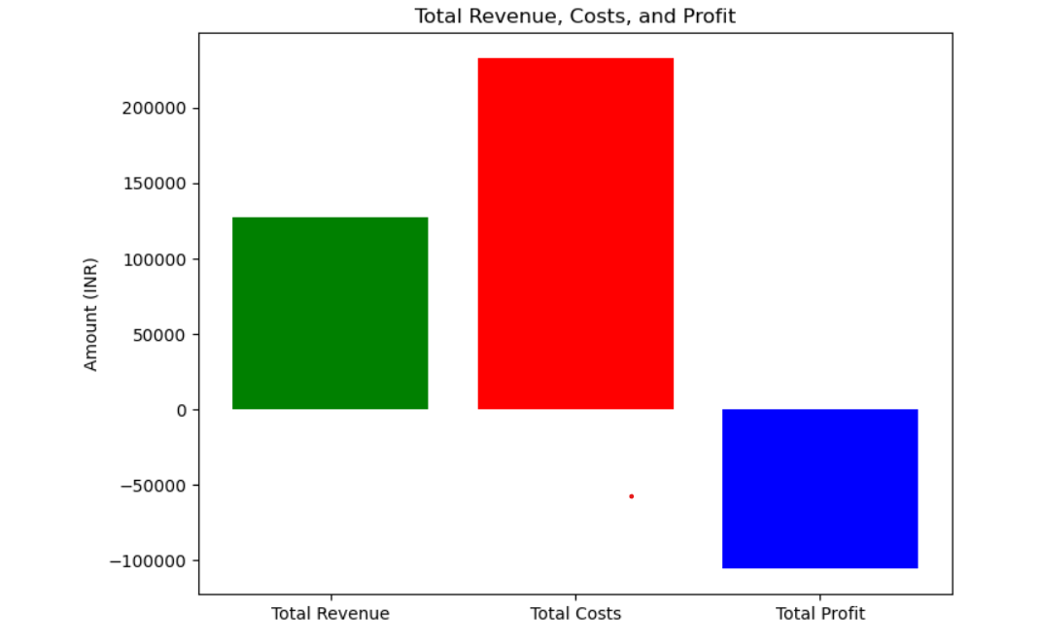
Comparison of total revenue, total costs and total profit
The bar chart compares total revenue, total costs, and total profit. It visually represents the gap between revenue and costs, clearly showing that the costs surpass the revenue, leading to a total loss.

Slide 14
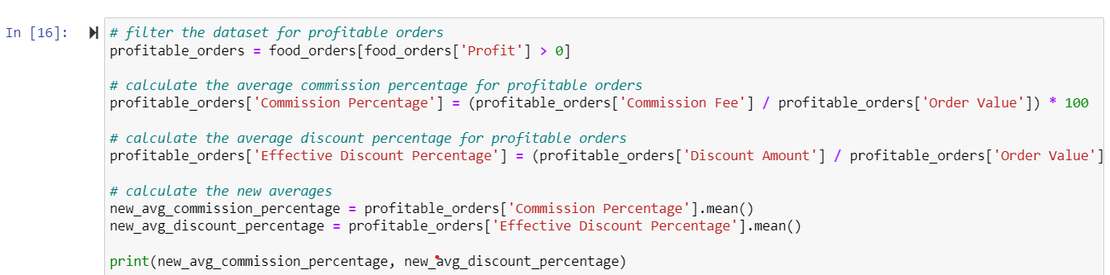
A new average commission percentage based on profitable orders.
A new average discount percentage for profitable orders
Output :

Slide 15

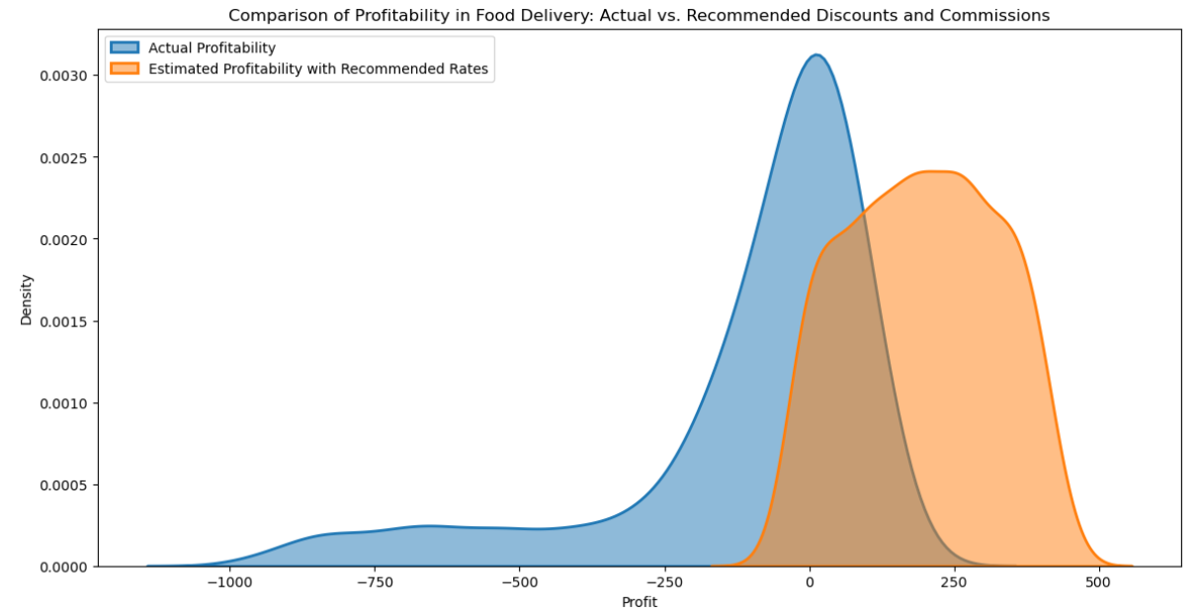
Comparison of profitability : Actual Vs. Recommended Discounts and Commissions
The visualization compares the distribution of profitability per order using actual discounts and commissions versus the simulated scenario with recommended discounts (6%) and commissions (30%).
The actual profitability distribution shows a mix, with a significant portion of orders resulting in losses (profit < 0) and a broad spread of profit levels for orders. The simulated scenario suggests a shift towards higher profitability per order. The distribution is more skewed towards positive profit, indicating that the recommended adjustments could lead to a higher proportion of profitable orders.

Slide 16
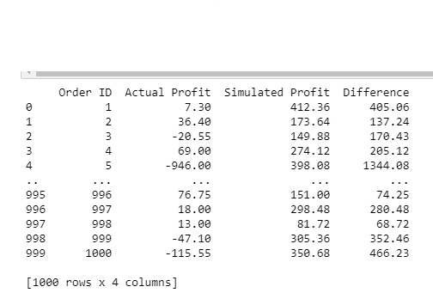
Profit Comparison
We can observe the difference between the Actual profit and Simulated profit

Slide 17
Findings
The current food delivery operations are operating at a significant loss, with total costs (2,32,709.85) exceeding total revenue (1,26,990), resulting in a net loss of 105,719.85.
The major cost component is the discount amount, accounting for 74.9% of the total costs. Payment processing fees (12.8%) and delivery fees (12.3%) contribute smaller but nearly equal shares of the remaining costs.
The distribution of profits per order is skewed towards lower profits, with many orders resulting in losses. The average profit per order is approximately -200, indicating that the average order is unprofitable.
The simulation analysis suggests that implementing recommended commission rates (30%) and discount rates (6%) could potentially improve profitability.
The recommended rates could lead to a higher concentration of profitable orders and potentially improve the overall financial health of the business.

Slide 18
Suggestions
Adopt Commission and Discount Rates: Implement recommended commission and discount rates to boost profitability.
Diversify Revenue Streams: Introduce new revenue sources like premium delivery options, subscription models, and restaurant partnerships for sponsored listings or ads.
Re-evaluate Discount Strategy: Assess and adjust discount strategies as they constitute the bulk of costs.
Reduce Operational Costs: Optimize delivery routes, enhance order management, improve customer service, negotiate better payment rates, and streamline processes to cut overhead expenses.
Monitor and Analyze Data: Continuously analyze order data, customer behavior, and market trends to inform pricing, promotions, and operational decisions.
Enhance Operational Efficiency: Implement measures to optimize delivery routes, improve order management, and enhance customer service for cost reduction and better customer satisfaction.

Slide 19
Thank You

