Slide 1

Global Trends in Mental Health Disorders HIT-750 (Data Analytics) Prof : Dr. Isaac Mativo
Team-3:
Mounika Atmakuri,
Sridhar Reddy Maram,
Everet Thokozani Kalongonda,
Shriya Kandikonda Venkatadri

Slide 2


Table of CONTENTS
Overview of the Topic and Dataset
Types of Mental Disorders
Contents of the Dataset
Install and Import necessary Libraries
Data Cleaning
Exploratory Data Analysis
Correlation Analysis
Key Insights
Policy Recommendations
Conclusion
References

Slide 3
Overview of the Topic
Approximately 1 in every 8 people worldwide live with a mental disorder.
Mental health impacts work, relationships, and community engagement.
Many individuals do not receive proper care due to stigma and lack of resources.
Data collection is crucial to understanding trends and improving treatments.

Slide 4
Importance of the Topic
Mental health disorders impact well-being, productivity, and society.
Understanding trends aids in developing prevention and treatment strategies.
Analysis informs policy-making and healthcare practices.
Reducing stigma encourages mental health awareness and support.

Slide 5
Research Facts on Mental Illness
1 in 3 women and 1 in 5 men experience major depression.
COVID-19 led to 53M new depression cases and 76M anxiety cases.
Mental health issues peak in early adulthood.
Despite available treatments, accessibility remains a challenge.

Slide 6
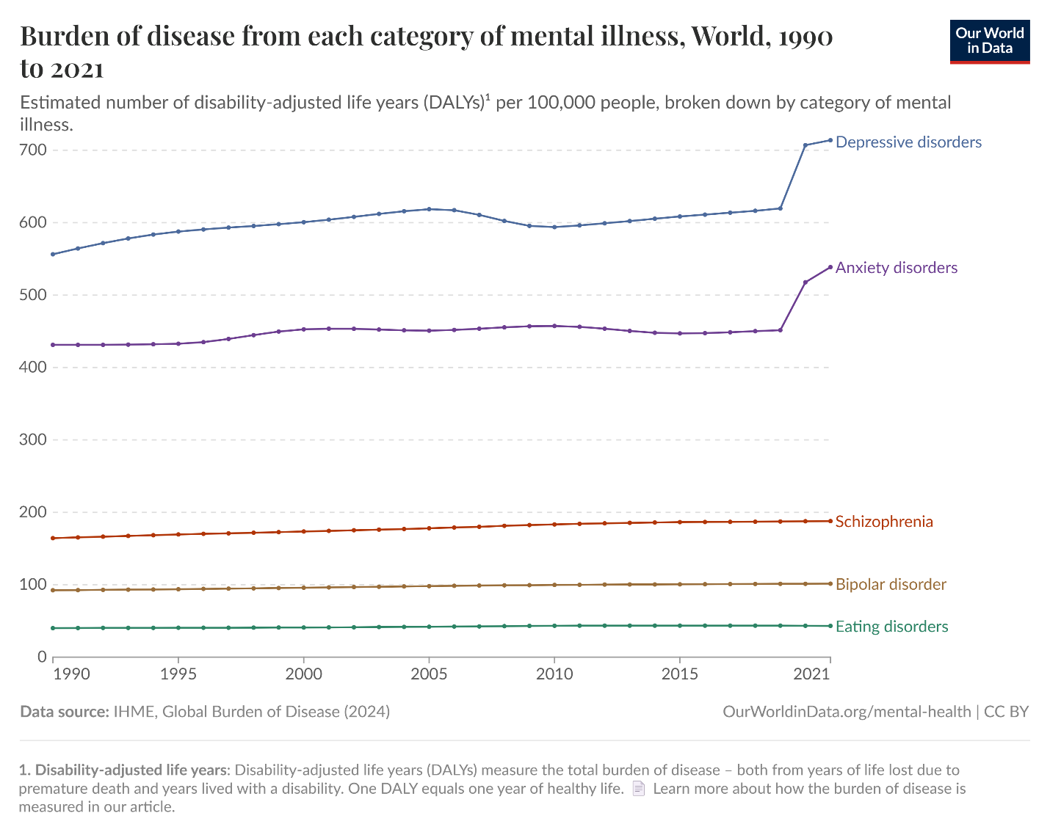
Plots from Online References
Fig 1 : Line chart for the distribution of Mental Disorders

Slide 7
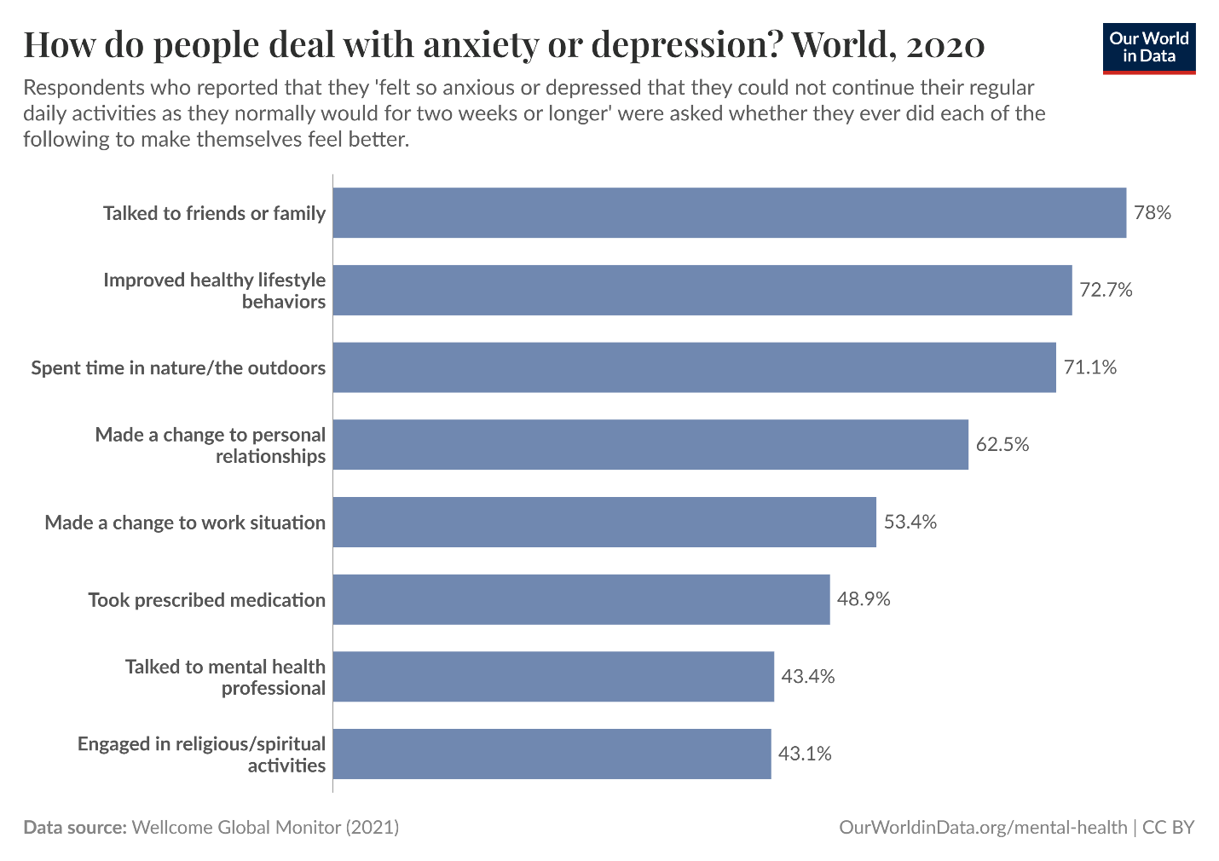
Plots from Online References
Fig 2 : Distribution pattern for overcoming Anxiety or Depression

Slide 8
Dataset Overview from Kaggle
The dataset titled "Global Trends in Mental Health Disorder" is available on Kaggle
“Mental Health” Published online at OurWorldinData.org. Retrieved from: 'https://ourworldindata.org/mental-health' [Original Online Resource]
Data includes:
- Country/Region
- Year
- Prevalence of mental health disorders

Slide 9

Types of Mental Disorders
Schizophrenia
Bipolar disorders
Eating disorders
Anxiety disorders
Drug use disorders
Depression
Alcohol use disorders

Slide 10
contents of the dataset
Entity – The country or region being analyzed.
Code – The standardized country code.
Year – The year of data collection.
Schizophrenia (%) – The percentage of the population diagnosed with schizophrenia.
Bipolar Disorder (%) – The percentage of individuals with bipolar disorder.
Eating Disorders (%) – The prevalence of eating disorders.
Anxiety Disorders (%) – The percentage of people experiencing anxiety disorders.
Drug Use Disorders (%) – The proportion of the population with substance abuse disorders.
Depression (%) – The prevalence of depression in the population.
Alcohol Use Disorders (%) – The percentage of individuals affected by alcohol-related disorders.

Slide 11
Install and Import necessary Libraries
readr → for reading data files
dplyr → for data manipulation
ggplot2 → for creating data visualizations
tidyr → for reshaping and tidying data (e.g., pivoting)
tidyverse → for loading a collection of DS packages including ggplot2, dplyr, tidyr, etc..
corrplot → for visualizing correlation matrices
sf → for handling and analyzing spatial data

Slide 12
Install and Import necessary Libraries
rnaturalearth → for downloading natural earth map data (country boundaries, etc.)
rnaturalearthdata → for providing the actual natural earth datasets used in mapping
viridis → for printer-friendly data visualizations
gridExtra → for arranging multiple ggplot plots in a grid layout
reshape2 → for reshaping data between wide and long formats (e.g., melt)
patchwork → for combining multiple ggplot2 plots
knitr → for creating tables from dataframe
fmsb → for creating Radar Chart

Slide 13
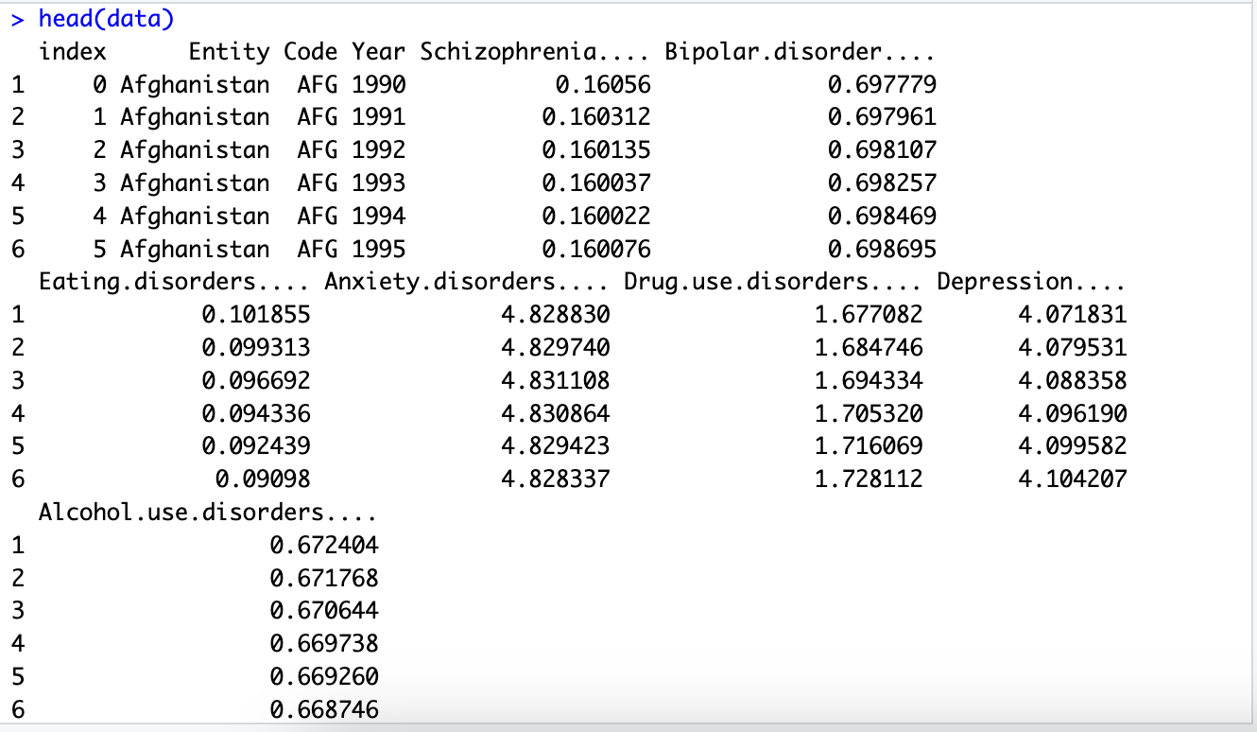
loaD the dataset

Slide 14
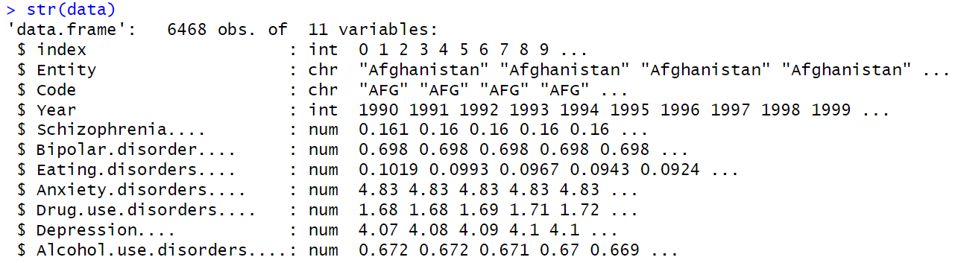
Display the structure of the data
explore the dataset

Slide 15
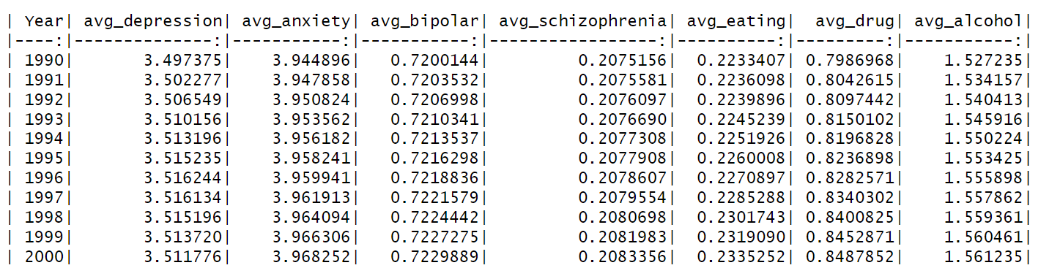
explore the dataset
Average Global Mental Disorder Rates (%) by year

Slide 16
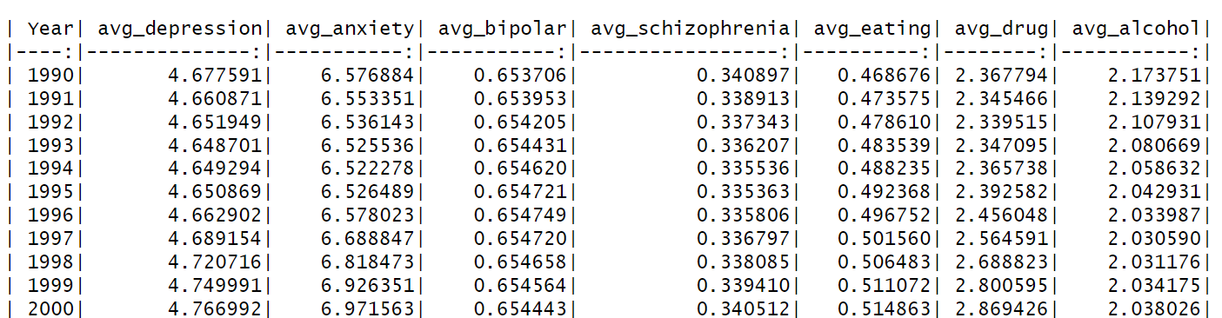
Average Mental Disorder Rates (%) by year for United States
explore the dataset

Slide 17
Structure of the data
Data Cleaning

Slide 18
Check for Duplicates # Count duplicates sum(duplicated(data)) # Remove duplicates, if available data <- distinct(data)
Data Cleaning
Handling Missing Values # Check Missing Values colSums(is.na(data)) # Remove Missing Values, if available (based on the dataset, either remove or replace with mean/median/mode) required_cols <- names(data)[1:11]
data <- data[complete.cases(data[, required_cols]), ]

Slide 19
Handling Inconsistent Columns and Rows # Drop index column data$index <- NULL # Drop Code Column data$Code <- NULL # Drop unnecessary rows non_countries<- c("World", "High SDI", "Low SDI", "Middle SDI", "High- income", "Low-middle SDI", "High-middle SDI“,….) data <- data[!(data$Entity %in% non_countries), ]
Data Cleaning

Slide 20
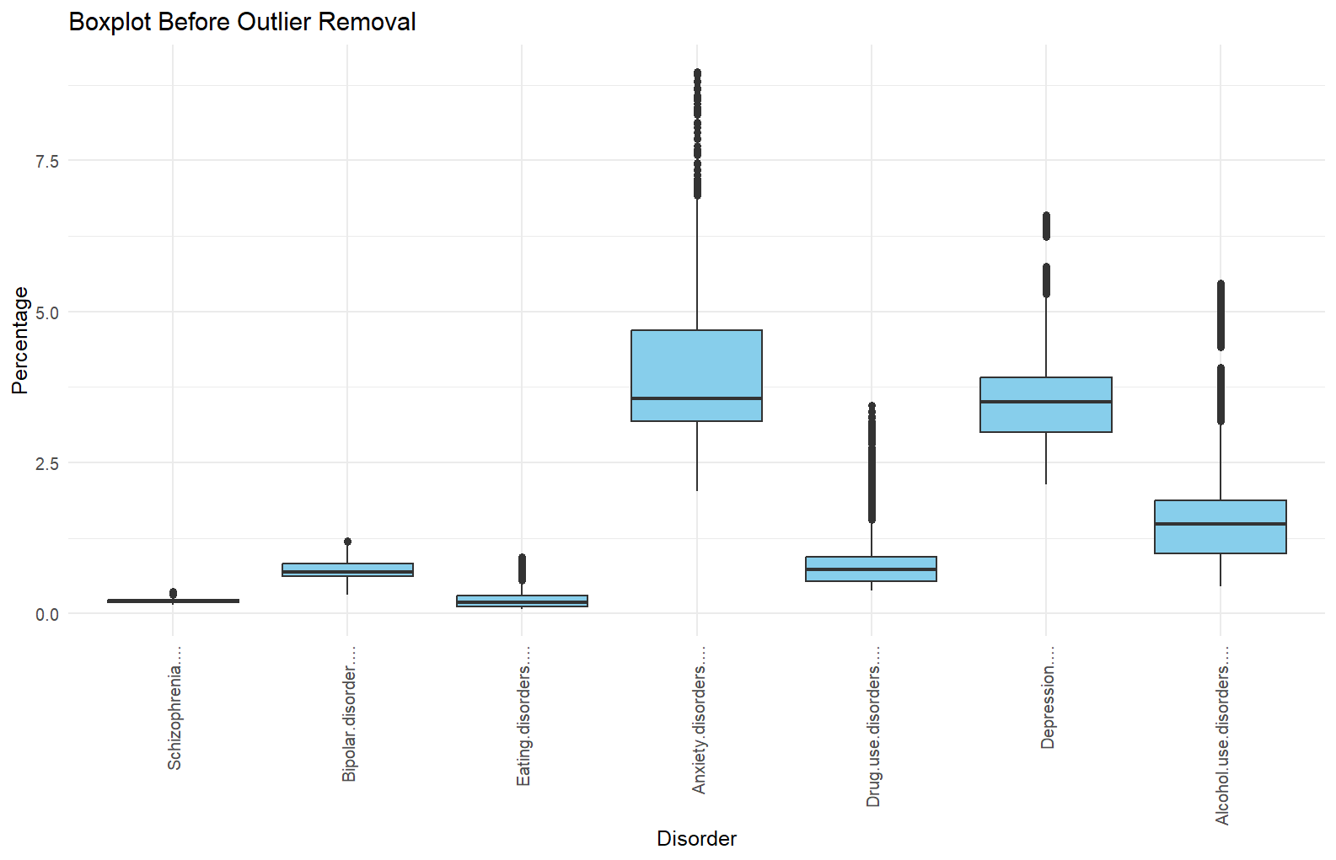
Data Cleaning

Slide 21
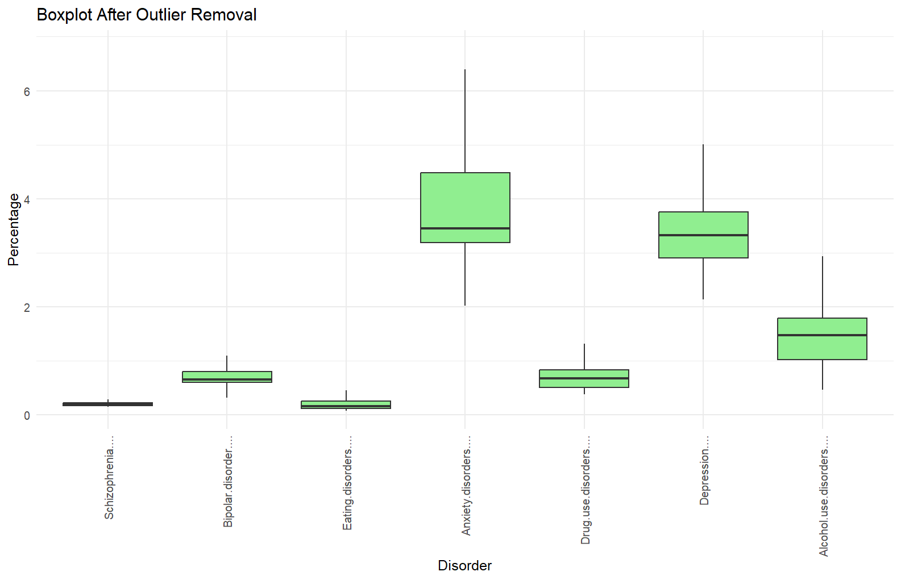
Data Cleaning

Slide 22
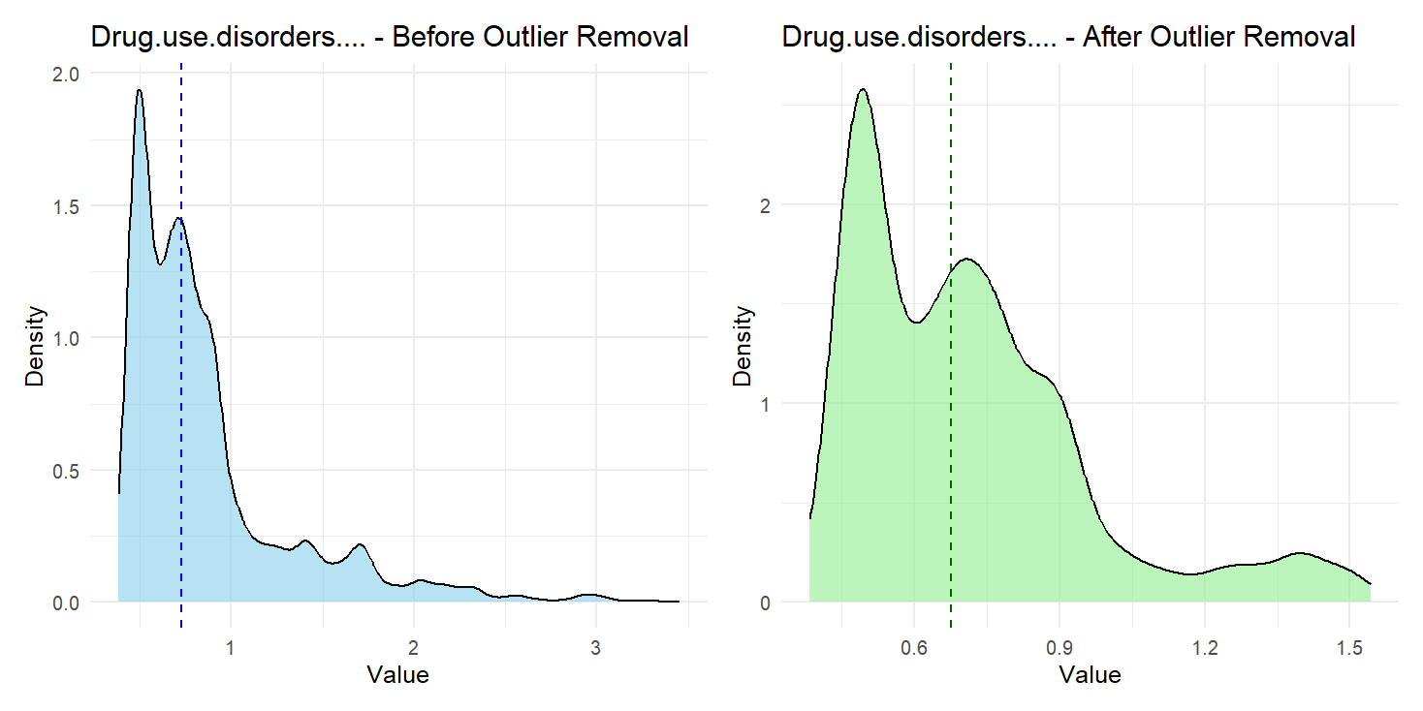
Exploratory Data Analysis
Density Plots Distribution

Slide 23
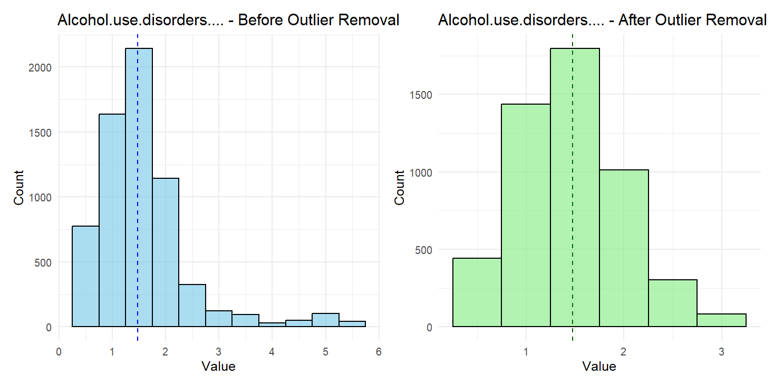
Exploratory Data Analysis
Histogram Plots Distribution

Slide 24
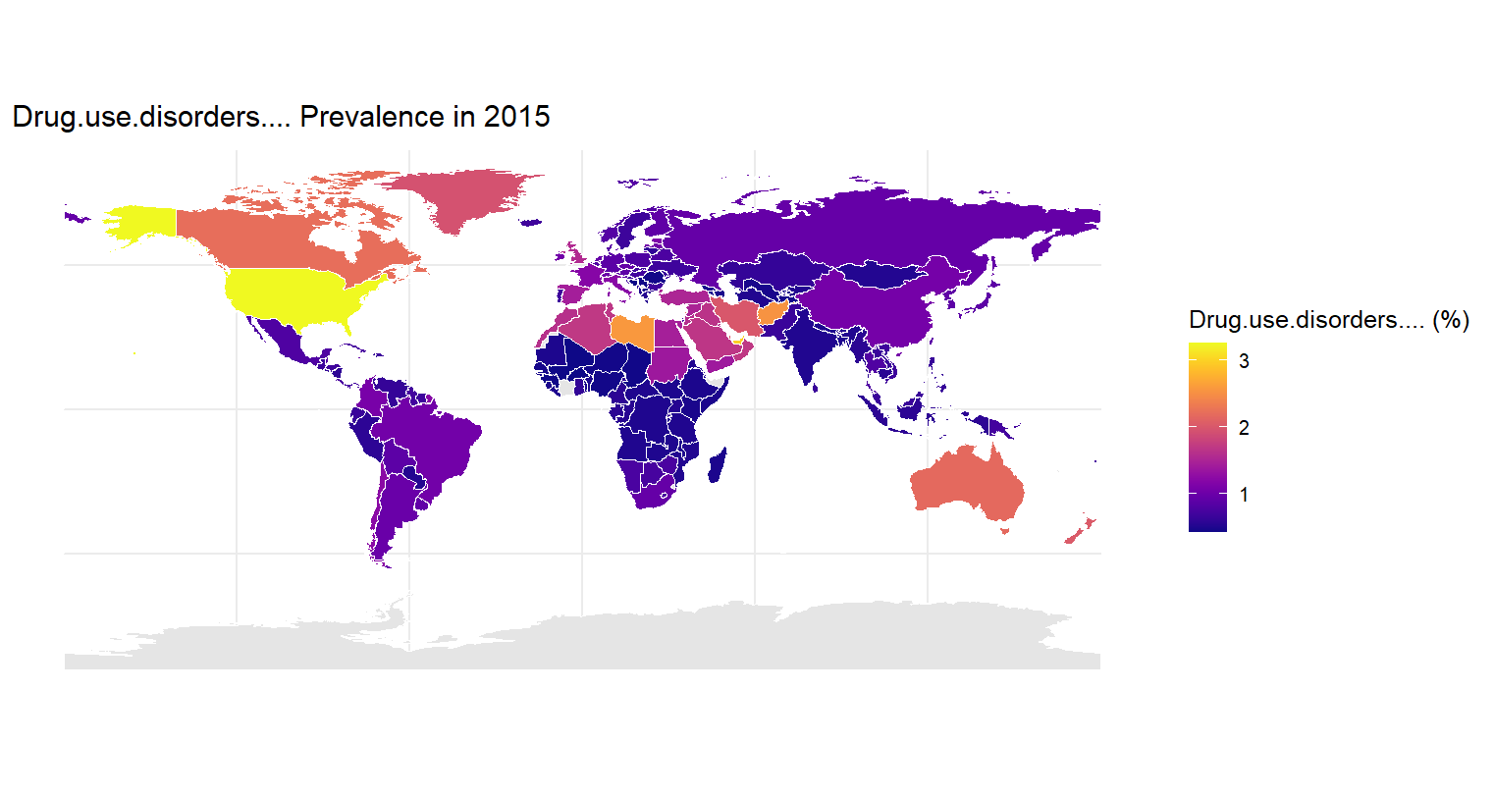
Exploratory Data Analysis

Slide 25
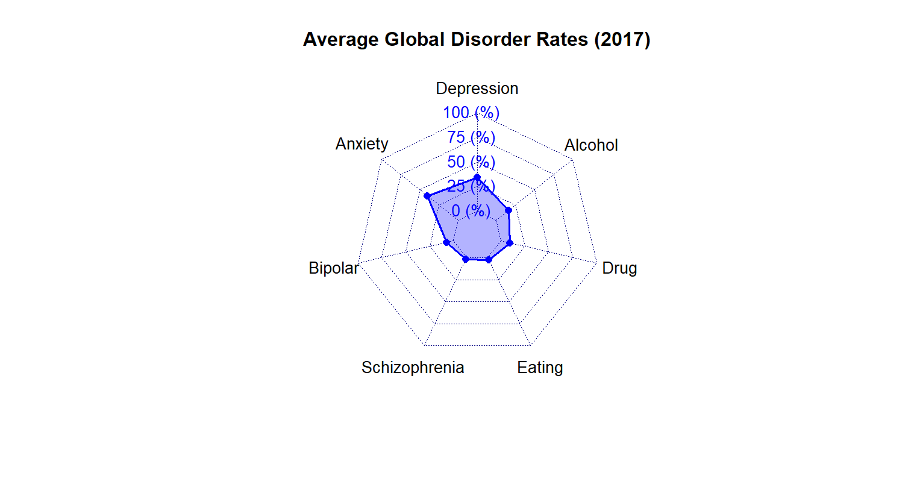
Exploratory Data Analysis
Radar Chart

Slide 26
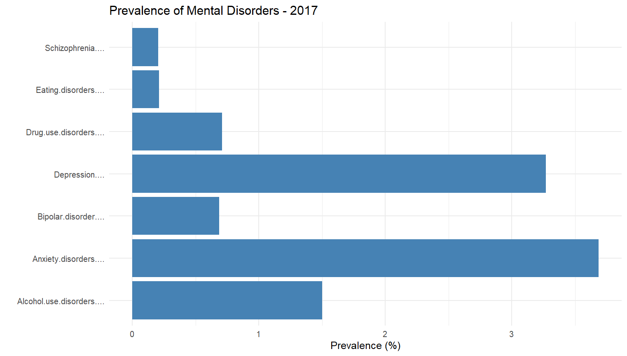
Exploratory Data Analysis
Bar graph for the distribution of Mental disorders for 2017

Slide 27
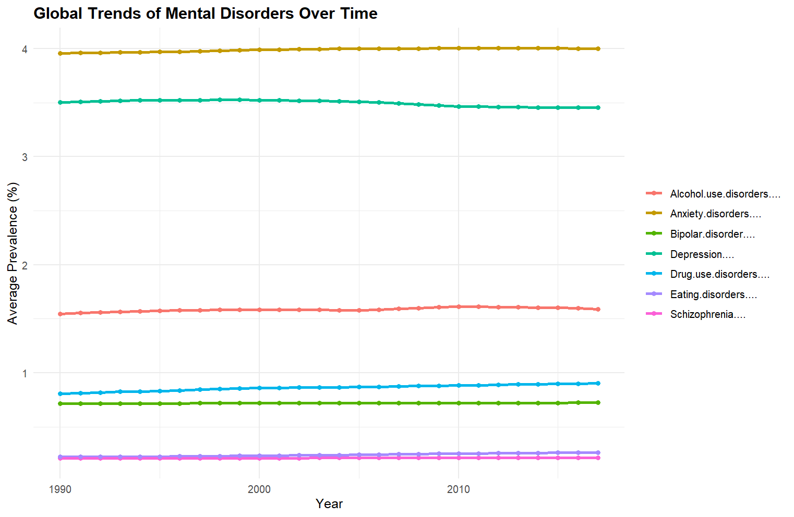
Exploratory Data Analysis
Line Plot for the distribution of Mental disorders for 2017

Slide 28
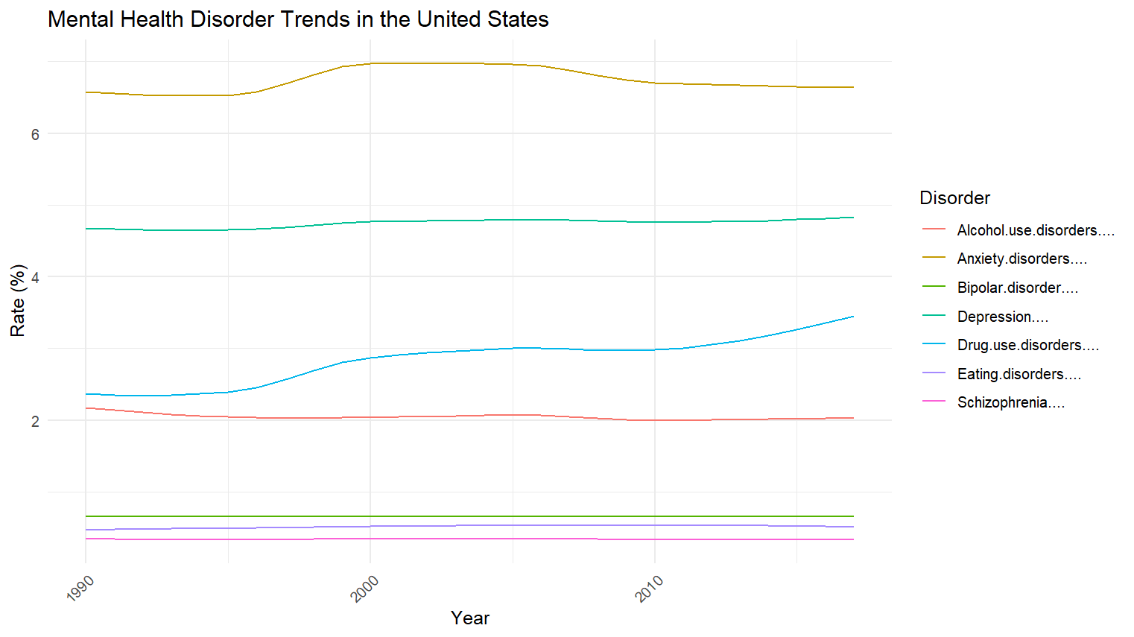
Exploratory Data Analysis
Line Plot for the distribution of Mental disorders in the United States

Slide 29
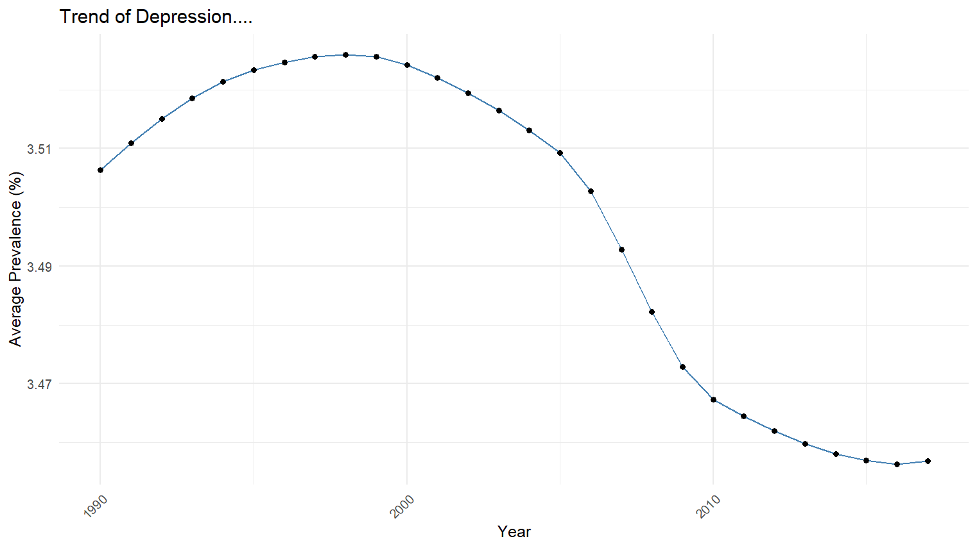
Exploratory Data Analysis
Time Series Analysis for the distribution of Global Depression

Slide 30
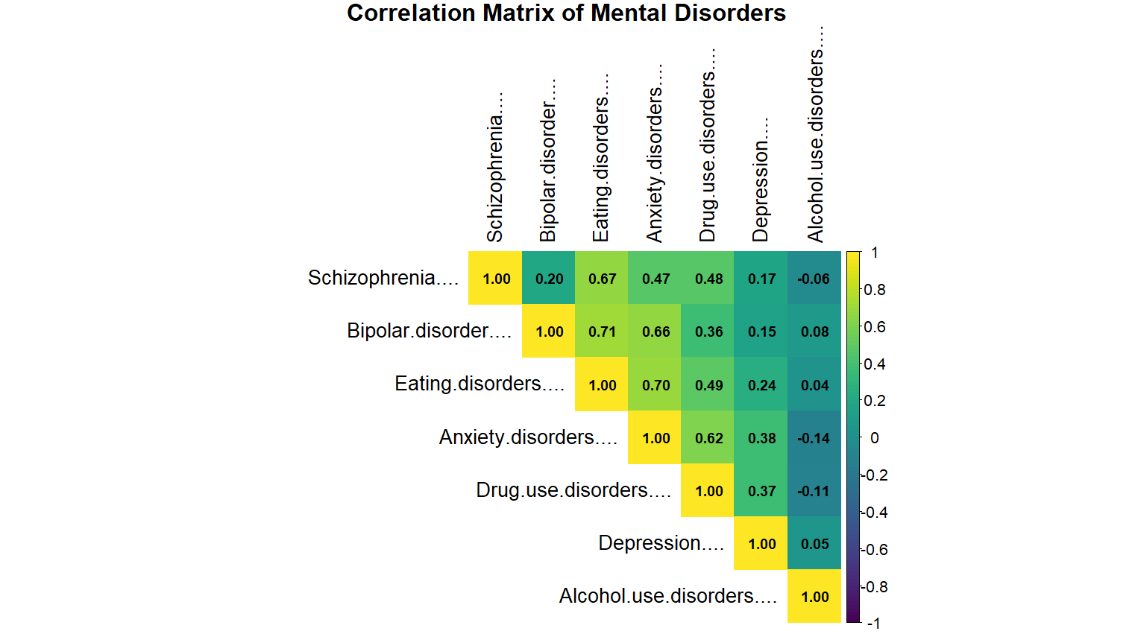
Correlation Analysis

Slide 31
key Insights
Eating disorders show strong correlations with both bipolar disorder and anxiety disorders. This means people with eating disorders often also struggle with mood swings or anxiety. So, treatment should focus on all these problems together.
Disorders like bipolar, eating, and drug use disorders show gradual increases, signaling growing public health challenges.

Slide 32
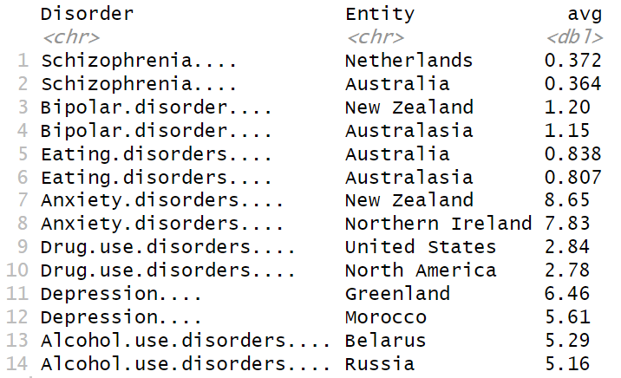
key Insights
Top two countries with highest rate of each mental disorder

Slide 33
KEY INSIGHTS
Depression and Anxiety are the most prevalent disorders globally, with a higher burden in high-income countries and regions in conflict.
Substance Use Disorders (Alcohol & Drugs) show significant regional variability—alcohol is high in Eastern Europe and Latin America; drug use is prominent in North America and parts of the Middle East.
Schizophrenia and Bipolar Disorder are less prevalent but require long-term care and community support structures.

Slide 34
KEY INSIGHTS
Eating Disorders are more frequent in high-income Western nations, especially among young women.
Youth (15–29) and women show disproportionately higher rates in most disorders.

Slide 35
Reasons behind Global Mental Health Disorders
Depression & Anxiety: Urban stress, economic hardship, conflict, stigma, limited care
Substance Use: Cultural norms, weak drug policies, self-medication in crisis zones
Schizophrenia & Bipolar: Genetic basis, poor literacy, lack of lifelong care
Eating Disorders: Media ideals, social media pressure, underreporting in LMICs
Youth & Women: Hormones, violence, social roles, academic stress, online toxicity

Slide 36
GLOBAL POLICY RECOMMENDATIONS
Universal mental health screening
Invest in community-based care
Emergency mental health response protocols in war/conflict zones.
Training programs for non-specialist health workers
Global data standardization and sharing to improve surveillance and response.
Campaigns against stigma, especially in low- and middle-income countries (LMICs).

Slide 37
KEY INSIGHTS for the united states
Drug Use Disorders are among the highest globally, especially due to the opioid epidemic.
Youth mental health crisis is growing, with significant spikes in depression, anxiety, and suicide ideation
Mental health disparities by race, income, and insurance coverage are stark
Access to care is inconsistent—rural areas are particularly underserved

Slide 38
Reasons behind the U.S Mental Health Disorders
Drug Use Disorders: Opioid overprescription, poor regulation, rural despair, stigma
Youth Crisis: Social media harms, pressure, violence fears, mental health gaps
Racial & Income Gaps: Mistrust, underfunding, cultural/language barriers
Rural Challenges: Provider shortages, privacy concerns, poor telehealth access

Slide 39
United states POLICY RECOMMENDATIONS
Expand insurance coverage for mental health parity
Opioid crisis response
Telehealth
Incentivize mental health professionals
Fund school-based mental health programs

Slide 40
Conclusion
Global burden is rising – Depression, anxiety, and substance use disorders are widespread.
Common drivers – Trauma, economic stress, stigma, and poor access to care.
Youth & women are most vulnerable – Affected by social, digital, and systemic pressures.

Slide 41
Conclusion
Global policies – Universal screening, destigmatization, community-based care.
U.S. priorities – Address opioid crisis, expand mental health coverage, support youth.
Call to action – Mental health solutions must be multi-level, inclusive, and equity-driven.

Slide 42
Conclusion
Acknowledge mental health as real and treatable — seek help early, without shame.
Talk openly — break the stigma through honest conversations in families, schools, and workplaces.
Build support systems — community, faith, and peer support can be life-changing.

Slide 43
Conclusion
Push for better policies — demand access, funding, and equity in mental healthcare.
Prioritize self-care and resilience — through mindfulness, connection, and healthy habits.
Empower others — be a mental health ally; listen, support, and guide.

Slide 44

Healing is possible. Progress is collective. A mentally healthy life is a human right — not a privilege.

Slide 45
references
Dattani, S., Rodés-Guirao, L., Ritchie, H., & Roser, M. (2023, June 20). Mental health. Our World in Data. https://ourworldindata.org/mental-health
World Health Organization: WHO. (2022, June 8). Mental disorders. https://www.who.int/news-room/fact-sheets/detail/mental-disorders
COVID-19 Mental Disorders Collaborators, & Santomauro, D. (2021). Global prevalence and burden of depressive and anxiety disorders in 204 countries and territories in 2020 due to the COVID-19 pandemic. In The Lancet (Vol. 398). https://doi.org/10.1016/S0140-6736(21)02143-7
Wu, Y., Wang, L., Tao, M., Cao, H., Yuan, H., Ye, M., Chen, X., Wang, K., & Zhu, C. (2023). Changing trends in the global burden of mental disorders from 1990 to 2019 and predicted levels in 25 years. Epidemiology and Psychiatric Sciences, 32. https://doi.org/10.1017/s2045796023000756
Global Trends in Mental health Disorder. (2022, December 14). Kaggle. https://www.kaggle.com/datasets/thedevastator/uncover-global-trends-in-mental-health-disorder

Slide 46

THANK YOU

