Slide 1

Global Trends in Mental Health Disorders HIT-750 (Data Analytics) Prof : Dr. Isaac Mativo
Team-3:
Mounika Atmakuri,
Sridhar Reddy Maram,
Everet Thokozani Kalongonda,
Shriya Kandikonda Venkatadri

Slide 2


Table of CONTENTS
Overview of the Dataset
Types of Mental Disorders
Contents of the Dataset
Install and Import necessary Libraries
Data Cleaning
Exploratory Data Analysis
Correlation Analysis
Key Insights
Policy Recommendations
Conclusion
References

Slide 3
Dataset Overview from Kaggle
The dataset titled "Global Trends in Mental Health Disorder" is available on Kaggle
“Mental Health” Published online at OurWorldinData.org. Retrieved from: 'https://ourworldindata.org/mental-health' [Original Online Resource]
Data includes:
- Country/Region
- Year
- Prevalence of mental health disorders

Slide 4

Types of Mental Disorders
Schizophrenia
Bipolar disorders
Eating disorders
Anxiety disorders
Drug use disorders
Depression
Alcohol use disorders

Slide 5
contents of the dataset
Entity – The country or region being analyzed.
Code – The standardized country code.
Year – The year of data collection.
Schizophrenia (%) – The percentage of the population diagnosed with schizophrenia.
Bipolar Disorder (%) – The percentage of individuals with bipolar disorder.
Eating Disorders (%) – The prevalence of eating disorders.
Anxiety Disorders (%) – The percentage of people experiencing anxiety disorders.
Drug Use Disorders (%) – The proportion of the population with substance abuse disorders.
Depression (%) – The prevalence of depression in the population.
Alcohol Use Disorders (%) – The percentage of individuals affected by alcohol-related disorders.

Slide 6
Install and Import necessary Libraries
readr → for reading data files
dplyr → for data manipulation
ggplot2 → for creating data visualizations
tidyr → for reshaping and tidying data (e.g., pivoting)
tidyverse → for loading a collection of DS packages including ggplot2, dplyr, tidyr, etc..
corrplot → for visualizing correlation matrices
sf → for handling and analyzing spatial data

Slide 7
Install and Import necessary Libraries
rnaturalearth → for downloading natural earth map data (country boundaries, etc.)
rnaturalearthdata → for providing the actual natural earth datasets used in mapping
viridis → for printer-friendly data visualizations
gridExtra → for arranging multiple ggplot plots in a grid layout
reshape2 → for reshaping data between wide and long formats (e.g., melt)
patchwork → for combining multiple ggplot2 plots
knitr → for creating tables from dataframe
fmsb → for creating Radar Chart

Slide 8
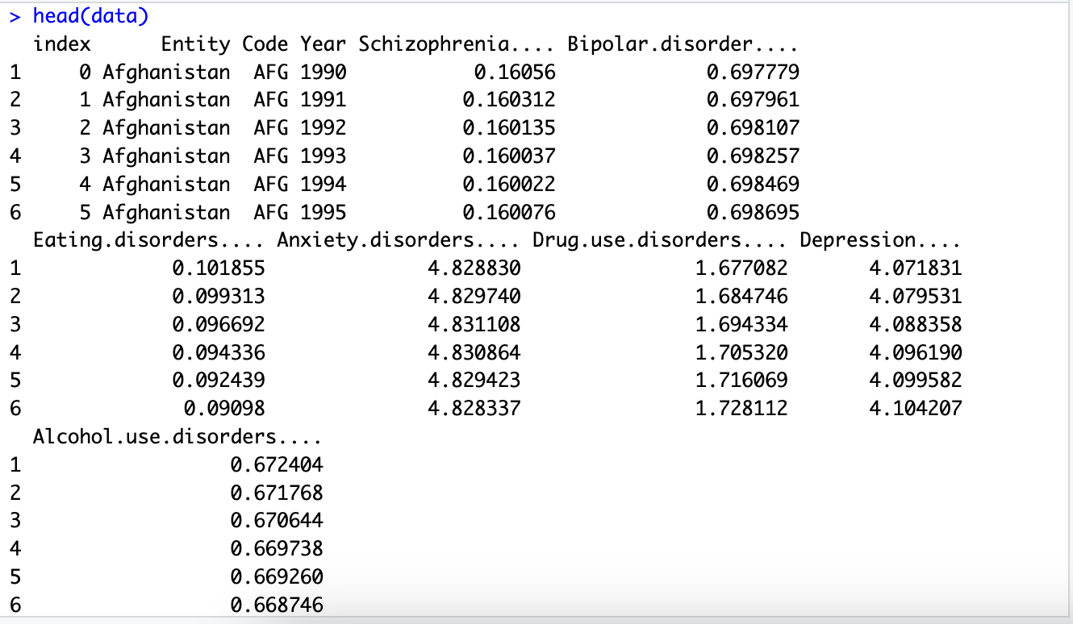
loaD the dataset

Slide 9
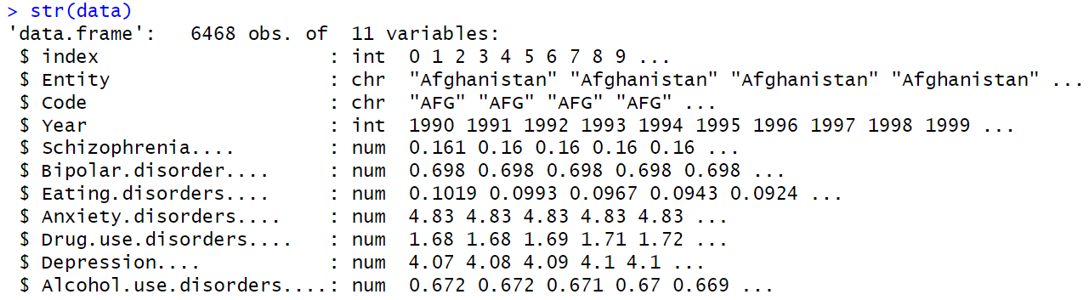
Display the structure of the data
explore the dataset

Slide 10
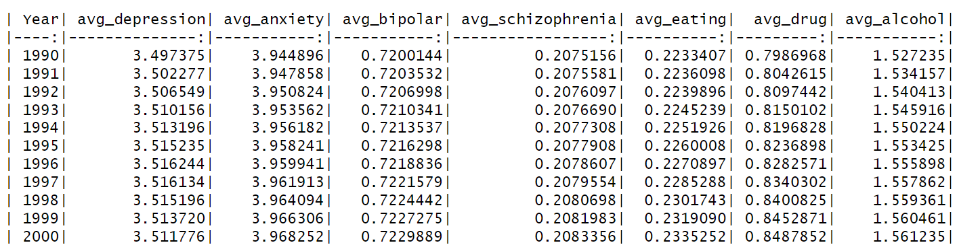
explore the dataset
Average Global Mental Disorder Rates (%) by year

Slide 11
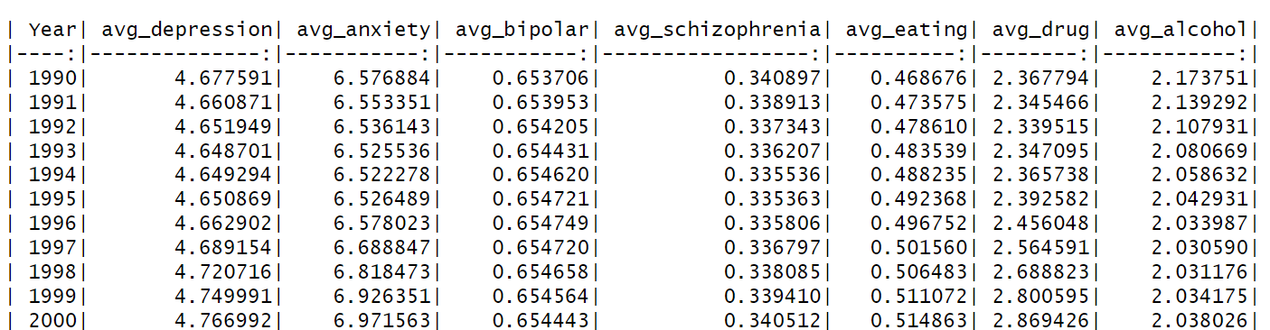
Average Mental Disorder Rates (%) by year for United States
explore the dataset

Slide 12
Structure of the data
Data Cleaning

Slide 13
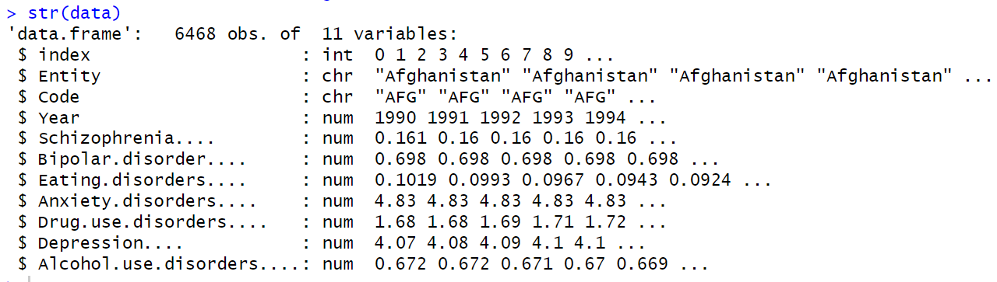
Structure of the data (After Data Conversion)
Data Cleaning

Slide 14
Check for Duplicates # Count duplicates sum(duplicated(data)) # Remove duplicates, if available data <- distinct(data)
Data Cleaning
Handling Missing Values # Check Missing Values colSums(is.na(data)) # Remove Missing Values, if available (based on the dataset, either remove or replace with mean/median/mode) required_cols <- names(data)[1:11]
data <- data[complete.cases(data[, required_cols]), ]

Slide 15
Handling Inconsistent Columns and Rows # Drop index column data$index <- NULL # Drop Code Column data$Code <- NULL # Drop unnecessary rows non_countries<- c("World", "High SDI", "Low SDI", "Middle SDI", "High- income", "Low-middle SDI", "High-middle SDI“,….) data <- data[!(data$Entity %in% non_countries), ]
Data Cleaning

Slide 16
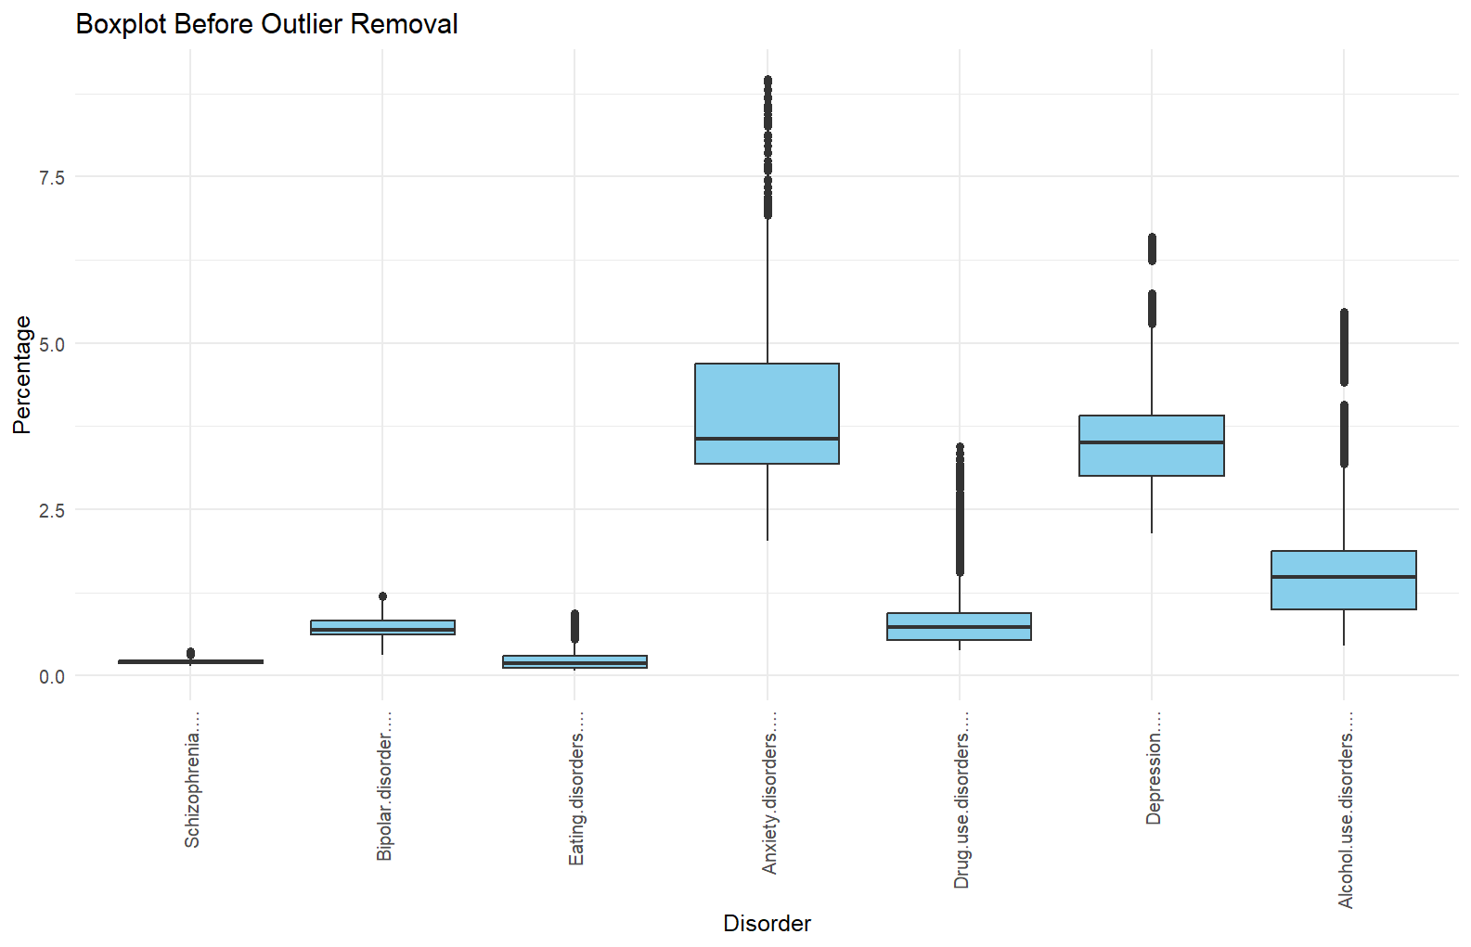
Data Cleaning

Slide 17
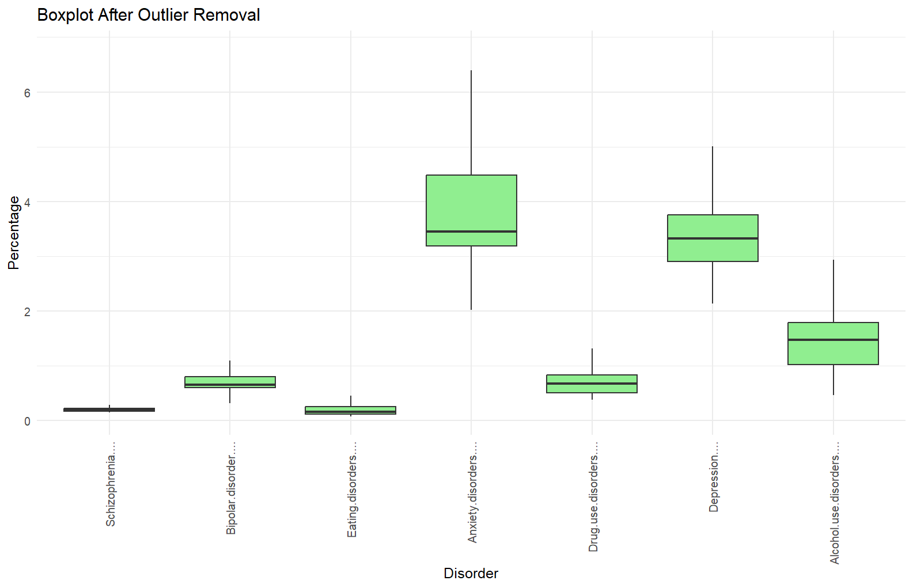
Data Cleaning

Slide 18
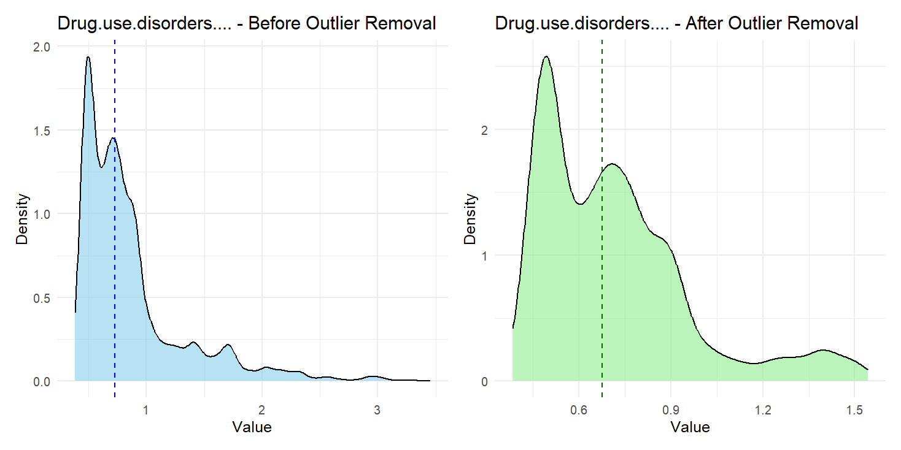
Exploratory Data Analysis
Density Plots Distribution

Slide 19
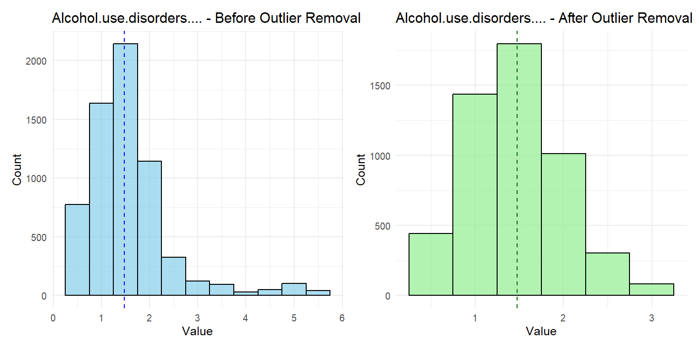
Exploratory Data Analysis
Histogram Plots Distribution

Slide 20
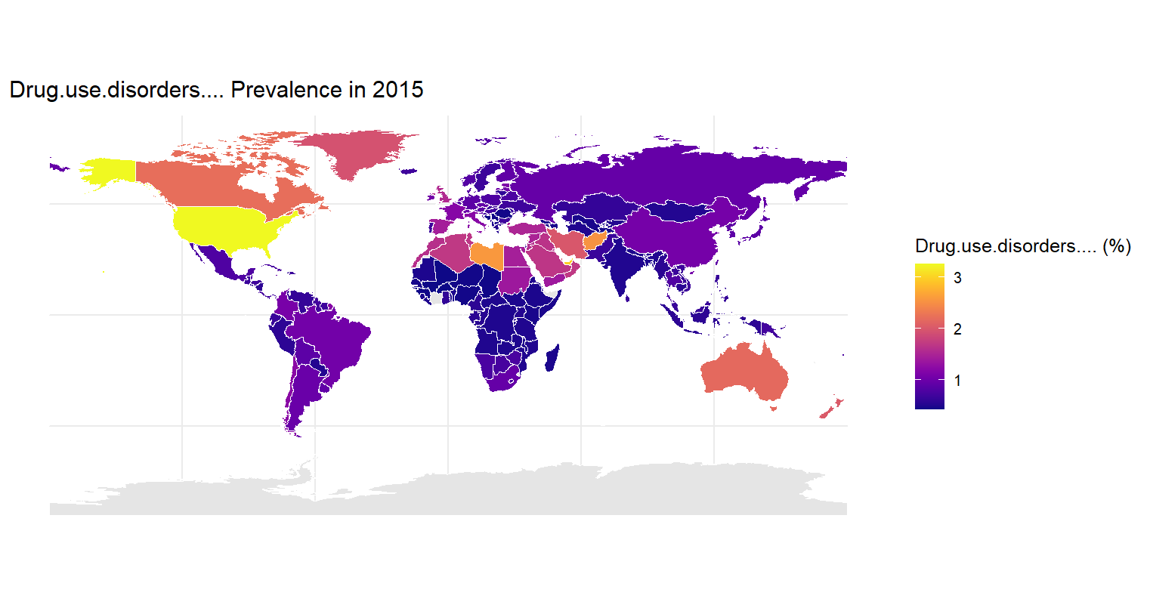
Exploratory Data Analysis

Slide 21
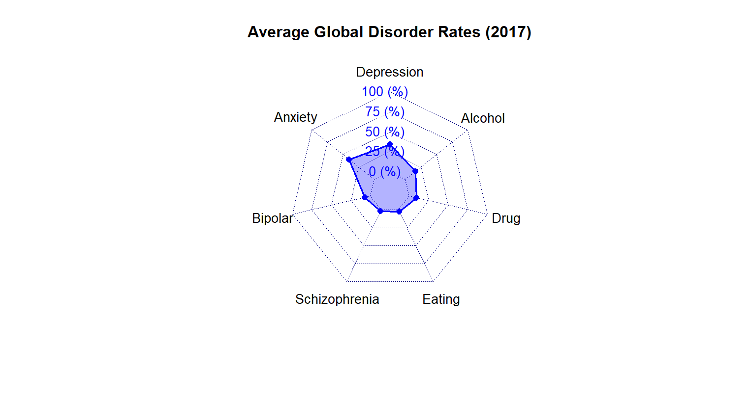
Exploratory Data Analysis
Radar Chart

Slide 22
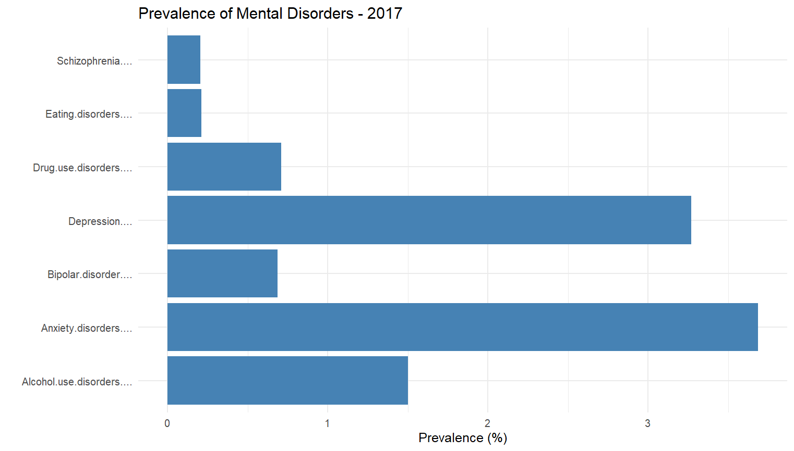
Exploratory Data Analysis
Bar graph for the distribution of Mental disorders for 2017

Slide 23
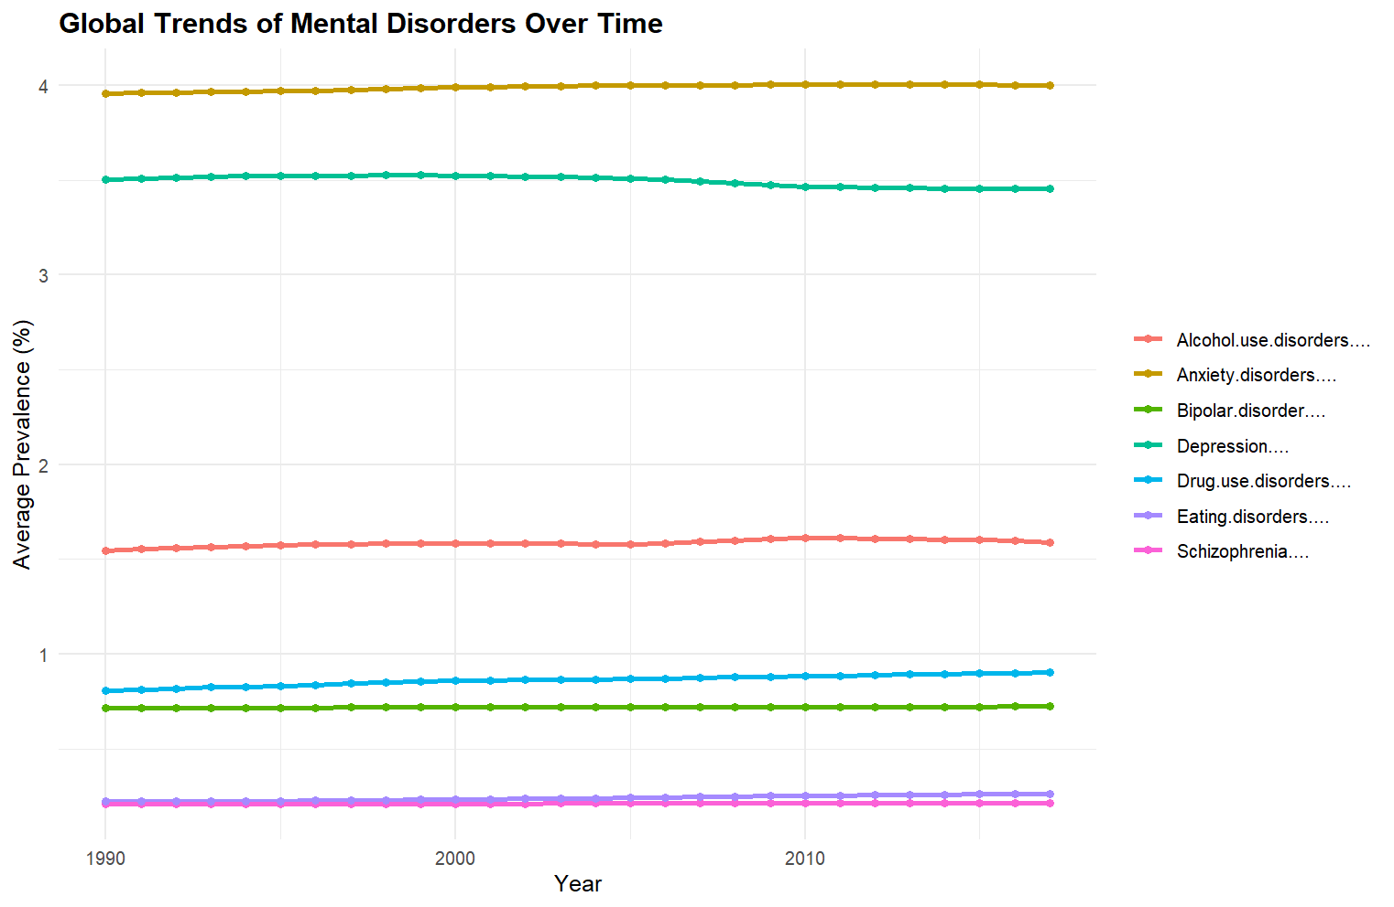
Exploratory Data Analysis
Line Plot for the distribution of Mental disorders for 2017

Slide 24
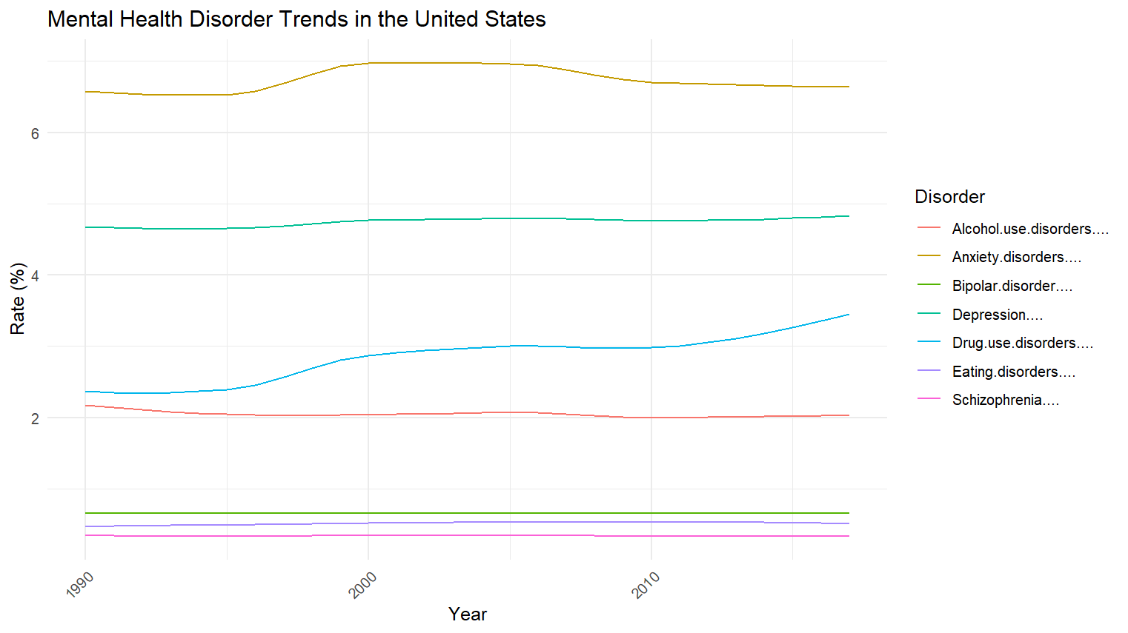
Exploratory Data Analysis
Line Plot for the distribution of Mental disorders in the United States

Slide 25
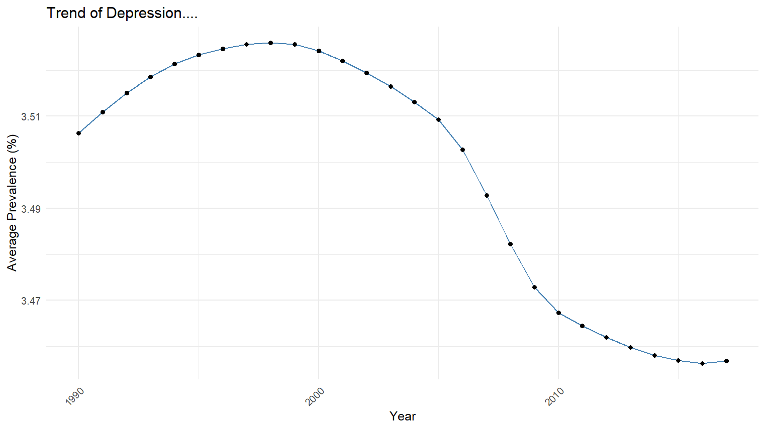
Exploratory Data Analysis
Time Series Analysis for the distribution of Global Depression

Slide 26
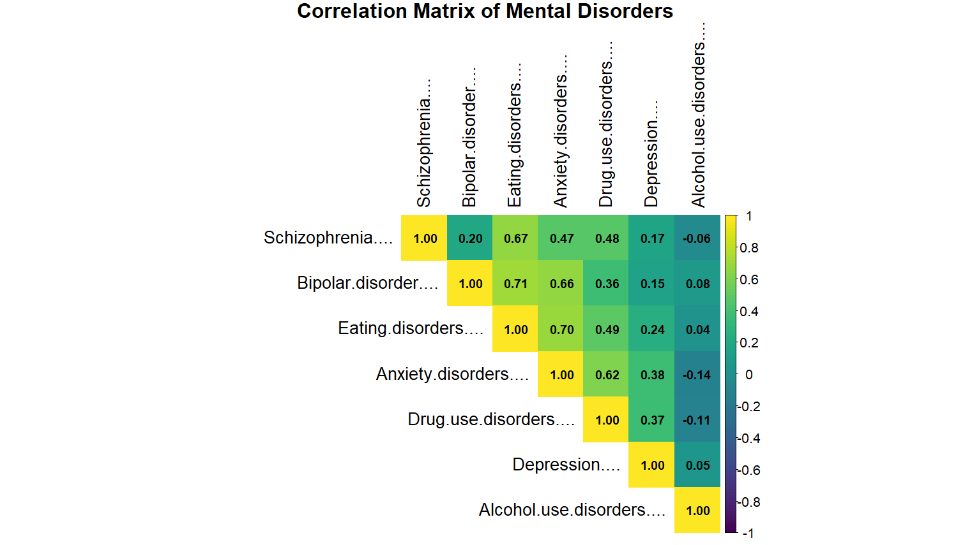
Correlation Analysis

Slide 27
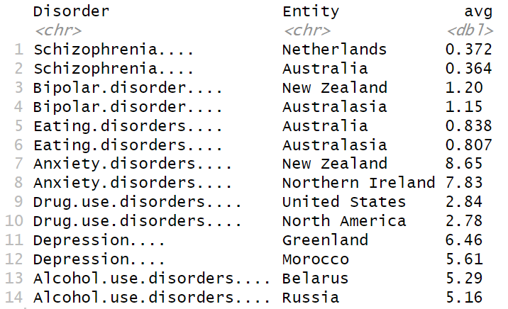
key Insights
Top two countries with highest rate of each mental disorder

Slide 28
Policy Recommendations
Schizophrenia
Resource allocation may focus more on chronic care than screening. Needs medication access, long-term support infrastructure, community-based psychiatric care and support services. Mostly reported in Netherlands and Australia.
Bipolar Disorder
Regional spikes in South America, Europe, Oceania; needs localized studies.
Eating Disorder
Raising in wealthy Western regions; needs awareness (Highest in Australia).

Slide 29
Policy Recommendations
Anxiety Disorder
High burden with regional variation; Mental health systems should be strengthened, especially in Oceania, and Northern Ireland.
Drug use Disorder
Policies should be tailored to national substance use patterns. Notably high in the United States, and Canada.
Eating Disorder
High in wealthy Western regions; needs awareness (Highest in Australia).

Slide 30
Conclusion
Eating disorders show strong correlations with both bipolar disorder and anxiety disorders. This means people with eating disorders often also struggle with mood swings or anxiety. So, treatment should focus on all these problems together.
Disorders like bipolar, eating, and drug use disorders show gradual increases, signaling growing public health challenges.

Slide 31
Conclusion
Universal screening and early intervention are key for depression and anxiety.
Substance abuse policies must be tailored to cultural and regional norms.
There is a global need for awareness, regional policy adaptation, and investment in mental health infrastructure, particularly community-based services.

Slide 32
references
Dattani, S., Rodés-Guirao, L., Ritchie, H., & Roser, M. (2023, June 20). Mental health. Our World in Data. https://ourworldindata.org/mental-health
World Health Organization: WHO. (2022, June 8). Mental disorders. https://www.who.int/news-room/fact-sheets/detail/mental-disorders
COVID-19 Mental Disorders Collaborators, & Santomauro, D. (2021). Global prevalence and burden of depressive and anxiety disorders in 204 countries and territories in 2020 due to the COVID-19 pandemic. In The Lancet (Vol. 398). https://doi.org/10.1016/S0140-6736(21)02143-7
Wu, Y., Wang, L., Tao, M., Cao, H., Yuan, H., Ye, M., Chen, X., Wang, K., & Zhu, C. (2023). Changing trends in the global burden of mental disorders from 1990 to 2019 and predicted levels in 25 years. Epidemiology and Psychiatric Sciences, 32. https://doi.org/10.1017/s2045796023000756
Global Trends in Mental health Disorder. (2022, December 14). Kaggle. https://www.kaggle.com/datasets/thedevastator/uncover-global-trends-in-mental-health-disorder

Slide 33


