Slide 1
Wellbore Geology Prediction

Slide 2
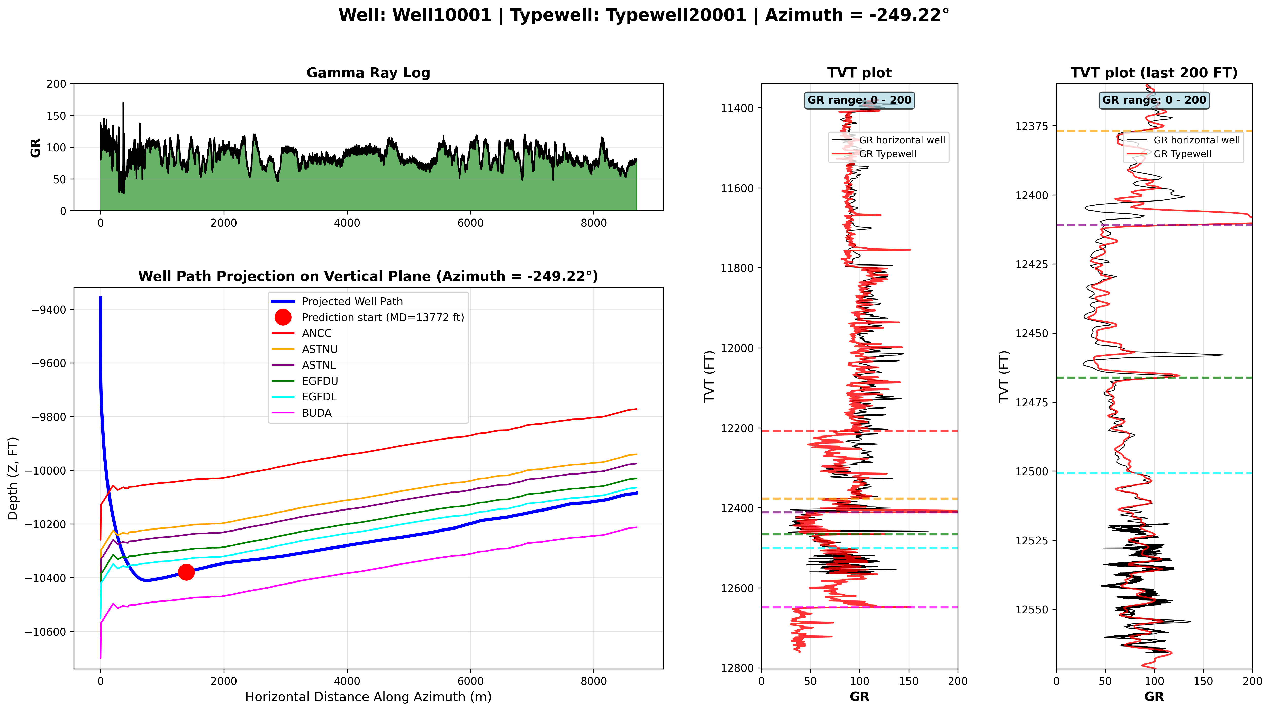
Data Available
Zoomed in TVT plot
Each well has two CSV files:
Well1XXXX__horizontal_well.csv – horizontal well data
Well1XXXX__typewell__Typewell2XXXX.csv – Typewell (vertical well data)

Slide 3
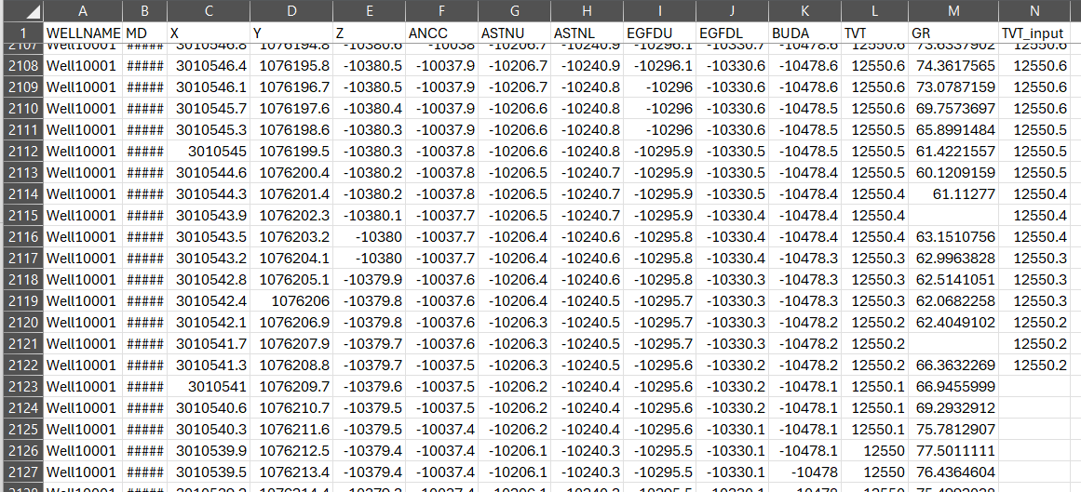
Horizontal Well Data
Well10001__horizontal_well.csv file
TVT (geology of the wellbore) must be predicted. This value is provided only for the training dataset
Top depth of each geological formation (provided only in the training dataset)
Provided for training and for prediction
Units: feet
MD – measured depth (well length) XYZ – coordinates of each point of the well
GR – GR – gamma ray values measured at each point of the horizontal well (some values may be NaN)
TVT – geology values (see next slide)
TVT_input – same geology values available until the Prediction Start (PS) point

Slide 4
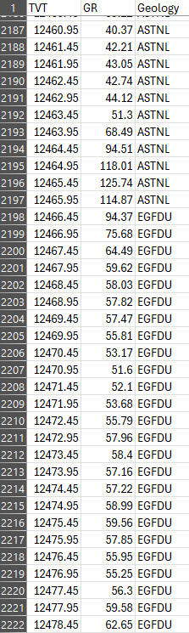
Vertical (Typewell) Well Data
Well10001__typewell__Typewell20001.csv file
Typewell assigned to Horizontal well
Each horizontal well is assigned one typewell Units: feet
TVT – true vertical thickness (depth in the vertical well)
GR – Gamma Ray Values measured at each point of the vertical well
Geology – name of geological layer

