Slide 1
AI for Faulty RIS Element Prediction
A Deep Dive into Classical & Quantum Machine Learning
Code Walkthrough & Project Defense

Slide 2
1. Project Overview
Modern 6G networks use Reconfigurable Intelligent Surfaces (RIS).
Think of RIS as a massive 'Smart Mirror' made of tiny tiles.
These mirrors bounce wireless signals perfectly to your phone.
Goal: Use AI to automatically detect if a tile breaks.

Slide 3
2. The Core Problem
RIS devices sit outdoors and face harsh weather.
Individual reflection tiles can and will break down.
When tiles break, the signal bounces wrong, and internet speed drops.
Manual inspection of thousands of tiny tiles on a building is impossible.

Slide 4
3. Our Solution Approach
We can't visually inspect the mirror, but we can 'listen' to it.
We analyze the wireless signal received by the user.
We train Artificial Intelligence to recognize the 'sound' of a broken mirror.
The AI will tell us EXACTLY which tile is broken just from the signal.

Slide 5
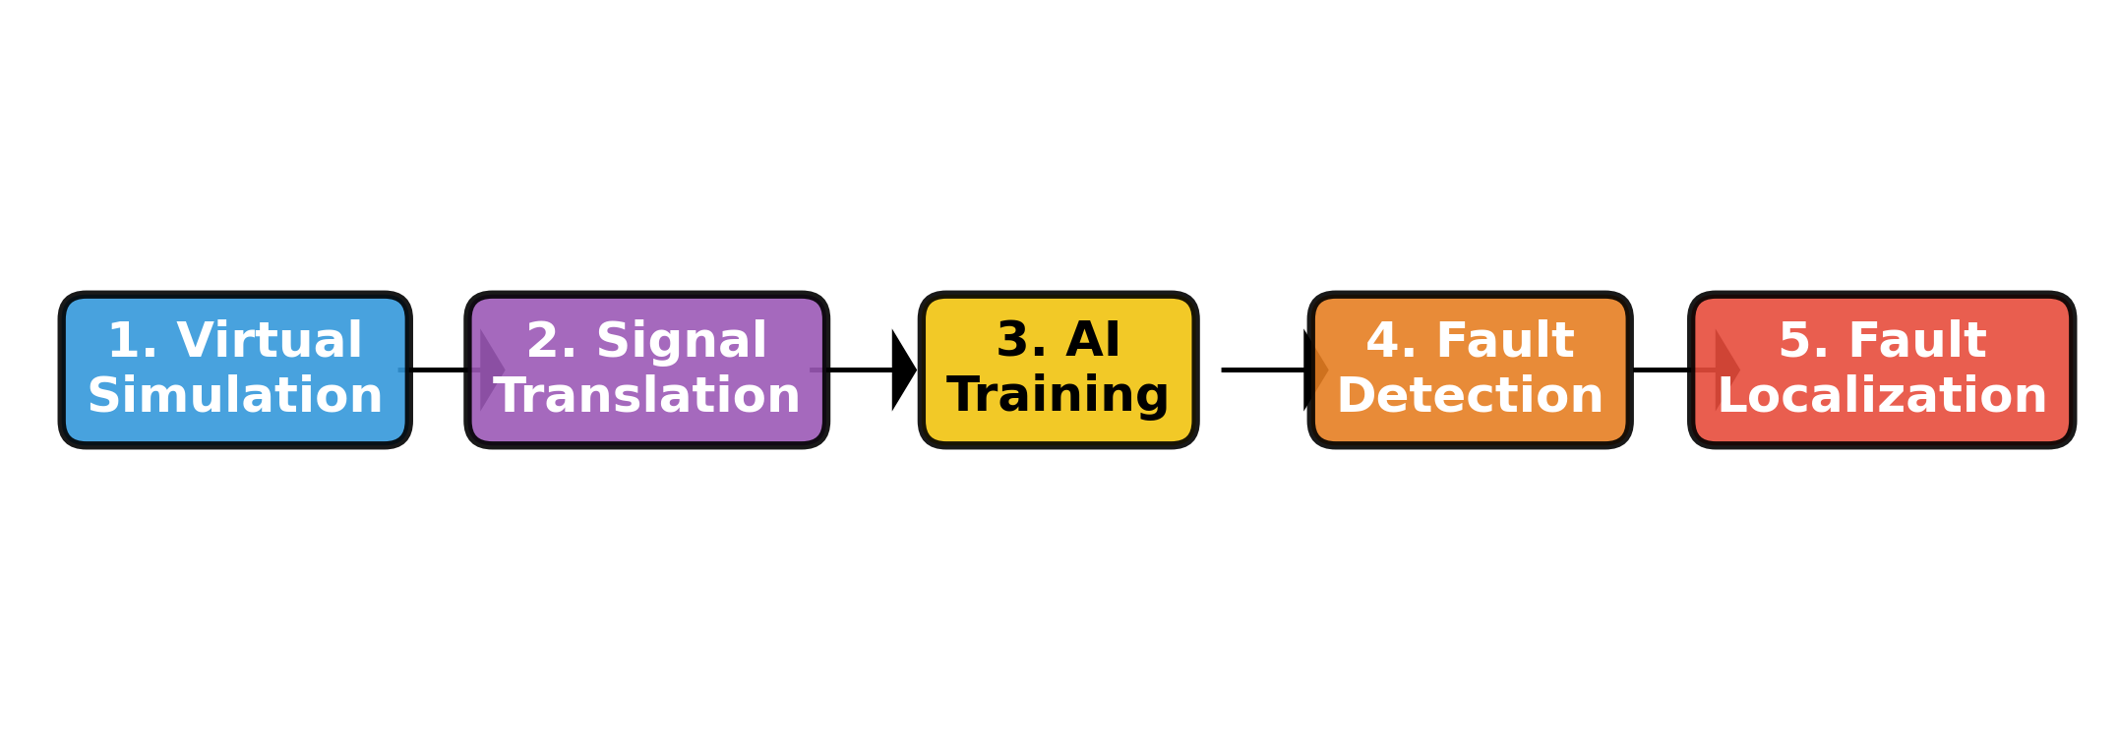
4. Project Workflow Overview

Slide 6
5. Step 1: The Virtual World
We don't have a physical broken smart mirror.
Instead, we wrote code to mathematically simulate the physical world.
The code simulates antennas, the RIS, the user, and signal bouncing.

Slide 7
6. Code Breakdown: generate_data.py
What it does: Acts as our 'Video Game Engine' for physics.
Key Code Variables:
> N_Tx = 4 : Number of antennas sending the signal.
> N_RIS = 8 : Elements on the mirror.
> frequency = 26e9 : The pitch of our wireless signal.

Slide 8
7. Injecting the Hardware Faults
How do we teach the AI what a broken mirror looks like?
We intentionally 'break' the mirror in our simulation.
Code Analogy: We literally turn off the reflection for one specific tile.

Slide 9
8. Code Breakdown: The Fault Simulator
Look at this line in the code:
> phi1[fault_idx] = 0.0
What it means:
> 'phi1' is the array of mirror tiles.
> 'fault_idx' is the exact tile we are breaking.
> '= 0.0' means we turn its reflection power to zero (broken!).

Slide 10
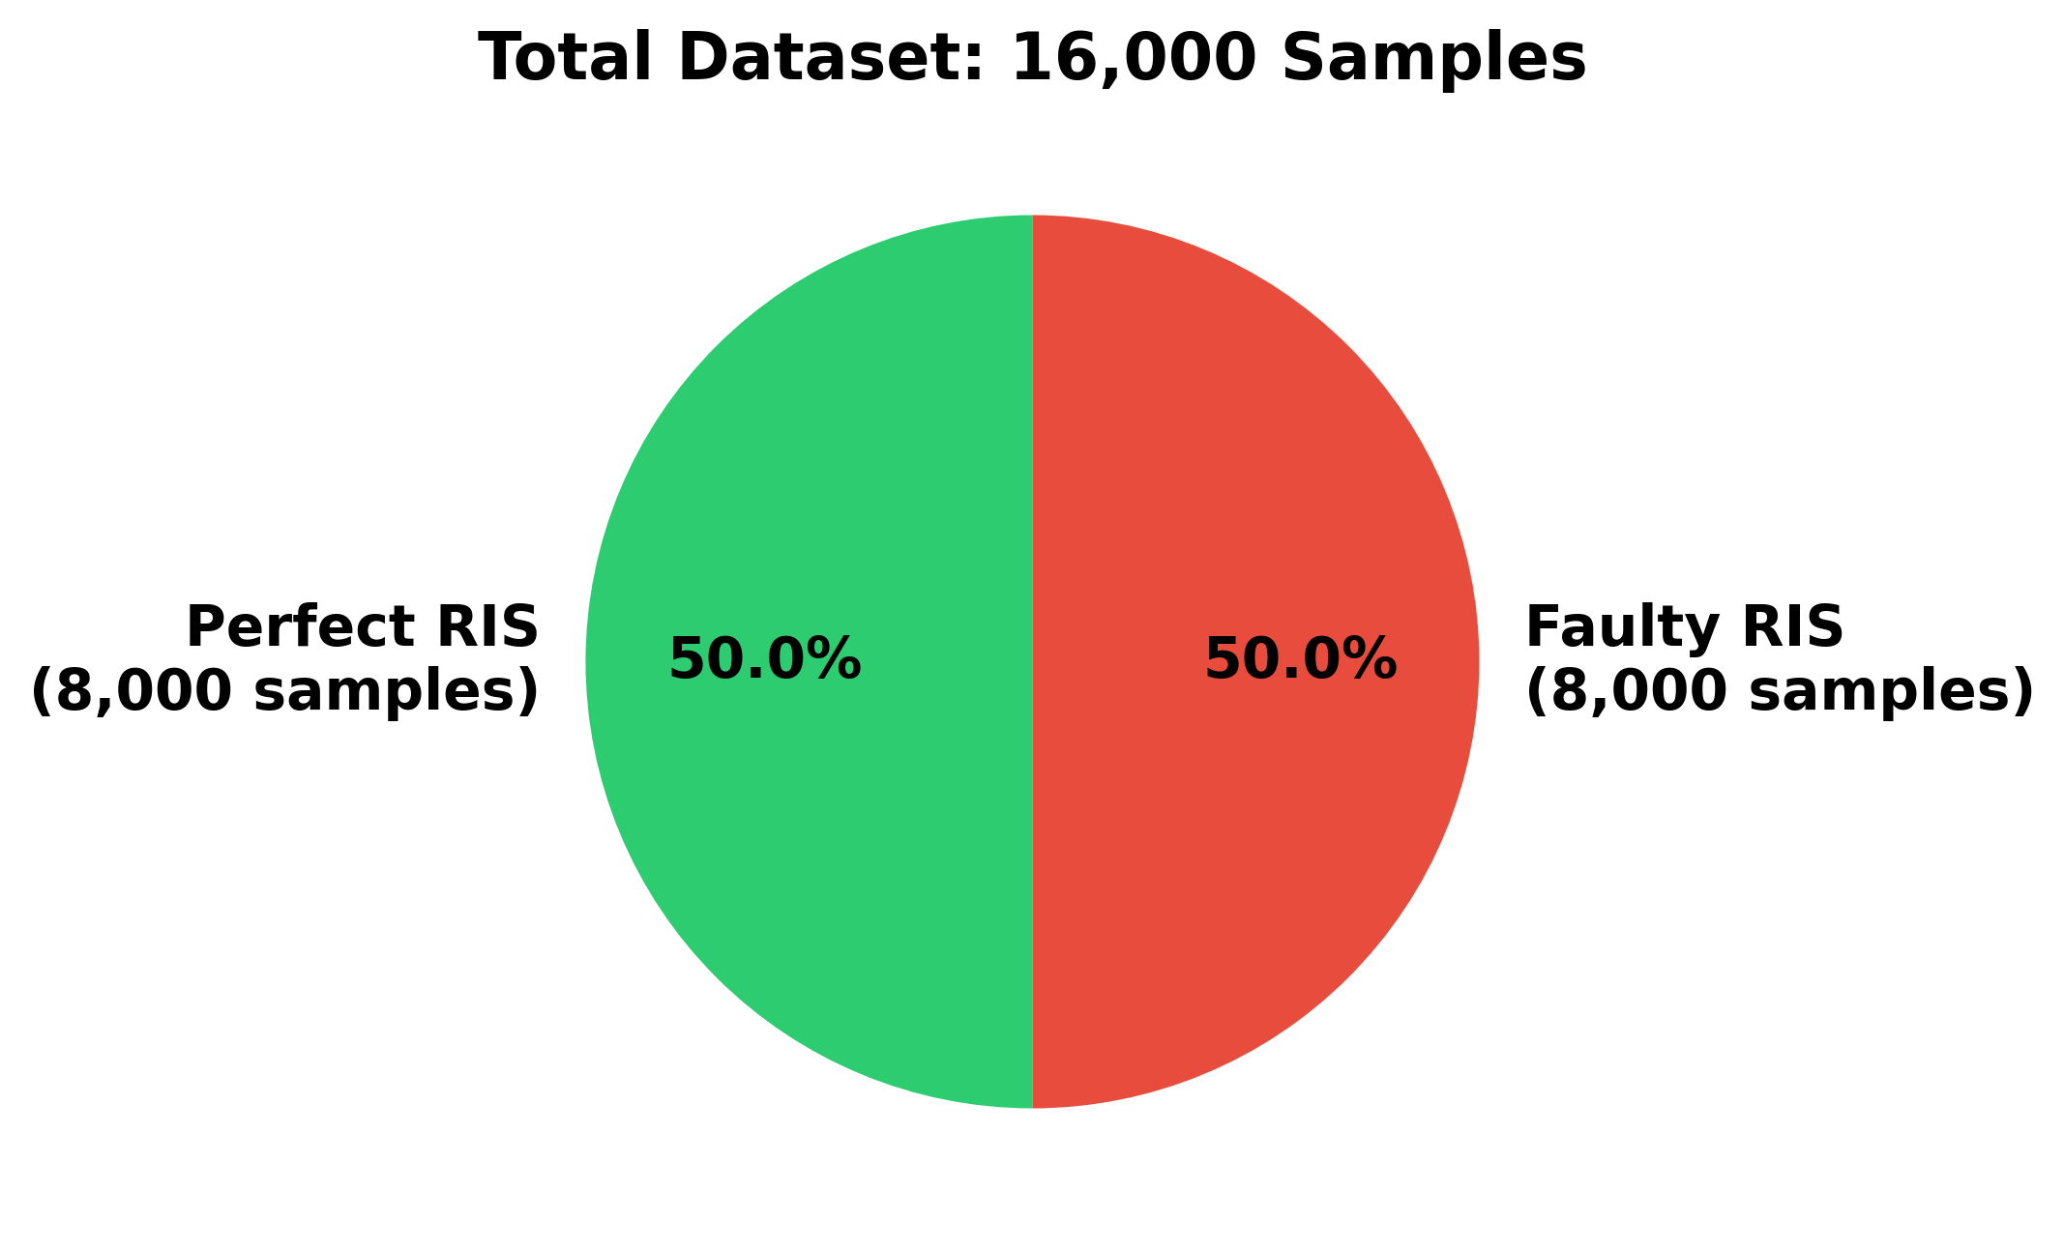
9. The Dataset Size
The AI needs massive amounts of examples to learn.
Total Dataset: 16,000 signal examples.
We balanced the data so the AI doesn't get biased.

Slide 11
10. Step 2: Data Preprocessing
Wireless signals are recorded as 'Complex Numbers' (Real + Imaginary).
Standard AI models are not very good at reading complex numbers.
We must translate this data into a language the AI understands.

Slide 12
11. Code Breakdown: Signal Translation
Look at the 'preprocess(complex_data)' function:
> np.real(complex_data)
> np.imag(complex_data)
What it does:
> It splits the signal into two plain numbers.
> Analogy: Like translating French into English so the AI can read it.

Slide 13
12. Step 3: The AI Brains
We tested three different AI 'Brains' to see which is smartest:
1. MLP (Multi-Layer Perceptron) - The Standard Brain
2. CNN (Convolutional Neural Network) - The Pattern Finder
3. QML (Quantum Machine Learning) - The Futuristic Brain

Slide 14
13. AI Model 1: MLP
Multi-Layer Perceptron (MLP).
This is a classic, standard Neural Network.
Pros: Simple, fast to train, well-understood.
Cons: Might struggle if the signal patterns are extremely complex.

Slide 15
14. AI Model 2: CNN
Convolutional Neural Network (CNN).
Usually used for Facial Recognition and Images.
Why use it here?
> We treat the signal like an 'image' to find hidden spatial patterns.
> CNNs are excellent at spotting tiny anomalies.

Slide 16
15. AI Model 3: QML
Quantum Machine Learning (QML).
A hybrid model using Quantum Computing concepts.
Why use it here?
> Quantum models can process complex possibilities simultaneously.
> It represents cutting-edge research in telecommunications.

Slide 17
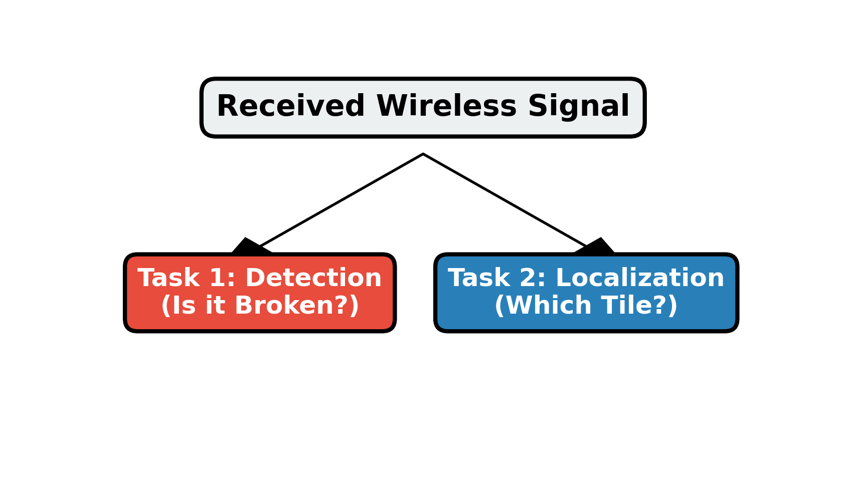
16. Step 4: The Two AI Tasks

Slide 18
17. Training the Models (train.py)
We send our 16,000 samples into the AI models.
We hide the answers, let the AI guess, and then grade its test.
Over time (Epochs), the AI adjusts its brain to guess better.

Slide 19
18. Code Breakdown: The Loss Function
Look at this code in train.py:
> criterion = nn.CrossEntropyLoss()
What it does:
> This is the 'Teacher' grading the AI's test.
> If the AI guesses wrong, the 'Loss' goes up.
> The AI's only goal is to make the Loss as close to 0 as possible.

Slide 20
19. Code Breakdown: The Optimizer
Look at this code in train.py:
> optimizer = torch.optim.Adam(model.parameters())
What it does:
> This is the mechanism that actually 'rewires' the AI's brain.
> After the Teacher (Loss) tells the AI it failed, Adam (Optimizer)
adjusts the math so the AI does better on the next try.

Slide 21
20. Evaluation Metrics
How do we know if the AI is actually smart?
1. Accuracy: Out of 100 tests, how many did it get perfectly right?
2. F1-Score: A balanced score that ensures the AI isn't just guessing 'Healthy' every time.
The code prints a final scorecard comparing MLP, CNN, and QML.

Slide 22
21. Conclusion
We successfully simulated a 6G smart mirror environment.
We proved that we can find hardware failures without physical inspection.
We compared classical AI against futuristic Quantum AI.
This project paves the way for self-healing wireless networks.

Slide 23
22. Questions & Answers
Thank you for your time.
Open for Questions regarding:
> The Simulation Math
> The Neural Network Architectures
> The Quantum Machine Learning approach

