Slide 1



CLIMATE CHANGE ANALYSIS (1961 – 2022)
MENTOR
Dr.R.Rajadevi,
Associate professor
PROJECT MEMBERS
NAVBILA K(22ADR071),
RAMYA K(22ADR085),
SRIDHAR S(22ADR102).

Slide 2
OBJECTIVE
Analyze historical surface temperature data to identify patterns and trends.
Employ advanced data analytics techniques to predict future surface temperature changes.
Utilize visualization tools to present complex findings in an accessible and impactful manner.
Provide actionable insights to support climate research and informed decision-making.

Slide 3
ABOUT DATASET
The dataset you provided consists of 225 records with 72 features.
The dataset includes key climate change indicators, such as country names, ISO codes, temperature changes from 1961 to 2022, and relevant metadata about the data sources and definitions.
Dataset Description
ObjectId - A unique identifier for each record in the dataset.
Country - The name of the country or region for which the data is provided.
ISO2 - The two-letter country code following ISO 3166-1 alpha-2 standard.
ISO3 - The three-letter country code following ISO 3166-1 alpha-3 standard. Indicator - Describes the climate change indicator, focusing on temperature changes.
Unit - The unit of measurement for the climate indicator.
Source - The organization or entity from which the data was sourced.
CTS_Code - A unique code representing the climate indicator. CTS_Name - The name of the climate indicator being tracked.
CTS_Full_Descriptor - A detailed description of the climate indicator.
F1961 to F2022 - Temperature change for each corresponding year from 1961 to 2022.

Slide 4
DATASET LINK:
https://www.kaggle.com/code/rewidashabaanmohamed/climate-change/input

Slide 5
DATA PREPROCESSING
Before analysis, the dataset was pre-processed to ensure data quality:
Handling Missing Values: Identify any missing values in the dataset columns, especially for annual temperature data (e.g., F1961 to F2022).
Standardizing Units: Ensure that all temperature data is recorded in the same unit (e.g., Degree Celsius). Convert if necessary and verify consistency.
Removing Duplicates: Check for any duplicate records in country-specific indicators, ISO codes, or other columns. Remove duplicates to avoid biased analysis.

Slide 6
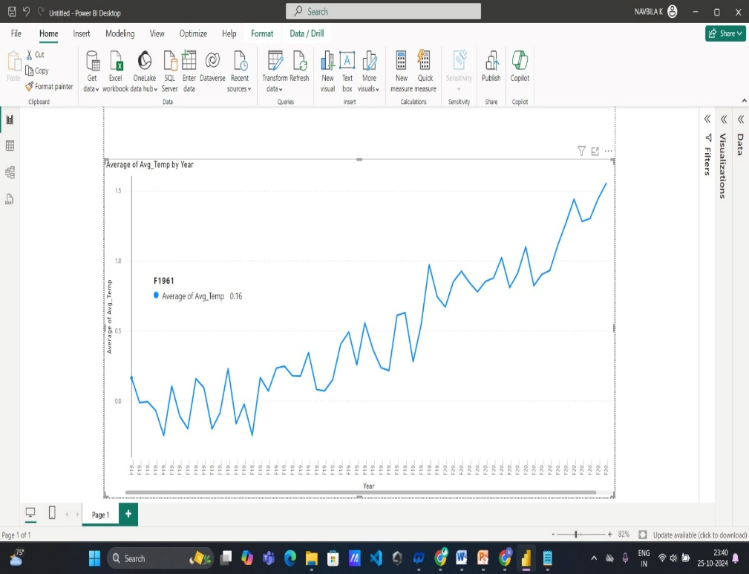

QUESTIONS FOR PERFORMINNG THE PROCESS IN DATASET
1.What is the overall global trend in temperature change from 1961 to 2022?
Inference: The average temperature increased from approximately 0.16 in 1961 to 1.55 in 2020, indicating significant warming over the decades. This trend highlights the potential impact of climate change and warrants further investigation.

Slide 7
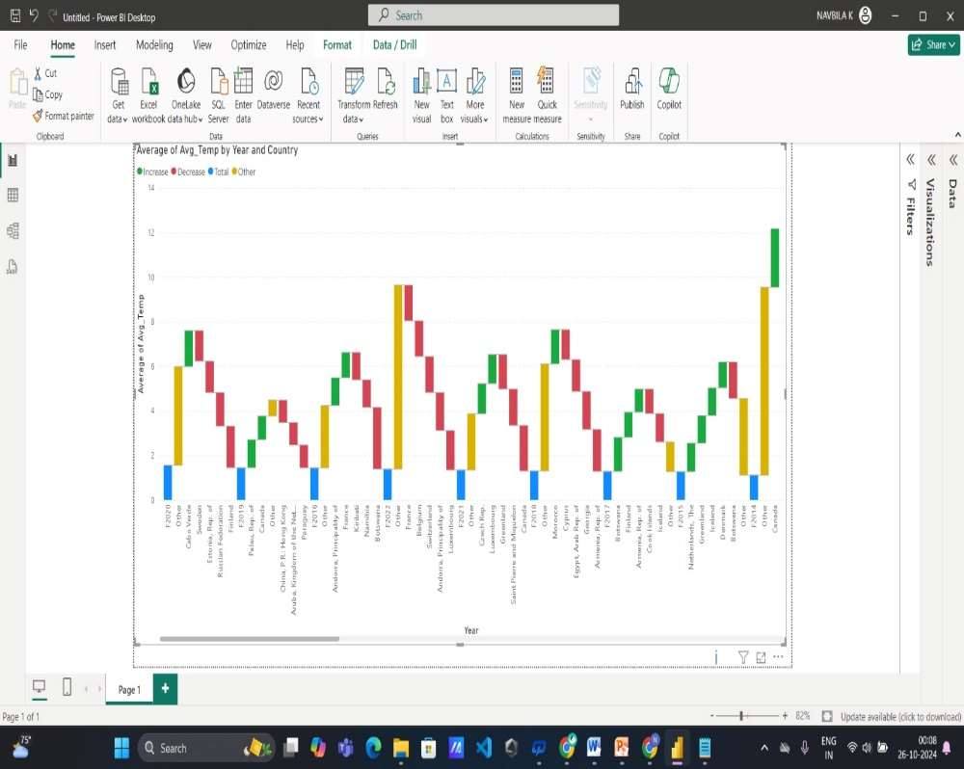
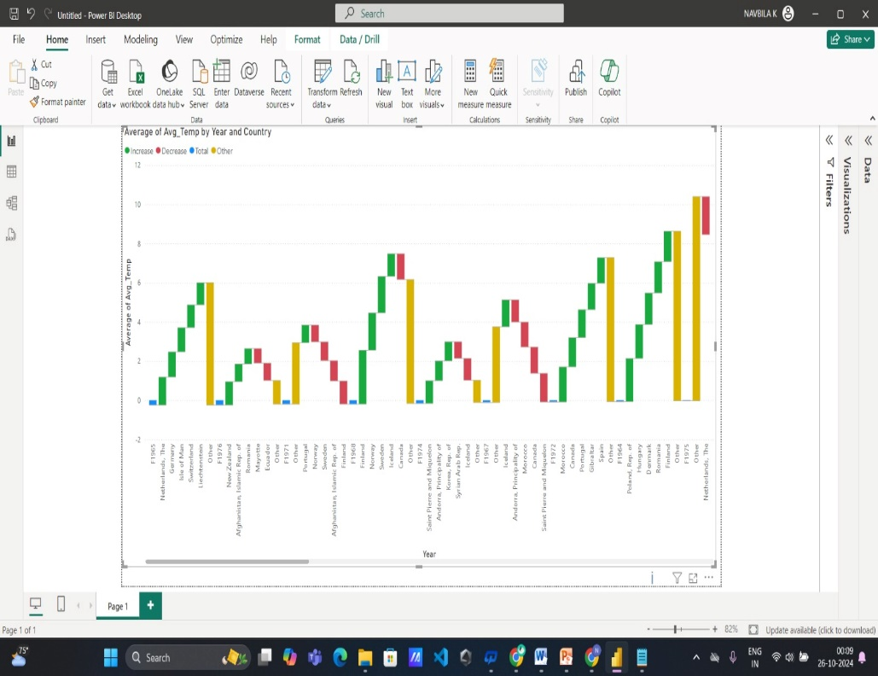
2.How do temperature changes vary across different regions or continents over the observed period?
Inference: The temperature data across various countries reveals a notable upward trend in average temperatures, especially since 2020. Northern and Southern Europe, along with Canada, demonstrate significant warming, while Africa and the Middle East exhibit more variable patterns.

Slide 8
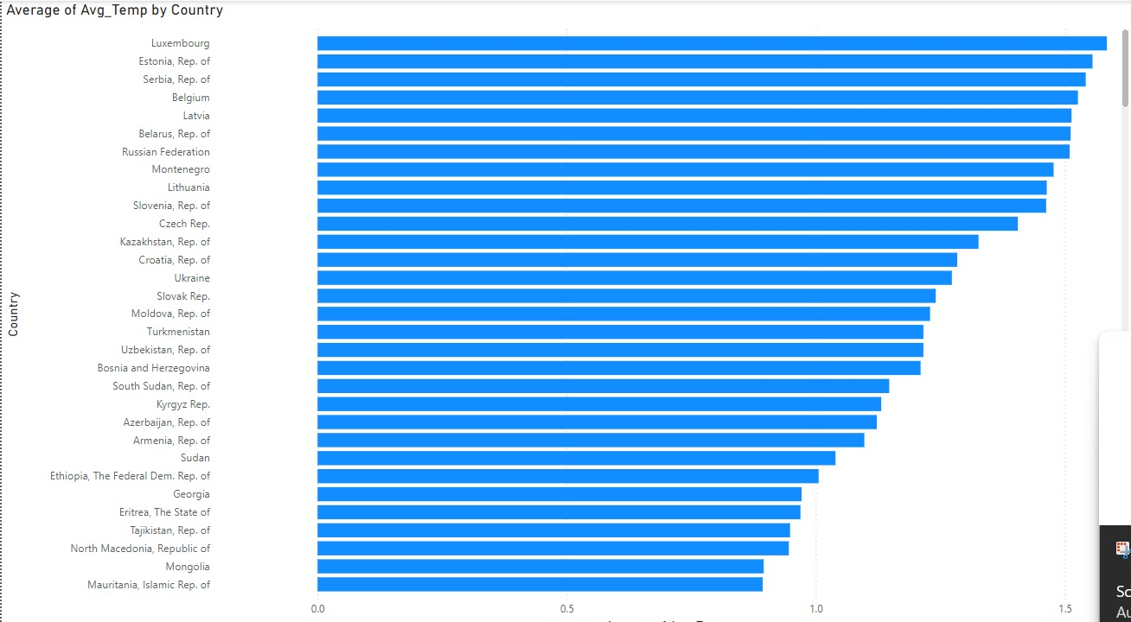
3.Which countries experienced the most significant temperature changes?
Inference : Countries such as Luxembourg, Estonia, Serbia, Belgium, and Latvia have the most significant temperature changes, with Luxembourg showing the highest average temperature increase. These notable rises in average temperatures indicate a pronounced warming trend, highlighting the impact of climate change across these regions.

Slide 9
4.How do yearly average temperature changes compare between developed and developing countries?
Calculated Column:
Classification =
SWITCH(
TRUE(),
Climate_2[Country] IN {"Australia", "Austria", "Belgium", "Canada", "Denmark", "Finland", "France", "Germany", "Iceland", "Ireland", "Italy", "Japan", "Netherlands", "New Zealand", "Norway", "Portugal", "Spain", "Sweden", "Switzerland", "United Kingdom", "United States"}, "Developed",
"Developing"
)
Measures:
AverageTempChange_Developed_Country =
CALCULATE(
AVERAGE(Climate_2[Avg_Temp]),
Climate_2[Classification] = "Developed"
)
AverageTempChange_Developing_Country =
CALCULATE(
AVERAGE(Climate_2[Avg_Temp]),
Climate_2[Classification] = "Developing"
)

Slide 10
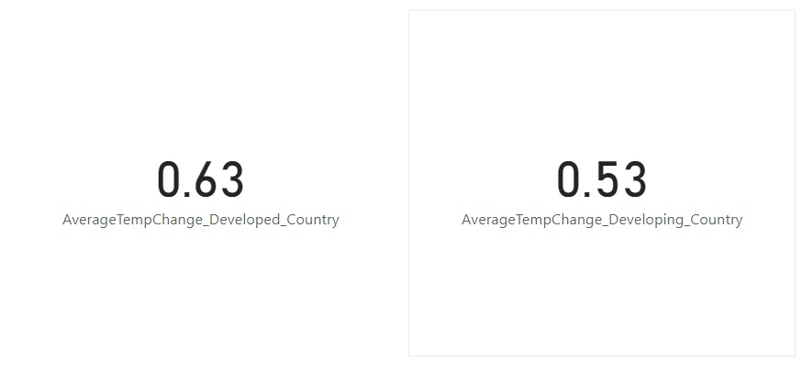
Inference: Developed countries have a higher average temperature change of 0.63°C compared to 0.53°C in developing countries, showing a difference of 0.10°C.

Slide 11
5.Are temperature changes more severe in landlocked countries compared to coastal nations?
Calculated Column:
Landlocked_Coastal =
SWITCH(
TRUE(),
Climate_2[Country] IN {"Afghanistan", "Armenia", "Austria", "Azerbaijan", "Bolivia", "Botswana", "Burkina Faso", "Burundi", "Central African Rep.", "Chad", "Czech Rep.", "Hungary", "Kazakhstan", "Kyrgyz Rep.", "Laos", "Lesotho", "Liechtenstein", "Luxembourg", "Malawi", "Mali", "Moldova", "Mongolia", "Nepal", "Niger", "North Macedonia", "Paraguay", "Rwanda", "San Marino", "Serbia", "Slovak Rep.", "South Sudan", "Swaziland", "Switzerland", "Tajikistan", "Turkmenistan", "Uganda", "Uzbekistan", "Zambia", "Zimbabwe"}, "Landlocked",
"Coastal"
)
Measures:
AverageTempChange_Landlocked_Countries =
CALCULATE(
AVERAGE(Climate_2[Avg_Temp]),
Climate_2[Landlocked_Coastal] = "Landlocked"
)

Slide 12
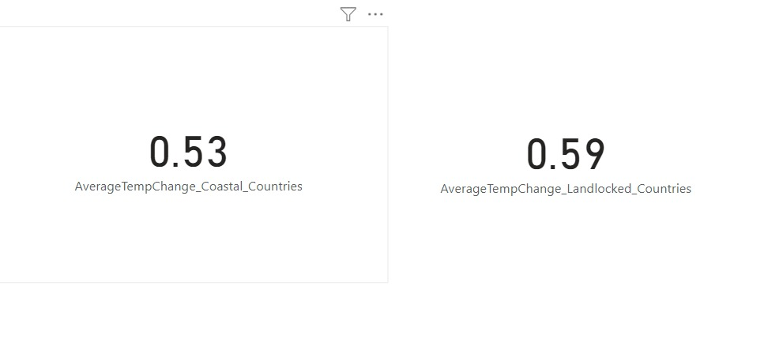
AverageTempChange_Coastal_Countries =
CALCULATE(
AVERAGE(Climate_2[Avg_Temp]),
Climate_2[Landlocked_Coastal] = "Coastal"
)
Inference: Temperature changes are more severe in landlocked countries, with an average increase of 0.59°C, compared to 0.53°C in coastal nations. This indicates that landlocked countries experience greater temperature fluctuations. The difference of 0.06°C suggests that geographical factors may influence climate impacts, potentially due to limited access to moderating oceanic influences.

Slide 13
6.How do temperature changes differ between the Northern and Southern Hemispheres?
Calculated Column:
Hemisphere =
SWITCH(
TRUE(),
Climate_2[Country] = "Canada", "Northern",
Climate_2[Country] = "United States", "Northern",
Climate_2[Country] = "Germany", "Northern",
Climate_2[Country] = "United Kingdom", "Northern",
Climate_2[Country] = "China, P.R.: Mainland", "Northern",
Climate_2[Country] = "Japan", "Northern",
Climate_2[Country] = "Australia", "Southern",
Climate_2[Country] = "Argentina", "Southern",
Climate_2[Country] = "Brazil", "Southern",
Climate_2[Country] = "South Africa", "Southern",
BLANK() // Default for countries not classified yet
)
Measures:
AverageTempChange_Northern =
CALCULATE(
AVERAGE(Climate_2[Avg_Temp]),
Climate_2[Hemisphere] = "Northern")

Slide 14
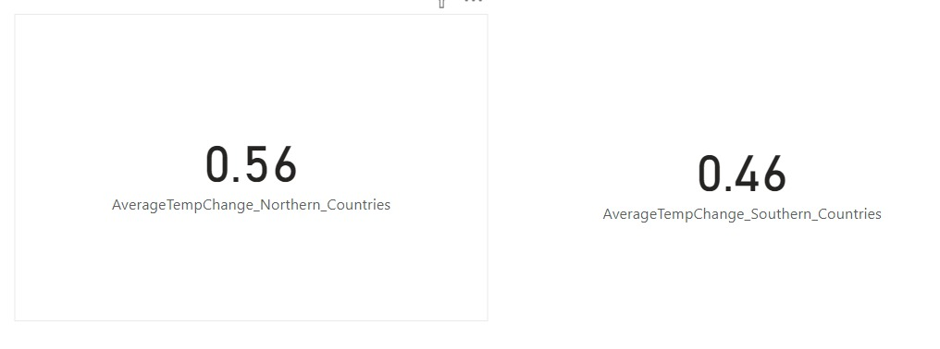
AverageTempChange_Southern =
CALCULATE(
AVERAGE(Climate_2[Avg_Temp]),
Climate_2[Hemisphere] = "Southern"
)
Inference: The analysis of temperature changes reveals that Northern Hemisphere countries have an average temperature increase of 0.56°C, while Southern Hemisphere countries shows lower increase of 0.46°C. This indicates that the Northern Hemisphere is experiencing a more significant rise in temperatures compared to the Southern Hemisphere.

Slide 15
7. How does the average temperature change vary between high-emission countries and low-emission countries?
Calculated Column:
Emission_Category =
SWITCH(
TRUE(),
Climate_9[Country] IN {"United States", "China, P.R.: Mainland", "India", "Russia", "Japan"}, "High-Emission",
Climate_9[Country] IN {"Malawi", "Fiji, Rep. of", "Bhutan", "Belize", "Gambia, The"}, "Low-Emission",
"Unknown"
)
Measures:
Avg_Temperature_Change_High_Emission_Countries =
CALCULATE(
AVERAGE(Climate_9[Temperature_Change]),
Climate_9[Emission_Category] = "Low-Emission"
)
Avg_Temperature_Change_Low_Emission_Countries =
CALCULATE(
AVERAGE(Climate_9[Temperature_Change]),
Climate_9[Emission_Category] = "High-Emission"
)

Slide 16
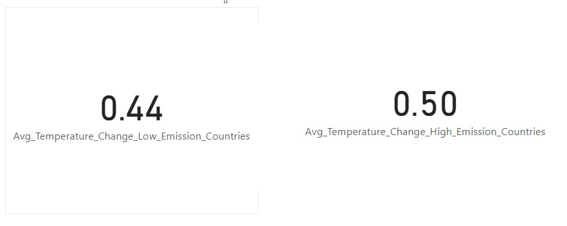
Inference:The average temperature change for low emission countries is 0.44°C, while high emission countries show a slightly higher change of 0.50°C. This indicates that high emission countries experience marginally greater temperature increases compared to their low emission counterparts. The difference suggests a potential link between emissions and temperature change trends. Overall, both categories exhibit relatively low temperature changes.

Slide 17
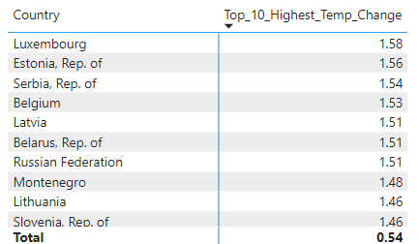
8.What are the top 10 countries that have shown consistent annual increases in temperature?
Inference: Based on the provided data, the top 10 countries that have shown consistent annual increases in temperature are Luxembourg, Estonia, Serbia, Belgium, Latvia, Belarus, the Russian Federation, Montenegro, Lithuania, and Slovenia. These countries exhibit the highest average temperatures, indicating a significant trend in rising temperatures over the years.

Slide 18
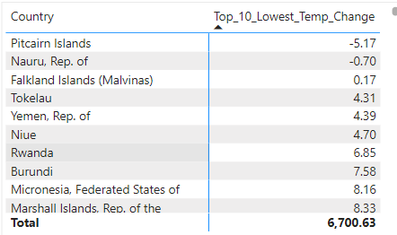
9.What are the top 10 countries that have shown the least change in temperature over the observed years?
Inference: The table lists the top 10 countries with the least change in temperature over the observed years. Pitcairn Islands shows the largest decrease at -5.17°C, while the Falkland Islands has a minimal increase of 0.17°C. The remaining countries, including Yemen and Niue, exhibit slight increases in temperature. Overall, these countries demonstrate relatively stable temperature trends compared to others.

Slide 19
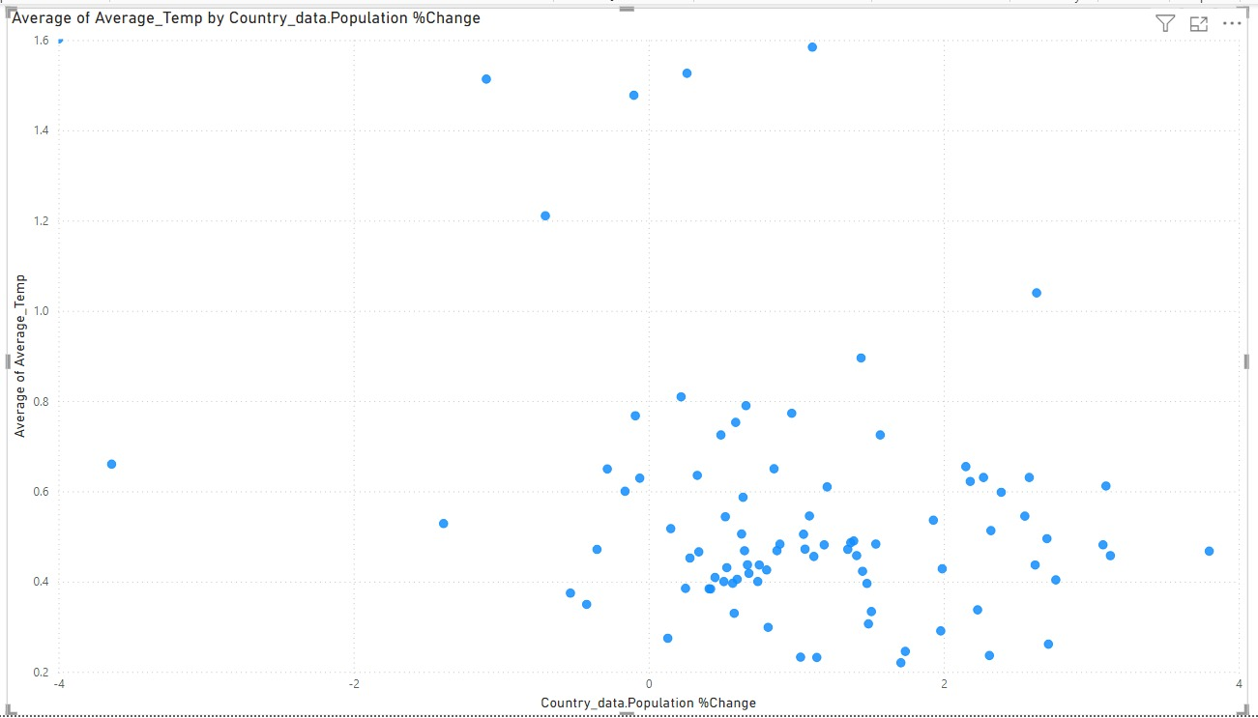
10.Is there any relationship between the size of a country (land area) and its temperature change ?
Inference: From the scatter plot analysis, it is evident that there is no strong correlation between population percentage change and average temperature change, as the points are widely dispersed without a clear pattern.

Slide 20
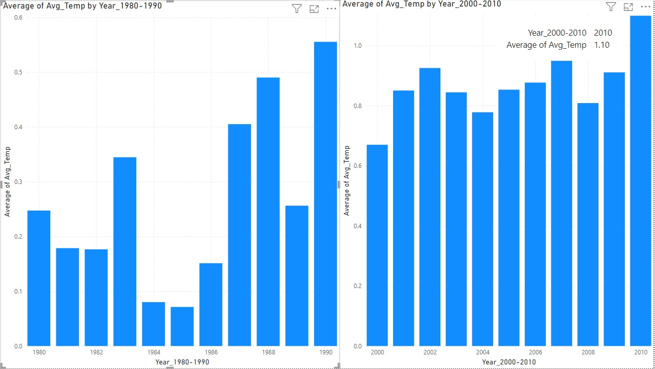
11.How did temperature changes accelerate or decelerate during certain decades (e.g., 1980-1990, 2000-2010)?
Inference: The bar charts illustrate the average temperature trends from 1980-1990 and 2000-2010. The first chart shows a gradual increase in average temperatures, peaking in 1990. In contrast, the second chart indicates a more consistent rise, with average temperatures reaching 1.10°C by 2010. Overall, there is a clear upward trend in average temperatures over the decades.

Slide 21
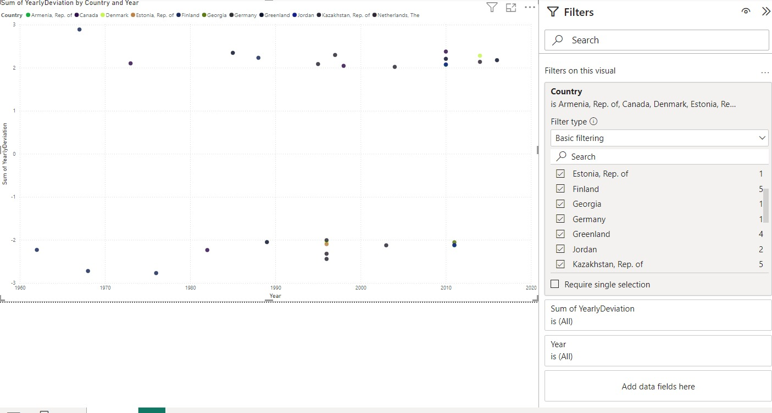
12. Are there any notable anomalies where a country’s temperature suddenly deviates from its previous trend?
Inference: The scatter plot reveals notable anomalies in temperature deviations for several countries. For instance, Finland shows a significant upward deviation in recent years, indicating a sharp increase in temperature compared to previous trends. Estonia also exhibits a sudden spike, suggesting an unusual temperature fluctuation. Overall, these deviations highlight specific countries experiencing unexpected changes in their temperature patterns.

Slide 22
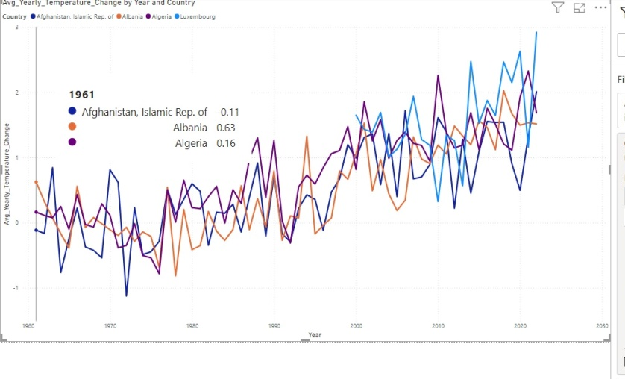
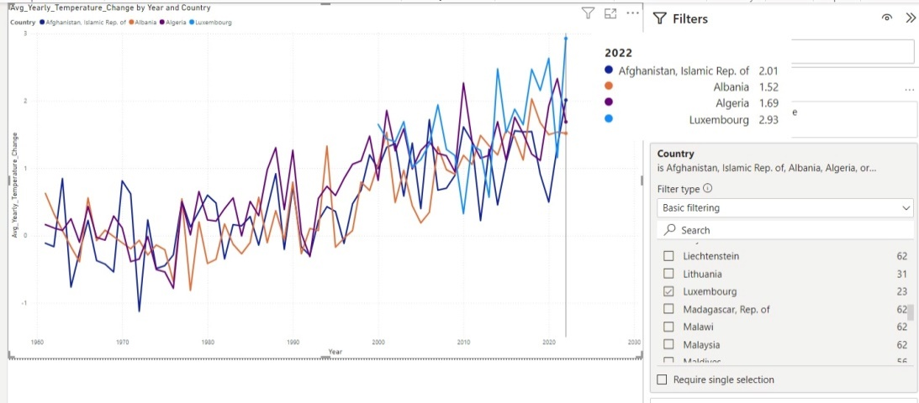
13.How do temperature trends vary across different continents and what regional factors contribute to these differences?
Measures:
Avg_Yearly_Temperature_Change = CALCULATE(AVERAGE(Climate_2[Avg_Temp]), ALLEXCEPT(Climate_2, Climate_2[Country], Climate_2[Year]))
Inference: Temperature trends across different countries show varying patterns, with Luxembourg experiencing the highest average temperature change at 2.93°C by 2022. In contrast, Afghanistan and Albania show lower increases, at 2.01°C and 1.52°C, respectively. Regional factors such as geographic location, urbanization, and climate policies likely contribute to these differences. Overall, the data indicates that European countries may be experiencing more significant temperature changes compared to some North African and Middle Eastern nations..

Slide 23
Calculated Column:
AverageTemperatureChangeColumn = CALCULATE( AVERAGE(Climate_9[Temperature_Change]), ALLEXCEPT(Climate_9, Climate_9[Country]))
ProjectedTemperatureChangeColumn = [AverageTemperatureChangeColumn] * 10
RiskCategory = SWITCH( TRUE(), [ProjectedTemperatureChangeColumn] > 5, "High Risk", [ProjectedTemperatureChangeColumn] > 2, "Moderate Risk", "Low Risk")
Measures:
HighRiskCountries = DISTINCTCOUNT(HighRiskCountries[Country])
LowRiskCountries = DISTINCTCOUNT(LowRiskCountries[Country])
ModerateRiskCountries = DISTINCTCOUNT(ModerateRiskCountries[Country])
14. How many countries are high, moderate, and low risk categories?

Slide 24

Inference: The data indicates significant surface temperature changes across different risk categories, with 103 countries categorized as high risk, 115 as moderate risk, and only 7 as low risk. This distribution shows that the majority of countries experience high and moderate temperature changes, highlighting a concerning trend in temperature increases, while a minimal number of countries fall into the low-risk category. This trend underscores the widespread impact of rising temperatures globally.

Slide 25
15.What are the average projected temperature changes for low, moderate, and high-risk countries?
Calculated Column:
HighRiskCountries = FILTER( Climate_9, Climate_9[RiskCategory] = "High Risk")
LowRiskCountries = FILTER( Climate_9, Climate_9[RiskCategory] = “Low Risk")
ModerateRiskCountries = FILTER( Climate_9, Climate_9[RiskCategory] = “Moderate Risk")
Measures:
HighRiskCountries = DISTINCT(HighRiskCountries[Country])
LowRiskCountries = DISTINCT(LowRiskCountries[Country])
ModerateRiskCountries = DISTINCT(ModerateRiskCountries[Country])

Slide 26
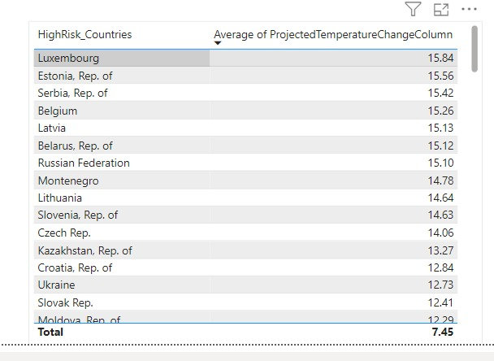
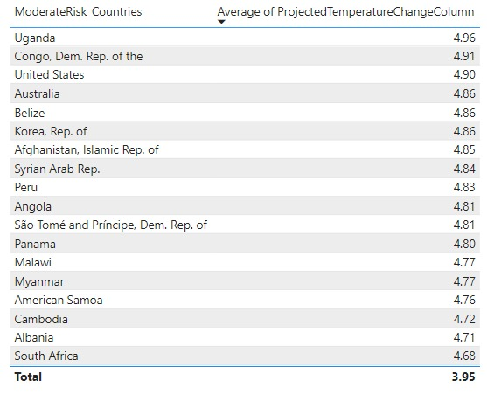
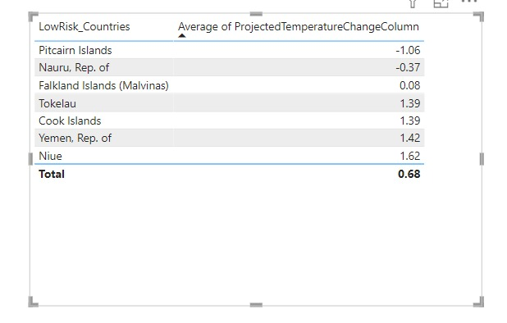
Inference: The data reveals that low-risk countries have an average projected temperature change of 0.68°C, with notable examples like Pitcairn Islands showing a decrease of -1.06°C. Moderate-risk countries have a higher average of 3.95°C, with Uganda leading at 4.96°C. In contrast, high-risk countries exhibit the most significant average change at 7.45°C, with Luxembourg experiencing the highest increase at 15.84°C. This indicates a clear trend where high-risk countries are projected to face more severe temperature changes compared to moderate and low-risk countries.

Slide 27
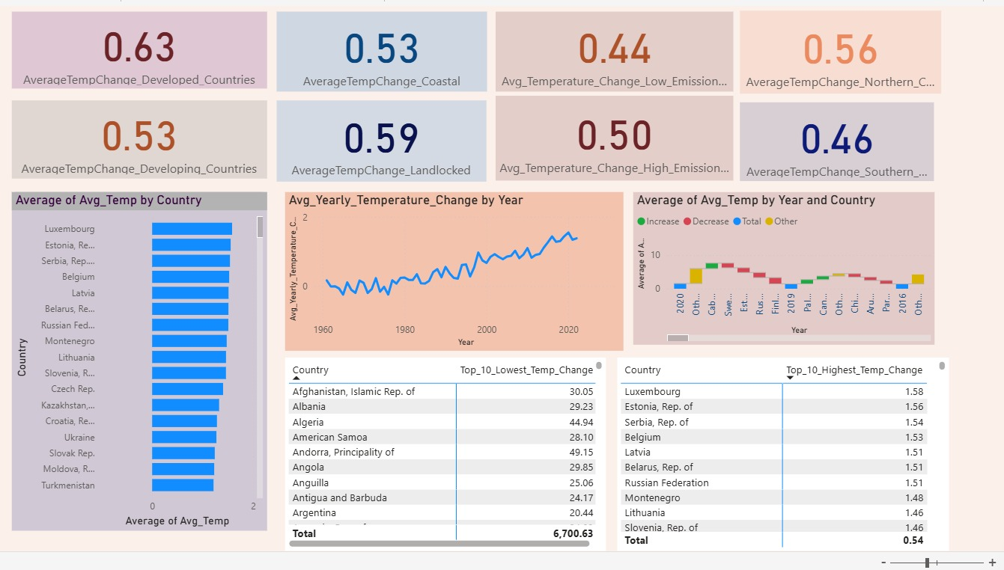
Dashboards
Dashboard 1 : Surface temperature change comparison among countries

Slide 28
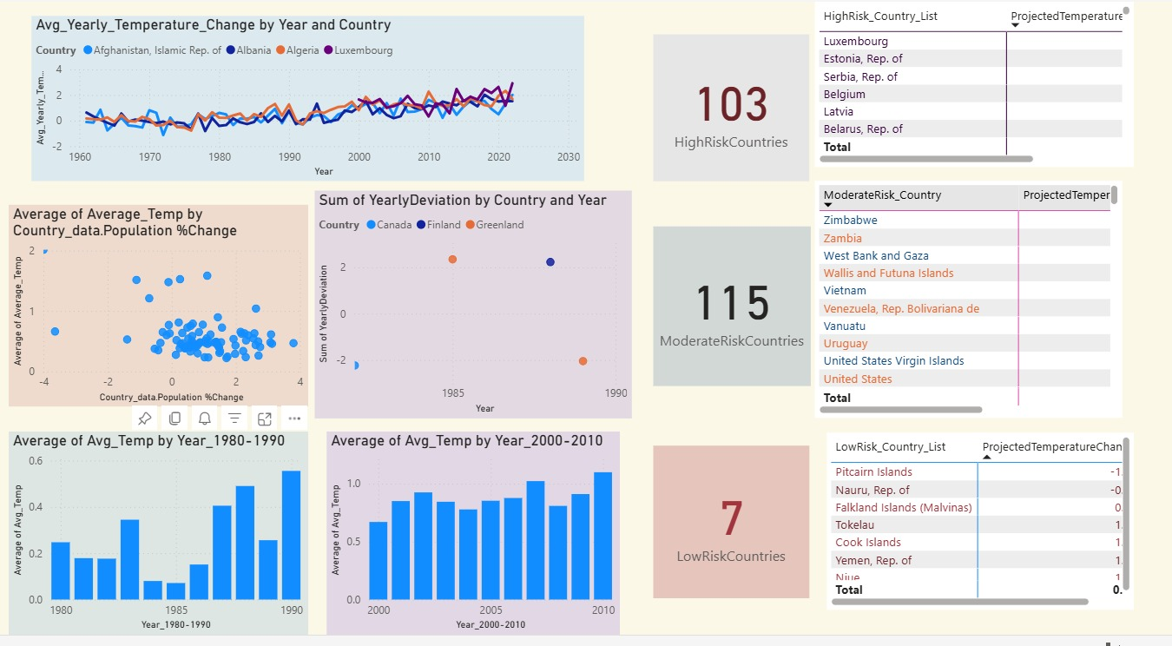
Dashboard 2 : Surface temperature change risk analysis

Slide 29
FUTURE WORK
Time-Series Analysis: Use the filtered HighRisk Countries dataset to apply your time-series models in Python or R.
Visualization: Once you generate predictions, integrate these results back into your Power BI dashboard to provide a clear comparison between historical and projected temperature data for high-risk countries.

Slide 30
References
[1] Smith, J., Brown, T., 2021. Analysis of temperature prediction models for urban areas: a comprehensive review. Urban Climate 38, 101273.Johnson, L., Martinez, R., 2022.
[2] Climate data analytics: approaches and applications in temperature forecasting. Environmental Research Letters 17 (5), 054015.Williams, D., Chang, P., 2020.
[3] The effectiveness of ARIMA and deep learning models in temperature prediction. Journal of Climate Studies 29 (3), 589-601.Chen, H., Zhao, L., 2023.
[4] Integrating climate data with visualization tools for effective environmental decision-making. Climate Informatics 12 (4), 232-247.Gupta, A., Li, Y., 2020.
[5] Machine learning approaches for long-term climate and temperature prediction. Earth Science Informatics 13 (1), 85-97.Davis, E., Green, S., 2021.
[6] Assessing climate change impacts on surface temperatures using predictive models. Applied Meteorology and Climatology 45 (2), 217-230.Patel, R., Wong, M., 2022.

Slide 31
THANK YOU

