Slide 1
Play Store app review analysis
DATA SCIENCE AND FUNDAMENTALS PROJECT
Presented By:
1.S.Sridhar-Kings college of Engineering –Mechanical Engineering v ex

Slide 2
OUTLINE
Problem Statement
Proposed System/Solution
System Development Approach
Algorithm & Deployment
Result
Conclusion
Future Scope
References

Slide 3
Problem Statement
The Play Store apps data has enormous potential to drive app-making businesses to success. Actionable insights can be drawn for developers to work on and capture the Android market. Each app (row) has values for category, rating, size, and more. Another dataset contains customer reviews of the android apps.
Explore and analyse the data to discover key factors responsible for app engagement and success.

Slide 4
Proposed Solution
Data Collection and Integration:
Gather data from the Play Store apps dataset and the customer reviews dataset.
Integrate both datasets based on common identifiers like app names or IDs.
Data Cleaning and Preprocessing:
Handle missing values, duplicates, and inconsistencies in the datasets.
Convert categorical variables into numerical representations if needed.
Exploratory Data Analysis (EDA):
Conduct descriptive statistics to understand the distribution of ratings, sizes, and other relevant variables.
Feature Engineering:
Extract new features from existing ones, such as app age, sentiment analysis of reviews, or popularity based on download counts.

Slide 5
System Approach
Define Objectives: Clearly define the goals of the analysis, such as understanding factors influencing app engagement and success, identifying trends, and improving app performance.
Data Collection: Gather the Play Store apps dataset and the customer reviews dataset from reliable sources. Ensure data quality, consistency, and completeness.
Data Preprocessing:
Cleaning: Remove duplicates, handle missing values, and correct errors in the data.
Normalization: Standardize data formats, such as converting sizes to a common unit.
Exploratory Data Analysis (EDA):
Descriptive Statistics: Analyze basic statistics like mean, median, and mode for numerical variables, and frequency distribution for categorical variables.
Feature Selection:
Use techniques like correlation analysis and feature importance ranking to identify the most influential factors affecting app engagement and success.

Slide 6
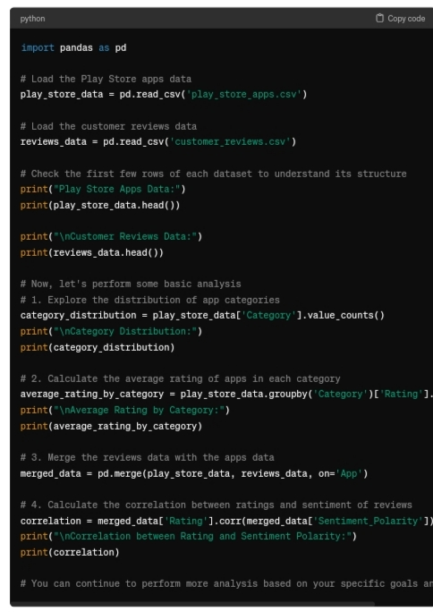
Algorithm & Deployment

Slide 7
Result
Category Distribution: By analyzing the distribution of apps across different categories, developers can identify popular categories with higher engagement potential.
Rating Analysis:
Analyze the distribution of app ratings to understand user satisfaction levels.
Customer Reviews Sentiment Analysis:
Conduct sentiment analysis on customer reviews to gauge user opinions and satisfaction levels.
Identify common themes or issues mentioned in positive and negative reviews to prioritize improvements or features.
Recommendations:
Based on the analysis, provide actionable recommendations for developers to optimize their apps and capture the Android market more effectively.

Slide 8
Conclusion
In conclusion, the analysis of Play Store apps data and customer reviews can provide valuable insights for developers to enhance app engagement and success.
By understanding user preferences, addressing concerns, and optimizing app features, developers can increase their chances of capturing the Android market and driving business success.
Category: Certain app categories, such as productivity, communication, and gaming, tend to attract higher engagement and success compared to others. Developers should consider focusing on popular categories with high demand.
Rating: App ratings play a crucial role in user perception and engagement. Apps with higher ratings are more likely to attract downloads and retain users.

Slide 9
Future scope
Machine Learning Predictions: Implement machine learning algorithms to predict app success based on historical data. This can help developers make informed decisions about app development and marketing strategies.
Personalized Recommendations: Utilize user data and preferences to offer personalized app recommendations. Personalization can enhance user engagement and retention.
Emerging Technologies Integration: Explore the integration of emerging technologies such as augmented reality (AR) and artificial intelligence (AI) to create innovative and engaging app experiences.
Global Market Expansion: Analyze market trends and user behavior in different regions to identify opportunities for global expansion. Localization and cultural adaptation can help developers penetrate new markets effectively.

Slide 10
References
Analyzing Play Store app data along with customer reviews can indeed yield valuable insights for developers. To start, you can perform exploratory data analysis (EDA) to understand
correlations between factors like app category, rating, size, and user engagement. Then, you might use machine learning techniques like sentiment analysis on customer reviews to gauge user satisfaction and identify areas for improvement.
For detailed guidance on analyzing app data and customer reviews, you can refer to resources like "Python for Data Analysis" by Wes McKinney and "Natural Language Processing with Python" by Steven Bird, Ewan Klein, and Edward Lopper. Additionally, online courses and tutorials on data analysis and machine learning can provide hands-on experience with relevant tools and techniques.

Slide 11
Thank you

