Slide 1
POMS.6220 Decision Analytics
Human Resources Predictive Analysis: Understanding Factors of Employee Attrition
Sridhar Rangan And Jason Tran

Slide 2
Agenda
Performed an analysis on fiction HR Dataset
Applied CRISP-DM Prior to analysis
Used several Classification methods to predict Attrition
Performed Sensitivity Analysis
Determined Top 5 Most Significant Predictors

Slide 3
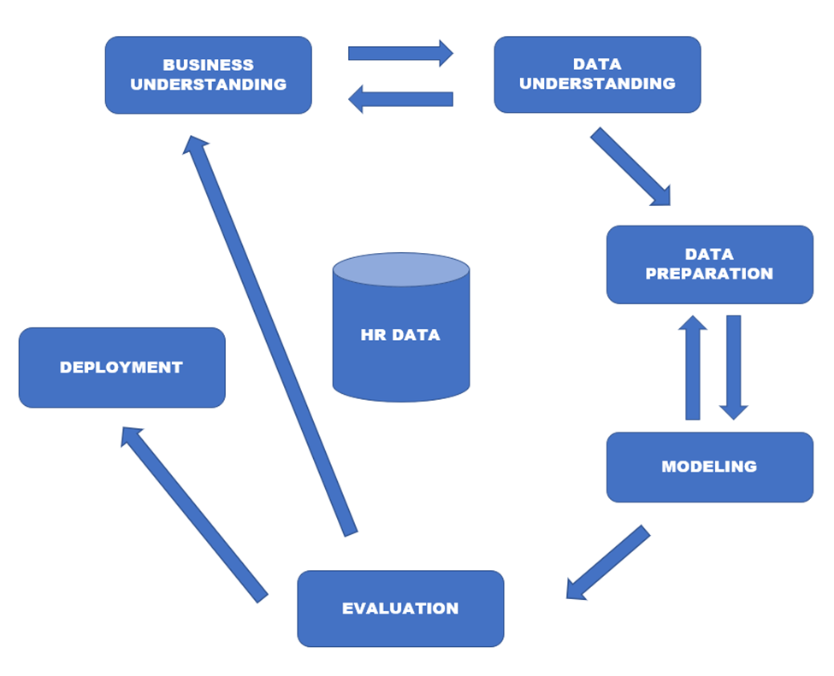
CRISP-DM Diagram

Slide 4
Dataset Preparation

Slide 5
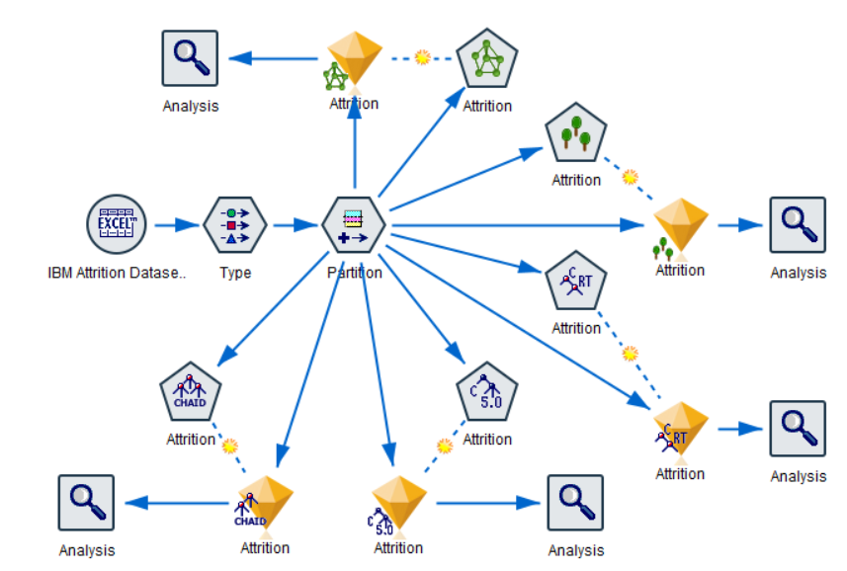
Visualization of IBM SPSS Modeler

Slide 6
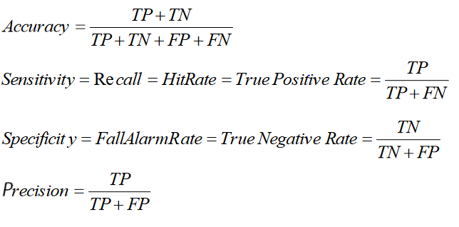
Measuring Accuracies of Model Results

Slide 7
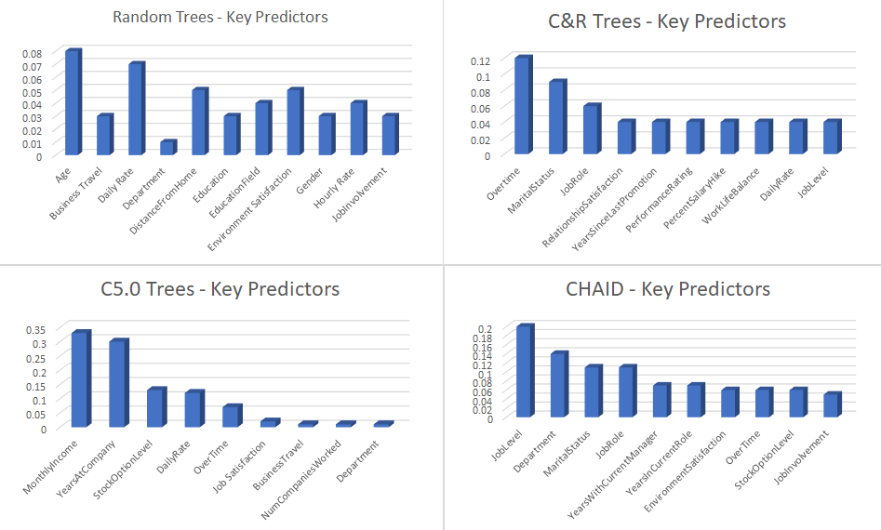
Understanding Key Predictors

Slide 8
Information Fusion-Based Sensitivity Analysis

Slide 9
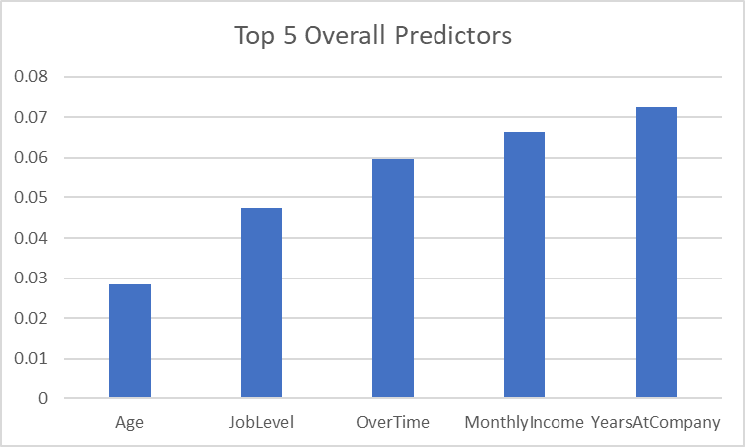
Overall Strongest Predictors

Slide 10
Conclusion
Important predictors are Age, Job Level, Overtime, Monthly Income and Years at Company
Predictive Analytics can support managerial decisions
Can improve Human Resources and attain company goals of lowering attrition
Recommendation is to incorporate modeling to benefit both Employees and attain HR Goals

