Slide 2
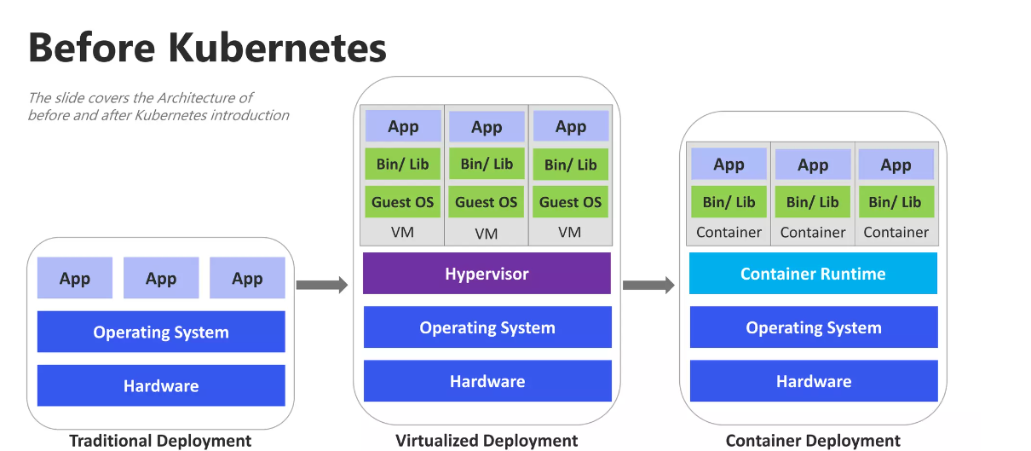


Slide 3
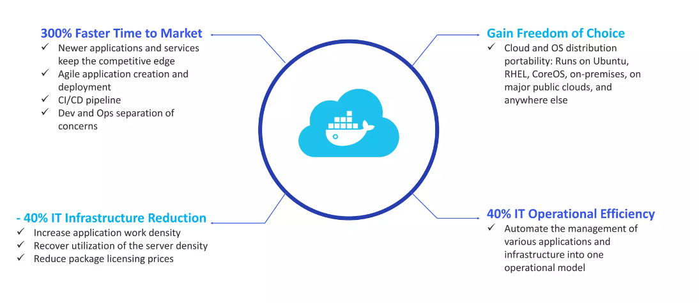
Benefits of Containers

Slide 4
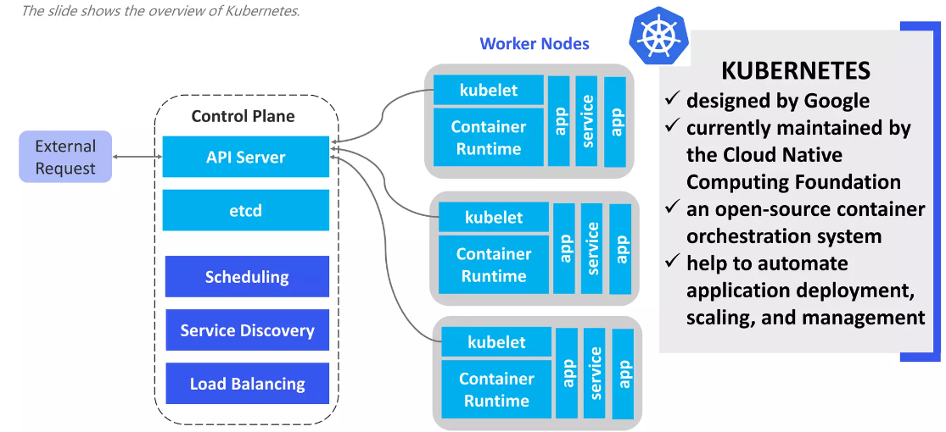
What is Kubernetes ?

Slide 5
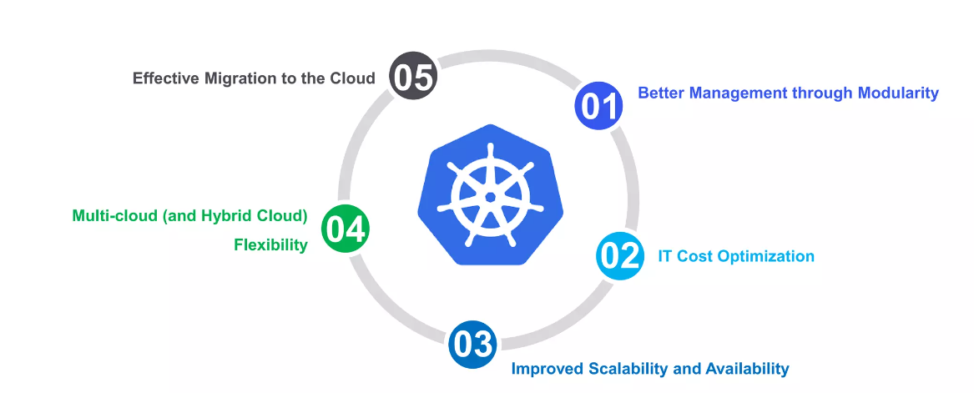
Why should Organization use Kubernetes?

Slide 6
What Kubernetes Can do ?
Service discovery and load balancing
Storage orchestration
Automated rollouts and rollbacks
Automatic bin packing
Self-healing
Secret and configuration management
Batch Execution
Horizontal Scaling

Slide 7
What Kubernetes Can’t do?
Containers runtime
Containerizing applications
Container image management
Infrastructure provisioning
Security

Slide 8
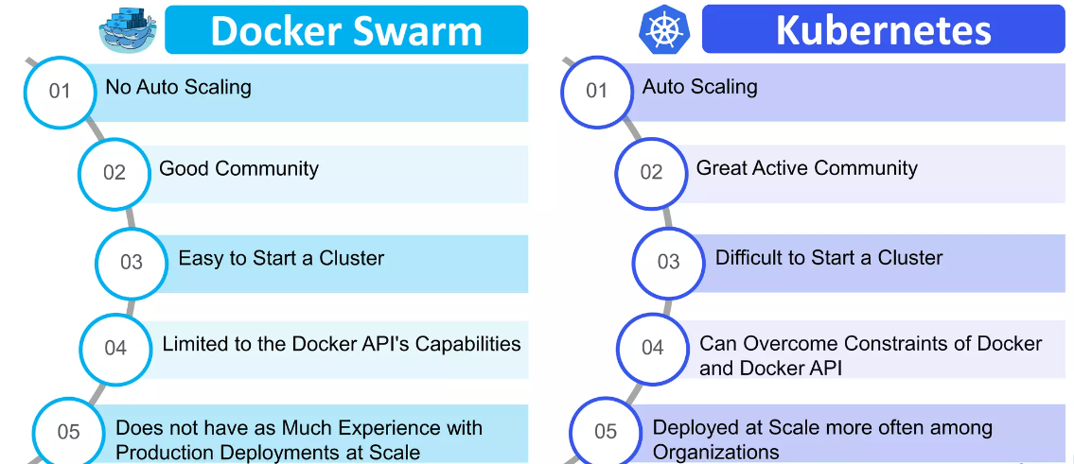
Kubernetes vs Docker Swarm

Slide 9
Advantages of Kubernetes
Kubernetes could be a future proof answer
Kubernetes helps to form your application run additional stable
Kubernetes is cheaper than its alternatives
Orchestrate containers on multiple hosts
TBD
TBD
TBD

Slide 10
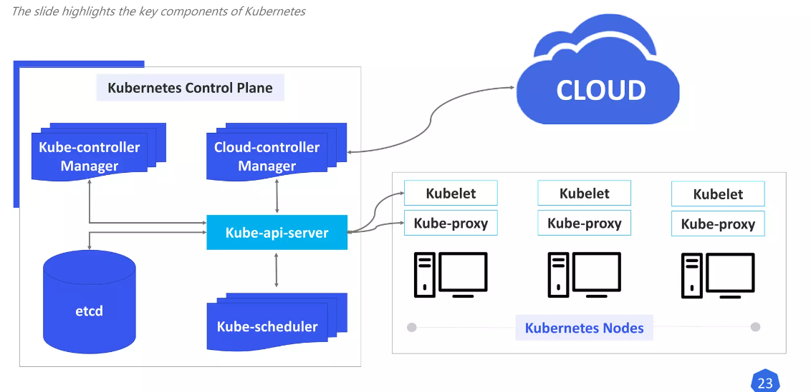

Kubernetes Components

Slide 11
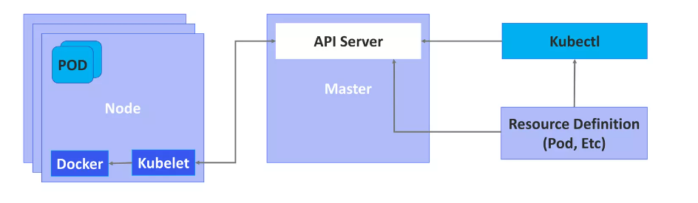
What is Kubelet?

Slide 12
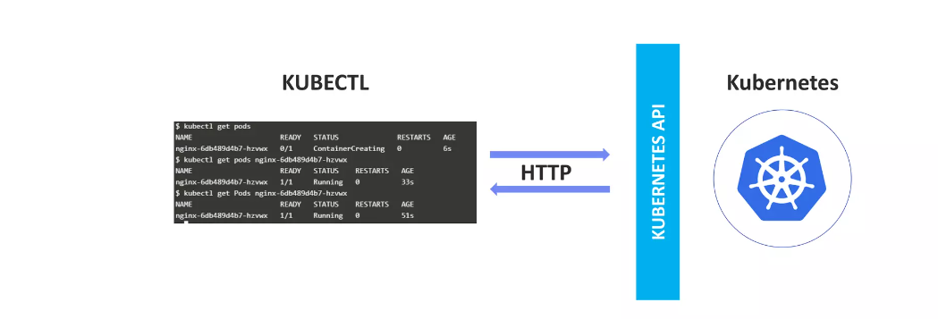
What is Kubectl?

Slide 13
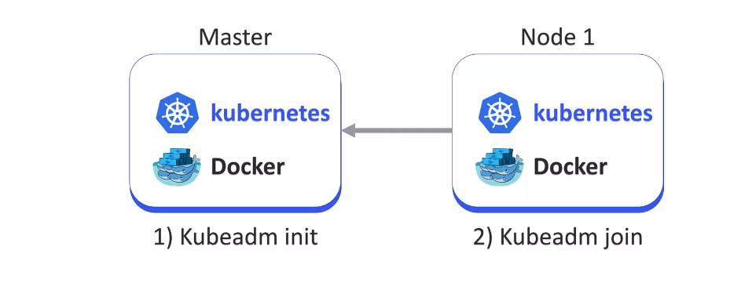
What is Kubeadm?

Slide 14
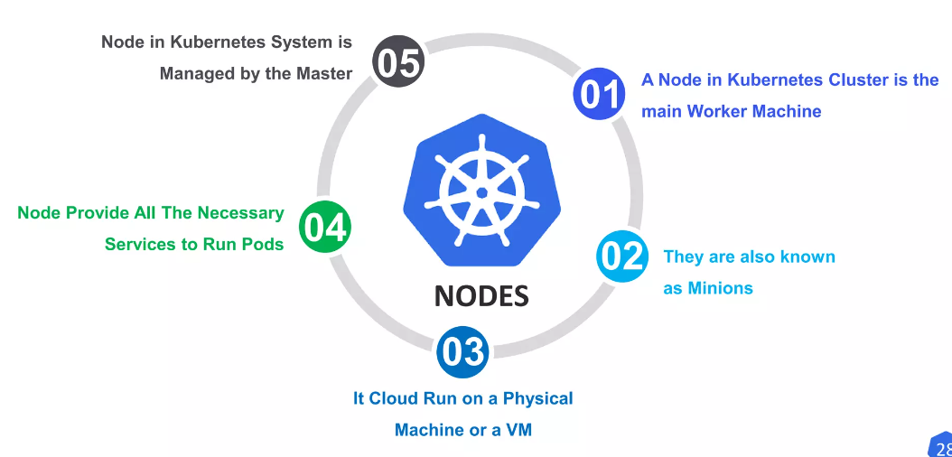

What is a Node in Kubernetes?

Slide 15
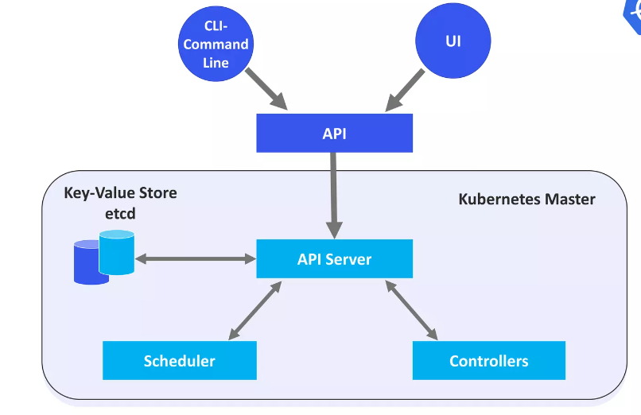

Master Node in Kubernetes

Slide 16
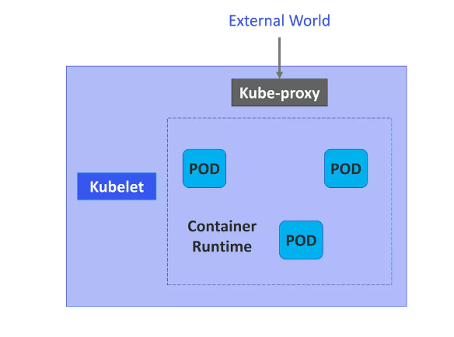
Worker/Slave Node in Kubernetes

