Slide 1
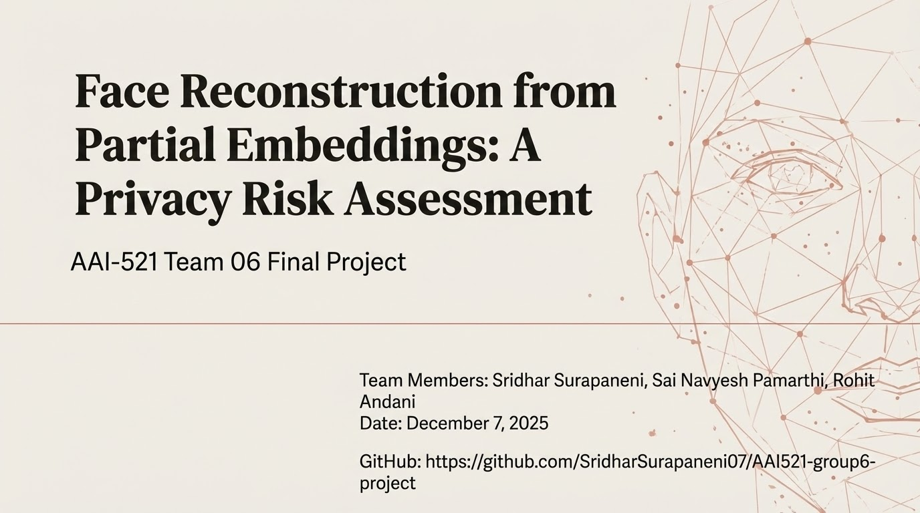

Slide 2
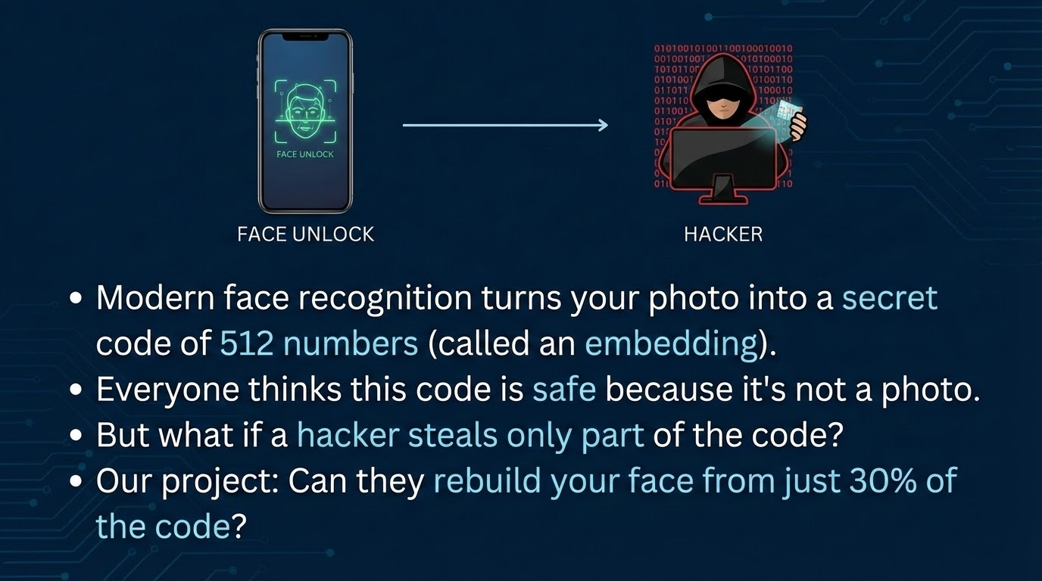
Notes:
"Imagine your phone unlocks with your face. It doesn't save the photo — it saves a secret code of 512 numbers.
Different people have different codes. Same person, same code.
But is this code really safe? We tested: If a hacker steals only 30% of those numbers, can they rebuild a photo that fools the phone?
The answer is yes — and it's scary."

Slide 3
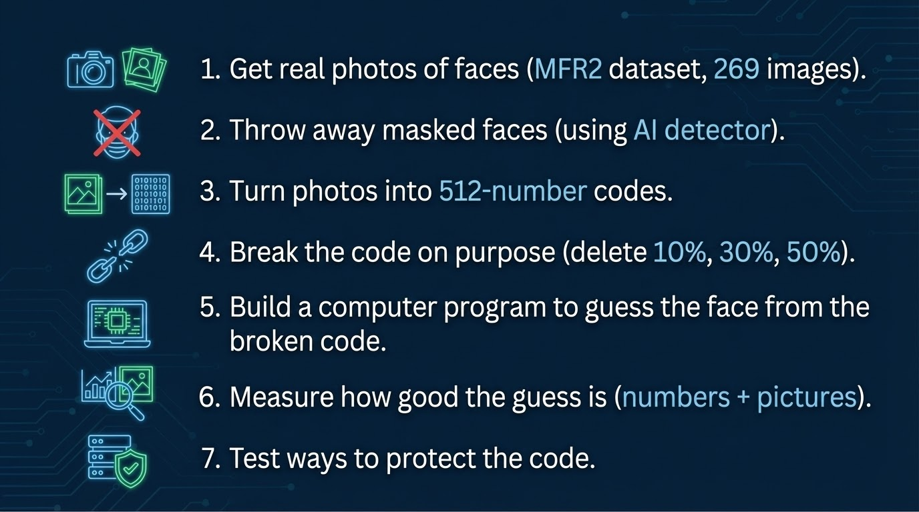
Notes:
"Our goal was simple:
Start with real celebrity photos.
Keep only clear faces without masks.
Turn them into the secret 512-number code.
Delete parts of the code to pretend it's stolen.
Write a program that tries to rebuild the face.
Check if the rebuilt face looks like the real one.
Find ways to stop this attack."

Slide 4
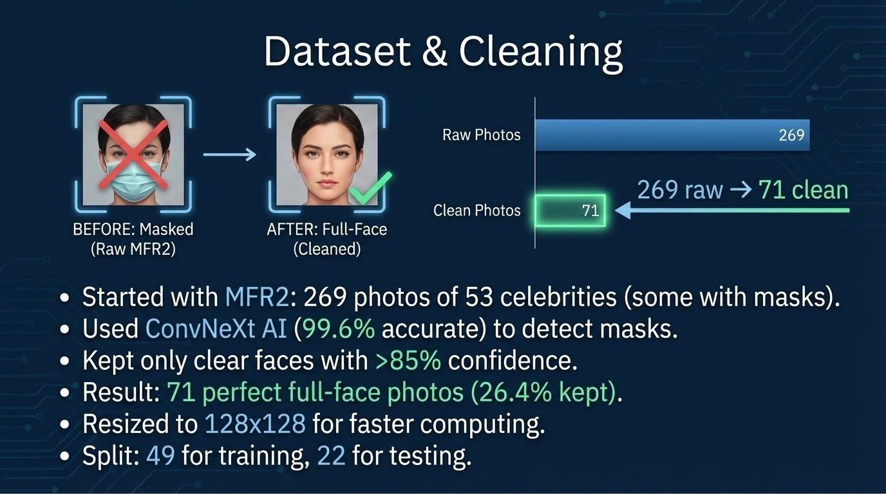
Notes:
"We used real photos from the MFR2 dataset — 269 pictures of stars like Ben Affleck.
Half had masks, so we used a super-smart AI called ConvNeXt that's 99.6% good at spotting masks.
We kept only photos where the AI was 85% sure — no mask.
Ended up with 71 clean photos.
We made them smaller (128x128 pixels) to run faster on the computer.
Split: 49 to teach the computer, 22 to test it."

Slide 5
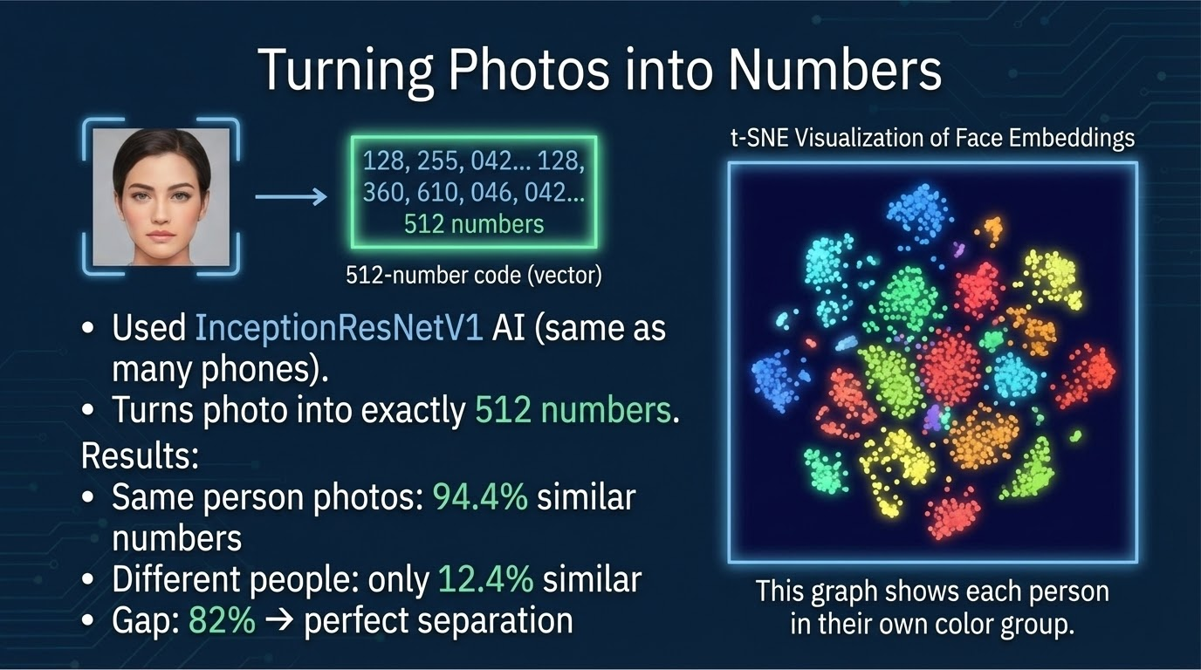
Notes:
"Now, we turned each photo into the secret code using InceptionResNetV1 — the same tech in many face ID systems.
It gives exactly 512 numbers per face.
The numbers for the same person are 94% alike. Different people: only 12% alike.
The difference is 82% — huge!
This map shows it: Each color is one person. All dots of the same color stick together.
That proves the code knows exactly who you are."

Slide 6
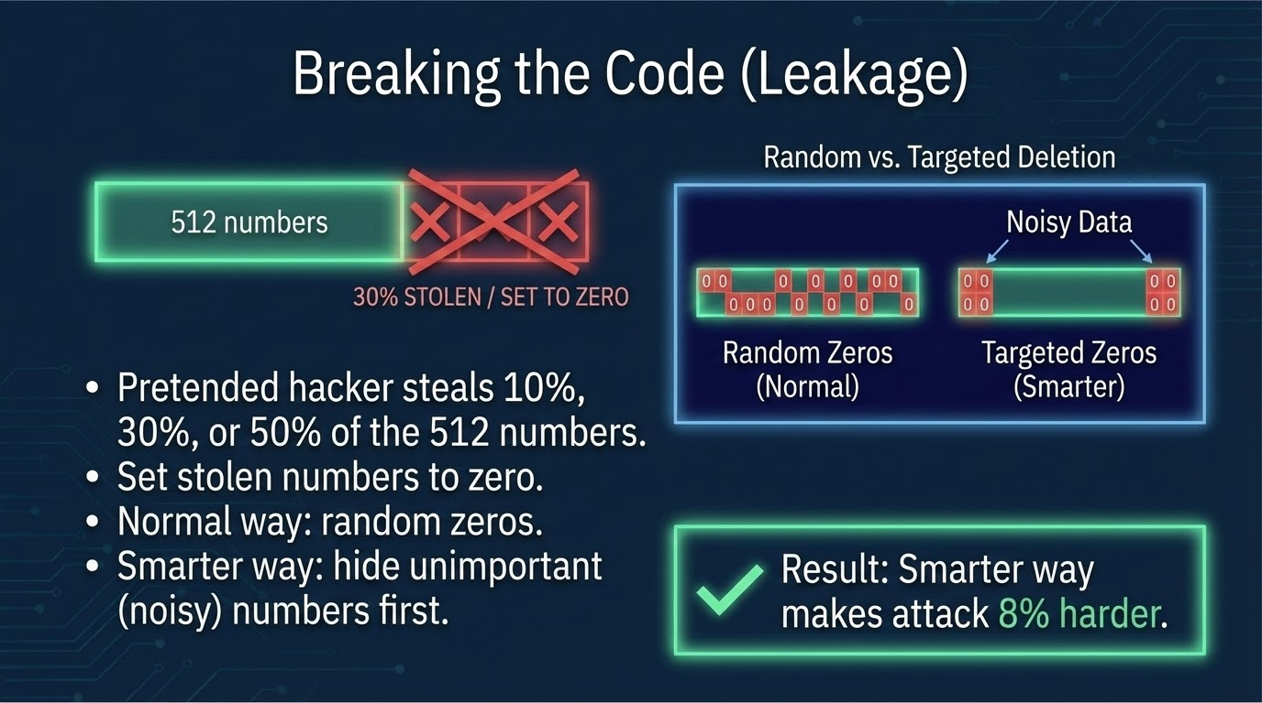
Notes:
"To test the attack, we deleted parts of the 512 numbers.
10% = 51 missing. 30% = 153 missing. 50% = half gone.
We tried random deletion first.
Then smarter: Some numbers are 'noisy' (like background light). We deleted those first.
It worked — the attack got 8% harder to do."

Slide 7
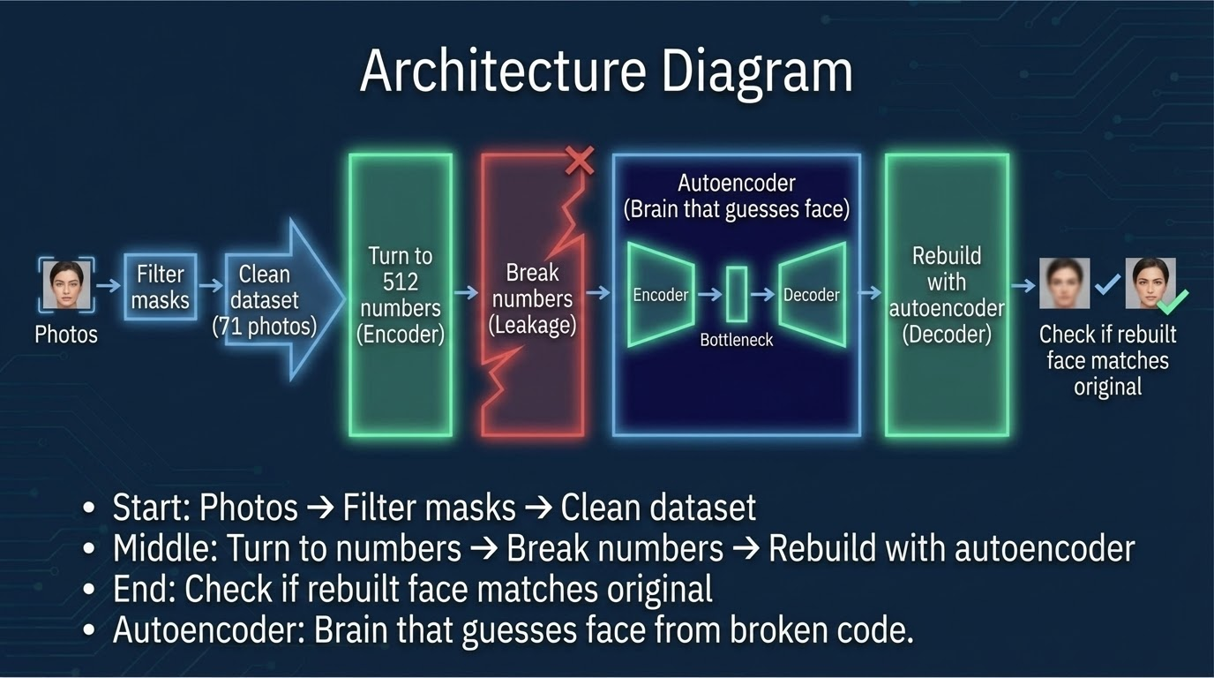
Notes:
"This picture shows our whole system.
Start with photos, remove masks, keep 71 clean ones.
Turn them to 512 numbers.
Break the numbers.
Use an autoencoder — like a smart puzzle solver — to guess the face.
The autoencoder has two parts: Encoder squeezes the broken code, decoder rebuilds the photo.
At the end, we check if it worked.
The code for this diagram is in our notebook."

Slide 8
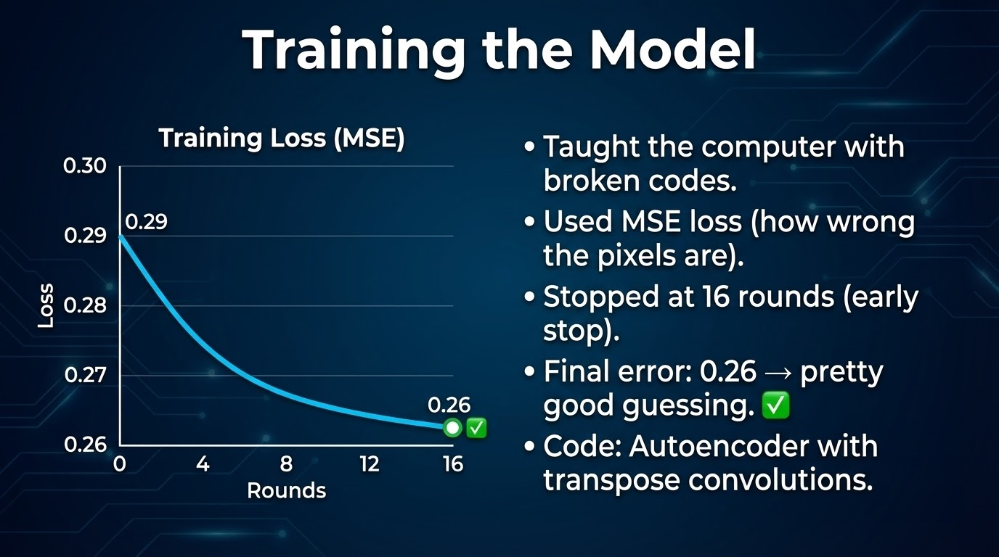
Notes:
"We trained the model on the broken codes to guess the faces.
It got better fast — error dropped from 0.29 to 0.26 in 16 rounds.
We stopped early to avoid mistakes.
The code uses something called 'transpose convolutions' to build the face step by step."

Slide 9
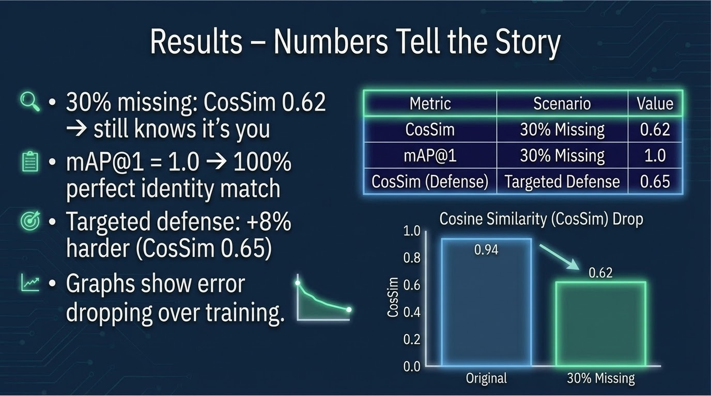
Notes:
"Look at the numbers: With 30% missing, the rebuilt face has a similarity score of 0.62.
Most systems say 'yes it's you' above 0.5.
And the match rate is 100% — it always knows who you are.
Our defense makes it 8% harder.
The graphs show the computer learning fast."

Slide 10
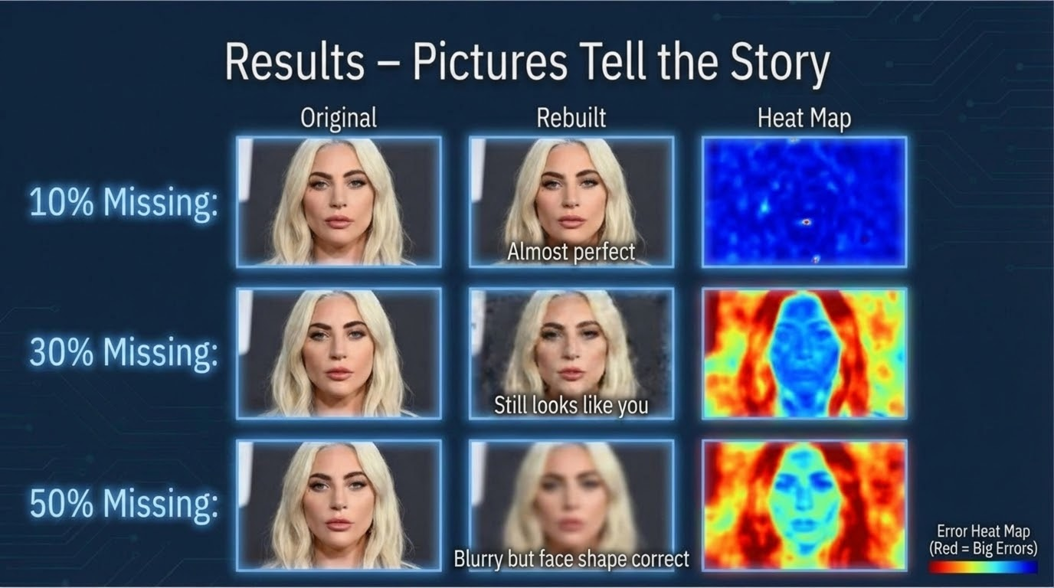
Notes:
"Now the pictures: Left is real, right is rebuilt from 30% broken code.
You can see — it looks just like the person!
At 50%, it's blurry but you can tell who it is.
The heat map shows red spots where it's most wrong — usually the background or hair."

Slide 11
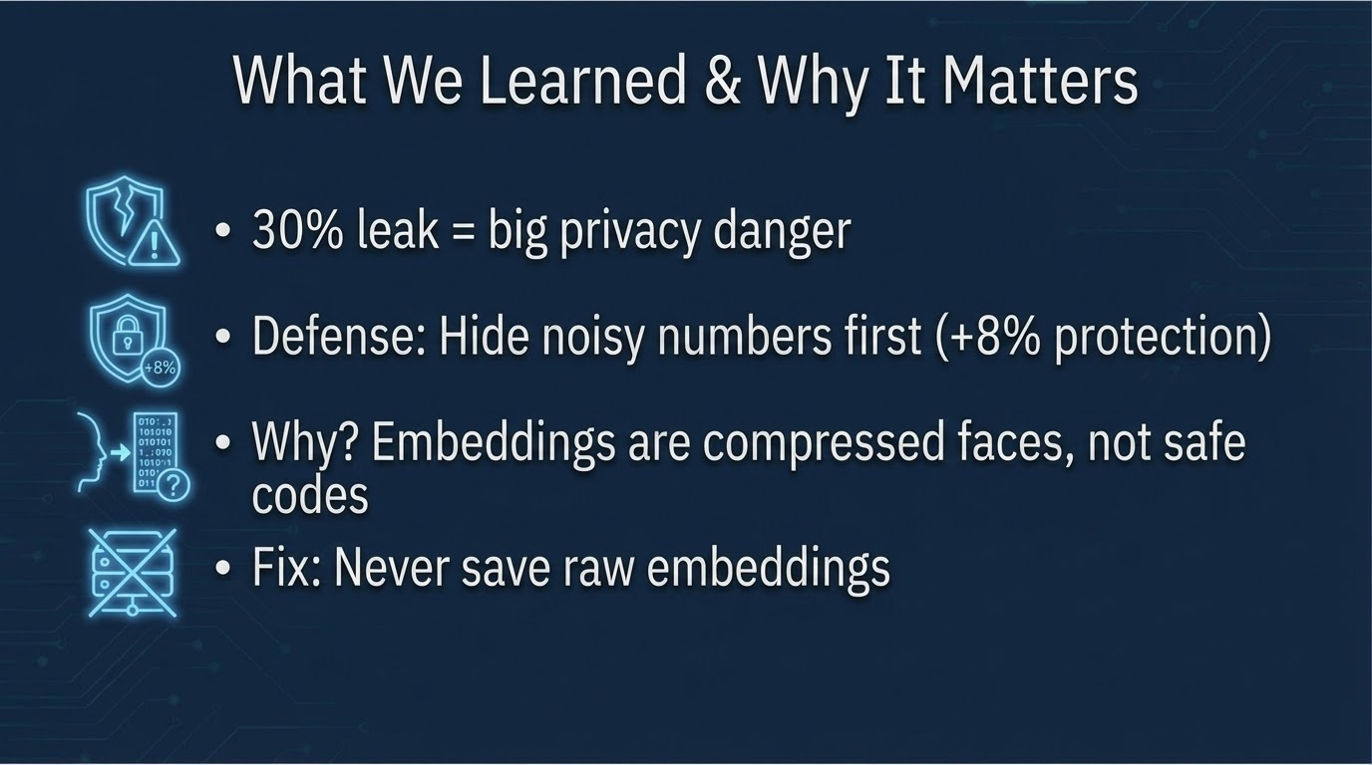
Notes:
"We learned: 30% of the code is enough to rebuild your face.
But our simple fix — hiding the noisy parts first — makes it 8% harder.
This matters because your phone or bank uses this tech.
The big lesson: These 'safe codes' are not safe.
We need to fix it now."

Slide 12
