Slide 1
Design and Implementation of a Blockchain-Based E-Voting System
TEAM MEMBERS :
S.THILLAIARASAN ( 620822205114 )
M.RAMANA ( 620822205083 )
V.SUGUMARAN ( 620822205107 )
K.UDHAY ( 620822205117 )
GUIDE : MR. JEEVA. D, AP/IT

Slide 2
Problem Statement
Existing electronic voting systems lack transparency and verifiability for voters.
Voters cannot independently verify whether their votes are recorded correctly.
Centralized databases are vulnerable to cyber-attacks and unauthorized modifications.
Manual verification and audit processes are time-consuming and error-prone.
There is a need for a secure, transparent, and verifiable voting system that minimizes human intervention.
The challenge is to design a system that ensures one-person-one-vote while preserving data integrity.

Slide 3
Objective
To design a secure and transparent electronic voting system using blockchain technology.
To prevent vote tampering and duplicate voting using smart contracts.
To enable verifiable and immutable vote storage.
To reduce reliance on centralized election authorities.
To provide a simple and user-friendly interface for voters.
To demonstrate a real-world application of blockchain in governance systems.

Slide 4
Existing System
Centralized electronic voting infrastructure.
Election data stored in traditional databases.
Vote counting and result generation controlled by authorities.
Limited transparency for voters.
Manual audits required to verify results.
Disadvantage
Single point of failure.
Susceptible to hacking and data manipulation.
Lack of voter trust and transparency.
Difficult to audit independently.
High operational and verification costs.

Slide 5
Proposed System :
Blockchain-based decentralized voting system.
Smart contracts manage voter registration and voting logic.
Votes stored on blockchain ensuring immutability.
Transparent result computation.
Automated enforcement of election rules.
Advantage
No single point of failure.
Tamper-proof and immutable vote records.
Improved transparency and trust.
Reduced manual verification.
High security through cryptographic techniques.

Slide 6
SYSTEM ARCHITECTURE/FLOW DIAGRAM
User Interface / Web Page
Backend ( node.js )
Express API and validation
Local Blockchain Network
Smart Contract ( Solidity )
Is user voted ?
No
Store Vote
Yes
Vote Denied

Slide 7
Modules :
User Interface Module
Voter Registration Module
Voting Module
Vote Verification Module
Result Management Module

Slide 8
MODULE 1: User Interface Module
Purpose: Provide a secure, intuitive front-end for all users (voters, admins, auditors).
Key Responsibilities:
Present registration, voting, and result views clearly.
Validate input before sending data to backend / blockchain.
Handle authentication flows and user feedback (errors, confirmations).
Key Features:
Responsive design for desktop and mobile.
Multi-language support (if in scope).
Accessibility-compliant layouts and controls.
Technology Stack :
Web: Javascript, Nodejs
Styling: CSS / TailwindCSS .
Integration: Express, Ganache.

Slide 9
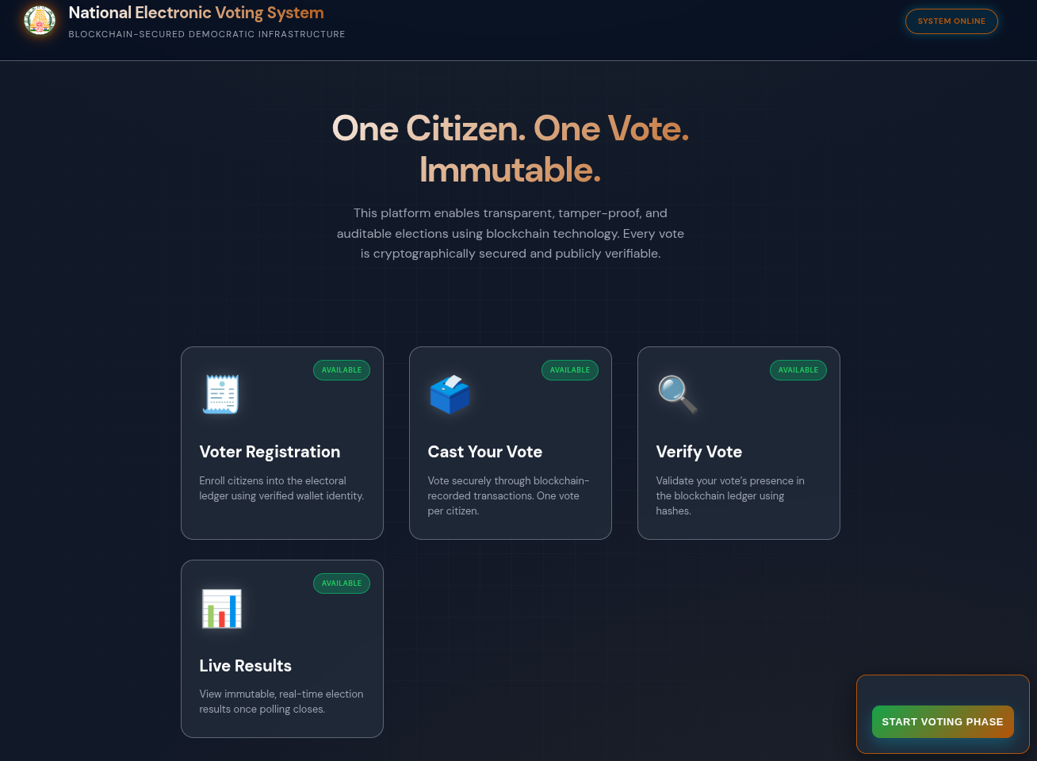
User Interface :

Slide 10
MODULE 2: Voter Registration Module
Purpose
Onboard eligible voters into the system.
Ensure that only verified and valid identities can participate in voting.
Key Responsibilities
Securely capture voter identity and eligibility information.
Verify voter data through external ID or government registry systems (if available).
Generate unique voter credentials or cryptographic keys linked to the voter’s blockchain identity.
Benefits
Prevents unauthorized voting.
Establishes a trusted voter identity layer for the blockchain voting system.

Slide 11
Registration Workflow, Security & Compliance
Core Workflows
New voter registration and identity verification.
Updating voter information based on predefined system rules.
De-duplication checks to prevent multiple registrations.
Fraud detection mechanisms to identify suspicious activity.
Security & Compliance
Follow KYC and jurisdiction-specific legal requirements.
Encryption of personally identifiable information (PII).
Strict access control policies.
Maintain audit logs for transparency and accountability.

Slide 12
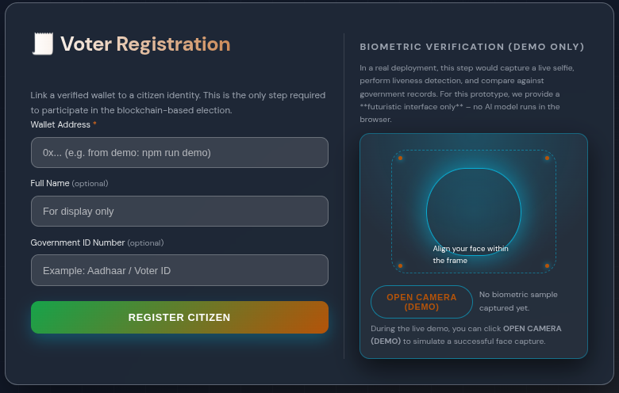
Registration UI :

Slide 13
MODULE 3: Voting Module
Purpose
Allow voters to cast their votes securely and anonymously using blockchain technology.
Key Responsibilities
Display live ballots and candidate/options to authenticated and eligible voters.
Verify voter eligibility before allowing them to vote.
Enforce the “one person, one vote” rule to prevent duplicate voting.
Submit each vote as a blockchain transaction ensuring transparency and integrity.
Benefits
Secure and tamper-resistant voting process.
Ensures privacy and authenticity of voter participation.

Slide 14
Voting Workflow, Quality & Security
Core Workflows
Ballot selection and confirmation with a review screen.
Vote encryption and digital signing using voter cryptographic keys.
Transaction submission to blockchain for permanent record.
Handling network or transaction failures with retry mechanisms.
Quality & Security
Use strong cryptography to protect ballot secrecy.
Prevent double voting through identity verification.
Protection against replay attacks and data tampering.
Maintain system reliability and auditability during voting.

Slide 15
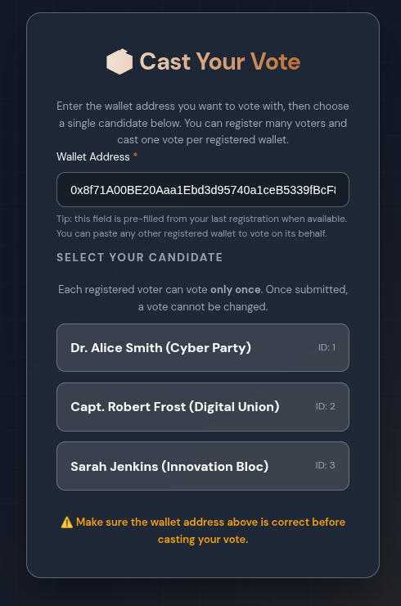
Voting Module

Slide 16
Conclusion
The proposed blockchain-based voting system addresses major drawbacks of traditional electronic voting.
Decentralization eliminates single points of failure and increases system reliability.
Smart contracts enforce election rules automatically without human intervention.
The system enhances transparency, security, and voter trust.
The prototype demonstrates the practical feasibility of blockchain in electronic voting.
This work lays the foundation for future large-scale and national-level implementations.
THANK YOU !

