Slide 1
Design and Implementation of a Blockchain-Based E-Voting System
TEAM MEMBERS :
S.THILLAIARASAN ( 620822205114 )
M.RAMANA ( 620822205083 )
V.SUGUMARAN ( 620822205107 )
K.UDHAY ( 620822205117 )
GUIDE : MR. JEEVA. D, AP/IT

Slide 2
Objective
Design a secure, transparent E-voting system using blockchain.
Prevent vote tampering and duplicate voting via smart contracts.
Enable immutable, verifiable vote storage on a distributed ledger.
Reduce reliance on centralized authorities for counting and verification.
Provide a simple, user-friendly interface for voters and administrators.
Showcase a real-world governance application of blockchain technology.

Slide 3
Existing System
Centralized e-voting infrastructure
Limited transparency
Lack of Verification
Managed by single authority
Disadvantage
Operational issues: Manual audits required to gain confidence in results. High operational and verification costs.
Security concerns: Single point of failure. Vulnerable to hacking, data manipulation, and insider threats.
Result: Lack of voter trust and difficult independent auditing.

Slide 4
Proposed System :
Decentralized blockchain-based voting:
No single point of failure.
data replicated across nodes.
Smart contracts: Encapsulate voter registration and voting logic. Automatically enforce election rules (phases, eligibility, one vote per user).
Advantage
Immutable vote storage: Votes stored as blockchain transactions; tampering is detectable.
Transparent and auditable: Anyone can verify tallies on-chain.
Reduced manual work: Automated result computation and integrity checks.
Improved security: Strong cryptography, tamper-proof ledger, higher voter trust.

Slide 5
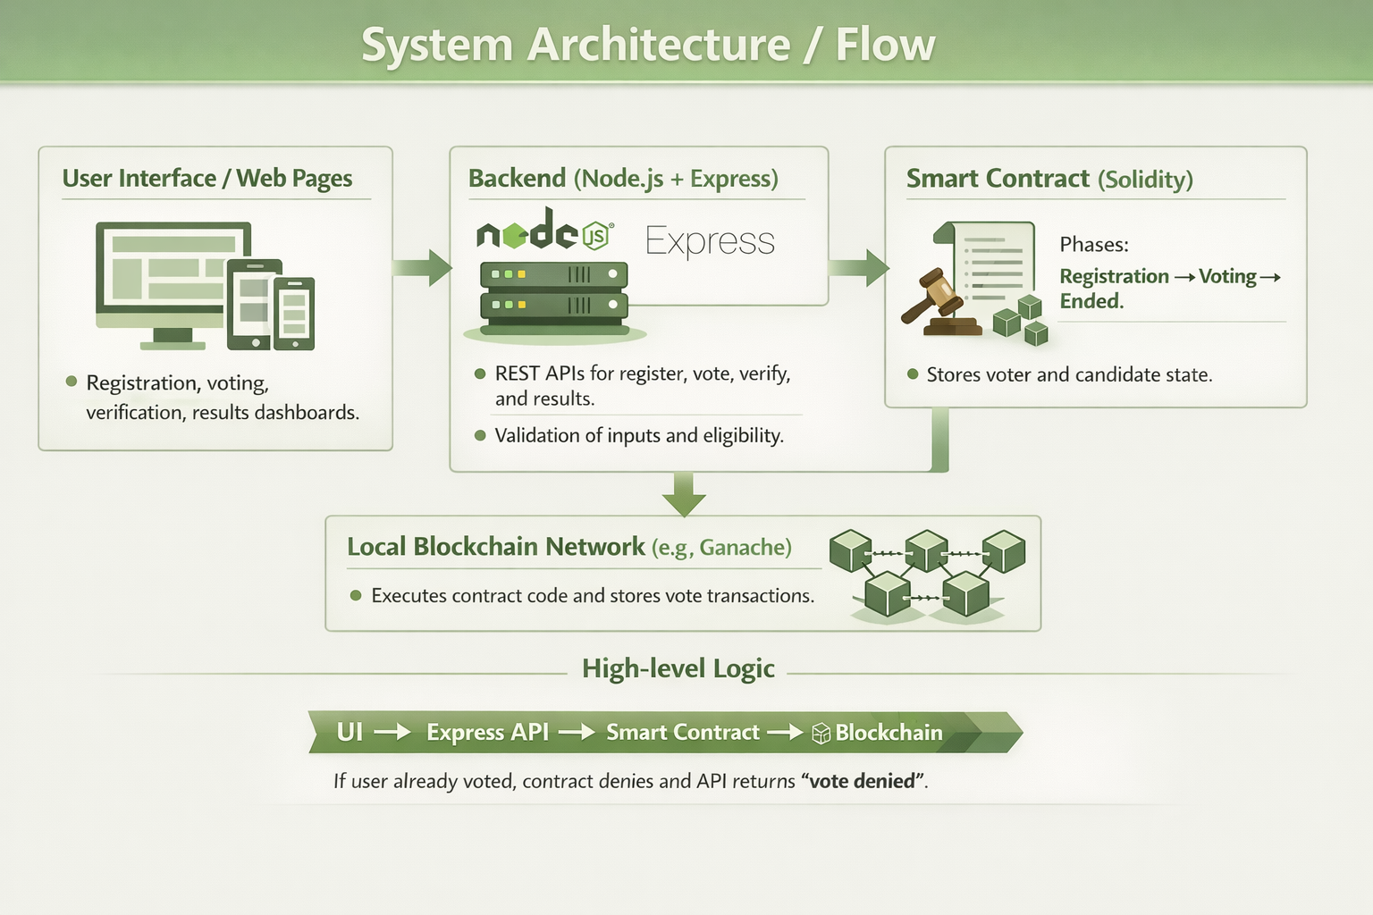
SYSTEM ARCHITECTURE/FLOW DIAGRAM

Slide 6
Modules :
User Interface Module
Voter Registration Module
Voting Module
Vote Verification Module
Result Management Module

Slide 7
MODULE 1: User Interface Module
Purpose:
Provide a secure, intuitive front-end for voters, admins, and auditors.
Key Responsibilities:
Present registration, voting, verification, and result views clearly.
Validate user input before sending data to backend/blockchain.
Handle user feedback: success messages, error alerts, and confirmations.
Key Features:
Responsive design for desktop and mobile.
(Optional) multi-language support.
Accessibility-aware layouts and controls.
Technology Stack:
Web (HTML, CSS, JavaScript).
Styling (Modern CSS/glassmorphism or TailwindCSS).
Integration (Express REST APIs, ethers.js, Ganache).

Slide 8
MODULE 2: Voter Registration
Voter registration performed by the election administrator.
Each voter is registered using a unique blockchain wallet address.
Smart contract verifies whether the voter is already registered.
Only registered voters are permitted to participate in voting.
Registration data stored securely and immutably on blockchain.
Prevents unauthorized registration and duplicate entries.
This module ensures authentication and prevents unauthorized voting.

Slide 9
MODULE 3: Voting Module
Registered voter selects a candidate and submits vote.
Backend calls castVote() on the smart contract.
Smart contract checks: voter is registered and has not voted.
Vote recorded as immutable transaction on blockchain.
Transaction hash returned to voter as proof of vote.
Duplicate vote attempts are automatically rejected by the contract.
Entire voting process is transparent and cryptographically secure.

Slide 10
MODULE 4: Voting Verification Module
Verifies that each cast vote is correctly and immutably recorded on the blockchain.
Provides cryptographic proof of vote submission to every voter.
Election observers can independently audit results without authority access.
Ensures full end-to-end verifiability — from cast to final count.
Prevents silent vote dropping or post-submission tampering.
Makes electoral process transparent and publicly auditable.
Supports real-time verification during active election and post-election audit.

Slide 11
MODULE 4: Implementation Details
Smart Contract Functions:
vote_cast() emits VoteCast(voter, candidateId, timestamp) event on blockchain.
getVoteStatus(address) → returns true if address has already voted.
getTransactionHash() → returns stored tx hash for voter's record.
Verification Flow:
After vote submission, backend returns transaction hash to user interface.
Voter stores tx hash and can verify via local blockchain explorer.
Block number and timestamp are embedded in each vote event.
Audit Trail:
All VoteCast events are queryable from contract event log.
Event log is append-only — no deletion possible once mined.
Admin can export full vote event log for independent audit.

Slide 12
MODULE 4: Verification Flow
Voter submits vote → smart contract validates → transaction mined
Transaction hash displayed on confirmation screen
getVoteStatus() confirms vote recorded
Block explorer shows event details
Observer audit: query all VoteCast events

Slide 13
MODULE 5: Result Management Module
Manages final vote tallying and transparent result declaration.
Only authorized election admin can trigger result finalization.
Smart contract automatically counts votes per candidate from blockchain.
Results are publicly verifiable on-chain by anyone at any time.
Prevents premature result disclosure before election officially closes.
Provides a real-time results dashboard for authorized viewers.
Ensures final declared results match on-chain vote records exactly.

Slide 14
MODULE 5: Implementation Details
Smart Contract Functions:
getTotalVotes() → returns aggregate total vote count across all candidates.
getResults() → returns array of vote counts indexed by candidateId.
declareResults() → admin-only; closes voting and marks election as finalized.
isElectionClosed() → boolean state flag checked before any result access.
Backend & Frontend:
Node.js API calls getResults() via web3.js and returns JSON to frontend
Results dashboard renders candidate names with vote counts and percentages.
Winner determined client-side by highest vote count.
Chart.js used for visual bar graph representation of results.
Security:
Result functions revert if election not yet declared closed.
Admin key required to call declareResults() — prevents unauthorized closure.

Slide 15
MODULE 5: Result Dashboard
Admin triggers declareResults() on smart contract
Backend fetches getResults() array from chain
Frontend renders real-time vote counts per candidate
Winner highlighted with highest vote count
All results verifiable independently on blockchain

Slide 16
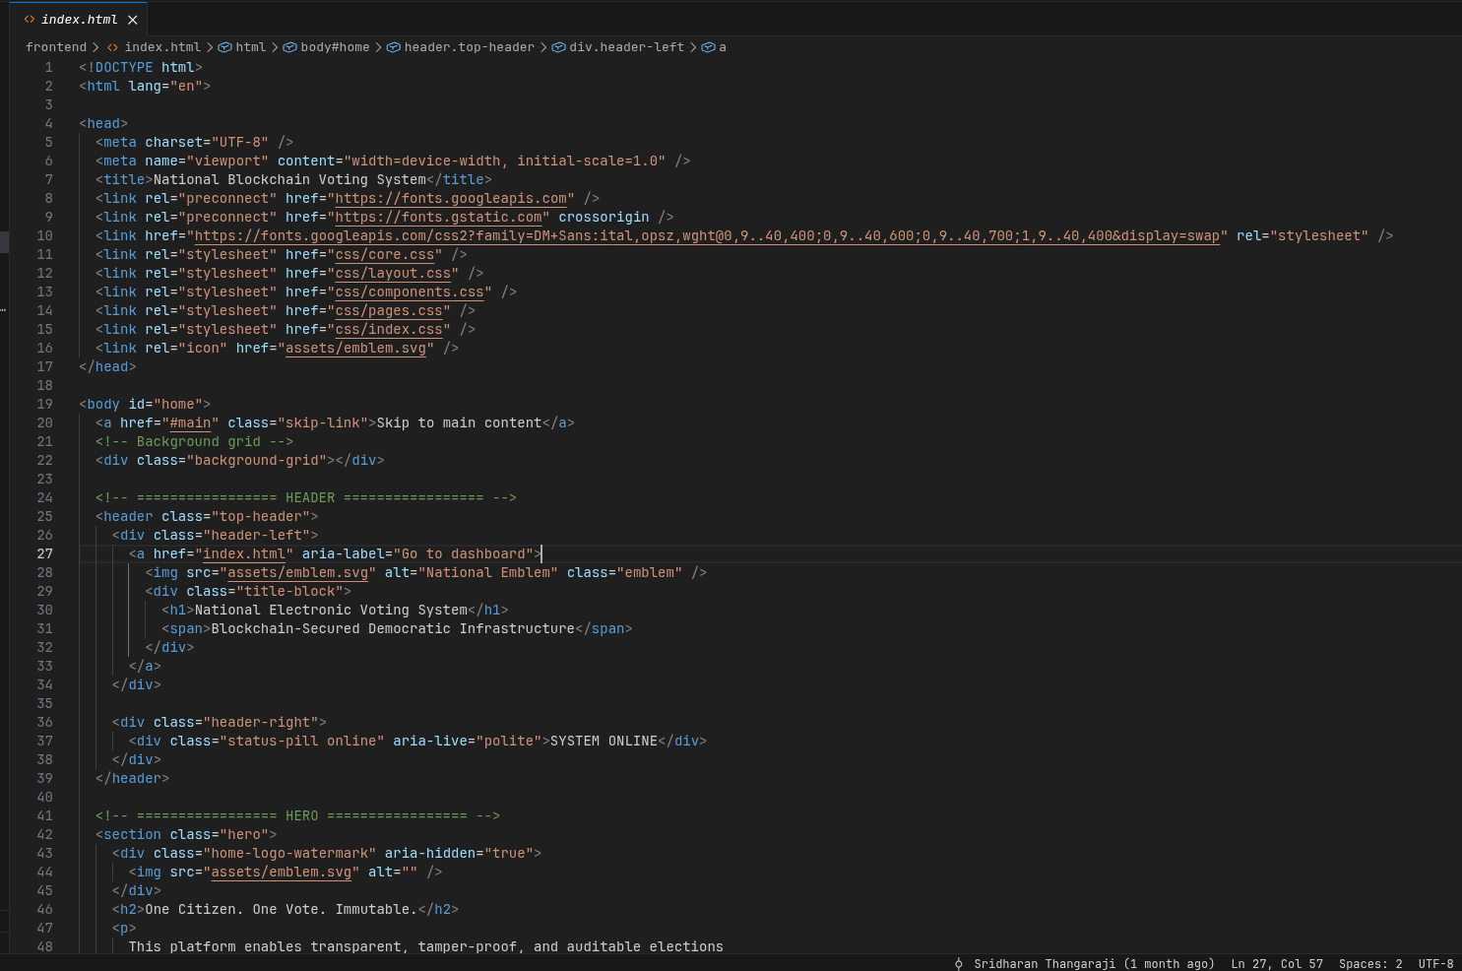
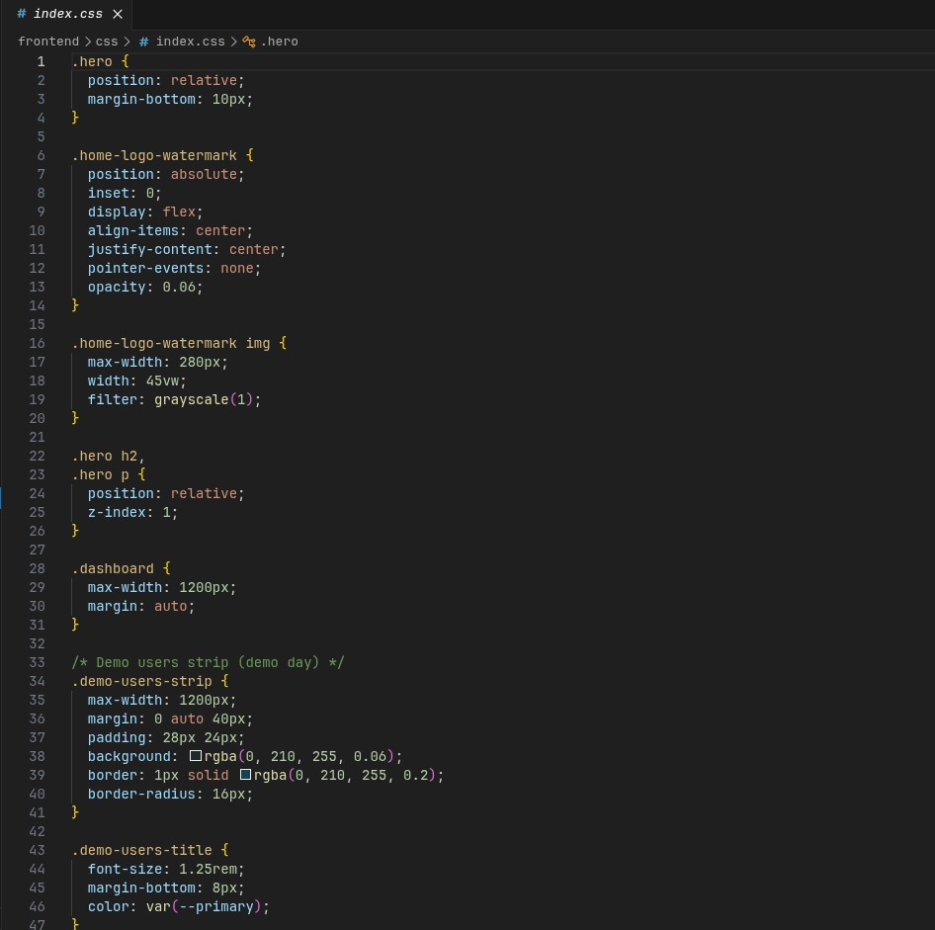
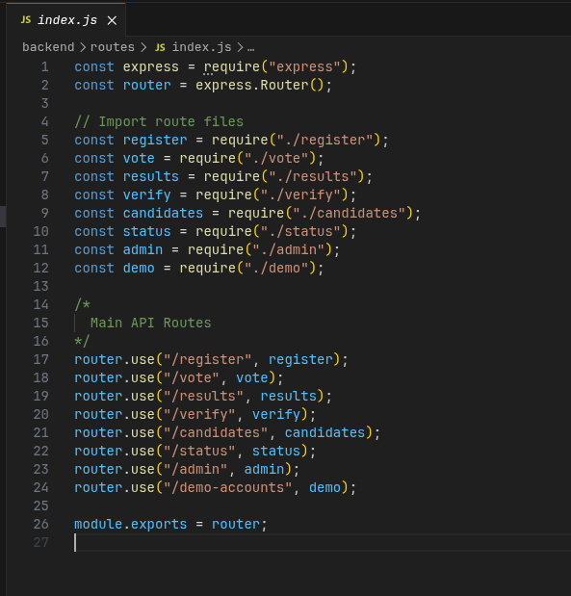
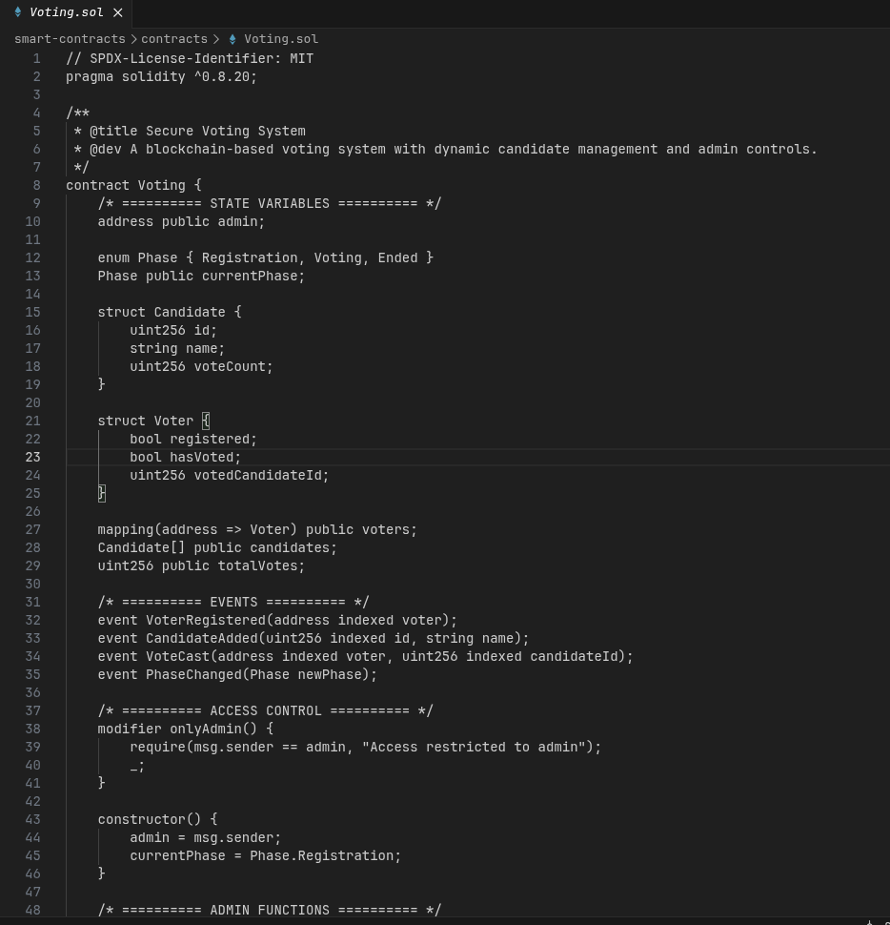
Screenshot: Source code

Slide 17
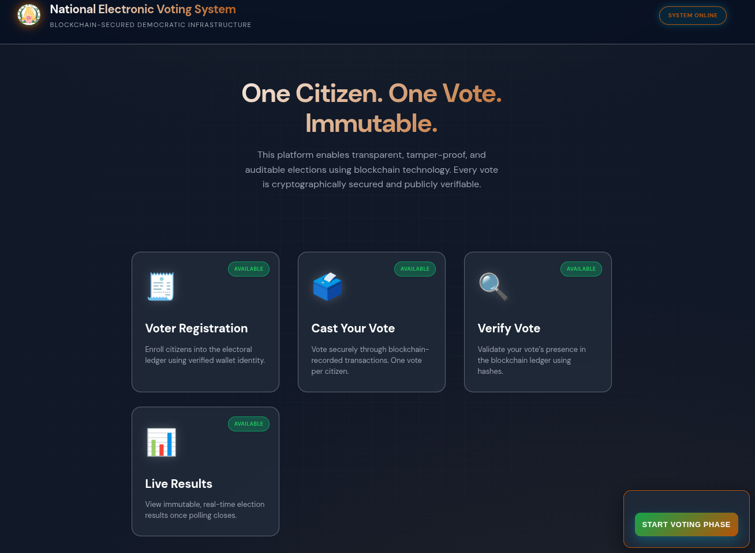
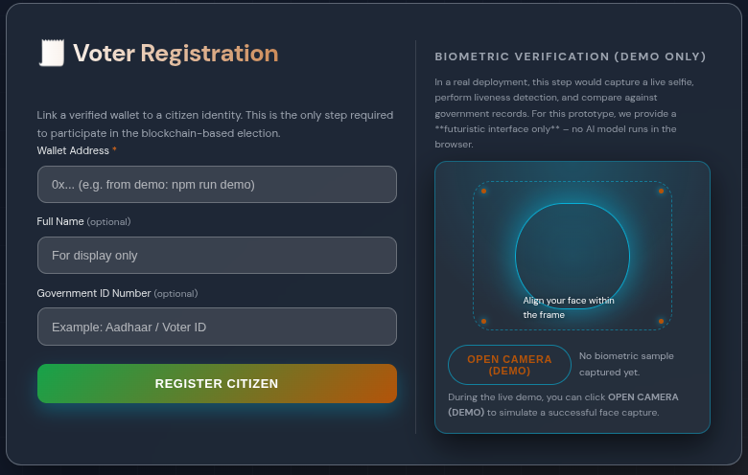
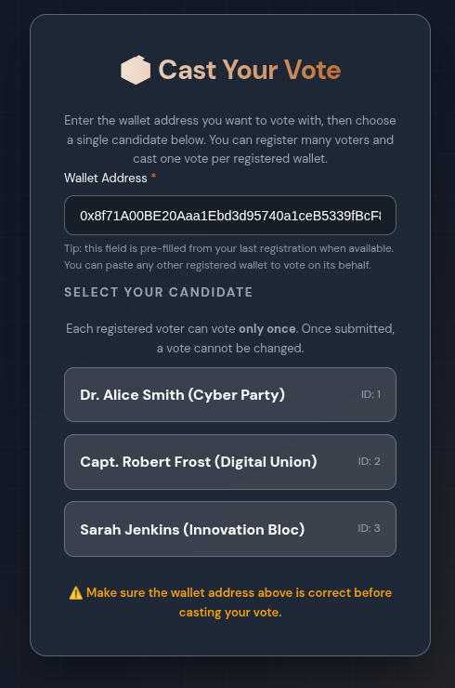
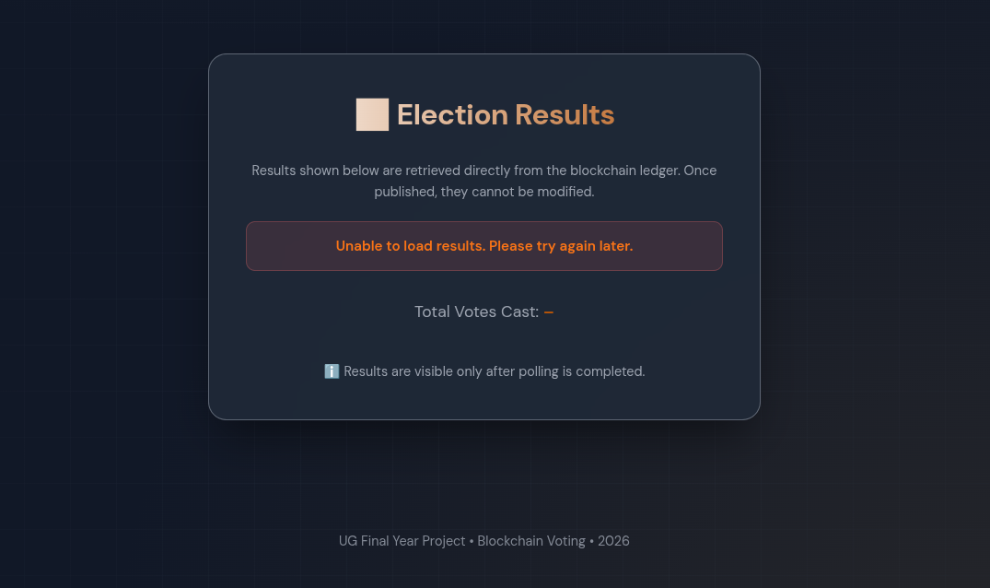
Screenshot: UI

Slide 18
Conclusion
Summary
Blockchain-based E-voting addresses transparency, integrity, and trust issues.
Key Benefits
Decentralization removes single points of failure.
Smart contracts enforce election rules automatically.
Immutable ledger enables independent verification and auditing.
Outcome
Prototype demonstrates practical feasibility of blockchain in electoral systems.
Provides a foundation for future large-scale or national-level deployments.
THANK YOU !

