Slide 1
A Cloud-Based Data Leakage Prevention System Using Rule-Based Content Inspection
TEAM MEMBERS :
SABARIRAJA. S ( 620822205090 )
RANJITH. P ( 620822205084 )
SHANTHOSH. M ( 620822205098 )
ROHITH. V ( 620822205088 )
GUIDE : MS. JAYANTHI. R,AP/IT

Slide 2
Problem Statement
Uncontrolled data leakage to cloud
Users upload files to cloud storage without any security inspection.
Sensitive information (PII, credentials, financial data) can be exposed accidentally.
Lack of real‑time inspection
Many systems only detect issues after data is already stored or shared; no “gatekeeper” at upload time.
Weak auditability
Limited or no tamper‑evident logs for who uploaded what and why it was allowed/blocked.
Integrity risks
Stored files can be altered or corrupted without easy detection.

Slide 3
Objective
Design a lightweight Cloud DLP gateway:
Inspect files before they are stored and block uploads that violate security policies.
Provide configurable DLP policies:
Regex‑based rules for emails, phone numbers, passwords, and sensitive patterns.
Encrypt and protect allowed content:
Encrypt allowed files at rest and store integrity hashes to detect tampering.
Offer full audit visibility:
Persist all upload attempts (ALLOWED / BLOCKED / ERROR) in an exportable audit log.
Expose a clean, user‑friendly web dashboard: Simple upload flow for users; clear stats, assets, and logs for admins.

Slide 4
Existing System
Manual or ad‑hoc checks: Security teams review data after upload (if at all). Reliant on user awareness.
Complex enterprise DLP suites: Heavyweight, complicated to configure and deploy. Overkill for smaller organizations or indiviuals.
Disadvantage
Limited transparency: Users and admins cannot easily see which uploads were blocked and why, or view currently stored assets.
Integrity monitoring gaps: Stored files can be updated or corrupted without straightforward integrity checks.
Result: Increased risk of accidental data leakage and difficulty demonstrating DLP behavior in PoC settings.

Slide 5
Proposed System :
Rule‑based upload gateway: FastAPI backend receives file uploads and applies regex‑based DLP policies before writing to storage.
Encrypted storage with integrity: Allowed files are encrypted (Fernet) and stored locally. SHA‑256 hashes of encrypted blobs are stored for verification.
Structured audit logging: Every attempt is logged in SQLite with reason and timestamp.
Advantage
Simple web dashboard: Users upload via a responsive UI; admins view stats, assets, and live audit logs.
Transparency & verifiability: Clear reasons for blocked uploads. Verify endpoint checks that stored files match recorded hashes.
Lightweight and extensible: Easy to plug in more policies, real cloud storage (e.g. S3/MinIO), and authentication later.

Slide 6
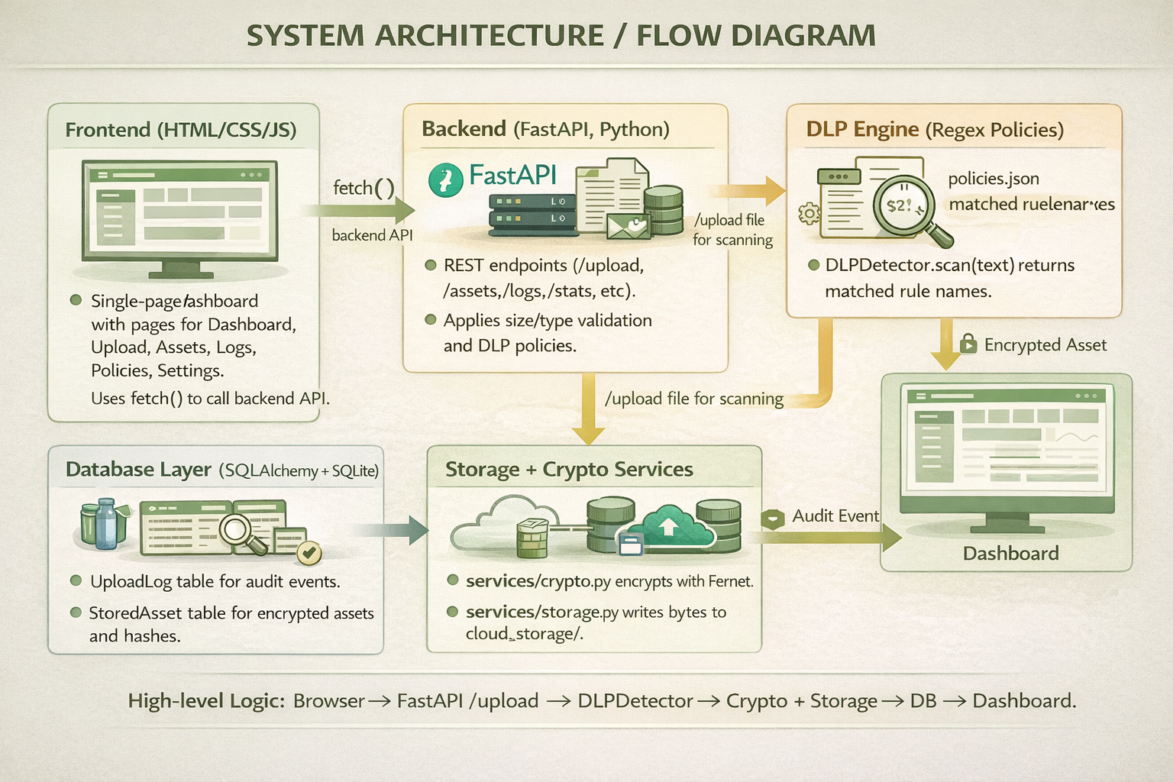
SYSTEM ARCHITECTURE/FLOW DIAGRAM

Slide 7
Modules :
Module 1: Rule-Based Content Inspection
Module 2: Cryptographic Hashing
Module 3: Secure Violation Logging
Module 4: User-Defined Security Policies
Module 5: Performance Optimization & Cloud Integration

Slide 8
Module 1: Rule‑Based Content Inspection
Purpose
Inspect file contents before upload to detect sensitive information (PII, credentials, etc.).
Core Idea
Use regex‑based rules on decoded text to flag patterns such as:
Email addresses, phone numbers, passwords / secrets, IDs.
Flow
Backend receives file → decodes bytes to text → calls DLPDetector.scan(text).
For each rule in policies.json, if regex matches, rule name is added to findings.
If findings is non‑empty, the upload is BLOCKED and never written to storage.
Benefits
Transparent and explainable: rules live in a simple JSON file.
Easy to extend with new patterns without changing core code.

Slide 9
Module 2: Cryptographic Hashing
Purpose
Ensure that stored (encrypted) files are not silently modified or corrupted.
Core Idea
Encrypt each allowed file and compute a SHA‑256 hash of the encrypted blob.
Why hash the encrypted data?
Integrity is verified on the exact bytes stored on disk.
Any change to the encrypted file (bit‑flip, truncation, replacement) changes the hash.
Where it fits
Runs only after a file passes DLP inspection.
Connects upload logic with the integrity verification endpoint.

Slide 10
Module 2: Flow & Data Path
Upload path
Allowed upload → encrypt_and_hash(content):
Load Fernet key from environment or .encryption_key file.
Encrypt plaintext bytes with Fernet.
Compute SHA‑256(encrypted_bytes) and store as file_hash.
Save encrypted bytes to cloud_storage/uuid.bin.
Store metadata in StoredAsset:
filename, storage_path, file_hash, created_at.
Verification path (/assets/{id}/verify)
Read encrypted file from disk via storage_path.
Recompute SHA‑256(encrypted_bytes) and compare with DB file_hash.
Return:
verified: true + “Hash matches” if equal.
verified: false + “Hash mismatch” or “File missing on storage”.

Slide 11
Module 2: Security & Benefits
Security properties
Detects any tampering with stored encrypted files (even if DB is unchanged).
Helps prove that “what we stored is still what we originally encrypted.”
Operational advantages
Simple, deterministic verification endpoint for demos and audits.
Can be run periodically or on demand to check storage health.
Extensibility
Easy to plug in other hash algorithms or HMACs if required.
Same pattern works when migrating from local disk to S3/MinIO.

Slide 12
Module 3: Secure Violation Logging
Purpose
Maintain a reliable audit trail for every upload attempt and its outcome.
Core Idea
Store structured log entries in SQLite with:
Filename, status (ALLOWED / BLOCKED / ERROR), reason, timestamp.
When it runs
On every /upload code path:
Size or type failure.
DLP violation.
Successful encrypted storage.
Internal errors (scan/storage issues).

Slide 13
Module 3: Logging Flow & UI Integration
Backend flow
/upload decides outcome → calls:
log_event(filename, status, reasons[]).
log_event:
Opens DB session (get_db_session).
Creates UploadLog row.
Commits or rolls back safely using a context manager.
Frontend /logs page
Fetches GET /logs and shows:
Filename, colored status badge, reason text, time.
Features:
Status filter (Allowed / Blocked / Error).
Search by filename or reason.
Auto‑refresh when Logs page is active.
CSV export button for offline analysis.

Slide 14
Module 3: Benefits & Use Cases
Benefits
Full visibility into:
Which uploads were allowed or blocked.
Exact reasons for blocking (e.g. “email, password”).
Frequency of errors and misconfigurations.
Use cases
Security analysis:
Identify common violation patterns (e.g., passwords in PDFs, API Keys).
Tuning DLP rules:
Adjust regexes based on real‑world violations seen in logs.
Teaching / demo:
Show live logs updating as students upload safe vs. sensitive files.

Slide 15
Conclusion
Summary
Cloud DLP gateway that inspects, encrypts, and logs file uploads for cloud environments.
Key Benefits
Prevents many accidental leaks before data even reaches storage.
Provides clear, human‑readable reasons for blocked uploads.
Ensures stored files are encrypted and integrity‑checked.
Offers a transparent, searchable audit trail and simple UI.
Outcome
A solid foundation to extend into a production‑grade DLP solution with richer policies, real cloud backends, and access control.
THANK YOU !

