Slide 1
Penguide A Lightweight Local AI Agent for Secure Linux Command Assistance
TEAM MEMBERS :
Vinisha. K ( 620822205119 )
Thirisha. S ( 620822205115 )
Rethika. T ( 620822205086 )
Yuvasri. S ( 620822205124 )
GUIDE : MRS, Gayathri. M, AP/IT

Slide 2
Objective
Teach Linux commands and kernel concepts through clear, beginner-friendly explanations.
Provide a safe practice environment using an allow-list shell to prevent harmful command execution.
Interpret natural-language questions and generate explanations with a single safe command when appropriate.
Ground responses using curated Linux kernel documentation (RAG-based contextual retrieval).
Support adaptive learning with “simple” and “detailed” explanation modes.
Ensure privacy by running inference locally (e.g., via Ollama) with no external data sharing.
Offer a structured CLI interface with meta-commands (help, history, clear, exit).

Slide 3
Existing System
Most existing AI assistants for system interaction operate as:
Cloud-hosted AI services
General-purpose conversational chatbots
Tools with unrestricted command execution
Examples include cloud IDE assistants and web-based AI shells.
Disadvantage
Dependence on internet connectivity
Exposure of system data to third-party servers
High latency and inconsistent response times
Risk of executing unsafe or privileged commands
Excessive explanations instead of direct results

Slide 4
Proposed System :
Penguide is a local AI command agent that:
Runs entirely on the user’s machine
Uses a local large language model for reasoning
Enforces strict command allowlists and policies
Executes at most one command per reques
Advantage
Complete data privacy and offline capability
Deterministic and predictable behavior
Strong security through command restrictions
Fast execution with minimal overhead
Scriptable and automation-friendly design

Slide 5
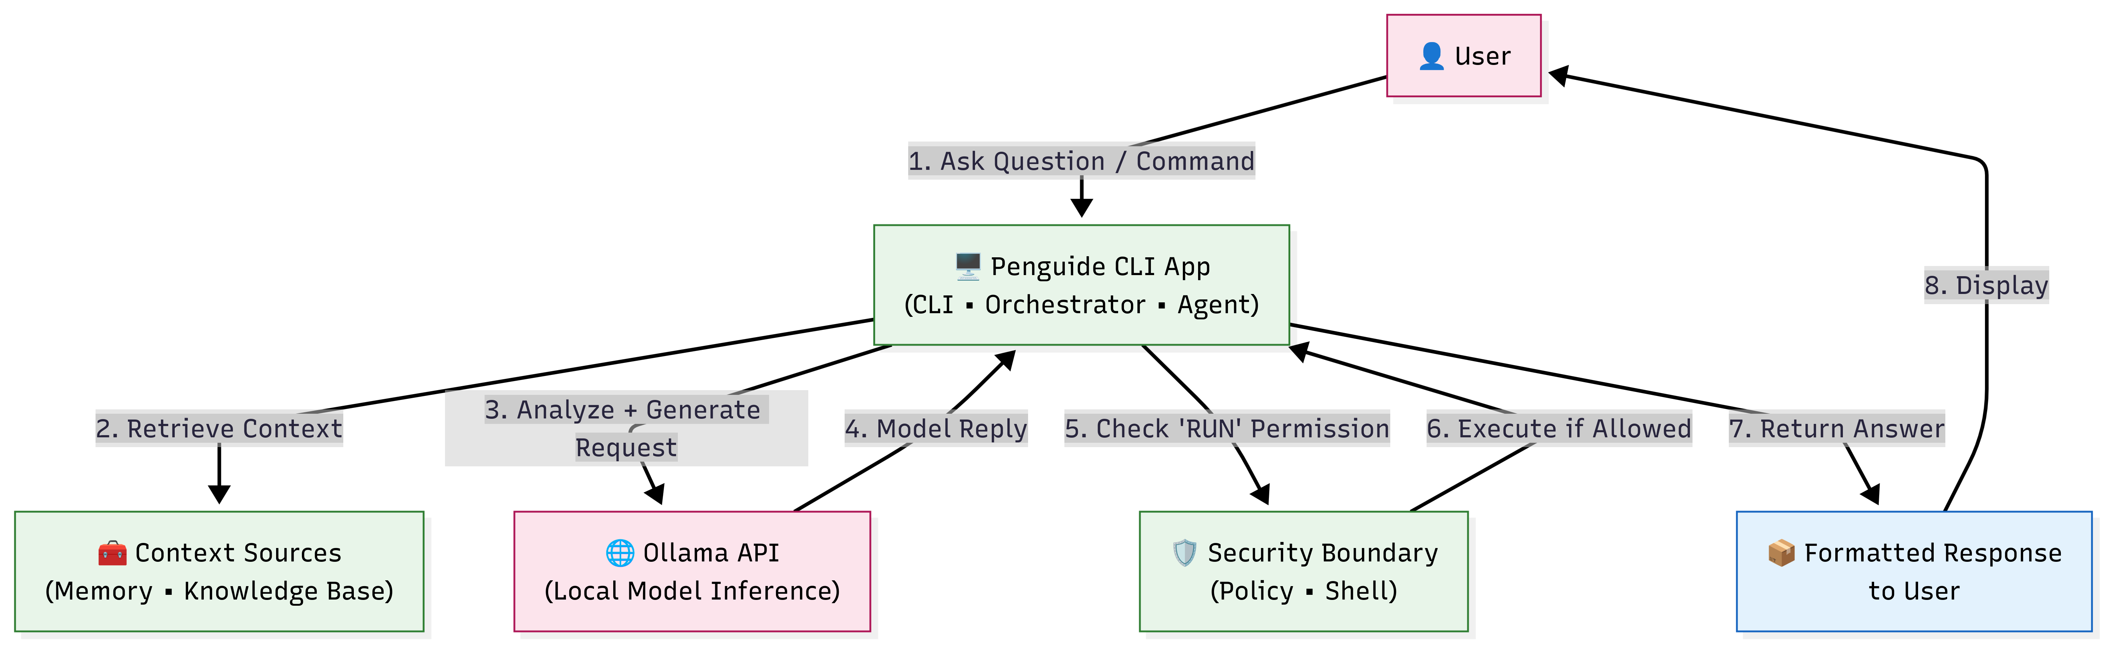
SYSTEM ARCHITECTURE/FLOW DIAGRAM

Slide 6
Modules :
Command-Line Interface Module
Agent Reasoning Module
Policy and Security Module
Shell Execution Module
Output Management Module

Slide 7
Module 1: Command-Line Interface Module
Purpose: Single entry point for the user; handles input, meta-commands, and formatted output.
Entry point: bin/penguide.py — interactive loop or one-shot query from the terminal.
Input handling: Reads natural-language questions; supports meta-commands: help, history, commands, mode simple / mode detailed, clear, exit / quit.
Teaching modes: “Simple” (short explanations) and “Detailed” (deeper explanations); switchable at runtime.
Output: Colored, boxed responses; distinct styling for explanations, executed commands, and errors; prompt label 🐧 penguide>.
Special views: commands lists allowed/denied shell commands; history shows recent conversation turns.

Slide 8
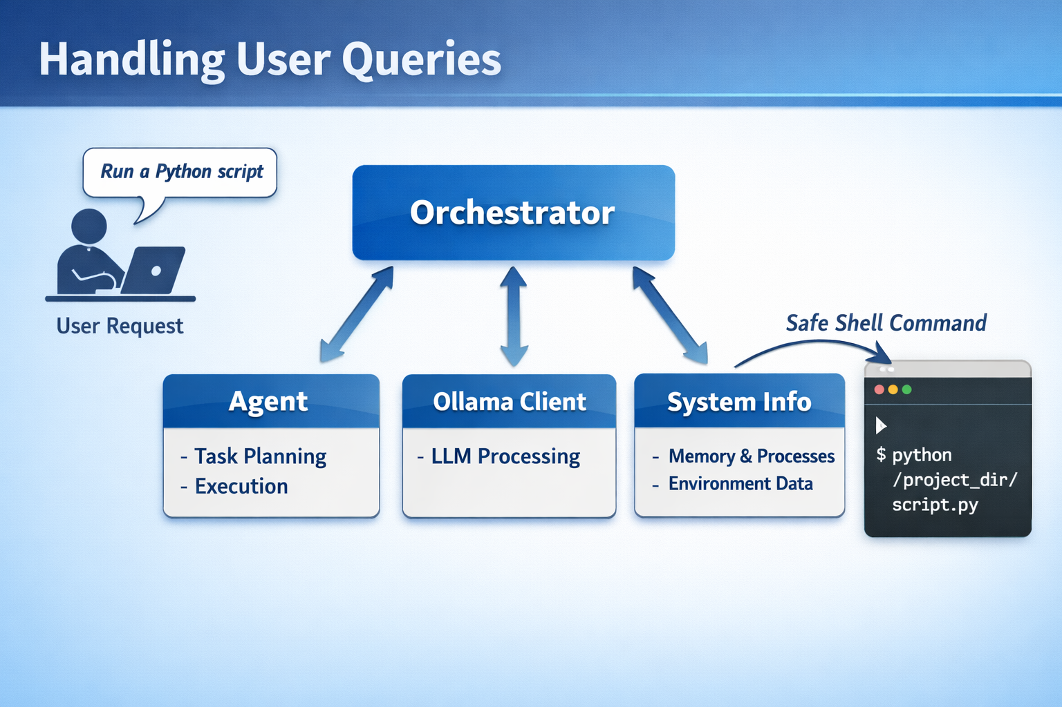
Module 2: Agent Reasoning Module
Role: Turns user queries into explanations and, when appropriate, a single safe shell command; coordinates LLM, memory, and kernel documentation.
Components: Orchestrator (core/orchestrator.py), Agent (core/agent.py), Ollama client (models/ollama.py).
Context per turn:
Memory: Last N conversation turns (configurable; e.g. PENGUIDE_MEMORY_MAX_TURNS).
Knowledge: Snippets from knowledge/kernel/*.md matched to the user’s question (e.g. memory, processes).
Environment: Home directory and current working directory injected so the model can suggest realistic paths (~, project dir).

Slide 9
Module 3: Policy and Security Module
Purpose: Ensure only safe, educational commands are executed; block destructive or privileged operations.
Policy source: configs/policy.py — two sets: ALLOWED_COMMANDS (e.g. ls, cat, pwd, ps, df, du, grep, find, ip, ss, nano, vim) and DENY_COMMANDS (e.g. sudo, chmod, chown, dd, mount, reboot, shutdown).
Scope: Only the first token (base command) is checked; arguments are not parsed for semantic safety.
Principle: Explicit allow-list plus deny-list; any command not allowed or explicitly denied is rejected before execution.

Slide 10
Module 4: Shell Execution Module
Manages safe subprocess execution for validated, policy-approved shell commands.
Enforces hard timeout boundaries on all command runs to prevent blocking.
Captures stdout and stderr separately with proper UTF-8 encoding handling.
Returns structured output (stdout, stderr, exit_code) to Agent Reasoning Module.
No privileged execution — runs as current user only (no sudo escalation).
Working directory set to user's home directory for safe default context.
Non-zero exit codes returned as diagnostic messages, not exceptions.
Provides 'explain → show command → show result' teaching loop consistency.

Slide 11
Module 4: Implementation Module
Core Implementation (tools/shell.py):
subprocess.run(cmd, shell=False, capture_output=True, timeout=TIMEOUT) used.
cmd parsed via shlex.split() to prevent shell injection via argument splitting.
stdout.decode('utf-8', errors='replace') handles binary/non-UTF output safely.
PENGUIDE_SHELL_TIMEOUT env var (default: 5s) caps execution time.
Output Handling:
Returns dict: { 'stdout': str, 'stderr': str, 'returncode': int, 'cmd': str }.
Non-zero returncode triggers: 'command exited with status N: <stderr>' message.
TimeoutExpired exception caught → returns 'command timed out after Ns' message.
Security Guarantee:
Shell Execution Module never called unless Policy Module approved the command.
No environment variable injection — clean env passed to subprocess.
stdin=DEVNULL prevents interactive prompt hanging.

Slide 12
Module 5: Output Management Module
Formats and presents agent responses with clear visual structure and color-coding.
Color-coded output distinguishes: explanation (white), command (yellow), result (green).
Boxed response containers using rich library improve terminal readability.
History management stores recent conversation turns (configurable max turns).
Supports terminal-aware rendering with ANSI escape codes for color and style.
Error messages displayed in red-bordered box for immediate visibility.
Mode indicator shows current teaching mode (simple/detailed) in prompt.
Clear command resets terminal display and optionally clears history buffer.

Slide 13
Module 5: Implementation Module
Core Implementation (sys/output.py):
rich.console.Console used for platform-aware ANSI color rendering.
rich.panel.Panel wraps each response in a bordered box with title.
Panel title shows: '🐧 penguide' with mode badge [simple] or [detailed].
History Management:
Conversation stored as list of dicts: [{'role': 'user'|'agent', 'text': str}].
history command renders numbered turns with role prefix and timestamp.
Max turns enforced by slicing history list to last N entries.
Output Sections:
Explanation section: white text in main panel body.
Executing section: '> Executing: <cmd>' in yellow bold.
Command result: actual output in green monospace block.
Error section: red border with stderr content and exit code.

Slide 14
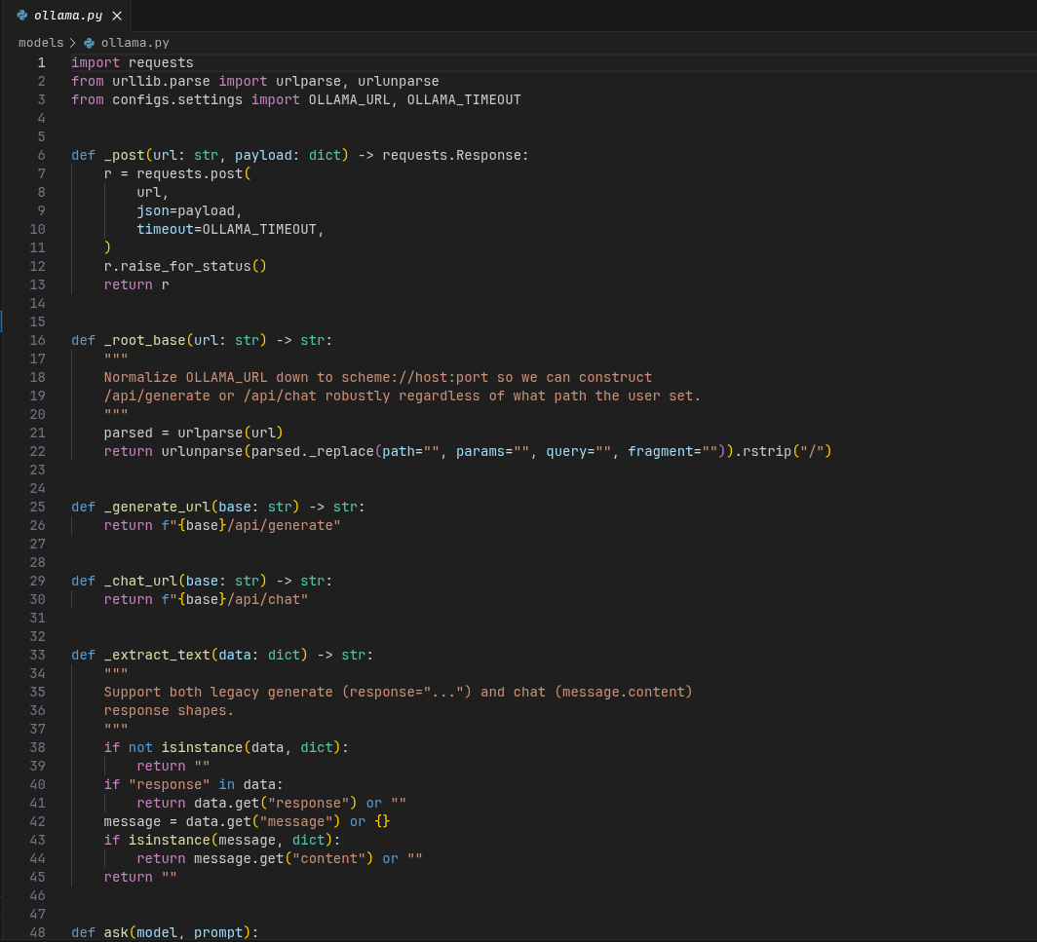
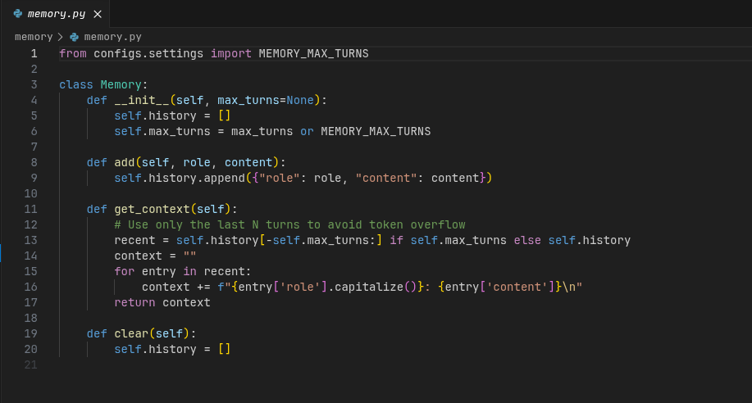
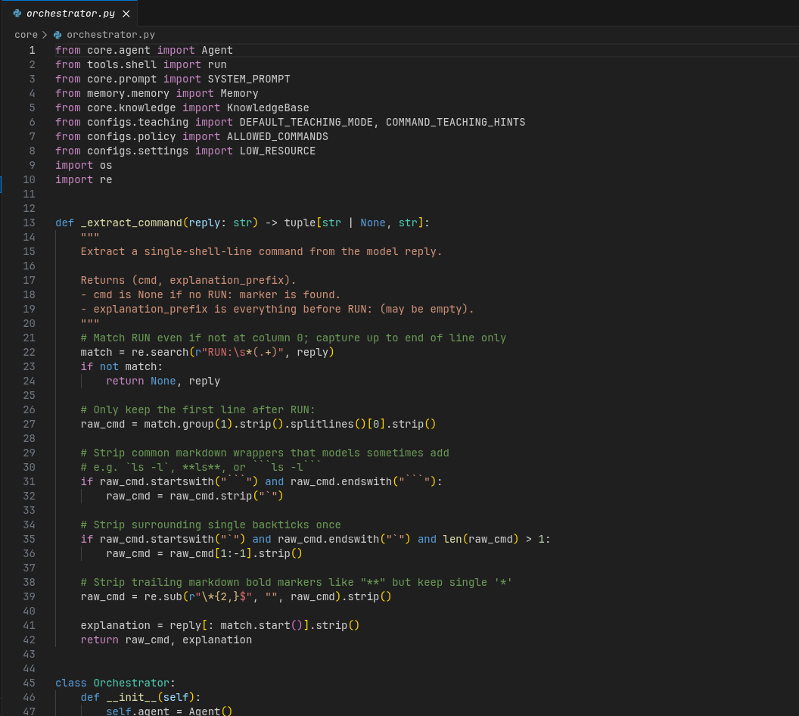
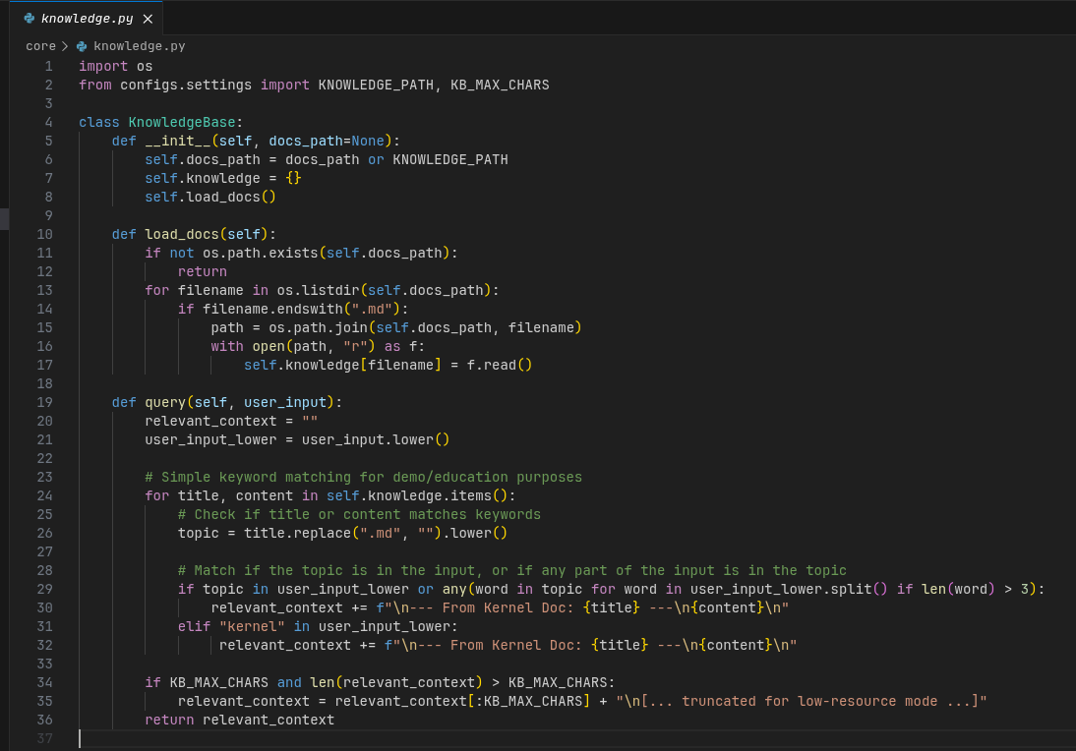
Screenshot: Source code

Slide 15
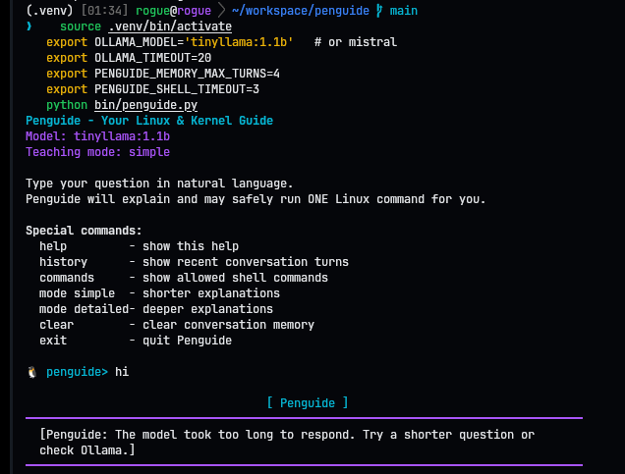
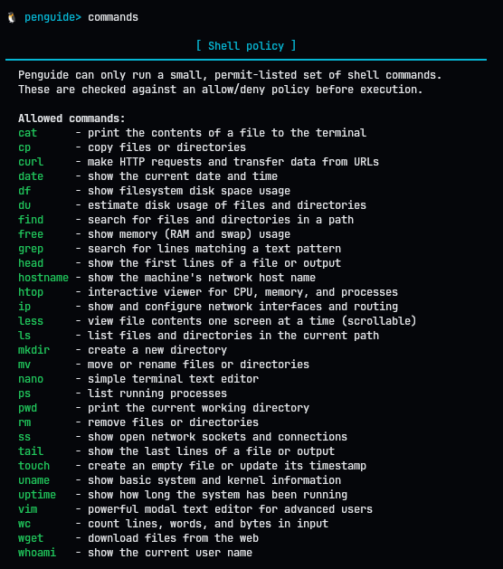

Screenshot: Output

Slide 16
Conclusion
Summary: Penguide is an educational agent that teaches Linux and kernel concepts through a safe, interactive CLI. It combines a Command-Line Interface Module, an Agent Reasoning Module, and a Policy and Security Module (with Shell Execution and Output Management reserved for later reviews) to provide explanations before executing any command.
Pedagogical value: Lowers the barrier to learning the command line and kernel by coupling “what to type” with “why it works,” in a guided loop of explanation, suggested command, and real output.
Future work: Extend documentation coverage, add adaptive difficulty, and consider Shell Execution and Output Management modules in the next review phase.
THANK YOU !

