Slide 1
Penguide A Lightweight Local AI Agent for Secure Linux Command Assistance
TEAM MEMBERS :
Vinisha. K ( 620822205119 )
Thirisha. S ( 620822205115 )
Rethika. T ( 620822205086 )
Yuvasri. S ( 620822205124 )
GUIDE : MRS, Gayathri. M, AP/IT

Slide 2
Problem Statement
Beginners learning Linux and kernel concepts lack a safe, guided environment that explains commands clearly, prevents harmful execution, provides documentation-backed answers, and preserves user privacy through fully local AI-based assistance.
Existing AI-powered assistants for system interaction suffer from severalcritical limitations. Most tools are cloud-dependent, creating privacy andreliability concerns.
In Many systems execute commands without sufficient restrictions, leading to potential security risks such as privilege escalation or destructive operations.
Additionally, AI assistants often behave like conversational chatbots, producing verbose explanations instead of actionable outputs, which reduces efficiency in real system workflows.
There is a lack of lightweight, locally deployable AI agents that can safely assist with Linux command execution while maintaining strict control over system behavior.

Slide 3
Objective
Teach Linux commands and kernel concepts through clear, beginner-friendly explanations.
Provide a safe practice environment using an allow-list shell to prevent harmful command execution.
Interpret natural-language questions and generate explanations with a single safe command when appropriate.
Ground responses using curated Linux kernel documentation (RAG-based contextual retrieval).
Support adaptive learning with “simple” and “detailed” explanation modes.
Ensure privacy by running inference locally (e.g., via Ollama) with no external data sharing.
Offer a structured CLI interface with meta-commands (help, history, clear, exit).

Slide 4
Existing System
Most existing AI assistants for system interaction operate as:
Cloud-hosted AI services
General-purpose conversational chatbots
Tools with unrestricted command execution
Examples include cloud IDE assistants and web-based AI shells.
Disadvantage
Dependence on internet connectivity
Exposure of system data to third-party servers
High latency and inconsistent response times
Risk of executing unsafe or privileged commands
Excessive explanations instead of direct results

Slide 5
Proposed System :
Penguide is a local AI command agent that:
Runs entirely on the user’s machine
Uses a local large language model for reasoning
Enforces strict command allowlists and policies
Executes at most one command per reques
Advantage
Complete data privacy and offline capability
Deterministic and predictable behavior
Strong security through command restrictions
Fast execution with minimal overhead
Scriptable and automation-friendly design

Slide 6
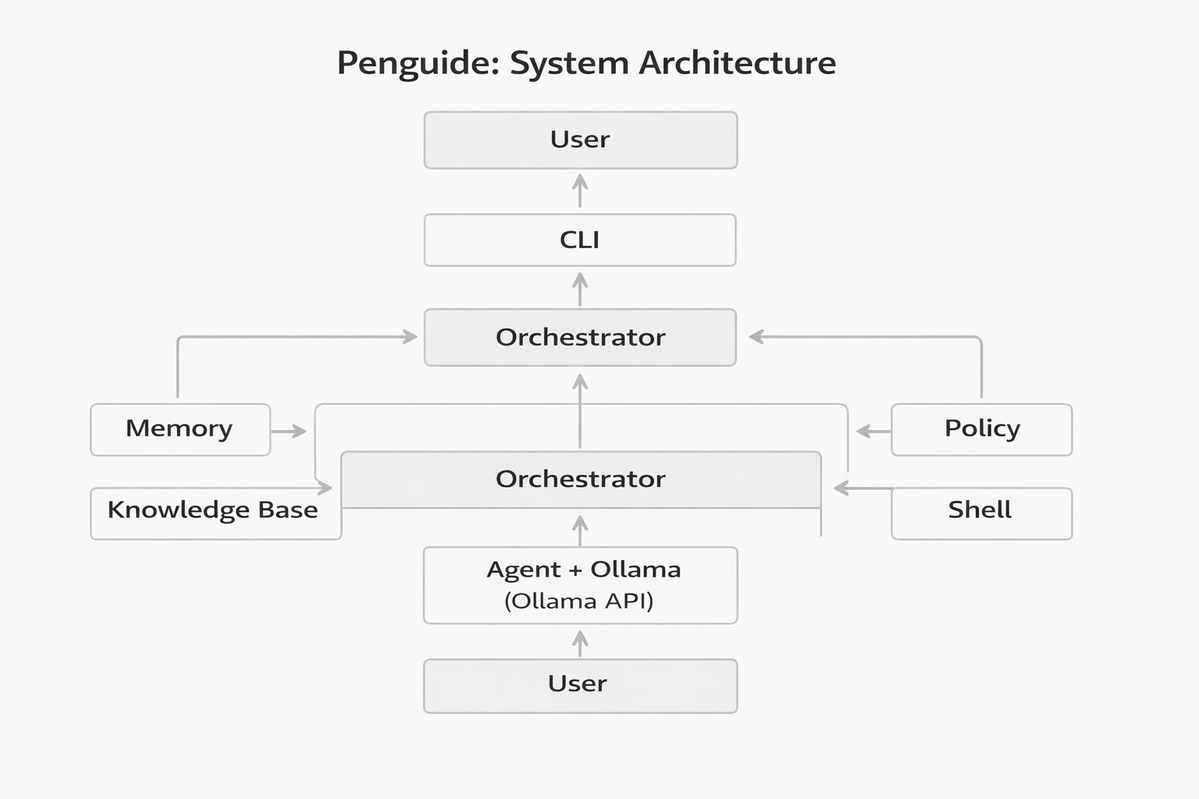
SYSTEM ARCHITECTURE/FLOW DIAGRAM

Slide 7
Modules :
Command-Line Interface Module
Agent Reasoning Module
Policy and Security Module
Shell Execution Module
Output Management Module

Slide 8
Module 1: Command-Line Interface Module
Purpose: Single entry point for the user; handles input, meta-commands, and formatted output.
Entry point: bin/penguide.py — interactive loop or one-shot query from the terminal.
Input handling: Reads natural-language questions; supports meta-commands: help, history, commands, mode simple / mode detailed, clear, exit / quit.
Teaching modes: “Simple” (short explanations) and “Detailed” (deeper explanations); switchable at runtime.
Output: Colored, boxed responses; distinct styling for explanations, executed commands, and errors; prompt label 🐧 penguide>.
Special views: commands lists allowed/denied shell commands; history shows recent conversation turns.

Slide 9
Module 2: Agent Reasoning Module
Role: Turns user queries into explanations and, when appropriate, a single safe shell command; coordinates LLM, memory, and kernel documentation.
Components: Orchestrator (core/orchestrator.py), Agent (core/agent.py), Ollama client (models/ollama.py).
Context per turn:
Memory: Last N conversation turns (configurable; e.g. PENGUIDE_MEMORY_MAX_TURNS).
Knowledge: Snippets from knowledge/kernel/*.md matched to the user’s question (e.g. memory, processes).
Environment: Home directory and current working directory injected so the model can suggest realistic paths (~, project dir).

Slide 10
Module 2: Prompting and Teaching Logic
System prompt: Defines Penguide as a beginner-friendly Linux guide; rules: one command per response, prefer safe commands, avoid inventing commands; format for actions: RUN: <command>.
Teaching mode: Injected as “Teaching mode: simple” or “Teaching mode: detailed”; optional per-command hints (e.g. how to explain ls, grep, ps) from configs/teaching.py.
Policy hint: Allow-list of shell commands is included so the model only suggests permitted commands.
Request flow: Full context (history + knowledge + env) + system block + user message → single non-streaming call to Ollama; response is parsed for explanation and optional RUN: line.

Slide 11
Module 2: Parsing and Fallback
Parsing: Scan model reply for RUN: <command>; strip markdown (backticks, bold); use only the first line after RUN: as the command string.
When RUN: is present: Explanation = text before RUN:; command is sent to Shell Execution Module; combined output = explanation + “> Executing: &lt;cmd&gt;” + real output.
Fallback: If the user types a line that starts with an allowed command (e.g. ls ~/workspace) and the model did not emit RUN:, the orchestrator still runs that command and appends “> Executing: …” and the result to the explanation.
Outcome: Every actionable step is “explain → show command → show result,” keeping the teaching loop consistent.

Slide 12
Module 3: Policy and Security Module
Purpose: Ensure only safe, educational commands are executed; block destructive or privileged operations.
Policy source: configs/policy.py — two sets: ALLOWED_COMMANDS (e.g. ls, cat, pwd, ps, df, du, grep, find, ip, ss, nano, vim) and DENY_COMMANDS (e.g. sudo, chmod, chown, dd, mount, reboot, shutdown).
Scope: Only the first token (base command) is checked; arguments are not parsed for semantic safety.
Principle: Explicit allow-list plus deny-list; any command not allowed or explicitly denied is rejected before execution.

Slide 13
Module 3: Enforcement Flow
When a command is proposed: Either extracted from the model’s RUN: line or taken from the user’s direct input (e.g. ls ~/).
Validation steps:
(1) Parse base command (e.g. using shlex.split for correct quoting).(2) Reject if base is in DENY_COMMANDS.(3) Reject if base is not in ALLOWED_COMMANDS.(4) If both checks pass, pass the full command string to the Shell Execution Module.
No execution: Rejected commands return an empty string to the orchestrator; no subprocess is spawned.
Result: The shell runner never executes sudo, dd, chmod, or other denied commands, regardless of what the model or user types.

Slide 14
Module 3: Timeouts and Boundaries
Timeout: Shell run is bounded by PENGUIDE_SHELL_TIMEOUT (e.g. 5 seconds); prevents long-running or blocking commands from hanging the CLI.
Error handling: If a command runs but exits non-zero (e.g. invalid options, permission error), the Shell Module returns a clear message (e.g. “command exited with status N…”) plus any captured output; the CLI displays this in the response box.
Academic note: This module demonstrates how to integrate an LLM with a live shell while enforcing a strict, auditable policy and fail-safe defaults—relevant for secure, educational AI assistants.

Slide 15
Conclusion
Summary: Penguide is an educational agent that teaches Linux and kernel concepts through a safe, interactive CLI. It combines a Command-Line Interface Module, an Agent Reasoning Module, and a Policy and Security Module (with Shell Execution and Output Management reserved for later reviews) to provide explanations before executing any command.
Pedagogical value: Lowers the barrier to learning the command line and kernel by coupling “what to type” with “why it works,” in a guided loop of explanation, suggested command, and real output.
Future work: Extend documentation coverage, add adaptive difficulty, and consider Shell Execution and Output Management modules in the next review phase.
THANK YOU !

