Slide 1
SmartDRM: Blockchain based Digital Rights Management System
TEAM MEMBERS :
Silambarasan. B ( 620822205102 )
Muralidharan. C ( 620822205064 )
Pradeep. M ( 620822205075 )
Srinath. P ( 620822205105 )
GUIDE : Mrs. Sathiyapriya K, AP/IT

Slide 2
Objective
To design a decentralized DRM framework using blockchain technology
To ensure immutable ownership and license records through smart contracts
To provide controlled and flexible access mechanisms for digital assets
To detect suspicious usage behavior using AI-based analysis
To maintain an auditable and transparent activity log
To develop a modern, user-friendly interface for asset management

Slide 3
Existing System
Current DRM solutions primarily operate using centralized servers managed by content distributors or platform providers.
Characteristics:
Central authority controls access and licenses
User authentication and permissions stored centrally
DRM policies enforced at application level
Disadvantage
Single-point failure and high vulnerability to attacks
Limited transparency in ownership verification
Dependency on trusted third parties
Difficult to audit access and usage
Poor scalability for large digital ecosystems

Slide 4
Proposed System :
Blockchain-based asset registration and ownership proof
Smart contract-driven license issuance and enforcement
AI-powered behavioral risk analysis
Secure audit logging for all critical actions
Full-stack web interface for real-time interaction
Advantage
Immutable and tamper-proof ownership records
Transparent license enforcement
Reduced piracy and unauthorized access
Automated royalty-ready transaction tracking

Slide 5
SYSTEM ARCHITECTURE/FLOW DIAGRAM
User Data / Files
Frontend (React + Tailwind)
Backend (FastAPI)
AI Engine
Blockchain Network
Audit & Storage

Slide 6
Modules :
Authentication Module
Asset Management Module
Blockchain & Smart Contract Module
AI-Based Risk Analysis Module
Front-end Dashboard Module

Slide 7
Module 1: Authentication Module
Purpose: Handles user registration, login, and identity verification for all protected APIs.
Key Features:
User registration with BCrypt-hashed passwords stored in SQLite (/auth/register).
Login endpoint that validates credentials and returns a lightweight token (user_id:username) (/auth/login).
Reusable get_current_user dependency that extracts the user from the Bearer token on every protected request.
Role field (admin / user) used by other modules (e.g., AI analytics, asset licensing) for authorization decisions.
Tech Stack: FastAPI, SQLAlchemy models, BCrypt hashing, HTTP Bearer auth.

Slide 8
Module 2: Asset Management Module
Encrypts files using AES-256-GCM before writing to disk — only encrypted blobs stored.
Associates each asset with metadata: owner, filename, asset hash, blockchain tx hash.
Upload: /asset/upload → encrypt → store .enc file → create asset DB row.
List My Assets: /asset/list shows owned assets; /asset/list/shared shows licensed assets.
Download: /asset/download/{hash} → license check → decrypt → stream file to user.
SHA-256 hash of asset computed at upload and stored for integrity verification.
Logs ASSET_UPLOADED and ASSET_ACCESSED events to audit trail automatically.

Slide 9
Module 3: Blockchain & Smart Contract
LicenseManager Solidity contract stores mappings of asset hashes and license records.
register_asset_on_chain(asset_hash) called automatically after each successful upload.
issue_license_on_chain(asset_id, holder, expiry, limit) records license terms on-chain.
On-chain data serves as independent audit layer beyond local database records.
Backend uses web3.py to communicate with deployed contracts on Ganache node.
Falls back to mock transaction hashes in offline or testing mode gracefully.
Browser (Frontend)
FastAPI Backend
Ganache Node
Smart Contract
SQLite DB

Slide 10
Module 4: AI-Based Risk Analysis Module
Monitors user behavior across all asset interactions and detects anomalous patterns.
Assigns quantitative risk scores to download, access, and license request events.
Flags high-risk users for admin review based on configurable thresholds.
Uses frequency analysis, time-of-day patterns, and unusual asset combinations.
Integrates directly with audit log for real-time event correlation and scoring.
Risk reports and summaries accessible only to users with admin role.
Historical access data analyzed per user and per asset for trend detection.
Helps content creators identify potential piracy or license abuse early.

Slide 11
Module 4: Implementation Details
API Endpoints (ai_routes.py):
GET /analytics/risk — returns per-user risk scores and flagged events.
GET /analytics/summary — aggregate stats: total events, blocked attempts, risk distribution.
GET /analytics/user/{user_id} — detailed risk timeline for a specific user.
Risk Scoring Algorithm:
Base score computed from: download frequency per hour, after-hours access, bulk requests.
Asset diversity score: high score if one user accesses many unrelated assets rapidly.
License expiry probing: repeated access after license expiry raises risk flag.
Risk levels: LOW (0–30), MEDIUM (31–60), HIGH (61–100).
Database Queries:
Queries AuditLog table grouped by user_id and time windows.
Anomaly threshold configurable via SMARTDRM_RISK_THRESHOLD env variable.
All risk computations are read-only — no modification to asset or user data.

Slide 12
Module 5: Front-end Dashboard Module
React-based single-page application for complete digital asset lifecycle management.
Tailwind CSS provides responsive, modern UI adapting to all screen sizes.
Role-aware views: content creator interface differs from consumer interface.
Real-time status updates via API polling for license approvals and risk alerts.
Full workflow: upload asset → request license → approve/deny → download.
Admin dashboard integrates AI risk scores, audit logs, and blockchain status.
Drag-and-drop file upload with progress indicator and encryption confirmation.
License request and approval workflow with expiry date and usage limit controls.

Slide 13
Module 5: Implementation Details
React Components:
AssetList: displays owned and licensed assets with metadata cards.
UploadForm: drag-and-drop with mime-type validation and progress bar.
RequestAccess: license request form with proposed terms (duration, usage limit).
AdminPanel: approves/denies requests; shows risk dashboard and audit log.
State Management & API:
Axios for all REST API calls with Bearer token injected via request interceptor.
React useState + useEffect for component-level state and polling.
JWT-style token stored in localStorage; cleared on logout.
Routing:
React Router v6: /dashboard, /upload, /assets, /requests, /admin.
Protected routes redirect unauthenticated users to /login.
Admin-only routes check role from decoded token before rendering.

Slide 14
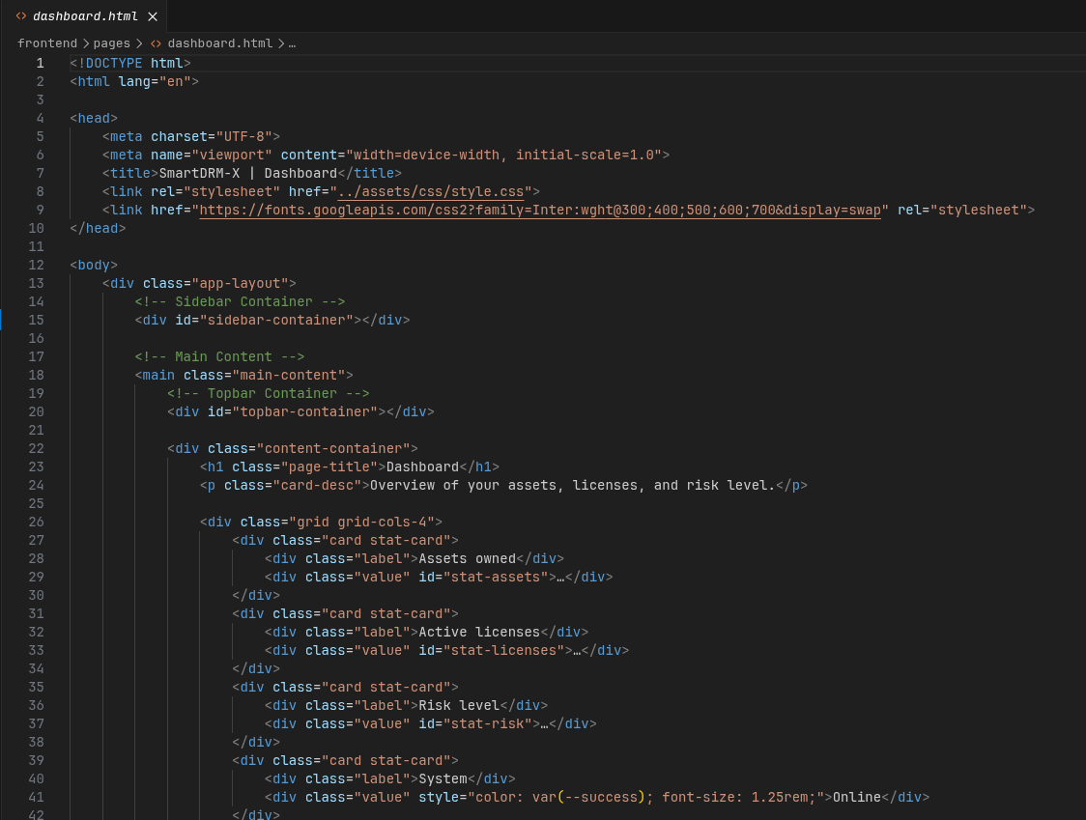
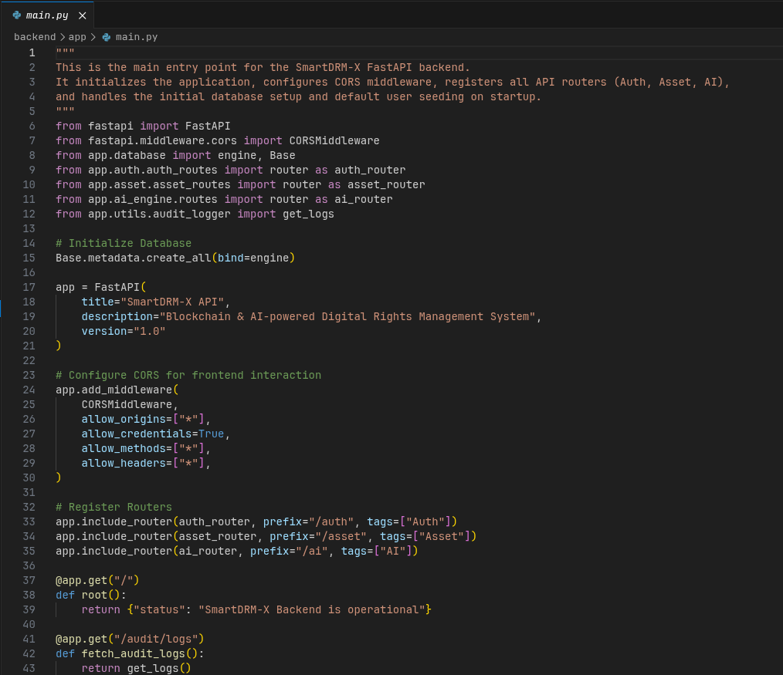
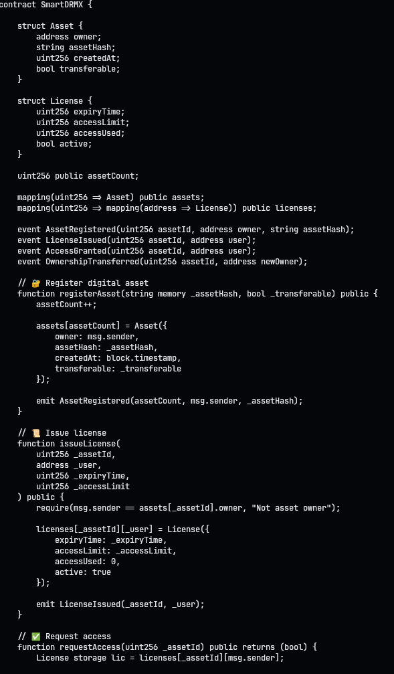
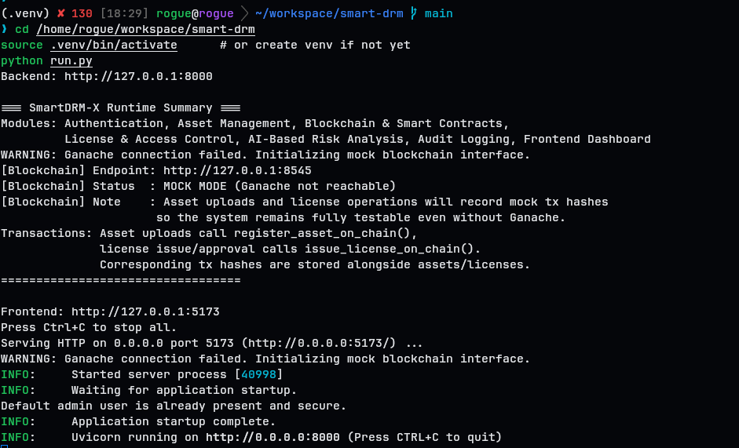
Screenshot: Source code

Slide 15
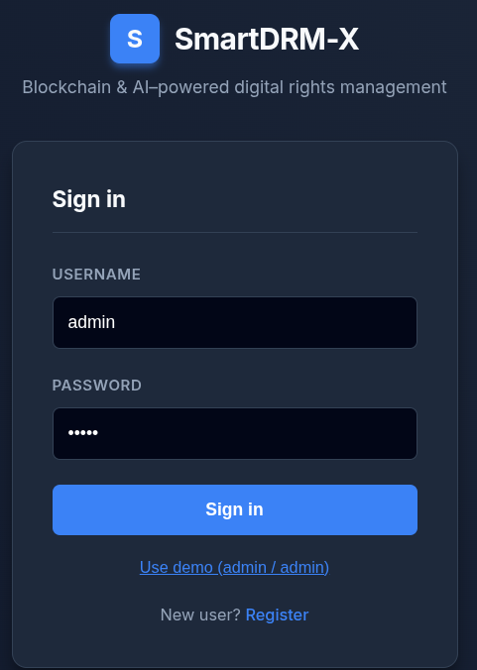
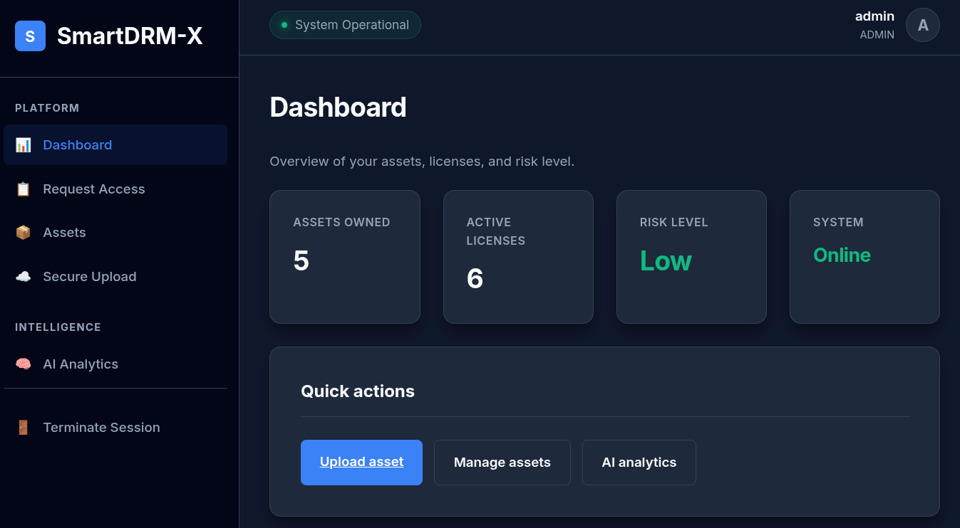
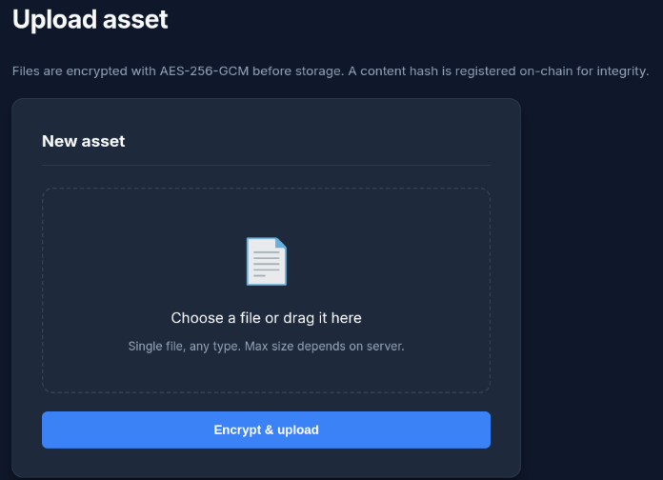
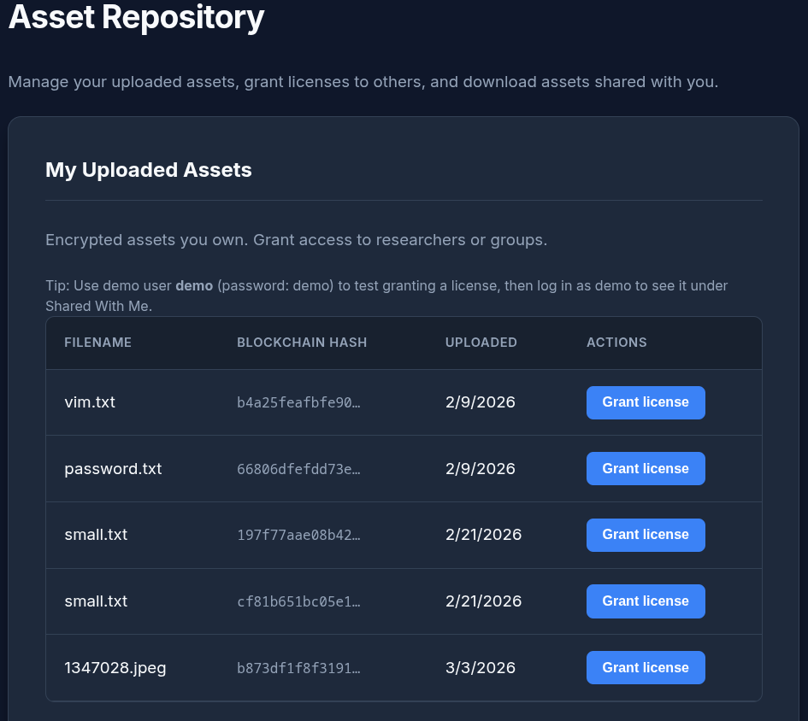
Screenshot: UI

Slide 16
Conclusion
SmartDRM-X demonstrates how blockchain and artificial intelligence can be effectively integrated to build a secure, transparent, and intelligent Digital Rights Management system. By decentralizing ownership records, automating license enforcement, and introducing behavioral analysis, the system significantly improves trust and security in digital content distribution.
The proposed framework is scalable, extensible, and suitable for applications in education, digital media platforms, enterprise document management, and software licensing. Future enhancements may include integration with decentralized storage systems and advanced machine learning models for predictive piracy detection.
THANK YOU !

