Slide 1


Dr. N.G.P. INSTITUTE OF TECHNOLOGY
(AN AUTONOMOUS INSTITUTE)
Coimbatore - 48
(Approved by AICTE, New Delhi & Affiliated to Anna University, Chennai
Recognized by UGC & Accredited by NAAC A+ and NBA (CSE, BME, EEE, ECE and Mech) Dr.N.G.P. Nagar, Kalapatti Main Rd, Coimbatore, Tamil Nadu 641048
Ph No: 0422 - 236 9105, Fax: 04222369106, E-mail: info@drngpit.ac.in
DEPARTMENT OF INFORMATION TECHNOLOGY
ONLINE PROJECT TRACKING SYSTEM
Guided By
Ms.A.Kavitha,
AP(SS)/ IT
Team Members
Mr.P.Rohan (710720205042)
Mr.R.Sridhar (710720205053)
Mr.A.Mohamed Hamja Yusuf(710720205302)

Slide 2
OUTLINE
Objective
Literature Survey
Problem Statement
Existing Methods
Proposed Methods
Hardware & Software Requirement
Technical Modules
Framework
Output
Conclusion
References

Slide 3
OBJECTIVE
To view projects which were done by the students through online.
To build an website to showcase the projects and reduce the work of searching in library.

Slide 4
LITERATURE SURVEY
S. No. | Title of the Paper | Author details | Publication & Year | Remarks
1. | A Web Application based Automated E-Library Management System | Peerzade.S, Andewale A & Jamidar S. | IEEE 2020 | Only book availability can be checked in online.
2. | Research on the management system of college students innovation. | Fangjing Li | IEEE 2019 | The work efficiency is low as it completely written in C#.
3. | Collaborative Project Management Software | Romano N.C. Chen, F, Nunamaker, J. F. | IEEE 2021 | Project tracking is a feature implemented but it can only manage single project at a time.

Slide 5
LITERATURE SURVEY (Contd.,)
S. No. | Title of the Paper | Author Details | Publication & Year | Remarks
4. | Advanced Library Management System using IoT | P.Dhaani Devi, S.Mirudhula, A.Devi | IEEE 2021 | High bandwidth needed for multiple resources for day-day usages.
5. | A cloud-based approach to library management solution for college libraries | Jitendra nath Shaw Tanmay De Sarkar | IEEE 2020 | High internet connectivity are needed to access the cloud platform.

Slide 6
PROBLEM STATEMENT
Difficulty in accessing and finding information about older projects in the college library has created a significant challenge for students.
It take long time to search for projects, locating and updating a project is slow and laborious.

Slide 7
EXISTING METHODS
The project files are stored in the library as a hardcopy and it will take long time to search a particular projects.
Unable to store large amount of projects manually.
Method:
Offline Library

Slide 8
PROPOSED METHOD
The proposed system will avoid searching time3 in the library and able to easily find the projects.
It saves the searching time of the projects and it can be access anytime.
Saves time and reduces the library’s operating cost.
Methods:
Online library

Slide 9
HARDWARE & SOFTWARE REQUIREMNETS
HARDWARE SPECIFICATION:
i3 Processor based computer/laptop
Memory:4GB RAM
Hard Drive:256 GB
Internet connection
SOFTWARE SPECIFICATION:
MySQL
Visual studio

Slide 10
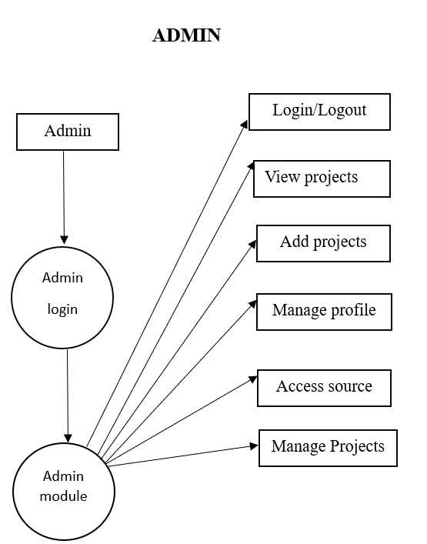
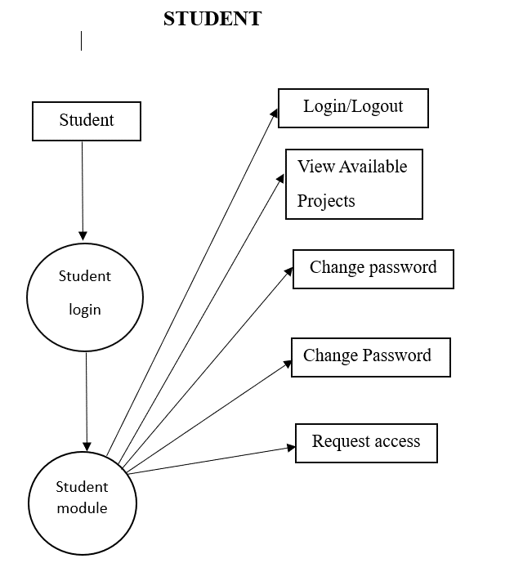
FRAME WORK
ADMIN
STUDENT

Slide 11
TECHNICAL MODULES
LOGIN PAGE
There are two login modules
1)Admin
2)Student
SIGN IN PAGE
It allows new user to create account or already existing users can sign
up with their email and password.
HOME PAGE
It allows users to view the projects in the website. The projects details can
be viewed by clicking on view details.

Slide 12
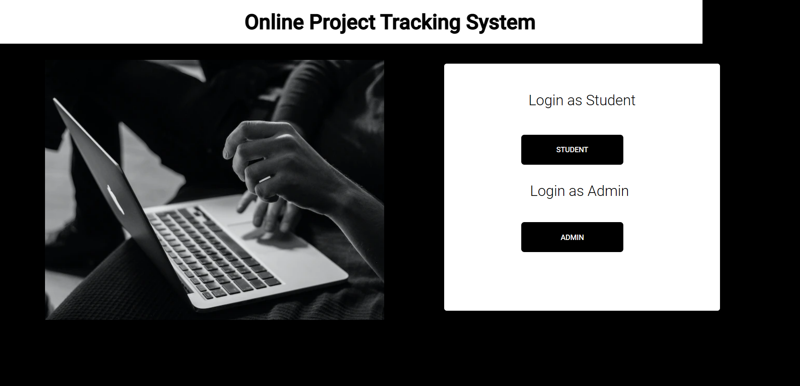
Module Description
LOGIN PAGE:
This module represents the login page.

Slide 13
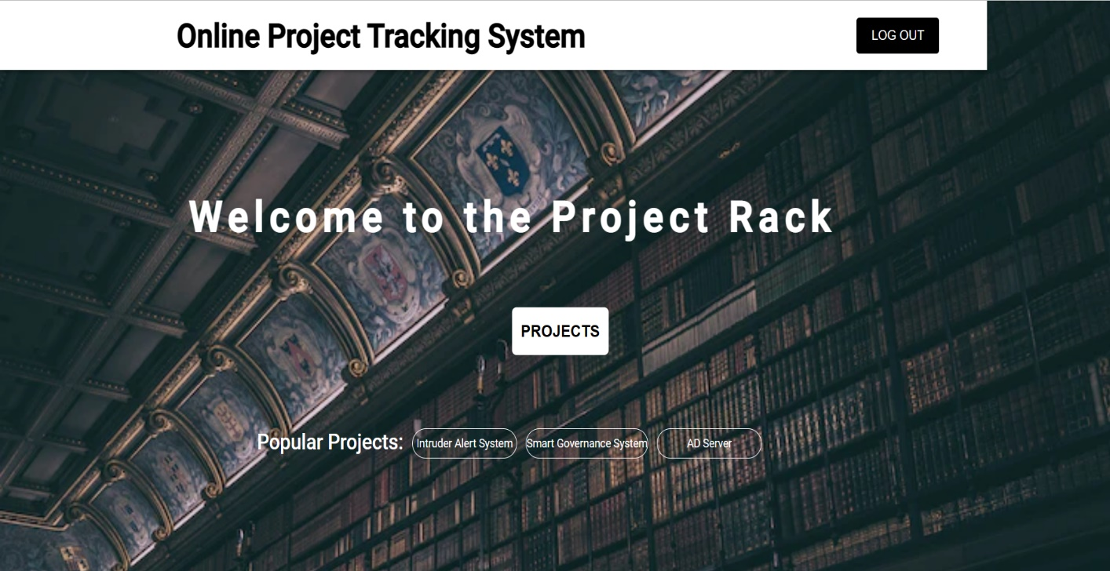
DASHBOARD:
This module represents the dashboard. User-friendly interfaces and appealing design are important components of the user experience in this application.

Slide 14
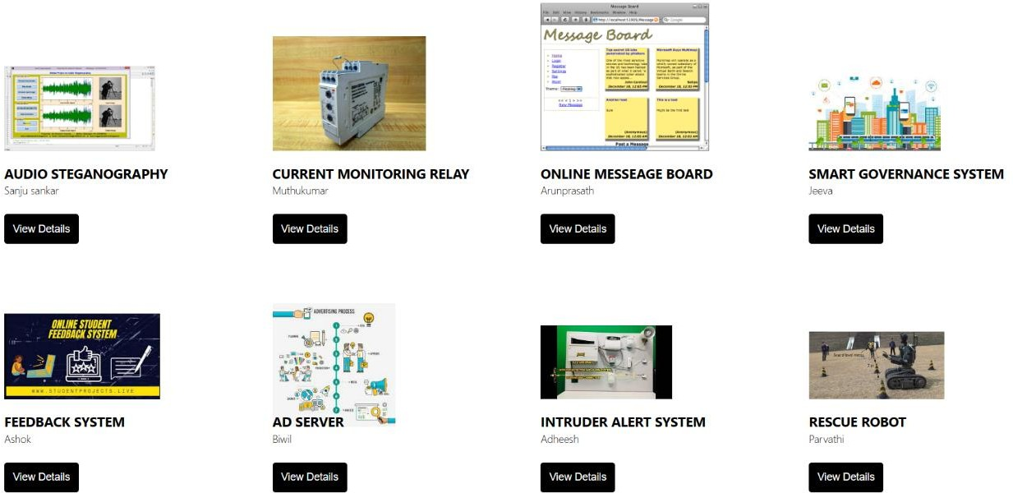
HOME PAGE
It is the main page of the application where it contains all the projects. The projects details can be displayed by using view details option.

Slide 15
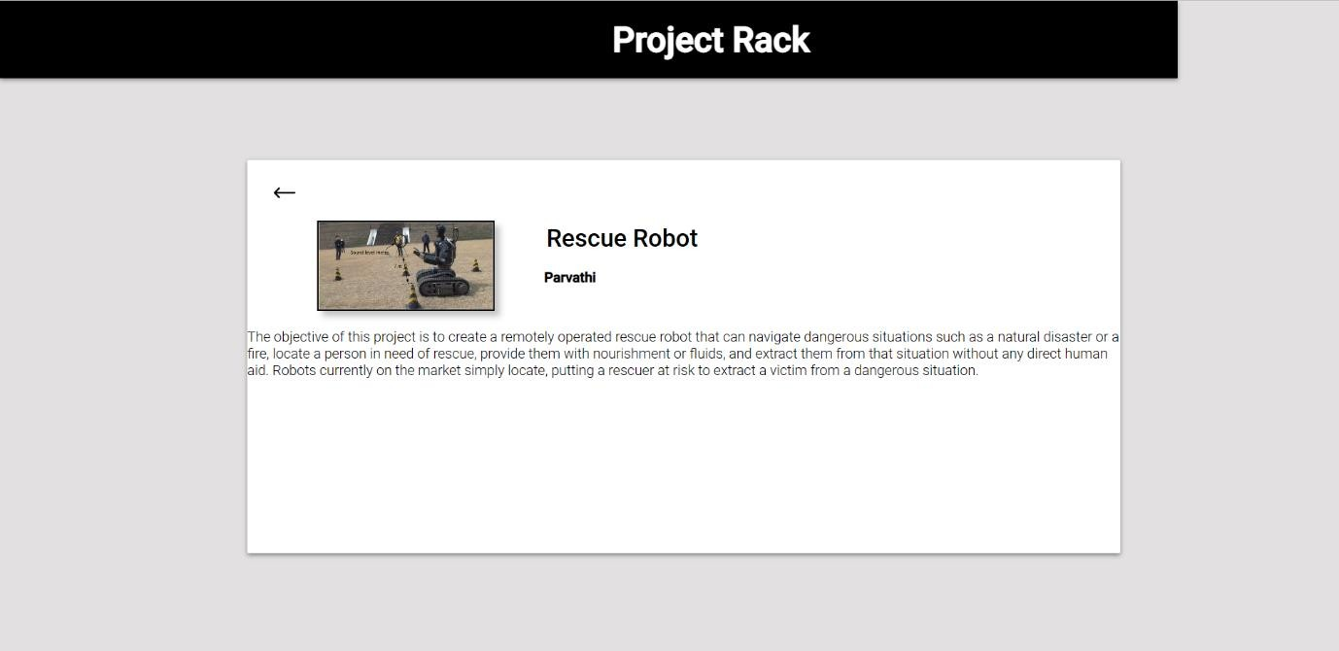
DETAILS PAGE
It shows the details of the selected projects which includes abstract and authors of the projects.

Slide 16
CONCLUSION
This website is efficient in maintaining project details and can easily view at any time. It reduces time to search a project manually.
When using this web application, it creates an easy and user-friendly platform to collaborate with one another and to get a knowledge about working in many projects and to gain an experience where efficient work progress, developing communication with fellow students and also to make every step of the projects visible to the team.

Slide 17
REFERENCES
Peerzade, S., Andewale, A., & Jamidar, S. (2023). A Web Application based Automated E-Library Management System. Journal of Web Development and Web Designing, 8(1), 34-41.W. Y. Yee, "Development of a web-based system for engineering change management", 2007
Li, F. (2022). Research On The Management System Of College Students’ Innovation And Entrepreneurship Education Based On B/S Architecture. Journal of Applied Science and Engineering, 26(5), 597-604.
Chen, F., Romano, N. C., & Nunamaker, J. F. (2006). A collaborative project management approach and a framework for its supporting systems. Journal of International Technology and Information Management (JIITM), 15(2).
Chan, S. L., & Leung, N. N. (2004). Prototype web-based construction project management system. Journal of construction engineering and management, 130(6), 935-943.

Slide 18
Cont.…
Kim, C., Jeon, J., & Kim, M. S. (2015). A project tracking system based on the PMBOK guide for student-centered learning. International Journal of Knowledge Engineering, 1(3), 185-190.
Bharamagoudar, S. R., Geeta, R. B., & Totad, S. G. (2013). Web based student information management system. International Journal of Advanced Research in Computer and Communication Engineering, 2(6), 2342-2348.
Kwak, Y. H., & Anbari, F. T. (2009). Analyzing project tracking research: Perspectives from top management journals. International journal of project management, 27(5), 435-446.
Shenhar, A. J., & Dvir, D. (2007). Project management research—The challenge and opportunity. Project management journal, 38(2), 93-99.

Slide 19
THANK YOU

