Slide 1

Predictive Analytics for NYC Taxi Trip Duration DS-670: Capstone Bigdata & Data science

Slide 2
Introduction
Objective:
Overview of the NYC taxi industry and its significance
Importance of accurate trip duration predictions for various stakeholders
Dataset source: Kaggle competition "NYC Taxi Trip Duration"
Project goal: Develop a machine learning model to predict taxi trip durations
Potential impact: Improved service efficiency and customer satisfaction
Challenges: Complex urban environment, traffic patterns, and external factors

Slide 3
Problem Statement
Primary objective:
1.Predict the duration of taxi trips in New York City
2. Build predictive models to estimate trip durations accurately.
3. Analyze influential factors like weather, trip distance, and traffic patterns
Key questions to address:
1. What factors most significantly influence trip duration?
2. How can we accurately model the relationship between these factors and trip time?
3. Can we create a robust model that generalizes well to unseen data?
Evaluation metric:
RMSE, R-squared, MAE
Additional goals:
Gain insights into NYC taxi operations and travel patterns

Slide 4
Dataset Overview
Source: 2016 NYC Yellow Cab trip record data
Features: id, vendor_id, pickup_datetime, dropoff_datetime, passenger_count, pickup_longitude, pickup_latitude, dropoff_longitude, dropoff_latitude, store_and_fwd_flag, trip_duration.
Target variable: trip_duration (in seconds)
Dataset size: 1,458,644 trip records
Time period covered: January 1 to June 30, 2016
Geographical scope: New York City's five boroughs

Slide 5
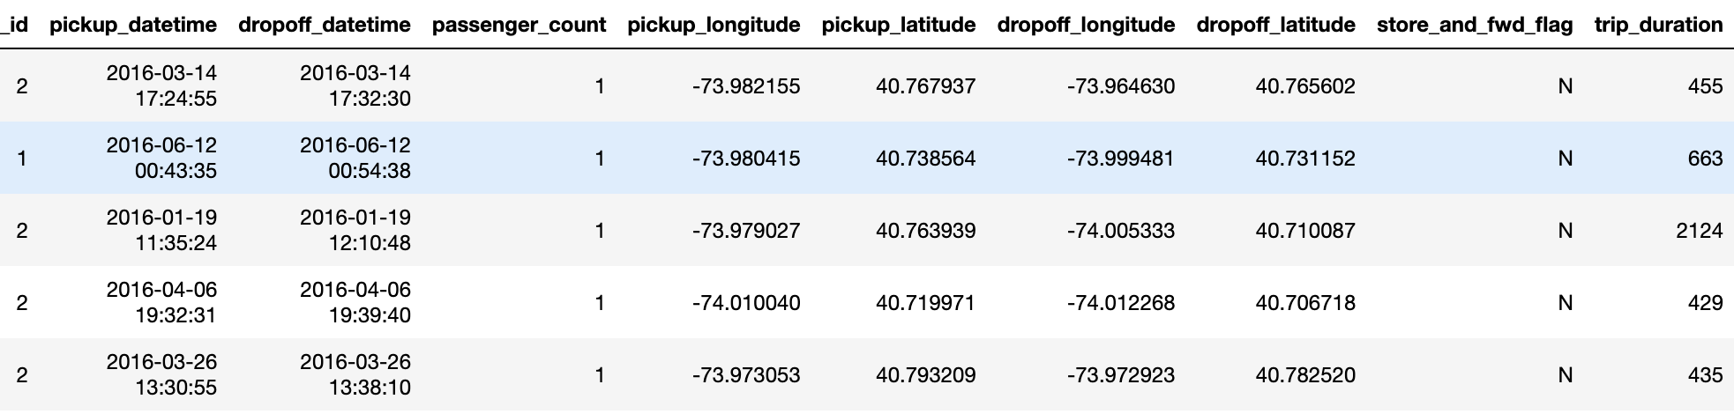

Slide 6
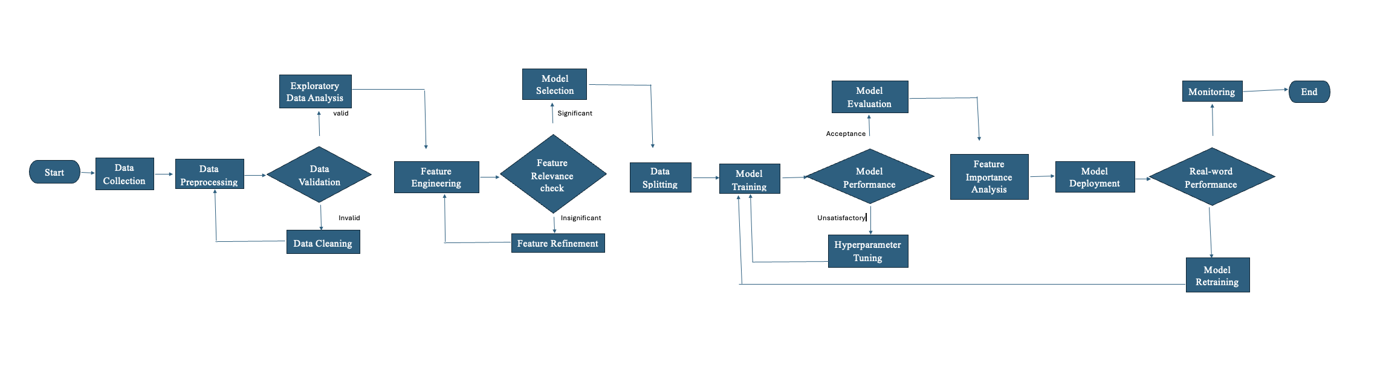
Flow Chat

Slide 7
Data Preprocessing
Handling missing values and outliers
Feature engineering: Extracting time-based features (hour, day, month, weekday)
Calculating trip distance using Haversine formula
Creating trip categories (short, medium, long) based on duration
Coordinate transformation and normalization
Encoding categorical variables (e.g., vendor_id, store_and_fwd_flag)
Splitting data into training and validation sets (80/20 ratio)

Slide 8
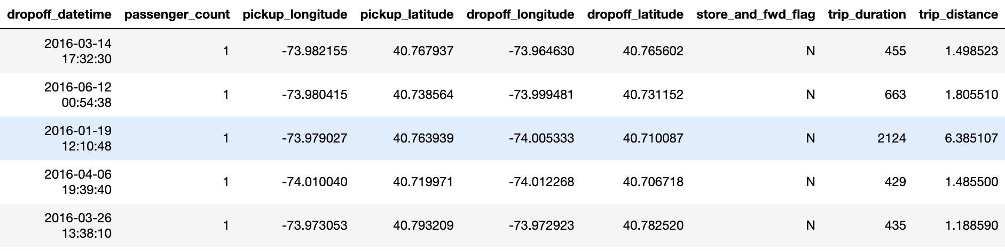

Slide 9
Exploratory Data Analysis (EDA)
Distribution of trip durations and distances
Temporal patterns: hourly, daily, and monthly trends
Geographical analysis: popular pickup/dropoff locations
Correlation analysis between features and trip duration
Passenger count impact on trip duration
Vendor comparison and performance analysis

Slide 10
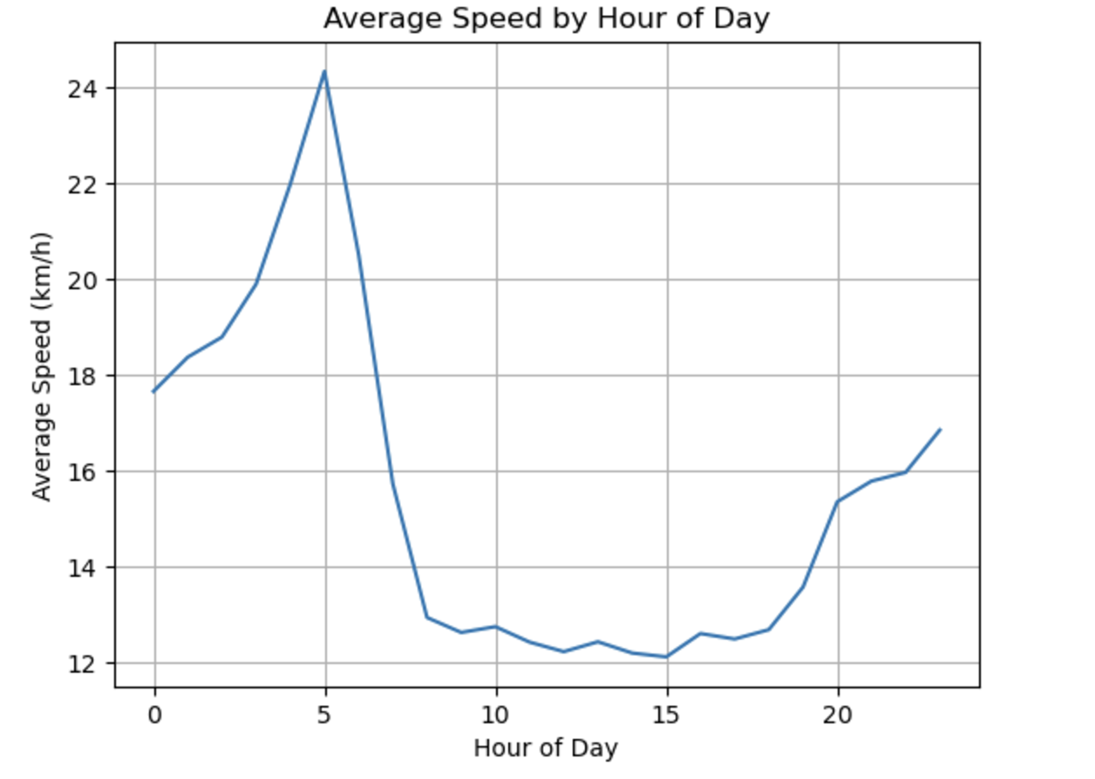

Slide 11
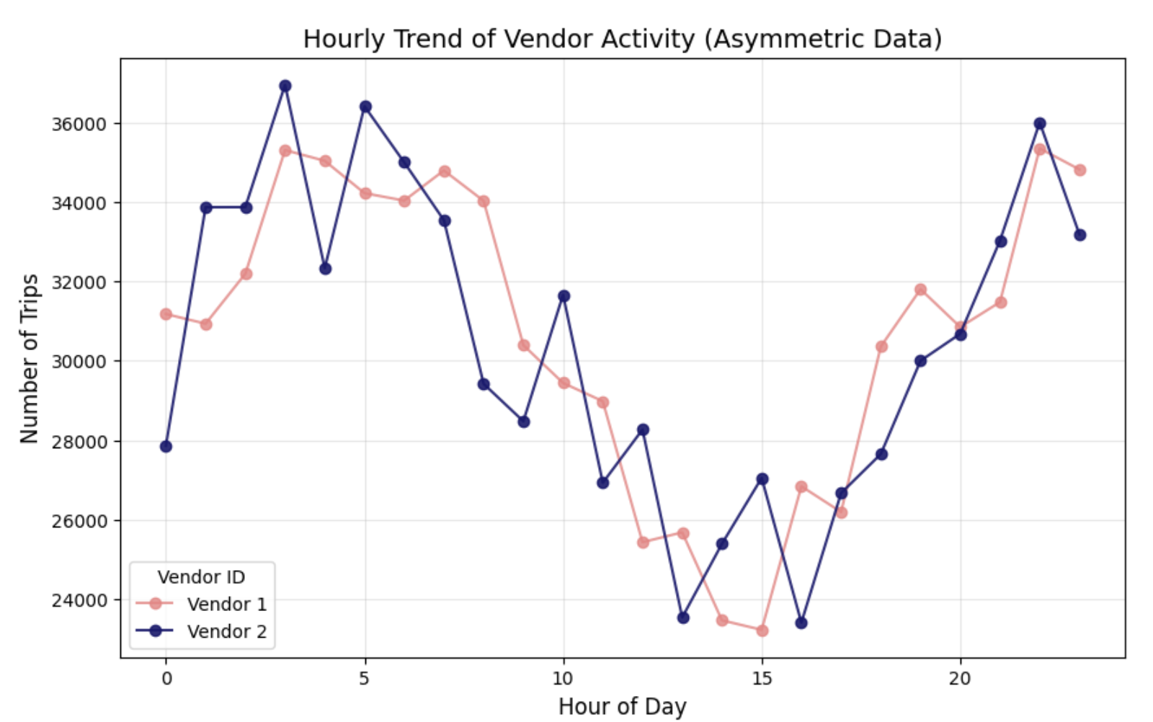
Hourly Trend of Vendor Activity

Slide 12
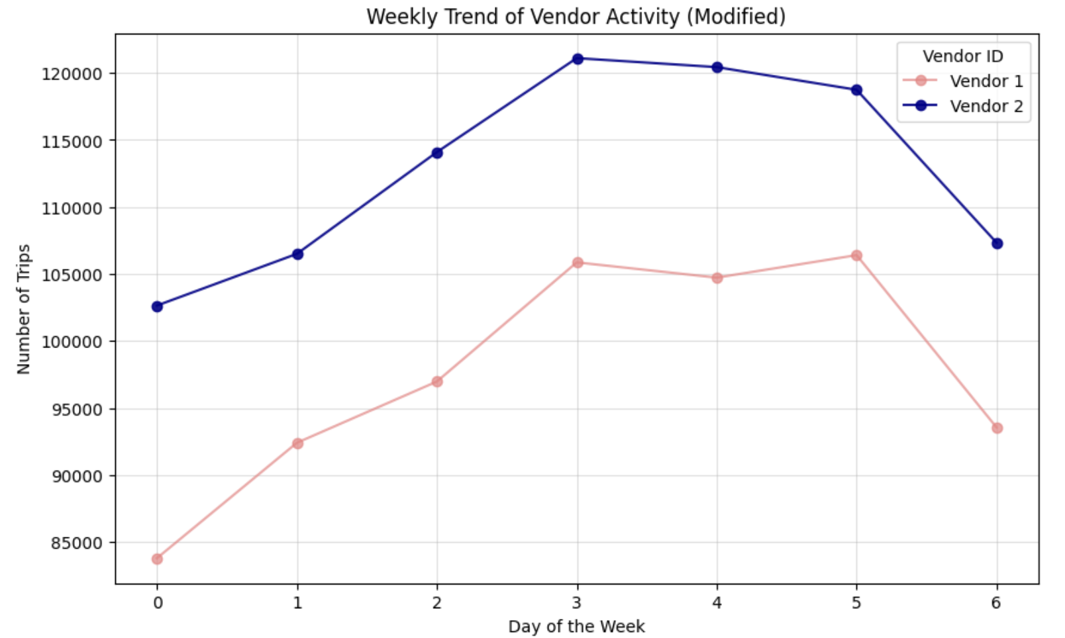
Weekly Trend of Vendor Activity

Slide 13
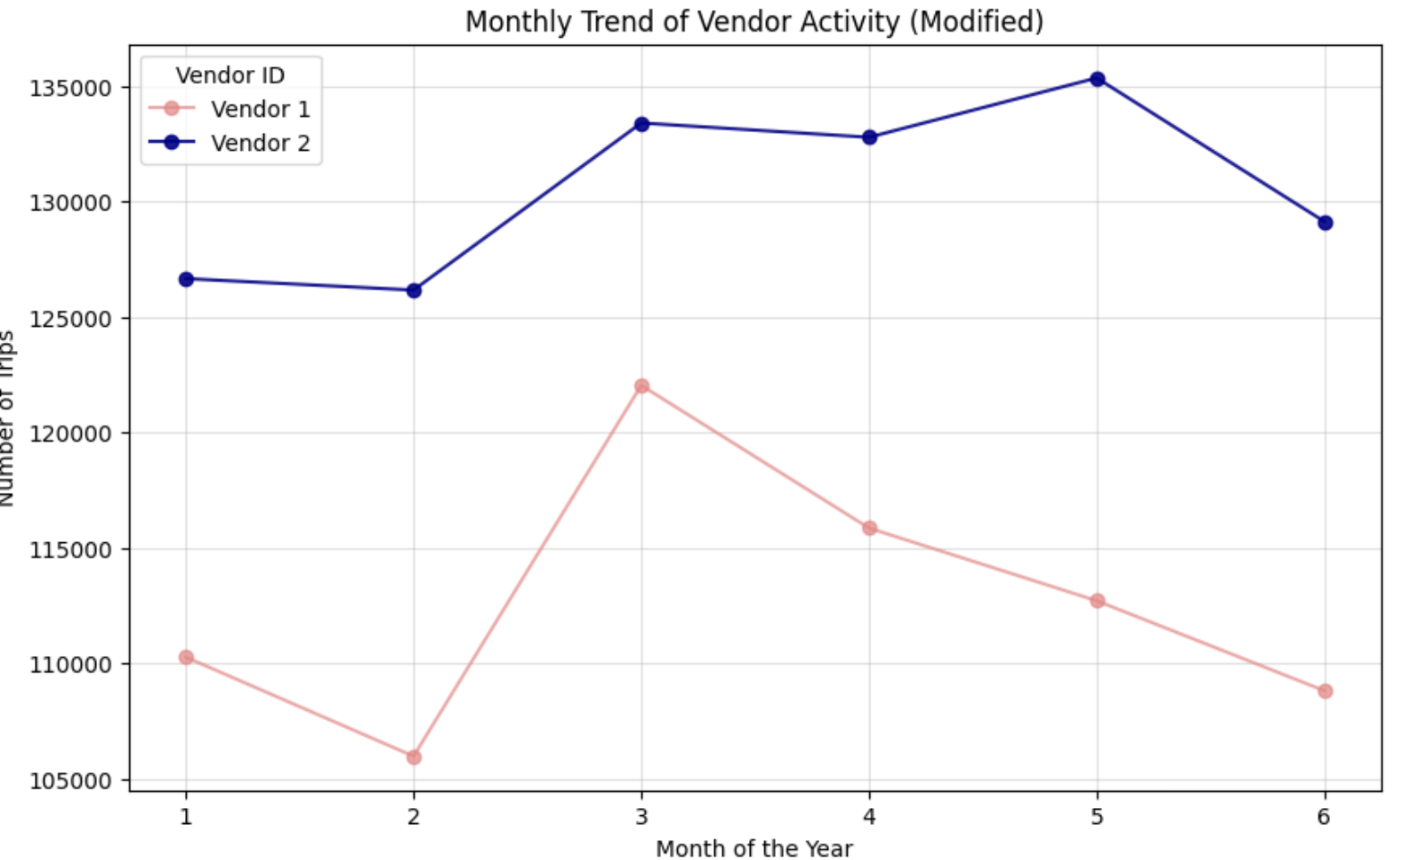
Monthly Trend of Vendor Activity

Slide 14
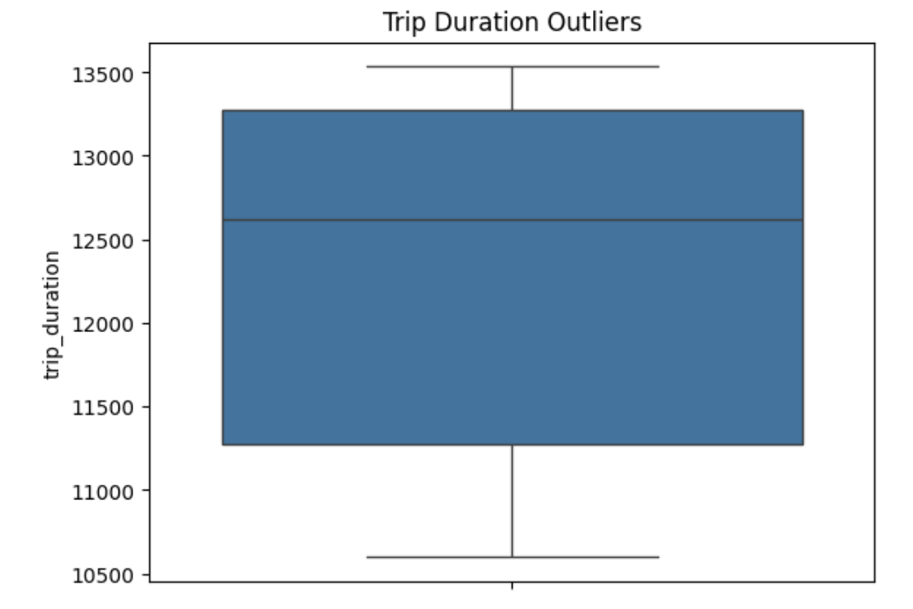
Trip Duration Outliers

Slide 15
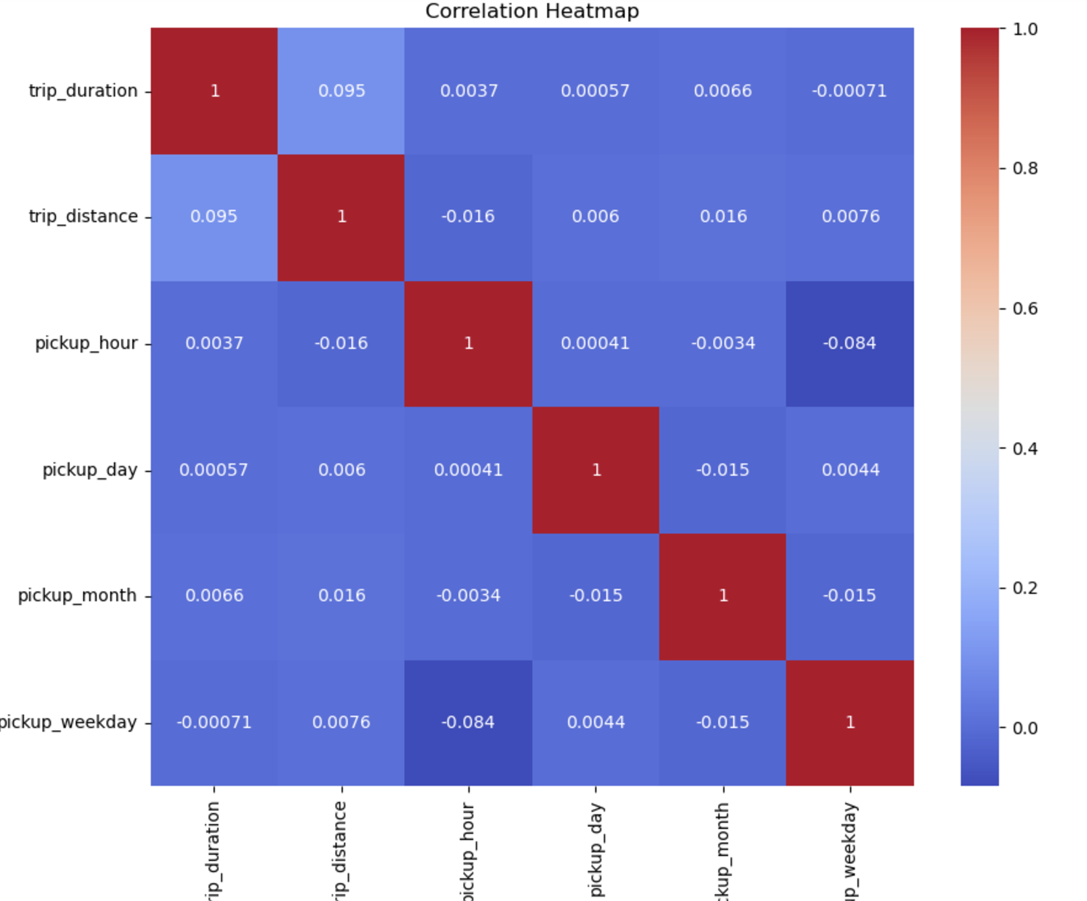

Slide 16
Feature Selection and Engineering
Importance of relevant features for prediction
Techniques used:
Correlation analysis with target variable
Feature importance from tree-based models (Random Forest)
Domain knowledge and intuition
Selected features and rationale behind each
Additional engineered features:
Time-based features (rush hour, weekend/weekday)
Geographical features (borough, neighborhood)

Slide 17
Model Selection
Comparison of various machine learning algorithms:
Linear Regression (baseline model)
Random Forest Regressor
Decision Tree
Gradient Boosting (LightGBM)
Evaluation metrics:
RMSE, R-squared, MAE
Cross-validation strategy: Time-based splitting to prevent data leakage
Hyperparameter tuning using GridSearchCV or RandomizedSearchCV

Slide 18
Model Training and Optimization
Training process for each model type
Hyperparameter optimization results
Learning curves analysis
Feature importance analysis from tree-based models
Ensemble methods: Stacking top-performing models

Slide 19
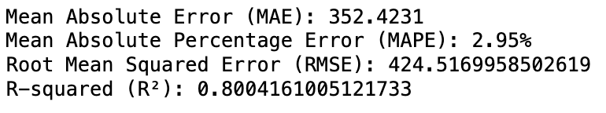
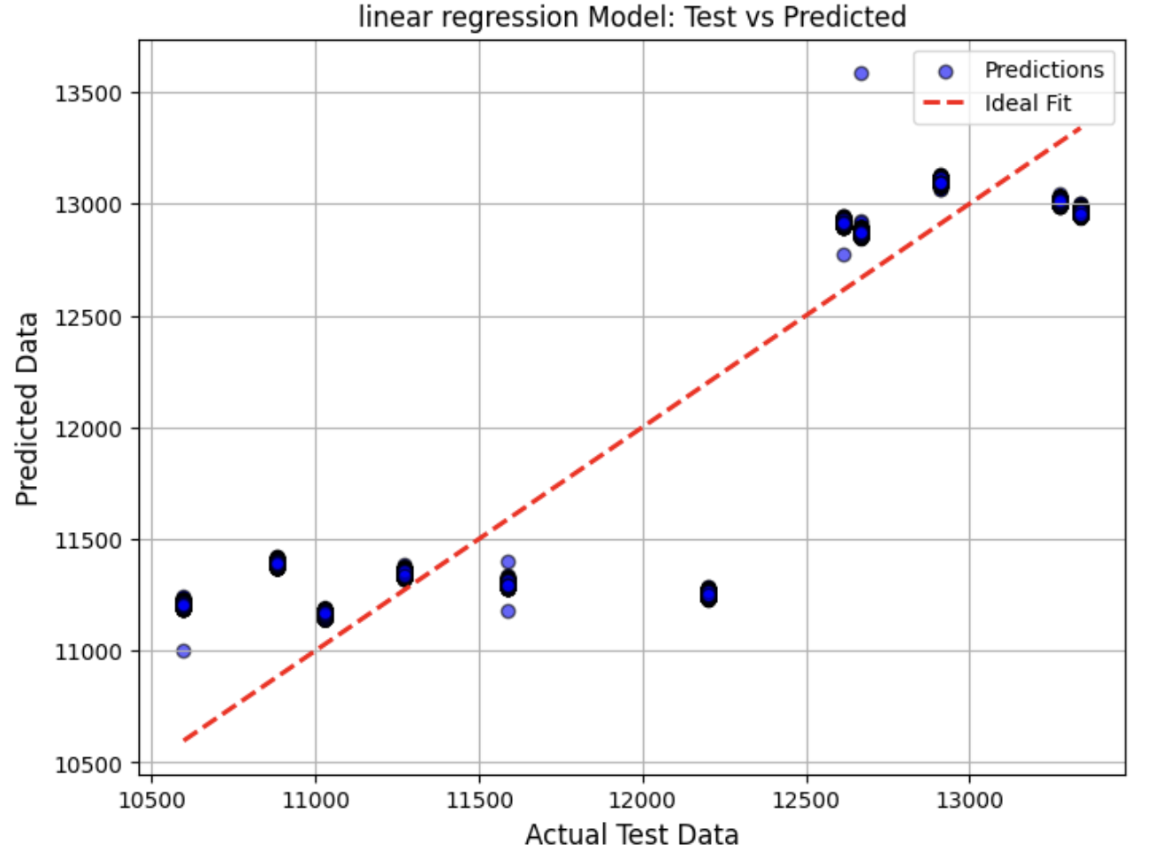
Linear Regression

Slide 20
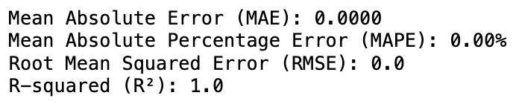
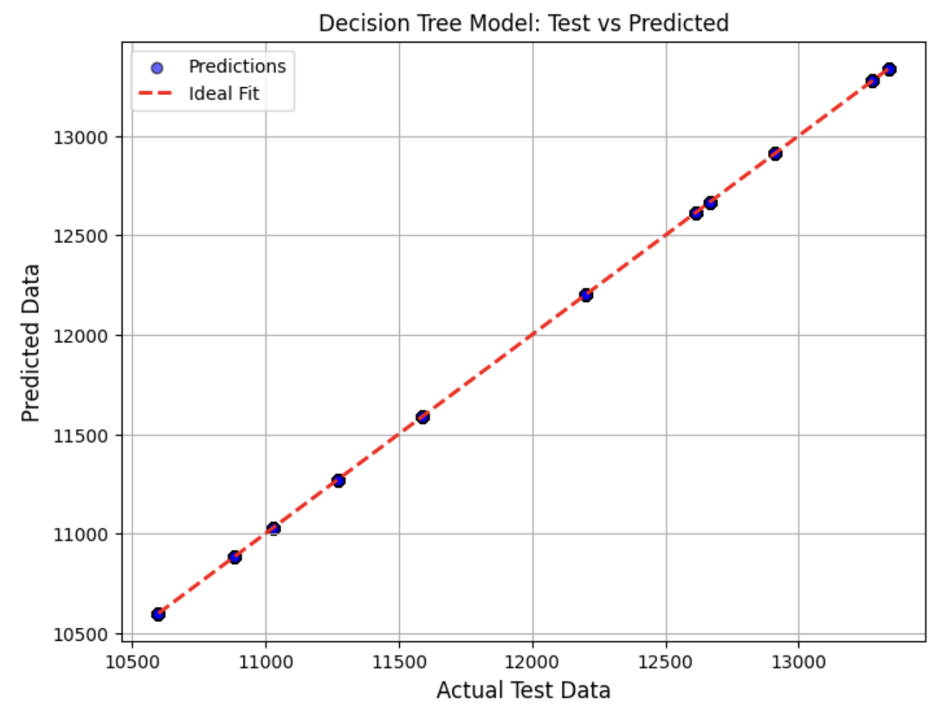
Decision Tree

Slide 21
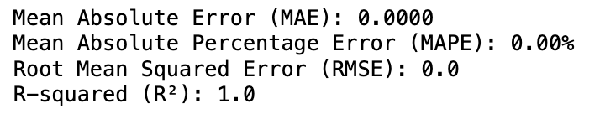
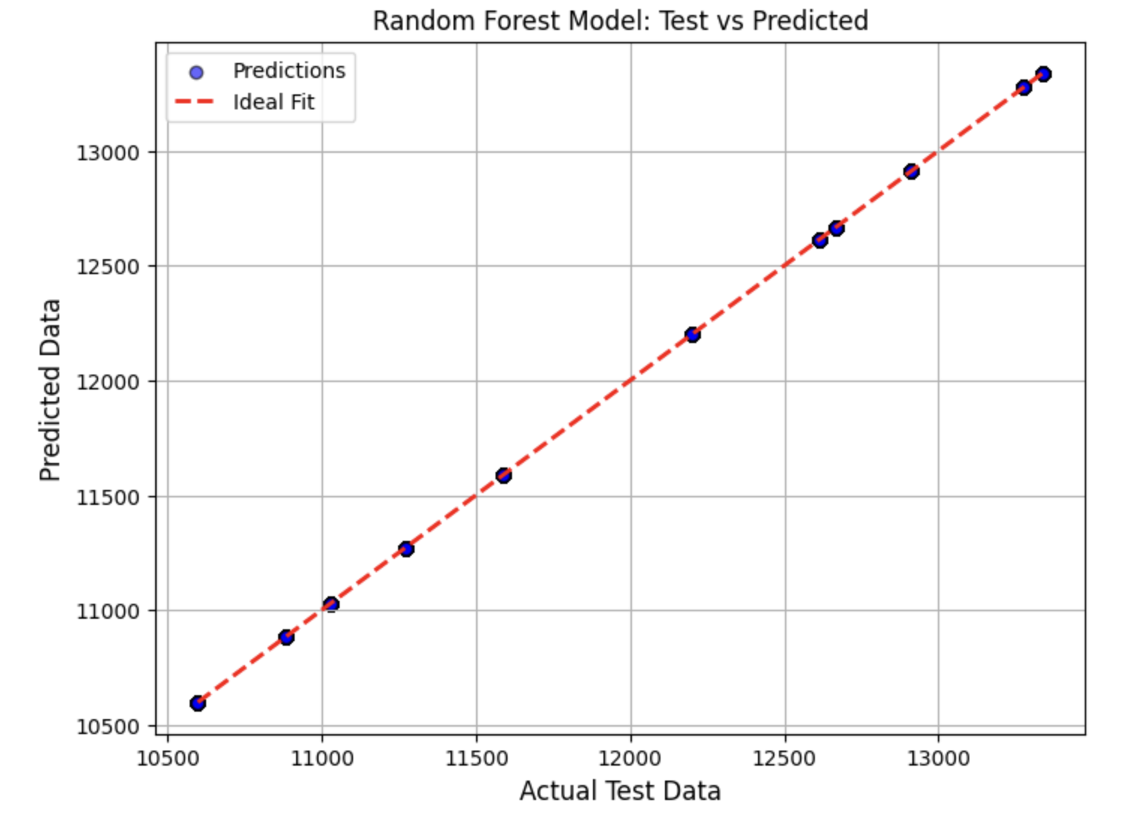
Random Forest

Slide 22
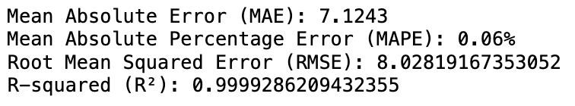
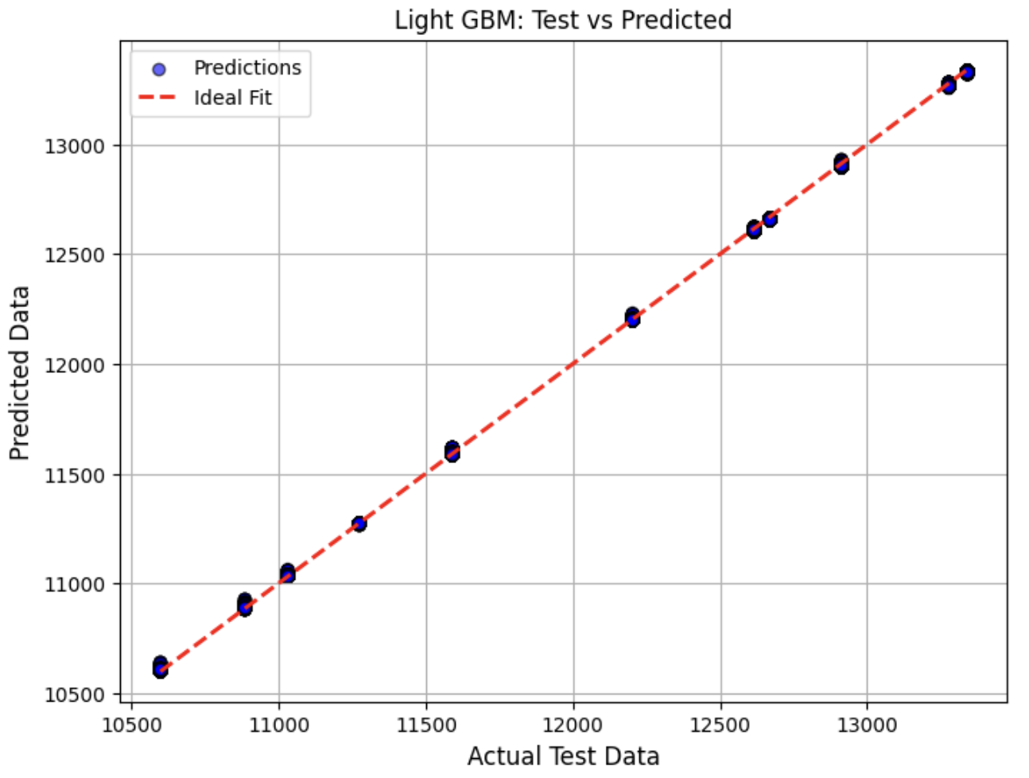
LightGBM

Slide 23
Results and Model Evaluation
Performance comparison of different models
Best model selection based on RMSE and other metrics
Analysis of prediction errors and residuals
Model interpretability: SHAP values or partial dependence plots

Slide 24
Future Work and Improvements
Incorporating additional data sources (weather, events, traffic)
Exploring advanced techniques (e.g., LSTM networks for time series)
Developing a real-time prediction system
Extending the model to other cities or transportation modes
Potential for a production-ready application or API

Slide 25
Thank You

