Slide 1
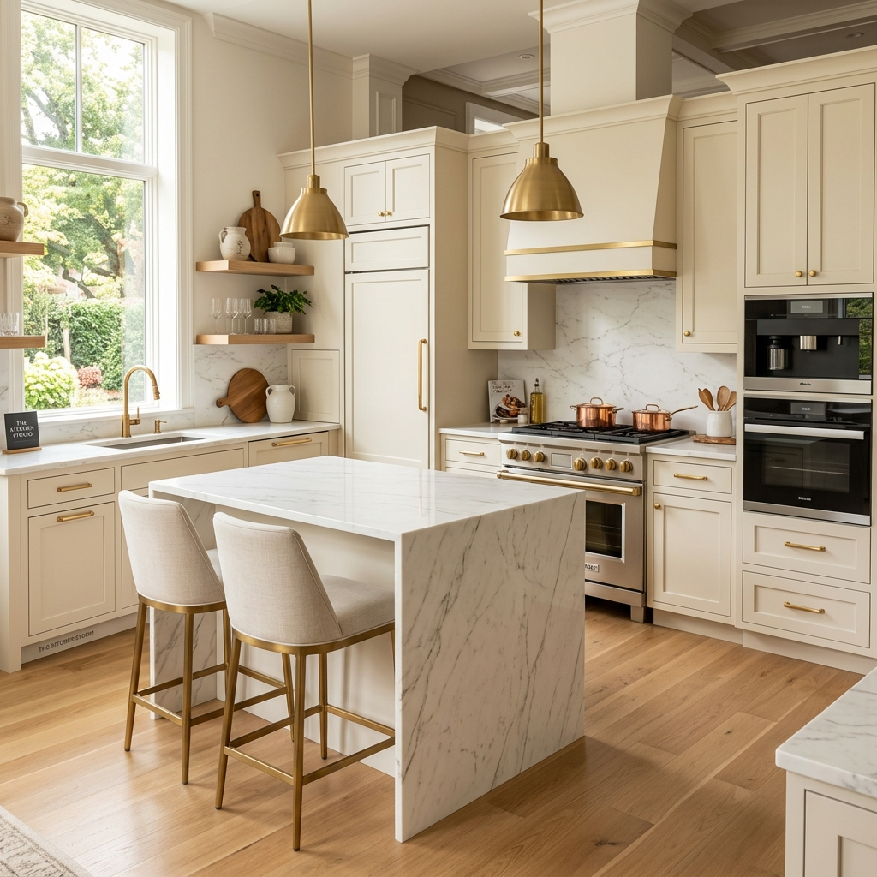

DREAMHOME
THE PINNACLE OF LUXURY KITCHENS
INVESTOR & COLLABORATION PROFILE
# 301/1, B/W 16th & 17th Cross, Sampige Road, Malleshwaram, Bangalore - 560003
Phone: 080-23344055, 9379599399 | Email: dreamhome.bengalure@gmail.com

Slide 2
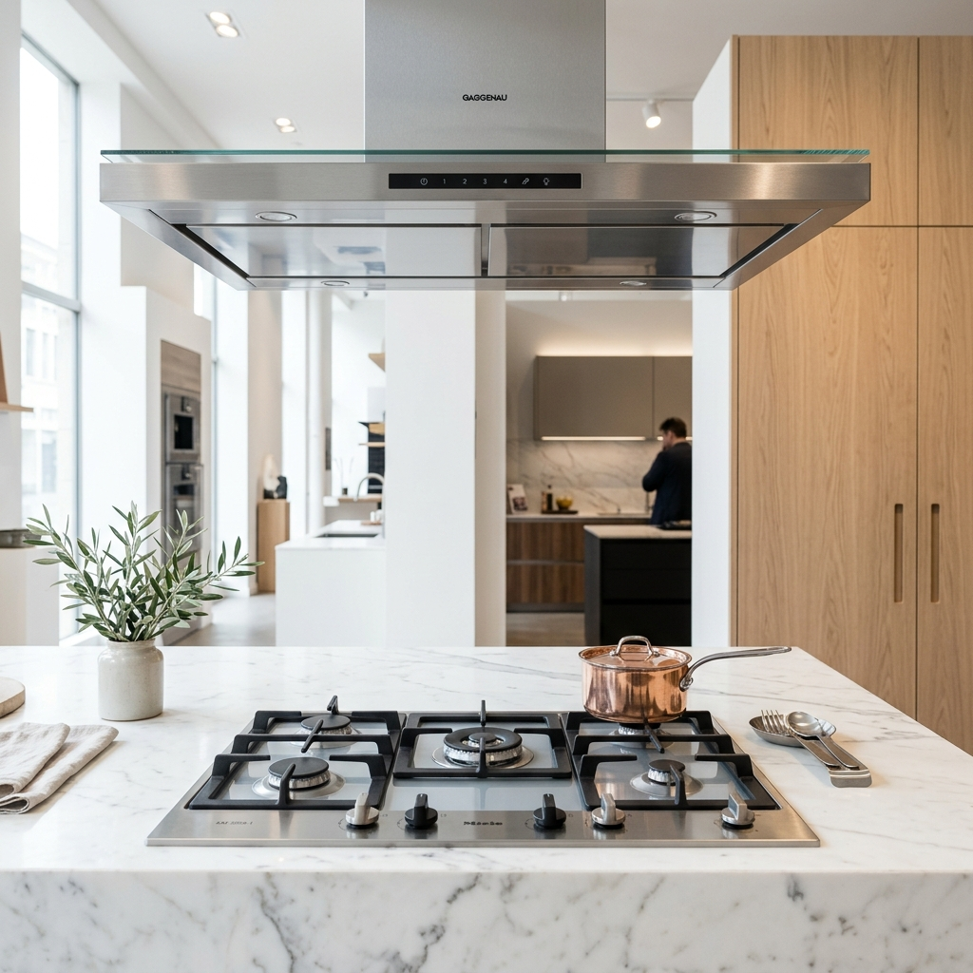
INVESTOR & COLLABORATION PROFILE
Experiential Showroom Hub
Strategic Hub: Malleshwaram prime retail node.
Elite Demographic: Serving Bangalore high-net-worth.
Live Test Labs: Active demonstrations in-store.
High Yields: ₹8L average retail ticket.

Slide 3
INVESTOR & COLLABORATION PROFILE
Elite Brand Portfolio
FABER
Italian Ventilation
ELECTROLUX
Swedish Eco Cooking
SIEMENS
German Smart Tech
BOSCH
German Laundry/Dish
KAFF
Premium Hobs/Hoods
HÄFELE
German Hardware
HINDWARE
Italian Collection
CARYSIL
Quartz Sinks
A. O. SMITH
Water Heaters/RO
ZERO B
Alkaline Purifiers
RACOLD
Thermal Heating
DAIKIN
Japanese HVAC

Slide 4
INVESTOR & COLLABORATION PROFILE
Curated Product Verticals
CULINARY
• Designer Chimneys
• Built-in Hobs
• Built-in Ovens
• Microwave Ovens
REFRIGERATION
• Built-in Cooling
• Luxury Refrigerators
• Beverage Cabinets
LAUNDRY & UTILITY
• Built-in Dishwashers
• Washing Machines
• Heat Dryers
WATER & COMFORT
• Quartz Composite Sinks
• Designer Faucets
• Water Purifiers
• Water Heaters

Slide 5
INVESTOR & COLLABORATION PROFILE
Market Potential & Traction
18%
YoY CATEGORY GROWTH
Built-in defaults: High modular kitchen upgrades.
Market speed: Strong upscale home transaction growth.
Allocated budgets: Growing premium appliance focus.
₹8L+
AVERAGE SHOWROOM TICKET

Slide 6
INVESTOR & COLLABORATION PROFILE
Collaboration Framework
Retail showcase: Global brand dealership margins.
Capital JVs: Scaling showroom cabinetry expansions.
Designer network: Referral program for architects.
Bulk builders: Developer pre-install kitchen packs.

Slide 7
INVESTOR & COLLABORATION PROFILE
Showroom Gallery
Left: Sunlit Custom Showroom Concept | Right: Premium Built-In Hob & Chimney Display Workspace

Slide 8
INVESTOR & COLLABORATION PROFILE
Initiate Collaboration
LET'S BUILD TOGETHER
We welcome brands, designers, and developers to schedule a private showroom walkthrough or margin review.
Connect with us to explore floorplans, margin structures, and dealer frameworks.
Address: # 301/1, B/W 16th & 17th Cross, Sampige Road, Malleshwaram, Bangalore - 560003.
Store Contact: 080-23344055 | +91 93795 99399.
Corporate Email: dreamhome.bengalure@gmail.com.

