Slide 1
Real Time Project
Unemployment Analysis
Name: Akshay Kumar
Roll No:22J41A67J5

Slide 2
1.Introduction to Unemployment Analysis
Unemployment analysis is crucial for understanding the state of the job market and economic health.
It helps policymakers, businesses, and individuals make informed decisions.
Utilizing technology in unemployment analysis can enhance accuracy and efficiency.
Notes:
Image source: https://mint.intuit.com/blog/unemployment/understanding-the-main-types-of-unemployment/

Slide 3
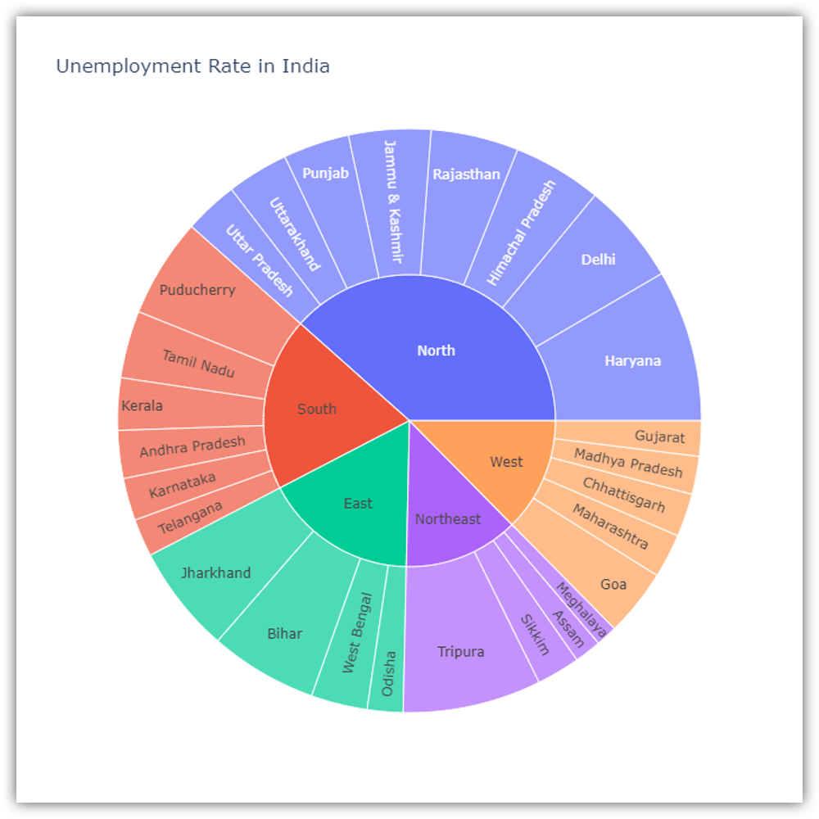
2.Big Data in Unemployment Analysis
Big data allows for the analysis of vast amounts of real-time employment data.
It enables the identification of correlations and patterns that may not be apparent with traditional methods.
Big data analytics can help forecast future labor market trends and inform policy decisions.
Notes:
Image source: https://thecleverprogrammer.com/2021/07/12/unemployment-analysis-with-python/

Slide 4
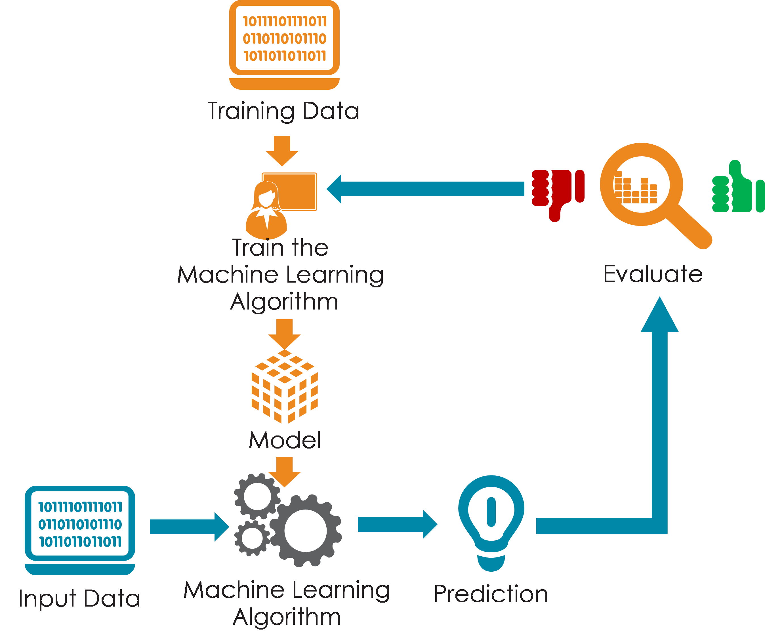
3.Artificial Intelligence (AI) in Unemployment Analysis
AI algorithms can analyze complex employment data sets quickly and accurately.
AI-powered chatbots and virtual assistants can provide real-time unemployment information to users.
Notes:
Image source: https://www.slidemake.com/presentation/role-of-ai-in-building-the-future-guidelines-problem-statment,solution,application,cost-estimations-6501c0720ebd7d73e6e96c98

Slide 5
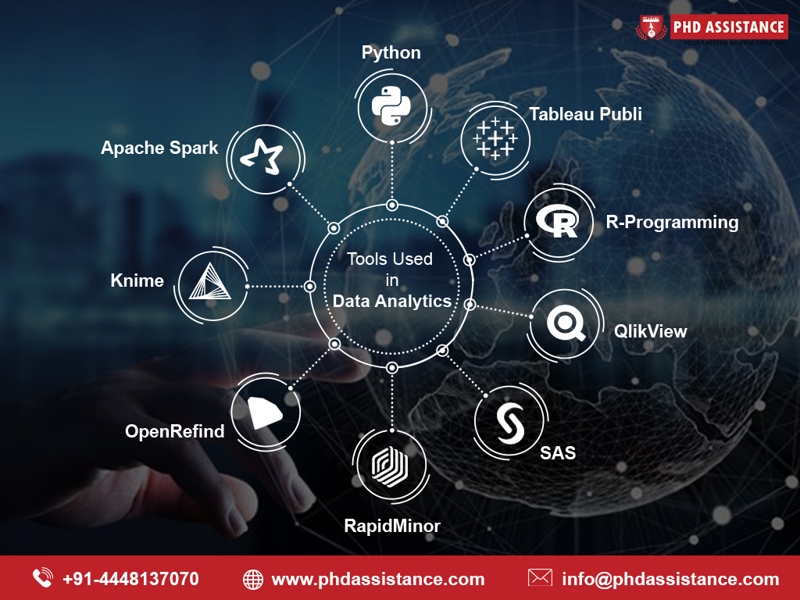
4.Technologies Utilized in Unemployment Analysis
Data analytics tools for processing and analyzing large datasets of employment data.
Machine learning algorithms for predicting future unemployment trends based on historical data.
Geographic information systems (GIS) for mapping and visualizing regional unemployment rates.
Python libraries : Pandas, NumPy and Matplotlib
Notes:
Image source: https://www.phdassistance.com/blog/what-are-the-different-fields-in-data-analytics/

Slide 6
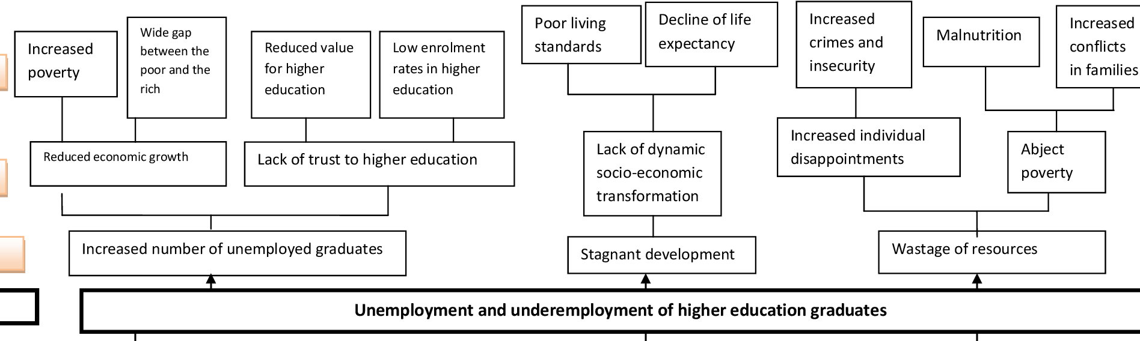
5.Advantages of Unemployment Analysis
Identifying trends and patterns in unemployment rates over time.
Assessing the impact of economic policies on job creation and labor force participation.
Providing insights into disparities in unemployment rates across different demographics.
Notes:
Image source: https://www.semanticscholar.org/paper/Usefulness-of-problem-tree,-objective-tree-and-to-Ndayambaje-Ntawiha/8d0c2d6530800e8283ad7c81206b77049929f7bf/figure/2

Slide 7
6.Predictive Analytics in Unemployment Analysis
Predictive analytics models can forecast future unemployment rates based on historical data and external factors.
These models can help policymakers and businesses anticipate labor market trends and plan accordingly.
Utilizing predictive analytics can improve decision-making and reduce the impact of sudden shifts in the job market.
Challenges in Unemployment Analysis
Data accuracy and reliability issues can affect the validity of unemployment analysis results.
Ensuring data privacy and security when handling sensitive employment information.
Notes:
Image source: https://fity.club/lists/suggestions/predictive-analysis/

Slide 8
Conclusion
Advancements in technology offer new opportunities for enhancing unemployment analysis.
By leveraging big data, AI, and predictive analytics, stakeholders can gain deeper insights into the job market.
It is essential to address challenges and ensure ethical use of technology in unemployment analysis for informed decision-making.
Notes:
Image source: https://datasciencedojo.com/blog/ai-and-machine-learning-trends/

