Slide 1
CSE512
Machine Learning
Project Presentation
Learning Cognitive states using Brain fMRI
Sriganesh N(109928706)
Vasudev B(110166551)

Slide 2
Motivation and Objective
OBJECTIVE:
Identify subject’s cognitive state - i.e. whether they are viewing an image or sentence - based on fMRI images
MOTIVATION:
Less Amount of Preprocessing. High Dimensional data. [Feature Selection]. Learn different algorithms based on different assumptions. Comparative study between these algorithms.
Notes:
Concentrate more on algorihtm implementation

Slide 3
Dataset
Dataset consists of 54 trials.
During each trial the subject is shown two stimuli - an image and a sentence .
fMRI images captures the blood-oxygen level of specific regions of the brain.
Each image contains ~5000 voxels.
Notes:
Each trial lasts ~27 seconds and fMRI images are sampled twice per second, i.e. 54 images
- each for a period of 4 seconds - with a four second gap between.

Slide 4
Feature Selection (Voxels)
Two selection criteria were used to restrict the features:
Voxels based on ROI (Regions of Interest)
Filter the voxels belonging to specific anatomic regions of interest. [Domain Knowledge]
Select 7 ROIs best suited to distinguish the cognitive state of the subject.
This reduced the set of features to ~1700.

Slide 5
Feature Selection(Voxels)
n-most active voxels
Perform t-test to compare activity between class stimulus and the rest period.
Top 100, 200, 300, 400 and 500 voxels are selected.
Perform pairwise-time averaging between adjacent fMRI-samples to reduce noise in the data.

Slide 6
Classifiers Used
Gaussian Naive Bayes [Conditional Independence]
Bayesian Networks [Conditional Dependence]
Tree Augmented Naive Bayes [TAN]
k-dependence TAN.
Based on different similarity measures between features
Linear SVM (LibLinear) [High Dim - Linear Kernel SVM]
k-NN [Distance based similarity measure]

Slide 7
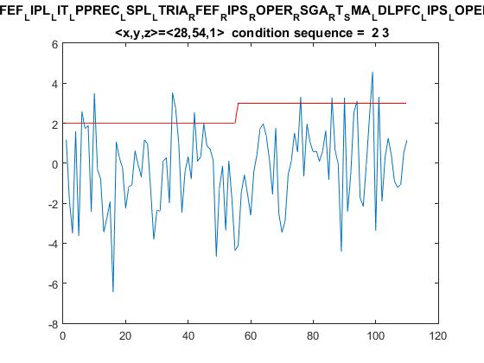
Why GNB?
Classify- assuming each feature contributes independently of each other. [Conditional Independence assumption.]
Continuous Data.
Simple Assumption: Features follow a Gaussian distribution.

Slide 8
TAN and KD-BN
Relaxed conditional independence.
Relation between features are characterised by conditional mutual info gain [Correlation coefficient]
3 phase:
Pre-Processing [Estimate relation between features]
Structural Learning [Produce dependency structure]
Inference [Predict based on dependency structure]

Slide 9







Structure Learning, Parameter Estimation
Information Gain ->
Correlation Coefficient
Likelihood of tree|data
Inference
Recomputed Mean
Recomputed Variance
Weighted difference (Beta)

Slide 10
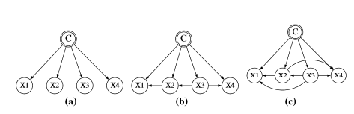
BN Structures
Naive Bayes
Tree Augmented Naive Bayes
k-Dependency Bayesian Network

Slide 11
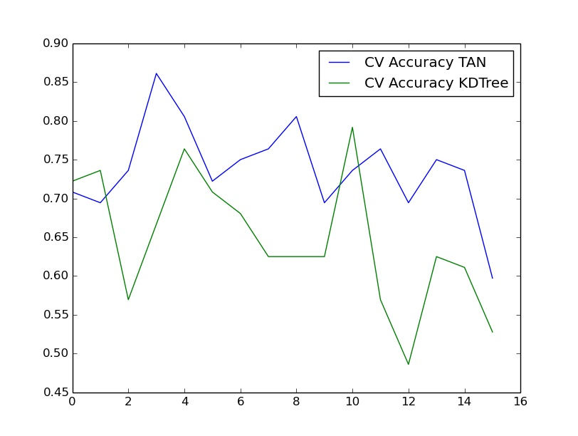
TAN Cross Validation Results
Feature Selection: Active 100
TAN Average Accuracy: 0.738
k-DB Average Accuracy: 0.645
Notes:
Average Accuracy Score for TAN: 0.738715277778
Average Accuracy Score for KDTAN: 0.645833333333

Slide 12
TAN
As expected, it performs better than SVM and GNB.
Test accuracies:
 | Selected ROIs | Active 100 | Active 200 | Active 300 | Active 400 | Active 500
TAN | 0.539 | 0.757 | 0.804 | 0.820 | 0.882 | 0.859
kDB | 0.578 | 0.632 | 0.787 | 0.855 | 0.863 | 0.852
GNB | 0.57 | 0.70 | 0.79 | 0.82 | 0.79 | 0.82

Slide 13
Why kNN?
Captures Similarity in terms of distance measure.
Highly varied performance.
Test Accuracy:
Based on ROIs: 0.5
Based on Active Voxels: 0.75 - 0.9
Performance significantly improves after reducing dimensionality.
k-nn is susceptible to irrelevant features. [Noise]

Slide 14
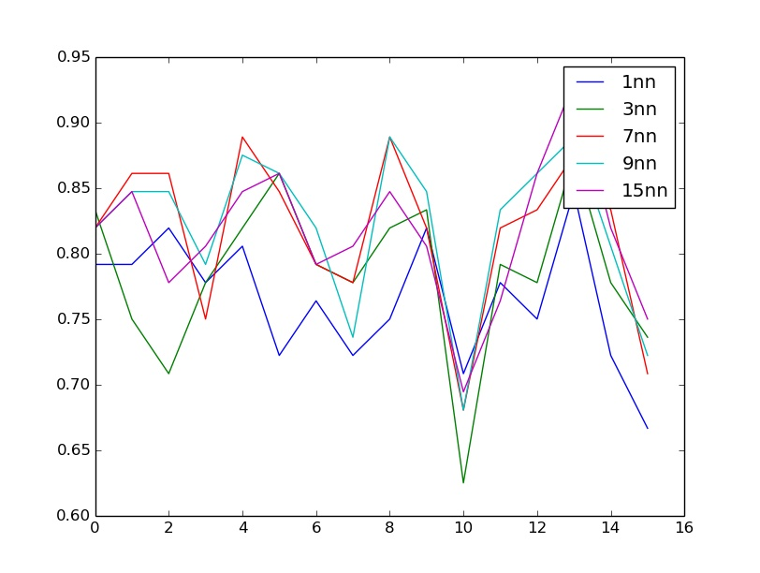
k-NN Cross Validation Results
Feature Selection: Active 100
Cross Validation Average Accuracy Score for:
1nn: 0.7482
3nn: 0.7803
7nn: 0.8029
9nn: 0.8098
15nn: 0.8211

Slide 15
k-NN Test Results
 | Selected ROIs | Active 100 | Active 200 | Active 300 | Active 400 | Active 500
1NN | 0.534 | 0.764 | 0.969 | 0.964 | 0.967 | 0.968
3NN | 0.547 | 0.784 | 0.955 | 0.960 | 0.963 | 0.961
7NN |  | 0.815 | 0.937 | 0.934 | 0.934 | 0.947
9NN |  | 0.82 | 0.930 | 0.925 | 0.928 | 0.936
15NN |  | 0.814 | 0.912 | 0.917 | 0.905 | 0.922

Slide 16
Why SVM?
High-dimensional data
Captures similarity between voxels (Linear Kernel)
Similarity only near the support vectors.
Test accuracies:
 | Selected ROIs | Active 100 | Active 200 | Active 300 | Active 400 | Active 500
SVM | 0.601 | 0.679 | 0.757 | 0.83 | 0.828 | 0.812

Slide 17
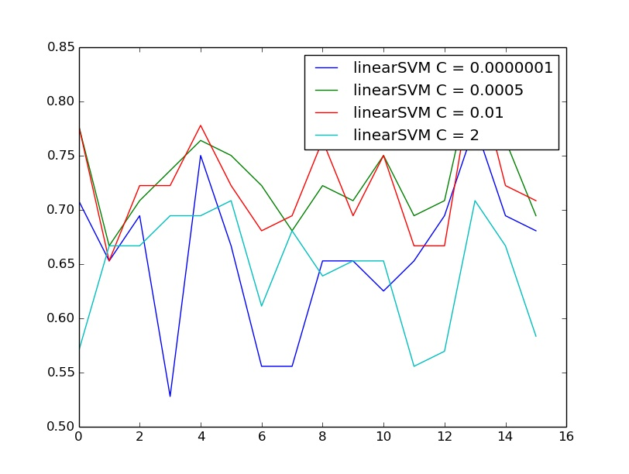
Linear SVM Cross Validation Results
Feature Selection: Active 100
Cross Validation Average Accuracy
C = 0.0000001 | 0.658
C = 0.0005 | 0.730
C = 0.01 | 0.722
C = 2 | 0.644
Notes:
SVM
0.601
0.679
0.757
0.83
0.828
0.812

Slide 18
Conclusions/Learnings/Next Steps
Used different learning algorithms based on the nature of the data.
Capturing dependency between features contribute to increase performance in classification.
Study - how to reduce the effect of noise in the dependency structure.
Decrease the computational complexity of the algorithm [maximum spanning tree and DAG formation].

