Slide 1

Java SE cont.
Presented By – Srigowri N
23rd May 2025

Slide 2
Agenda
Inner Classes
Formatting and Regex
Using Streams for I/O
Exception Handling

Slide 3
Inner Classes
An inner class (or nested class) is a class defined inside another class. It helps in logically grouping classes, improves encapsulation, and can access outer class members (even private ones).
Inner class types:
Non static (Member) Inner class
Static Inner class
Local Inner class
Anonymous Inner class

Slide 4
Member Inner Class
It can access any instance variables and other members of the outer class.
Like any other instance variable, we can have access modifier private, protected, public, and default modifier.
Inner class is implicitly associated with the object of its outer class and hence the inner class couldn't define a static method.
But Since JAVA Version 16 we can have static members in the inner class.
Like class, an interface can also be nested and can have access specifiers.
Uses: Event handling, helper classes.

Slide 5
2. Static Inner Class
Static Inner Classes are like a static members of outer class.
Defined with static and cannot access non-static outer class members.
Creating an instance of the inner class does not require an instance of the outer class to exist.
Uses: Utility classes, grouping related logic.

Slide 6
3. Local Inner Class
Defined inside a method/block. Only accessible within that method.
Method Local inner classes cannot use a local variable of the outer method until that local variable is declared as final.
Local inner class cannot access non-final local variable till JDK 1.7. Since JDK 1.8, it is possible to access the non-final local variable in method local inner class.
Method local inner class can’t be marked as private, protected or static but can be marked as abstract and final, but not both at the same time.
Uses: method-specific logic.

Slide 7
4. Anonymous Inner Class
Anonymous inner classes are declared without any name at all. They are created in two ways.
  As a subclass of the specified type
  As an implementer of the specified interface.
Cannot have a constructor.
Uses: Overriding methods on-the-fly, (e.g., GUI listeners Button.setOnClickListener() in Android).

Slide 8

Formatting and Regex
Java provides several ways to format strings:
String.format()
System.out.printf()
Format classes
Regular Expressions

Slide 9
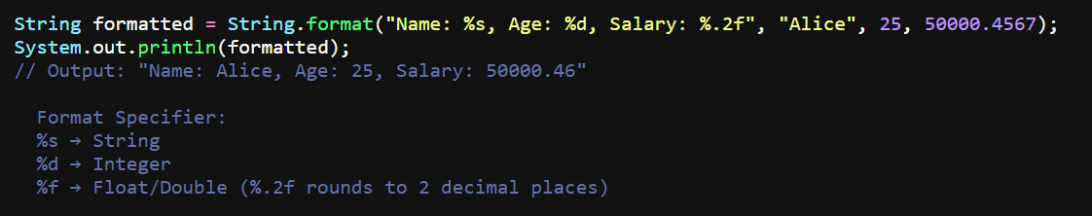
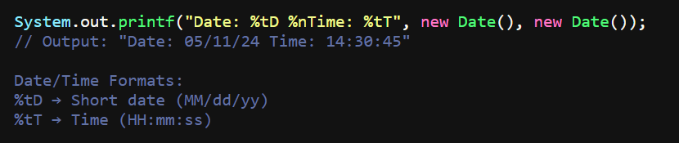
Using String.format()
2. Using System.out.printf()

Slide 10
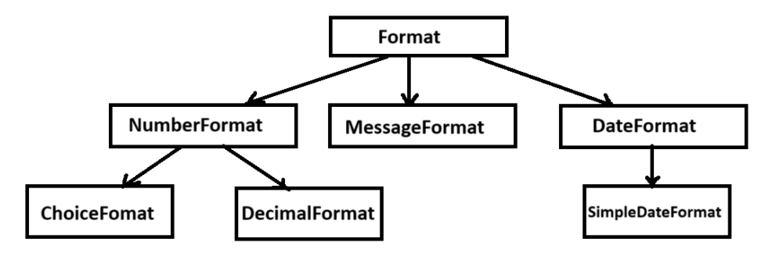
3. Format Classes - java.text.Format
In Java, the Format class serves as an abstract base class for formatting locale-sensitive data, such as dates, numbers, and messages. It provides a foundation for converting objects into strings and parsing strings back into objects.
Format is an abstract base class defines the basic API for formatting. Number format, Date Format are the two abstract sub classes and Message format is a concrete subclass that extends Format class.
When use Format classes?
When formatting large text blocks (e.g., logs, CSV files).
2) When you need to write formatted output directly to a file or stream.

Slide 11
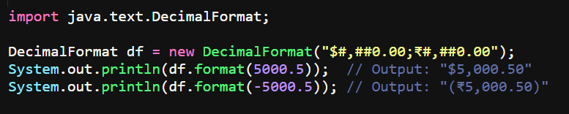
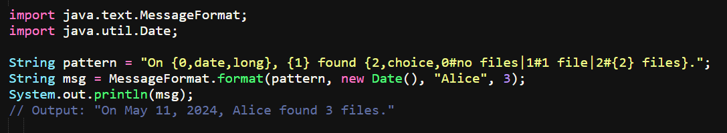
Using DecimalFormat()
b. Using MessageFormat()

Slide 12
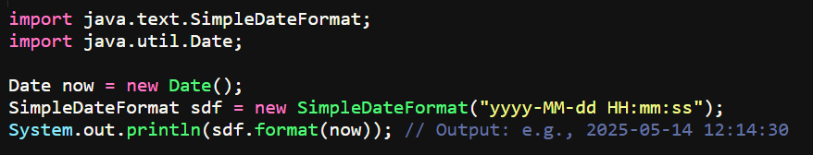
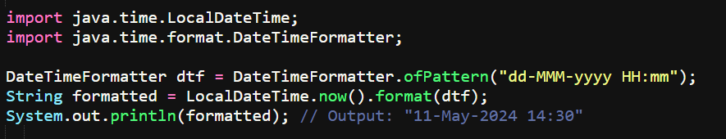
c. Using SimpleDateFormat()
d. Using DateTimeFormat()

Slide 13
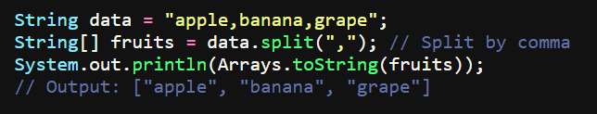
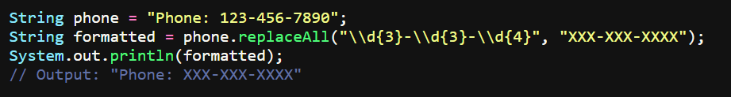
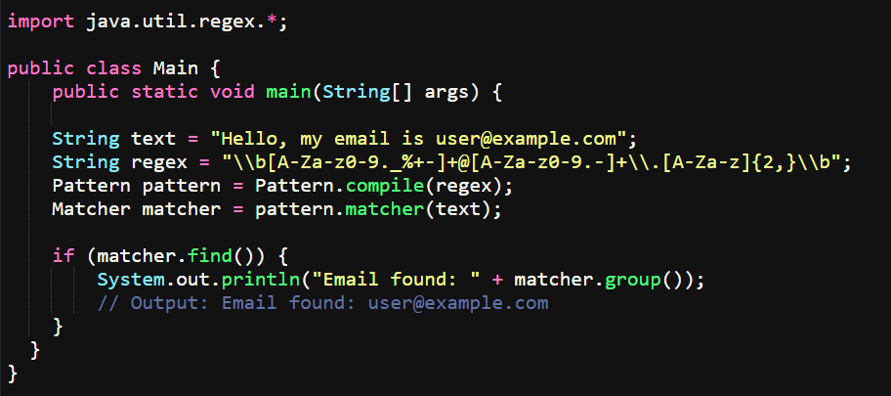
4. Regular Expression and Pattern matching

Slide 14
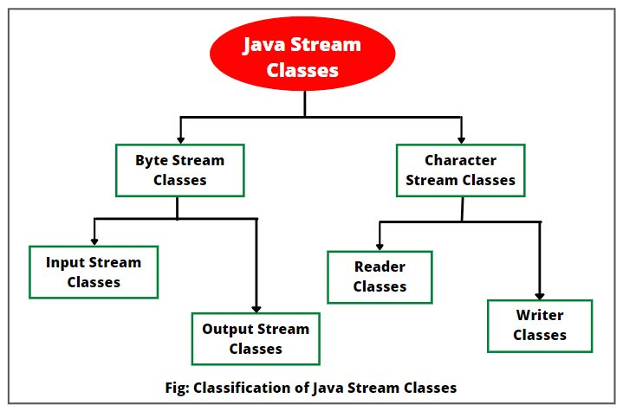
Streams I/O
Java I/O streams facilitate reading and writing data to various sources and destinations, such as files, network connections, and memory.
They are categorized into byte streams (for binary data) and character streams (for text data).

Slide 15
Streams I/O Types:
A. Byte Streams
Operate on individual bytes. Works on all files.
FileInputStream / FileOutputStream: Read/write bytes from/to files.
BufferedInputStream / BufferedOutputStream: Add buffering for efficiency.
DataInputStream / DataOutputStream: Read/write primitive data types.
B. Character Streams
Handle character data, automatically handling character set translation. Works on .txt .csv .json files only.
FileReader / FileWriter: Read/write characters from/to files.
BufferedReader / BufferedWriter: Add buffering for efficiency.
PrintWriter: Print formatted data as text.

Slide 16
Byte I/O Stream
FileInputStream Operations:
read()
read(byte[] b)
skip()
available()
close()
FileOutputStream Operations:
write()
flush()
close()

Slide 17
Character I/O Stream
FileReader Operations:
read()
skip()
close()
The FileReader in Java lacks an available() method because it reads character data, and the concept of "available" is more relevant to byte streams.
FileWriter Operations:
write()
flush()
close()

Slide 18
InputStreamReader
InputStreamReader in Java serves as a bridge, converting byte streams to character streams. It extends the Reader abstract class and decodes bytes into characters using a specified charset. This class is particularly useful when handling character-based data from a byte-based source, such as reading text from a file or network connection.
OutputStreamWriter
An OutputStreamWriter is a bridge from character streams to byte streams: Characters written to it are encoded into bytes using a specified charset. The charset that it uses may be specified by name or may be given explicitly, or the platform's default charset may be accepted.

Slide 19
ObjectInputStream
In Java, ObjectInputStream is a class used for deserializing objects, which is the process of reconstructing an object from a stream of bytes. It allows reading primitive data types and objects that were previously written using ObjectOutputStream.
ObjectOutputStream
In Java, ObjectOutputStream facilitates writing objects to an output stream, enabling persistence or transmission. Serialization, the process of converting an object into a byte stream, is handled by ObjectOutputStream. This stream can then be stored in a file, database, or transmitted over a network.

Slide 20
Serializable
The Serializable interface in Java is a marker interface, meaning it doesn't contain any methods or fields. Its primary purpose is to signal to the Java runtime that objects of a class implementing it can be converted into a byte stream (serialized)
Serialization is useful for:
  Persisting objects to storage (e.g., files, databases).
  Transmitting objects across a network.
  Distributed cached objects – For better performance while working with objects in distributed system.
To serialize an object, the class must implement java.io.Serializable. The ObjectOutputStream class is used to write the object's state to a stream, and ObjectInputStream is used to read it back that is Deserialization.

Slide 21
Exception Handling
An Exception is an unwanted or unexpected event that occurs during the execution of a program (i.e., at runtime) and disrupts the normal flow of the program’s instructions. It occurs when something unexpected happens, like accessing an invalid index, dividing by zero, or trying to open a file that does not exist.
Exception handling in Java allows developers to manage runtime exceptions effectively by using mechanisms like try-catch block, finally block, throwing Exceptions, Custom Exception handling, etc.

Slide 22
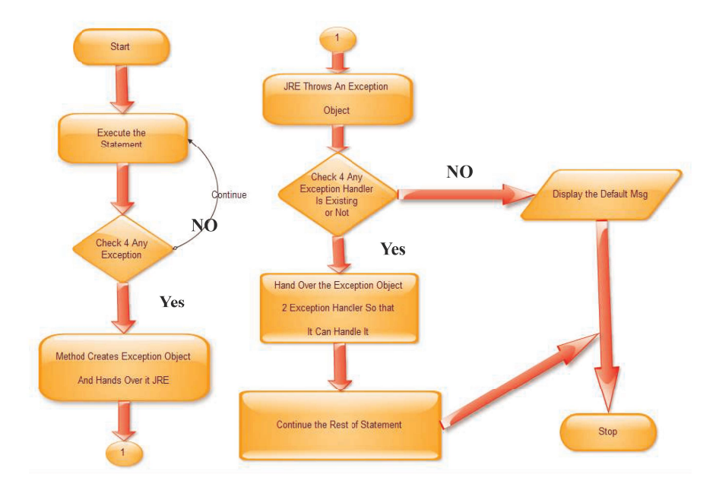
Exception Handling

Slide 23
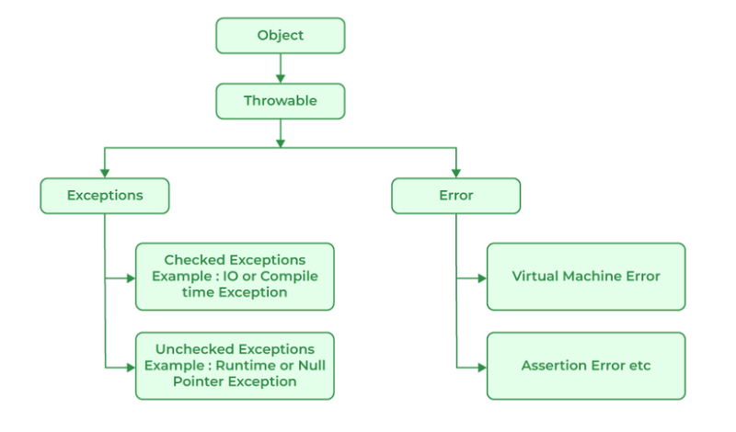
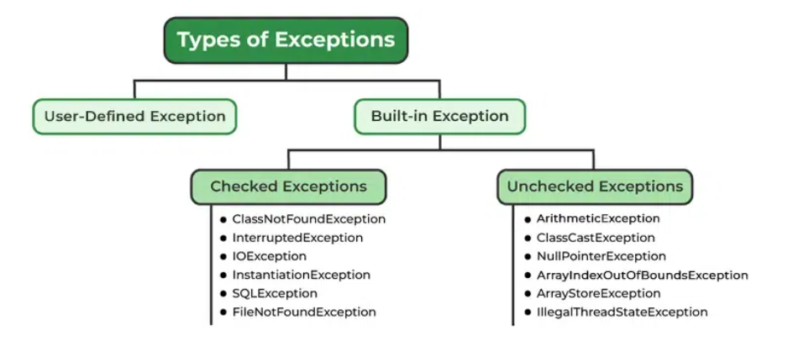
Java Exception Hierarchy
All exception and error types are subclasses of the class Throwable, which is the base class of the hierarchy.

Slide 24
Checked Exception
Checked exceptions are called compile-time exceptions because these exceptions are checked at compile-time by the compiler. Examples of Checked Exception are listed below:
ClassNotFoundException: Throws when the program tries to load a class at runtime but the class is not found because the class is not present in the correct location or it is missing from the project.
IOException: Throws when input/output operation fails.
InstantiationException: Thrown when the program tries to create an object of a class but fails because the class is abstract, an interface, or has no default constructor.
SQLException: Throws when there’s an error with the database.
FileNotFoundException: Thrown when the program tries to open a file that doesn’t exist.
InterruptedException: Thrown when a thread is paused and another thread interrupts it.

Slide 25
B. Unchecked Exception
The unchecked exceptions are just opposite to the checked exceptions. The compiler will not check these exceptions at compile time. In simple words, if a program throws an unchecked exception, the program will not give a compilation error.
ArithmeticException: It is thrown when there’s an illegal math operation.
ClassCastException: It occurs when you try to cast an object to a class it does not belong to.
NullPointerException: It is thrown when you try to use a null object (e.g. accessing its methods or fields)
ArrayIndexOutOfBoundsException: It occurs when we try to access an array element with an invalid index.
ArrayStoreException: This happens when you store an object of the wrong type in an array.
IllegalThreadStateException: It is thrown when a thread operation is not allowed in its current state

Slide 26
Throw vs Throws
Feature | throw | throws
Definition | It is used to explicitly throw an exception. | It is used to declare that a method might throw one or more exceptions.
Location | It is used inside a method or a block of code. | It is used in the method signature.
Usage | It can throw both checked and unchecked exceptions. | It is only used for checked exceptions. Unchecked exceptions do not require throws
Responsibility | The method or block throws the exception. | The method’s caller is responsible for handling the exception.

Slide 27
Thank you

