Slide 1
CASE STUDY
EventLens
Upload one selfie. Get every photo you appear in.
And how we ran the GPU on JarvisLabs only for the seconds it was actually earning its keep.
NestJS + SvelteKit
Postgres + pgvector
RetinaFace + ArcFace
JarvisLabs GPU
Notes:
Open with the problem, not the architecture. Say: 4,000 fest photos, you want the 12 you are in. Then: the matching needs a GPU, and a GPU costs money every second it is on. That second half is the real story today.

Slide 2
NINETY MINUTES
What you will walk out knowing
What the product does
10 min
1
Live demo first. No slides, no code — just the thing working.
How a face becomes a number
15 min
2
Detection, embeddings, vector search. No maths required.
Why the GPU lives on its own machine
10 min
3
One codebase, two deployables, one queue between them.
JarvisLabs — the main event
25 min
4
No REST API, per-second billing, and how to not get a scary bill.
Results, lessons, and your questions
25 min
5
Real measured numbers, five portable rules, then Q&A.
Notes:
Say the two questions out loud: how does a photo become "a photo of you", and how do you run a GPU you cannot afford to leave switched on.

Slide 3
THE PROBLEM
Nobody scrolls 4,000 photos to find themselves
4,000
~12
1 hr
photos from one college fest
of them actually have you in
of scrolling to find them by hand
The product answer
You submit one selfie on a public link and get a private gallery containing exactly the photos you appear in. No account. No scrolling. No access to anyone else’s pictures.
The engineering answer is the rest of this session.
Notes:
Ask the room how they would find their own photos today. Let someone say "WhatsApp group". That is the competitor.

Slide 4
THREE KINDS OF USER
What EventLens actually is
Organisers
Participants
Admins
Create an org and an event
Bulk upload, or import straight from Google Drive / OneDrive
Review detected people
Erase a participant on request
Open a public event link
Submit one selfie
Get a tokenised private gallery
Download the lot as a zip
Watch every queue live
See what the GPU box is doing and what it has cost
Wake it or pause it by hand
Notes:
Keep this to 90 seconds. The demo does the real work.

Slide 5
SWITCH TO THE BROWSER
Demo — the whole product in four minutes
1
Create an event and drag in 50 photos
Watch the processing badges flip as jobs drain.
2
Open the public link as a stranger
No login. Just a selfie box and a privacy notice.
3
Submit a selfie
Either a live queue position, or "we will email you".
4
Open the personal gallery
Only that person’s photos. Download all as a zip.
One thing to notice: after "upload", nothing waits on the browser. Everything is a queued job.
Notes:
Have the dev stack already warm. Do not run pnpm install on stage. Fallback screen recording ready in case the ML sidecar is cold.

Slide 6
THE MACHINE LEARNING BIT
How a face becomes a number
1
2
3
4
Detect
→
Embed
→
Store
→
Search
RetinaFace finds the face boxes in a photo.
ArcFace (buffalo_l) turns each face into 512 numbers.
Those vectors go into Postgres with pgvector.
A selfie becomes one vector. Find its nearest neighbours.
The analogy that works
A fingerprint written as coordinates. Similar faces land near each other in 512-dimensional space, so "who is this?" becomes "what is closest to this point?" — a question a database can answer.
Notes:
Do not go near cosine similarity or loss functions. If someone asks, offer to stay after.

Slide 7
THE RULE THAT MATTERS MOST
A face from Event A must never match into Event B
Why it is not optional
How it is enforced
Two different events may contain the same person. Letting one selfie reach across events would hand a stranger photos from a party they never attended.
The vector search is scoped to one event id at the query level — not filtered afterwards in application code, where a future refactor could quietly drop it.
test/face-isolation.spec.ts
Seed two events with the same person, run the matcher, assert nothing crosses. If anyone ever breaks the isolation, the build goes red before the privacy incident happens.
Takeaway: when a rule is a privacy rule, encode it as a test — not a comment.
Notes:
This is the slide students should photograph. Say it plainly: comments do not fail builds.

Slide 8
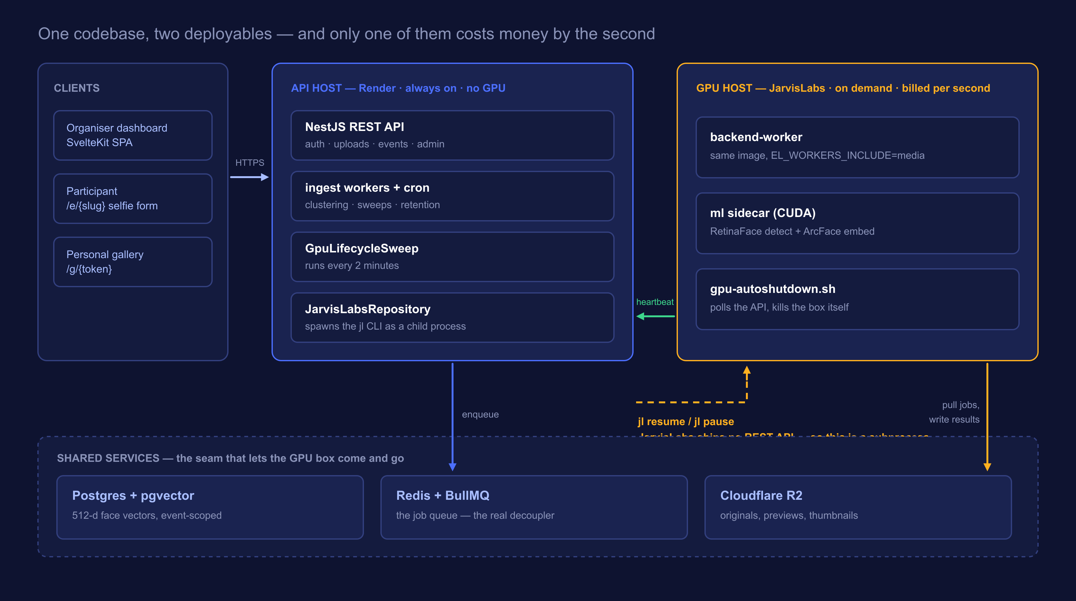
ARCHITECTURE
Two machines, and only one of them is expensive
Notes:
Trace the arrows in this order: client to API, API to Redis, GPU worker pulls from Redis, GPU worker calls back with a heartbeat, API shells out to jl. The arrow DIRECTIONS are the lesson.

Slide 9
DEPLOYMENT
Same image. Different environment variable.
API host — Render
GPU host — JarvisLabs
EL_WORKERS_INCLUDE=api,ingest
EL_WORKERS_INCLUDE=media
Serves every HTTP request
Owns the cron schedules
Runs face clustering (CPU is fine)
Decides when the GPU should exist
Face detection and embedding
Thumbnails and video transcode
Runs the ml sidecar next to it
Exists only while there is work
Microservices do not require separate repositories. They require separate lifecycles — and here the queue, not the network call, is what separates them.
Notes:
Most students assume microservices means many repos. Break that here. Then say: because the API never calls the GPU directly, the GPU is allowed to not exist.

Slide 10
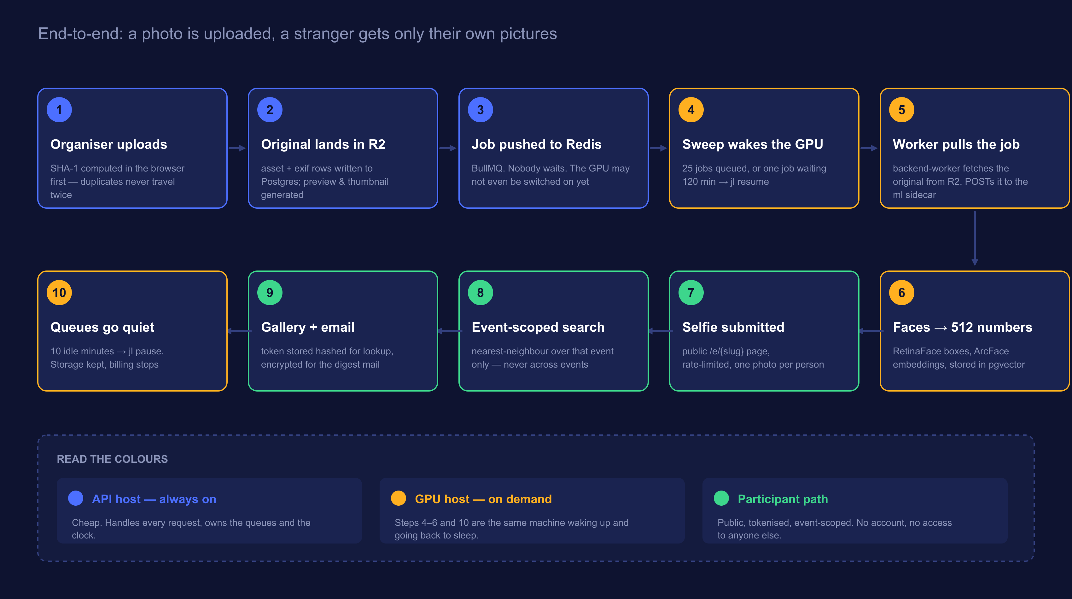
PROCESS FLOW
From an uploaded photo to a stranger’s private gallery
Notes:
Walk it once quickly end to end, then a second time pointing only at the amber steps: that is the GPU's entire life.

Slide 11
THE MAIN EVENT
JarvisLabs
Four problems we hit running a per-second GPU from a web app — and what each one taught us.
No REST API exists
When to wake it
When to sleep it
What if the stop call fails
Notes:
Before moving on, ask the room: "just turn it off when idle — what could go wrong?" Collect answers. Then walk the ones they miss.

Slide 12
PROBLEM ZERO
The workload is bursty. The billing is not.
What a GPU costs you
What the work actually needs
24 × 7
minutes a day
Billed per second, whether or not a single photo was uploaded that day.
A fest dumps 4,000 photos in one evening, then nothing at all for two weeks.
So: switch the machine on when there is work, and off when there is not.
Easy to say. The next four slides are everything that goes wrong between saying it and it being safe to run unattended.
Notes:
Do not quote a price you have not verified. Talk in shape — bursty vs flat — rather than invented rupees.

Slide 13
PROBLEM 1
JarvisLabs ships no REST API
There is a jl CLI and a Python SDK. That is it. So the Node backend controls a GPU by spawning a child process.
Auth through the environment
JL_API_KEY is read straight from env. No jl setup, no config file written — which is exactly why it works on a read-only container filesystem.
Machine-readable by force
--json on every call; --yes only on the verbs that prompt, because the read-only verbs reject it.
Installed into a venv
Debian marks the system Python externally-managed (PEP 668), so a plain pip install is refused. The image puts it in /opt/jarvislabs and symlinks jl.
Notes:
Show jarvislabs.repository.ts on screen while you say this. The header comment says most of it already.

Slide 14
PROBLEM 1, CONTINUED
Three ways driving a CLI bites you
Errors arrive on stdout, not the exit code
1
jl reports failure as {"error": "..."} on stdout with a non-zero exit. Read the body — the exit code alone tells you nothing useful to show an operator.
Resume can hand back a different machine id
2
Keep using the old id and you are targeting a machine that no longer exists. We log the reassignment and adopt the new id immediately.
A missing binary must look like a message, not a crash
3
ENOENT becomes "the jl CLI is not installed on this host". This runs on the API box; a JarvisLabs outage should surface on the admin panel, not as an unhandled rejection.
"No API" does not mean "cannot automate". It means your integration layer is a subprocess — and subprocesses need defensive handling.
Notes:
This is the most transferable slide for students. Every one of them will shell out to something eventually.

Slide 15
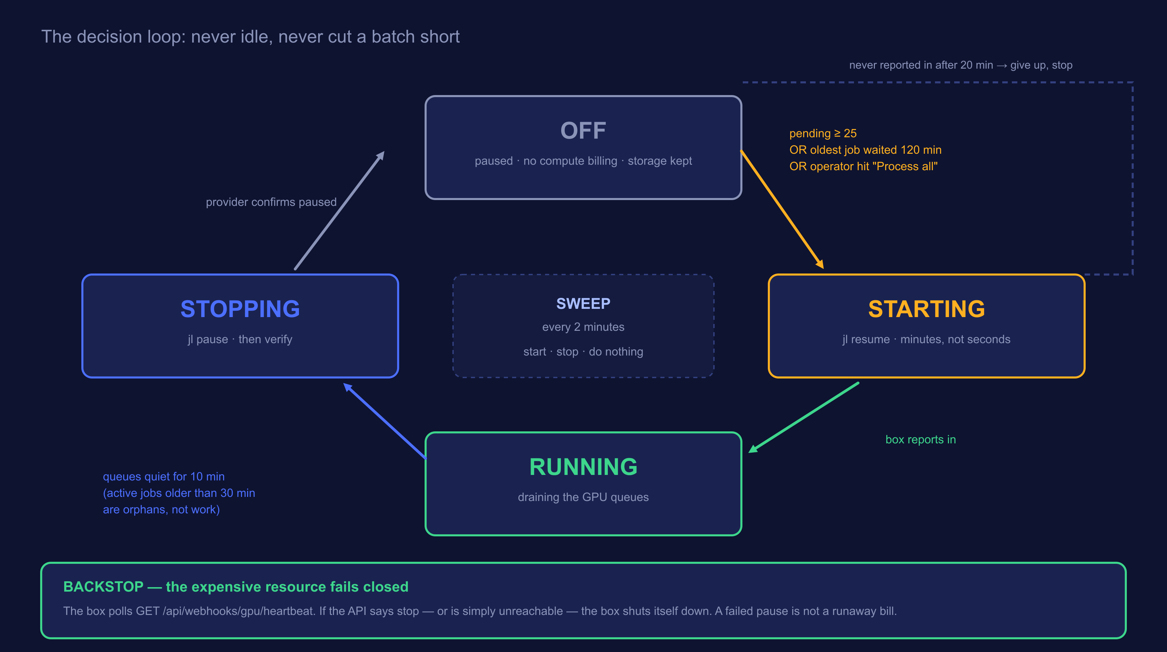
PROBLEMS 2 & 3
When to wake it, and when to let it sleep
Notes:
Open the real Admin -> GPU worker panel next to this if the demo stack is up.

Slide 16
THE ACTUAL SETTINGS
Four numbers decide everything
pendingThreshold
25
Wake once this many jobs are queued across the GPU queues.
maxPendingAgeMinutes
120
…or once the oldest waiting job has sat this long.
idleShutdownMinutes
10
Stop this long after the queues go quiet.
startTimeoutMinutes
20
Give up and stop if the box never reports in.
Why there are two wake conditions: a threshold on its own starves a single job forever. The age rule is what rescues the one photo that arrived on a quiet Tuesday.
Notes:
This is a bug students will write. Showing the fix before they write it is worth the 90 seconds.

Slide 17
PROBLEM 4
What if the stop call simply fails?
Fast path
Backstop
The API runs jl pause.
The box polls us and kills itself.
Quick, normal, and the thing that happens 99% of the time.
GET /api/webhooks/gpu/heartbeat → { keepAlive, reason, pending }. If the API says stop — or is simply unreachable — the box shuts down on its own.
The expensive resource fails closed.
An outage, a bad deploy, or a bug costs you an idle machine for a few minutes — not a weekend of GPU billing. And because the box polls us rather than us pushing to it, the VM needs no inbound network access at all.
Notes:
Say "the direction of the arrow is the security design and the cost design at the same time". Point back at the architecture diagram if they look unsure.

Slide 18
THE BUG THAT PAYS FOR ITSELF
One orphaned job can pin a GPU up forever
▶
The box is paused mid-batch
By design — that is the whole point of pausing.
▶
A job is left "active" in Redis
Nobody is alive to finish it or fail it. It never clears on its own.
▶
active > 0 keeps the box alive
And that is exactly the runaway bill the autoshutdown existed to prevent.
The fix: anything active for more than 30 minutes is an orphan, not work.
Generous on purpose. A long video transcode legitimately holds a job for many minutes, and cutting the box off mid-encode wastes the work already done. Thirty minutes is past any real job here and still caps the damage.
Notes:
Good moment to say that most "cost bugs" are really state bugs. The bill is just where you notice them.

Slide 19
THE PART NOBODY EXPECTS
The GPU’s sleep schedule changed the copy on the page
live
deferred
Box awake and keeping up
Box asleep, or badly backed up
A spinner, "you are number 4 in the queue", and a rough estimate. It flips to the result if it finishes while they watch.
"Thanks — we will email you when your photos are ready." No fake progress bar, no promise we cannot keep.
The cutoff is total GPU queue depth, not the selfie queue’s own depth. The selfie queue can be nearly empty while an import has thousands of faces queued ahead of it on the same GPU — total depth is the only honest signal for whether an estimate means anything.
Cost optimisation was not a setting bolted on at the end. It changed the queue design, the deploy topology, and the words on the page.
Notes:
Close the JarvisLabs section on this. It is the line worth remembering.

Slide 20
MEASURED, NOT CLAIMED
What we can actually prove
13.7s
0
79 / 11
to rematch 10,000 faces across 500 participants
duplicate persons, and zero cross-identity matches
faces found and sensible clusters, on real photos
And the GPU?
What is honestly not done
Up during ingest bursts, paused the rest of the time, with the pause visible on the admin panel alongside what the provider itself reports — because the two disagreeing is the expensive case.
Live OAuth for the cloud imports is still unverified, and the multi-VM deploy has never been run on real VMs — only in compose. Browser-level UI testing is still API-level only.
Notes:
Naming what is unfinished buys you more credibility than any number on this slide. Do not skip the right-hand card.

Slide 21
TAKE THESE HOME
Five rules that outlive this project
Queues are what let you turn expensive things off.
1
No API? A CLI subprocess is a legitimate integration layer — just parse it defensively.
2
Make the expensive resource fail closed, and let it kill itself rather than trusting someone else to.
3
Every managed dependency deserves a real local stand-in. No mocks, same code paths.
4
Privacy rules belong in tests, not comments.
5
None of these are about face recognition. All of them are about running something you cannot afford to leave switched on.
Notes:
Read them out. Then pause. This is where the recording gets rewatched.

Slide 22
Questions
Seed the room with these if it goes quiet:
Why not just run inference on CPU?
What happens if the same person is in two different events?
Why not serverless GPU instead of a machine you pause?
How would you know if the pause silently failed?
Code: github.com/Sriharan-S/event-media-platform · Deployment notes: docs/deploy-production.md
Notes:
Offer to stay on the call for anyone who wants to see the code. Share the recording and this deck in the chat before you leave.

