Slide 1
DEEP DIVE — PART 2
512 numbers
that mean “you”
How a photograph turns into a face, a face turns into a vector, and a pile of vectors turns into a person.
RetinaFace
ArcFace buffalo_l
pgvector
find and align the faces
turn each face into 512 numbers
store them and search them fast
Notes:
Say up front: no maths on these slides. If you can picture a map with dots on it, you can follow all of this.

Slide 2
START HERE
The one-paragraph version — and the three things it misses
“Your face is analysed into a 512-number fingerprint. Your other photos produce nearby numbers. Those nearby ones get grouped together into a person.”
That is right. Three details change how you would build it:
Numbers, not digits
1
They are 512 decimals like -0.118 — not 512 single digits. Together they are one arrow pointing somewhere in space.
One distance, not 512 comparisons
2
You never compare number 7 to number 7. All 512 collapse into a single distance, and one threshold decides.
Grouped one at a time, not all at once
3
There is no big grouping pass. Each new face asks one question — “does a close neighbour already have a person?” — and joins or starts one.
Notes:
This slide exists because someone WILL arrive with roughly this model. Confirm it warmly, then correct precisely. Do not lead with the correction.

Slide 3
THE WHOLE THING IN SIX WORDS
Find · Align · Measure · Store · Compare · Group
1
2
3
Find
Align
Measure
RetinaFace locates every face in the frame.
Each face is cropped and rotated upright.
ArcFace turns the crop into 512 numbers.
4
5
6
Store
Compare
Group
The vector goes into Postgres with pgvector.
Distance to every other face in the event.
Close enough? Same person.
Steps 1–4 happen once per photo, on the GPU. Steps 5–6 happen once per face, and they are just database queries.
Notes:
Give them this six-word spine early. Every later slide is a zoom into one of these words.

Slide 4
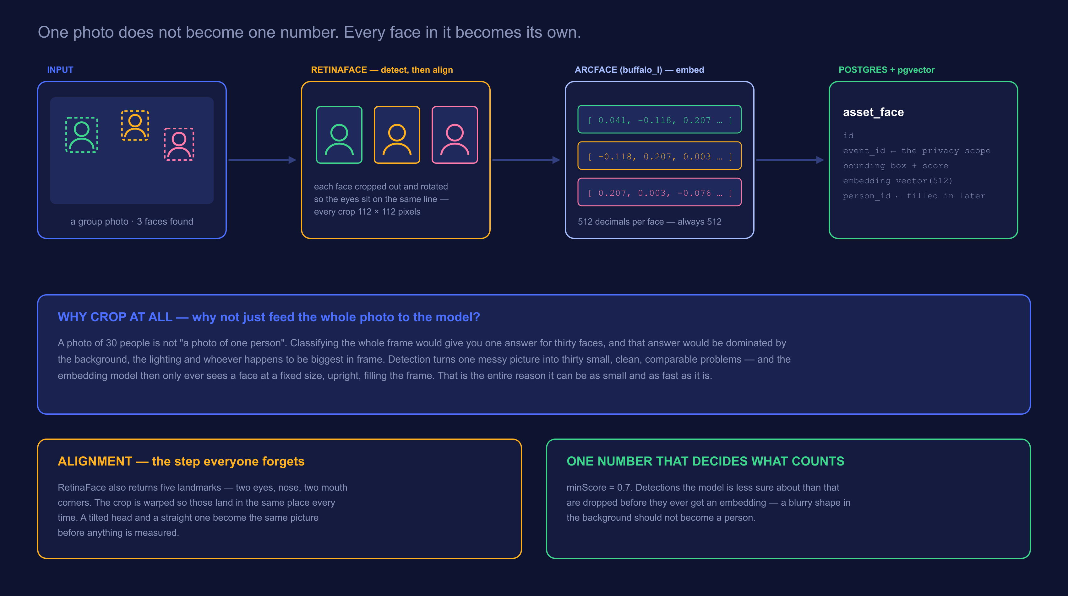
THE PIPELINE
A photo goes in. One vector per face comes out.
Notes:
Walk left to right once. Then point at the third panel and say: everything after this point is arithmetic on those numbers. The photograph is never looked at again.

Slide 5
YOU ASKED ABOUT THIS ONE
Yes — RetinaFace crops. And that changes the problem entirely.
The wrong question
The right question
If you classified the whole photo
Because you crop each face first
One answer for a frame containing thirty people
The background and lighting dominate the result
A person at the edge is ignored; the biggest face wins
Move the camera and the “identity” changes
Thirty faces become thirty separate, comparable problems
The model only ever sees a face, filling the frame
A face at the edge counts exactly as much as one in front
The same person in two photos produces two close vectors
Detection is not a preprocessing chore. It is what makes the recognition model small, fast, and comparable across photos it has never seen together.
Notes:
This is the second half of their question and they got it right. Say so explicitly before expanding it.

Slide 6
STEP 1 — FIND
What detection actually hands back
A bounding box
x1, y1, x2, y2 — where the face sits in the frame. Stored per face, so we can crop a portrait later without re-running the model.
A confidence score
How sure it is that this is a face at all. Below minScore = 0.7 it is thrown away before it ever costs us an embedding.
Five landmarks
Two eyes, the nose, two mouth corners. Not used to identify anyone — used to straighten the crop.
Detection runs on the downscaled preview, not the original — but the person portrait is cropped from the original, because a face is a small part of a group photo and upscaling a handful of pixels looks terrible.
Notes:
The last box is a nice real-world detail: the same face has two different sources depending on what you need it for.

Slide 7
STEP 2 — ALIGN
The step nobody mentions, and everything depends on it
Every crop is warped so the eyes, nose and mouth land in the same place — a fixed 112 × 112 tile. A tilted head and a straight one become the same picture before anything is measured.
Without alignment
With alignment
The model would have to learn “this is the same person, just rotated 20 degrees” separately for every angle — and waste half its 512 numbers describing pose instead of identity.
Pose is removed before the model sees anything. All 512 numbers get spent on what actually distinguishes one person from another.
Rule of thumb: every bit of variation you can remove before the model is a bit of capacity you get back for the thing you actually care about.
Notes:
Ask the room to tilt their heads. Say: to you these are obviously the same face. To a naive model they are two unrelated grids of pixels.

Slide 8
STEP 3 — MEASURE
What “512 numbers” literally is
[ 0.041, -0.118, 0.207, 0.003, -0.076, 0.162, … 506 more ]
1
Decimals, not digits
2
No single number means anything
Each one is a signed decimal, usually somewhere between -1 and 1. “512-digit number” is the one thing worth un-learning.
Number 47 is not “nose width”. The meaning lives in the whole 512 together — nobody, including the people who trained it, can tell you what one slot is for.
3
Always exactly 512
4
Normalised to length 1
A blurry face, a child, a face at the edge of the frame — all produce exactly 512 numbers. That fixed size is what makes them comparable.
The whole arrow is scaled so it has length 1. Brightness and contrast largely drop out, and comparison becomes an angle.
Notes:
The "no single number means anything" card usually gets a question. Good — it is the honest answer, and it is also why you cannot audit these by eye.

Slide 9
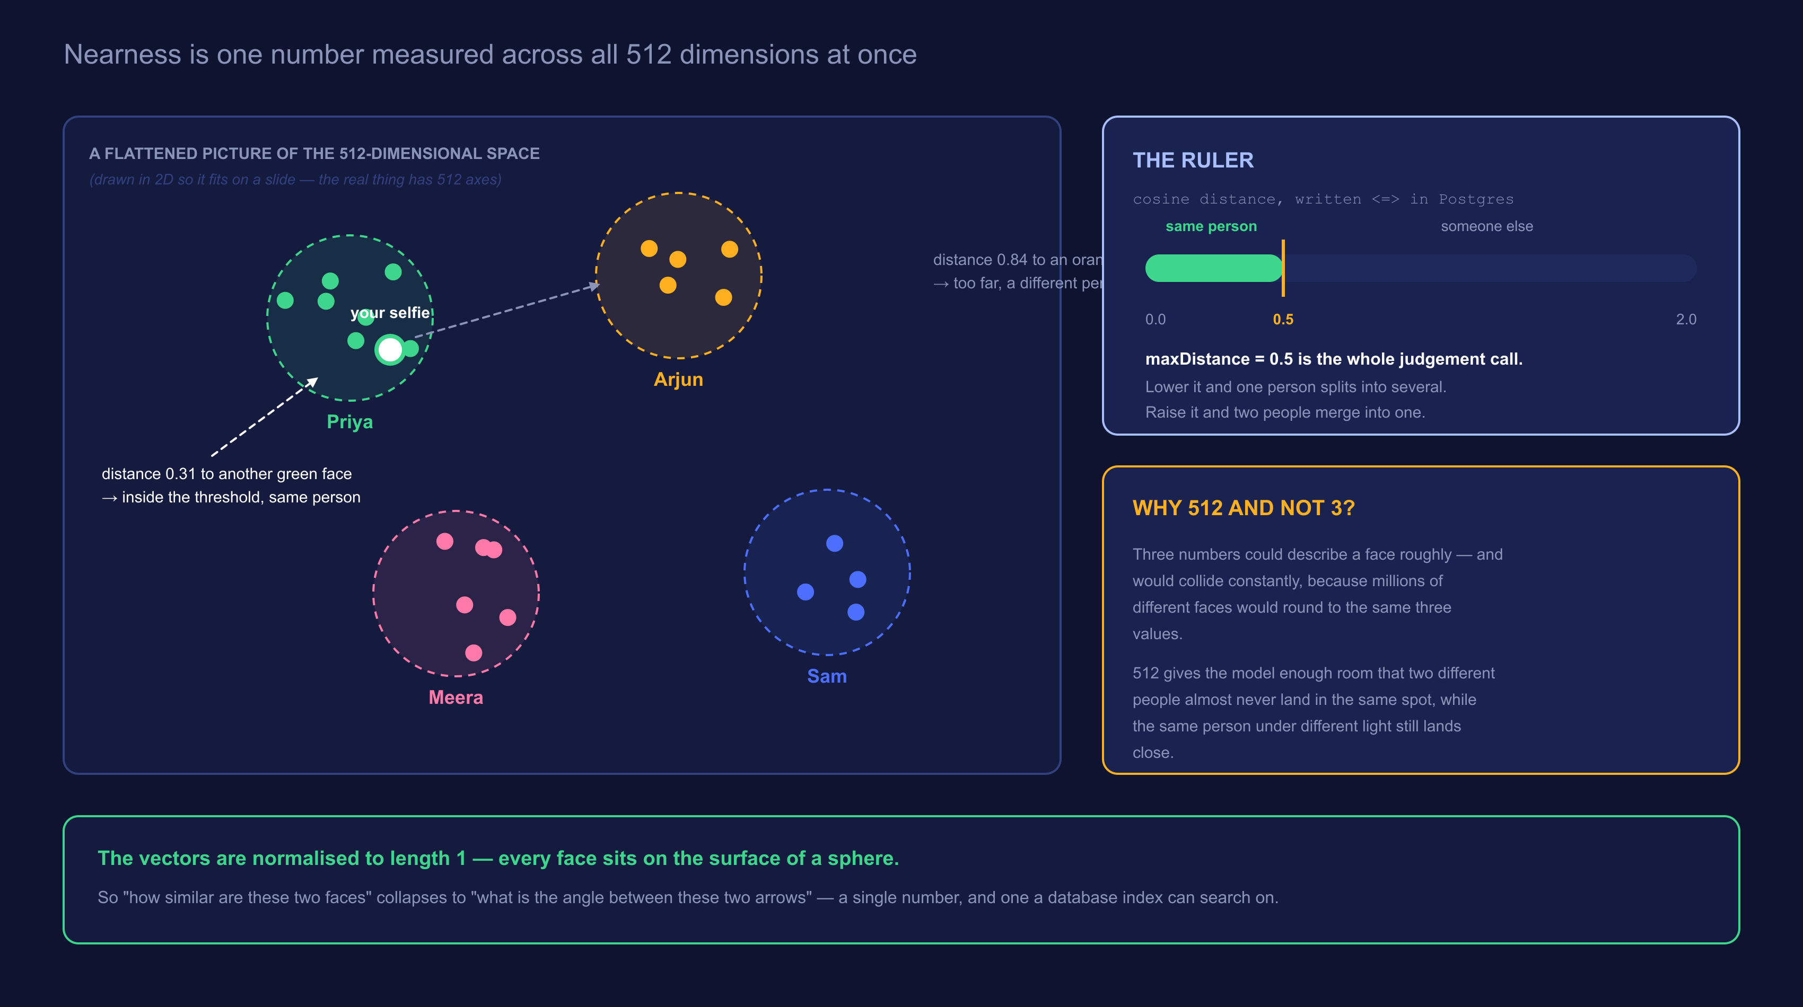
STEP 5 — COMPARE
Same person = close together. That is the whole trick.
Notes:
Stress that the 2D picture is a lie of convenience. In 512 dimensions there is far more room, which is exactly why the clusters stay separated.

Slide 10
ONE NUMBER, TWO FAILURE MODES
maxDistance = 0.5 is a judgement call, not a fact
Set it too low
0.2
Set it too high
0.9
The same person splits into several “people”
You in sunglasses becomes a different person from you without
Participants get only half their photos
Two different people merge into one
Someone receives photos of a stranger
The failure nobody can un-see
The two mistakes are not equally bad.
Missing a few of your own photos is an annoyance you can fix by submitting a better selfie. Showing you a stranger’s photos is a privacy incident. When you tune this number, tune it in the direction where the failure is recoverable.
Notes:
Best decision-making lesson in the deck. Asymmetric costs should push the default, not a coin flip.

Slide 11
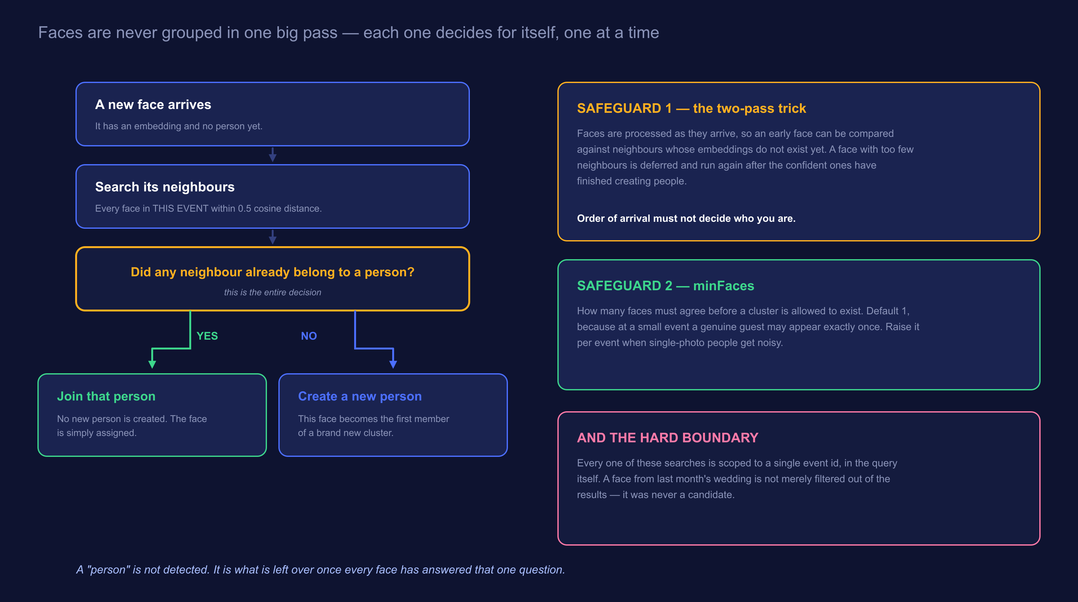
STEP 6 — GROUP
How a pile of vectors becomes a list of people
Notes:
Walk the YES branch and the NO branch out loud. Then say: run that for every face and people fall out. Nobody ever wrote a function called findPeople().

Slide 12
THE DESIGN CHOICE
Why not just collect everything and group it at the end?
One big pass
One face at a time
Needs every face in memory before it can start
Re-runs from scratch every time a photo is added
Cost grows with the whole event, not with the new work
A 4,000-photo upload means one enormous job
Starts the moment the first face exists
A new photo only asks about itself
Cost is proportional to what actually arrived
Fits a queue — which is what lets us pause the GPU mid-batch
The incremental design is also what connects this deck to the last one: because clustering is a queue of tiny independent jobs, the machine running them is allowed to disappear halfway through and pick up where it left off.
Notes:
Callback to the JarvisLabs session. The ML design and the cost design are the same decision viewed twice.

Slide 13
WHAT GOES WRONG, AND THE FIX
Two safeguards that stop order from deciding identity
The problem
Faces are processed as they arrive. The very first face has nobody to compare against — not because it is alone, but because its neighbours have not been embedded yet.
Safeguard 1 — the two-pass trick
A face with too few neighbours is not judged immediately. It is deferred and run again after the confident faces have finished creating people. Order of arrival must not decide who you are.
Safeguard 2 — minFaces
How many faces must agree before a cluster is allowed to exist at all. Default 1, because at a small event a real guest may genuinely appear in exactly one photo. Raise it per event when single-photo people get noisy.
Notes:
If you only have time for one of these, keep the two-pass one. It is the subtler bug and the better story.

Slide 14
A DISTINCTION WORTH DRAWING
Clustering and selfie-matching are not the same job
Clustering
Selfie matching
“Who is in this event at all?”
“Which of these people is me?”
Runs on faces already in the database
Compares faces to each other
Produces anonymous “people” the organiser can name
Happens automatically, in the background
Runs on one selfie a guest just submitted
Compares that one vector against the event
Produces a tokenised gallery and an email
Happens on demand, while someone waits
Same embeddings, same distance metric, same threshold — two completely different user-facing features. That reuse is the payoff for having turned faces into numbers in the first place.
Notes:
Students often assume the selfie flow re-runs clustering. It does not. Make that explicit.

Slide 15
THE INVARIANT
Every one of these searches is fenced to one event
The event id is part of the query, not a filter applied to the results. A face from last month’s wedding is not removed from the answer — it was never a candidate for it.
1
2
3
Why it matters here specifically
Why a filter is not enough
How we keep it true
The same person really does attend two different events. Without the fence, one selfie would reach across both — and hand someone photos from a party they never went to.
A filter is a step someone can forget during a refactor. A scoped query cannot silently lose its scope without the query itself changing.
test/face-isolation.spec.ts seeds two events with the same person and asserts nothing crosses. If anyone breaks it, the build goes red before a person does.
Privacy rules belong in tests, not comments.
Notes:
Repeat the line from the first session. Repetition across two decks is deliberate — it is the thing you most want them to keep.

Slide 16
BE HONEST ABOUT THIS
Where 512 numbers stop being enough
Identical twins
Faces too small
Hard profiles
Genuinely close in the space. No threshold separates them cleanly.
A face 20 pixels across carries almost no signal. It fails minScore, or worse, scrapes past it.
Alignment needs landmarks. A face turned fully sideways has too few to straighten.
Heavy occlusion
Extreme lighting
Years apart
Masks, big sunglasses, a hand across the face — each removes a chunk of what the model measures.
Backlit or heavily blown-out faces drift. Normalisation helps; it does not fix it.
A child at 6 and at 12 will not land close. The model measures a face, not a person.
Which is why an organiser can merge, split and rename people by hand — and why a participant can ask to be erased.
Notes:
Never present recognition as solved. The manual review tools exist precisely because this list exists.

Slide 17
IF YOU REMEMBER FIVE SENTENCES
The whole deck, compressed
A photo is never classified. Every face in it is found, cropped and straightened first.
1
Each face becomes 512 decimals — one arrow in space, meaningless slot by slot, meaningful as a whole.
2
Similarity is one distance across all 512 at once, and a single threshold decides.
3
People are not detected. They are what is left over after every face asks “does a close neighbour already have a person?”
4
Every comparison is fenced to one event — enforced in the query, and guarded by a test.
5
Everything else — the GPU, the queues, the pausing — exists only to make those five things happen cheaply.
Notes:
End here, then take questions. If they ask about training the model, be clear we did not train anything — we run a pretrained ArcFace.

Slide 18
Questions
The ones that always come up:
Did you train the model yourself?
Can you get the face back from the 512 numbers?
What happens with identical twins?
Why 0.5 — where did that number come from?
Short answers: no, we run a pretrained ArcFace · not faithfully, but treat embeddings as personal data anyway · they defeat it · it is Immich’s default, and we kept it because the safer failure is splitting, not merging.
Notes:
The "can you reconstruct the face" question matters legally as much as technically. Say plainly: we treat embeddings as personal data, which is why erasure deletes them.

