Slide 1
CASE STUDY
EventLens
Upload one selfie. Get every photo you appear in.
How three models turn a photograph into a person — and how we ran the GPU on JarvisLabs only for the seconds it was actually earning its keep.
RetinaFace
ArcFace buffalo_l
CLIP ViT-B-32
JarvisLabs GPU
find the faces
measure each face
search by description
run it all, briefly
Notes:
Open with the problem, not the architecture. 4,000 fest photos, you want the 12 you are in. Matching needs a GPU. A GPU costs money every second it is on. Those are the two halves of today.

Slide 2
THREE ACTS, ABOUT TWO HOURS
What you will walk out knowing
15 min
0
The problem, and the product
A live demo before a single slide of architecture.
45 min
1
The models, and how a face becomes a number
Three pretrained models, 512 numbers, and how people fall out of them.
40 min
2
Running it — JarvisLabs and the per-second GPU
No REST API, bursty work, flat billing, and how to not get a scary bill.
20 min
3
Results, lessons, and your questions
Measured numbers, six portable rules, then Q&A.
Two questions run through all of it: how does a photo become “a photo of you”, and how do you run a GPU you cannot afford to leave switched on?
Notes:
Say the two questions out loud. They are the spine of the whole session.

Slide 3
THE PROBLEM
Nobody scrolls 4,000 photos to find themselves
4,000
~12
1 hr
photos from one college fest
of them actually have you in
of scrolling to find them by hand
The product answer
You submit one selfie on a public link and get a private gallery containing exactly the photos you appear in. No account. No scrolling. No access to anyone else’s pictures.
The engineering answer is the rest of this session.
Notes:
Ask how they would find their own photos today. Someone will say "the WhatsApp group". That is the competitor.

Slide 4
THREE KINDS OF USER
What EventLens actually is
Organisers
Participants
Admins
Create an org and an event
Bulk upload, or import from Google Drive / OneDrive
Review and name detected people
Erase a participant on request
Open a public event link
Submit one selfie
Get a tokenised private gallery
Download the lot as a zip
Watch every queue live
See what the GPU box is doing and what it has cost
Wake it or pause it by hand
Notes:
Ninety seconds. The demo does the real work.

Slide 5
SWITCH TO THE BROWSER
Demo — the whole product in four minutes
1
Create an event and drag in 50 photos
Watch the processing badges flip as jobs drain.
2
Open the public link as a stranger
No login. Just a selfie box and a privacy notice.
3
Submit a selfie
Either a live queue position, or “we will email you”.
4
Open the personal gallery
Only that person’s photos. Download all as a zip.
One thing to notice: after “upload”, nothing waits on the browser. Everything is a queued job.
Notes:
Have the dev stack warm. Fallback screen recording ready in case the ML sidecar is cold.

Slide 6
ACT ONE
The models
Three pretrained models do all the intelligence here. We trained none of them — and that is the point.
Detect the faces
Measure each face
Understand the scene
Notes:
Set expectations: this is an engineering project that USES models, not a research project that builds them. Say that plainly — it is a legitimate and very common position.

Slide 7
THE THREE MODELS
What each model is for
DETECTION
RECOGNITION
SCENE SEARCH
RetinaFace
ArcFace — buffalo_l
CLIP — ViT-B-32
“Where are the faces?”
“Who is this face?”
“What is happening in this photo?”
In: a whole photo
Out: a box, a confidence score and 5 landmarks per face
Ships inside the buffalo_l pack
Its output is a crop, never an identity
In: one aligned 112×112 face crop
Out: 512 numbers (a vector)
Never sees a whole photo
Everything downstream is arithmetic on its output
In: the whole photo preview
Out: 512 numbers describing the scene
Powers “find similar photos”
Nothing to do with identity
All three are pretrained and run inside one Python sidecar — a verbatim copy of Immich’s machine-learning service. We wrote none of the model code. What we built is everything around it: the queues, the scoping, the storage and the machine they run on.
Notes:
If someone asks "so what did you actually build?" — this bottom band is the answer. Say it confidently, not apologetically.

Slide 8
THE PRACTICAL SIDE OF THE MODELS
What they cost you to run
MODEL
HOW OFTEN
RUNS ON
WHY IT MATTERS
RetinaFace
once per photo
GPU
Cheap and fast. The gate that decides how much work everything else has to do.
ArcFace
once per face
GPU
A group photo of 30 people means 30 runs. This is what actually fills the GPU queue.
CLIP
once per photo
GPU
Optional. Kept in its own service and queue so a constrained deployment can drop it entirely.
This table is the whole reason Act Two exists.
Three models, all wanting a GPU, all doing nothing at all between events. Every architectural decision in the second half of this session follows from that one sentence.
Notes:
Bridge slide. Plant the cost problem here so Act Two feels inevitable rather than bolted on.

Slide 9
START HERE
The one-paragraph version — and the three things it misses
“Your face is analysed into a 512-number fingerprint. Your other photos produce nearby numbers. Those nearby ones get grouped together into a person.”
That is right. Three details change how you would build it:
Numbers, not digits
1
They are 512 decimals like -0.118 — not 512 single digits. Together they are one arrow pointing somewhere in space.
One distance, not 512 comparisons
2
You never compare number 7 to number 7. All 512 collapse into a single distance, and one threshold decides.
Grouped one at a time, not all at once
3
There is no big grouping pass. Each new face asks one question — “does a close neighbour already have a person?” — and joins or starts one.
Notes:
Someone WILL arrive with roughly this model. Confirm it warmly, then correct precisely. Do not lead with the correction.

Slide 10
THE WHOLE PIPELINE IN SIX WORDS
Find · Align · Measure · Store · Compare · Group
1
2
3
Find
Align
Measure
RetinaFace locates every face in the frame.
Each face is cropped and rotated upright.
ArcFace turns the crop into 512 numbers.
4
5
6
Store
Compare
Group
The vector goes into Postgres with pgvector.
Distance to every other face in the event.
Close enough? Same person.
Steps 1–4 happen on the GPU. Steps 5–6 are just database queries.
Notes:
Give them this six-word spine early. Every later slide is a zoom into one of these words.

Slide 11
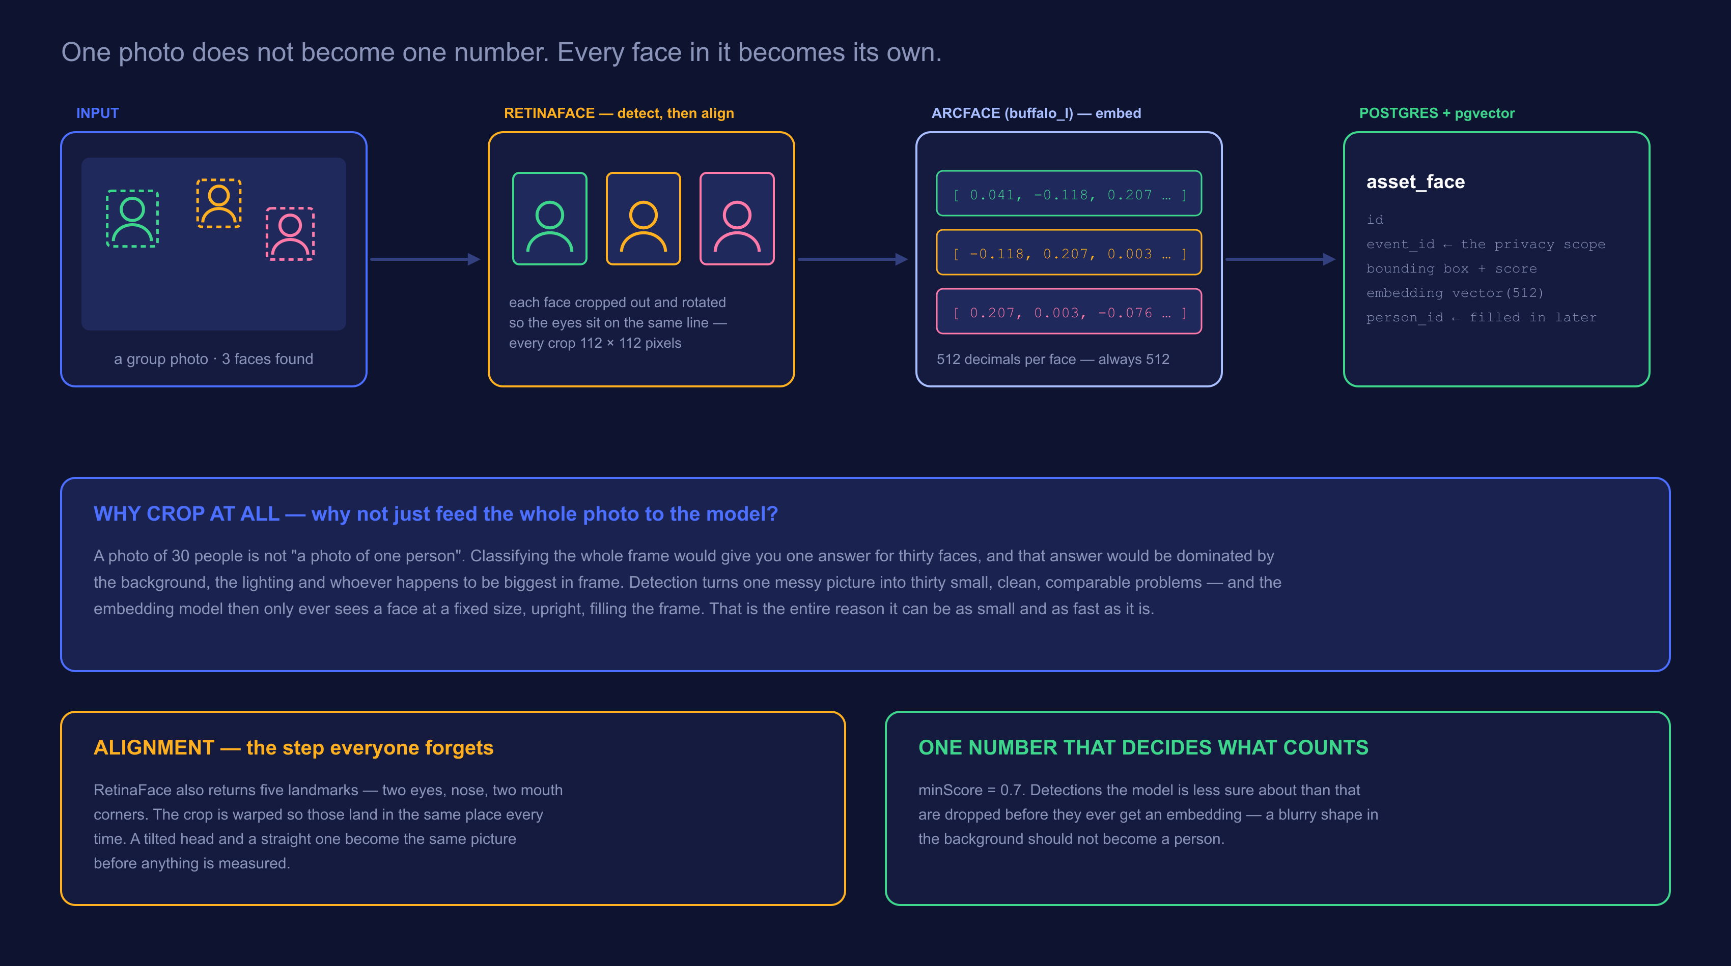
THE PIPELINE
A photo goes in. One vector per face comes out.
Notes:
Walk left to right once. Then point at the third panel: everything after this point is arithmetic on those numbers. The photograph is never looked at again.

Slide 12
WHY DETECTION COMES FIRST
RetinaFace crops — and that changes the problem entirely
The wrong question
The right question
If you classified the whole photo
Because you crop each face first
One answer for a frame containing thirty people
The background and lighting dominate the result
A person at the edge is ignored; the biggest face wins
Move the camera and the “identity” changes
Thirty faces become thirty separate, comparable problems
The model only ever sees a face, filling the frame
A face at the edge counts as much as one in front
The same person in two photos gives two close vectors
Detection is not a preprocessing chore. It is what makes the recognition model small, fast, and comparable across photos it has never seen together.
Notes:
Ask them what "classify this photo" would even mean for a picture with thirty people in it. Let the answer be awkward.

Slide 13
STEP 1 — FIND
What detection actually hands back
A bounding box
x1, y1, x2, y2 — where the face sits in the frame. Stored per face, so a portrait can be cropped later without re-running the model.
A confidence score
How sure it is that this is a face at all. Below minScore = 0.7 it is thrown away before it ever costs us an embedding.
Five landmarks
Two eyes, the nose, two mouth corners. Not used to identify anyone — used to straighten the crop.
Detection runs on the downscaled preview, but the person portrait is cropped from the original — a face is a small part of a group photo, and upscaling a handful of pixels looks terrible.
Notes:
Nice real-world detail: the same face has two different sources depending on what you need it for.

Slide 14
STEP 2 — ALIGN
The step nobody mentions, and everything depends on it
Every crop is warped so the eyes, nose and mouth land in the same place — a fixed 112 × 112 tile. A tilted head and a straight one become the same picture before anything is measured.
Without alignment
With alignment
The model would have to learn “same person, rotated 20 degrees” separately for every angle — and waste half its 512 numbers describing pose instead of identity.
Pose is removed before the model sees anything. All 512 numbers get spent on what actually distinguishes one person from another.
Rule of thumb: every bit of variation you remove before the model is capacity you get back for the thing you actually care about.
Notes:
Ask the room to tilt their heads. To them these are obviously the same face. To a naive model they are two unrelated grids of pixels.

Slide 15
STEP 3 — MEASURE
What “512 numbers” literally is
[ 0.041, -0.118, 0.207, 0.003, -0.076, 0.162, … 506 more ]
1
Decimals, not digits
2
No single number means anything
Each one is a signed decimal, usually between -1 and 1. “512-digit number” is the one thing worth un-learning.
Number 47 is not “nose width”. The meaning lives in all 512 together — nobody, including the people who trained it, can tell you what one slot is for.
3
Always exactly 512
4
Normalised to length 1
A blurry face, a child, a face at the edge — all produce exactly 512 numbers. That fixed size is what makes them comparable.
The whole arrow is scaled to length 1. Brightness and contrast largely drop out, and comparison becomes an angle.
Notes:
The "no single number means anything" card usually gets a question. Good — it is the honest answer, and it is why you cannot audit these by eye.

Slide 16
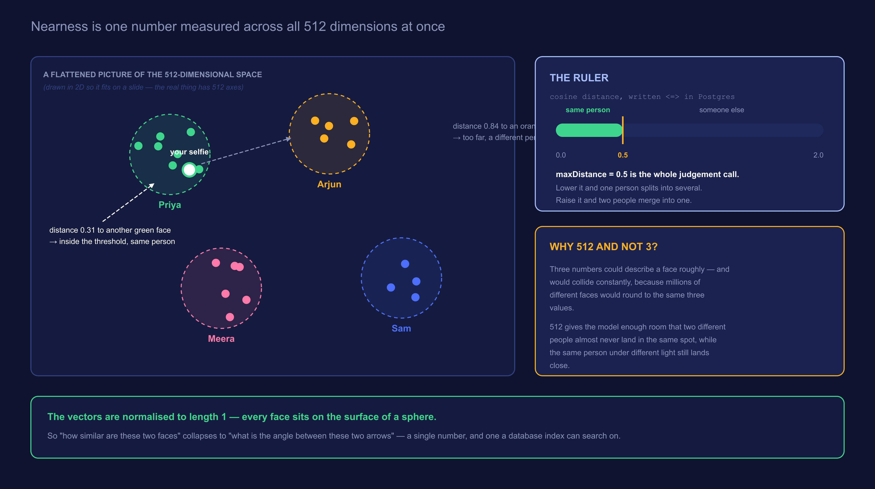
STEP 5 — COMPARE
Same person = close together. That is the whole trick.
Notes:
Stress that the 2D picture is a lie of convenience. In 512 dimensions there is far more room, which is exactly why the clusters stay separated.

Slide 17
ONE NUMBER, TWO FAILURE MODES
maxDistance = 0.5 is a judgement call, not a fact
Set it too low
0.2
Set it too high
0.9
The same person splits into several “people”
You in sunglasses becomes a different person from you without
Participants get only half their photos
Two different people merge into one
Someone receives photos of a stranger
The failure nobody can un-see
The two mistakes are not equally bad.
Missing a few of your own photos is an annoyance you fix by submitting a better selfie. Showing you a stranger’s photos is a privacy incident. When you tune this number, tune it toward the recoverable failure.
Notes:
Best decision-making lesson in the deck. Asymmetric costs should push the default, not a coin flip.

Slide 18
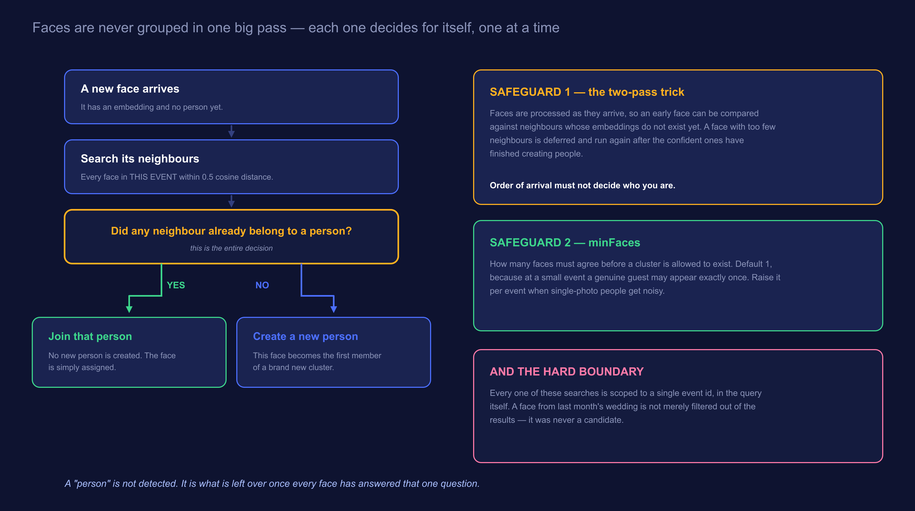
STEP 6 — GROUP
How a pile of vectors becomes a list of people
Notes:
Walk the YES branch and the NO branch out loud. Then say: run that for every face and people fall out. Nobody ever wrote a function called findPeople().

Slide 19
WHAT GOES WRONG, AND THE FIX
Two safeguards that stop order from deciding identity
The problem
Faces are processed as they arrive. The very first face has nobody to compare against — not because it is alone, but because its neighbours have not been embedded yet.
Safeguard 1 — the two-pass trick
A face with too few neighbours is not judged immediately. It is deferred and run again after the confident faces have finished creating people. Order of arrival must not decide who you are.
Safeguard 2 — minFaces
How many faces must agree before a cluster may exist at all. Default 1, because at a small event a real guest may genuinely appear in exactly one photo. Raise it per event when single-photo people get noisy.
Notes:
If you only have time for one, keep the two-pass one. Subtler bug, better story.

Slide 20
A DISTINCTION WORTH DRAWING
Clustering and selfie-matching are not the same job
Clustering
Selfie matching
“Who is in this event at all?”
“Which of these people is me?”
Runs on faces already in the database
Compares faces to each other
Produces anonymous “people” the organiser can name
Happens automatically, in the background
Runs on one selfie a guest just submitted
Compares that one vector against the event
Produces a tokenised gallery and an email
Happens on demand, while someone waits
Same model, same metric, same threshold — two completely different user-facing features. That reuse is the payoff for having turned faces into numbers in the first place.
Notes:
Students often assume the selfie flow re-runs clustering. It does not. Make that explicit.

Slide 21
THE INVARIANT
Every one of these searches is fenced to one event
The event id is part of the query, not a filter applied to the results. A face from last month’s wedding is not removed from the answer — it was never a candidate for it.
1
2
3
Why it matters here specifically
Why a filter is not enough
How we keep it true
The same person really does attend two different events. Without the fence, one selfie would reach across both — and hand someone photos from a party they never went to.
A filter is a step someone can forget during a refactor. A scoped query cannot silently lose its scope without the query itself changing.
test/face-isolation.spec.ts seeds two events with the same person and asserts nothing crosses. If anyone breaks it, the build goes red before a person does.
Privacy rules belong in tests, not comments.
Notes:
This is the slide students should photograph. Comments do not fail builds.

Slide 22
BE HONEST ABOUT THIS
Where 512 numbers stop being enough
Identical twins
Faces too small
Hard profiles
Genuinely close in the space. No threshold separates them cleanly.
A face 20 pixels across carries almost no signal. It fails minScore, or worse, scrapes past it.
Alignment needs landmarks. A face turned fully sideways has too few to straighten.
Heavy occlusion
Extreme lighting
Years apart
Masks, big sunglasses, a hand across the face — each removes a chunk of what the model measures.
Backlit or blown-out faces drift. Normalisation helps; it does not fix it.
A child at 6 and at 12 will not land close. The model measures a face, not a person.
Which is why an organiser can merge, split and rename people by hand — and why a participant can ask to be erased.
Notes:
Never present recognition as solved. The manual review tools exist precisely because this list exists.

Slide 23
ACT TWO
Running it
Three models, all wanting a GPU, all doing nothing between events. Everything here follows from that.
No REST API exists
When to wake it
When to sleep it
When the stop fails
Notes:
Before moving on, ask the room: "just turn it off when idle — what could go wrong?" Collect answers, then walk the ones they miss.

Slide 24
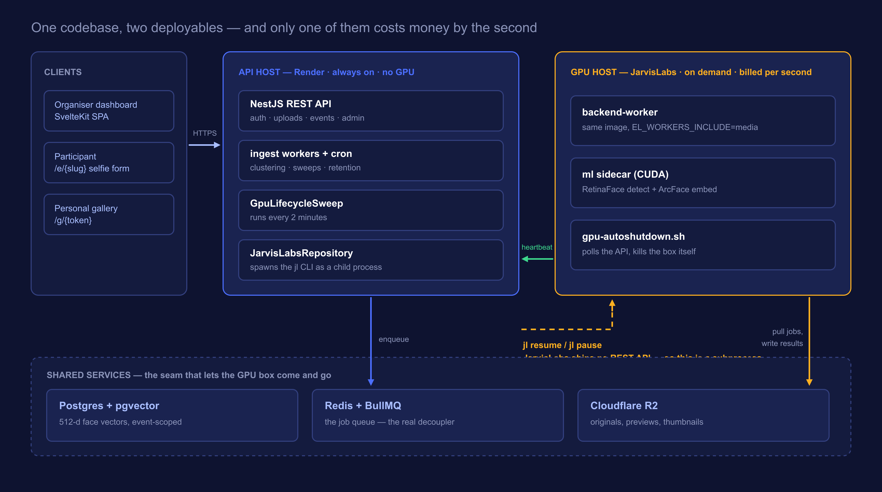
ARCHITECTURE
Two machines, and only one of them is expensive
Notes:
Trace the arrows in order: client to API, API to Redis, GPU worker pulls from Redis, GPU worker heartbeats back, API shells out to jl. The arrow DIRECTIONS are the lesson.

Slide 25
DEPLOYMENT
Same image. Different environment variable.
API host — Render
GPU host — JarvisLabs
EL_WORKERS_INCLUDE=api,ingest
EL_WORKERS_INCLUDE=media
Serves every HTTP request
Owns the cron schedules
Runs face clustering (CPU is fine)
Decides when the GPU should exist
All three models run here
Thumbnails and video transcode
Runs the ml sidecar next to it
Exists only while there is work
Microservices do not require separate repositories. They require separate lifecycles — and here the queue, not the network call, is what separates them.
Notes:
Break the "microservices = many repos" assumption. Then: because the API never calls the GPU directly, the GPU is allowed to not exist.

Slide 26
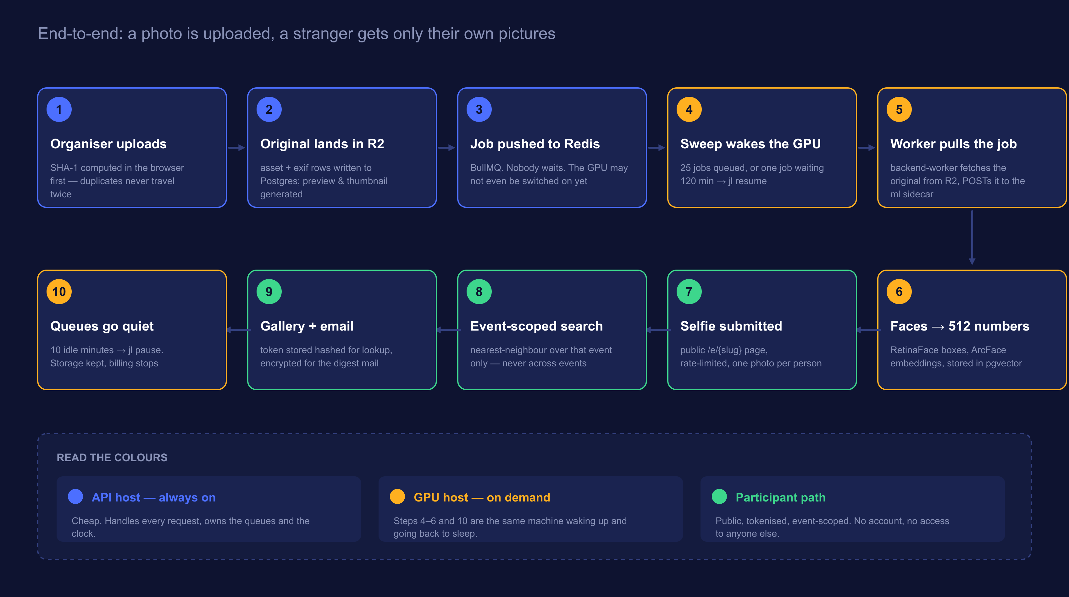
PROCESS FLOW
From an uploaded photo to a stranger’s private gallery
Notes:
Walk it once quickly end to end, then again pointing only at the amber steps: that is the GPU's entire life.

Slide 27
PROBLEM ZERO
The workload is bursty. The billing is not.
What a GPU costs you
What the work actually needs
24 × 7
minutes a day
Billed per second, whether or not a single photo was uploaded that day.
A fest dumps 4,000 photos in one evening, then nothing at all for two weeks.
So: switch the machine on when there is work, and off when there is not.
Easy to say. The next four slides are everything that goes wrong between saying it and it being safe to run unattended.
Notes:
Do not quote a price you have not verified. Talk in shape — bursty vs flat.

Slide 28
PROBLEM 1
JarvisLabs ships no REST API
There is a jl CLI and a Python SDK. That is it. So the Node backend controls a GPU by spawning a child process.
Auth through the environment
JL_API_KEY is read straight from env. No jl setup, no config file written — which is exactly why it works on a read-only container filesystem.
Machine-readable by force
--json on every call; --yes only on the verbs that prompt, because the read-only verbs reject it.
Installed into a venv
Debian marks the system Python externally-managed (PEP 668), so a plain pip install is refused. The image puts it in /opt/jarvislabs and symlinks jl.
Notes:
Show jarvislabs.repository.ts on screen. The header comment says most of it already.

Slide 29
PROBLEM 1, CONTINUED
Three ways driving a CLI bites you
Errors arrive on stdout, not the exit code
1
jl reports failure as {"error": "..."} on stdout with a non-zero exit. Read the body — the exit code alone tells you nothing useful to show an operator.
Resume can hand back a different machine id
2
Keep using the old id and you are targeting a machine that no longer exists. We log the reassignment and adopt the new id immediately.
A missing binary must look like a message, not a crash
3
ENOENT becomes “the jl CLI is not installed on this host”. This runs on the API box; a JarvisLabs outage should surface on the admin panel, not as an unhandled rejection.
“No API” does not mean “cannot automate”. It means your integration layer is a subprocess — and subprocesses need defensive handling.
Notes:
Most transferable slide in Act Two. Every student will shell out to something eventually.

Slide 30
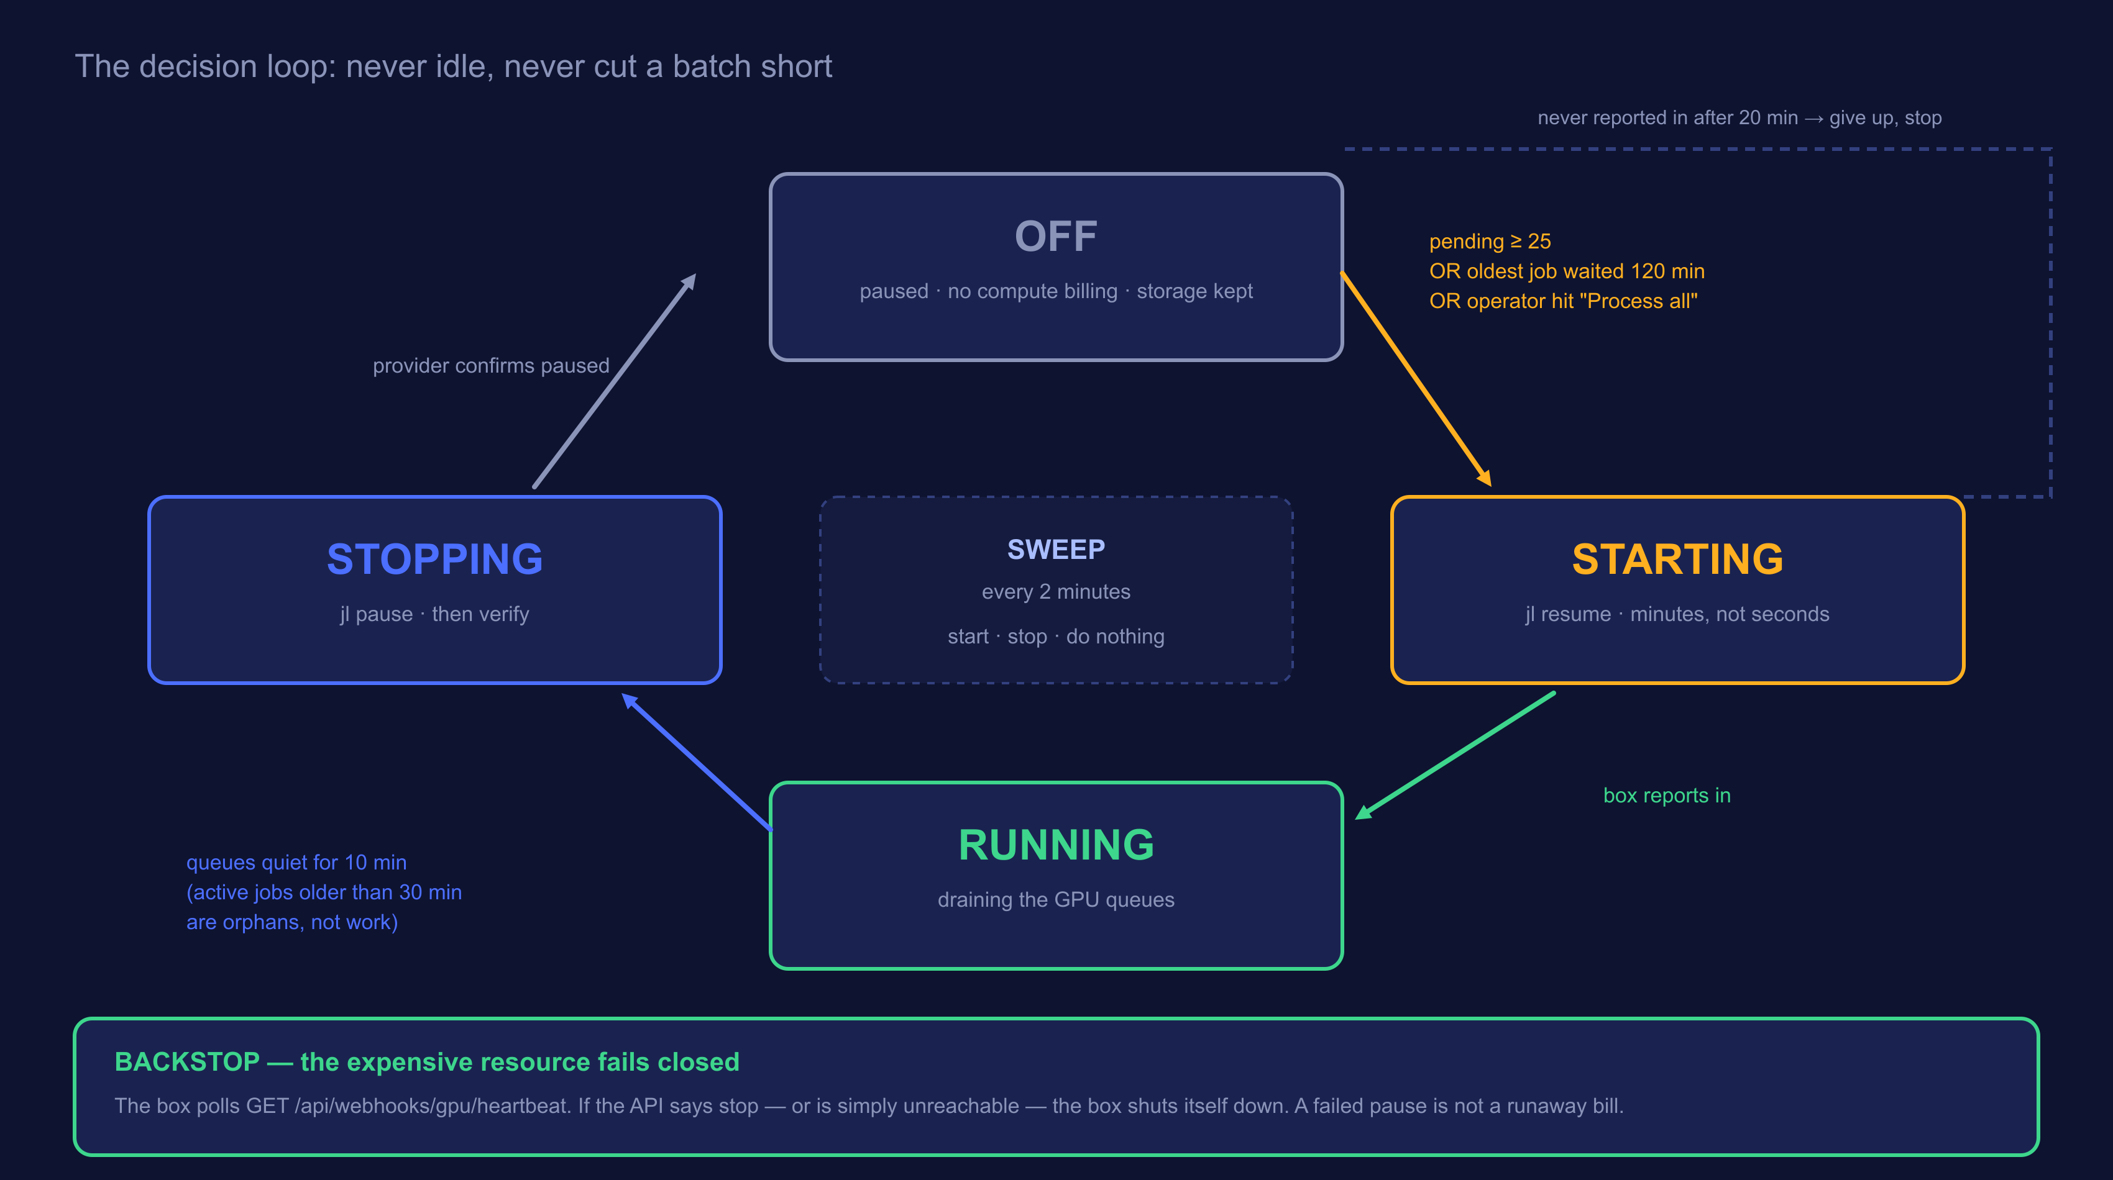
PROBLEMS 2 & 3
When to wake it, and when to let it sleep
Notes:
Open the real Admin -> GPU worker panel next to this if the demo stack is up.

Slide 31
THE ACTUAL SETTINGS
Four numbers decide everything
pendingThreshold
25
Wake once this many jobs are queued across the GPU queues.
maxPendingAgeMinutes
120
…or once the oldest waiting job has sat this long.
idleShutdownMinutes
10
Stop this long after the queues go quiet.
startTimeoutMinutes
20
Give up and stop if the box never reports in.
Why there are two wake conditions: a threshold on its own starves a single job forever. The age rule is what rescues the one photo that arrived on a quiet Tuesday.
Notes:
This is a bug students will write. Showing the fix before they write it is worth 90 seconds.

Slide 32
PROBLEM 4
What if the stop call simply fails?
Fast path
Backstop
The API runs jl pause.
The box polls us and kills itself.
Quick, normal, and what happens 99% of the time.
GET /api/webhooks/gpu/heartbeat → { keepAlive, reason, pending }. If the API says stop — or is simply unreachable — the box shuts down on its own.
The expensive resource fails closed.
An outage, a bad deploy, or a bug costs you an idle machine for a few minutes — not a weekend of GPU billing. And because the box polls us rather than us pushing to it, the VM needs no inbound network access at all.
Notes:
Say: the direction of the arrow is the security design and the cost design at the same time.

Slide 33
THE BUG THAT PAYS FOR ITSELF
One orphaned job can pin a GPU up forever
▶
The box is paused mid-batch
By design — that is the whole point of pausing.
▶
A job is left “active” in Redis
Nobody is alive to finish it or fail it. It never clears on its own.
▶
active > 0 keeps the box alive
And that is exactly the runaway bill the autoshutdown existed to prevent.
The fix: anything active for more than 30 minutes is an orphan, not work.
Generous on purpose. A long video transcode legitimately holds a job for many minutes, and cutting the box off mid-encode wastes the work already done. Thirty minutes is past any real job here and still caps the damage.
Notes:
Most "cost bugs" are really state bugs. The bill is just where you notice them.

Slide 34
THE PART NOBODY EXPECTS
The GPU’s sleep schedule changed the copy on the page
live
deferred
Box awake and keeping up
Box asleep, or badly backed up
A spinner, “you are number 4 in the queue”, and a rough estimate. It flips to the result if it finishes while they watch.
“Thanks — we will email you when your photos are ready.” No fake progress bar, no promise we cannot keep.
The cutoff is total GPU queue depth, not the selfie queue’s own depth. The selfie queue can be nearly empty while an import has thousands of faces queued ahead of it on the same GPU — total depth is the only honest signal for whether an estimate means anything.
Cost optimisation was not a setting bolted on at the end. It changed the queue design, the deploy topology, and the words on the page.
Notes:
Close Act Two on this. It is the line worth remembering.

Slide 35
MEASURED, NOT CLAIMED
What we can actually prove
13.7s
0
79 / 11
to rematch 10,000 faces across 500 participants
duplicate persons, and zero cross-identity matches
faces found and sensible clusters, on real photos
And the GPU?
What is honestly not done
Up during ingest bursts, paused the rest of the time, with the pause visible on the admin panel alongside what the provider itself reports — because the two disagreeing is the expensive case.
Live OAuth for the cloud imports is still unverified, and the multi-VM deploy has never been run on real VMs — only in compose. Browser-level UI testing is still API-level only.
Notes:
Naming what is unfinished buys more credibility than any number on this slide. Do not skip the right-hand card.

Slide 36
TAKE THESE HOME
Six rules that outlive this project
Use the pretrained model. The interesting engineering is almost never inside it.
1
Remove variation before the model — alignment buys you capacity you would otherwise waste.
2
When two failure modes cost different amounts, let the cheaper failure set your default.
3
Queues are what let you turn expensive things off.
4
Make the expensive resource fail closed, and let it kill itself rather than trusting someone else to.
5
Privacy rules belong in tests, not comments.
6
Only two of these are about machine learning. The rest are about running something you cannot afford to leave switched on.
Notes:
Read them out, then pause. This is where the recording gets rewatched.

Slide 37
Questions
The ones that always come up:
Did you train any of the models yourself?
Can you get the face back from the 512 numbers?
What happens with identical twins?
Why 0.5 — where did that number come from?
Why not just run inference on CPU?
Why not serverless GPU instead of pausing a machine?
Short answers: no, all three are pretrained · not faithfully, but we treat embeddings as personal data anyway · twins defeat it · 0.5 is Immich’s default and we kept it because the safer failure is splitting, not merging.
Notes:
The "can you reconstruct the face" question matters legally as much as technically. Say plainly: we treat embeddings as personal data, which is why erasure deletes them.

