Slide 1
A TRUE STORY ABOUT 4,000 PHOTOGRAPHS
The night everyone
took everyone else’s picture
…and how one selfie found the twelve that had Meera in them.
Three models
One queue
One GPU, mostly asleep
Notes:
Do not open with architecture. Open with the night. Tell them there is a person in this story and her name is Meera, and everything you build today is for her.

Slide 2
BEFORE WE BEGIN · THE CAST
Three characters, and only one of them is a person
Everything in this session is one of these three doing something for one of the others.
The organiser
Meera
The machine
Ran the fest. Has 4,000 photos, a laptop, and no interest in becoming a photo librarian. She uploads and then wants to be finished.
Was there. Is in about twelve of the photos. Has no account, will never make one, and will give you exactly one selfie and thirty seconds of patience.
Rented by the second. Extremely good at looking at faces. Terrible at knowing when to stop. Left alone, it will happily bill you for a fortnight of doing nothing.
The whole design falls out of what each one will not do.
The organiser will not tag. Meera will not sign up. The machine will not switch itself off unless you make it.
Notes:
Land the constraints as character traits, not requirements. People remember characters.

Slide 3
01
CHAPTER ONE
It is eleven at night
The fest is over. Four thousand photographs exist. Somewhere in them, twelve have Meera in them — and there is no way on earth she is going to scroll for them.
Notes:
Ask the room how they find their own photos today. Someone will say "the WhatsApp group". That is your competitor, and it is beating you.

Slide 4
THE PROBLEM, IN THREE NUMBERS
The haystack is fine. It is the needle that is the problem.
4,000
~12
1 hour
photographs from one evening
of them actually have her in
of scrolling to find them by hand
Nobody in this story is willing to do the work that would fix it.
Not the organiser, who would have to tag four thousand pictures. Not Meera, who would have to scroll them. So the work has to move somewhere else — and that somewhere is going to have a rental price per second.
So: one selfie in, only her photos out.
No account, no scrolling, no access to anybody else’s pictures. That promise is the entire product.
Notes:
Two beats: the problem is unwillingness, not difficulty. Then state the promise plainly and move to the demo.

Slide 5
STOP TALKING · SWITCH TO THE BROWSER
Four minutes, no slides
1
Drag in fifty photos
Badges flip as the jobs drain. Nobody is waiting on a progress bar.
2
Open the public link as a stranger
No login. A selfie box and a plain-English privacy notice.
3
Submit one selfie
Either a live queue position, or “we’ll email you”. You will see why later.
4
Open the gallery that comes back
Only her photos. Download the lot as a zip.
Notice what did not happen: nothing waited on the browser.
Every single thing after “upload” was a job on a queue. Remember that — it is the hinge the second half of the story turns on.
Notes:
Have the stack warm before the call. Keep a fallback recording ready — a cold ML sidecar will embarrass you live.

Slide 6
02
CHAPTER TWO
Teaching a machine to see a face
Nobody in this project trained a model. Three pretrained ones do all the seeing — and each answers exactly one question.
Notes:
Say plainly: this is an engineering project that uses models, not a research project that builds them. That is a legitimate and extremely common position — do not be sheepish about it.

Slide 7
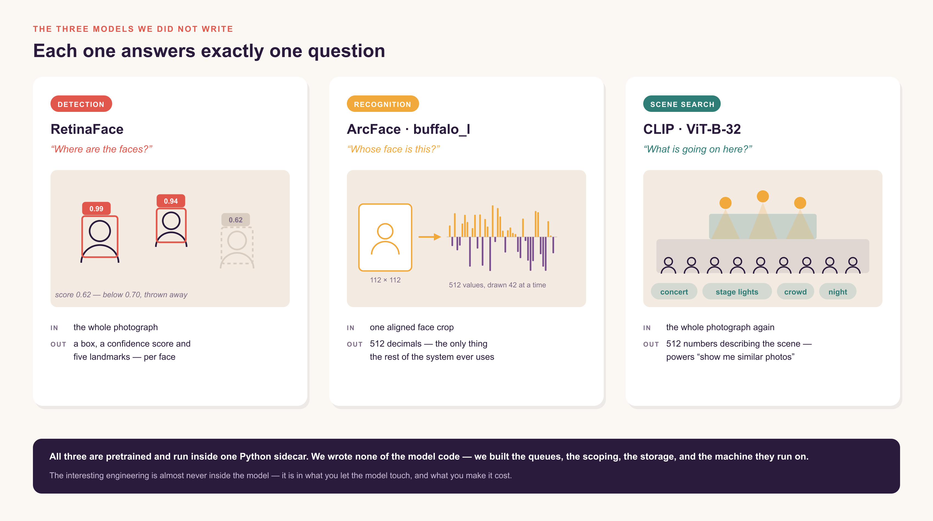
Notes:
Walk the three cards left to right. Dwell on the 0.62 face in the first panel — the model is allowed to be unsure, and we throw those away before they cost us anything.

Slide 8
THE PRACTICAL SIDE OF THREE MODELS
What they cost you to run
This table is the reason the second half of this story exists.
MODEL
HOW OFTEN
WHY IT MATTERS
RetinaFace
once per photo
The gate. It decides how much work everything downstream has to do.
ArcFace
once per FACE
A group photo of thirty people is thirty runs. This is what fills the GPU queue.
CLIP
once per photo
Optional. Its own service and queue, so a small deployment can drop it entirely.
Three models, all wanting a GPU, all doing nothing at all between events.
Every architectural decision in the rest of this story follows from that one sentence.
Notes:
Bridge slide. Plant the cost problem here so the JarvisLabs chapters feel inevitable rather than bolted on.

Slide 9
03
CHAPTER THREE
One photograph, all the way through
Follow a single picture from the camera roll to the database — and watch it stop being a picture somewhere in the middle.
Notes:
This chapter is the heart of the ML explanation. Slow down.

Slide 10
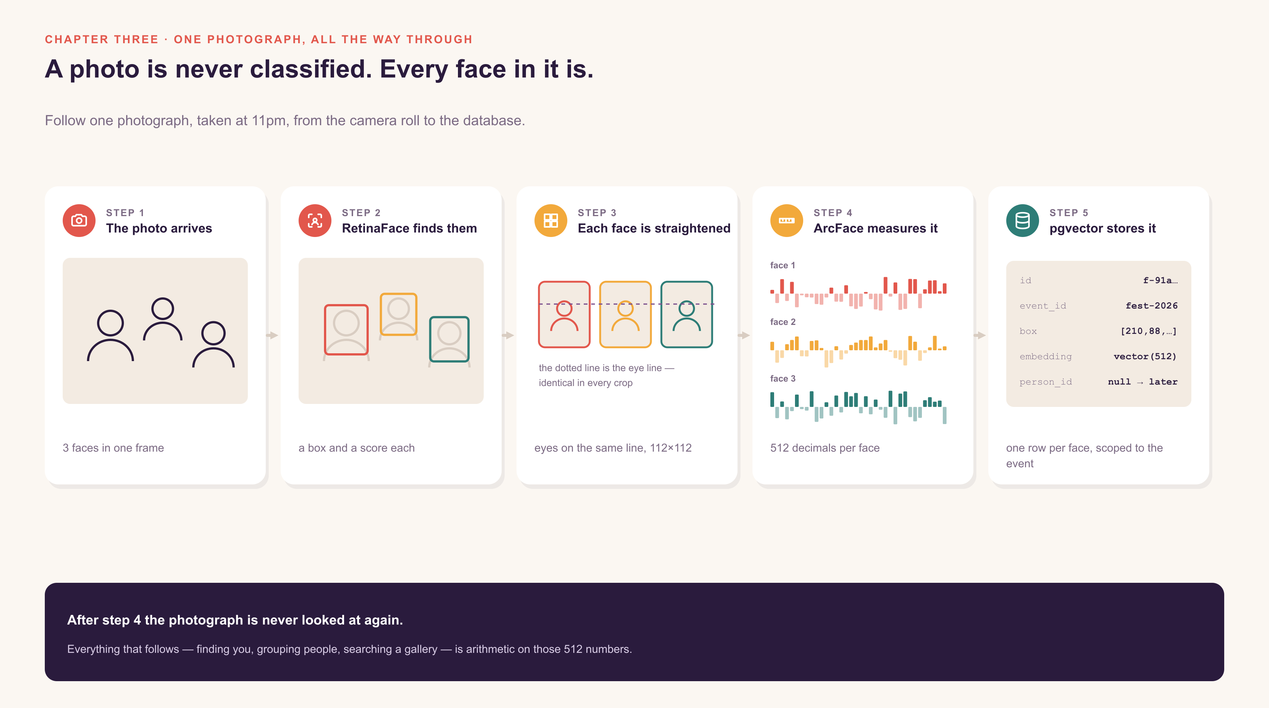
Notes:
Walk left to right once. Then put your finger on step 4 and say: after this, the photograph is never opened again. Everything else in this deck is arithmetic on those numbers.

Slide 11
THE QUESTION PEOPLE ALWAYS ASK
Why cut the faces out? Why not show it the whole photo?
If you fed it the whole frame
Because you crop each face first
• One answer for a picture with thirty people in it
• The background and the lighting dominate
• The biggest face wins; the girl at the edge is ignored
• Move the camera and the “identity” changes
• Thirty faces become thirty small, comparable problems
• The model only ever sees a face, filling the frame
• The girl at the edge counts as much as the boy in front
• The same person in two photos gives two close answers
Detection is not a chore you do before the interesting part. It IS the interesting part.
It turns one impossible question into thirty easy ones — and that is the only reason the recognition model can be small and fast enough to run at all.
Notes:
Ask them what "classify this photo" would even mean for a picture with thirty people in it. Let the answer be awkward before you rescue it.

Slide 12
THE STEP NOBODY MENTIONS
Every face is straightened before it is measured
Five landmarks — two eyes, a nose, two mouth corners — are used to warp every crop so they land in the same place. A tilted head and a straight one become the same picture.
Without it
With it
The general rule
The model has to learn “same person, rotated twenty degrees” separately for every angle — and spends half of its 512 numbers describing pose instead of identity.
Pose is gone before the model sees anything. All 512 numbers get spent on the thing you actually care about: what makes this person not that person.
Every bit of variation you remove before the model is capacity you get back. This is true far beyond faces — it is most of what feature engineering ever was.
Ask the room to tilt their heads.
To a human those are obviously the same face. To a model without alignment, they are two unrelated grids of pixels.
Notes:
Genuinely ask them to tilt. It gets a laugh and it makes the point in one second.

Slide 13
04
CHAPTER FOUR
What “you” looks like as numbers
Meera’s face becomes 512 decimals. Her other photographs become 512 decimals that land nearby. Everything after this is measuring the gap.
Notes:
This is where the audience mental model gets set. Get the next slide right.

Slide 14
YOU PROBABLY ALREADY HALF-KNOW THIS
The version most people arrive with — and what it misses
“Your face is turned into a 512-number fingerprint. Your other photos give nearby numbers. The nearby ones get grouped into a person.”
All of that is right. Three details change how you would build it:
1
2
3
One distance, not 512 comparisons
Numbers
One at a time, not one big pass
They are decimals like -0.118, not single digits. Together they make one arrow pointing somewhere.
You never compare slot 7 to slot 7. All 512 collapse into a single number, and one threshold decides.
There is no grouping step. Each face asks “does a close neighbour already have a name?” and joins, or starts one.
Confirm the model warmly before you correct it.
Someone in the room is about to say this out loud, and they are 85% right. Tell them so first.
Notes:
Do not lead with the correction. Confirm, then sharpen. The three corrections are the ones that actually change code.

Slide 15
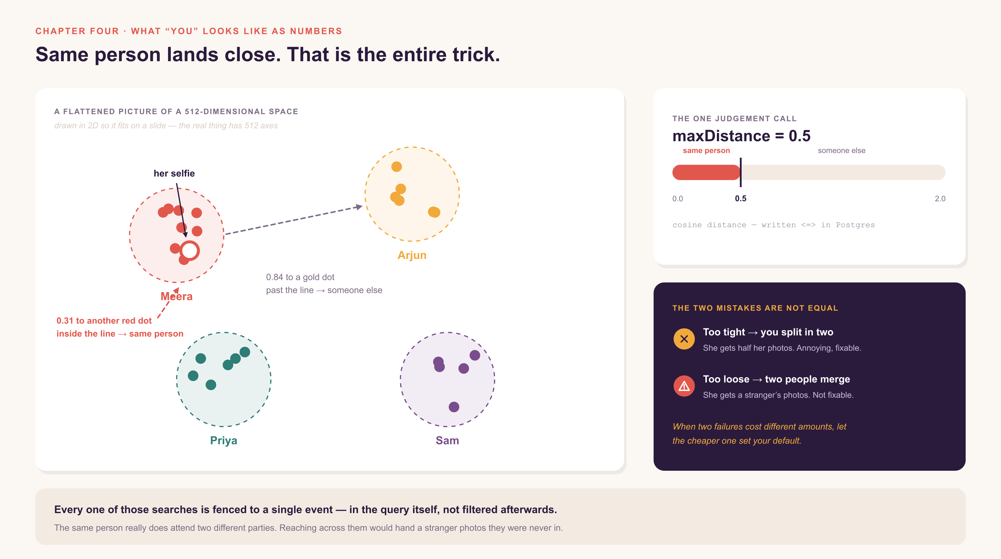
Notes:
Stress that the 2D picture is a lie of convenience — in 512 dimensions there is vastly more room, which is exactly why the clusters stay apart. Then dwell on the dark panel: the two mistakes are not equal.

Slide 16
05
CHAPTER FIVE
How strangers become people
Nobody ever wrote a function called findPeople(). People are simply what is left over once every face has answered one question.
Notes:
The best "aha" in the deck. Set it up as a mystery: at no point does anything in this system decide there are eleven people at this party.

Slide 17
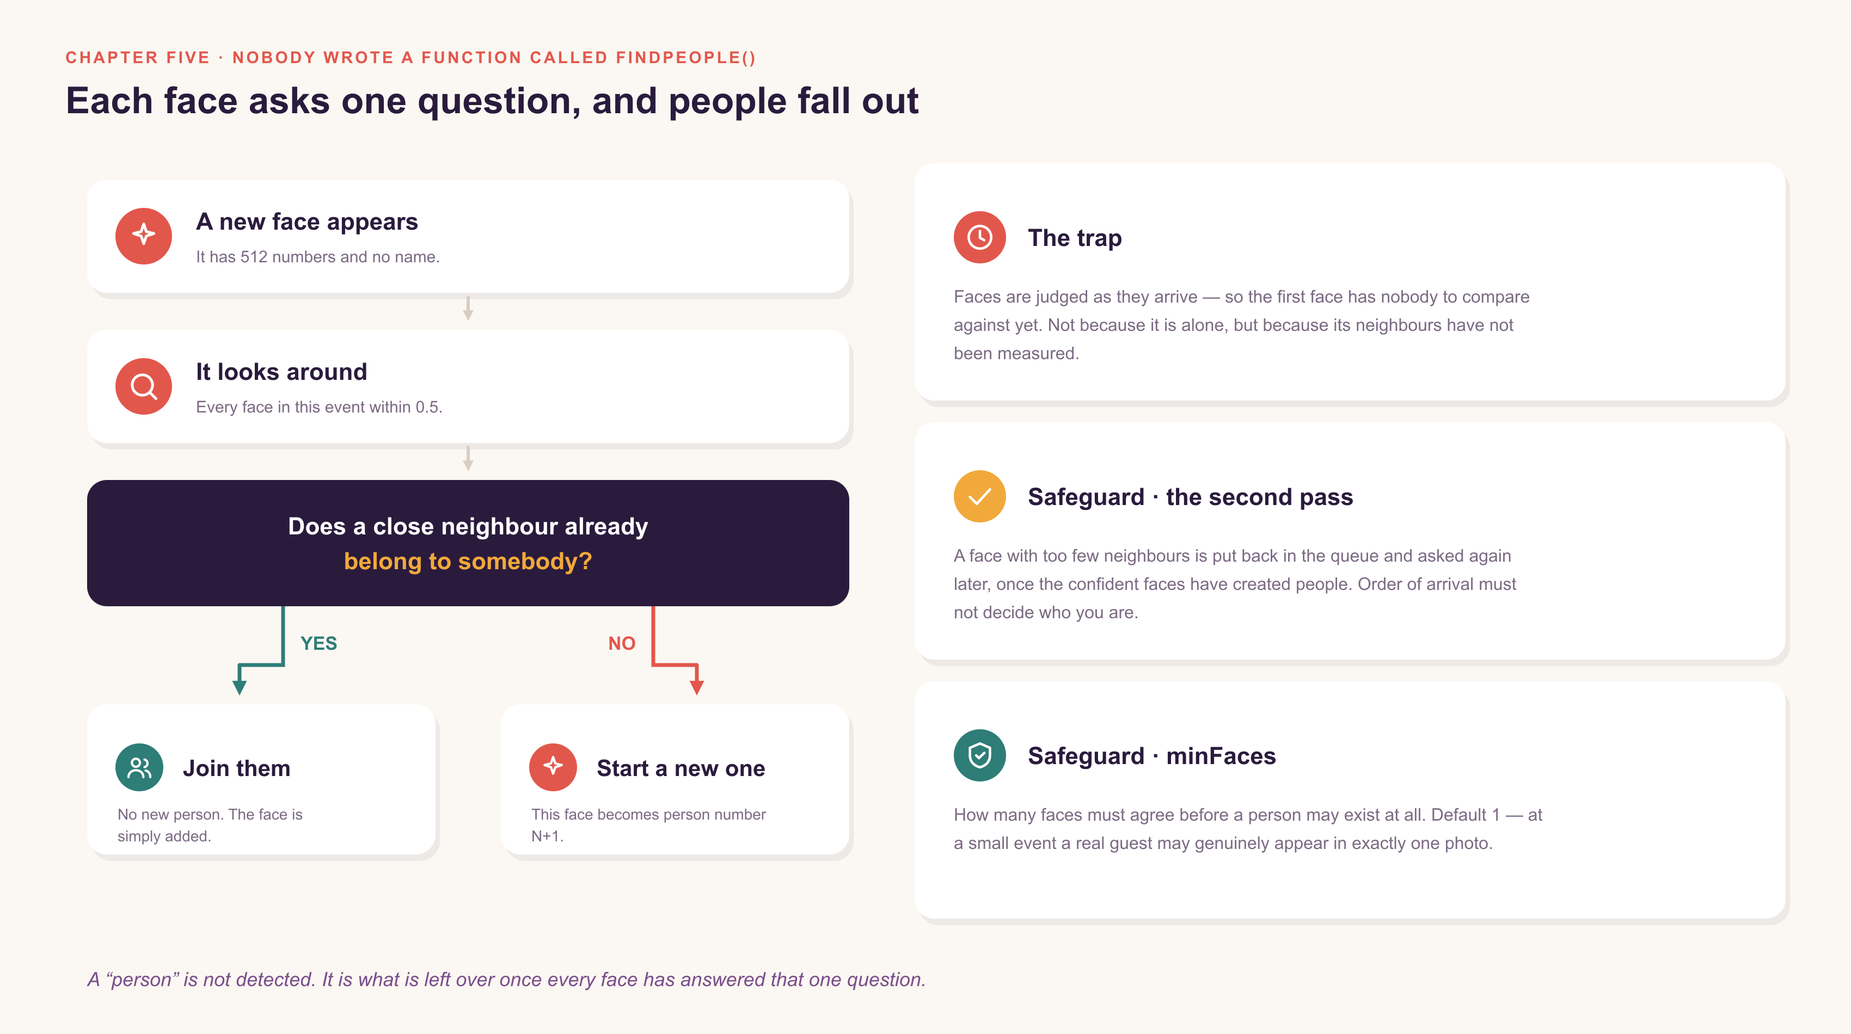
Notes:
Walk the YES branch and the NO branch aloud. Then say: run that for every face and people fall out of the bottom. Nobody counted them.

Slide 18
A DISTINCTION WORTH DRAWING
Two different questions, one set of numbers
Clustering asks:
“who is at this party at all?”
Matching asks:
“which of them is me?”
Runs on faces already in the database. Compares them to each other. Produces anonymous people the organiser can name. Happens quietly, in the background, without anybody asking.
Runs on one selfie Meera just submitted. Compares that single vector against the event. Produces a private gallery and an email. Happens on demand, while she waits.
Same model, same ruler, same threshold — two completely different features.
That reuse is the whole payoff for having turned faces into numbers in the first place. Build the representation once, and the features get cheap.
Notes:
Students assume the selfie flow re-runs clustering. It does not. Say so explicitly.

Slide 19
BE HONEST ABOUT THIS
Where 512 numbers stop being enough
Identical twins
Faces too small
Hard profiles
Genuinely close together in the space. No threshold separates them cleanly. None.
Twenty pixels across carries almost no signal — it fails the score, or worse, scrapes past it.
Straightening needs landmarks. A head turned fully sideways has too few of them to warp.
Masks and sunglasses
Brutal lighting
Years apart
Each one removes a chunk of exactly what the model was measuring.
Backlit or blown out, faces drift. Normalising helps. It does not rescue.
A child at six and at twelve will not land close. It measures a face, not a person.
Which is exactly why a human can merge, split and rename people by hand.
And why Meera can ask to be erased entirely. The manual tools are not a fallback for a bad model — they are the honest response to a list like this one.
Notes:
Never present recognition as solved. This slide buys you more credibility than any accuracy number would.

Slide 20
06
CHAPTER SIX
The machine that costs money to think
Everything so far needed a GPU. A GPU is rented by the second. The fest lasted one evening, and then nothing happened for a fortnight.
Notes:
Ask the room: "so just turn it off when it is idle — what could go wrong?" Collect answers. Then walk the ones they miss. That participation is what makes the next three slides land.

Slide 21
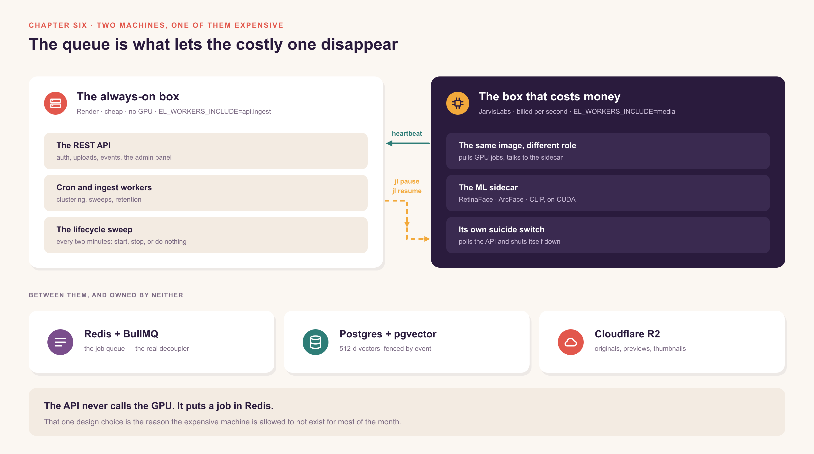
Notes:
Trace the arrows in this order: the API puts a job in Redis; the GPU worker pulls it; the GPU worker calls back with a heartbeat; the API shells out to jl. The arrow directions ARE the lesson.

Slide 22
THE SHAPE OF THE PROBLEM
The work is bursty. The bill is not.
What a rented GPU costs
What the work actually needs
24 × 7
minutes a day
Billed by the second, whether or not a single photograph was uploaded that day.
One evening of a fest dumps four thousand photos. Then nothing at all for a fortnight.
So switch it on when there is work, and off when there is not. Obvious. Everybody says it.
The next three slides are everything that goes wrong between saying it and it being safe to leave unattended.
Notes:
Do not quote a rupee figure you have not verified. Talk about the SHAPE — bursty versus flat — and it is unarguable.

Slide 23
PROBLEM ONE
JarvisLabs has no REST API. None. Only a command.
So a Node web server controls a GPU by spawning a child process — and that is a perfectly respectable thing to do, as long as you are paranoid about it.
Errors arrive on stdout, not the exit code
1
The CLI reports failure as a JSON body while also exiting non-zero. Read the body — the exit code alone gives an operator nothing they can act on.
Resume can hand back a different machine
2
Keep using the old id and you are talking to a machine that no longer exists. Log the swap and adopt the new id immediately.
A missing binary must read as a sentence
3
“The jl CLI is not installed on this host” belongs on the admin panel. A provider outage should never surface as an unhandled rejection.
“No API” never means “cannot automate”.
It means your integration layer is a subprocess — and subprocesses need defensive handling the way network calls need timeouts.
Notes:
The most transferable slide in the whole session. Every one of them will shell out to something eventually.

Slide 24
07
CHAPTER SEVEN
Waking it, and letting it sleep
Four numbers decide when the expensive machine exists. A fifth mechanism decides what happens when the switch itself fails.
Notes:
Open the real Admin → GPU worker panel alongside this chapter if the stack is up.

Slide 25
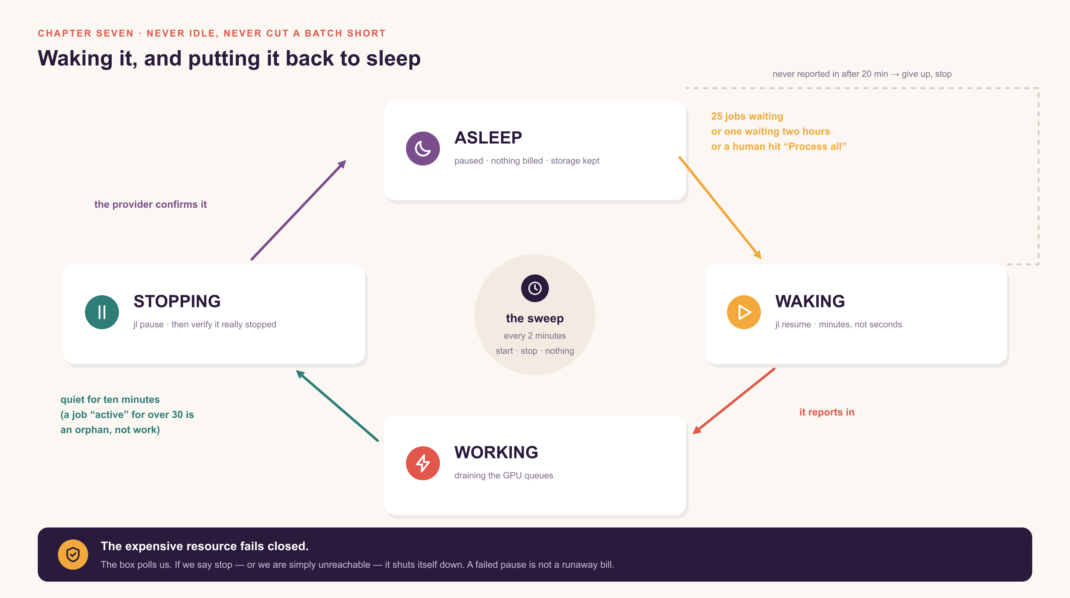
Notes:
Walk the loop clockwise, then point at the dashed line: that is the case where the box never wakes up and we stop paying for a machine that never arrived.

Slide 26
THE SETTINGS, IN FULL
Four numbers decide everything
pendingThreshold
25
Wake up once this many jobs are waiting.
maxPendingAgeMinutes
120
…or once the oldest one has waited this long.
idleShutdownMinutes
10
Go back to sleep this long after things go quiet.
startTimeoutMinutes
20
Give up, and stop, if it never reports for duty.
Why there are two ways to wake it up.
A threshold on its own starves a single job forever. The age rule is what rescues the one photograph that arrived on a quiet Tuesday — and that is a bug most people write before they fix it.
Notes:
Worth ninety seconds. This is a bug they will write, and showing the fix before they write it is the whole point of teaching.

Slide 27
PROBLEM TWO · WHAT IF THE OFF SWITCH FAILS?
So the machine is given the power to kill itself
The fast path
The backstop
The API runs the pause command. Quick, ordinary, and what happens ninety-nine times out of a hundred.
The box polls us every few seconds and asks “should I still be alive?” If we say no — or if we cannot be reached at all — it shuts itself down.
The expensive resource fails closed.
An outage, a bad deploy, or a bug costs you an idle machine for a few minutes — never a weekend of billing. And because it polls us rather than us pushing to it, the machine needs no inbound access at all.
The direction of that arrow is the cost design and the security design at the same time.
Notes:
If they remember one operational idea from the whole session, make it this one.

Slide 28
THE BUG THAT PAYS FOR ITSELF
How one forgotten job pins a GPU up forever
The box is paused halfway through a batch
1
By design. That is the entire point of pausing it.
A job is left marked “active” in Redis
2
Nobody is alive to finish it or fail it, and it never clears on its own.
“Active jobs exist” is what keeps the box awake
3
So a single ghost job holds up a GPU indefinitely — the exact bill the whole mechanism existed to prevent.
The fix: anything “active” for more than thirty minutes is a ghost, not work.
Generous on purpose. A long video legitimately holds a job for many minutes, and cutting the machine off mid-encode throws away work already paid for. Thirty minutes is past any real job here, and still caps the damage.
Notes:
Most "cost bugs" are really state bugs. The bill is just the place where you finally notice them.

Slide 29
08
CHAPTER EIGHT
The end of the night
Meera opens a link, submits one selfie, and gets twelve photographs. Here is everything that happened between those two moments.
Notes:
This is the payoff. The next spread is the whole story on one page — use it as the recap.

Slide 30
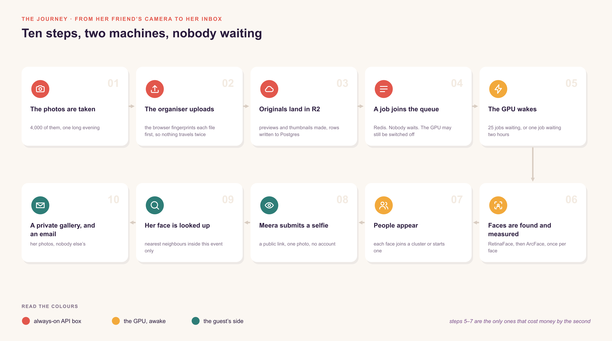
Notes:
Walk it once quickly end to end. Then walk it again touching only the gold cards and say: that is the machine's entire life. Everything else was free.

Slide 31
THE PART NOBODY EXPECTS
The machine’s sleep schedule changed the words on the page
When the box is awake and keeping up
When it is asleep, or badly behind
She sees a spinner, “you’re number four in the queue”, and a rough estimate — and it flips to her gallery if it finishes while she is still watching.
“Thanks — we’ll email you when your photos are ready.” No fake progress bar. No promise we are not in a position to keep.
The cutoff is the TOTAL queue depth, not her own queue. Her selfie can be next in line while an import has thousands of faces ahead of it on the same GPU — total depth is the only honest signal for whether an estimate means anything.
Cost was not a setting we bolted on at the end.
It changed the queue design, the deployment, and in the end the sentence a stranger reads on her phone.
Notes:
Close the operational chapters here. It is the line worth remembering, and it ties the two halves of the story together.

Slide 32
MEASURED, NOT CLAIMED
What we can actually prove
13.7s
zero
79 / 11
to rematch 10,000 faces across 500 participants
duplicate people, zero cross-identity matches
faces found, and sensible clusters, on real photos
And the machine?
What is honestly not finished
Awake during the bursts, asleep the rest of the time — with what we believe shown on the panel next to what the provider actually reports. The two disagreeing is the expensive case, so it should be visible, not discovered on an invoice.
Live OAuth for the cloud imports is unverified. The two-machine deployment has only ever run in compose, never on real VMs. UI testing is still API-level only.
Notes:
Naming what is unfinished buys more credibility than any number on the left. Do not skip the right-hand card.

Slide 33
WHAT TO TAKE HOME
Six rules that outlive this project
Use the pretrained model.
The interesting engineering is almost never inside it.
Remove variation before the model.
Alignment buys back capacity you would otherwise waste on pose.
Let the cheaper failure set your default.
Splitting a person is annoying. Merging two is a privacy incident.
Queues are what let you turn expensive things off.
Decoupling is a cost strategy, not just an architecture diagram.
Make the expensive thing fail closed.
Give it the power to kill itself rather than trusting you to remember.
Privacy rules belong in tests, not comments.
A comment has never once failed a build.
Only two of them are about machine learning. The rest are about running something you cannot afford to leave switched on.
Notes:
Read them out, then pause. This is the slide the recording gets rewatched for.

Slide 34
Meera got her twelve photographs.
The machine that found them was awake for about four minutes, and has been asleep ever since.
QUESTIONS THAT ALWAYS COME UP
Did you train any of the models?
Can you get the face back from the numbers?
No. All three are pretrained.
Not faithfully — but we treat them as personal data anyway.
What about identical twins?
Why 0.5, and not something else?
They defeat it. Honestly.
Upstream default, kept because the safer failure is splitting.
Why not just use CPU?
Why not serverless GPU?
Try it on four thousand photos and report back.
Cold starts, and a model that has to load every time.
EventLens · deployment notes in docs/deploy-production.md
Notes:
End on Meera, not on the architecture. Then open the floor. Offer to stay on the call for anyone who wants to see the code.

