Slide 1
IE630 Project – Simulating Aromas Operations
Team Members-
Kundan Pratap (24N0454)
Kishan Upadhyay (24N0453)
Manish (24N0451)
Sunrit Pal (24N0456)

Slide 2
Project Objective
The project objective is to perform simulation of Aromas Restaurant Operations.
Customers arrive through both offline and online modes.
Food orders span four categories: Juice, Fast Food, Canteen, Restaurant
Separate sources for each mode and food category, distinct queues for each category type
Unidirectional Customer Flow: Entry -> Queue -> Service -> Exit

Slide 3
Input Data Analysis
Some initial input data used for this project was collected at Aromas, rest was synthetically generated
It is known that interarrival times can follow exponential, Weibull, Gamma, Pareto, Erlang, Log-Normal
Statistical Parameters for each of the above distributions were estimated and KS test was performed for all the datasets
Histograms with various statistical results were plotted alongside various fitted distributions to compare and identify the best one

Slide 4
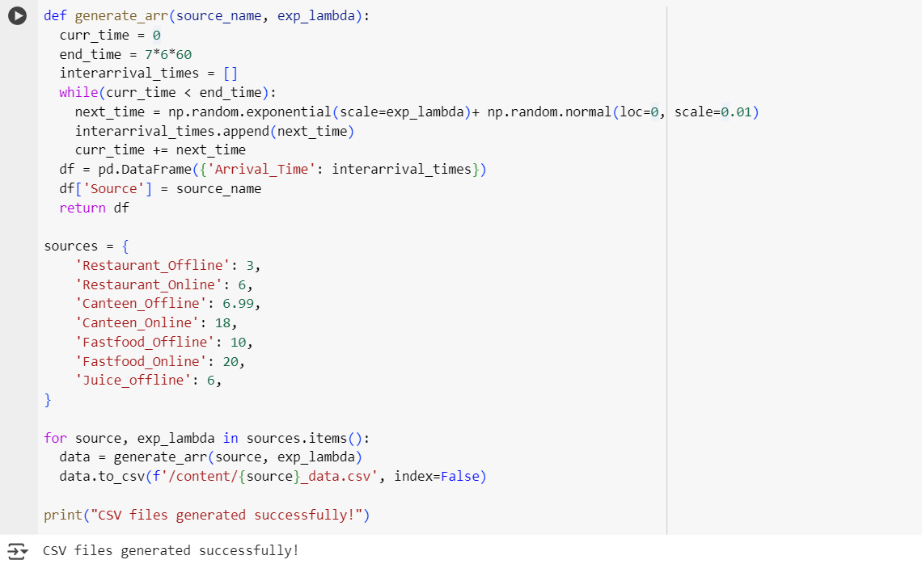
Code for generating Synthetic Data
https://colab.research.google.com/drive/1rbvi1BHtEsS_IIDL4jfM35Un4Rt9kke5#scrollTo=p5oewRZe9yUD

Slide 5
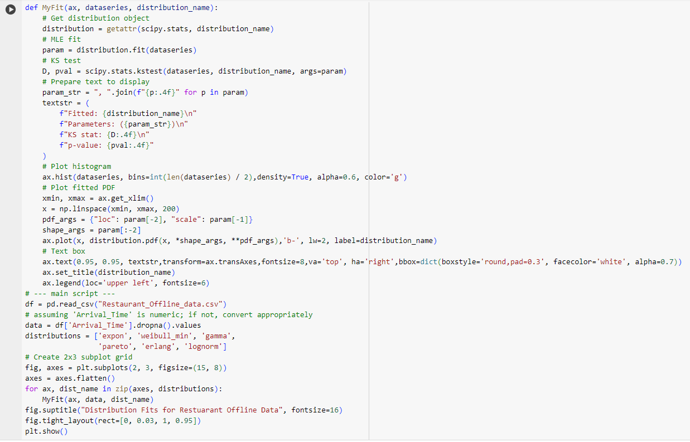
Code for fitting distributions

Slide 6
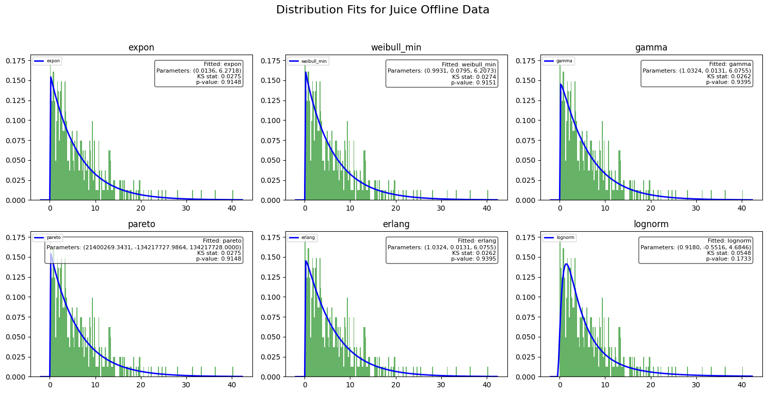

Slide 7
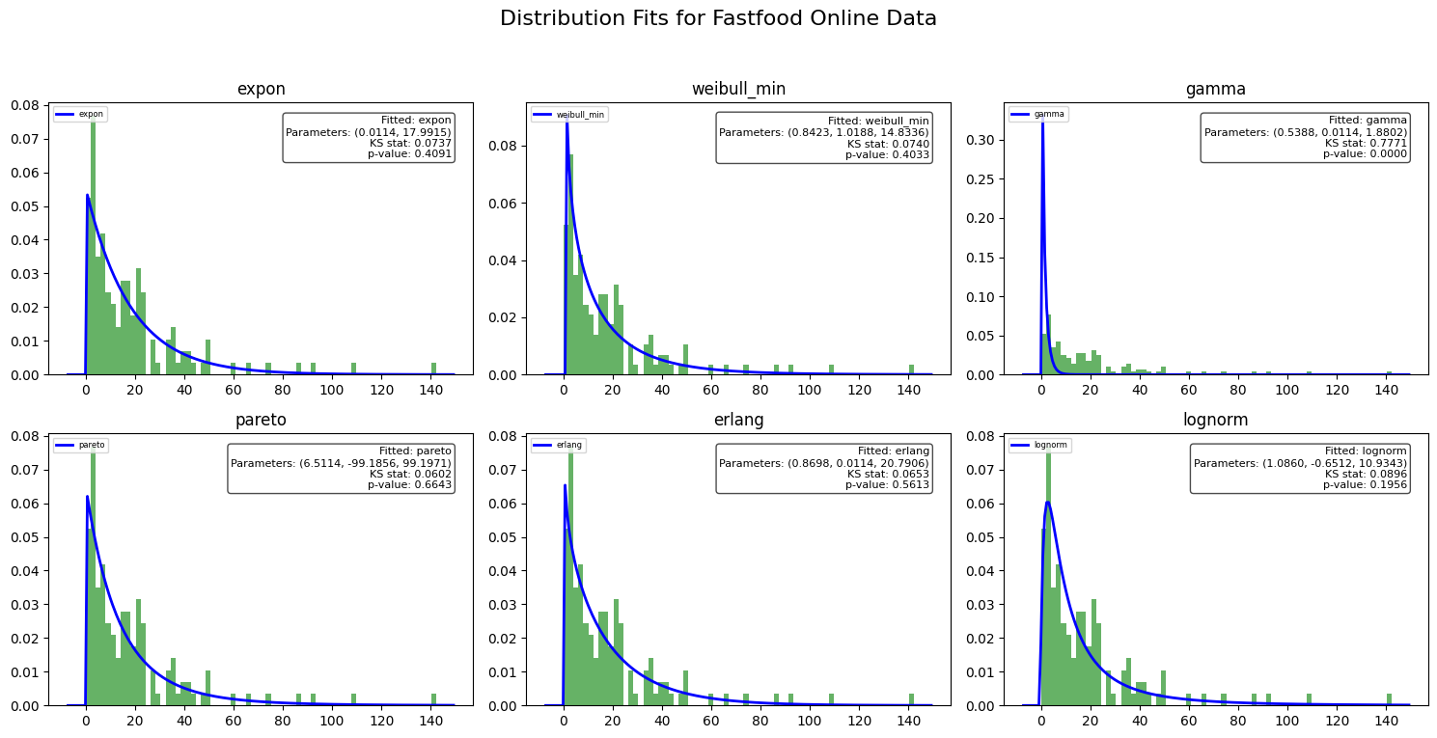

Slide 8
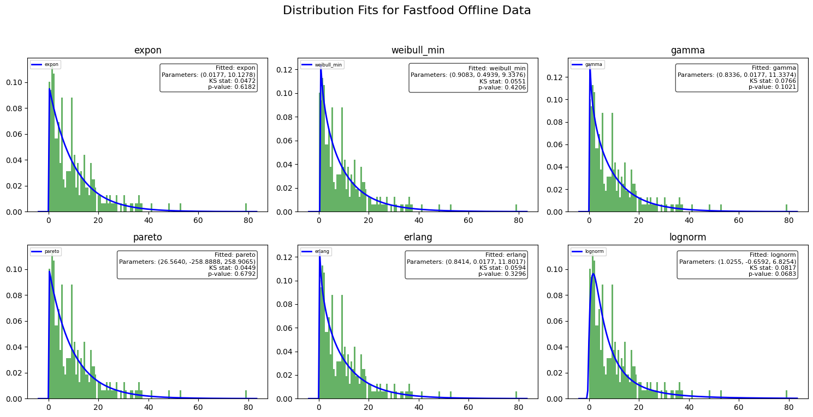

Slide 9
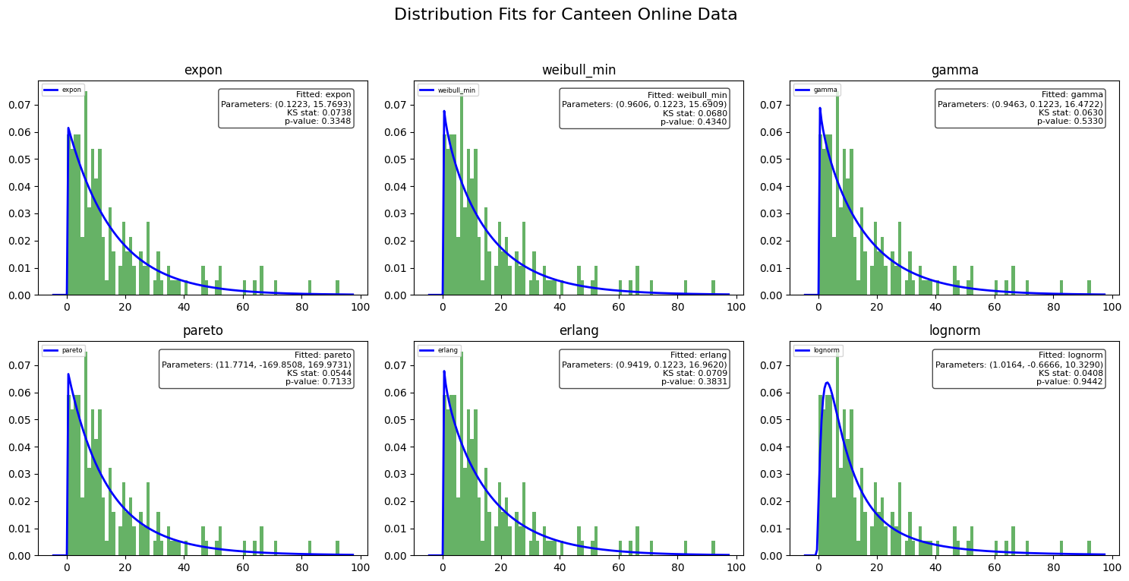

Slide 10
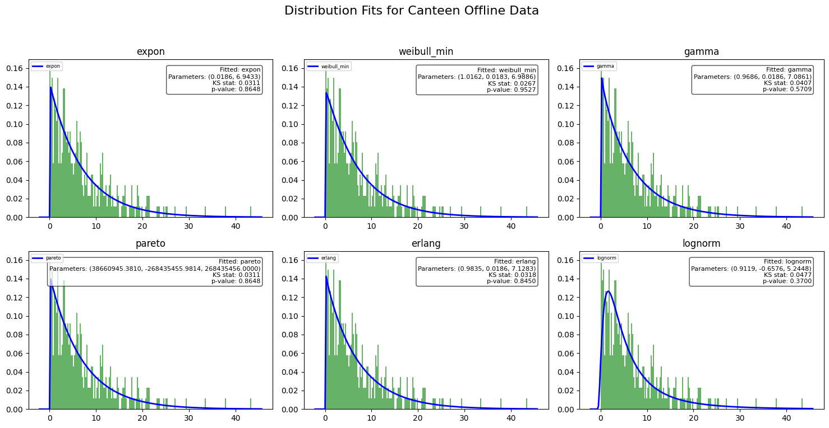

Slide 11
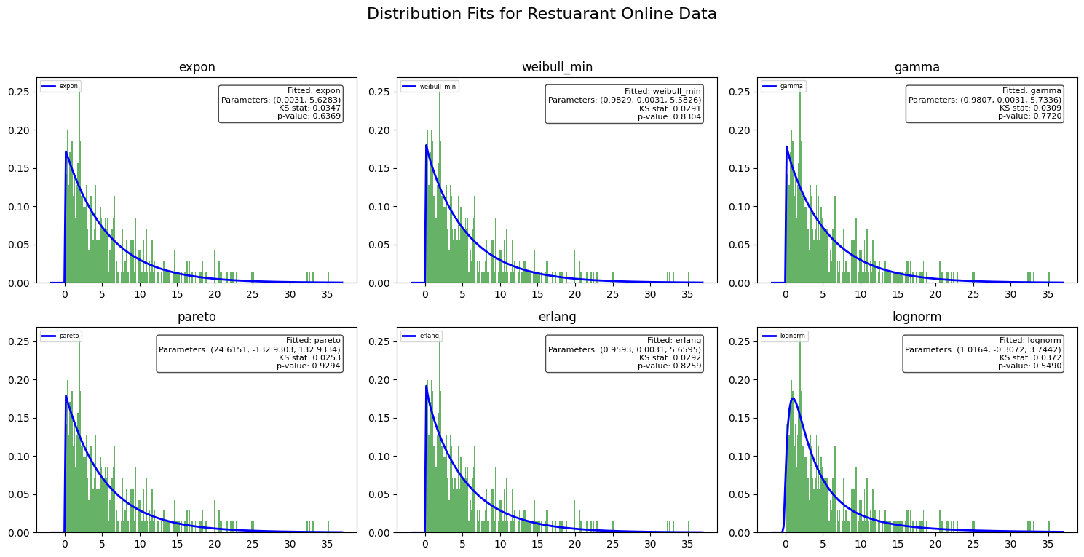

Slide 12
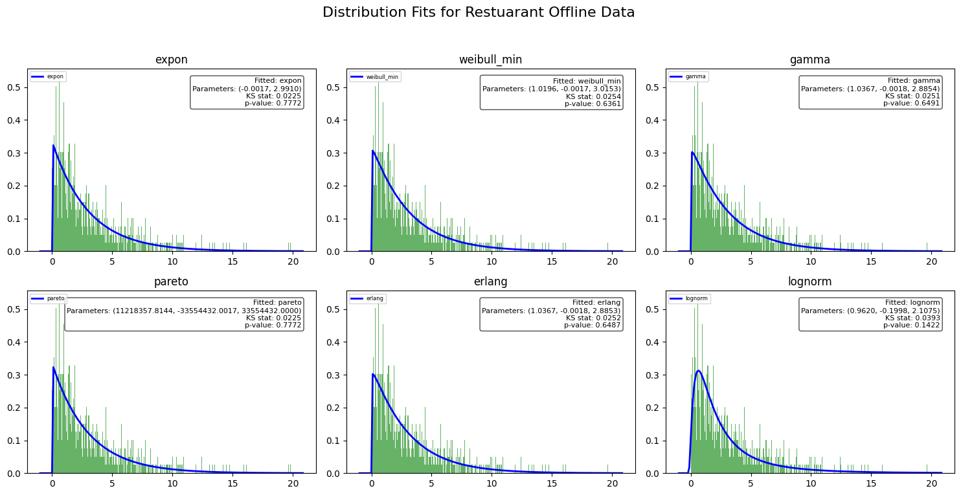

Slide 13
How we constructed the Model
We have used 7 sources for the offline and online customer arrivals.
We have taken 4 servers using delay blocks that provide service to these arrivals.
We have added decision nodes to differentiate between Offline and Online Customers because we wanted to know to know the number of offline customers so that we could decide the optimal seating capacity
We have also added sliders for dynamically updating arrival rates and capacity of seating area, so that we can observe changes during simulation run itself.
We have also plotted the PDF of the waiting times for all the sources. We have also plotted line plots to see variation in the waiting times over time.

Slide 14
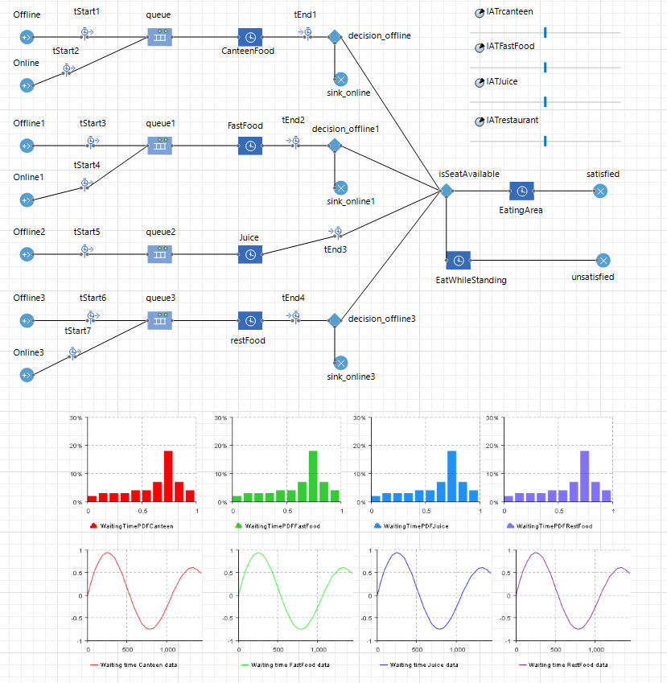
Model

Slide 15
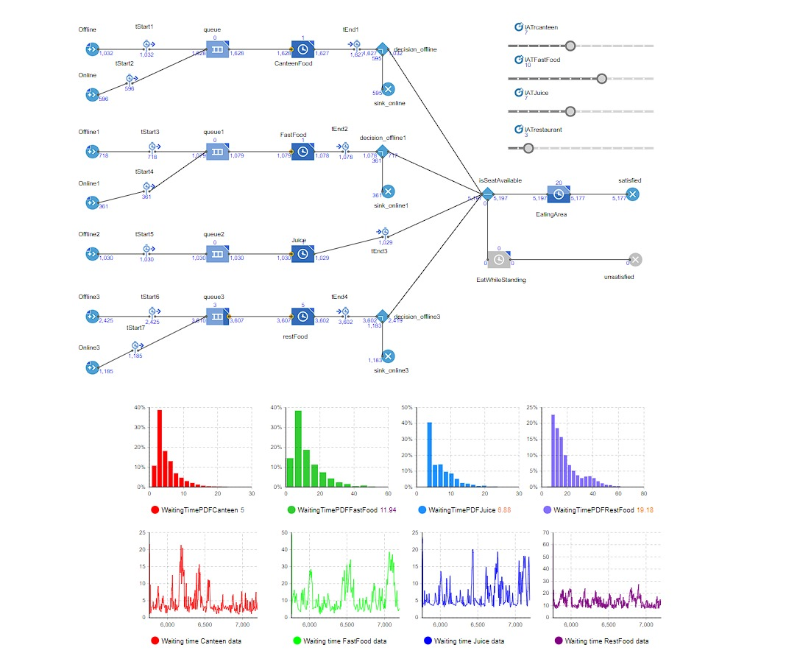
Output of Simulation

Slide 16
What If Analysis : Vary Parameters and Observe Model

Slide 17
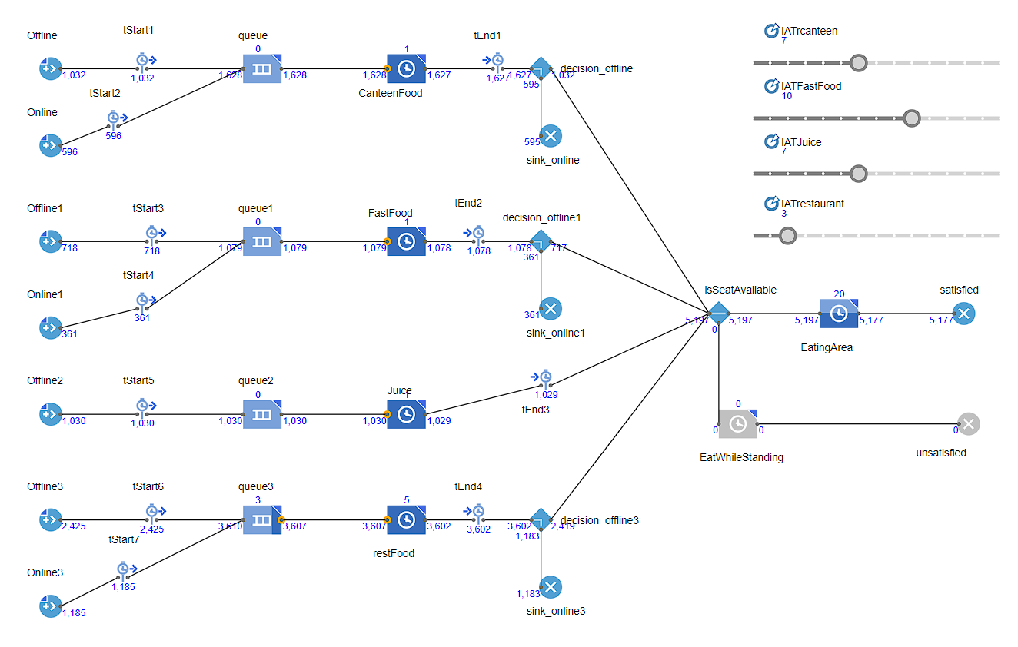
Capacity=55

Slide 18
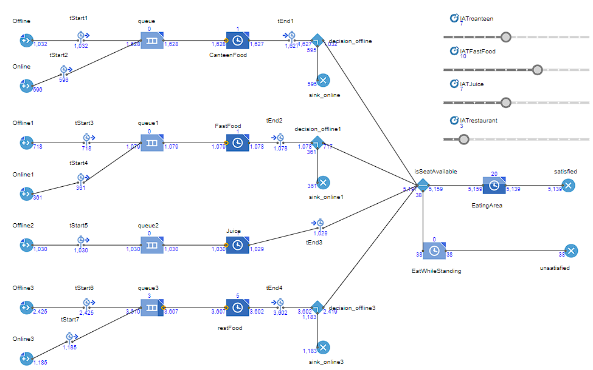
Capacity=45

Slide 19
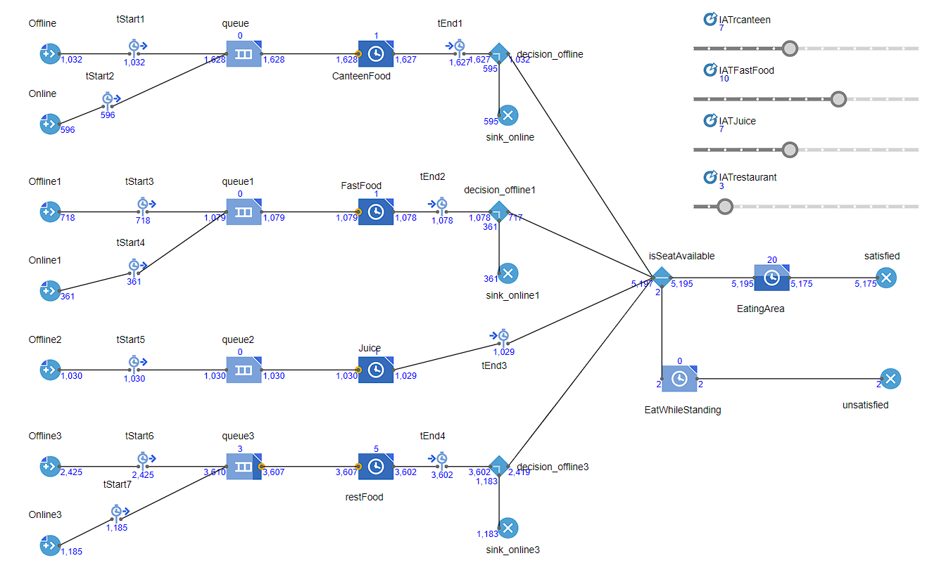
Capacity=48

Slide 20
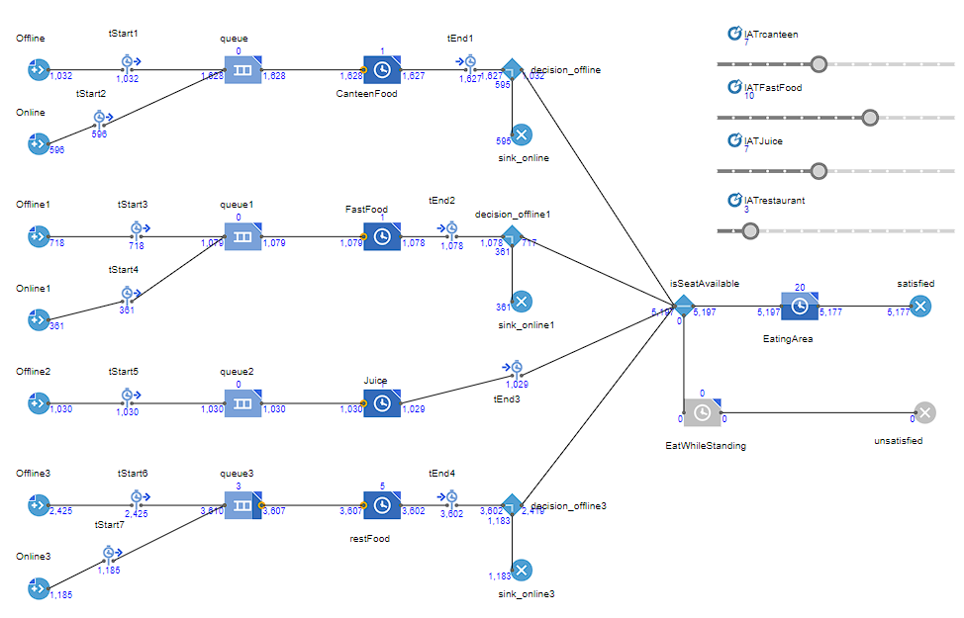
Capacity=49

Slide 21
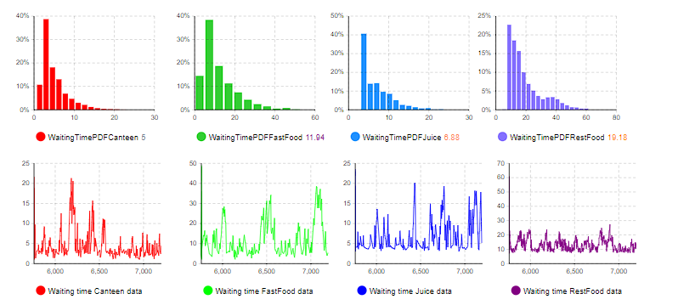
No. of workers at Restaurant = 5

Slide 22
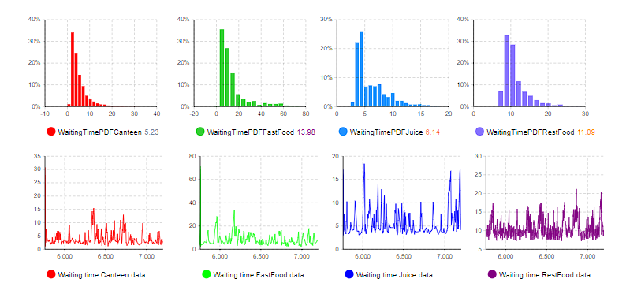
No. of workers at Restaurant = 6

Slide 23
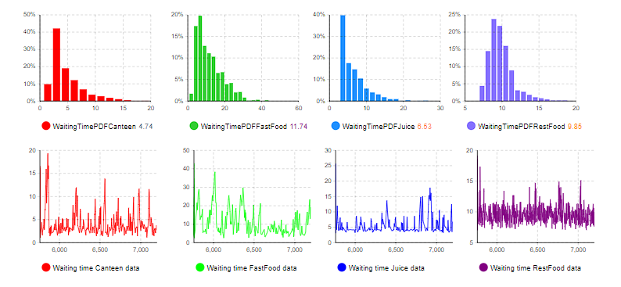
No. of workers at Restaurant = 7

Slide 24
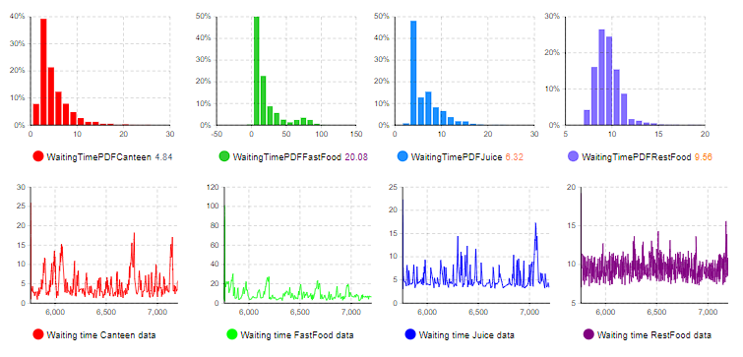
No. of workers at Restaurant = 8

Slide 25
What If Analysis
The first parameter that we have varied is the capacity of seating area. We started with 55 and ran the simulation and ended up with 0 unsatisfied customers. We then decreased the capacity to 45 where we got 38 unsatisfied customers. We then increased it to 48 and 49, and got 2 and 0 unsatisfied customers respectively.
The second parameter that we vary is the number of Workers in the Restaurant. We start with 5 workers, which gives us average waiting time in restaurant of 19.18. We increase the number to 6, which gives us average waiting time of 11.09. 7 and 8 workers give 9.85 and 9.56 respectively.
We can similarly vary the other parameters and see the changes to understand their optimal values.

Slide 26
Recommendation
On the basis of What If analysis where we varied the seating capacity, we observed that 49 is the optimal number of benches and thus as per our synthetic data its found that 6 are extra unnecessary seats. So they can be removed to reduce cost.
On the basis of What If analysis where we varied the Number of Workers in the Restaurant, we see that there is a huge decrease in the waiting time from 5 to 6 but not so much from 6 to 7 and so on. So this means that 6 is optimal number. Increasing the number of servers beyond 6 does not help to reduce waiting time, so no cost should be incurred for any extra workers.

