Slide 1

Language Identifier in Theory of Computation
By
S .Avinash(192211117)
R .Srihari (192211120)

Slide 2
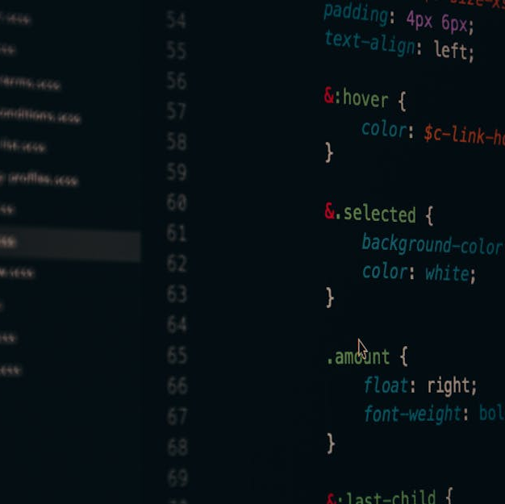
Introduction to Language Identification
Definition
Language identification refers to the process of determining the language of a given piece of text or speech. It is a crucial concept in the fields of computational linguistics, natural language processing, and information retrieval.
Importance
Understanding and automating the identification of languages is essential for tasks such as machine translation, multilingual information retrieval, and language-specific text analysis.
Relevance in Theory of Computation
In the theory of computation, language identification is fundamental for understanding the computational complexity of language recognition and the design of algorithms for processing multilingual data.
Photos provided by Pexels

Slide 3
Formal Language and Automata Theory
Relevance to Language Identification
Formal Languages
Automata Theory
Formal language and automata theory provides the foundation for modeling language recognition processes, constructing language recognition algorithms, and determining the computational complexity of language identification.
Formal languages are defined by specific sets of symbols and rules for their combination, often described using formal grammars. They serve as the basis for representing and analyzing natural and programming languages.
Automata theory studies abstract machines and computational processes to understand the capabilities and limitations of computational systems. It provides the theoretical framework for understanding language recognition and generation.

Slide 4
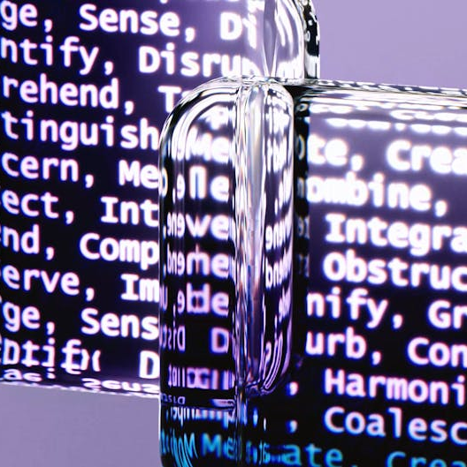
Types of Language Recognition
Finite Automata
Finite automata are mathematical models of computation with finite memory. They are used to recognize regular languages, which in turn represent the simplest form of language structures.
Pushdown Automata
Pushdown automata extend the capabilities of finite automata by incorporating a stack-based memory, enabling them to recognize context-free languages with nested structures.
Turing Machines
Turing machines are theoretical models of computation that can simulate any algorithmic process. They serve as the foundation for recognizing recursively enumerable languages.
Photos provided by Pexels

Slide 5

Language Recognition Algorithms
Deterministic Finite Automaton (DFA)
Nondeterministic Finite Automaton (NFA)
DFAs are state machines that process input strings and determine whether the input belongs to a particular language. They are implemented as directed graphs and used in lexing and pattern matching tasks.
NFAs are automata that allow multiple possible transitions from a state on a given input, providing a powerful tool for language recognition algorithm design.
Parsing Algorithms
Parsing algorithms analyze the syntactic structure of input strings based on formal grammars, enabling the identification of languages with complex grammatical rules.

Slide 6

Language Recognition in Practice
Real-world Applications
Language recognition techniques and algorithms are utilized in various real-world applications, including language detection for web content, multilingual chatbots, and language-specific search engines.
Challenges
Language recognition faces challenges such as dialect identification, code-switching, and identifying languages with limited textual resources, which require advanced algorithmic solutions.
Photos provided by Pexels

Slide 7
Challenges and Future Directions
Integration of NLP
Data Sparsity
Cross-Lingual Understanding
Integrating natural language processing techniques with language identification opens opportunities for enhanced multilingual information extraction and semantic understanding.
Identifying languages with limited textual resources is a significant challenge in language recognition, requiring the development of techniques for leveraging scarce data effectively.
Advancing language identification towards cross-lingual understanding entails developing algorithms that can comprehend and analyze multilingual content comprehensively.

