Slide 1

Analysing Tourist Behaviour using Big Data Technology
CS5530 – Principles of Data Science
Shravani Pasham-12601949
Sri Hari avula-16344742
Padmaja K-16338729
Vijay Shenkar Konnakala-16345715

Slide 2
ABSTRACT
In this project we are implementing Popular Tourist Place Recommendation using Bigdata framework called SPARK. Spark can process data in distributed manner so it can handle any size of data.
In propose work we are using Geo Tagged images dataset to extract places information and then this text data will be cluster to group similar behaviour tourist into same cluster. For this we have used K-means clustering.
Whenever new user input any query then clustering algorithm will predict similar cluster as per user query and then suggest top 5 popular visited similar interest places as recommendation.

Slide 3
OBJECTIVES
This project is to develop and assess a "big data analytics" technique to assist strategic decision-making in tourism destination management using a design science research methodology.
Textual metadata processing to extract a list of interest candidates from geotagged pictures.
To analyse and predict tourist behavioural patterns at specific destinations through the use of geotagged photos uploaded by tourists to the photo-sharing social media site,
The resulting visualization helps identify patterns and relationships between tourist interests and visitation numbers within each cluster.
Geographical data clustering to identify popular tourist locations for each of the identified tourist interests.
When a new user enters a query, the clustering algorithm predicts similar clusters based on the query and recommends the top 5 frequently visited locations that are similar in interest.

Slide 4
INTRODUCTION
The content generated by individual travelers on various online platforms, such as Facebook, Flickr, YouTube, and Twitter, contains valuable information. This data can offer insights into visitor behavior and preferences relevant to Tourism Destination (TD) management.
Despite the abundance of data on social media platforms, tourism authorities often overlook gathering and analyzing this information. The untapped potential lies in the rich source of data that could enhance understanding of traveler preferences and behaviors.
The data from individual travelers could be crucial for decision-making in TD management. However, the gap in tools and methods for effective analysis hinders the extraction of meaningful insights from this wealth of information.
The enormity and diversity of big data sets from individual travelers pose challenges for traditional analytics tools, limiting their effectiveness in processing and deriving actionable insights.

Slide 5
SOURCE DATASET
This dataset is taken from Kaggle which contains different attributes
Photo ID
Title
Description
Tags
Favourites as Number of times visited

Slide 6
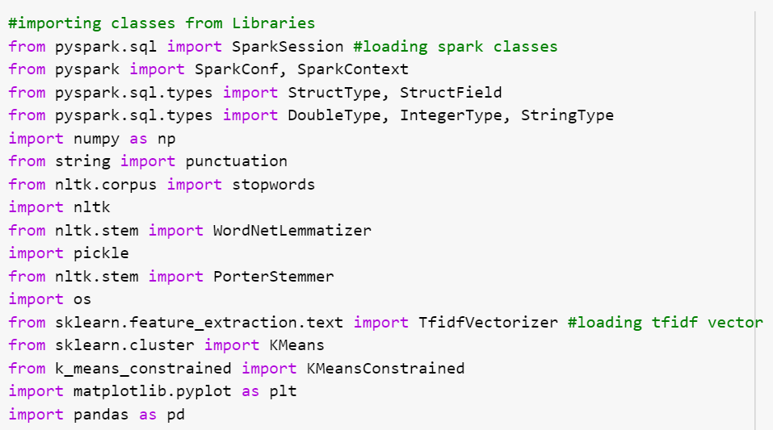
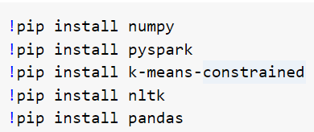
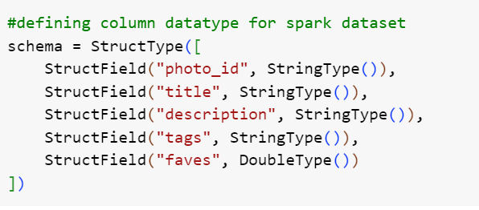
PACKAGES AND LIBRARIES

Slide 7
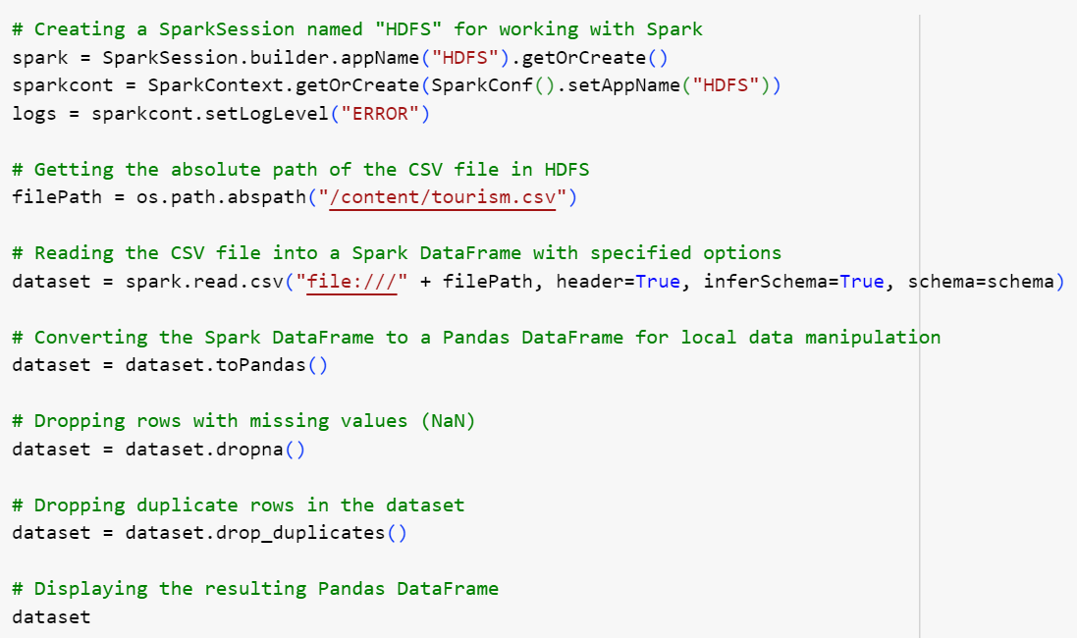
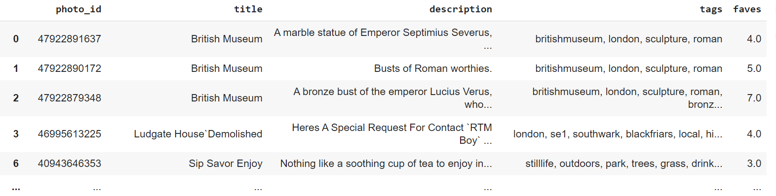
DATA COLLECTION

Slide 8
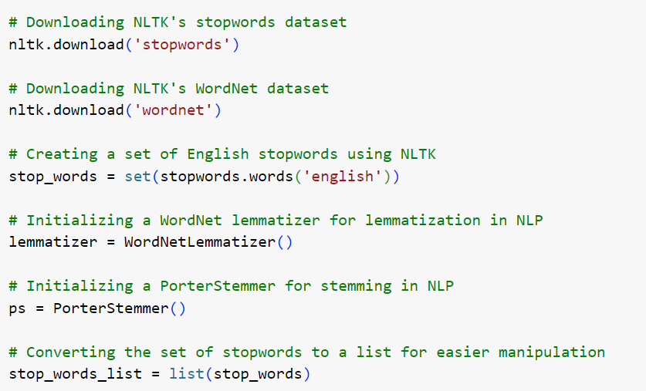
DATA PREPROCESSING

Slide 9
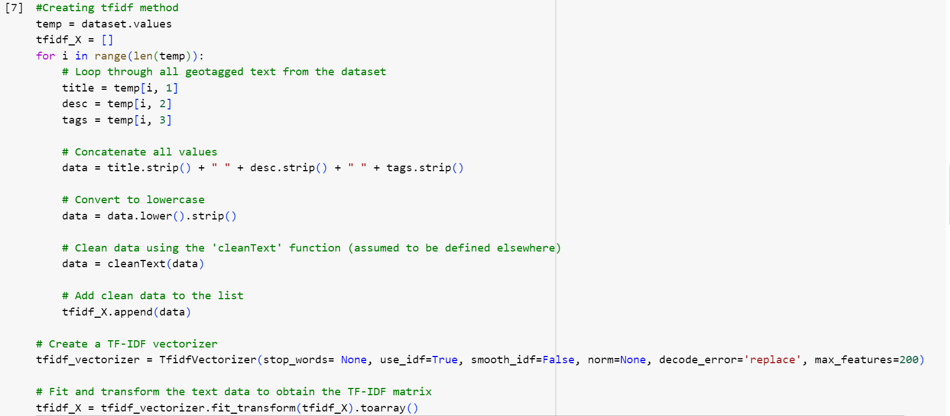
DATA PROCESSING

Slide 10
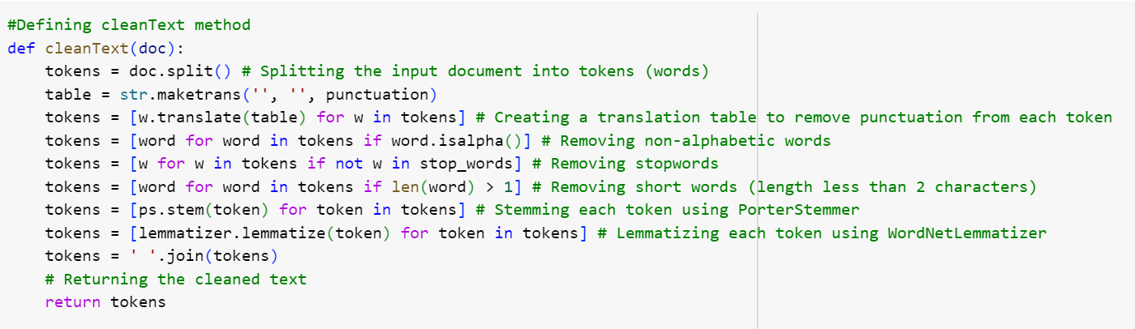
DATA PROCESSING
DEFINING FUNCTION TO CLEAN THE DATA

Slide 11
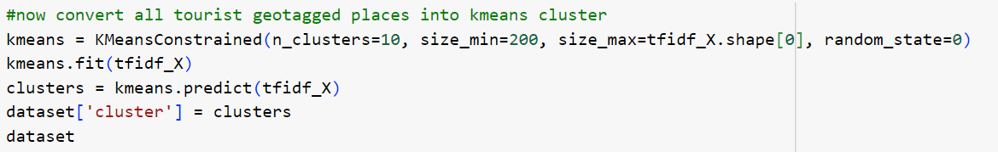
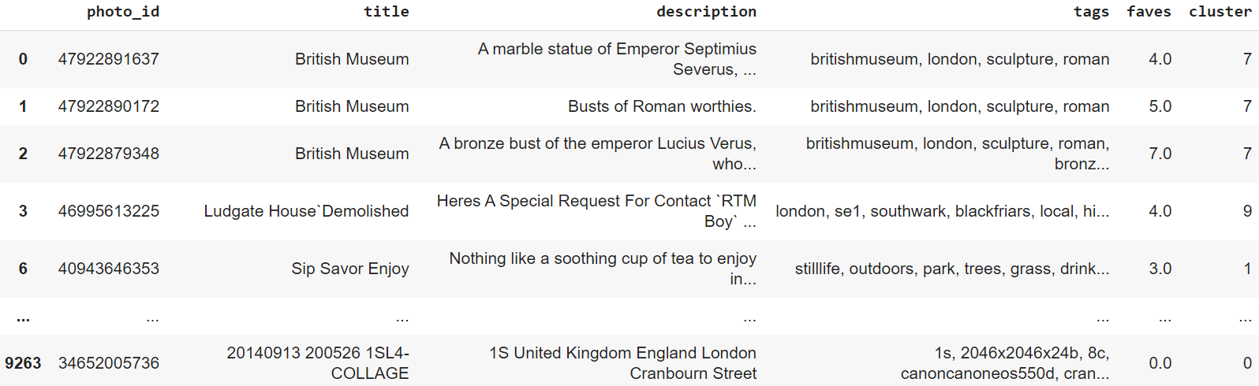
CLUSTERING
K-MEANS CLUSTERING

Slide 12
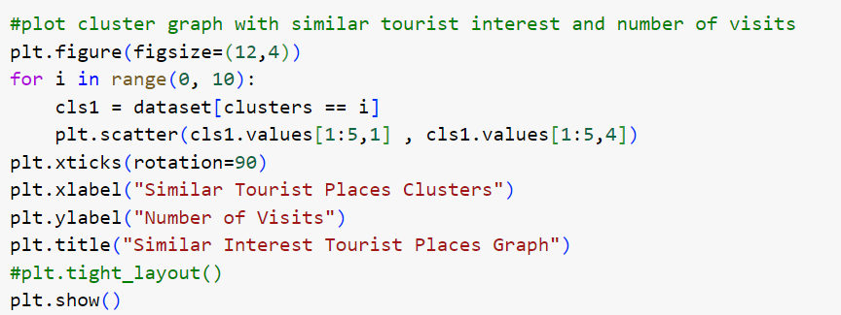
DATA VISUALIZATION

Slide 13
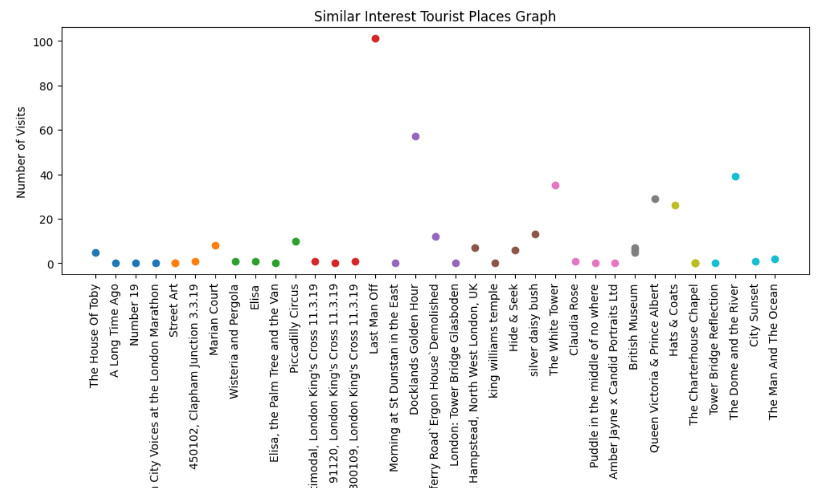
DATA VISUALIZATION

Slide 14
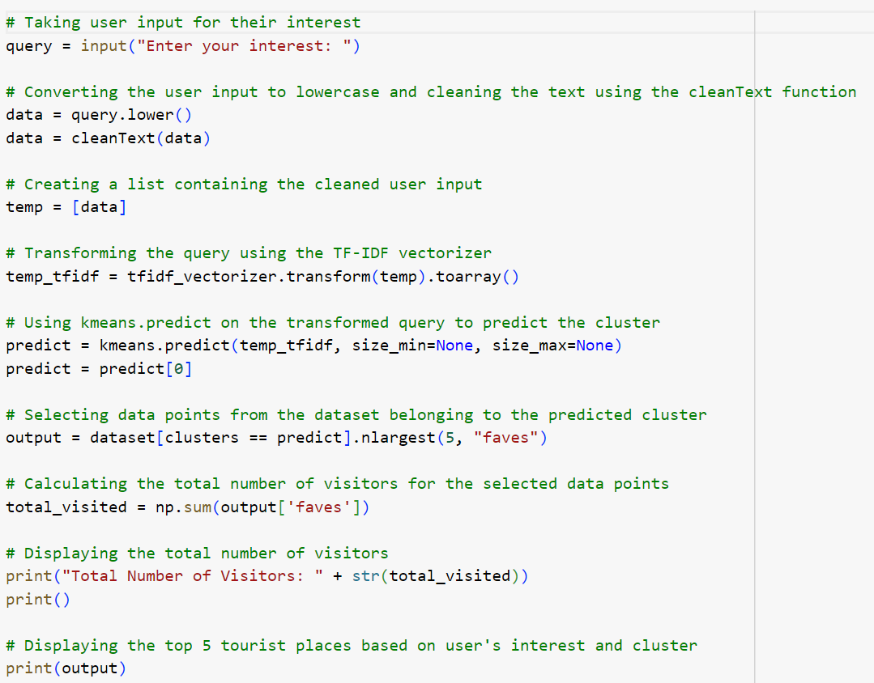
RESULT

Slide 15
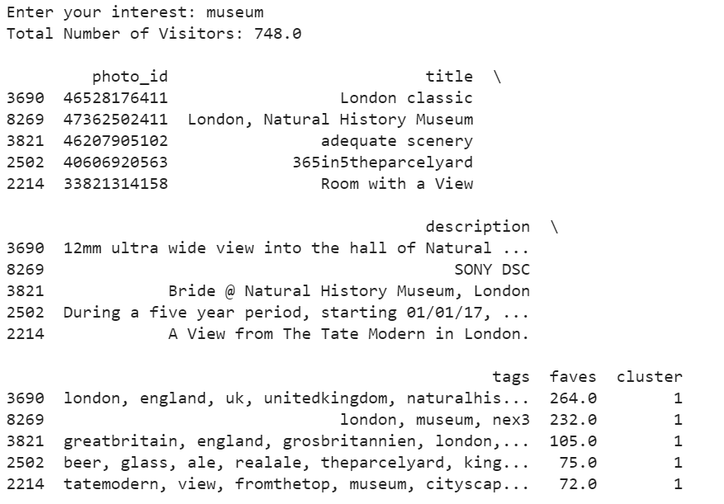
RESULT

Slide 16
THANK YOU

