Slide 1

Code
Maestro’s
VNR DESIGN-A-THON 2025
Problem Statement ID – 1.1
Problem Statement Title- - Development of AI/ML based solution for detection of face-swap based deep fake videos and audio.
Team Name- Code Maestro’s
Team Members: 1.Srihari Sakshith
2.Vighnesh Adithya
3.Raviteja

Slide 2
IDEA TITLE
Code
Maestro’s
Our deepfake classification app allows users to independently verify and classify media as "real" or "fake" and provide statistics of our model's prediction.
Our app can be used by social media platforms to quickly classify uploaded audio and video, tagging them to help maintain content integrity.
Our app can provide information on live running video conferences if they are using deepfakes.
InceptionResNet: Detects facial, lighting, and motion inconsistencies.
Anomaly Detection: Identifies inconsistencies in frame transitions.
Artifact Detection: Spots unnatural blending and facial movement issues.
Idea/Solution
Problem Resolution
Our video classification model has 95% accuracy, and audio classification has 98% accuracy.
Faster processing of complete videos without skipping frames.
Uniqueness / Novelty

Slide 3
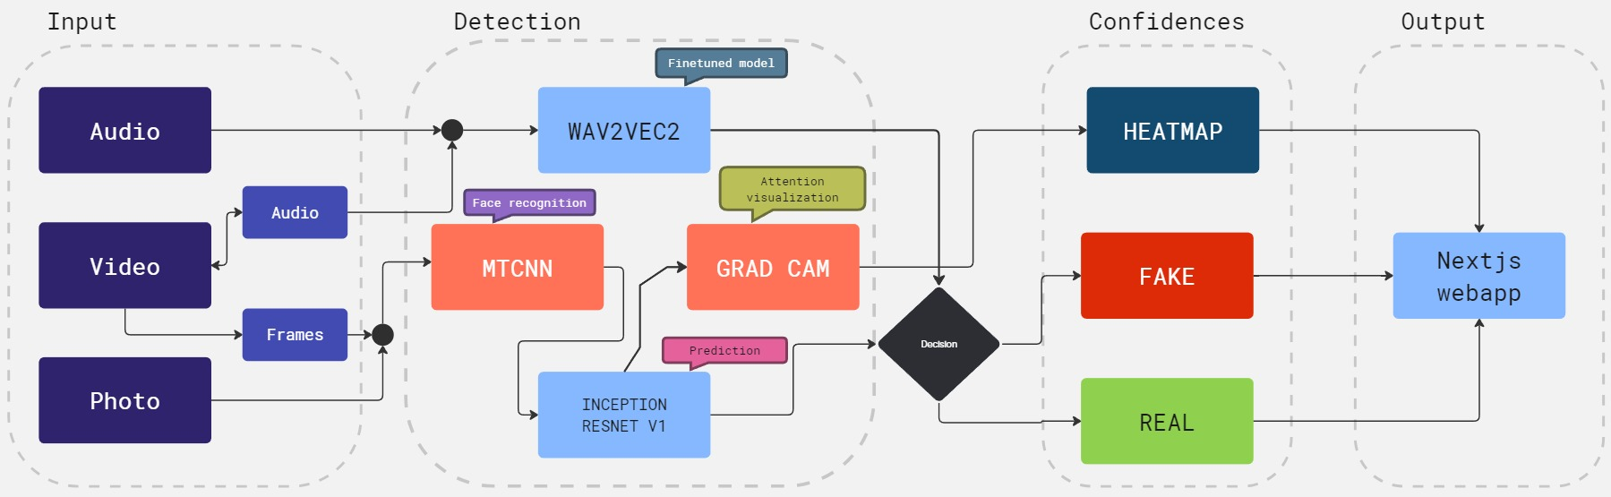
TECHNICAL APPROACH
Code
Maestro’s
Frameworks and Libraries: PyTorch for model training, OpenCV,Mediapipe for image/video processing, Python for backend development , Nextjs for frontend.
Programming Languages: Python,Html,Css,Javascript.
Multi Model Deepfake Detection Architecture:

Slide 4
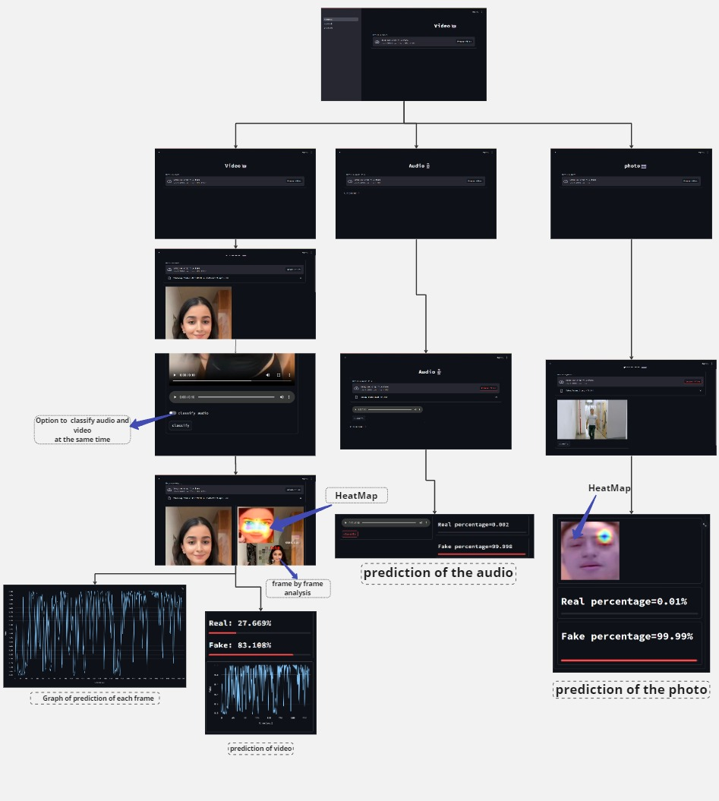
FEASIBILITY AND VIABILITY
Code
Maestro’s
Technological Feasibility: The idea is viable with current technologies like PyTorch for ML models and OpenCV for processing. Hardware needs, such as GPUs/TPUs, are accessible and suitable.
Economic Feasibility: While initial costs for cloud computing and servers are manageable, budgeting is crucial for ongoing operational expenses.
Operational Feasibility: Our web interface is user friendly , quick in processing the given data
Data Quality and Availability: Challenge of obtaining high-quality, diverse datasets; mitigated by using multiple sources and data augmentation.
Model Accuracy and Robustness: Risk of models becoming obsolete due to evolving deep fake technology, addressed by regular updates and training.
Proto type Work flow

Slide 5
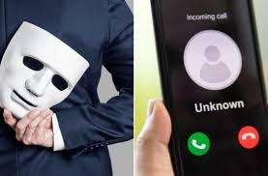
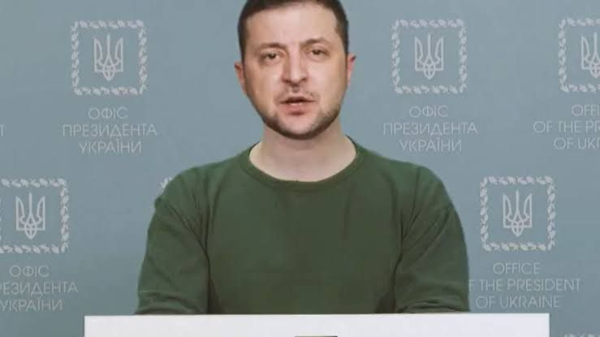
IMPACT AND BENEFITS
Code
Maestro’s
Impacts and Benefits of our app are:
IMPACTS | BENEFITS
Preventing Misinformation/Disinformation | Early detection curbs misinformation, protecting the public from manipulation.
Enhancing Trust in Digital Media | Detection restores confidence in the authenticity of digital content.
Fraud calls
IN INDIA:
Elderly man duped of Rs 50,000 by men who ‘kidnapped’ nephew; police looking into possible use of AI software
Elderly Delhi Man Duped y Al-Cloned Voice, Loses US$603 In Extortion
Others:
A fake video of Ukrainian President Volodymyr Zelenskyy circulated on social media by hackers.
Fake video of zelenskyy

Slide 6
RESEARCH AND REFERENCES
Code
Maestro’s
Pytorch for models and datasets from Kaggle,and various other sources for diversity in data
Research Paper: Enhancing Deepfake Detection leveraging MTCNN and Inception Resnet V1 (IJSREM)
Comparative study:
Advantages Of Our Model | Disadvantages of Other Models
Live video classification. | Live video processing is not supported.
We used inceptionresnet_V1 model which has 95% accuracy. | Existing models have 85-90% of accuracy.
Audio classification has 98% accuracy. | Frame skipping (less accuracy).
We have higher processing speed. | Slower processing speed .
Our App works on video and audio(together). | Other models won’t work together efficiently and accurately.

