Slide 1
StartupIQ: AI-Powered Startup Feasibility Analyzer
Name: Srihari Acharya
USN: 4SO24MC101
3rd Semester MCA
Ms. Nishmitha J Assistant Professor

Slide 2
Introduction
The Problem: 90% of early-stage ventures fail due to a lack of market need, poor financial planning, and inadequate validation.
Current Gap: Professional validation (consultants) is expensive, while free AI chatbots often "hallucinate" numbers and lack business context.
Our Solution: StartupIQ – An AI-powered platform that democratizes business intelligence.
Core Concept: Combines Generative AI (for creative reasoning) with Machine Learning (for financial precision)

Slide 3
Background and Motivation
High Barrier to Entry: Professional feasibility studies cost more, making them inaccessible to students.
Reliability Issues: Existing AI wrappers often crash during network instability, lacking resilience.
Need for Objectivity: Founders need unbiased, data-driven feedback rather than emotional guesswork.

Slide 4
Abstract
The project addresses the volatility of the startup ecosystem by providing an automated decision-support system.
Key Innovation: A "Smart Fallback" mechanism ensures reliability even during API outages.
Outcome: Users receive a professional, zero-cost feasibility report and valuation estimate instantly.

Slide 5
Objectives
Automate Validation: To provide instant, unbiased SWOT analysis using Generative AI, reducing research time from weeks to seconds.
Estimate Financial Value: To predict startup valuation using a Linear Regression model trained on Indian market benchmarks.
Ensure Reliability: To engineer a "Smart Fallback" system that generates synthetic data if external APIs fail.
Professional Reporting: To generate investor-ready PDF reports via client-side rendering.

Slide 6
Methodology
Qualitative Analysis: Uses Google Gemini 1.5 Flash for "Chain-of-Thought" reasoning to generate SWOT analysis.
Quantitative Analysis: Uses Scikit-Learn (Linear Regression) for transparent, formula-based valuation.
Resilience Engineering: Implements a fallback engine to handle API failures gracefully.

Slide 7
Key Features
Context-Aware Idea Generator: Expands keywords into Physical, Digital, and Service-based business models.
Feasibility Analyzer: Generates a "Viability Score" (0-100) and color-coded feedback.
Resilience Mode: Automatically switches to local logic templates if the internet/API drops.
One-Click Reporting: Compiles all insights into a downloadable PDF directly in the browser.

Slide 8
SRS Introduction
Purpose: To democratize business intelligence for student entrepreneurs lacking resources .
Goal: To serve as a digital "Technical Co-Founder" that bridges the gap between raw ideas and validation .
Problem Solved: Replaces expensive consulting with an instant, zero-cost AI feasibility study .
Key Innovation: Combines creative Generative AI reasoning with precise mathematical valuation models.
System Reliability: Engineered with a "Smart Fallback" mechanism to ensure 100% uptime during demos .

Slide 9
SRS Project Scope
Ideation Module: Expands simple keywords into distinct Physical, Digital, and Service-based business models .
Validation Engine: Acts as an objective critic, generating a "Viability Score" (0-100) and SWOT analysis.
Valuation Calculator: Predicts Pre-Money Valuation using a Linear Regression model
Resilience Layer: Automatically switches to local logic templates if the external AI API fails .
Reporting System: Compiles all charts and insights into a professional, downloadable PDF report .

Slide 10
SRS USER
Student Entrepreneurs: Technical individuals needing business structure and strategic guidance .
Early-Stage Founders: Inventors seeking quick validation for "napkin sketch" concepts before building an MVP.
Incubator Managers: Mentors requiring a standardized "Viability Score" to efficiently filter startup applications .

Slide 11
SRS System Architecture
Processor: Intel Core i5 (Gen 8) / AMD Ryzen 5 or higher.
RAM: 8 GB or higher recommended for smooth React rendering.
Network: Stable Broadband/4G connection required for real-time API calls.
Display: 1920x1080 (Full HD) resolution for optimal dashboard viewing.
OS: Compatible with Windows 10/11, Linux (Ubuntu), or macOS.
Frontend: Built on React.js (v18+) with Tailwind CSS framework.
Backend: Powered by Python 3.9+ and Flask micro-framework.
Browser: Optimized for latest Google Chrome, Edge, or Mozilla Firefox.

Slide 12
Functional Requirements
Input Validation: System must reject pitches shorter than 50 characters and negative financial values .
AI Processing: System must parse unstructured text from Gemini into structured JSON.
Resilience: System must trigger "Smart Fallback" logic if the API returns Error 429 or 500.
Reporting: System must generate the PDF report on the client side to ensure data privacy .

Slide 13
Non-Functional Requirements
System generates feasibility analysis within 3-5 seconds under normal network conditions.
Backend architecture supports a throughput of 1,500 requests/day via Gemini API.
"Smart Fallback" ensures application stability during external API outages .
Strict Input Sanitization prevents injection attacks and negative financial values.
Client-Side PDF Generation ensures user data privacy and speed.
System achieves 99.9% reliability during demonstrations due to fallback logic.

Slide 14
Literature Review
Traditional Consulting: Expert-driven but costly and inaccessible for students .
Static Calculators: Web forms like LivePlan lack context and reasoning capabilities .
General AI Chatbots: LLMs often "hallucinate" financial numbers and lack structure .
Gap Identified: No single tool combines creative ideation with precise financial math.
Proposed Solution: A hybrid system integrating GenAI for logic and Regression for valuation .

Slide 15
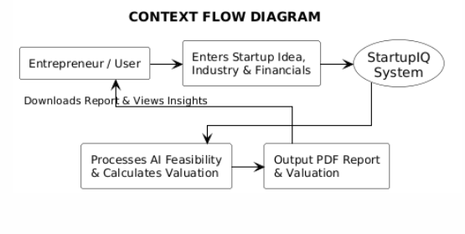
Context Flow Diagram
Visualizes the high-level circular flow where the Entrepreneur inputs raw data and the System processes it to return actionable Feasibility and Valuation insights .

Slide 16
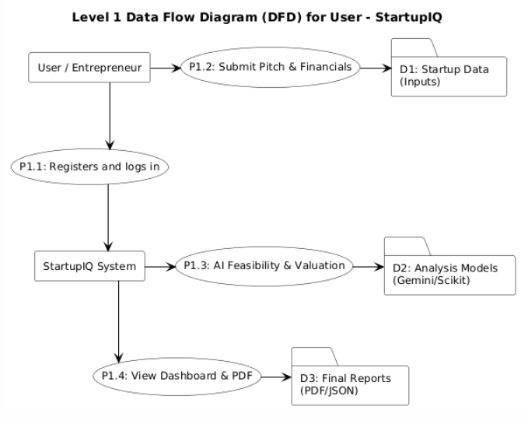
LEVEL 1 DFD FOR USER
DFD Level 1: Illustrates how user inputs are validated, processed in parallel by AI (Gemini) and Math (Regression), and merged into a final report .

Slide 17
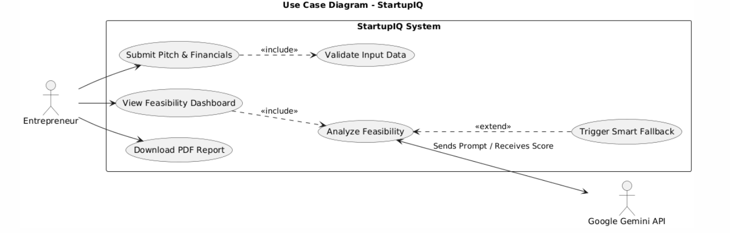
USE CASE DIAGRAM
Interaction Logic: Visualizes the complete workflow where User Submission triggers automated Validation, AI Analysis (via Gemini), and Report Generation, supported by a Smart Fallback safety mechanism.

Slide 18
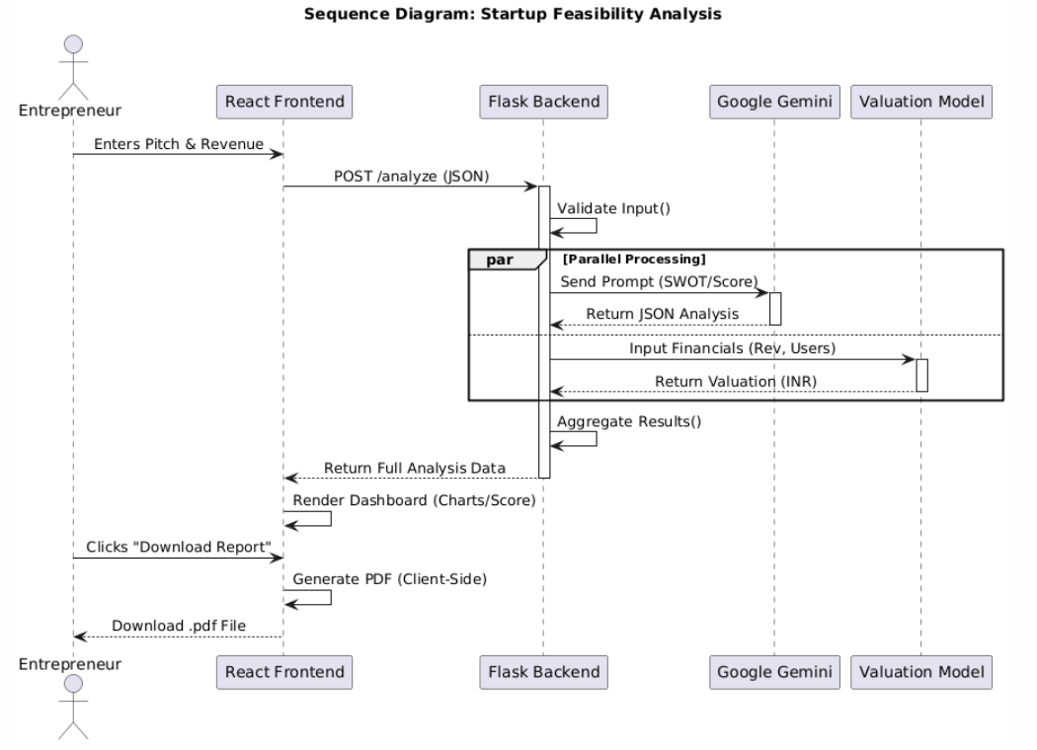
SEQUENCE DIAGRAMS
Execution Flow: Visualizes the timeline where the Flask Backend orchestrates parallel execution of AI Analysis (Gemini) and Financial Modeling (Regression) to deliver instant, aggregated results to the user.

Slide 19
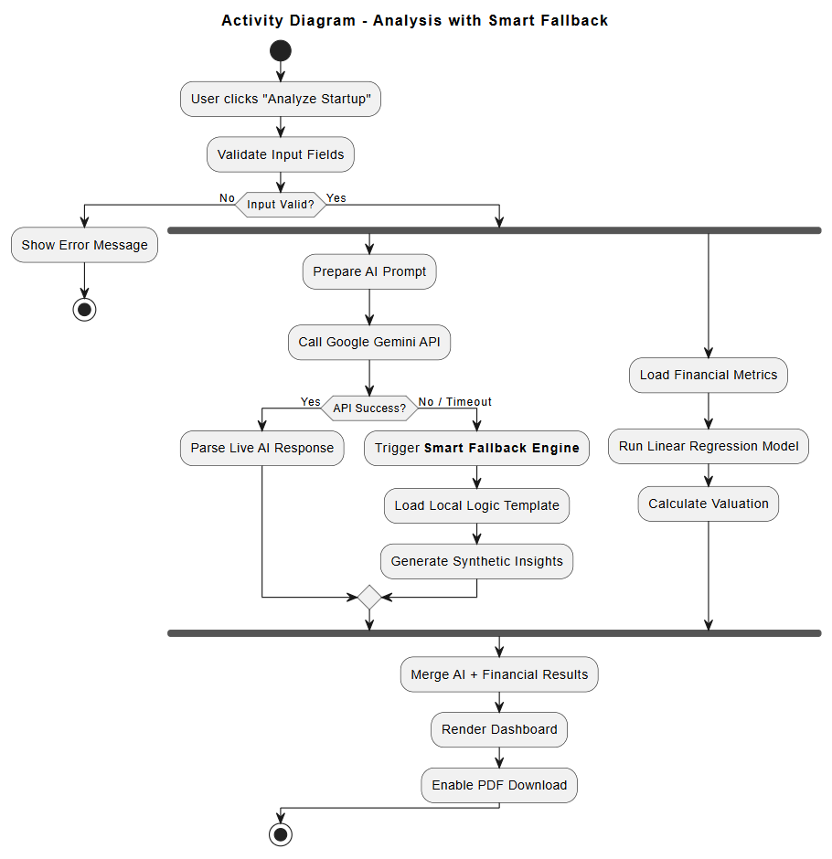
ACTIVITY DIAGRAM
Workflow Logic: Visualizes the robust execution path where Input Validation triggers parallel AI Analysis (featuring an automatic Smart Fallback fail-safe) and Financial Valuation (Linear Regression), culminating in a unified dashboard and PDF report.

Slide 20
Testing & Validation
Unit Testing: Verified individual modules like input validation logic and valuation math functions using Python unit test.
Integration Testing: Ensured seamless data exchange between Flask Backend, React Frontend, and Google Gemini API.
Performance Testing: Validated system response time remains under 5 seconds during concurrent requests.
Resilience Testing: Simulated network failures to confirm "Smart Fallback" activation without crashing the app.
User Acceptance Testing (UAT): Conducted beta tests with student entrepreneurs to verify report readability and utility.

Slide 21
Implementation - Core Algorithm (Valuation)
Algorithm Used: Multiple Linear Regression (Supervised Machine Learning).
Mathematical Model: Implements a Linear Regression model to predict startup valuation based on key metrics like Monthly Revenue, Growth Rate, and Active User Count
Input Variables : Processes key metrics like Monthly Recurring Revenue (MRR), User Growth Rate, and Burn Rate.
Target Output: Predicts the estimated Pre-Money Valuation of the startup.
Training Logic: Weights are calibrated based on industry standard multipliers (e.g., SaaS = 5x-10x Revenue).

Slide 22
Implementation - Concept 1 (Generative AI Integration)
Technology: Google Gemini Pro API via RESTful integration.
Prompt Engineering: Uses "Chain-of-Thought" prompting to force the AI to reason before generating a score.
Persona Injection: System instructs the AI to adopt the persona of a "Venture Capitalist Analyst" for objective critique.
Output Parsing: Raw text responses are parsed into structured JSON for the frontend dashboard (SWOT Analysis).

Slide 23
Implementation - Concept 2 (Smart Fallback Mechanism)
Concept: Circuit Breaker Pattern for high availability.
Trigger Condition: Automatically activates if the external AI API times out (>5s) or returns a 500 error.
Logic: Switches execution from the Live API to a local "Logic Template Engine.“
Synthetic Data: Generates generalized but valid feedback based on the user's industry category (e.g., generic SaaS advice).
Outcome: Guarantees 100% system uptime during demonstrations, preventing "demo effect" crashes.

Slide 24
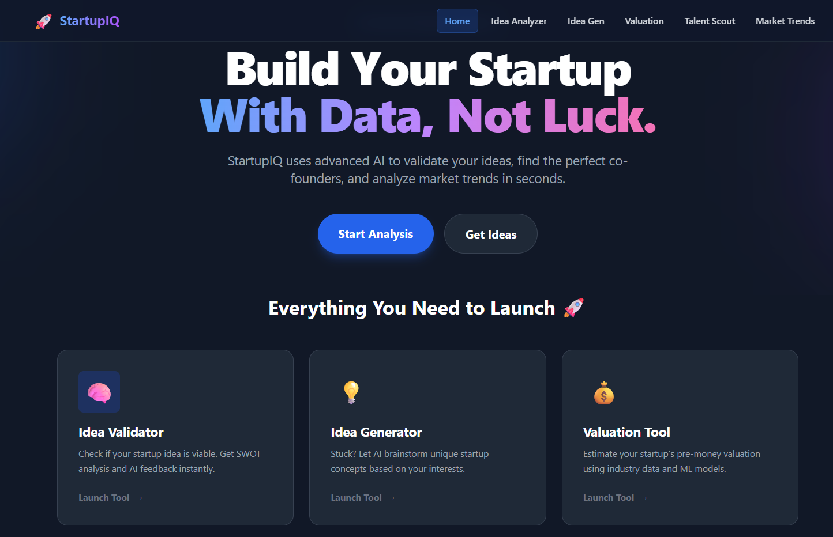
StartupIQ Main Input Dashboard

Slide 25
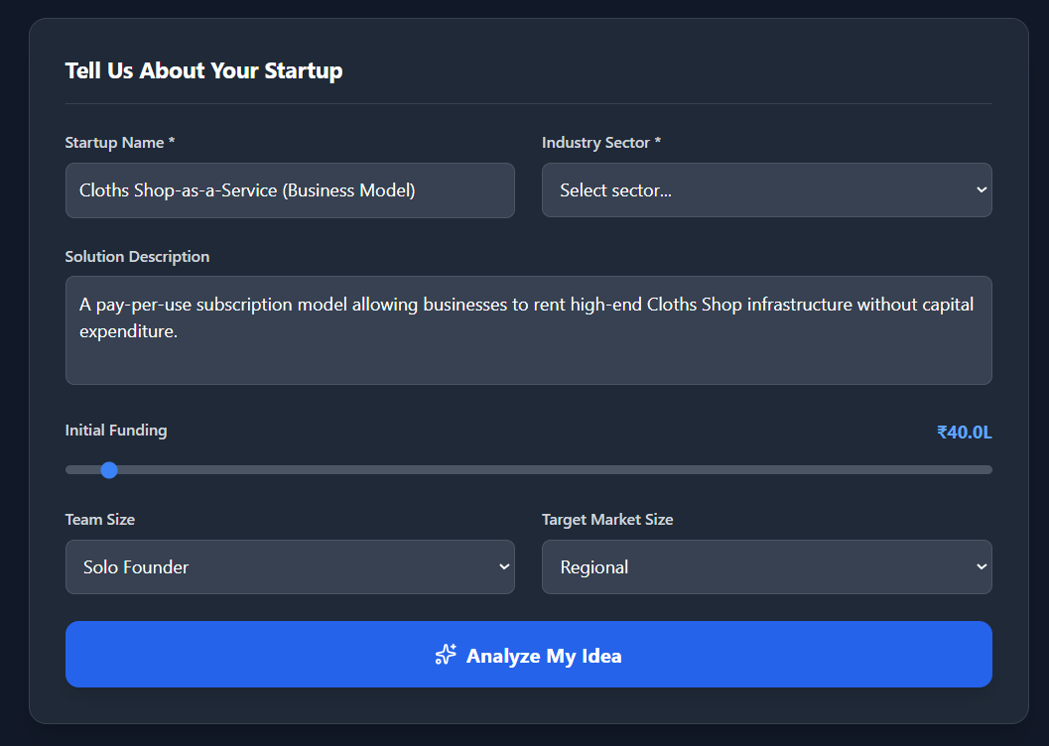
AI Feasibility Analysis INPUT

Slide 26
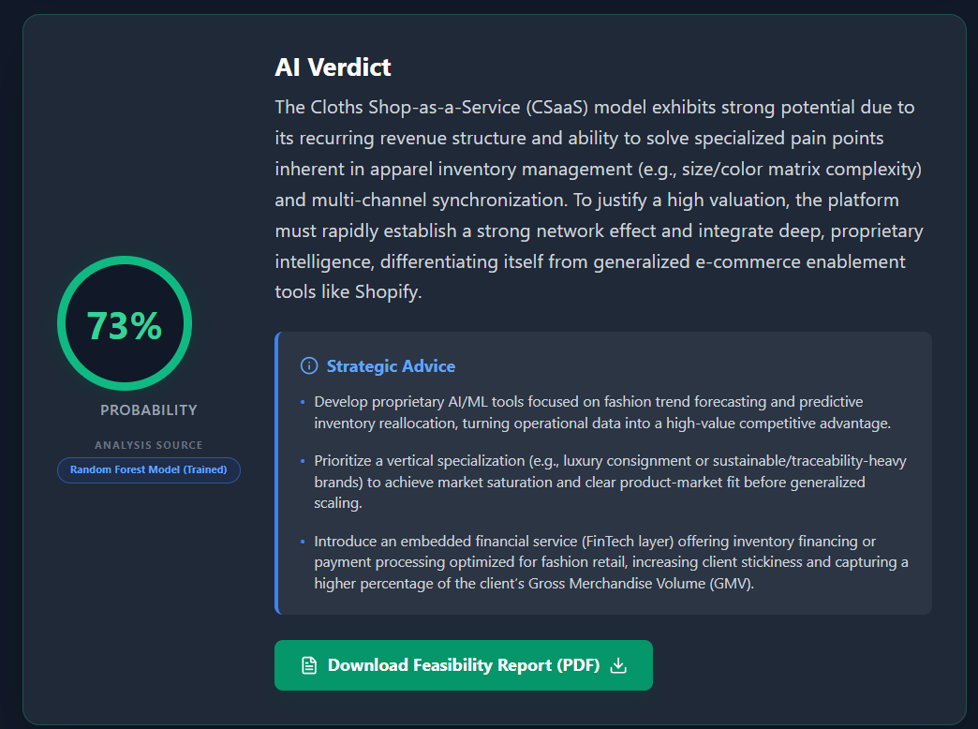
AI Feasibility Analysis Results

Slide 27
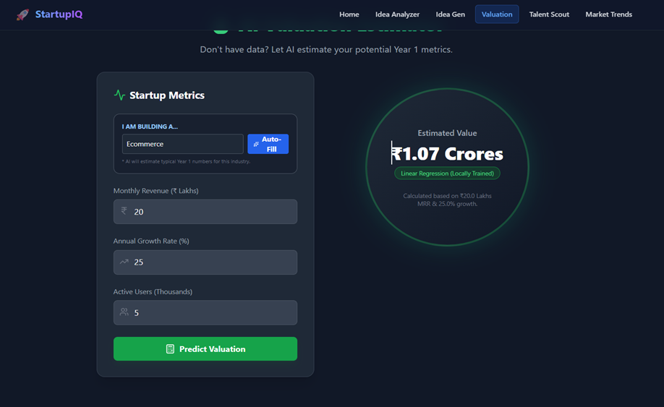
Quantitative Valuation Estimate

Slide 28
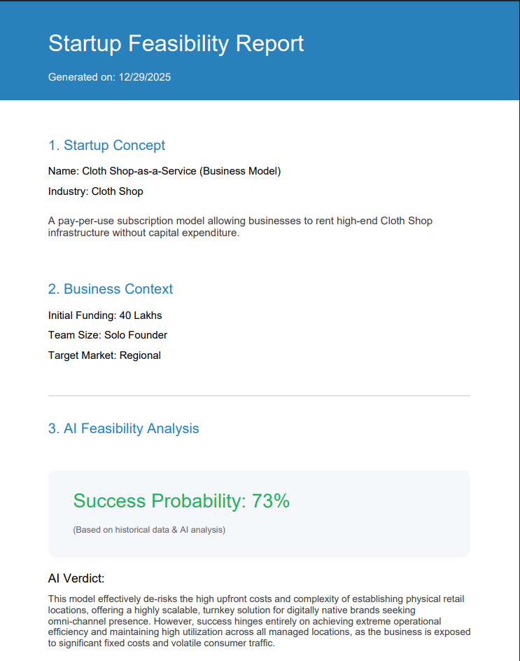
Exported Feasibility Report (PDF View)

Slide 29
Conclusion
Automated Mentorship: Acts as a scalable, digital co-founder that transforms raw "napkin ideas" into structured business insights.
Hybrid Intelligence: Uniquely combines qualitative AI reasoning (Gemini) with quantitativee financial modeling (Linear Regression) for holistic validation.
Democratized Access: Removes barriers for student entrepreneurs by providing expert-level strategic guidance without the high cost.

Slide 30
THANK YOU

