Slide 1
Graphs and reports

Slide 2
Top 20 words after performing data cleansing and removal stop words
[('not', 1115), ('fire', 759), ('kindle', 729), ('amazon', 715), ('great', 586), ('use', 564), ('sound', 525), ('one', 496), ('will', 460), ('dont', 450), ('im', 447), ('headphones', 442), ('tablet', 437), ('device', 399), ('echo', 397), ('tap', 393), ('screen', 359), ('well', 342), ('good', 336), ('new', 319)]

Slide 3
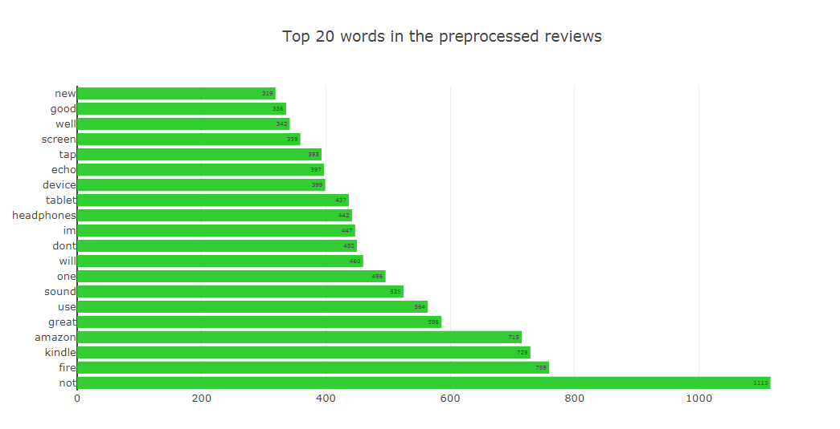

Slide 4
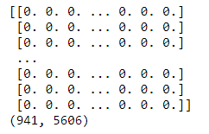
Xtrain_tfidf

Slide 5
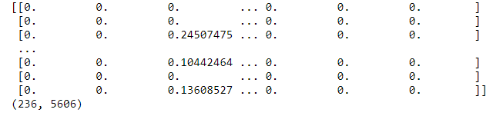
Xtest_tfidf

Slide 6
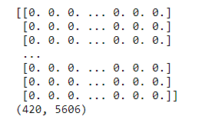
New_Reviews_tfidf that doesn’t contains any lables

Slide 7
Accuracy score after removing stopwords(its improved!!!)
Multinomial Accuracy : 0.8601694915254238
Bernoulli Accuracy : 0.864406779661017
RandomForest Accuracy : 0.8898305084745762

Slide 8
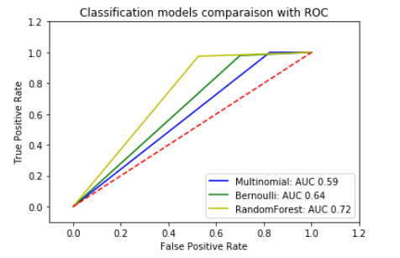
ROC

Slide 9
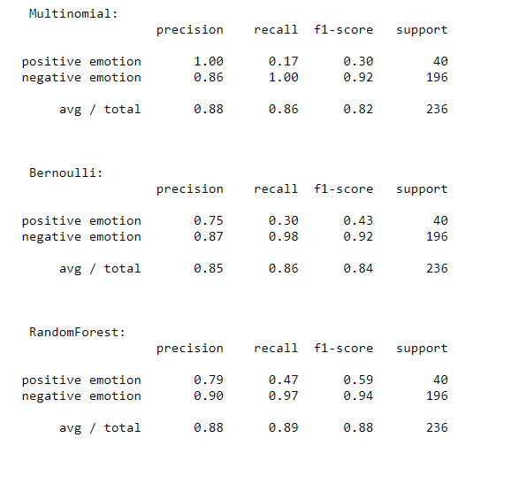
Final report

