Slide 1

DRIVER DROWSINESS DETECTION USING MACHINE LEARNING WITH VISUAL BEHAVIOUR.

Slide 2
AGENDA
Abstract
Introduction
Existing system
Disadvantages
Proposed system
Advantages
Modules
System architecture
System requirements
Conclusion

Slide 3
ABSTRACT
The main aim of this project is :
A person while driving a vehicle - if does not have proper sleep or rest, is more inclined to fall asleep which may cause a traffic accident. This is why a system is required which will detect the drowsiness of the driver.
A driver's condition can be estimated by basic characteristics age, gender and driving experience. Also, driver's driving behaviours, facial expressions, bio-signals can prove helpful in the estimation.
Machine Learning has brought progression in video processing which enables images to be analysed with accuracy we proposed a method for detecting drowsiness by using convolution neural network model over position of eyes and extracting detailed features of the mouth using OpenCV and Dlib to count the yawning.

Slide 4
INTRODUCTION
This Python project aims to develop a cost-effective, real-time driver drowsiness detection system using OpenCV and Deep Learning.
The process involves capturing images from a webcam, detecting the driver’s face, and defining a Region of Interest (ROI) for the eyes.
The system then classifies whether the eyes are open or closed using a Deep Learning model.
By focusing on facial features without requiring intrusive sensors, this approach provides a portable and low-cost solution to monitor driver fatigue and enhance road safety.

Slide 5
EXISTING SYSTEM
Now a days maximum members are using vehicle (car, lorry, bus).
according to survey 10 to 15% are accidents are accruing because of the driver was in sleepy mode.
No software is having to give alert to the driver

Slide 6
Disadvantages
More Accidents are accruing
Unable to give alert while driver was sleepy
No confidentially

Slide 7
PROPOSED system
A block diagram of the proposed driver drowsiness monitoring system has been depicted in 1. The camera will be positioned in front below Fig of the driver to capture the front face image.
From the video , the frames are extracted to obtain 2-D images. Face is detected in the frames using histogram of oriented gradients (HOG) and linear support vector machine (SVM) for object detection.
If drowsiness is detected, an alarm will be sent to the driver to alert him/her.

Slide 8
ADVANTAGES
Provide alert to the driver
Decrease the accidents.

Slide 9
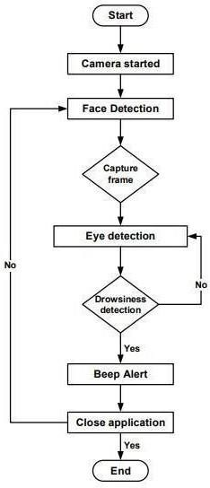
SYSTEM ARCHITECTURE

Slide 10
SYSTEM REQUIRMENTS
HARDWARE SYSTEM CONFIGURATION
System :Pentium IV 2.4 GHz.
Hard Disk : 40GB
Floppy Drive :1.44mb
SOFTWARE SYSTEM REQUIRMENTS
Technology : Python
Web Server :Django
Designing :Html,CSS.JavaScript,AJAX.
Database and Algorithm :MySql And Deep Neural Network

Slide 11
modules
Data Acquisition
Face Detection
Facial Landmark marking
Feature Extraction

Slide 12
conclusion
This paper presents a low-cost, real-time driver drowsiness detection system using webcam video to analyze eye, mouth, and nose ratios.
Adaptive thresholding and machine learning (FLDA and SVM) are used for classification, showing high accuracy.
The system will be implemented in hardware and tested with drivers.
A traffic density control system is also proposed.

Slide 13
THANK YOU…

