Slide 1
Exploratory Data Analysis
Music Recommender System
Batch 16

Slide 2
What is Exploratory Data Analysis
Exploratory data analysis is an approach of analyzing data sets to summarize their main characteristics, often using statistical graphics and other data visualization methods.
By the end of EDA we must be able to find the KPIs and remove all unnecessary data that can reduce the accuracy of our conclusions.
The main Objective of EDA is to understand the relationship between the variables and further use them to increase the accuracy of the system.

Slide 3
What is Data Exploration
Data Exploration is the first stage of Exploratory Data Analysis.
Data Exploration is a process where analyst explore the data in unstructured way and find out the preliminary insights present in the data to better understand its characteristics .
Data Exploration can further classified into
Summarization of Statistics.
Visulatzation

Slide 4
Steps of Data Exploration and Preparation
Variable Identification.
Univariate Analysis.
Bi-variate Analysis.
Missing values treatment.
Outlier treatment.
Variable transformation.
Variable creation.
}
Descriptive Statistics

Slide 5
Analysis of Data Set
The dataset is provided by Kaggle Million Song Dataset Challenge.
The data contains around
100000+ Users
1400000+ songs
The data set is open and easily available .
Content:
Triplets (User, Song ,Count)
Meta - data, content - analysis
No User Demographic Information .

Slide 6
Understanding Data
Triplets dataset consists of
User ID - No User Demographic Information .
Song ID - The Song Unique ID
Frequency - Times Unique User Listened to a particular song
Unique Tacks Data consists of
Song Id / Track ID - The Song Unique ID
Artist name - Artist Name or the Band Name
Release - basically Song Name

Slide 7
Data Preprocessing
We Performed following steps to analyze the dataset:
Checking missing values and duplicates.
Merging Unique_ tracks and Triplets Dataset.
Descriptive Statistics.
Frequency Distribution.
Number of songs listened per User.
Analysis of Popular Artists and Songs.

Slide 8
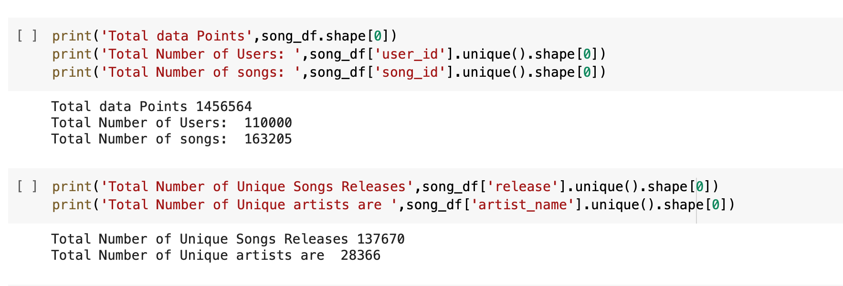
Understanding The Data
Describing the basic statistics results of the data

Slide 9
Checking Missing Values
df = pd.read_csv('kaggle_visible_evaluation_triplets.txt',sep='\t',names=['user_id','song_id','freq'])
df.head()
df.isnull().sum()#checking the null values in each column
user_id 0
song_id 0
freq 0
dtype: int64

Slide 10
Outlier
An outlier is a data point that differs significantly from other observations. An outlier may be due to variability in the measurement or it may indicate experimental error; the latter are sometimes excluded from the data set.

Slide 11
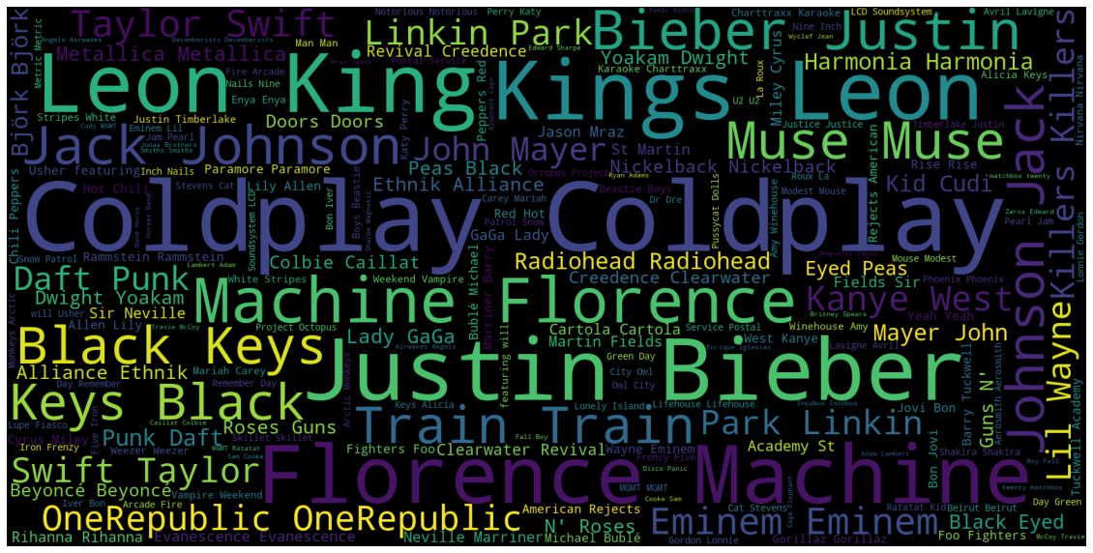
Word Cloud Representing Top Popular Artists

Slide 12
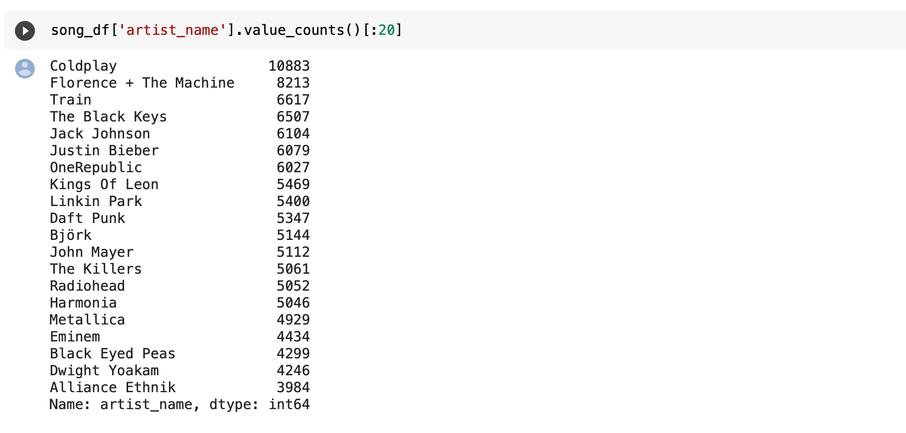
Data Analysis Using Artist Names
The Popular Bands / Artists are
1.ColdPlay
2.Florence + The Machine
3.Train etc.,

Slide 13
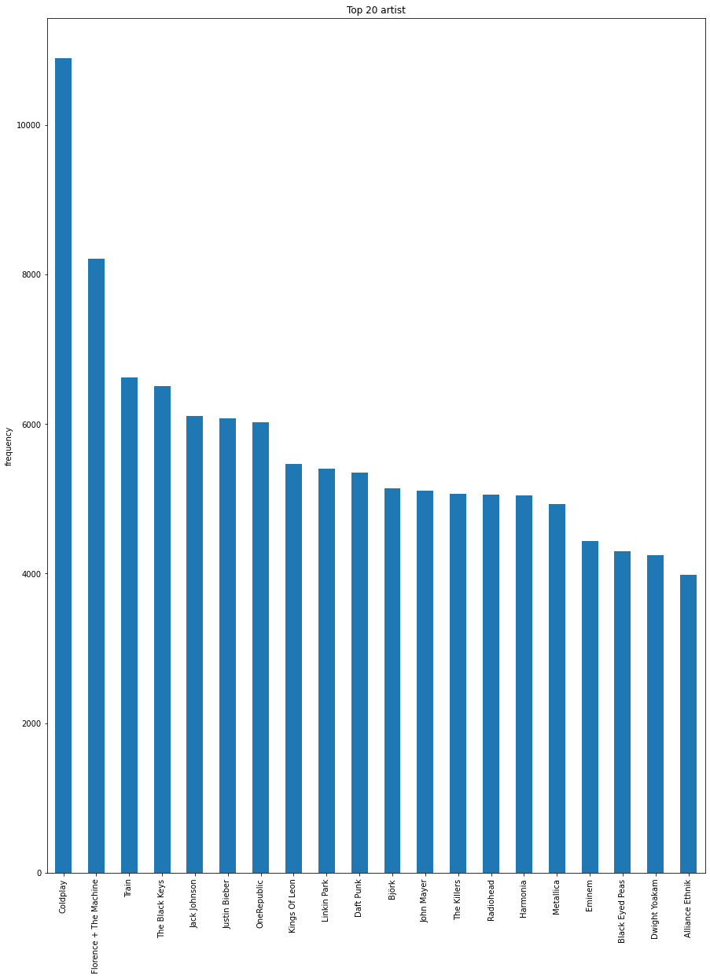
top_artist = sorted_artist_popularity.head()
top_artist.plot(kind='bar', figsize=(15,5));
plt.title("Top 20 artist")
plt.ylabel('frequency');

Slide 14
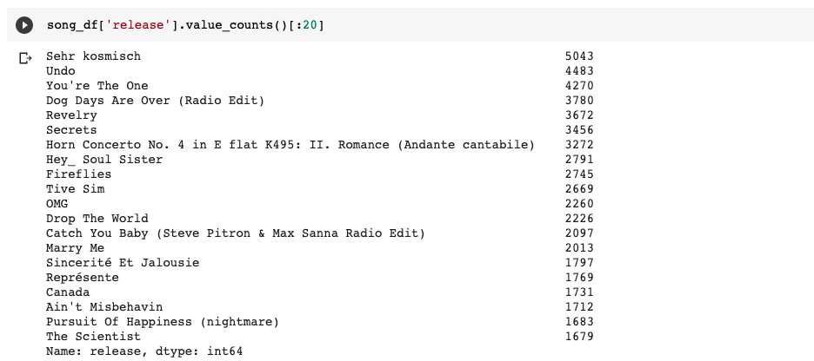
Data Analysis Using Release(Song Name)
The Most Popular Song is
Sehr Kosmisch
Followed by Undo,
You ‘re the One

Slide 15
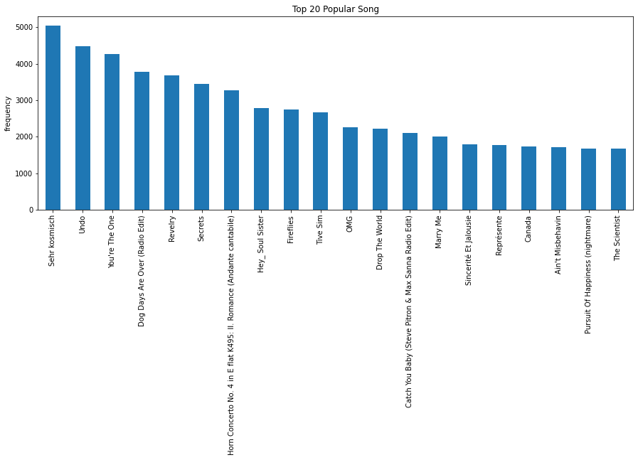
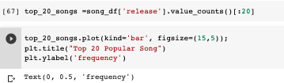
Here is a Histogram showing Top 20 Songs

Slide 16
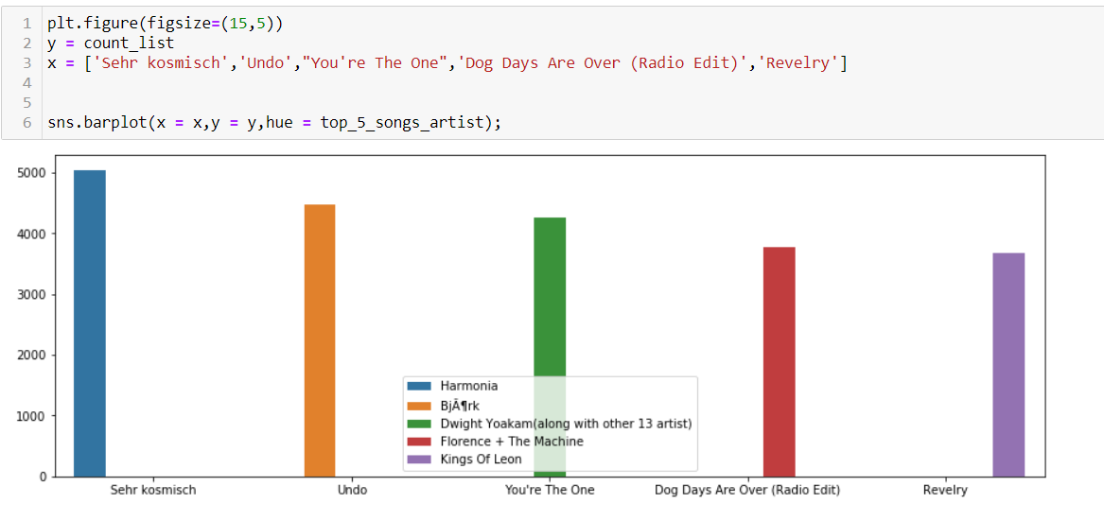
Top 5 Songs and their Respective Artists

Slide 17
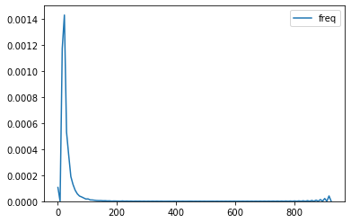
Song Frequency Using Density Plot
Kde Plot representing the song frequency

Slide 18
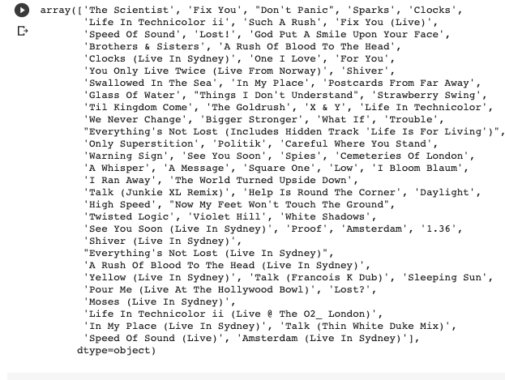
All Songs Of The Most Popular Band

Slide 19
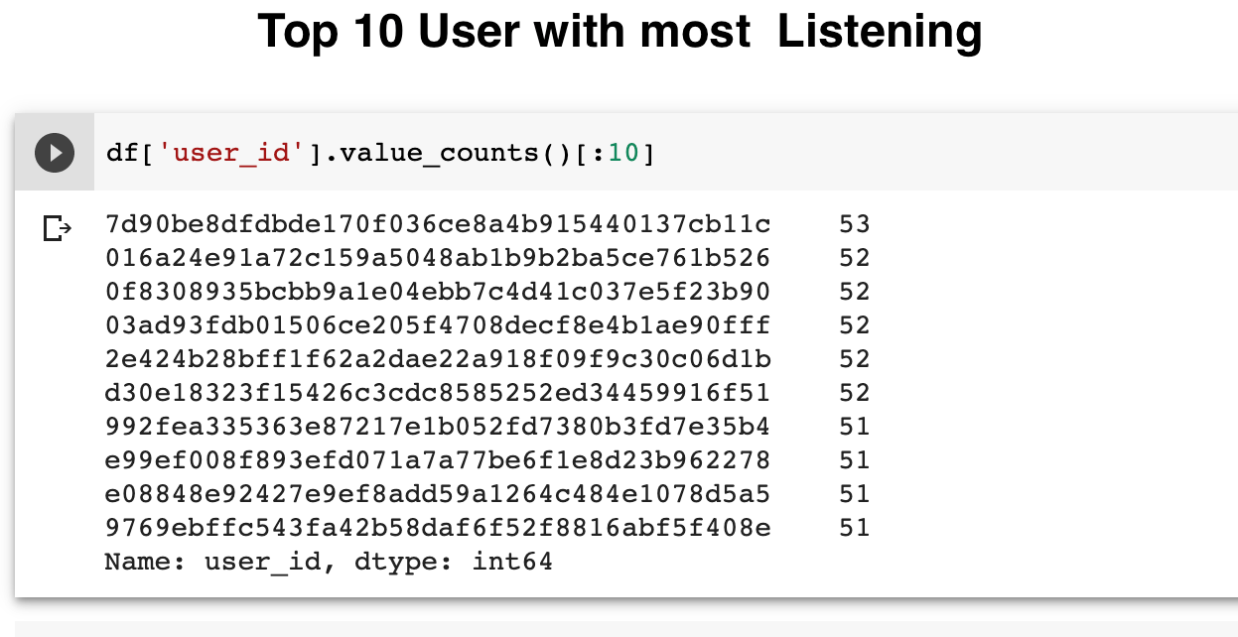
Data Analysis Using User
Here are the top listening User using their listen values.

Slide 20
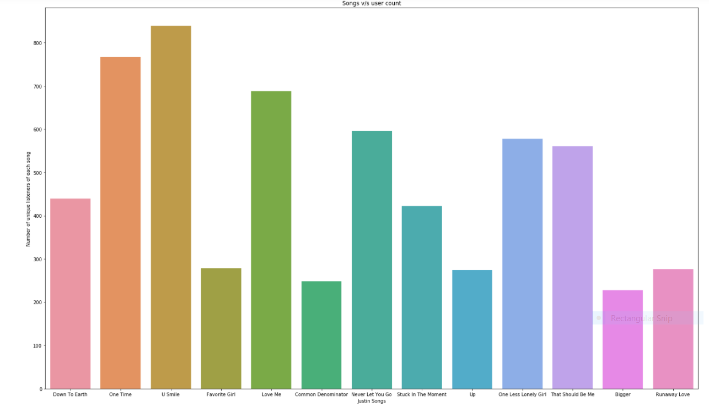
Count of Unique Listeners for artist “Justin Bieber”
Observation:
from the histogram we can conclude that U smile is most listened and Bigger is least favourite song to Users from all Justin Bieber Songs

Slide 21
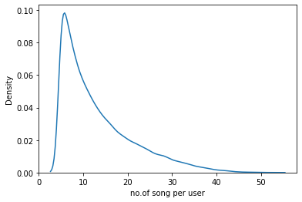
Density Plot representing Users
Density Plot Showing the Average listen by a user

Slide 22
Conclusions
From the above analysis we can conclude that the variables falls under various filtering technique categories
Artist Name - Collaborative Filtering
Song Name - Collaborative Filtering
Users Name - Content Based Filtering

Slide 23
From the Density Plot representing the “Average listens by a user” we can conclude that the data is into a cold-start problem as we can see that most of the users are listening on an average around 8-10 songs and the most songs listened by a unique user is 32 where we have around 1400000+ songs

