Slide 1

ANALYSIS ON TOP 20 COMPANIES IN AMBITION BOX ON VARIOUS FACTORS
BATCH NO : 332 K. SANJANA T. SRI HARSHA

Slide 2

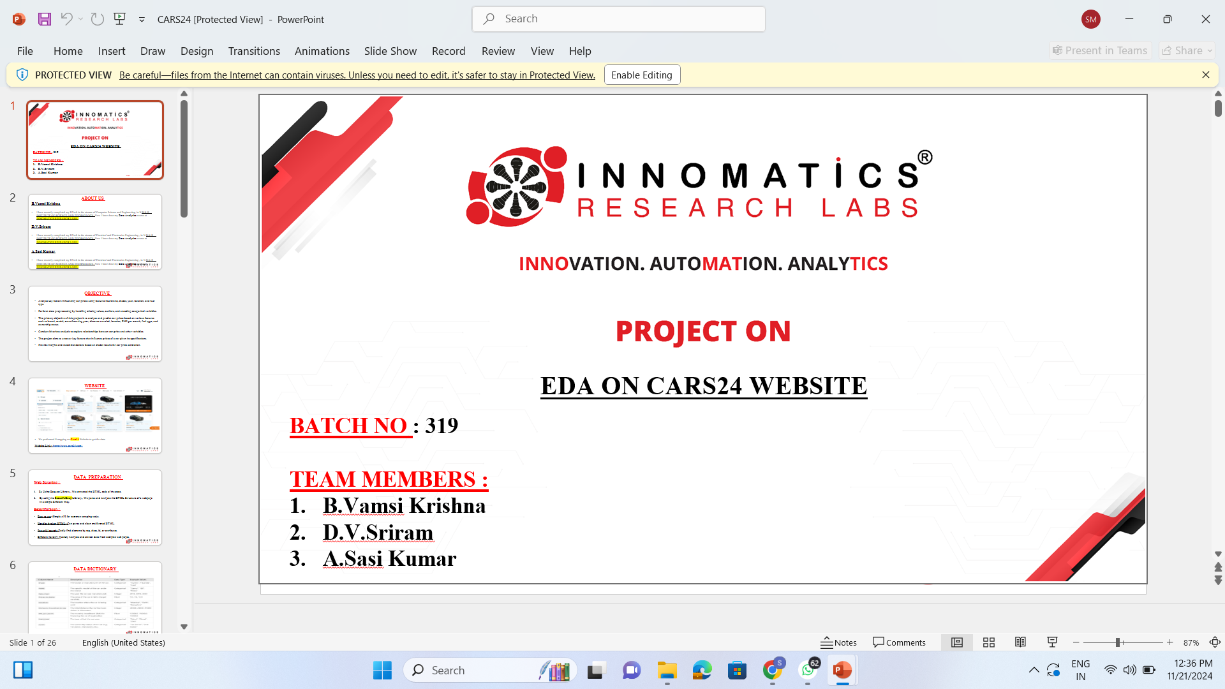
PROBLEM STATEMENT
Evaluate and compare the top 20 companies listed on Ambition Box across key factors such as ratings, reviews, salaries, number of benefits, and job opportunities.
Aims to identify trends, patterns, and insights that can help job seekers and professionals make informed decisions about career opportunities.
Assisting job seekers in identifying companies that align with their career aspirations.
Helping companies benchmark their performance against competitors.

Slide 3
INTRODUCTION
This project focuses on analyzing data from AmbitionBox, a platform that provides insights into companies through employee reviews, ratings, salaries, and job opportunities.
The dataset includes information on various companies from multiple locations, offering a rich resource for evaluating organizational performance and employee satisfaction.
This dataset provides the details from companies across various industries and regions.
The dataset covered various metrics such as ratings, reviews, salaries, benefits.

Slide 4
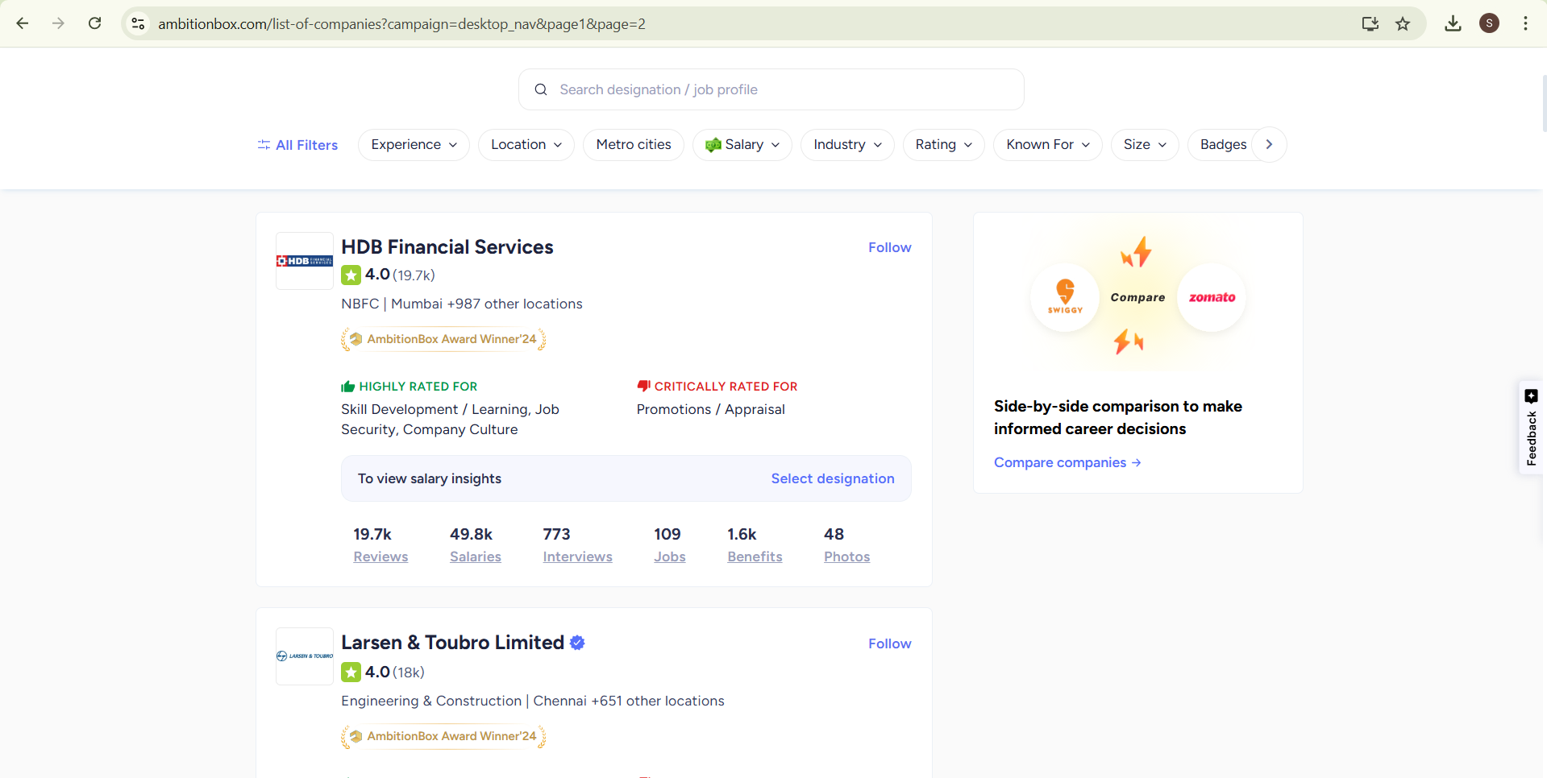
DATA COLLECTION
Website Link:-Website Link

Slide 5
WEB SCRAPING
Web Scraping is a technique used to extract data from websites. It involves programmatically accessing web pages, parsing their content, and collecting specific information for analysis or use in applications.
Key features of web scraping include:
Automating the process of data extraction.
Collecting structured or unstructured data such as text, tables, images, and links.
Utilizing tools and libraries like Beautiful Soup, Selenium, or Scrapy in Python for efficient data gathering.

Slide 6
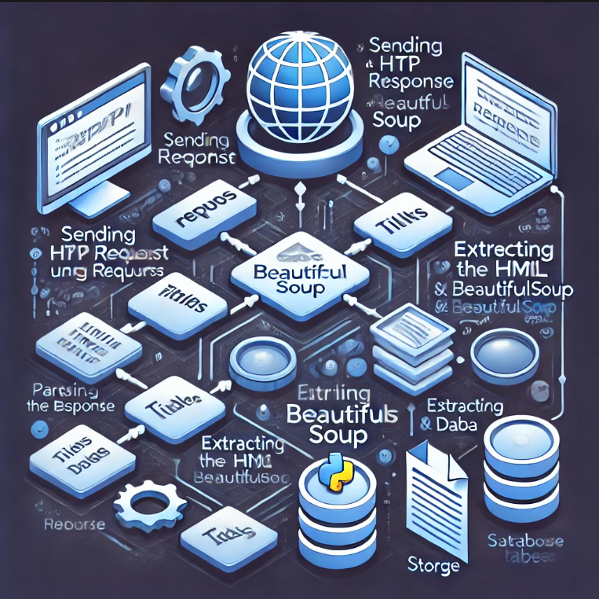
Python Libraries
Requests
Beautiful Soup
Regular expression(re)
NumPy
Pandas
Matplotlib
Seaborn
plotly

Slide 7
SUMMARY OF THE DATA
Key Columns:
Company: Names of companies (e.g., HDB Financial Services, Deloitte, BYJU’S).
Rating: Average company ratings on a 5-point scale.
Field: Industry or sector of the company (e.g., NBFC, EdTech, Banking).
Location: Headquarters or primary operation location.
Reviews: Total number of reviews by employees.
Salaries: Total salary data entries available.
No_of_Interviews: Count of interviews listed for each company.
No_of_jobs: Number of active job openings.
No_of_Benefits: Count of benefits listed for each company.

Slide 8
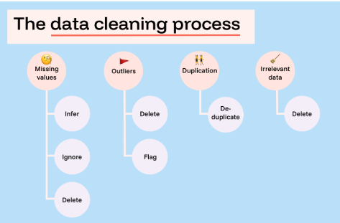
EXPLORATORY DATA ANALYSIS

Slide 9
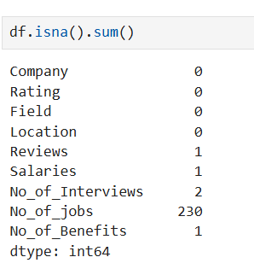
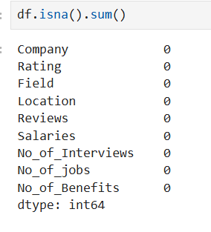
Removing the missing values
BEFORE DATA CLEANING AFTER DATA CLEANING

Slide 10
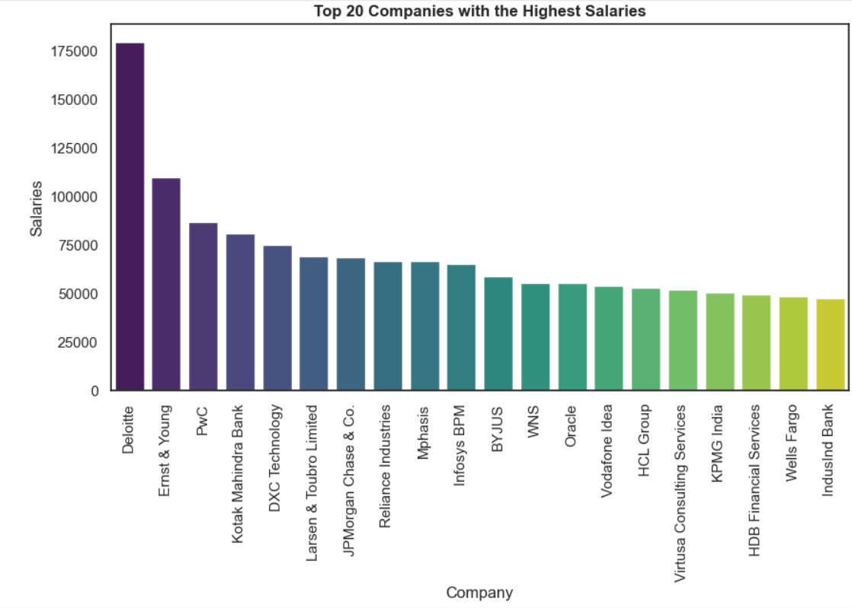
Exploring Correlations: Bivariate Analysis of Key Metrics on AmbitionBox
Highest Salary: Deloitte offers the highest salary at approximately 175,000.
Top Contenders: Ernst & Young and PwC follow closely, with salaries around 100,000.
Middle Range: Companies like Kotak Mahindra Bank, DXC Technology, Larsen & Toubro, and JPMorgan Chase offer salaries between 50,000 to 75,000.
Significant Drop: There is a steep decline in salary levels after the top three companies

Slide 11
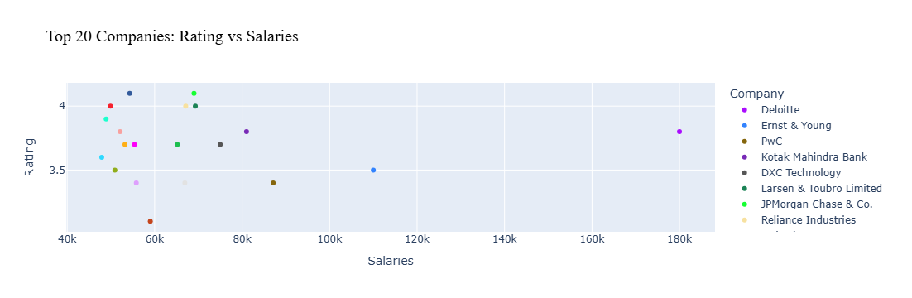
No Direct Correlation Between Salary and Rating: Companies with higher salaries don’t always have the highest ratings.
Few Companies Offer Extremely High Salaries: These companies are rare and have varying ratings, suggesting that higher salary doesn’t always mean better employee satisfaction.
High-Rating Companies Exist Across Salary Ranges: Some companies with lower salaries have ratings above 4, indicating factors beyond salary influence ratings.

Slide 12
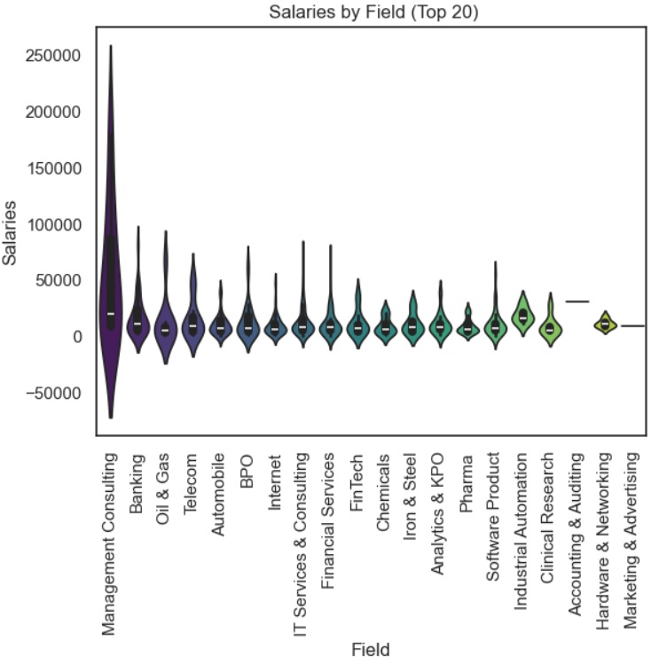
Banking and Oil & Gas: These fields also exhibit considerable salary variability, with a notable spread in salary distributions.
High Variability in Management Consulting: This field shows the widest salary range, indicating significant variability in compensation.
Banking and Oil & Gas: These fields also exhibit considerable salary variability, with a notable spread in salary distributions.
Marketing & Advertising Has the Lowest Salary Range: The salaries in this field appear more concentrated and lower compared to other industries, with fewer high-paying opportunities.

Slide 13
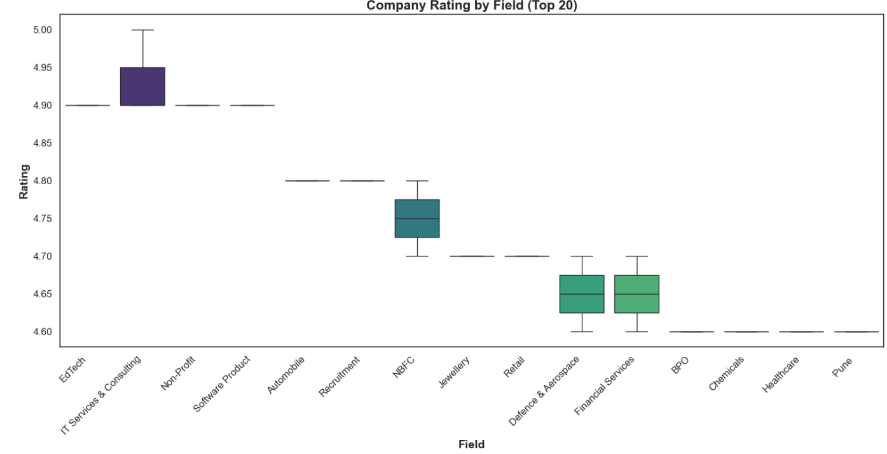
Top-Rated Field: IT Services & Consulting has the highest median rating, close to 4.95, indicating strong industry performance and reputation.
Industries with Lower Ratings :Defense & Aerospace, Financial Services, BPO, Chemicals, Healthcare show the lowest median ratings (around 4.6 to 4.7).
Additional Insights:
The box plot whiskers indicate the range of ratings for each industry.
A shorter whisker means the ratings are consistent across companies in that field.
A longer whisker suggests more variation, indicating that some companies are highly rated while others may not be.

Slide 14
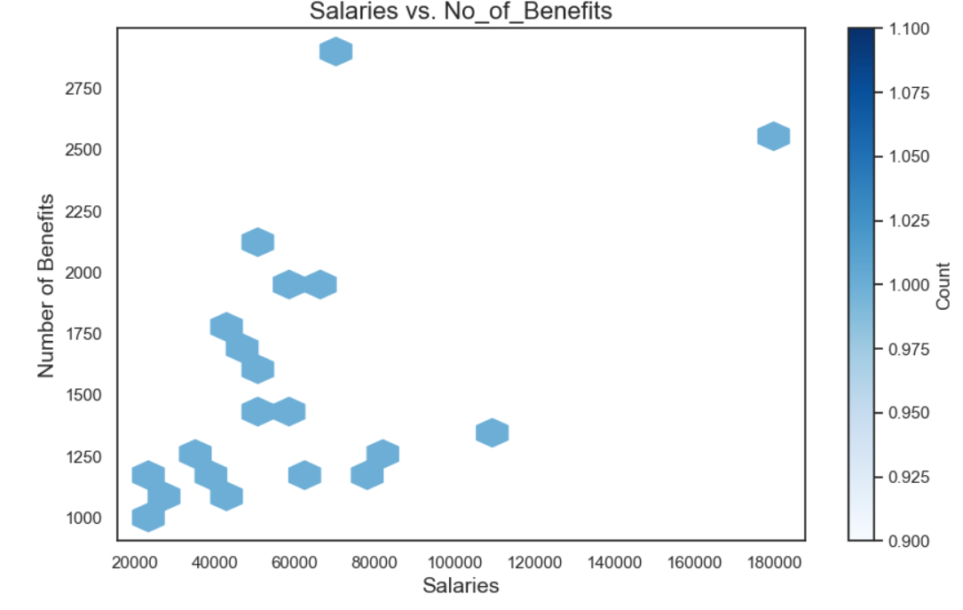
Employees Fall in the Mid-Salary Range
($30,000 - $70,000):
This range also receives moderate benefits (1,000 - 2,000).
Lower Salary Jobs Still Receive Fair Benefits:
Even at $20,000 - $40,000, employees get ~1,000+ benefits.
No Strong Correlation Between Salary & Benefits:
Higher salaries don’t always mean significantly more benefits.
Higher Salaries Have Fewer Data Points
Suggests fewer high-paying jobs; benefits vary widely.

Slide 15
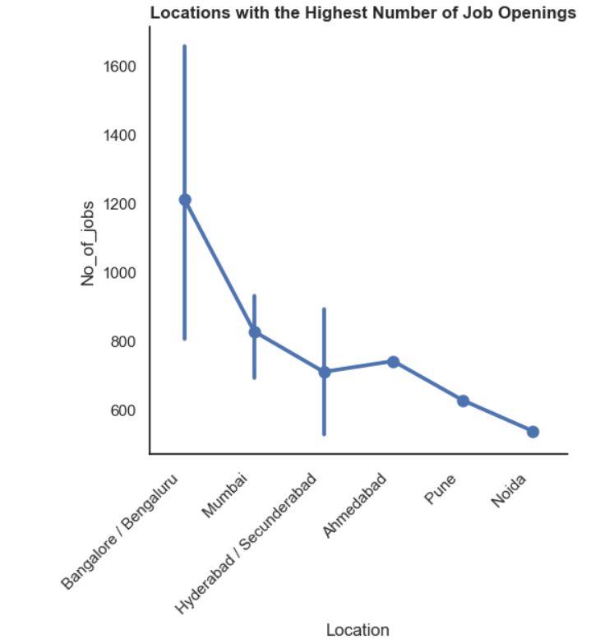
Bangalore Leads in Job Openings:
Bangalore/Bengaluru has the highest number of job openings, exceeding 1,200, making it India's top job hub.
Ahmedabad and Pune Show Moderate Demand:
These cities have 600–700 job openings, suggesting stable but comparatively fewer opportunities.
Noida Has the Lowest Job Openings Among Top Cities:
With under 600 openings, Noida has the lowest demand among the top locations but remains significant.

Slide 16
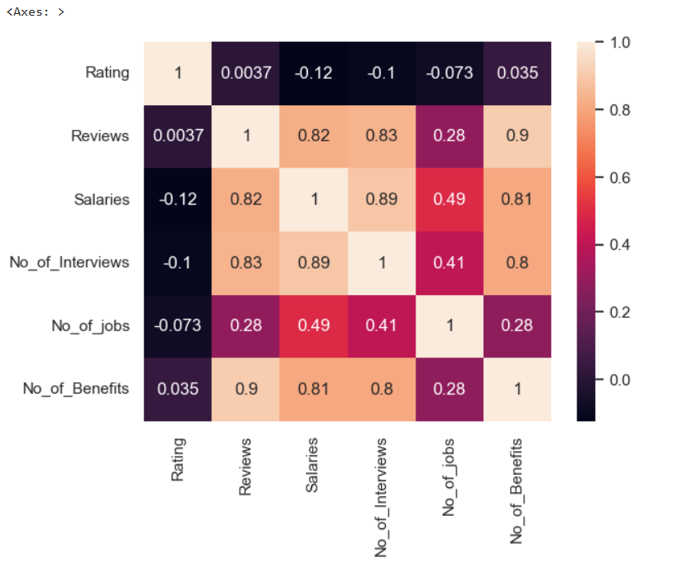
Strong Correlation Between Reviews and Benefits (0.9):The number of reviews is highly correlated with the number of benefits provided. This suggests that employees tend to leave more reviews when they receive better benefits.
Salaries & Interviews (0.89):Higher salaries correlate with more interviews.
Weak or Negative Correlation Between Rating and Other Factors: The overall rating of a company has a very weak or even negative correlation with salaries (-0.12), interviews (-0.1), and jobs available (-0.073). This suggests that higher salaries or more job openings do not necessarily lead to higher ratings.
Moderate Correlation Between Salaries and Number of Jobs (0.49):A positive correlation between salaries and the number of jobs available suggests that companies offering more jobs tend to have higher salaries.

Slide 17
Conclusion:
For Job Seekers: Focus beyond just salary; company ratings and employee reviews provide better insights into work culture and satisfaction.
For Companies: Higher pay alone does not guarantee a high rating; factors like work environment, benefits, and growth opportunities matter.
For Industry Trends: IT Services & Consulting remains a preferred choice for employees, while fields like Marketing & Advertising need to improve compensation structures.
For Location Preferences: Bangalore offers the most opportunities, making it an attractive choice for job seekers.

Slide 18

THANK YOU

