Slide 1

Department of Computer Science and Engineering
Advance Programming in java
Unit -2
Ashok Kumar Saini
Assistant Professor

Slide 2
NETWORKING
The term network programming refers to writing programs that execute across multiple devices (computers), in which the devices are all connected to each other using a network.
The java.net package of the J2SE APIs contains a collection of classes and interfaces that provide the low-level communication details, allowing you to write programs that focus on solving the problem at hand.

Slide 3
The java.net package provides support for the two common network protocols −
TCP − TCP stands for Transmission Control Protocol, which allows for reliable communication between two applications. TCP is typically used over the Internet Protocol, which is referred to as TCP/IP.
UDP − UDP stands for User Datagram Protocol, a connection-less protocol that allows for packets of data to be transmitted between applications.
This chapter gives a good understanding on the following two subjects −
Socket Programming − This is the most widely used concept in Networking and it has been explained in very detail.
URL Processing − This would be covered separately. Click here to learn about URL Processing in Java language.

Slide 4
Java Networking Terminology
The widely used java networking terminologies are given below:
IP Address
Protocol
Port Number
MAC Address
Connection-oriented and connection-less protocol
Socket

Slide 5
1) IP Address:
IP address is a unique number assigned to a node of a network e.g. 192.168.0.1 . It is composed of octets that range from 0 to 255.
It is a logical address that can be changed.
2) Protocol:
A protocol is a set of rules basically that is followed for communication. For example:
TCP
FTP
Telnet
SMTP
POP etc.

Slide 6
3) Port Number
The port number is used to uniquely identify different applications. It acts as a communication endpoint between applications.
The port number is associated with the IP address for communication between two applications.
4) MAC Address
MAC (Media Access Control) Address is a unique identifier of NIC (Network Interface Controller). A network node can have multiple NIC but each with unique MAC.

Slide 7
5) Connection-oriented and connection-less protocol
In connection-oriented protocol, acknowledgement is sent by the receiver. So it is reliable but slow. The example of connection-oriented protocol is TCP.
But, in connection-less protocol, acknowledgement is not sent by the receiver. So it is not reliable but fast. The example of connection-less protocol is UDP.
6) Socket
A socket is an endpoint between two way communication.
Visit next page for java socket programming.
What we will learn in Networking TutorialNetworking and Networking Terminology
Socket Programming (Connection-oriented)
URL class
Displaying data of a webpage by URLConnection class
InetAddress class
DatagramSocket and DatagramPacket (Connection-less)

Slide 8
Java Socket Programming
Java Socket programming is used for communication between the applications running on different JRE.
Java Socket programming can be connection-oriented or connection-less.
Socket and ServerSocket classes are used for connection-oriented socket programming and DatagramSocket and DatagramPacket classes are used for connection-less socket programming.
The client in socket programming must know two information:
IP Address of Server, and
Port number.

Slide 9
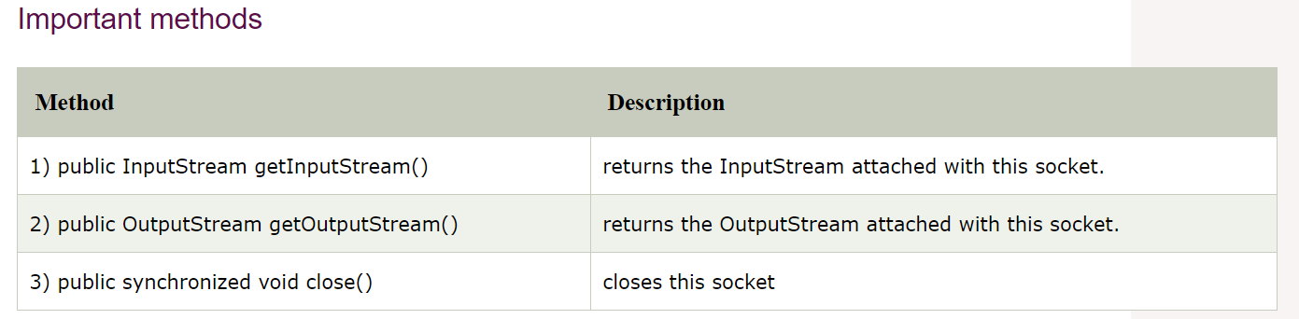
Socket class:
A socket is simply an endpoint for communications between the machines. The Socket class can be used to create a socket.

Slide 10
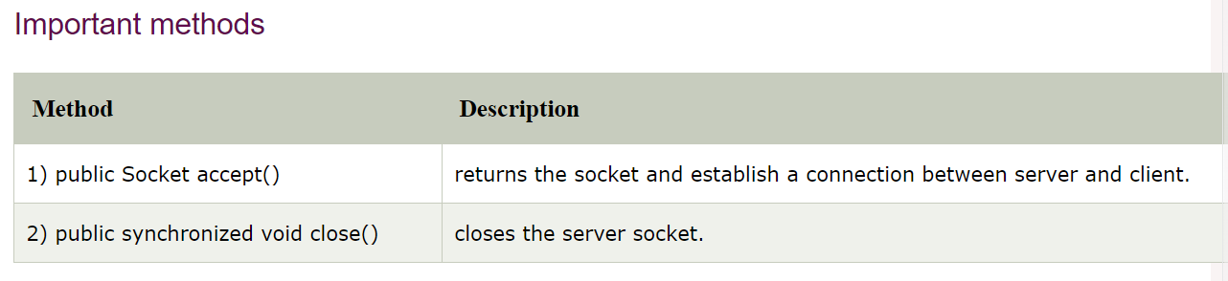
Common JDBC Components
ServerSocket class
The ServerSocket class can be used to create a server socket. This object is used to establish communication with the clients.

Slide 11
Example of Java Socket Programming
File: MyServer.java
import java.io.*;
import java.net.*;
public class MyServer {
public static void main(String[] args){
try{
ServerSocket ss=new ServerSocket(6666);
Socket s=ss.accept();//establishes connection
DataInputStream dis=new DataInputStream(s.getInputStream());
String str=(String)dis.readUTF();
System.out.println("message= "+str);
ss.close();
}catch(Exception e){System.out.println(e);}
}
}

Slide 12
File: MyClient.java
import java.io.*;
import java.net.*;
public class MyClient {
public static void main(String[] args) {
try{
Socket s=new Socket("localhost",6666);
DataOutputStream dout=new DataOutputStream(s.getOutputStream());
dout.writeUTF("Hello Server");
dout.flush();
dout.close();
s.close();
}catch(Exception e){System.out.println(e);}
}
}

Slide 13
Java Socket Programming (Read-Write both side)
File: MyServer.java
import java.net.*;
import java.io.*;
class MyServer{
public static void main(String args[])throws Exception{
ServerSocket ss=new ServerSocket(3333);
Socket s=ss.accept();
DataInputStream din=new DataInputStream(s.getInputStream());
DataOutputStream dout=new DataOutputStream(s.getOutputStream());
BufferedReader br=new BufferedReader(new InputStreamReader(System.in));
String str="",str2="";
while(!str.equals("stop")){
str=din.readUTF();
System.out.println("client says: "+str);
str2=br.readLine();
dout.writeUTF(str2);
dout.flush();
}
din.close();
s.close();
ss.close();
}}

Slide 14
File: MyClient.java
import java.net.*;
import java.io.*;
class MyClient{
public static void main(String args[])throws Exception{
Socket s=new Socket("localhost",3333);
DataInputStream din=new DataInputStream(s.getInputStream());
DataOutputStream dout=new DataOutputStream(s.getOutputStream());
BufferedReader br=new BufferedReader(new InputStreamReader(System.in));
String str="",str2="";
while(!str.equals("stop")){
str=br.readLine();
dout.writeUTF(str);
dout.flush();
str2=din.readUTF();
System.out.println("Server says: "+str2);
}
dout.close();
s.close();
}}

Slide 15
Java URL
The Java URL class represents an URL. URL is an acronym for Uniform Resource Locator.
It points to a resource on the World Wide Web. For example:
http://www.javatpoint.com/java-tutorial
A URL contains many information:
Protocol: In this case, http is the protocol.
Server name or IP Address: In this case, www.javatpoint.com is the server name.
Port Number: It is an optional attribute. If we write http//www.javatpoint.com:80/sonoojaiswal/ , 80 is the port number. If port number is not mentioned in the URL, it returns -1.
File Name or directory name: In this case, index.jsp is the file name.

Slide 16
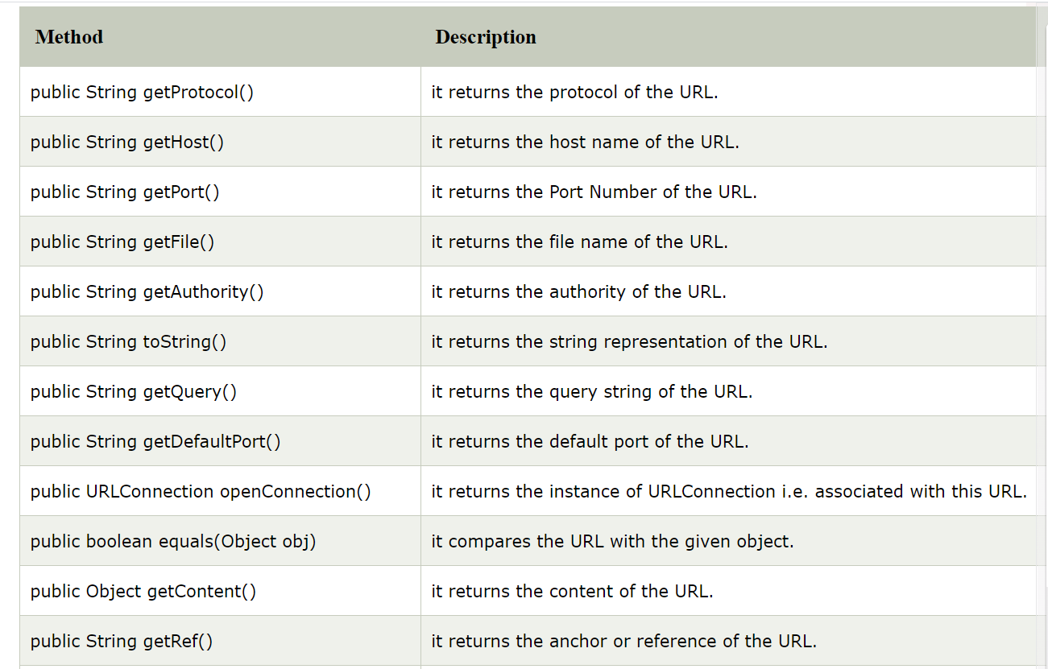
Commonly used methods of Java URL class
Method | Description
public String getProtocol() | it returns the protocol of the URL.
public String getHost() | it returns the host name of the URL.
public String getPort() | it returns the Port Number of the URL.
public String getFile() | it returns the file name of the URL.
public URLConnection openConnection() | it returns the instance of URLConnection i.e. associated with this URL.

Slide 17
Example of Java URL class
//URLDemo.java
import java.io.*;
import java.net.*;
public class URLDemo{
public static void main(String[] args){
try{
URL url=new URL("http://www.javatpoint.com/java-tutorial");
System.out.println("Protocol: "+url.getProtocol());
System.out.println("Host Name: "+url.getHost());
System.out.println("Port Number: "+url.getPort());
System.out.println("File Name: "+url.getFile());
}catch(Exception e){System.out.println(e);}
}
}

Slide 18
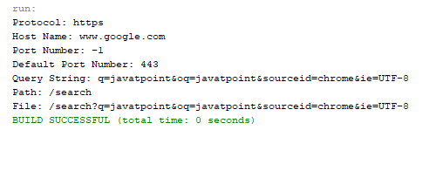
import java.net.*;
public class URLDemo{
public static void main(String[] args){
try{
URL url=new URL("https://www.google.com/search?q=javatpoint&oq=javatpoint&sourceid=chrome&ie=UTF-8");
System.out.println("Protocol: "+url.getProtocol());
System.out.println("Host Name: "+url.getHost());
System.out.println("Port Number: "+url.getPort());
System.out.println("Default Port Number: "+url.getDefaultPort());
System.out.println("Query String: "+url.getQuery());
System.out.println("Path: "+url.getPath());
System.out.println("File: "+url.getFile());
}catch(Exception e){System.out.println(e);}
}
}

Slide 19
Java URLConnection class
The Java URLConnection class represents a communication link between the URL and the application. This class can be used to read and write data to the specified resource referred by the URL.
How to get the object of URLConnection class
The openConnection() method of URL class returns the object of URLConnection class. Syntax:
public URLConnection openConnection()throws IOException{}

Slide 20
Displaying source code of a webpage by URLConnecton class:
The URLConnection class provides many methods, we can display all the data of a webpage by using the getInputStream() method.
The getInputStream() method
returns all the data of the specified URL in the stream that can be read and displayed.

Slide 21
Java HttpURLConnection class:
The Java HttpURLConnection class is http specific URLConnection. It works for HTTP protocol only.
By the help of HttpURLConnection class, you can information of any HTTP URL such as header information, status code, response code etc.
The java.net.HttpURLConnection is subclass of URLConnection class.
How to get the object of HttpURLConnection class:
The openConnection() method of URL class returns the object of URLConnection class.
Syntax:
public URLConnection openConnection()throws IOException{}

Slide 22
You can typecast it to HttpURLConnection type as given below.
URL url=new URL("http://www.javatpoint.com/java-tutorial");
HttpURLConnection huc=(HttpURLConnection)url.openConnection();

Slide 23
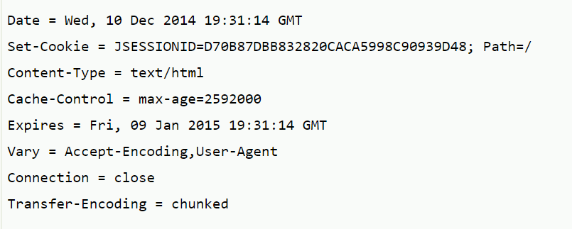
Java HttpURLConnecton Example:
import java.io.*;
import java.net.*;
public class HttpURLConnectionDemo{
public static void main(String[] args){
try{
URL url=new URL("http://www.javatpoint.com/java-tutorial");
HttpURLConnection huc=(HttpURLConnection)url.openConnection();
for(int i=1;i<=8;i++){
System.out.println(huc.getHeaderFieldKey(i)+" = "+huc.getHeaderField(i));
}
huc.disconnect();
}catch(Exception e){System.out.println(e);}
}
}

Slide 24
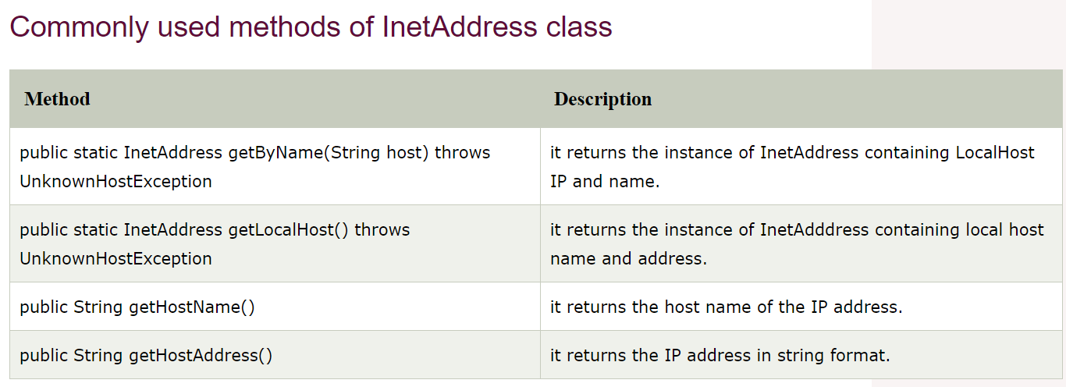
Java InetAddress class
Java InetAddress class represents an IP address. The java.net.InetAddress class provides methods to get the IP of any host name for example www.javatpoint.com, www.google.com, www.facebook.com etc.
ethod | Description
public static InetAddress getByName(String host) throws UnknownHostException | it returns the instance of InetAddress containing LocalHost IP and name.
public static InetAddress getLocalHost() throws UnknownHostException | it returns the instance of InetAdddress containing local host name and address.
public String getHostName() | it returns the host name of the IP address.
public String getHostAddress() | it returns the IP address in string format.

Slide 25
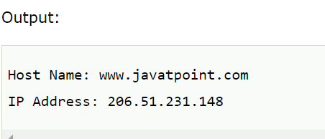
Example of Java InetAddress class
import java.io.*;
import java.net.*;
public class InetDemo{
public static void main(String[] args){
try{
InetAddress ip=InetAddress.getByName("www.javatpoint.com");
System.out.println("Host Name: "+ip.getHostName());
System.out.println("IP Address: "+ip.getHostAddress());
}catch(Exception e){System.out.println(e);}
}
}

Slide 26
Java DatagramSocket and DatagramPacket:Java DatagramSocket and DatagramPacket classes are used for connection-less socket programming.
Java DatagramSocket class:
Java DatagramSocket class represents a connection-less socket for sending and receiving datagram packets.
A datagram is basically an information but there is no guarantee of its content, arrival or arrival time.
Commonly used Constructors of DatagramSocket class
DatagramSocket() throws SocketEeption: it creates a datagram socket and binds it with the available Port Number on the localhost machine.
DatagramSocket(int port) throws SocketEeption: it creates a datagram socket and binds it with the given Port Number.
DatagramSocket(int port, InetAddress address) throws SocketEeption: it creates a datagram socket and binds it with the specified port number and host address.

Slide 27
Java DatagramPacket class
Java DatagramPacket is a message that can be sent or received. If you send multiple packet, it may arrive in any order. Additionally, packet delivery is not guaranteed.
Commonly used Constructors of DatagramPacket class
DatagramPacket(byte[] barr, int length): it creates a datagram packet. This constructor is used to receive the packets.
DatagramPacket(byte[] barr, int length, InetAddress address, int port): it creates a datagram packet. This constructor is used to send the packets.

Slide 28
Example of Sending DatagramPacket by DatagramSocket
//DSender.java
import java.net.*;
public class DSender{
public static void main(String[] args) throws Exception {
DatagramSocket ds = new DatagramSocket();
String str = "Welcome java";
InetAddress ip = InetAddress.getByName("127.0.0.1");
DatagramPacket dp = new DatagramPacket(str.getBytes(), str.length(), ip, 3000);
ds.send(dp);
ds.close();
}
}

Slide 29
Example of Receiving DatagramPacket by DatagramSocket
//DReceiver.java
import java.net.*;
public class DReceiver{
public static void main(String[] args) throws Exception {
DatagramSocket ds = new DatagramSocket(3000);
byte[] buf = new byte[1024];
DatagramPacket dp = new DatagramPacket(buf, 1024);
ds.receive(dp);
String str = new String(dp.getData(), 0, dp.getLength());
System.out.println(str);
ds.close();
}
}

Slide 30
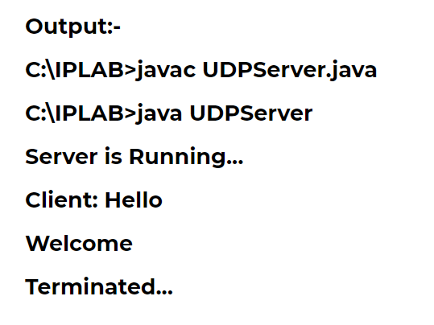
source code java programming UDP Chat server (server)
import java.io.*; import java.net.*; class UDPServer { public static DatagramSocket serversocket; public static DatagramPacket dp; public static BufferedReader dis; public static InetAddress ia; public static byte buf[] = new byte[1024]; public static int cport = 789,sport=790; public static void main(String[] a) throws IOException { serversocket = new DatagramSocket(sport); dp = new DatagramPacket(buf,buf.length); dis = new BufferedReader (new InputStreamReader(System.in)); ia = InetAddress.getLocalHost(); System.out.println("Server is Running..."); while(true) { serversocket.receive(dp); String str = new String(dp.getData(), 0, dp.getLength()); if(str.equals("STOP")) { System.out.println("Terminated..."); break; } System.out.println("Client: " + str); String str1 = new String(dis.readLine()); buf = str1.getBytes();
serversocket.send(new DatagramPacket(buf,str1.length(), ia, cport)); } } }

Slide 31
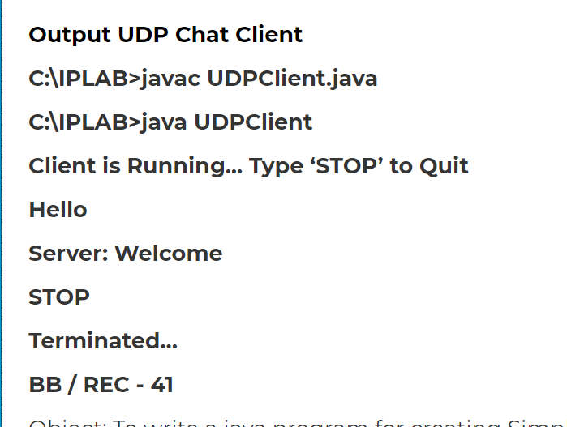
source code java programming UDP Chat server(client)
_{import java.io.*;} _{import java.net.*;} _{class UDPClient} { public static DatagramSocket clientsocket; public static DatagramPacket dp; public static BufferedReader dis; _{public static InetAddress ia;} public static byte buf[] = new byte[1024]; public static int cport = 789, sport = 790; public static void main(String[] a) throws IOException { clientsocket = new DatagramSocket(cport); dp = new DatagramPacket(buf, buf.length); dis = new BufferedReader(new InputStreamReader(System.in)); ia = InetAddress.getLocalHost(); System.out.println("Client is Running... Type 'STOP’ to Quit"); _{while(true)} { String str = new String(dis.readLine()); _{buf = str.getBytes();} _{if(str.equals("STOP"))} { System.out.println("Terminated..."); clientsocket.send(new DatagramPacket(buf, str.length(), ia, sport)); _{break;} } clientsocket.send(new DatagramPacket(buf, str.length(), ia, sport)); _{clientsocket.receive(dp);} String str2 = new String(dp.getData(), 0, dp.getLength()); System.out.println("Server: " + str2); } } }

Slide 32
References
java.sql package
http://java.sun.com/j2se/1.4.2/docs/api/java/sql/package-summary.html
https://www.javatpoint.com/java-networking
JDBC Technology Guide: Getting Started
http://java.sun.com/j2se/1.4.2/docs/guide/jdbc/getstart/GettingStartedTOC.fm.html
JDBC API Tutorial and Reference (book)
http://java.sun.com/docs/books/jdbc/
https://www.javatpoint.com/java-tutorial
https://www.infoworld.com/article/2853780/socket-programming-for-scalable-systems.html

