Slide 1

Department of Computer Science and Engineering
Advance Programming in java
Unit -1
Ashok Kumar Saini
Assistant Professor

Slide 2
GUI Programming
In this chapter we will explore the creation of graphical user interfaces (GUIs).Although console programs like the ones we have written in the preceding chapters are still very important, the majority of modern desktop applications have graphical user interfaces.
Supplement 3G introduced a DrawingPanel class that allowed you to draw two-dimensional graphics on the screen.This class is useful for certain applications, but writing a GUI is not the same as drawing shapes and lines onto a canvas. A real graphical user interface includes window frames which you create that contain buttons, text input fields, and other onscreen components.

Slide 3
Graphical Input and Output with Option Panes The simplest way to create a graphical window in Java is to have an option pane pop up. An option pane is a simple message box that appears on the screen and presents a message or a request for input to the user.
import javax.swing.*; // for GUI components JOptionPane can be thought of as a rough graphical equivalent of System.out.println output and Scanner console input. The following program creates a “Hello, world!” message on the screen with the use of JOptionPane:

Slide 4
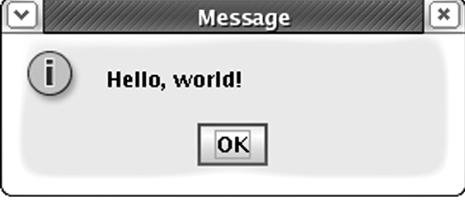
// A graphical equivalent of the classic "Hello world" program.
import javax.swing.*; // for GUI components
public class HelloWorld {
public static void main(String[] args) {
JOptionPane.showMessageDialog(null, "Hello, world!");
}
}

Slide 5
Every user interface considers the following three main aspects:
UI Elements: These are the core visual elements the user eventually sees and interacts with. GWT provides a huge list of widely used and common elements varying from basic to complex, which we will cover in this tutorial.
Layouts: They define how UI elements should be organized on the screen and provide a final look and feel to the GUI (Graphical User Interface).
This part will be covered in the Layout chapter. Behavior: These are the events which occur when the user interacts with UI elements. This part will be covered in the Event Handling chapter.

Slide 6
JDBC(java database connectivity)
JDBC stands for Java Database Connectivity, which is a standard Java API for database independent connectivity between the Java programming language, and a wide range of databases.
The JDBC library includes APIs for each of the tasks mentioned below that are commonly associated with database usage.
Making a connection to a database.
Creating SQL or MySQL statements.
Executing SQL or MySQL queries in the database.
Viewing & Modifying the resulting records.

Slide 7
Fundamentally, JDBC is a specification that provides a complete set of interfaces that allows for portable access to an underlying database.
Java can be used to write different types of executables, such as:
Java Applications
Java Applets
Java Servlets
Java ServerPages (JSPs)
Enterprise JavaBeans (EJBs). All of these different executables are able to use a JDBC driver to access a database, and take advantage of the stored data.
What is API
API (Application programming interface) is a document that contains a description of all the features of a product or software. It represents classes and interfaces that software programs can follow to communicate with each other. An API can be created for applications, libraries, operating systems, etc.

Slide 8
Why Should We Use JDBC
Before JDBC, ODBC API was the database API to connect and execute the query with the database. But, ODBC API uses ODBC driver which is written in C language (i.e. platform dependent and unsecured). That is why Java has defined its own API (JDBC API) that uses JDBC drivers (written in Java language).
We can use JDBC API to handle database using Java program and can perform the following activities:
Connect to the database
Execute queries and update statements to the database
Retrieve the result received from the database.

Slide 9
JDBC Architecture
The JDBC API supports both two-tier and three-tier processing models for database access but in general, JDBC Architecture consists of two layers:
JDBC API: This provides the application-to-JDBC Manager connection.
JDBC Driver API: This supports the JDBC Manager-to-Driver Connection.
The JDBC API uses a driver manager and database-specific drivers to provide transparent connectivity to heterogeneous databases.
The JDBC driver manager ensures that the correct driver is used to access each data source. The driver manager is capable of supporting multiple concurrent drivers connected to multiple heterogeneous databases.

Slide 10
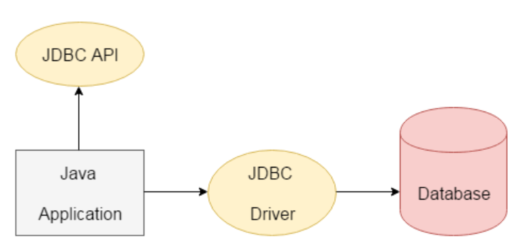

Slide 11
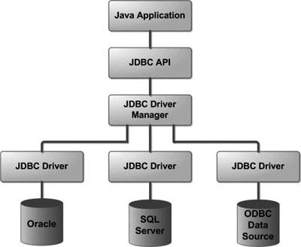
JDBC Architecture

Slide 12
Common JDBC Components
The JDBC API provides the following interfaces and classes:
DriverManager: This class manages a list of database drivers. Matches connection requests from the java application with the proper database driver using communication subprotocol. The first driver that recognizes a certain subprotocol under JDBC will be used to establish a database Connection.
Driver: This interface handles the communications with the database server. You will interact directly with Driver objects very rarely. Instead, you use DriverManager objects, which manages objects of this type. It also abstracts the details associated with working with Driver objects.

Slide 13
Connection: This interface with all methods for contacting a database. The connection object represents communication context, i.e., all communication with database is through connection object only.
Statement: You use objects created from this interface to submit the SQL statements to the database. Some derived interfaces accept parameters in addition to executing stored procedures.
ResultSet: These objects hold data retrieved from a database after you execute an SQL query using Statement objects. It acts as an iterator to allow you to move through its data.
SQLException: This class handles any errors that occur in a database application.

Slide 14
What is JDBC Driver?
JDBC drivers implement the defined interfaces in the JDBC API, for interacting with your database server.
For example, using JDBC drivers enable you to open database connections and to interact with it by sending SQL or database commands then receiving results with Java.
The Java.sql package that ships with JDK, contains various classes with their behaviours defined and their actual implementaions are done in third-party drivers. Third party vendors implements the java.sql.Driver interface in their database driver.

Slide 15
JDBC Driver
JDBC Driver is a software component that enables java application to interact with the database. There are 4 types of JDBC drivers:
JDBC-ODBC bridge driver
Native-API driver (partially java driver)
Network Protocol driver (fully java driver)
Thin driver (fully java driver)

Slide 16
JDBC Drivers Types
Type 1: JDBC-ODBC Bridge Driver
In a Type 1 driver, a JDBC bridge is used to access ODBC drivers installed on each client machine. Using ODBC, requires configuring on your system a Data Source Name (DSN) that represents the target database.
When Java first came out, this was a useful driver because most databases only supported ODBC access but now this type of driver is recommended only for experimental use or when no other alternative is available.

Slide 17
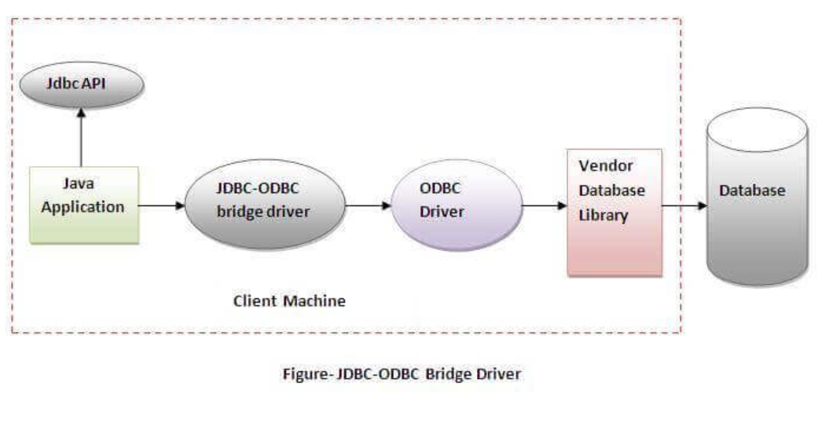

Slide 18
The JDBC-ODBC bridge driver uses ODBC driver to connect to the database. The JDBC-ODBC bridge driver converts JDBC method calls into the ODBC function calls. This is now discouraged because of thin driver.
Oracle does not support the JDBC-ODBC Bridge from Java 8. Oracle recommends that you use JDBC drivers provided by the vendor of your database instead of the JDBC-ODBC Bridge.
Advantages:
easy to use.
can be easily connected to any database.
Disadvantages:
Performance degraded because JDBC method call is converted into the ODBC function calls.
The ODBC driver needs to be installed on the client machine.

Slide 19
Type 2: JDBC-Native API
In a Type 2 driver, JDBC API calls are converted into native C/C++ API calls, which are unique to the database. These drivers are typically provided by the database vendors and used in the same manner as the JDBC-ODBC Bridge. The vendor-specific driver must be installed on each client machine.
If we change the Database, we have to change the native API, as it is specific to a database and they are mostly obsolete now, but you may realize some speed increase with a Type 2 driver, because it eliminates ODBC's overhead.
The Native API driver uses the client-side libraries of the database. The driver converts JDBC method calls into native calls of the database API. It is not written entirely in java.

Slide 20
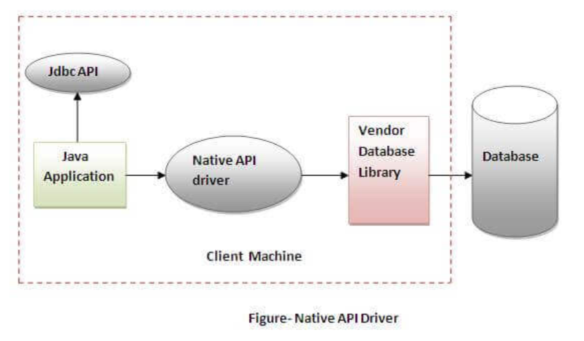

Slide 21
Advantage:
performance upgraded than JDBC-ODBC bridge driver.
Disadvantage:
The Native driver needs to be installed on the each client machine.
The Vendor client library needs to be installed on client machine.

Slide 22
Type 3: JDBC-Net(Network Protocol driver) Pure Java
In a Type 3 driver, a three-tier approach is used to access databases. The JDBC clients use standard network sockets to communicate with a middleware application server. The socket information is then translated by the middleware application server into the call format required by the DBMS, and forwarded to the database server.
This kind of driver is extremely flexible, since it requires no code installed on the client and a single driver can actually provide access to multiple databases.
The Network Protocol driver uses middleware (application server) that converts JDBC calls directly or indirectly into the vendor-specific database protocol. It is fully written in java.

Slide 23
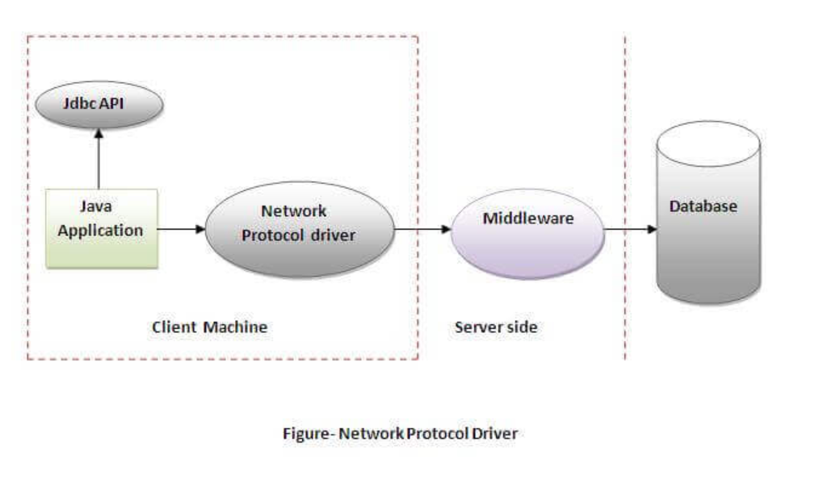

Slide 24
Advantage:
No client side library is required because of application server that can perform many tasks like auditing, load balancing, logging etc.
Disadvantages:
Network support is required on client machine.
Requires database-specific coding to be done in the middle tier.
Maintenance of Network Protocol driver becomes costly because it requires database-specific coding to be done in the middle tier.

Slide 25
Type 4: (Thin driver) 100% Pure Java
In a Type 4 driver, a pure Java-based driver communicates directly with the vendor's database through socket connection. This is the highest performance driver available for the database and is usually provided by the vendor itself.
This kind of driver is extremely flexible, you don't need to install special software on the client or server. Further, these drivers can be downloaded dynamically.
The thin driver converts JDBC calls directly into the vendor-specific database protocol. That is why it is known as thin driver. It is fully written in Java language, these drivers can be downloaded dynamically.

Slide 26
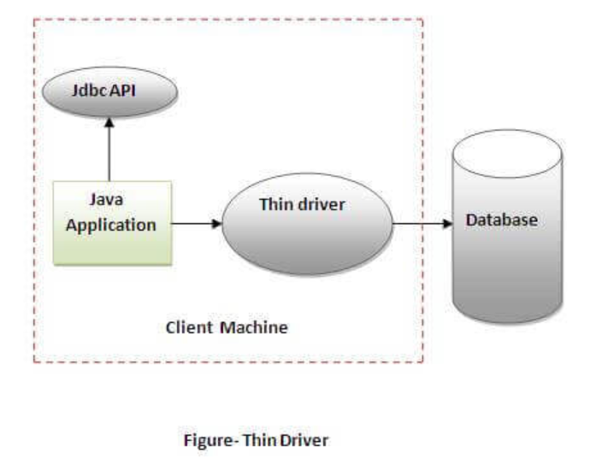

Slide 27
Which Driver should be Used?
If you are accessing one type of database, such as Oracle, Sybase, or IBM, the preferred driver type is 4.
If your Java application is accessing multiple types of databases at the same time, type 3 is the preferred driver.
Type 2 drivers are useful in situations, where a type 3 or type 4 driver is not available yet for your database.
The type 1 driver is not considered a deployment-level driver, and is typically used for development and testing purposes only.

Slide 28
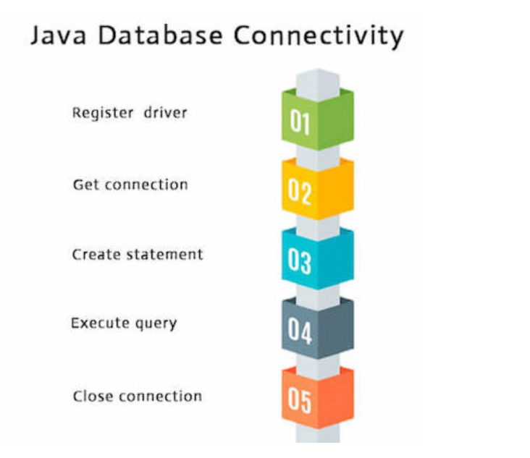
Basic steps to use a database in Java
1.Establish a connection
2.Create JDBC Statements
3.Execute SQL Statements
4.GET ResultSet
5.Close connections

Slide 29
1. Establish a connection
import java.sql.*;
Load the vendor specific driver(Register the driver class)
Class.forName("oracle.jdbc.driver.OracleDriver");
The forName() method of Class class is used to register the driver class. This method is used to dynamically load the driver class.
Dynamically loads a driver class, for Oracle database
Make the connection
Connection con = DriverManager.getConnection( "jdbc:oracle:thin:@oracle-prod:1521:OPROD", username, passwd);
The getConnection() method of DriverManager class is used to establish connection with the database.

Slide 30
2. Create JDBC statement(s)
Statement stmt = con.createStatement() ;
Creates a Statement object for sending SQL statements to the database
Execute the query
The executeQuery() method of Statement interface is used to execute queries to the database. This method returns the object of ResultSet that can be used to get all the records of a table.

Slide 31
Executing SQL Statements
String createLehigh = "Create table Lehigh " +
"(SSN Integer not null, Name VARCHAR(32), " + "Marks Integer)";
stmt.executeUpdate(createLehigh);
//What does this statement do?
String insertLehigh = "Insert into Lehigh values“ + "(123456789,abc,100)";
stmt.executeUpdate(insertLehigh);
Example to execute query
ResultSet rs=stmt.executeQuery("select * from emp");
while(rs.next()){
System.out.println(rs.getInt(1)+" "+rs.getString(2));
}

Slide 32
Get ResultSet
String queryLehigh = "select * from Lehigh";
ResultSet rs = Stmt.executeQuery(queryLehigh);
//What does this statement do?
while (rs.next()) {
int ssn = rs.getInt("SSN");
String name = rs.getString("NAME");
int marks = rs.getInt("MARKS");
}

Slide 33
Close connection
stmt.close();
con.close();

Slide 34
create table emp(id number(10),name varchar2(40),age number(3));
Create a Table Before establishing connection, let's first create a table in oracle database. Following is the SQL query to create a table.
create table emp(id number(10),name varchar2(40),age number(3));

Slide 35
Sample program: Java Database Connectivity with Oracle
import java.sql.*;
class OracleCon{
public static void main(String args[]){
try{
//step1 load the driver class
Class.forName("oracle.jdbc.driver.OracleDriver");
//step2 create the connection object
Connection con=DriverManager.getConnection(
"jdbc:oracle:thin:@localhost:1521:xe","system","oracle");
//step3 create the statement object
Statement stmt=con.createStatement();
//step4 execute query
ResultSet rs=stmt.executeQuery("select * from emp");
while(rs.next())
System.out.println(rs.getInt(1)+" "+rs.getString(2)+" "+rs.getString(3));
//step5 close the connection object
con.close();
}catch(Exception e){ System.out.println(e);}
}
}

Slide 36
Java Database Connectivity with MySQL
import java.sql.*;
class MysqlCon{
public static void main(String args[]){
try{
Class.forName("com.mysql.jdbc.Driver");
Connection con=DriverManager.getConnection(
"jdbc:mysql://localhost:3306/sonoo","root","root");
//here sonoo is database name, root is username and password
Statement stmt=con.createStatement();
ResultSet rs=stmt.executeQuery("select * from emp");
while(rs.next())
System.out.println(rs.getInt(1)+" "+rs.getString(2)+" "+rs.getString(3));
con.close();
}catch(Exception e){ System.out.println(e);}
}
}

Slide 37
Sample program(cont)
ResultSet rs = s.getResultSet();
if (rs != null) // if rs == null, then there is no ResultSet to view
while ( rs.next() ) // this will step through our data row-by-row
{ /* the next line will get the first column in our current row's ResultSet
as a String ( getString( columnNumber) ) and output it to the screen */
System.out.println("Data from column_name: " + rs.getString(1) );
}
s.close(); // close Statement to let the database know we're done with it
con.close(); //close connection
}
catch (Exception err) { System.out.println("ERROR: " + err); }
}
}

Slide 38
Connectivity with Access without DSN
There are two ways to connect java application with the access database.
Without DSN (Data Source Name)
With DSN
Java is mostly used with Oracle, mysql, or DB2 database. So you can learn this topic only for knowledge.

Slide 39
Example to Connect Java Application with access without DSN
import java.sql.*;
class Test{
public static void main(String ar[]){
try{
String database="student.mdb";//Here database exists in the current directory
String url="jdbc:odbc:Driver={Microsoft Access Driver (*.mdb)};
DBQ=" + database + ";DriverID=22;READONLY=true";
Class.forName("sun.jdbc.odbc.JdbcOdbcDriver");
Connection c=DriverManager.getConnection(url);
Statement st=c.createStatement();
ResultSet rs=st.executeQuery("select * from login");
while(rs.next()){
System.out.println(rs.getString(1));
}
}catch(Exception ee){System.out.println(ee);}
}}

Slide 40
Example to Connect Java Application with access with DSN
import java.sql.*;
class Test{
public static void main(String ar[]){
try{
String url="jdbc:odbc:mydsn";
Class.forName("sun.jdbc.odbc.JdbcOdbcDriver");
Connection c=DriverManager.getConnection(url);
Statement st=c.createStatement();
ResultSet rs=st.executeQuery("select * from login");
while(rs.next()){
System.out.println(rs.getString(1));
}
}catch(Exception ee){System.out.println(ee);}
}}

Slide 41
Connection interface
A Connection is the session between java application and database. The Connection interface is a factory of Statement, PreparedStatement, and DatabaseMetaData i.e. object of Connection can be used to get the object of Statement and DatabaseMetaData. The Connection interface provide many methods for transaction management like commit(), rollback() etc.

Slide 42
Commonly used methods of Connection interface:
1) public Statement createStatement(): creates a statement object that can be used to execute SQL queries.
2) public Statement createStatement(int resultSetType,int resultSetConcurrency): Creates a Statement object that will generate ResultSet objects with the given type and concurrency.
3) public void setAutoCommit(boolean status): is used to set the commit status.By default it is true.
4) public void commit(): saves the changes made since the previous commit/rollback permanent.
5) public void rollback(): Drops all changes made since the previous commit/rollback.
6) public void close(): closes the connection and Releases a JDBC resources immediately.

Slide 43
Statement interface:
The Statement interface provides methods to execute queries with the database. The statement interface is a factory of ResultSet i.e. it provides factory method to get the object of ResultSet.
Commonly used methods of Statement interface:
The important methods of Statement interface are as follows:
1) public ResultSet executeQuery(String sql): is used to execute SELECT query. It returns the object of ResultSet.
2) public int executeUpdate(String sql): is used to execute specified query, it may be create, drop, insert, update, delete etc.
3) public boolean execute(String sql): is used to execute queries that may return multiple results.
4) public int[] executeBatch(): is used to execute batch of commands.

Slide 44
import java.sql.*;
class FetchRecord{
public static void main(String args[])throws Exception{
Class.forName("oracle.jdbc.driver.OracleDriver");
Connection con=DriverManager.getConnection("jdbc:oracle:thin:@localhost:1521:xe","system","oracle");
Statement stmt=con.createStatement();
//stmt.executeUpdate("insert into emp765 values(33,'Irfan',50000)");
//int result=stmt.executeUpdate("update emp765 set name='Vimal',salary=10000 where id=33");
int result=stmt.executeUpdate("delete from emp765 where id=33");
System.out.println(result+" records affected");
con.close();
}}

Slide 45
ResultSet interface
The object of ResultSet maintains a cursor pointing to a row of a table. Initially, cursor points to before the first row.
By default, ResultSet object can be moved forward only and it is not updatable.
By default, ResultSet object can be moved forward only and it is not updatable.

Slide 46
But we can make this object to move forward and backward direction by passing either TYPE_SCROLL_INSENSITIVE or TYPE_SCROLL_SENSITIVE in createStatement(int,int) method as well as we can make this object as updatable by:
Statement stmt = con.createStatement(ResultSet.TYPE_SCROLL_INSENSITIVE,
ResultSet.CONCUR_UPDATABLE);

Slide 47
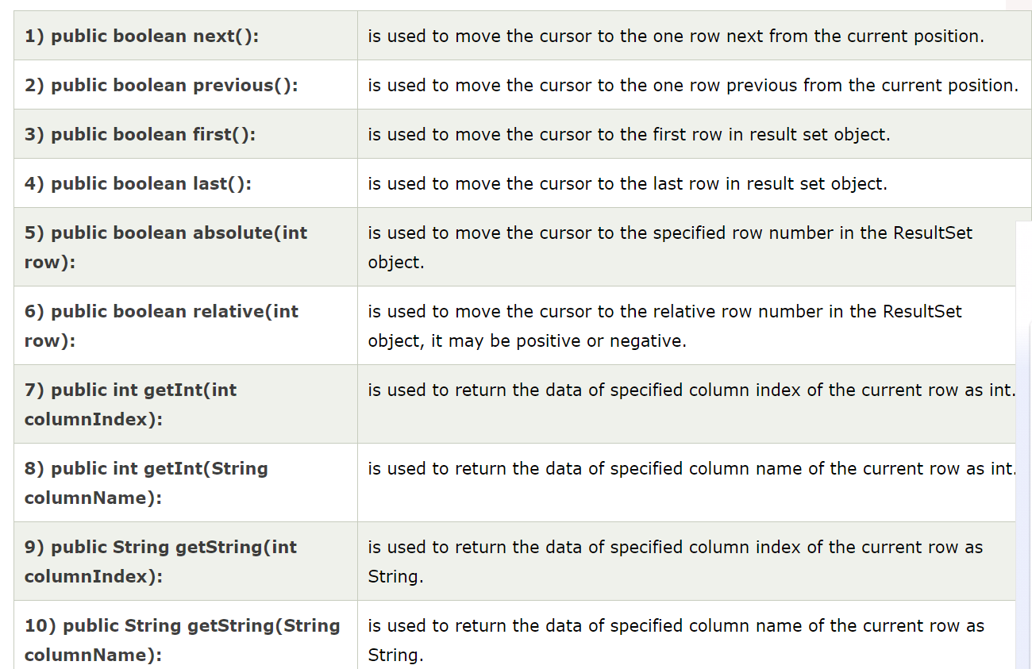
Commonly used methods of ResultSet interface

Slide 48
Example of Scrollable ResultSet Let’s see the simple example of ResultSet interface to retrieve the data of 3rd row.
import java.sql.*;
class FetchRecord{
public static void main(String args[])throws Exception{
Class.forName("oracle.jdbc.driver.OracleDriver");
Connection con=DriverManager.getConnection("jdbc:oracle:thin:@localhost:1521:xe","system","oracle");
Statement stmt=con.createStatement(ResultSet.TYPE_SCROLL_SENSITIVE,ResultSet.CONCUR_UPDATABLE);
ResultSet rs=stmt.executeQuery("select * from emp765");
//getting the record of 3rd row
rs.absolute(3);
System.out.println(rs.getString(1)+" "+rs.getString(2)+" "+rs.getString(3));
con.close();
}}

Slide 49
PreparedStatement interface
The PreparedStatement interface is a subinterface of Statement. It is used to execute parameterized query.
Let's see the example of parameterized query:
String sql="insert into emp values(?,?,?)";
Why use PreparedStatement?
Improves performance: The performance of the application will be faster if you use PreparedStatement interface because query is compiled only once.

Slide 50
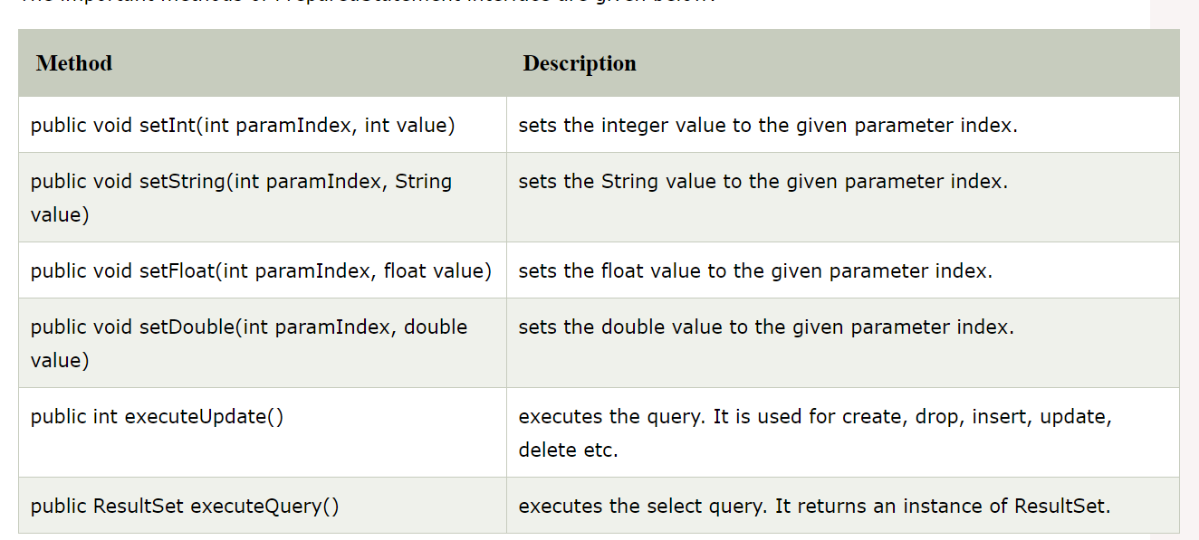
Methods of PreparedStatement interface

Slide 51
import java.sql.*;
class InsertPrepared{
public static void main(String args[]){
try{
Class.forName("oracle.jdbc.driver.OracleDriver");
Connection con=DriverManager.getConnection("jdbc:oracle:thin:@localhost:1521:xe","system","oracle");
PreparedStatement stmt=con.prepareStatement("insert into Emp values(?,?)");
stmt.setInt(1,101);//1 specifies the first parameter in the query
stmt.setString(2,"Ratan");
int i=stmt.executeUpdate();
System.out.println(i+" records inserted");
con.close();
}catch(Exception e){ System.out.println(e);}
}
}

Slide 52
Example of PreparedStatement interface that updates the record
PreparedStatement stmt=con.prepareStatement("update emp set name=? where id=?");
stmt.setString(1,"Sonoo");//1 specifies the first parameter in the query i.e. name
stmt.setInt(2,101);
int i=stmt.executeUpdate();
System.out.println(i+" records updated");

Slide 53
Example of PreparedStatement interface that deletes the record
PreparedStatement stmt=con.prepareStatement("delete from emp where id=?");
stmt.setInt(1,101);
int i=stmt.executeUpdate();
System.out.println(i+" records deleted");

Slide 54
Example of PreparedStatement interface that retrieve the records of a table
PreparedStatement stmt=con.prepareStatement("select * from emp");
ResultSet rs=stmt.executeQuery();
while(rs.next()){
System.out.println(rs.getInt(1)+" "+rs.getString(2));
}

Slide 55
Example of PreparedStatement to insert records until user press n
_{import java.sql.*;}
_{import java.io.*;}
_{class RS{}
public static void main(String args[])throws Exception{
Class.forName("oracle.jdbc.driver.OracleDriver");
Connection con=DriverManager.getConnection("jdbc:oracle:thin:@localhost:1521:xe","system","oracle");
PreparedStatement ps=con.prepareStatement("insert into emp130 values(?,?,?)");
BufferedReader br=new BufferedReader(new InputStreamReader(System.in));
_{do{}
System.out.println("enter id:");
int id=Integer.parseInt(br.readLine());
System.out.println("enter name:");
_{String name=br.readLine();}
System.out.println("enter salary:");
float salary=Float.parseFloat(br.readLine());
_{ps.setInt(1,id);}
_{ps.setString(2,name);}
_{ps.setFloat(3,salary);}
_{int i=ps.executeUpdate();}
System.out.println(i+" records affected");
System.out.println("Do you want to continue: y/n");
_{String s=br.readLine();}
_{if(s.startsWith("n")){}
_{break;}
}
_{}while(true);}
_{con.close();}
}}

Slide 56
Java CallableStatement Interface
CallableStatement interface is used to call the stored procedures and functions.
We can have business logic on the database by the use of stored procedures and functions that will make the performance better because these are precompiled.
Suppose you need the get the age of the employee based on the date of birth, you may create a function that receives date as the input and returns age of the employee as the output.

Slide 57
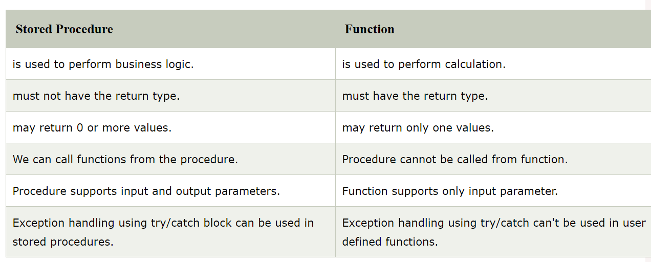
What is the difference between stored procedures and functions.

Slide 58
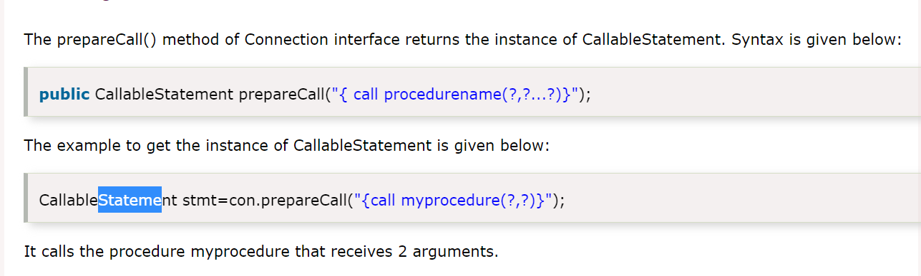
How to get the instance of CallableStatement?

Slide 59
example to call the stored procedure using JDBC
create or replace procedure "INSERTR"
(id IN NUMBER,
name IN VARCHAR2)
is
begin
insert into user420 values(id,name);
end;

Slide 60
In this example, we are going to call the stored procedure INSERTR that receives id and name as the parameter and inserts it into the table user420. Note that you need to create the user420 table as well to run this application.
import java.sql.*;
public class Proc {
public static void main(String[] args) throws Exception{
Class.forName("oracle.jdbc.driver.OracleDriver");
Connection con=DriverManager.getConnection(
"jdbc:oracle:thin:@localhost:1521:xe","system","oracle");
CallableStatement stmt=con.prepareCall("{call insertR(?,?)}");
stmt.setInt(1,1011);
stmt.setString(2,"Amit");
stmt.execute();
System.out.println("success");
}
}

Slide 61
Batch Processing in JDBC
Instead of executing a single query, we can execute a batch (group) of queries. It makes the performance fast.
The java.sql.Statement and java.sql.PreparedStatement interfaces provide methods for batch processing.
Advantage of Batch Processing
Fast Performance

Slide 62
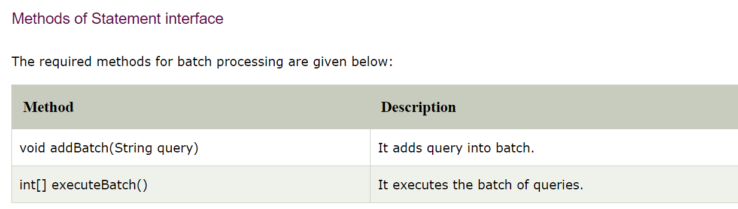

Slide 63
Example of batch processing in jdbc
Let's see the simple example of batch processing in jdbc.
It follows following steps:
Load the driver class
Create Connection
Create Statement
Add query in the batch
Execute Batch
Close Connection

Slide 64
import java.sql.*;
class FetchRecords{
public static void main(String args[])throws Exception{
Class.forName("oracle.jdbc.driver.OracleDriver");
Connection con=DriverManager.getConnection("jdbc:oracle:thin:@localhost:1521:xe","system","oracle");
con.setAutoCommit(false);
Statement stmt=con.createStatement();
stmt.addBatch("insert into user420 values(190,'abhi',40000)");
stmt.addBatch("insert into user420 values(191,'umesh',50000)");
stmt.executeBatch();//executing the batch
con.commit();
con.close();
}}

Slide 65
Example of batch processing using PreparedStatement
import java.sql.*;
import java.io.*;
class BP{
public static void main(String args[]){
try{
Class.forName("oracle.jdbc.driver.OracleDriver");
Connection con=DriverManager.getConnection("jdbc:oracle:thin:@localhost:1521:xe","system","oracle");
PreparedStatement ps=con.prepareStatement("insert into user420 values(?,?,?)");
BufferedReader br=new BufferedReader(new InputStreamReader(System.in));
while(true){
System.out.println("enter id");
String s1=br.readLine();
int id=Integer.parseInt(s1);
System.out.println("enter name");
String name=br.readLine();
System.out.println("enter salary");
String s3=br.readLine();
int salary=Integer.parseInt(s3);
ps.setInt(1,id);
ps.setString(2,name);
ps.setInt(3,salary);
ps.addBatch();
System.out.println("Want to add more records y/n");
String ans=br.readLine();
if(ans.equals("n")){
break;
}
}
ps.executeBatch();
System.out.println("record successfully saved");
con.close();
}catch(Exception e){System.out.println(e);}
}}

Slide 66
JDBC references
JDBC Data Access API – JDBC Technology Homepage
http://java.sun.com/products/jdbc/index.html
JDBC Database Access – The Java Tutorial
http://java.sun.com/docs/books/tutorial/jdbc/index.html
JDBC Documentation
http://java.sun.com/j2se/1.4.2/docs/guide/jdbc/index.html
java.sql package
http://java.sun.com/j2se/1.4.2/docs/api/java/sql/package-summary.html
JDBC Technology Guide: Getting Started
http://java.sun.com/j2se/1.4.2/docs/guide/jdbc/getstart/GettingStartedTOC.fm.html
JDBC API Tutorial and Reference (book)
http://java.sun.com/docs/books/jdbc/
https://www.javatpoint.com/java-tutorial

