Slide 1



Multi-Echelon Supply Chain Management System : Using Reinforcement Learning
Team – E7
Muppavarapu Sri Harshini - BL.EN.U4AIE21083
Pranav H - BL.EN.U4AIE21105
Rachuri Tarun - BL.EN.U4AIE21109

Slide 2
Overview
02
Existing Works & gaps
04
Enviroment
Description
03
Problem Statement
05
Methodology & Results
01
SCM ?
& Why RL in SCM ?

Slide 3

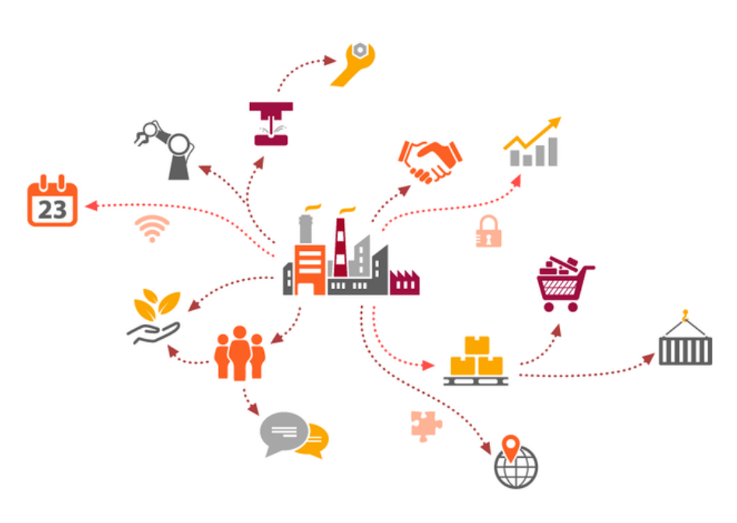
Supply chain Management
Supply chains are highly complex systems consisting of hundreds if not thousands of manufacturers and logistics carriers around the world who combine resources to create the products we use and consume every day.
Supply Chains enable :
• Better ability to predict and meet customer demands
• Fewer process inefficiencies and less product waste
• Improved cash flow and more efficient logistics

Slide 4
Where Reinforced Learning comes in Supply Chain Management ?
Manages demand uncertainty and supply disruptions.
Optimizes across multiple locations and products
RL in SCM
Enhances decision-making in dynamic environments
Reduces Cost of Operation hence increasing profits
Improves overall supply chain performance.

Slide 5
Key Contributions
Developing Multi-Echelon Supply Chain Management System to maximize profits and minimize costs.
Robust Learning over Large Data of over 12 years ensure Profitability
Using Deep Reinforcement Learning to enable the agent to keep training itself with every new datapoint.

Slide 6
Literature Review
Sr.No: | Paper Title | Year, Publisher Author’s Name | Inference
1 | Deep Reinforcement Learning toward Robust Multi-echelon Supply Chain Inventory Optimization | 2022 IEEE 18th International Conference on Automation Science and Engineering (CASE) | Developed GymSC for multi-echelon supply chain simulation. Applied deep reinforcement learning for inventory optimization. DRL outperforms traditional heuristics in dynamic environments. Demonstrated adaptability to unforeseen, non-stationary customer demands. Encourages DRL integration into supply chain management research.
2 | A vendor-managed inventory model based on optimal retailers selection and reliability of supply chain | Journal of Industrial and Management Optimization, 2022 | VMI model focuses on retailer selection and reliability. Redundancy allocation problem enhances vendor reliability. Analytical hierarchical process used for retailer selection. Genetic algorithm and particle swarm optimization solve model. Model's effectiveness shown through electronic supply chain case.
3 | A Deep Reinforcement Learning Approach to Supply Chain Inventory Management | arXiv preprint arXiv:2204.09603 (2022). | DRL applied to optimize supply chain inventory management. Mathematical model for stochastic two-echelon supply chain developed. Open-source library for DRL algorithm interfacing introduced. PPO algorithm outperforms VPG and A3C in adaptability. DRL surpasses traditional reorder

Slide 7
Research Gaps identified
01
Focus on only Inventory Management ignoring the other components of SCM
02
Scalability
03
Real World Fluctuations in Demand
04
Cost Optimisation across the SCM is not accounted

Slide 8
Problem statement
We Specifically focus on optimizing returns in a Multi-Echelon Supply Chain Management System, considering factors like Multiple Locations, Transportation, Seasonal Demand, and Manufacturing Costs.
Multi-Echelon Supply Chain Management System

Slide 9
Environment Description
01
Components of Environment
The Environment is from which the agent interacts with learns the it’s task. The environment is defined by defining the Components of the Environment, State Space, Actions, Rewards and Penalties.
The Environment is a custom supply chain environment that is made to be compatible with OpenAI Gym interface, which will enable easier integration with multiple RL algorithms
02
State Space
03
Actions
04
Rewards and Penalties

Slide 10
Environment Description : Components
The Components for the custom supply chain environment are made to simulate a real – life dynamic supply chain environment and mimic its intricacies and complexities. It Consists of 3 major parts :
Factory
Warehouse
Transportation.

Slide 11
Environment Description : Components
Sr.No: | Component | Description | Parameter
1 | Factory | The Manufacturing hub of the product, the factory is where the products are made it also has a central warehouse where the produced products are stored before being shipped to the subsequent Warehouses. | Production Capacity: The factory has a defined production capacity, representing the maximum number of units it can produce in each time step. Inventory Levels: The factory maintains inventory, which includes raw materials and finished goods. The inventory levels fluctuate based on production and shipments to warehouses
2 | Warehouse | The Warehouse is where the products are received from the factory and stored, before distribution/final delivery. | Storage Capacity: Each warehouse has a limited storage capacity that constrains the maximum inventory it can hold. Inventory Levels: Warehouses store the goods received from the factory. The inventory levels at each warehouse change based on shipments received and customer demand fulfilment. Demand Fulfilment: Warehouses fulfil customer demands, which are variable and can change over time based on historical patterns and random fluctuations.
3 | Transportation | This has only one parameter, which involves the cost of shipping from the Factory to the Warehouse | Shipping Costs: Costs associated with transporting goods from the factory to various warehouses. These costs are influenced by the distance and volume of goods shipped.

Slide 12
Environment Description : State space
Sr.No: | State | Description
1 | Production Level | The quantity of goods to produce at the factory.
2 | Shipments to Warehouses | Quantities of goods to ship from the factory to each warehouse
By adjusting production levels and shipments, the agent can manage inventory levels at the factory and warehouses, responding to demand fluctuations and optimizing the distribution of goods, and by improve profits by optimizing shipments.

Slide 13
Environment Description : Actions
Sr.No: | ACTION | Description
1 | Factory stock level | The current inventory level at the factory
2 | Warehouse stock levels | Inventory levels at each warehouse.
3 | Demand history | Historical demand data for each warehouse.
4 | Time step | The current time step within the episode.
The state space representation allows the agent to capture the current state past demand patterns, and the temporal aspect for decision-making.

Slide 14
Environment Description : Rewards and Penalties
Sr.No: | Reward | Description
1 | Revenue from sales | Generated by fulfilling customer demands at the warehouses.
2 | Production costs | Associated with manufacturing goods at the factory.
3 | Storage costs | Incurred due to maintaining inventory at the factory and warehouses
4 | Transportation costs | Arising from shipping goods from the factory to warehouses..
5 | Penalties for stockouts | Penalizing instances where demand exceeds available inventory.
The reward function guides the agent's decision-making process by providing feedback on the desirability of its actions. In this environment, the reward function balances revenue generation with cost minimization and penalty avoidance. The agent optimizes the profits by maximizing the reward function.

Slide 15

Agent : The td3 algorithm
The Twin Delayed DDPG (TD3) algorithm is a variant of the Deep Deterministic Policy Gradient (DDPG) algorithm, that is optimized and designed to improve the stability, computational efficiency and performance in reinforcement learning tasks with continuous and evolving action spaces.
01
Twin Critic Networks
02
Delayed Policy Updation
03
Target Policy Smoothing
04
Clipped Double – Q Learning

Slide 16
Agent : The td3 algorithm : Policy Network
To effectively learn and identify the complex patterns and dynamics of the supply chain environment a neural network is used to update the policy and values. The network consists of 2 fully connected hidden layers of 300 and 400 units respectively. This is followed by a Relu activation function.
01
Twin Critic Networks
02
Delayed Policy Updation
03
Target Policy Smoothing
04
Clipped Double – Q Learning

Slide 17
TD3 : Twin Critic Networks
TD3 uses two separate critic networks to estimate the most optimal Q – values, by taking the minimum among the two values among the two Q – Values to calculate the targeted Q – values, this reduces the overestimation bias present in single critic networks, thereby improving both accuracy and stability.

Slide 18
TD3 : Target Policy Smoothing
During the selection of actions, TD3 applies target smoothing, by adding noise to target actions before computing the Q – Value, TD3 enables the policy to explore more diverse action spaces, hence improving the robustness of the learned policies.

Slide 19
TD3 : Clipped Double – Q Learning
In order to prevent overestimation, the target Q – Values are clipped limiting the potential for excessively optimistic Q – Value Estimates, enhancing stability during training.

Slide 20
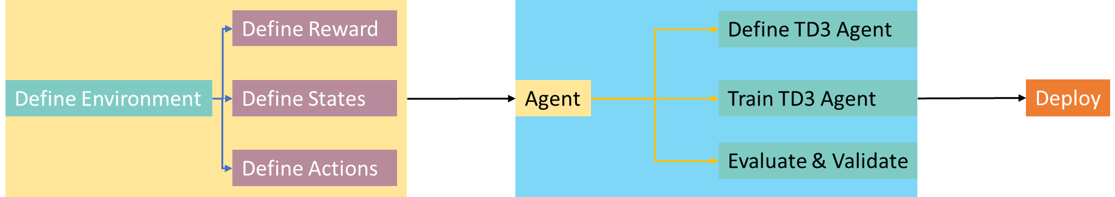
Model overview
Multi-Echelon Supply Chain Management System

Slide 21
Implementation and results
Scenario of Training and Assumptions :
The Agent was used to predict and optimize a scenario where 2 products Product_A and Product_B were produced at the factory, and it had to supply 2 warehouses with a mixture of both the products based on demand .
The assumptions made for this scenario were :
• Factory produces a product with a fixed cost
• Warehouses have a fixed capacity
• Tangible but fixed transportation and storage costs
• Any unfulfilled demand is carried over to the next time step with a penalty.

Slide 22
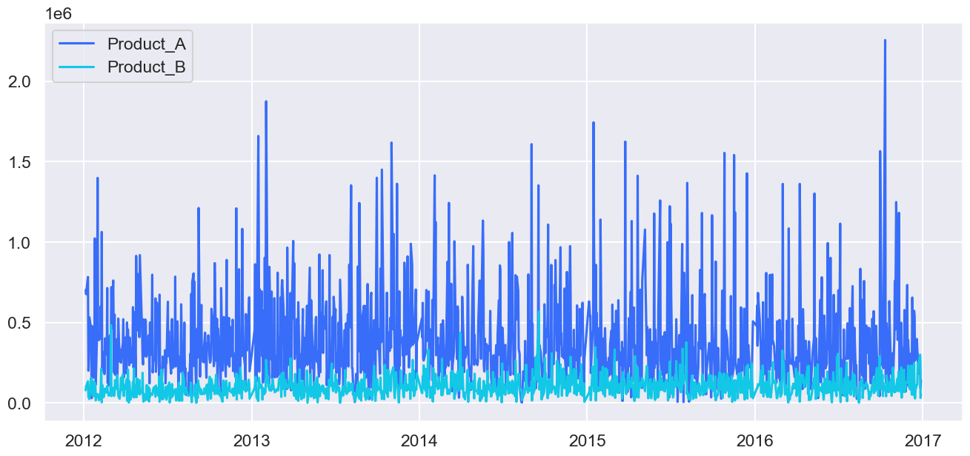
Implementation and results
Dataset Description
 | Demand_A | Demand_B
count | 1.21E+03 | 1207
mean | 3.90E+05 | 101404.7225
std | 2.87E+05 | 64070.55749
min | 2.00E+03 | 100
25% | 1.97E+05 | 57600
50% | 3.14E+05 | 90200
75% | 5.01E+05 | 131000
max | 2.26E+06 | 568000
To model an RL agent to learn, there is a need to utilize a large dataset for the agent to have sufficient background knowledge to find understand the varying patterns of demand for products during various seasons to accomplish this, the data was modelled for 2 products (Product A and Product B) for a duration ranging from 01-05-2012 to 31-03-2024 (roughly a period of 12 years) the demand being varied using Gaussian Noise with a varying step for similarity.

Slide 23
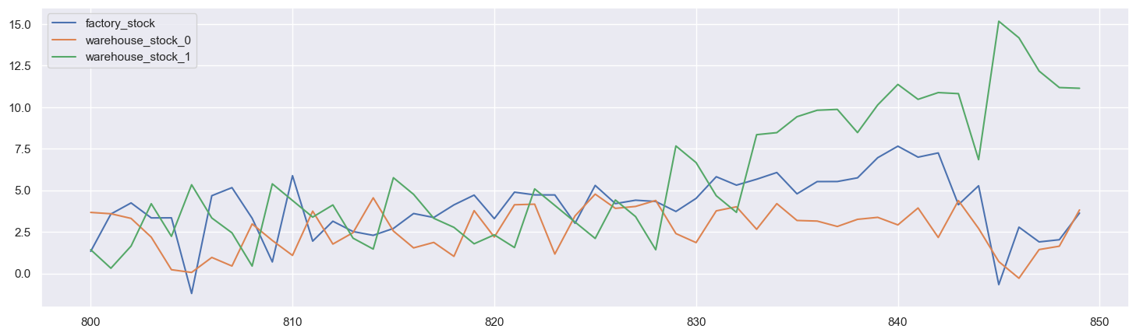
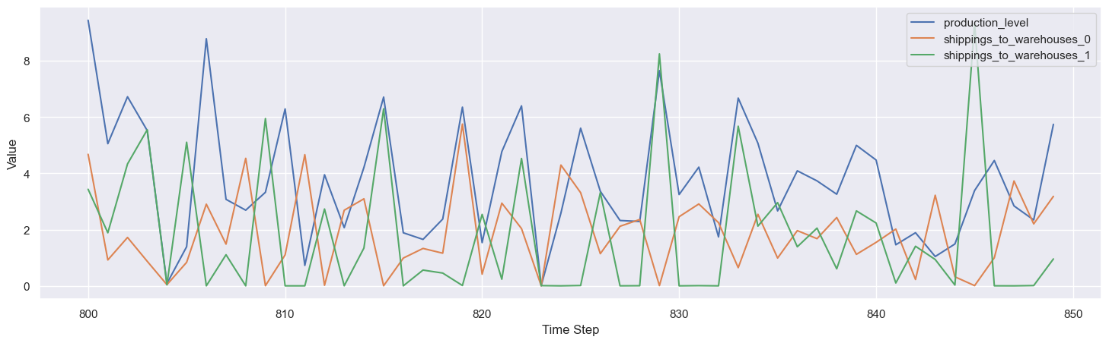
Implementation and results
Production and Distribution Management
The TD3 agent efficiently managed the stock levels of both Product_A and Product_B at the factory and the two warehouses. It adjusted production levels and shipment quantities dynamically, ensuring that demand was met as closely as possible while minimizing costs. The figures illustrate how the agent balanced production and distribution over time, maintaining optimal inventory levels and avoiding stockouts whenever possible.

Slide 24
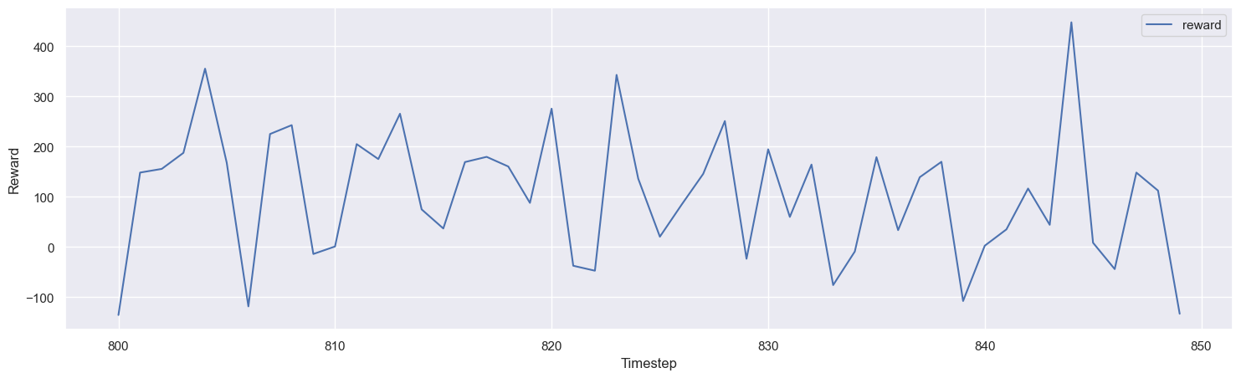
Implementation and results
Reward Optimisation
The agent's performance improved steadily over time, as evidenced by the increasing rewards depicted in Figure 5. The reward function was designed to balance revenue from sales against production, storage, and transportation costs, as well as penalties for unfulfilled demand. As the agent learned from its interactions with the environment, it became more adept at maximizing this reward function, indicating improved decision-making and efficiency.

Slide 25
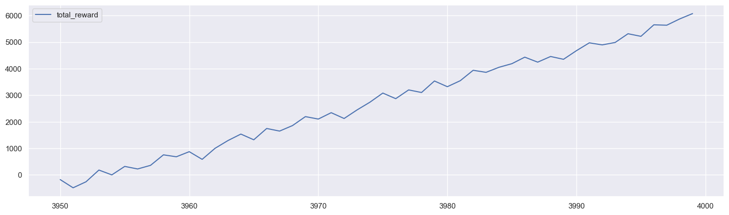
Implementation and results
Profit Maximisation
The trained TD3 agent was able to generate high profits, achieving a profit (reward) of 6078, as shown in Figure 5. This agent was able to effectively navigate the complexities of the supply chain environment and make decisions that enhance overall profitability.

Slide 26
Future scope
Future work could involve extending the model to more complex environments, incorporating additional variables, and further refining the reward function to better align with real-world business objectives.

Slide 27
Future Work
The trained agent was not only able to effectively navigate the supply chain scenario and generate considerable rewards but also was capable of ensuring optimization in each metric within the broader supply chain such as Production and Distribution by maintain optimal production and stock levels, the model was also able to considerably improve over its training cycle.
This project underscores the potential of reinforcement learning, particularly the TD3 algorithm, in optimizing supply chain operations. The agent not only shows impressive efficiency and responsiveness but also has high profitability through intelligent decision-making.

Slide 28

Thank you

