Slide 1

Degree Plan Automation
By team Shan
Nanditha
Sharanya
Sri Harshini
Aravind

Slide 2

Project Description
Degree plan is a system used by UNT CSE department to track the courses taken by student.
The process will start after a student completes 18 credit hours and then they need to submit the list of courses they took and they are willing to take in future.

Slide 3
Project Description
Our aim is to Automate the degree plan process.
We basically have two modules:
Student Module
Professor Module

Slide 4
Software Development Requirements
Programming Language: Java 8, HTML 5, CSS 3, Mysql (Workbench)
IDE: Eclipse (photon)
Framework: Spring MVC (version 4)
Project Management Software: Gantt Project
Software management system: Maven, Github.
Server: Apache Tomcat Server (version 9)
Testing software: Junit
Hardware: Windows 64 bit Systems

Slide 5
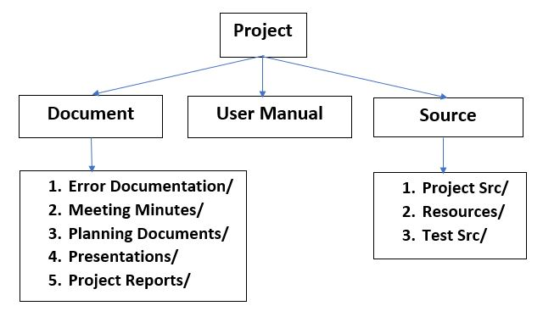
Directory Structure

Slide 6
Planning
Plan is according to the incremental model of software development.
The WBS has 7 Steps:
Planning and requirement gathering
Design
Development Phase1
Development Phase 2
Development Phase 3
Integration & Testing
Delivery

Slide 7
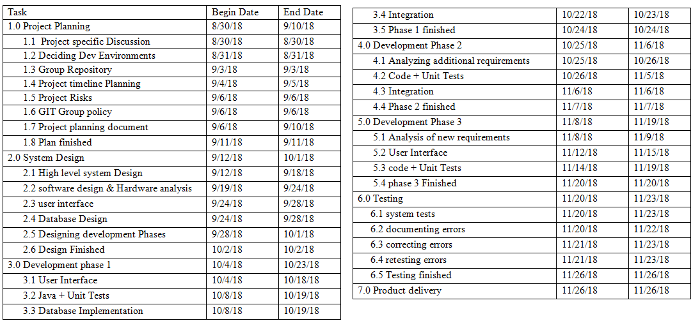
Project Milestones

Slide 8
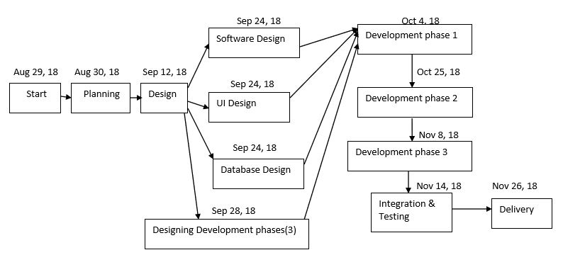
Development Model

Slide 9
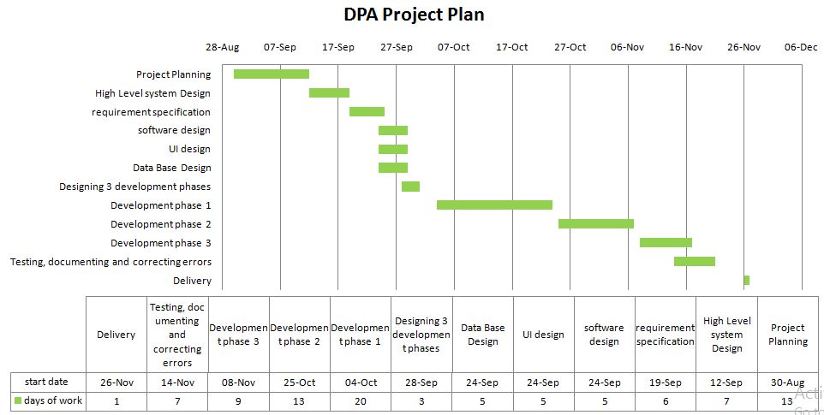

Slide 10
Risk Management(Generic)
Communication Gaps:
Lack of proper communication may affect project development.
Work Around:
Regular meetups on Tuesday ,Thursday and Fridays.
Delays in Schedule:
Technical difficulties.
Absence of team member.
Work Around:
Monitor schedule.
Compensate for lost time.

Slide 11
Risk Management
Lack of Familiarity with Spring MVC:
Only one resource has knowledge of Spring MVC.
Work Around:
Dedicated extra hours to learn Spring MVC
Knowledge Transfer.
Non Maintenance of Efficient Coding Standards:
Poor coding standards and inefficient code will effect the application performance.
Work Around:
Pairing up the experienced and non experienced resources.

Slide 12
Risk Management
Mapping of values from Frontend to Backend:
development for frontend and backend would be performed simultaneously as per our project schedule
Improper Mapping can cause severe setback for our project
Work Around:
While designing the modules, we would make sure that the variables are correctly mapped from frontend to backend.

Slide 13
Roles And Responsibilities
Nanditha Bodanapu:
Backend design and development Student module.
Peer reviewer for Professor module.
Responsible for updating meeting minutes every week in Git.
Sharanya Gottimukkula:
Database design and Integration
2. Peer reviewer for front end.

Slide 14
Role And Responsibilities
Sriharshini Vallabhaneni:
Frontend design and development.
Peer reviewer for database design.
Aravind Thottempudi:
Backend design and development Professor module.
Peer reviewer for Student module.

Slide 15
References
Software Engineering: A Practitioners Approach, 8th Edition, Roger Pressman and Bruce Maxim, McGraw-Hill
https://ourcodingclub.github.io/2017/02/27/git.html
Referred Lecture notes by Professor Hymnbook Do

Slide 16
Thank You

