Slide 1
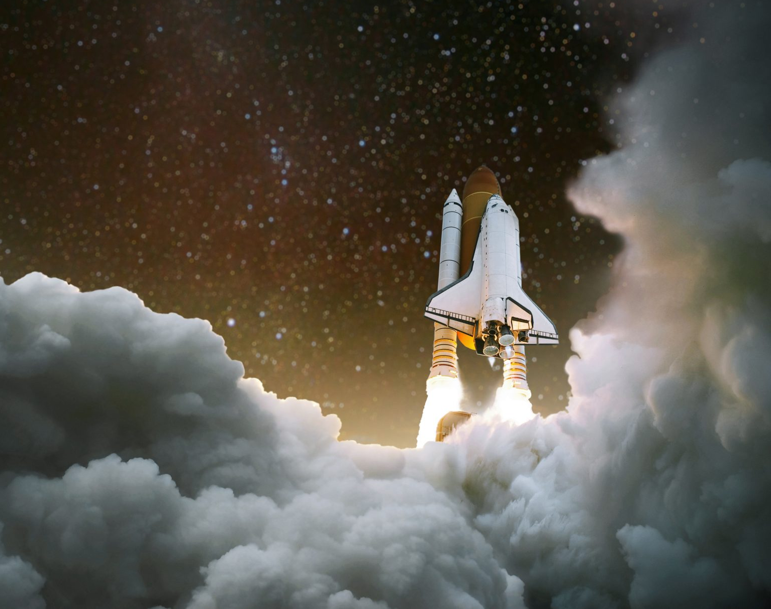
EMP SpaceHack
By Srihith Chennareddy
and Andrew Ma

Slide 2
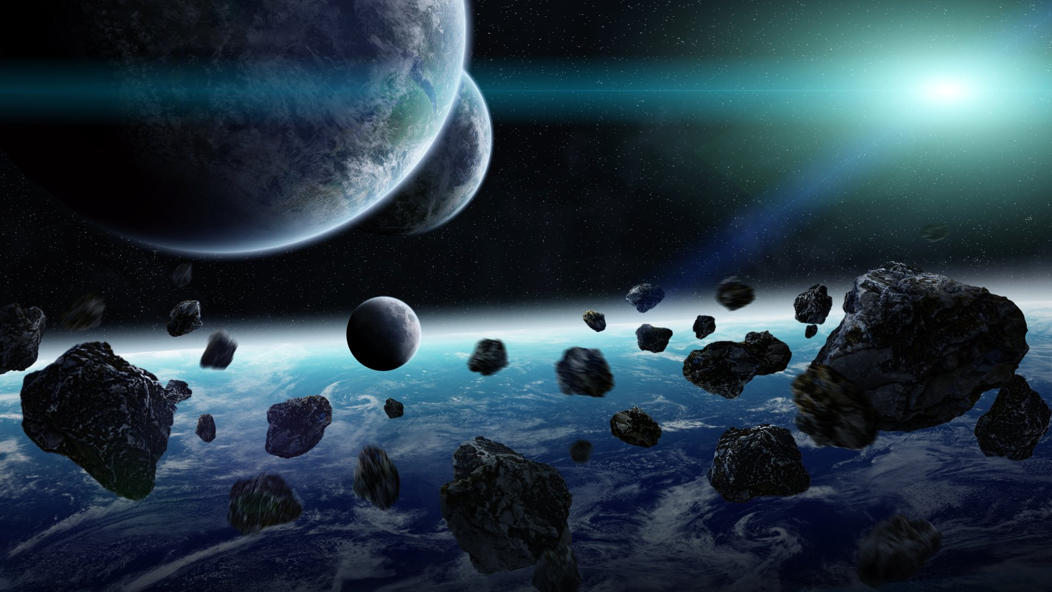
Asteroid Mining
Asteroid contain massive amounts of valuable metal such as gold and rare earth metals.
These are used in all electronics, including navigation systems
Asteroid Mining is the field that has the potential to impact for all aspects of life.

Slide 3
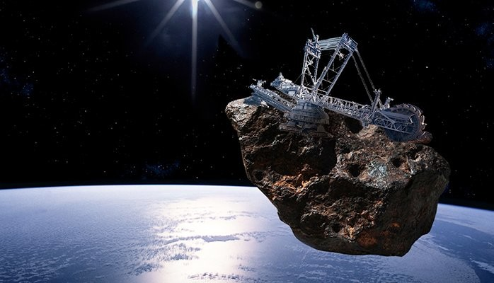
16 Psyche
16 Psyche is one of the biggest metal rich asteroid in the solar system
Its is worth 100,000 quadrillion
https://www.space.com/psyche-metal-asteroid-composition

Slide 4
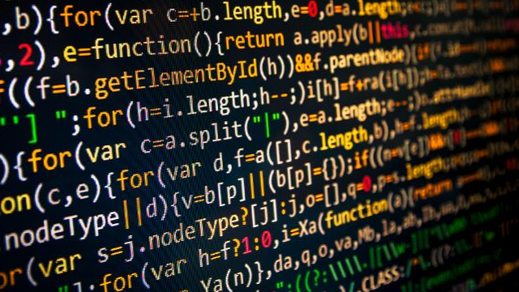
Programing in Asteroid Mining
Used Algorithms to calculate in Real Time
Value of Asteroid, cost of mission and profit.
Distance from Earth
Diameter of Asteroid
Thrust to move asteroid to LEO
Velocity towards earth

Slide 5
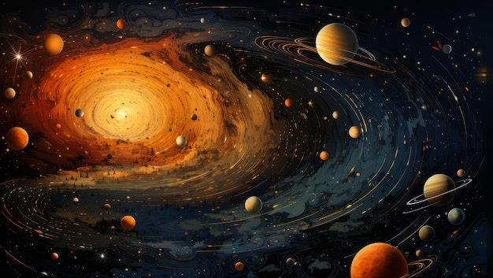
NASA Real Time Asteroid Model
We used NASA’s Eyes on Asteroid Near Earth Objects to show all asteriod
https://eyes.nasa.gov/apps/asteroids/#/watch/2024_re1

Slide 6
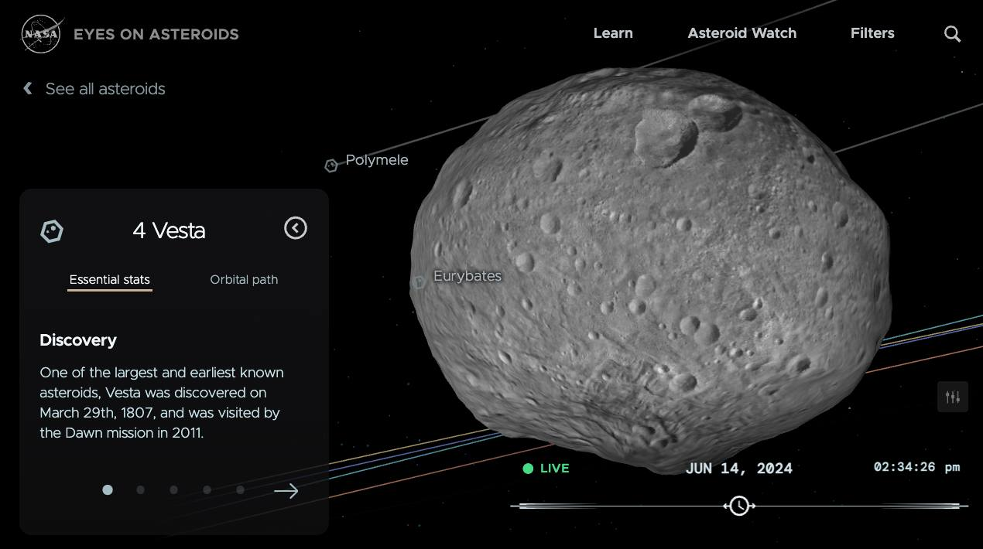
NASA API View
Using the Nasa’s API we got data that updates every 5 seconds
This includes asteroid measurements so the program changes output such as distance and profit.

Slide 7
Deep Dive into Code
We used JavaScript with Replit to program the algorithm as it updates in real time.
https://replit.com/@srihithchennare/asteroid-mining

Slide 8
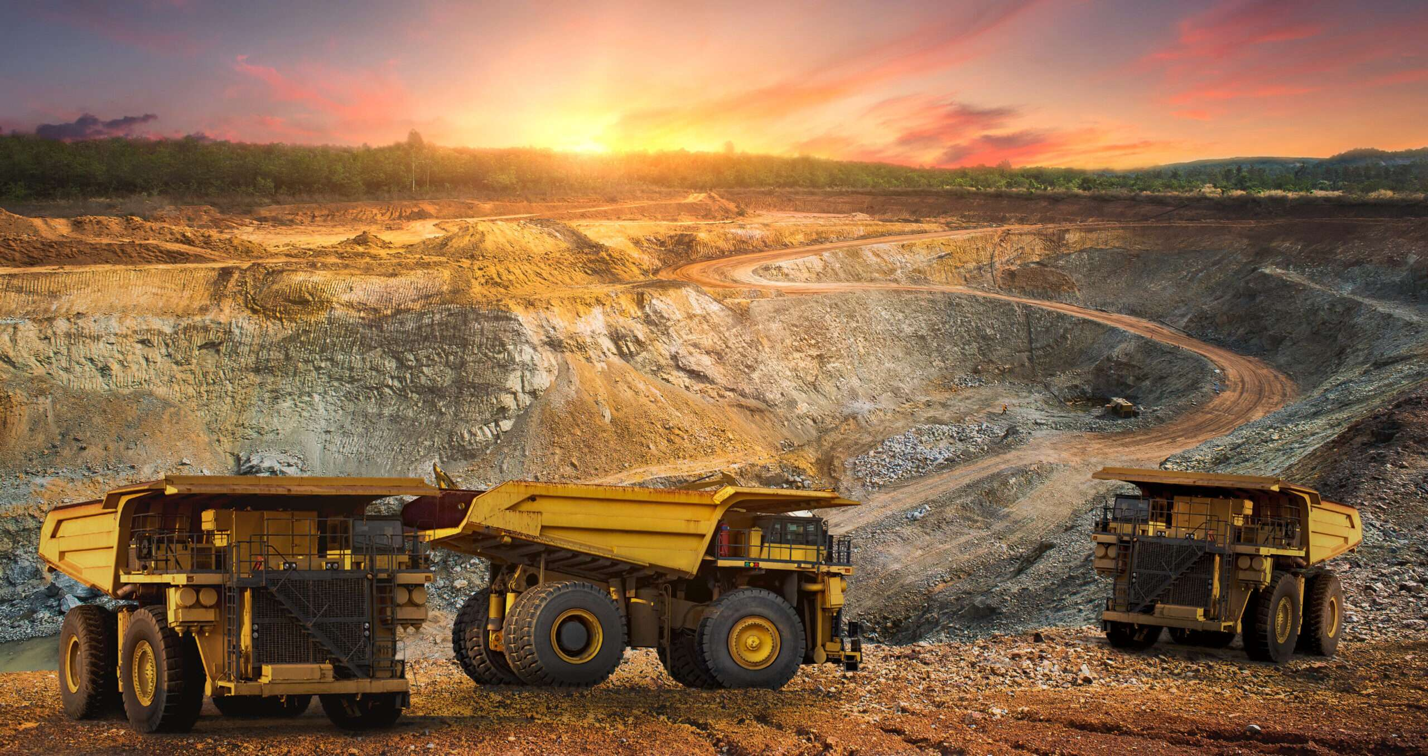
Benefits of Asteroid Mining
Eliminate the traditional Earth Mining Industry which protects the environment.
Provide large supply of rare and valuable metals that will increase technological innovation and materials for all human development.

Slide 9
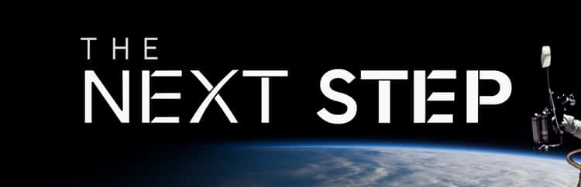
With the software developed the next step is to add all asteroids into a powerful computer
Can be used in space mission
Launch more basic app for general public to follow missions.

Slide 10


