Slide 1
COMPLIER DESIGN
Parse Tree Generator GUI
Team Members
Name: BANDI SRIHITHA Rollno: 2420030099
Name: VANJARI SAI DHANUSH Rollno: 2420030162
Name: R.L.S GIRIDHAR Rollno: 2420030171
Name: D.CHAITHANYA Rollno:2420090077
Under the Esteemed Guidance of
B . DWARAKANATH sir

Slide 2
Contents
Abstract
Introduction
Problem Statement
Objectives
Project Plan
Proposed Architecture and Methodology
Implementation and Results
Course Outcomes (CO1, CO2, CO3 and CO4)
Conclusion

Slide 3
ABSTRACT
The Parse Tree Generator GUI is an interactive educational application developed using Python and Tkinter to simplify Compiler Design concepts.
Automates Context-Free Grammar (CFG) analysis.
Eliminates direct and indirect left recursion.
Performs left factoring and computes FIRST and FOLLOW sets.
Generates LL(1) parsing tables and validates input strings.
Produces leftmost and rightmost derivations.
Generates and visualizes parse trees using a graphical interface.
Key Outcome: Simplifies complex grammar analysis through automation and interactive visualization.

Slide 4
INTRODUCTION
Introduction
Compiler Design involves grammar analysis, parsing, and syntax tree construction.
Context-Free Grammars (CFGs) define the syntactic structure of programming languages.
LL(1) parsing is a top-down predictive parsing technique that uses one lookahead symbol.
Manual grammar analysis involves lengthy calculations and is prone to errors.
Our project integrates multiple compiler operations into a single graphical application.
Technology Stack: Python | Tkinter | LL(1) Parsing | Tkinter Canvas

Slide 5
PROBLEM STATEMENT
Problem Statement
Compiler Design involves complex grammar analysis, transformations, parsing techniques, and parse tree construction. Traditional manual methods require considerable time and effort to calculate FIRST and FOLLOW sets, remove left recursion, perform left factoring, and construct LL(1) parsing tables. These processes are prone to human errors and make it difficult for students to understand the complete parsing process. Existing parser generation tools may also provide limited step-by-step educational visualization. Therefore, an automated and interactive Grammar Analyzer and Parse Tree Generator is required to simplify grammar processing, validate input strings, and visually represent parsing operations.
Motivation
-Manual grammar analysis and parsing are time-consuming.
-Calculating FIRST and FOLLOW sets manually can lead to errors.
-Removing direct and indirect left recursion requires multiple steps.
-Constructing LL(1) parsing tables is complex for beginners.
-Students need better visualization of grammar transformations and parse trees.
-An interactive tool can improve understanding of Compiler Design concepts.

Slide 6
OBJECTIVES
Objectives
Develop an interactive GUI for entering CFG rules and input strings.
Validate grammar syntax and identify grammatical errors.
Automatically detect and eliminate direct and indirect left recursion.
Perform left factoring to prepare grammars for LL(1) parsing.
Compute FIRST and FOLLOW sets automatically.
Generate LL(1) parsing tables and validate input strings.
Display leftmost and rightmost derivations.
Construct and graphically visualize parse trees.

Slide 7
PROJECT PLAN
Phase 1 – Requirement Analysis
Identify compiler design concepts, functional requirements, and system specifications.
Phase 2 – System Design
Design the GUI, modular architecture, and processing workflow.
Phase 3 – Grammar Processing
Implement grammar parsing, validation, left recursion removal, and left factoring.
Phase 4 – Parsing Implementation
Implement FIRST, FOLLOW, LL(1) parsing table, and predictive parsing.
Phase 5 – Visualization
Generate derivations and graphical parse trees using Tkinter Canvas.
Phase 6 – Testing and Evaluation
Test different CFG examples and evaluate correctness, functionality, and usability.

Slide 8
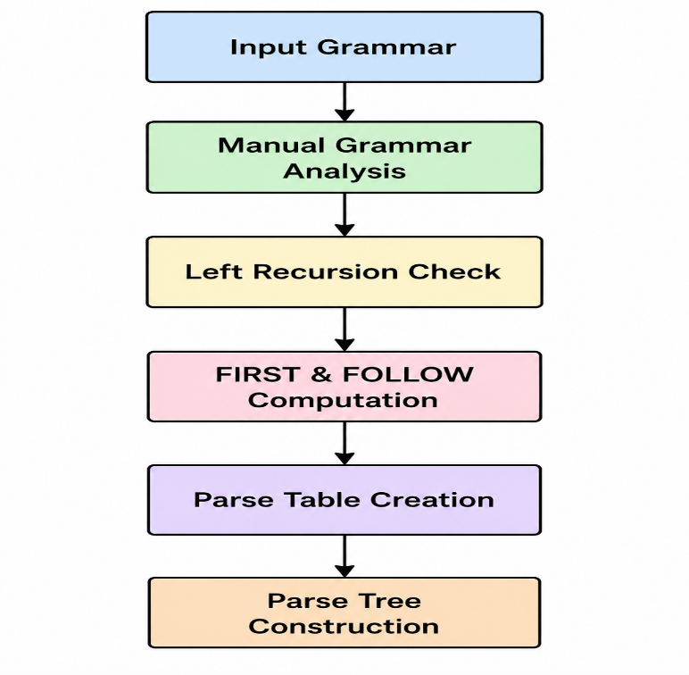
PROPOSED ARCHITECTURE/METHODOLOGY
Implementation
Developed the graphical interface using Python Tkinter.
Implemented grammar processing and validation algorithms.
Automated left recursion removal and left factoring.
Generated FIRST and FOLLOW sets.
Constructed LL(1) parsing tables.
Implemented stack-based predictive parsing.
Generated leftmost and rightmost derivations.
Visualized parse trees using Tkinter Canvas with color-coded nodes.

Slide 9
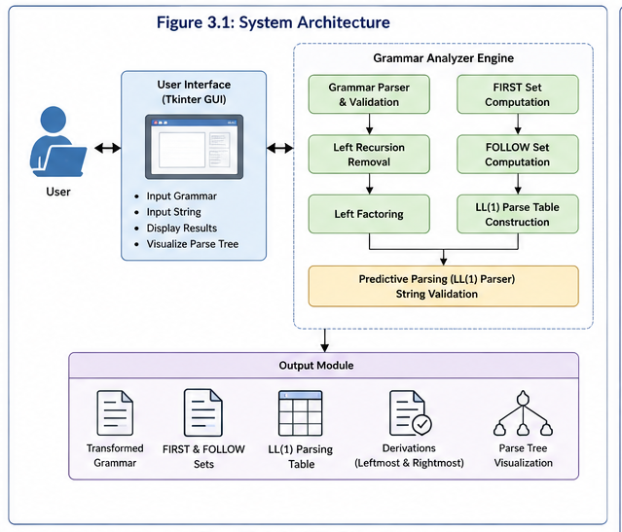
ARCHITECTURE/METHODOLOGY

Slide 10
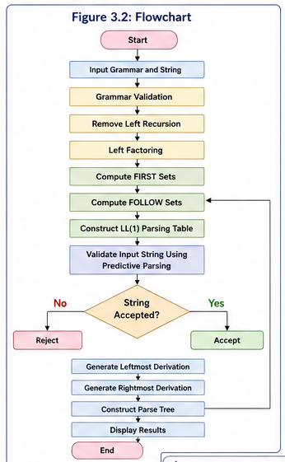
ARCHITECTURE/METHODOLOGY

Slide 11
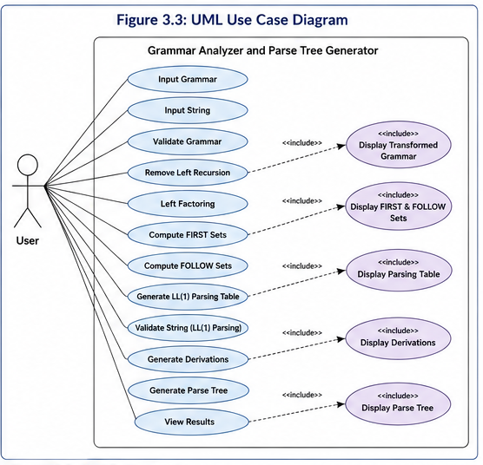
ARCHITECTURE/METHODOLOGY

Slide 12
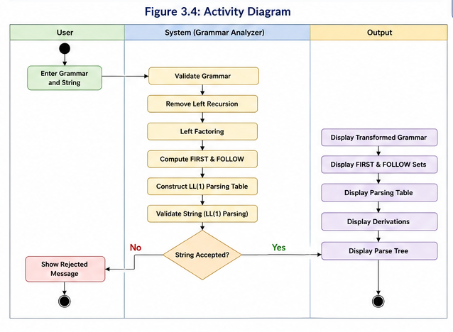
ARCHITECTURE/METHODOLOGY

Slide 13
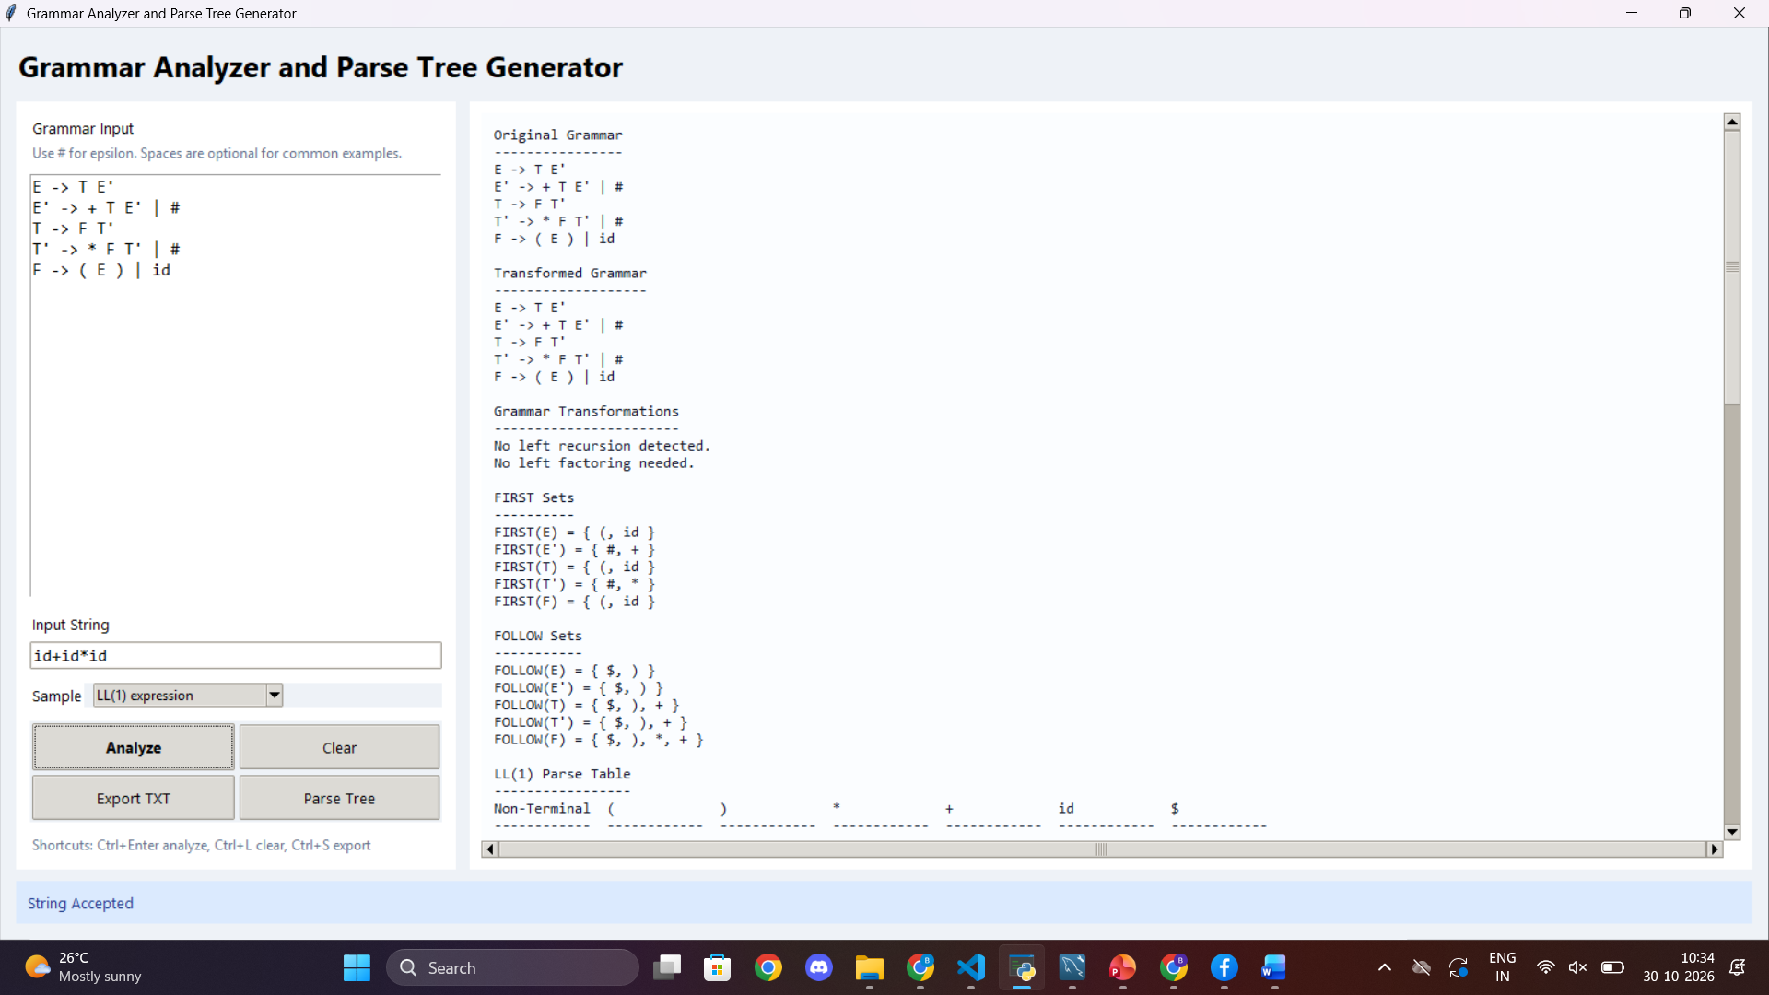
RESULTS

Slide 14
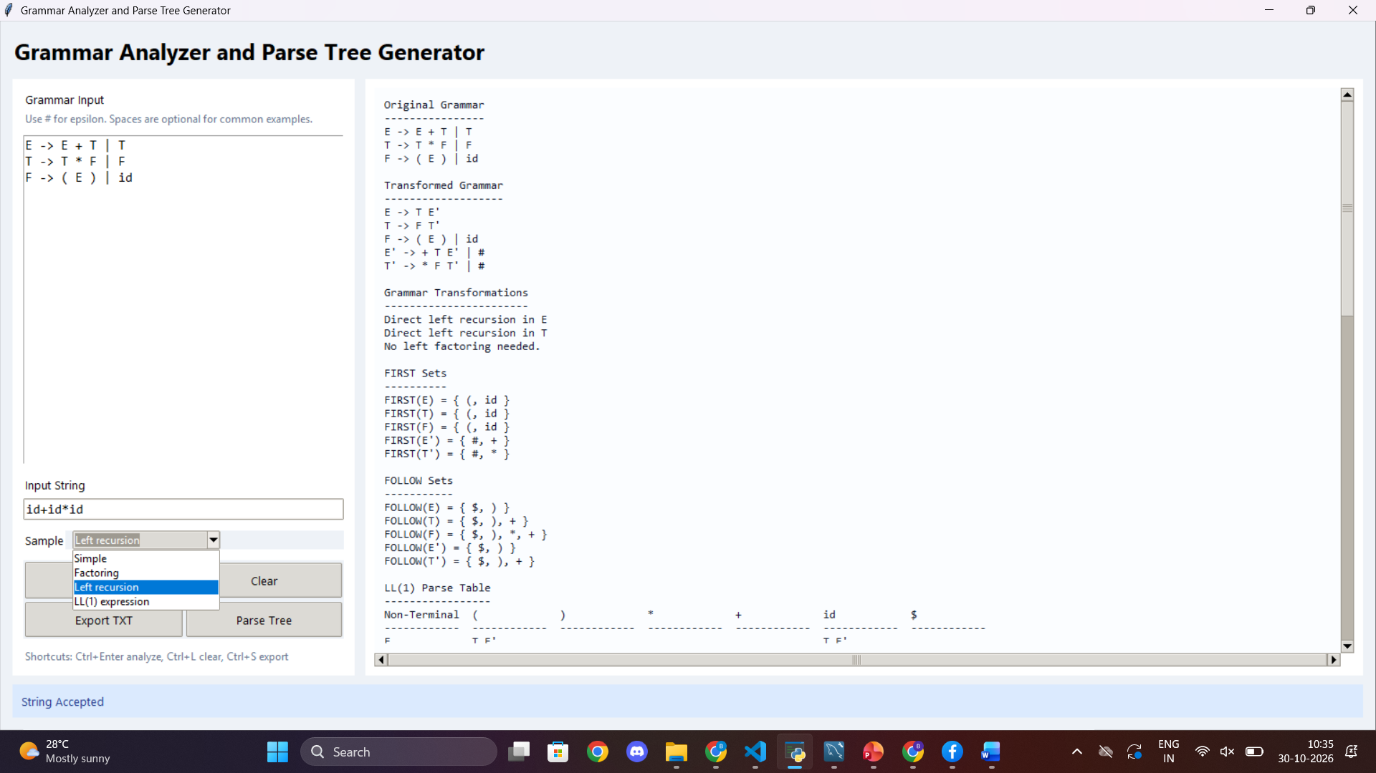
RESULTS

Slide 15
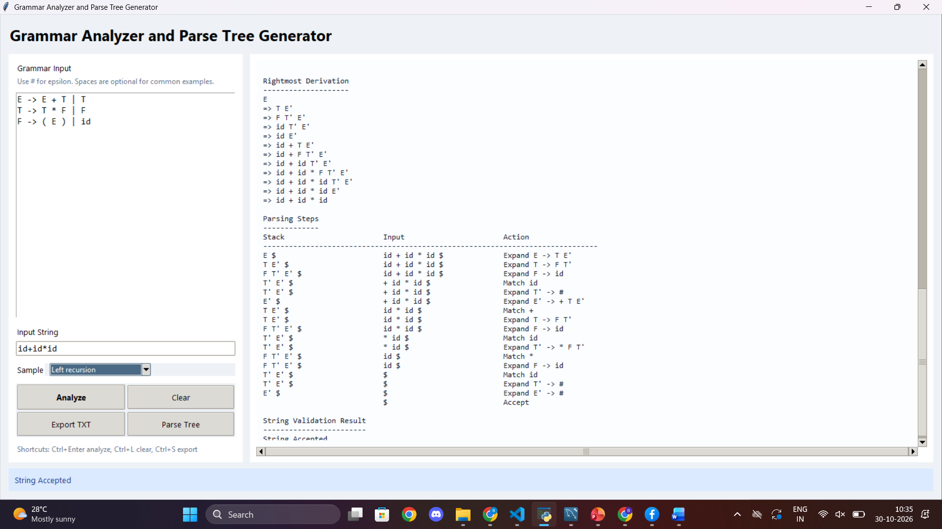
RESULTS

Slide 16
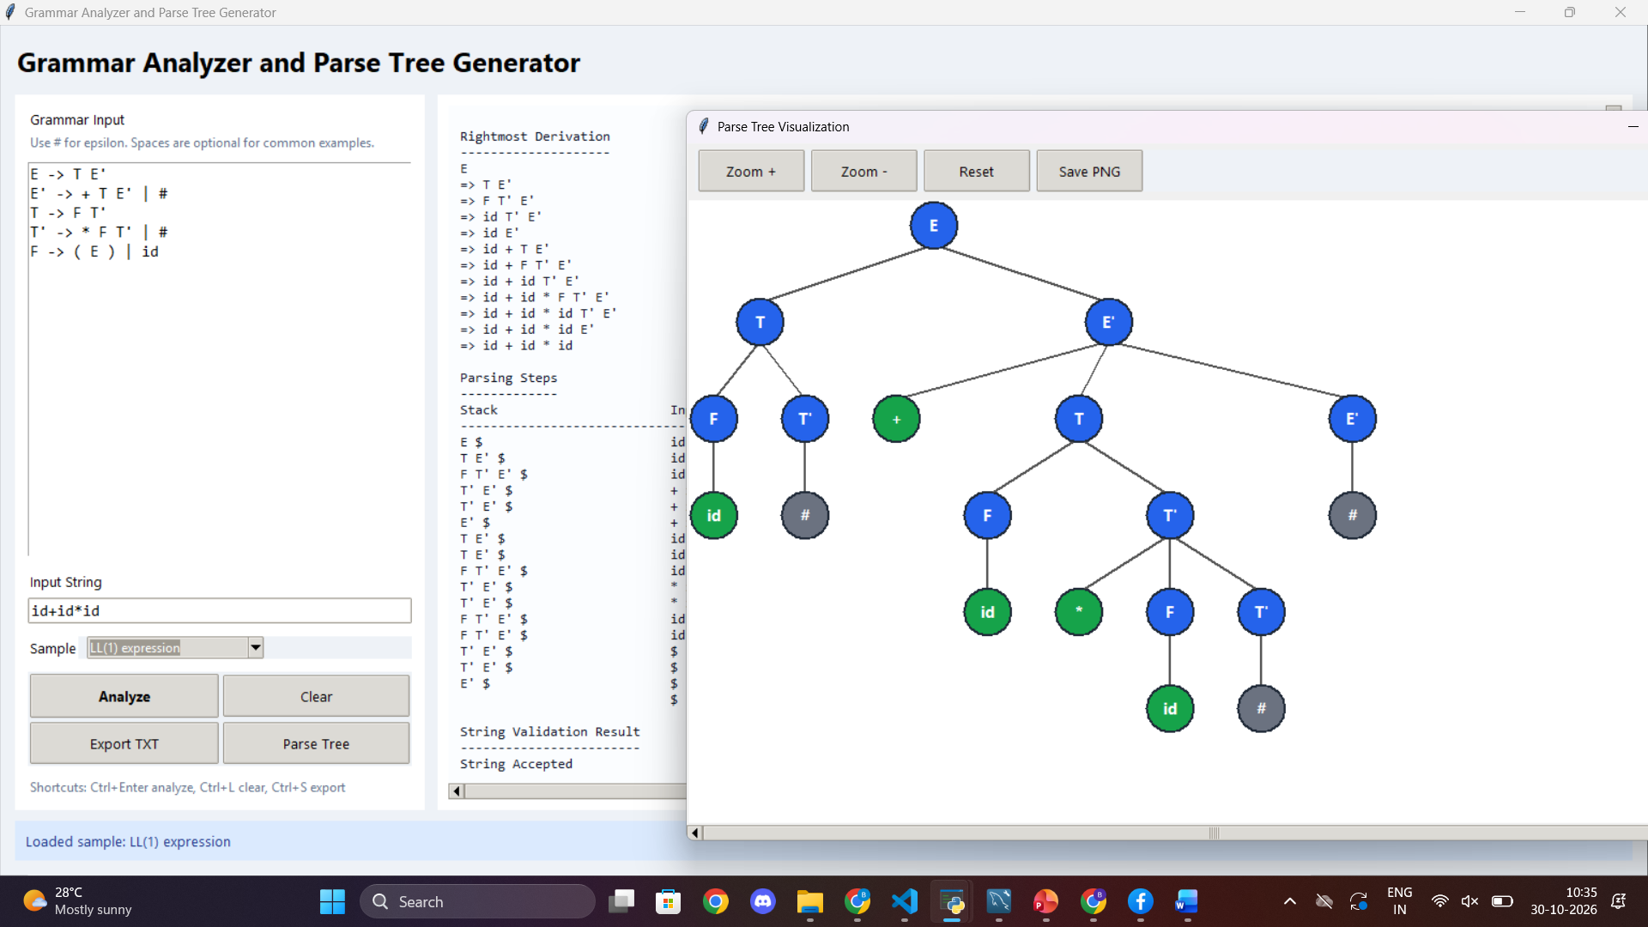
RESULTS

Slide 17
CONCLUSION
Conclusion
Successfully developed an interactive Grammar Analyzer and Parse Tree Generator.
Automated CFG validation and grammar transformations.
Implemented left recursion removal and left factoring.
Generated FIRST and FOLLOW sets and LL(1) parsing tables.
Validated input strings using predictive parsing.
Generated leftmost and rightmost derivations.
Visualized parse trees using a graphical interface.
Reduced manual effort and improved understanding of Compiler Design concepts.

Slide 18
Thankyou

