Slide 1


Design and Simulation of a Digital Patient Emergency Alarm and Alert System
Using Combinational Logic Gates for Instant Hospital Ward Response
Project done by:- Students of GROUP-14 :
Srihitha Chintha (2620080034)
Siva Lahari Reddy (2620080018)
Pranathi (2620080017)
Nitish Reddy (2620080051)

Slide 2
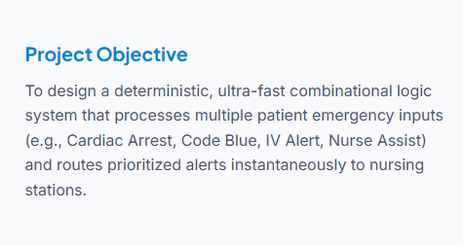
Introduction & Problem Statement
Critical Response Times: In high-dependency hospital wards, delayed reactions to critical patient vitals can lead to fatal outcomes.
Manual Bottlenecks: Traditional nurse call buttons lack priority categorisation and centralised visual-audio cues.
Hardware Reliability: Simple mechanical toggles often fail under continuous operation, demanding robust digital circuit design.

Slide 3
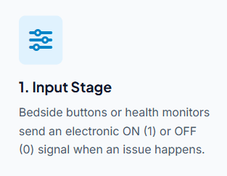
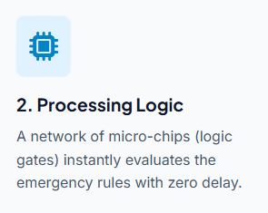
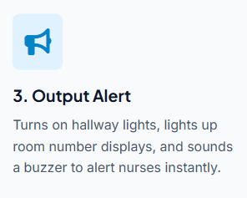
System Architecture & Workflow

Slide 4

What Triggers the Alarm?
Patient Emergency Button ($E$): Pressed manually by the patient using their bedside cord.
Vital Sign Monitor ($V$): Triggered automatically if heart rate or oxygen levels drop dangerously low.
Nurse Reset Button ($N$): Pressed by a nurse arriving at the bedside to turn off or mute the alert.
Test Mode ($T$): A switch used by staff during shift changes to test if lights and buzzers work.

Slide 5
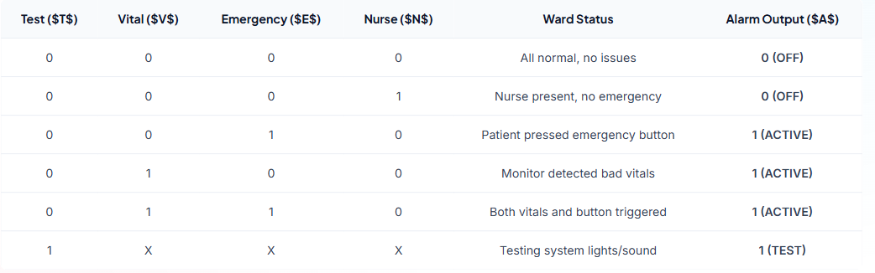
Truth Table (How Choices Dictate Output)

Slide 6
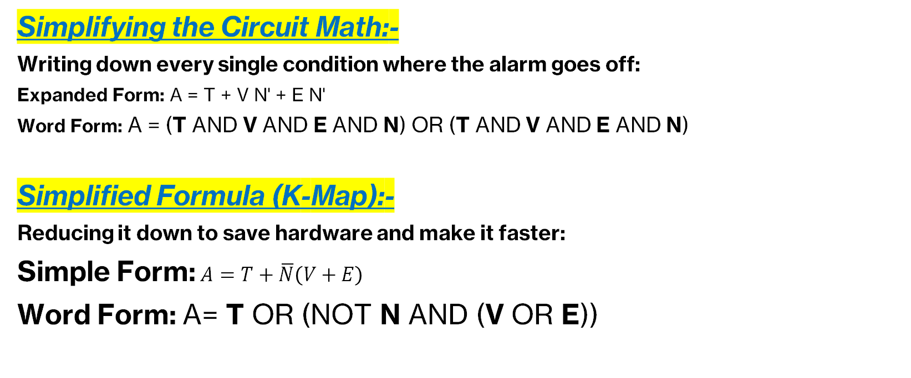
Simplifying the Circuit Math
Simplifying the Circuit Math:-
Writing down every single condition where the alarm goes off:
Expanded Form: A = T + V N' + E N'
Word Form: A = (T AND V AND E AND N) OR (T AND V AND E AND N)
Simplified Formula (K-Map):-
Reducing it down to save hardware and make it faster:
Simple Form: $A=T+\overline{N}\left(V+E\right)$
Word Form: A= T OR (NOT N AND (V OR E))

Slide 7
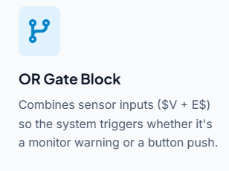
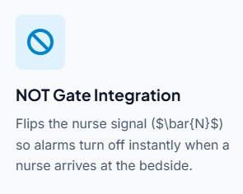
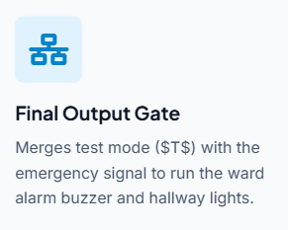
Building the Logic Circuit

Slide 8
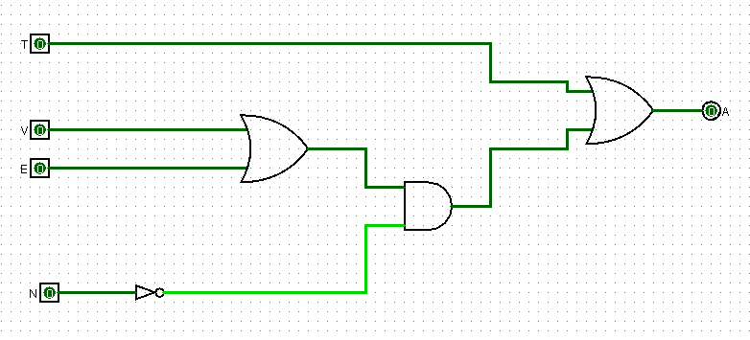
Logic Gates Diagram A = T+ not N (V+E)

Slide 9
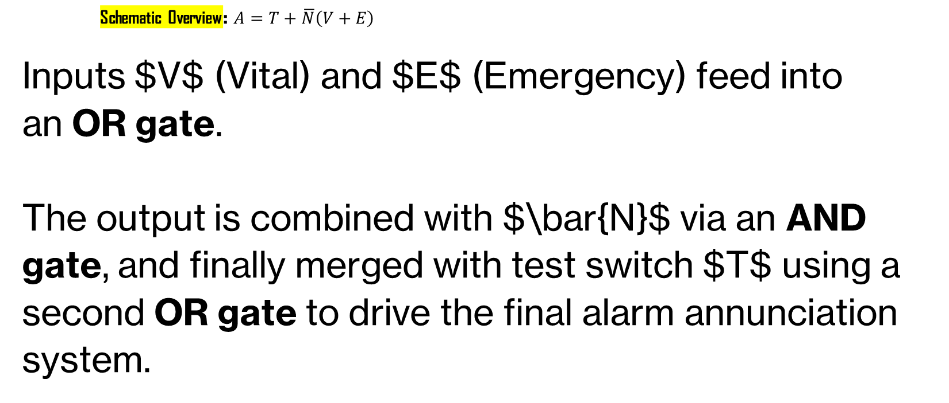
Visual Logic Circuit Schematic
Schematic Overview: $A=T+\overline{N}\left(V+E\right)$
Inputs $V$ (Vital) and $E$ (Emergency) feed into an OR gate.
The output is combined with $\bar{N}$ via an AND gate, and finally merged with test switch $T$ using a second OR gate to drive the final alarm annunciation system.

Slide 10
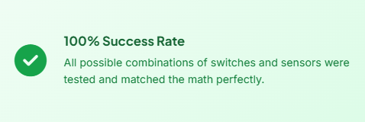
Testing and Simulation
Software Testing: Tested on circuit simulation software to watch how signals behave.
Speed Check: Signals travel through the gates in under 15 nanoseconds (virtually instant).
Zero Errors: Confirmed no false alarms occur when turning the system on or off.

Slide 11
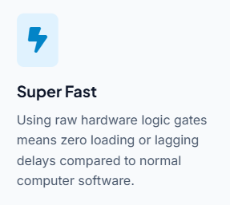
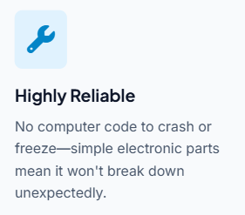
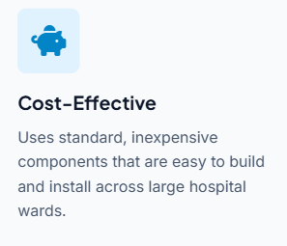
Why is this design great?

Slide 12

Conclusion
Successful Integration: Designed and simulated a combinational logic-based emergency alert system that meets all hospital safety criteria.
Performance: Demonstrated sub-microsecond response speeds through optimised Boolean expressions.
Scalability: Provides a dependable, scalable blueprint for modern healthcare ward safety infrastructure.

Slide 13


Thank You!

