Slide 1

UNIVERSITY COLLEGE OF ENGINEERING BHARATHIDASAN INSTITUTE OF TECHNOLOGY CAMPUS, ANNA UNIVERSITY, TRICHY- 620 024.
Malicious URL Detection using Deep Learning
MOHAMMED KAIF S
810019205064
GUIDED BY:
MRS.S.CHITRA DEVI,
ASSISTANT PROFESSOR,
DEPARTMENT OF CSE/IT.
SRIIKANTH U S
810019205096

Slide 2
TABLE OF CONTENTS
ABSTRACT
OBJECTIVES
INTRODUCTION
LITERATURE SURVEY
PROPOSED SYSTEM
SYSTEM ARCHITECTURE
USE CASE
DATA FLOW DIAGRAM
ALGORITHM
MODULES
OUTPUT
SYSTEM ADVANTAGES AND DISADVANTAGES
Future Works
REFERENCES

Slide 3
ABSTRACT
The World Wide Web services are essential in our daily lives and are accessed through Uniform Resource Locator URL links. Due to the rapid growth of internet services such as online banking, business, entertainment and government e-services like Aadhar and PAN now became online. This resulted in the increase of cyber crimes. Therefore, detecting malicious URLs is crucially important to prevent the occurrence of many cybercriminal activities. To address this issue, many web phishing and malware detection systems are developed to prevent users from falling victims to online threats such as phishing, malware, and scams. Machine learning techniques have show promising results in identifying malicious URLs. Existing only detects whether the URL is malicious or benign. This system proposes a malicious URL detection system using a deep learning algorithm Multi-Layer Perceptron which classifies which type of malicious URL it is and it also classifies idn homograph characters. The system is designed to extract features from URLs and classify them as benign, defacement, phishing and malware URLs. We experimentally evaluate the performance of our system using a huge dataset comprising 651,192 records of URLs. Furthermore, we conduct feature importance analysis to identify the most significant features that contribute to the system’s performance. Experimental results demonstrate that the proposed method achieves an accuracy of 94.95%

Slide 4
OBJECTIVES
To develop a dataset of URLs categorized as benign, malware, phishing, or defacement.
To design and train an MLP model to accurately classify URLs based on their malicious intent.
To evaluate the model's performance using appropriate metrics to assess its effectiveness.
To implement a real-time detection system that can efficiently classify URLs and provide actionable insights for maintaining a secure online environment.

Slide 5
INTRODUCTION
The rapid growth of the internet has brought numerous benefits, but it has also given rise to cyber threats, including malicious URLs. These URLs lead users to websites with harmful intent, such as phishing or malware distribution. Detecting and preventing access to malicious websites is crucial for maintaining a secure online environment. This project aims to develop a malicious URL detection system using Multilayer Perceptron (MLP) neural networks.
MLP is an effective type of artificial neural network known for its ability to learn complex patterns and make accurate predictions. The project focuses on classifying URLs as benign, malware, phishing, or defacement. Benign URLs are safe to browse, while malware URLs inject harmful software into the user's system. Defacement URLs involve hackers replacing legitimate websites with their own content. Phishing URLs are designed to steal personal or financial information. By extracting relevant features from the URLs, such as domain information and path structure, a comprehensive dataset is created to train the MLP model. The model learns to recognize patterns associated with malicious URLs, enabling it to accurately identify potential threats.

Slide 6
LITERATURE SURVEY
SI.NO | Journal Name & Year | Authors | Concepts/ Techniques | Advantages | Disadvantages/Issues
1. | Malicious URL Detection Based on Machine Learning.[2020] | Chodo Xuas, Hou Dinn Ngugen, Victor | -Random Forest. -SVM. | It consist of new set of URL features and behavious ,BigData Technology. | It does not use Special attributes.
2 | Scalable data of web malware or smartphone | Sachin Shetty,Klaledd Jayib | Navie Bayes, DF, LR | It detect web Malware on Android device | It take more time to process.
3 | Detecting malicious web links and their Attack types(2011) | Hyunsang Choi, Heejo Leo, Bin Zhu. | Rule based Anti phishing | It detects both Malicious URL and Types of Attack. | It uses non machine learning approach
4 | Malicious Website Detection & Effective issues(2011) | Birhanu Eshete, Adolfo Villafiorita, Komminist. | Offline ML techniques | It is fast in processing | It does not adaptable to different parameter.
5 | Web phishing Detection using Deep Learning Framework(2018) | Ping Yi, Yuxian | DBN,TPR | It detect both features for web phishing detection | It is trained with only smaller dataset.

Slide 7
SI.NO | Journal Name & Year | Authors | Concepts/ Techniques | Advantages | Disadvantages/Issues
6. | Machine Learning based malicious web detection(2020) | Niranjan Swarap, madhan Kumar | Logistic Regression , Random Forest | Data Training is Easier | It an predict only disease function.
7 | Intelligent malicious URL Determination with feature Analysis | Yu-Chun chan,Yi-Wei-ma,Jeanes-Lian chen | XGBoost | It provides type based on domains based database | Different to understand & learn
8 | Detection and analysis of drive by downloads & Malicious website | Montha Aldwain | Naive Bayes,JRIP,J48 | It applied via Blocklist content &System based evaluation | The work include to small dataset and number of Classifier& Actual real time texting
9 | A convolutional based system for Malicious URL detection(2020) | Sten Su,Zihong Jian | CNN | It uses Auto encode to represent the URL | Thee representation and Discrimination both needes to be Updated
10 | Detecting Malicious URL using ML techniques | Kerken Salan,Rami Muusthafa | LR & DT | It explain common URL feature type & possible types of Attack | Requires Huge Dataset

Slide 8
PROPOSED SYSTEM
The proposed model is to develop a web based malicious url detection system which classifies the urls based on the features using deep learning algorithm.
Multi Layer Perceptron(MLP) Algorithm is used for classification.
This system detects idn homograph characters.
This system classifies which type of malicious URL it is(malware, defacement, phishing).

Slide 9
SYSTEM ARCHITECTURE
URL dataset
Testing and evaluation phase
Testing model
Data pre-processing
Feature extraction
Vectorization
Malicious URL detection System
UI
Splitting training & test data
Input URL
Training
MLP
Benign (OR) Malicious
(Type 1, Type 2, Type 3)
OUTPUT

Slide 10
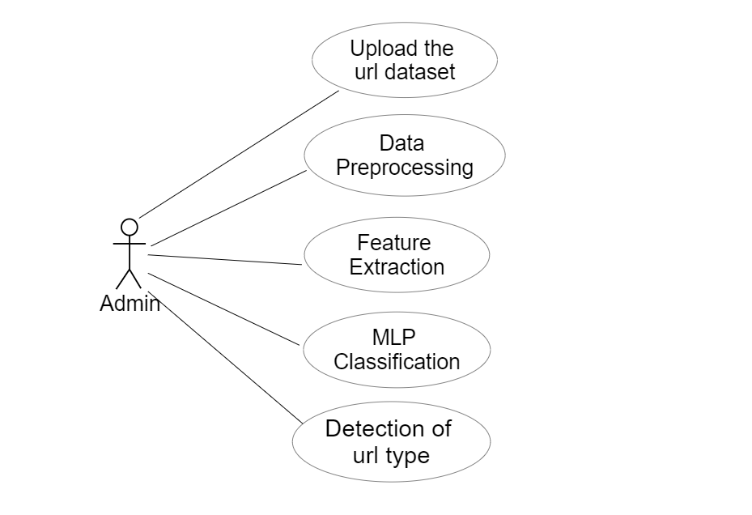
USE CASE

Slide 11
DATA FLOW DIAGRAM:
Data flow diagram level 0
User Input
(url)
Deep Learning Algorithm
Result

Slide 12
Data flow diagram level 1 Level
User Input
(url)
URL validation
Malware Detection
Display Result

Slide 13
Data flow diagram level 2
URL Dataset
Input URL
Feature Extraction
Feature Extraction
Deep Learning Algorithm
Predict the results
Trained Model
Display the results

Slide 14
ALGORITHM:
Multi Layer Perceptron(MLP)
A multi-layer perceptron (MLP) is a type of artificial neural network (ANN) that consists of multiple layers of interconnected nodes, called neurons. It is a feedforward neural network, meaning that information flows through the network in one direction, from the input layer to the output layer.
Architecture: An MLP typically consists of three types of layers: an input layer, one or more hidden layers, and an output layer. Each layer is composed of multiple neurons, and each neuron is connected to neurons in the adjacent layers. The input layer receives the input data, the hidden layers process the information, and the output layer produces the final predictions or outputs.

Slide 15
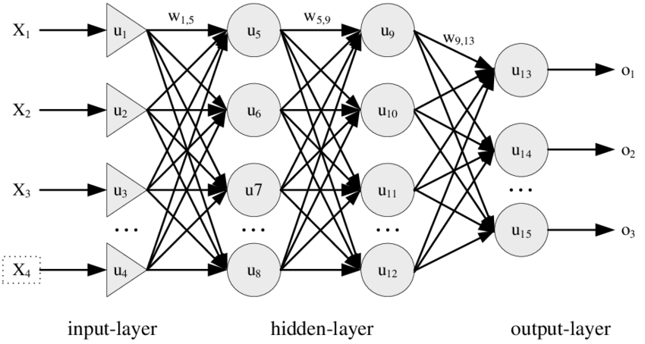
Neurons and Activation Functions: Each neuron in the MLP performs a weighted sum of the inputs it receives, applies an activation function to the sum, and produces an output. The activation function introduces non-linearity into the network, enabling it to model complex relationships in the data. Common activation functions include the sigmoid, tanh, and ReLU functions.

Slide 16
MODULES
1.Data preprocessing and Feature Extraction:
Load the URL data contains (Url,Types).
Using pd.read_csv (“malurl.csv”) load the dataset.
The extract the URL length, having @ symbol, double slash, having subdomains, HTTPS tokens, idn- homograph characters.
Extract the features.
After the extracting the features save the features in a csv file and export it.
Then check for the Null values in the dataset using “data.dropna (inplace=true)”.
2.Training the model:
Import the required libraies like sklearn, matplotlib, joblib, seaborn.
Load the extracted features dataset.
Then split the dataset into training and test sets.
Apply the algorithm MLP classifier using elf=MLP(classifier).
‘Relu’ activation function is used.
Then set the maximum number of iterations.

Slide 17
3.Make predictions:
Make prediction using test dataset.
Then calculate the accuracy score.
Save the model as ‘joblib’ file.
4.Data Visualization:
Plot the confusion matrix using print(conf.Matrix).

Slide 18
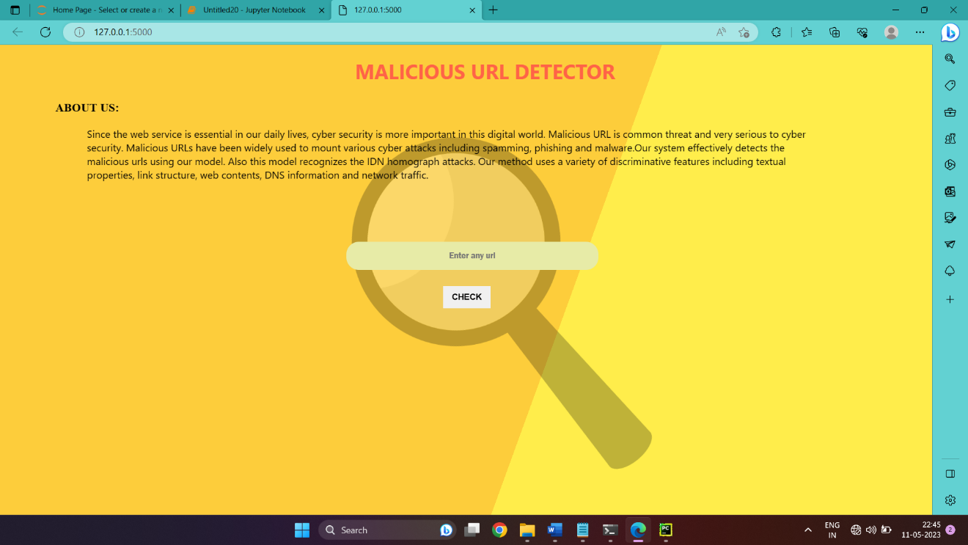
OUTPUT

Slide 19
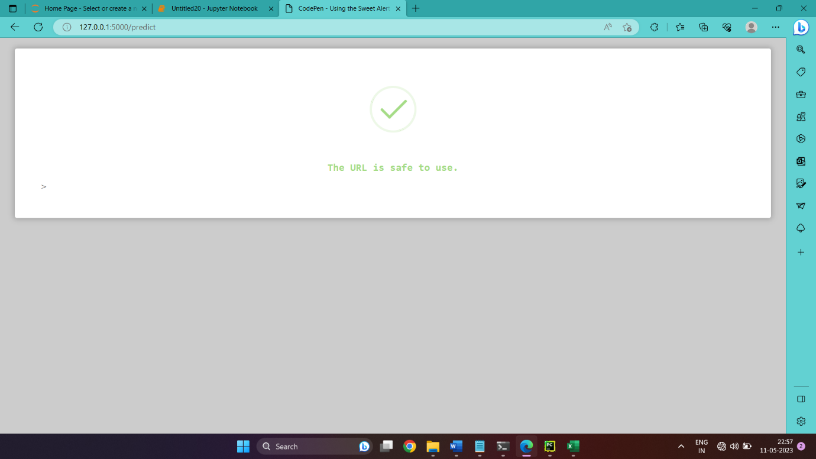
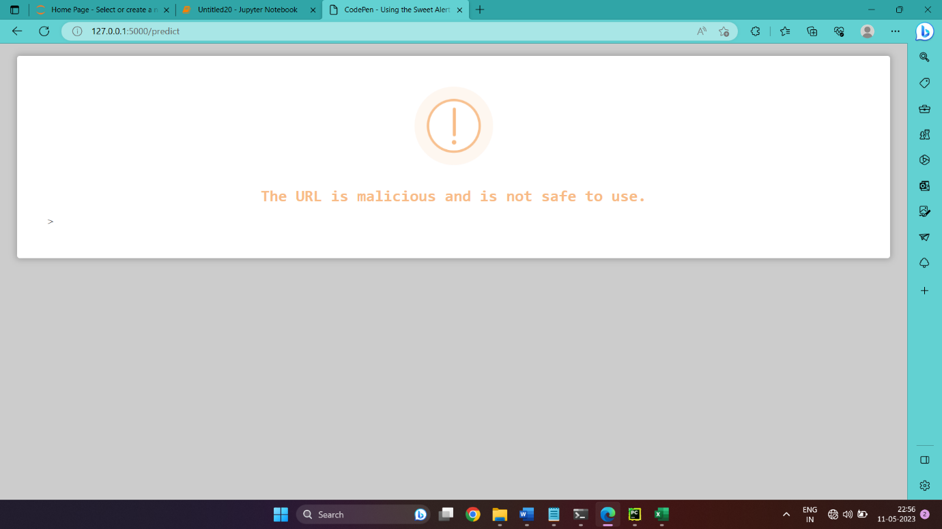

Slide 20
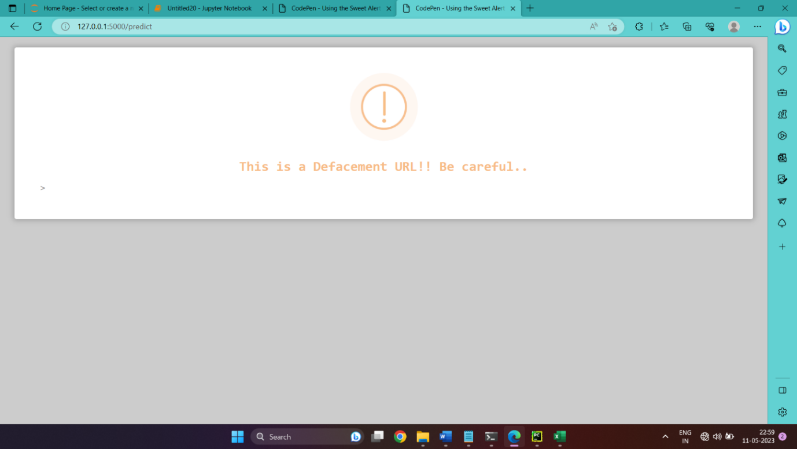
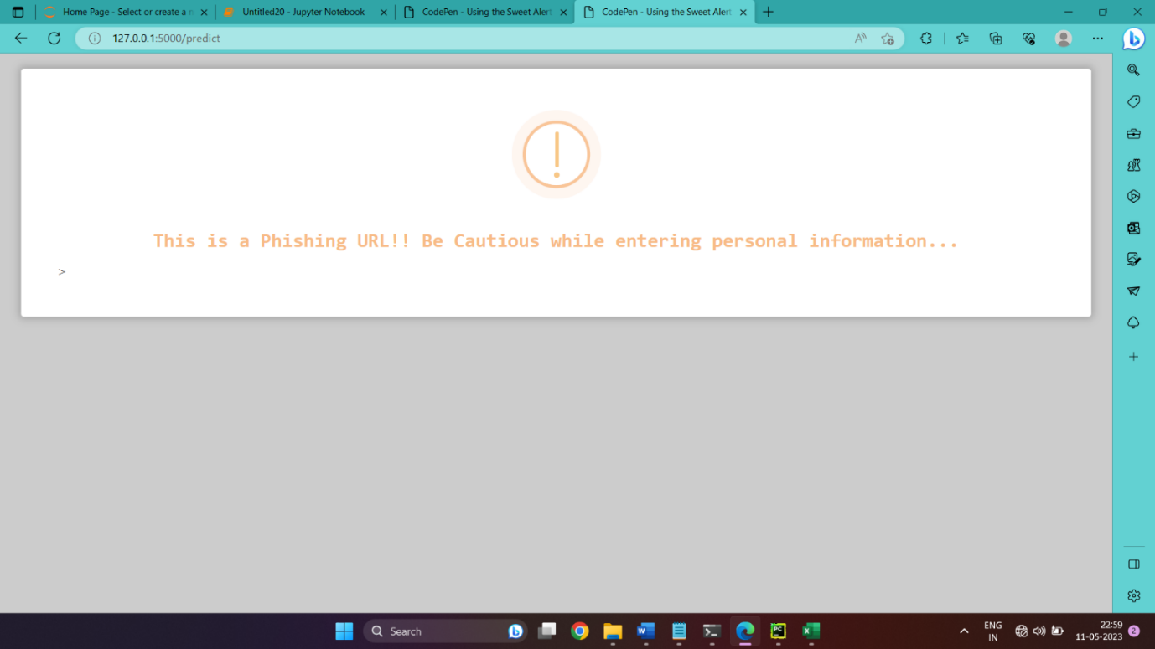

Slide 21
System Advantages
Classification model provides precise results in many cases.
Classifies in depth which type of harmful URL it is.
Detects homograph characters which resembles like normal English Alphabets.
System Disadvantages
Need to improve the accuracy.
More features needed to be extracted and processed so that it can detect accurately.

Slide 22
Future Works
As the future work, we will be working on reducing the time complexity and more features needed to be extracted and processed so that it can detect accurately.
Create an browser extension so that it can detect automatically whenever a malicious URL is detected.

Slide 23
REFERENCES
Wen Zhang, Yu-Xin Ding, Yan Tang, Bin Zhao, Malicious Web Page Detection Based On On-Line Learning Algorithms. IEEE Xplore: International Conference on Machine Learning and Cybernetics. (2019).
Cho Do Xuan, Hoa Dinh Nguyen, Tisenko Victor Nikolaevich, MALICIOUS URL DETECTION BASED ON MACHINE LEARNING, INTERNATIONAL JOURNAL OF ADVANCED COMPUTER SCIENCE AND APPLICATIONS(IJACSA), 2020.
Hyunsang Choi, Bin B. Zhu, Heejo Lee, Detecting Malicious Web Links and Identifying Their Attack Types, ResearchGate, 2011.
Birhanu Eshete, Adolfo Villafiorita, Komminist Weldemariam, Malicious Website Detection: Effectiveness and Efficiency Issues, Proceedings of the 2011 International Conference on Machine Learning and Cybernetics, Guilin, 10-13 July, 2011.
Ping Yi, Yuxiang Guan, Futai Zou, Yao Yao, Wei Wang and Ting Zhu, Web phishing detection using deep learning framework, Hindawi Wireless Communications and Mobile Computing Volume 2018.

Slide 24
REFERENCES
Nureni Ayofe Azeez, Balikis Bolanle Salaudeen, Sanjay Misra, Robertas Damaševičius, Rytis Maskeliūnas, Identifying phishing attacks in communication networks using url consistency features
Yu-Chen Chen, Yi-Wei Ma, Jiann-Liang Chen, Intelligent malicious URL detection with feature analysis, IEEE Symposium on Computers and Communications(ISCC), 2020.
Peng Yang, Guangzhen Zhao and Peng Zeng, Phishing Website Detection based on Multidimensional Features driven by Deep Learning, IEEE Access, 2019
Shantanu, Janet B, Joshua Arul Kumar R, Malicious URL Detection, 2021.
Jino S Ganesh, Niranjan Swarup. V, Madhan Kumar.R, Harinisree.A, Machine Learning Based Malicious Website Detection, 2020

Slide 25
THANKING YOU

