Slide 1

RAINFALL
Team Members :
Sumit Gulyan
Harika
Sri Hari
Jagadeesh
TEAM
SKIRTS
SOUVENIR
TIME SERIES ANALYSIS ON ABOVE DATASETS USING PYTHON.
KINGS LIFESPAN
BIRTHS

Slide 2
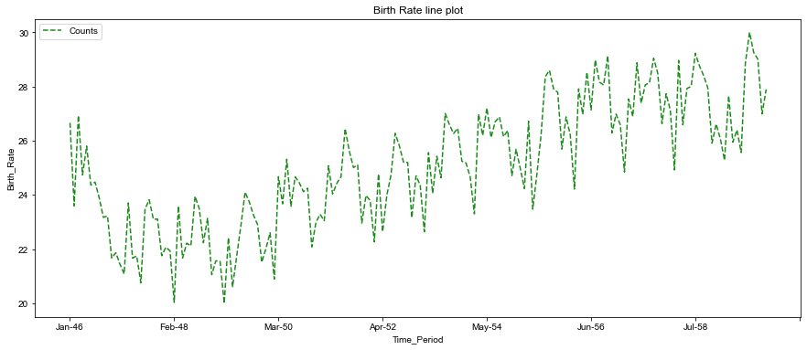

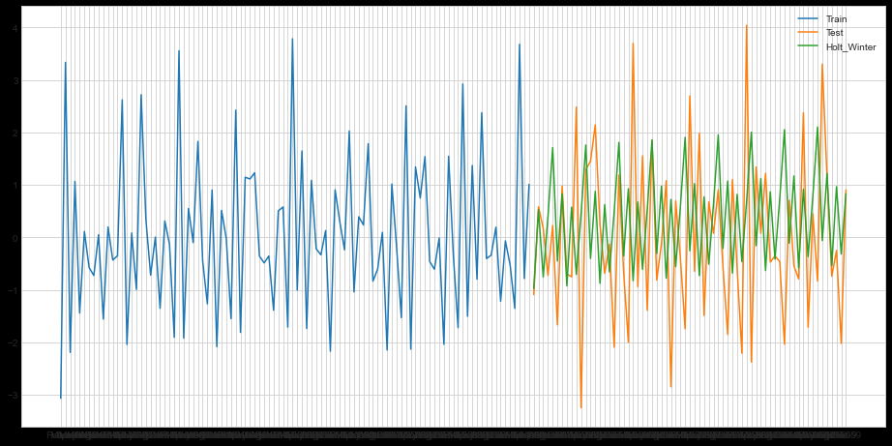
BIRTHS
Before applying the model
After applying the Holt’s Winter model
TEST RMSE :
1.944

Slide 3
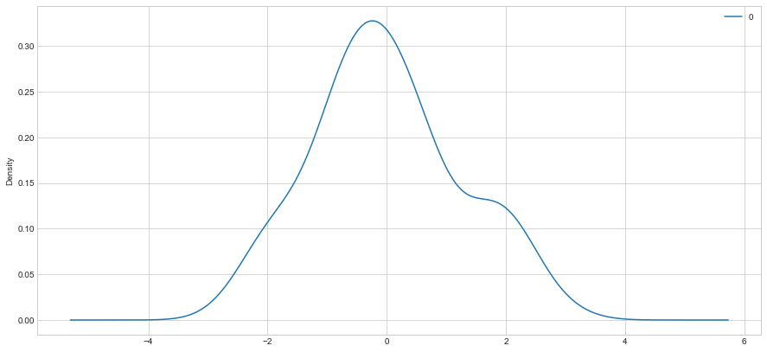
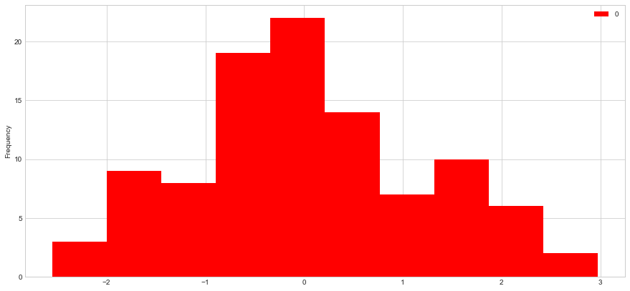
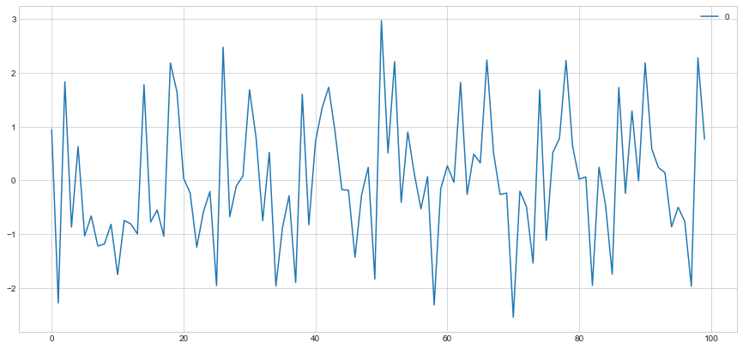
Normal Distribution Plot for residuals after holt’s winter method
Histogram Plot for residuals after holt’s winter method
Line Plot for residuals after holt’s winter method

Slide 4
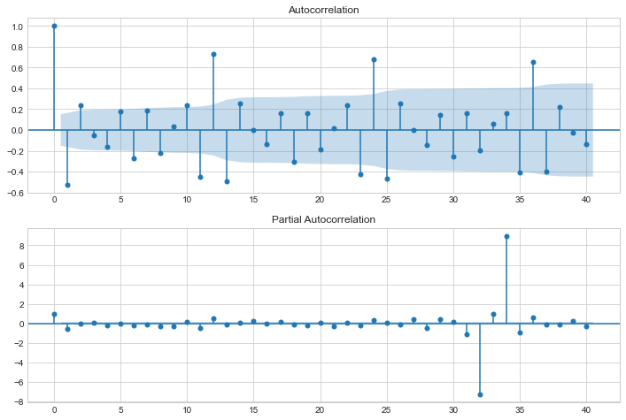
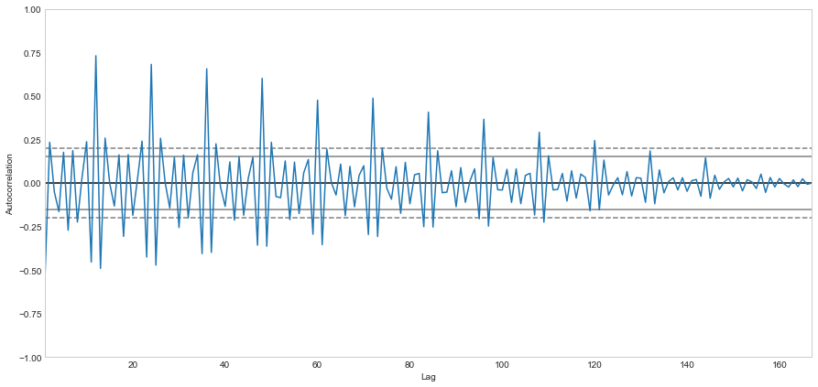
Auto Correlation function Plot after holt’s winter method
Partial Auto Correlation function Plot after holt’s winter method
Auto Correlation Plot after holt’s winter method

Slide 5

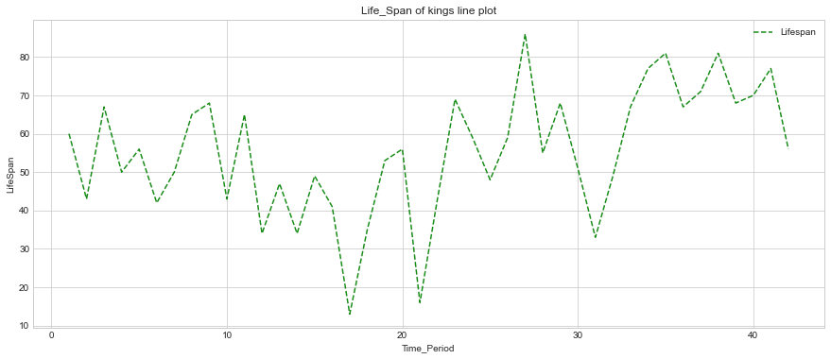
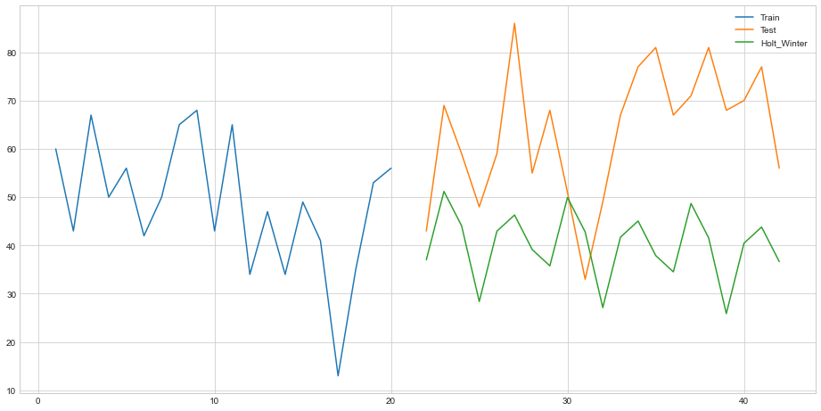
KINGS
Before applying the model
After applying the Holt’s Winter model
TEST RMSE :
27.4

Slide 6
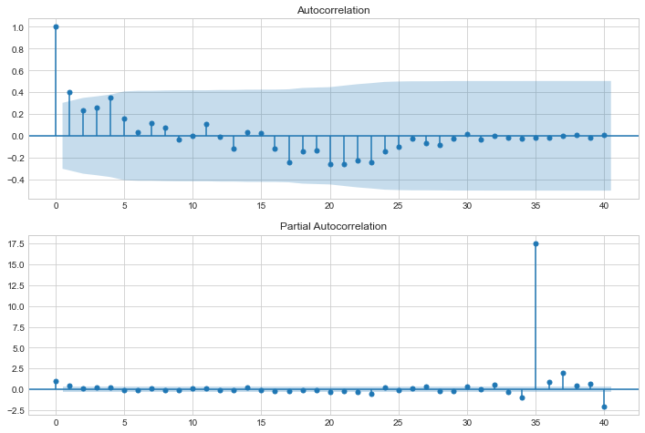
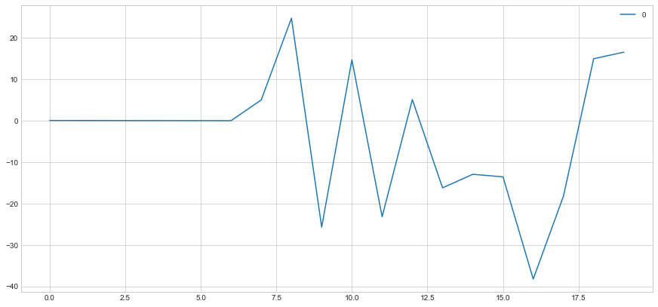
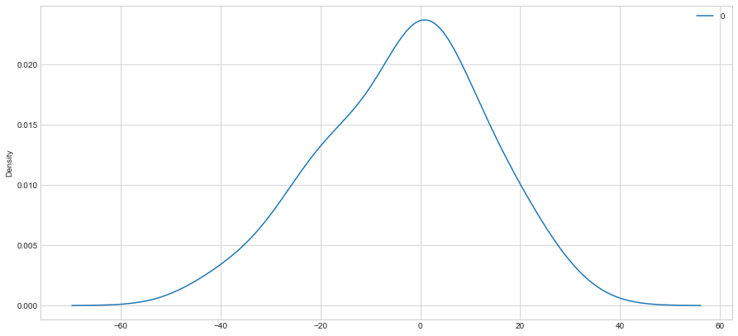
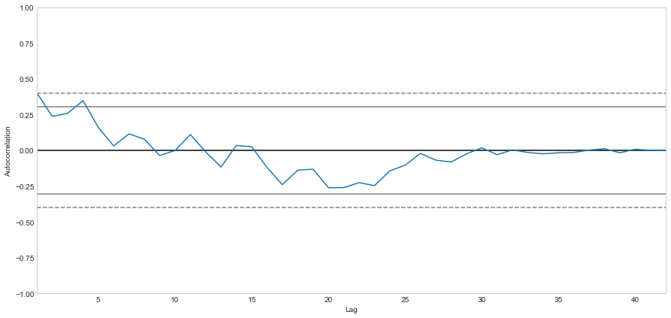
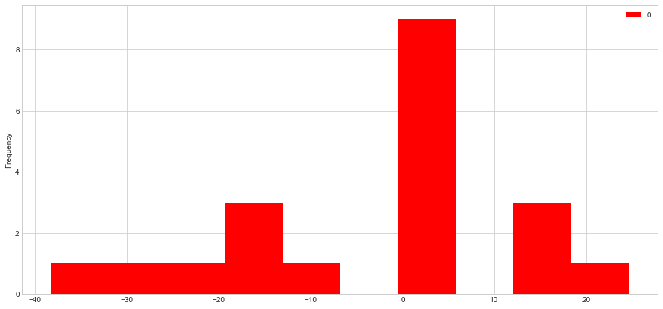
Residual Line Plot after Holt’s Winter method
Auto Correlation and Partial Auto Correlation Plot after Holt’s Winter method
Residual Normal Distribution Plot after Holt’s Winter method
Histogram Plot after Holt’s Winter method
Auto Correlation Plot after Holt’s Winter method

Slide 7

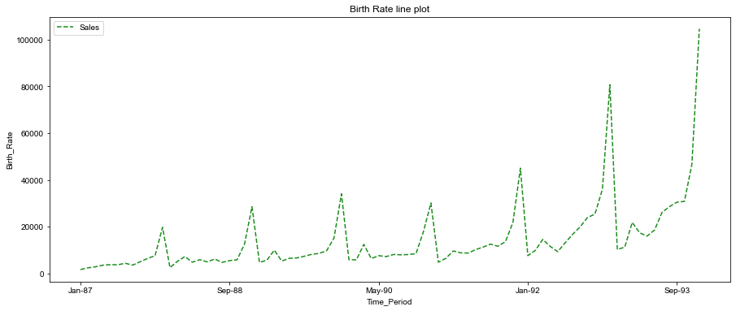
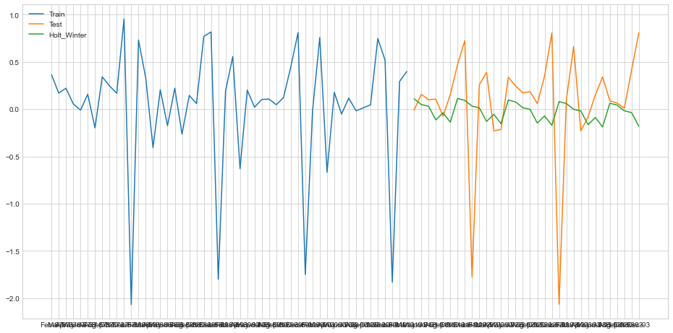
SOUVENIR
Before applying the model
After applying the Holt’s Winter model
TEST RMSE :
0.619

Slide 8
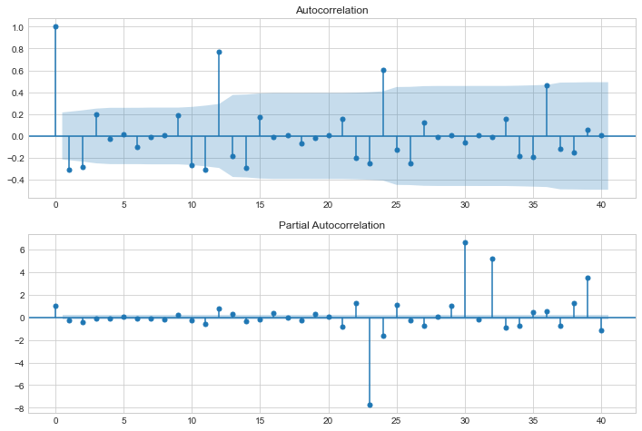
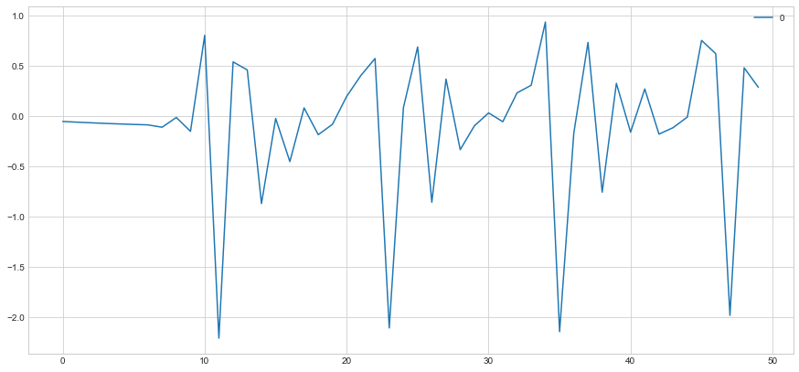
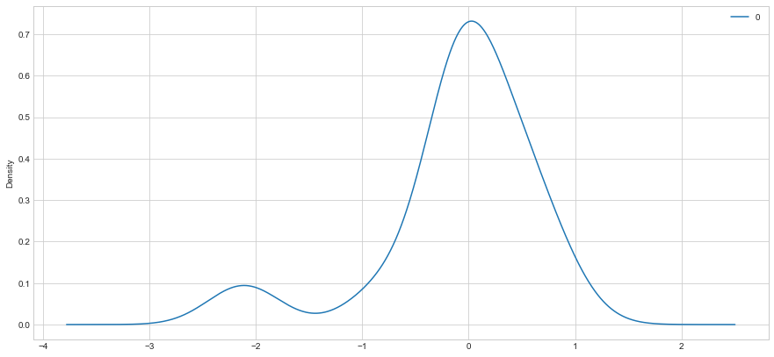
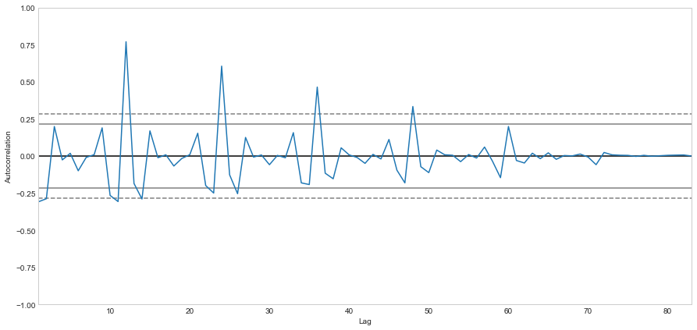
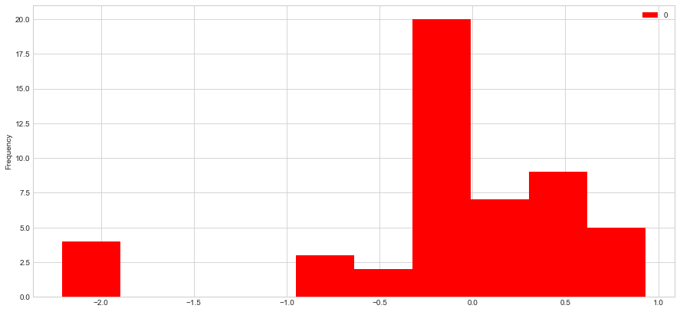
Residual Line Plot after Holt’s Winter method
Auto Correlation and Partial Auto Correlation Plot after Holt’s Winter method
Residual Normal Distribution Plot after Holt’s Winter method
Histogram Plot after Holt’s Winter method
Auto Correlation Plot after Holt’s Winter method

Slide 9
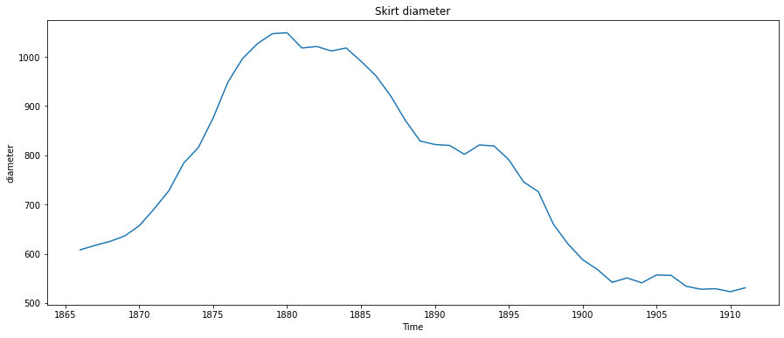

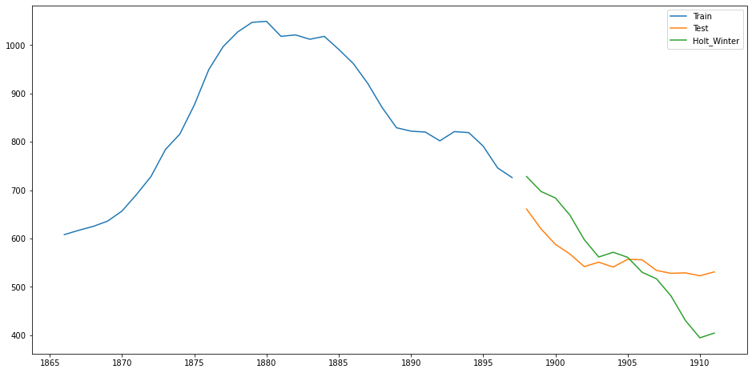
SKIRTS
Before applying the model
After applying the Holt’s Winter model

Slide 10
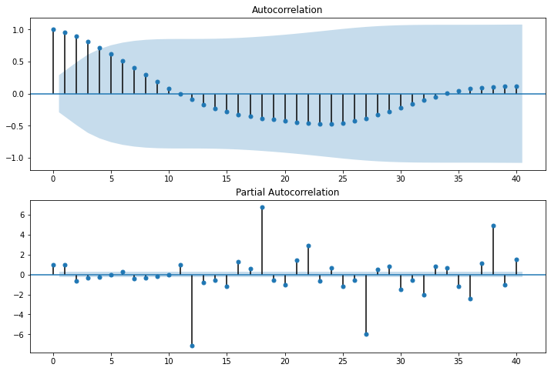
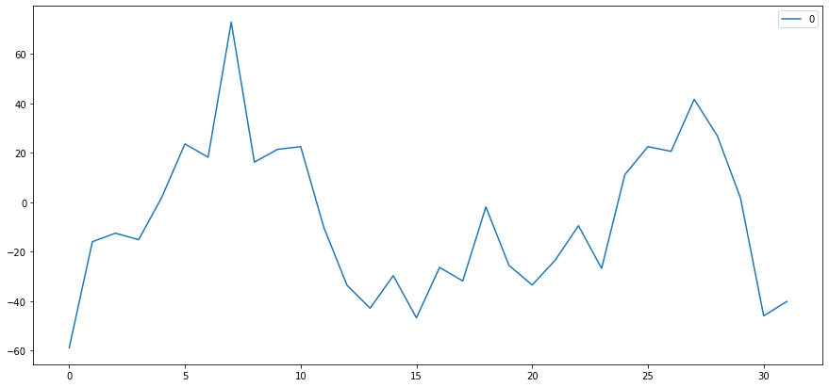
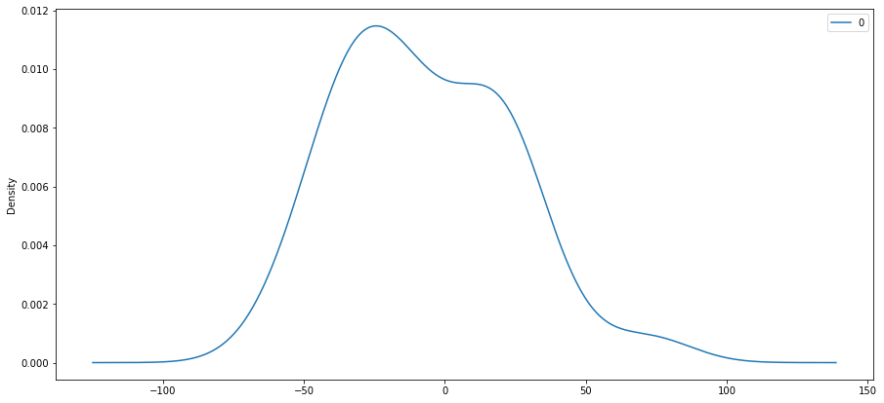
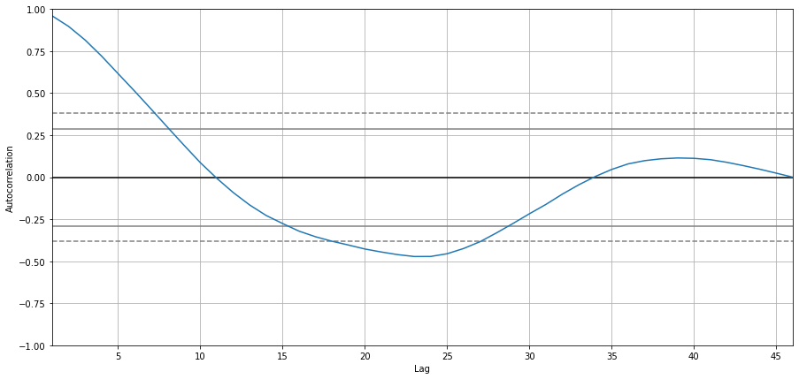
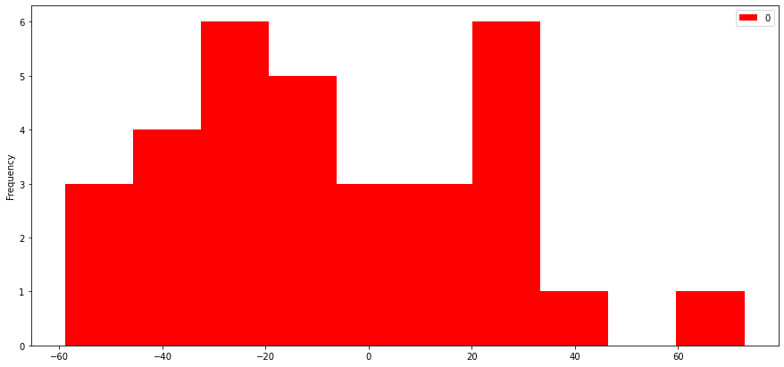
Residual Line Plot after Holt’s Winter method
Auto Correlation and Partial Auto Correlation Plot after Holt’s Winter method
Residual Normal Distribution Plot after Holt’s Winter method
Histogram Plot after Holt’s Winter method
Auto Correlation Plot after Holt’s Winter method

Slide 11

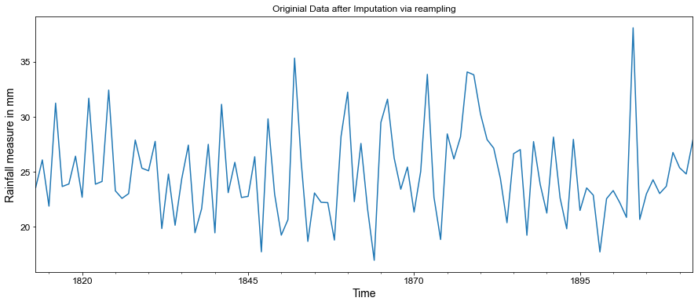
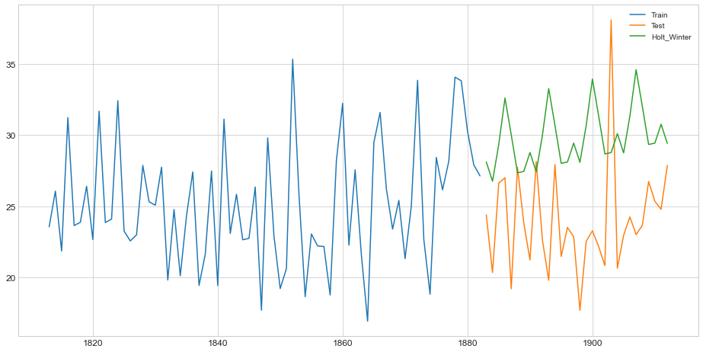
RAIN
Before applying the model
After applying the Holt’s Winter model
TEST RMSE :
7.28

Slide 12
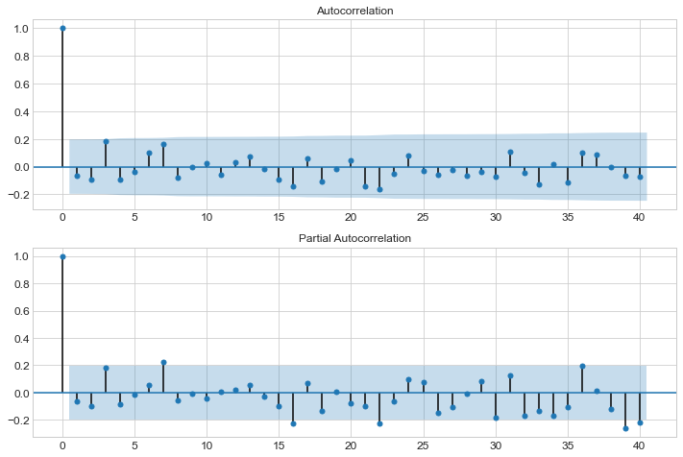
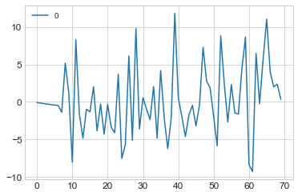
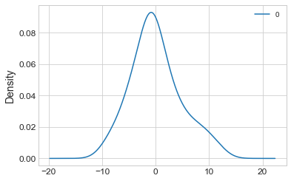
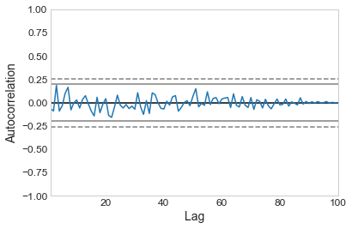
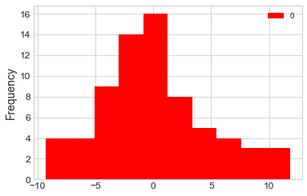
Residual Line Plot after Holt’s Winter method
Auto Correlation and Partial Auto Correlation Plot after Holt’s Winter method
Residual Normal Distribution Plot after Holt’s Winter method
Histogram Plot after Holt’s Winter method
Auto Correlation Plot after Holt’s Winter method

Slide 13


