Slide 1
CAR ANALYSER
-1. SRIRAM R (15BCS039)
-2. IRSHAAD A (15BCS046)
-3. ASHWIN G(15BCS008)

Slide 2
ABSTRACT
This project explores a best consultant system for car buying respect to choices
However, people visiting showrooms and selecting the car with right specifications & features is one of the complex.
Hence a application is necessary to suggests the best cars for the respective people aspects.
So, here introducing the Car Suggestion System with three aspects such as ( Luxury, Performance and Classic) based on machine learning techniques.
A machine learning model is applied to predict the best car among the car dataset based on user inputs.
The Kth nearest neighbor algorithm is work excellent for this concept among other machine learning algorithms. And a label encoding technique is used to labelling the car model in order to improve the KNN prediction.

Slide 3
INTRODUCTION
As kids, we can all relate to having fond memories of going from dealership to dealership with our parents, jumping in and out of the backseats of different cars, testing out all the different features.
While test drives haven’t fallen by the wayside, the modern 2017 car shopper will only visit an average of 2 dealerships on their journey to buying their perfect new car.
The car buying journey has radically changed due to the digital boom over the past couple years. People are spending less time in dealership showrooms and more time researching and building out the perfect car.
With the massive amount of information available on every model, it’s important to attract potential dealers to provide the right content, at the right time.

Slide 4
PROJECT OBJECTIVE
To predict a car for an user based upon his actual requirements rather than all the car promotions that are broadcasted.
To categorise the vehicles based upon economy ,luxury , performance with regards to their built materials.
To get input from the users in order to decide the best fit .

Slide 5
EXISTING SYSTEM
Several approaches based on machine learning are implemented, such as
Naive Bayes,
SVM Classifier,
Linear Regression

Slide 6
DRAWBACKS OF EXISTING SYSTEM
.
That’s always relying on previous data.
Miss classification(Doesn’t supports Multi-Label Classification)
Less prediction
Normally, a lot of users tend to purchase vehicles based upon false information given by online car websites.
People usually consider the price rather than the requirements that they need without knowing that there are better cars which will suit them under their budget .

Slide 7
LITERATURE REVIEW
1)Study on Consumer Buying Behavior During Purchase of a Second Car:
Factor 1 : Product Efficacy
Factor 2 : Image Equalizer
Factor 3 : Experienced Maven
Factor 4 : Social Appreciation
Factor 5 : Favourite Fondness
Factor 6 :Family First.

Slide 8
2) Factors Influencing the Purchase Decision of Passenger Cars in Puduchery:
The Hypothesis tested:
H01 There is no significant relationship between economic factor and purchase decision.
H02 There is no significant relationship between technical factor and purchase decision.
H03 There is no significant relationship between convenience and purchase decision.
H04 There is no significant relationship between performance factor and purchase decision.
H05 There is no significant relationship between safety and purchase decision.
H06 There is no significant relationship between beauty and purchase decision.
H07 There is no significant relationship between social factor and purchase decision.

Slide 9
3) Attitude Of Consumers
PRE 1990 -Owning a car (Ambassador,Fiat-A) Basic car providing or fulfilling the need of owning car .
Post Liberalization 1998-Drive comfort , small size low operating cost (Santro).
1999-Owning a foreign brand(Ford Ikon).
2005-Drive comfort Space and reliability MARUTI Swift (Petrol And Diesal).
2008-Aspiration to buy a bigger car and with excellent drive comfort (Swift Desire).
2010 onwards- High esteem value,Muscular looks and Owning a Foreign brand (Fortune, XUV 500).

Slide 10
4) CUSTOMER SATISFACTION AND SERVICE QUALITY IN AUTOMOBILE SERVICE SECTOR
i. Consumer perceptions of service quality resulting from comparing expectations prior to receiving the service and actual experiences with the service.
ii. There is specified level of quality on which "exceptions" or "problems" can be dealt.
iii. Interactions between customers and company representatives can figure prominently in the quality image of firms.
iv. Raising early expectations to unrealistic levels may result to more initial business, but this strategy invariably fosters
v.customer disappointment and discourages repeat business.

Slide 11
PROPOSED METHODOLOGY
We’ll use machine learning algorithms inorder to get the requirements from the user.
For e.g., the environment in which the user uses the vehicle, miles travelled per day, performance requirements etc.
Finally , the analysis will yield a result which will be a right choice for the user based upon the simple information given rather than more complex technical terms.

Slide 12
ALGORITHM
The KNN algorithm trained with the features extracted and predict the best car model.
Well, KNN it capable of doing both classification on multi-labelled data.
The benefit is that you can capture much more complex relationships between your data without having to perform difficult transformations on your own. .
KNN Algorithm from the Scikit-learn Python library which implements this algorithm. This algorithm produces a prediction label.
Label encoder technique is used label the car model in the dataset and makes classification more accurate than general label information. After the inverse label information, it gives predicted car model all details.
Also this implementation is further improved with GUI interface for easy accessing by the users.

Slide 13
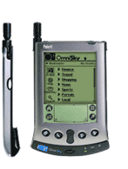
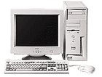




INSTANCE BASED ALGORITHM
Its very similar to a
Desktop!!

Slide 14
REMARKS
+Highly effective inductive inference method for noisy training data and complex target functions
+Target function for a whole space may be described as a combination of less complex local approximations
+Learning is very simple
- Classification is time consuming

Slide 15
BLOCK DIAGRAM
Train Input
Pre-processing
Feature Extraction
Test Data
Pre-processing
Feature Extraction
ML KNN Classifier
Predict best model

Slide 16
MODULE DESCRIPTION
So the goal is to get the requirements from the user and predict the appropriate suggestions of cars which match the requirements . 1.Splitting up of cars into three genres ( Performance, Luxury, class) 2.Fusing together the columns of the dataset based upon conditions which will be unique for the three classes. 3.Getting the user requirements 4.Using supervised learning algorithm to predict the suggestions based upon the conditions that were fused earlier.

Slide 17
MODULE 1:- Software installation & packages configuration. Load Train Dataset & Pre-processing
MODULE 2:- Feature Extraction, Create train model
MODULE 3:- Load test data, Pre-processing & Feature Extraction
MODULE 4:- Classify the best car by taken their features

Slide 18
TESTING DATA
Test data is data which has been specifically identified for use in tests, typically of a computer program.
Some data may be used in a confirmatory way, typically to verify that a given set of input to a given function produces some expected result.

Slide 19
PRE-PROCESSING
Data preprocessing includes cleaning, Instance selection, normalization, transformation, feature extraction and selection.
Data cleaning is the process of detecting, correcting or removing the inaccurate records from data

Slide 20
FEATURE EXTRACTION
Feature extraction is the process of transforming the input data into a set of vector features which can very well represent the input data
Hence Label encoder is used for that label vector representation.

Slide 21
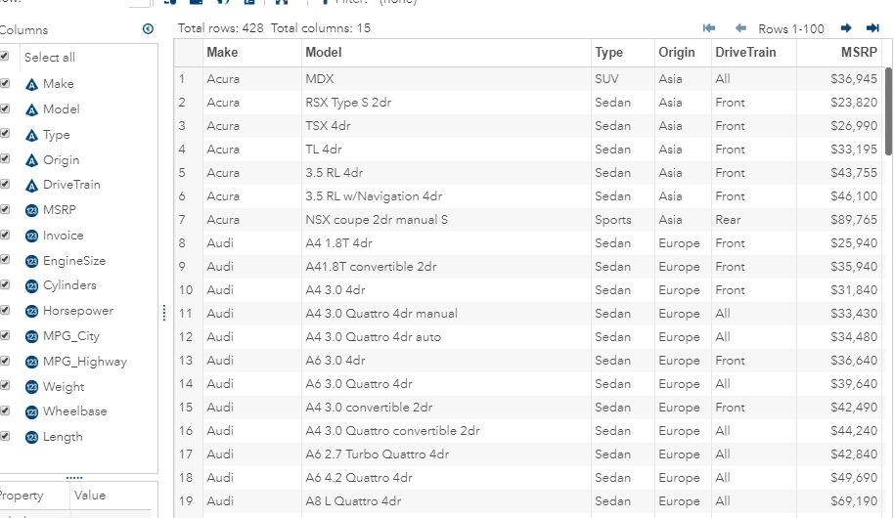
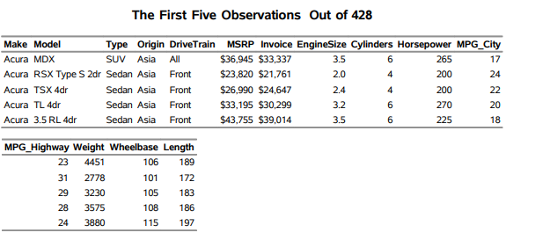
DATASET

Slide 22
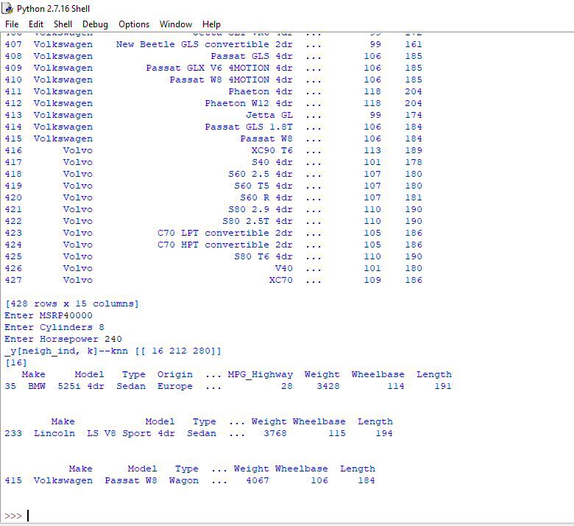
PERFORMANCE_BASED.PY

Slide 23
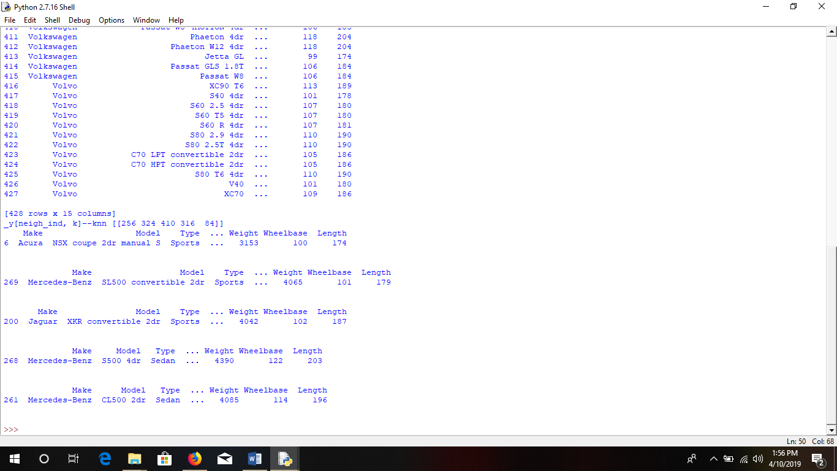
LUXURY_BASED.PY

Slide 24
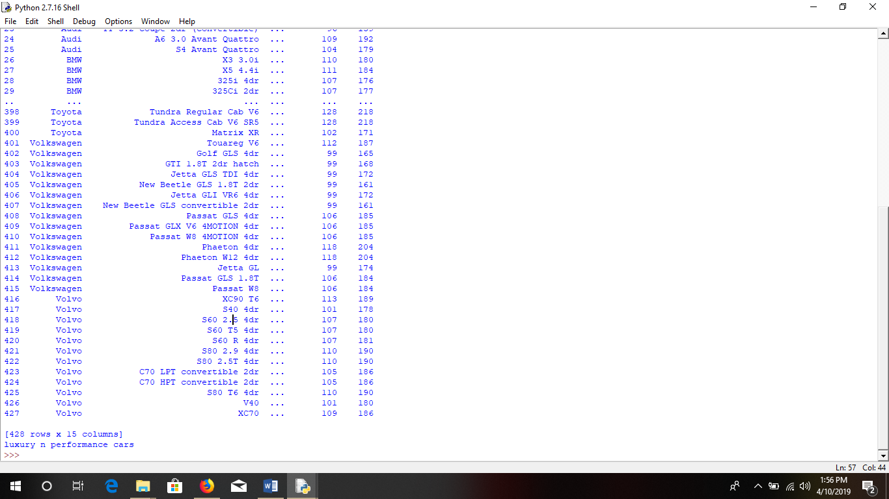
LUXURY&PERF.PY

Slide 25
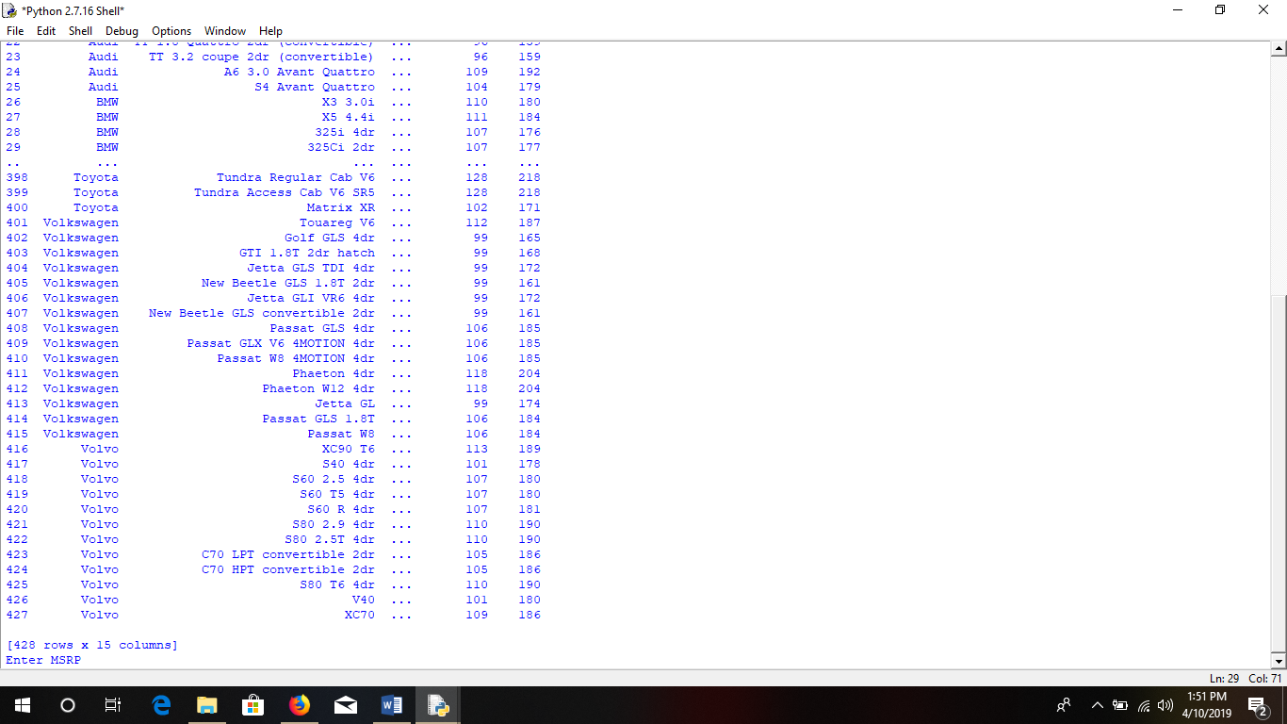
CLASS_BASED.PY

Slide 26
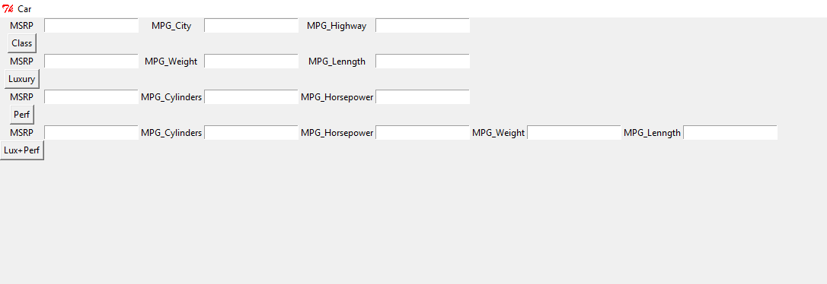
FINAL OUTPUT WITH GUI

Slide 27
CONCLUSION
We aim at providing the best fit for an individual based on his requirements.
If the person thinks they’re getting a good value, they’ll go ahead and make the purchase feeling elated with the value that will soon be added to their life.
As we take a closer look at how people buy cars we can see that people like to do business with other people. However, during the research process they like to find things out on their own.
With our algorithm, people will find out everything they can to make the most informed decision possible. Meet people where they are in their car buying journey to give them the content they’re looking for.
This way, we can help them make the best possible decision in your favor.

Slide 28
REFERENCES
Pudaruth,S. 2014. “Predicting the Price of Used Cars Using Machine Learning Techniques”, International Journal of information & Computation Technology,4(7), p.753-764.
Kuiper, S. 2008. “Introduction to Multiple Regression: How Much Is Your Car Worth?”, Journal of Statistics Education, 16(3).
Listiani M. 2009. Support Vector Regression Analysis for Price Prediction in a Car Leasing Application. Master Thesis. Hamburg University of Technology.
Limsombunchai, V. 2004. House price prediction: Hedonic price model vs. artificial neural network. In New Zealand Agricultural and Resource Economics Society Conference, New Zealand, pp. 25-26.
Bourassa, S.C., Cantoni, E. and Hoesli, M. 2007. “Spatial dependence, housing submarkets, and house price prediction”, The Journal of Real Estate Finance and Economics, 35(2), p.143-160.
Nau, R. 2014. Notes on linear regression analysis, Lecture handouts, Duke University, Furqa School of Business, 26 nov 2014.
Singh, Y., Bhatia, P. K., & Sangwan, O. 2007. “A review of studies on machine learning techniques”, International Journal of Computer Science and Security, 1(1), 70-84.

