Slide 1

DECLARATIVE TIME-BASED ANIMATION USING DOMAIN-SPECIFIC LANGUAGE
Presented by
Priyadharsan K ( 227003112 )
Srikaanth R ( 227003116 )
Srinivasan S ( 227003142 )
Under the Guidance of
Dr Moratanch N ( AP III )

Slide 2
PRESENTATION OUTLINE
Problem Statement
Objective
Literature Review
Dataset
System Architecture
List of References

Slide 3
PROBLEM STATEMENT
Difficult to visualize timing when multiple elements are involved
Manual handling of delays becomes complex
Coordinating multiple animations is error-prone
Debugging animation behavior is challenging
Animation logic and timing are tightly coupled with CSS code
Suitable for simple animations, but hard to manage for complex sequences

Slide 4
OBJECTIVES
To design a web-based visual animation tool
To enable timeline-based creation of animations
To provide real-time preview of animations
To generate clean and reusable CSS animation code
To reduce the complexity of manual CSS keyframe writing
To internally manage animation logic using GameScript-inspired concepts
To apply agent-based, state-driven rules for animation sequencing
To extend the GameScript execution model to the web animation domain

Slide 5
LITERATURE REVIEW
PAPER TITLE | AUTHOR(S) | ABSTRACT | LIMITATIONS
Rule-Based Game Scripting Models for Modern Engines | A. Kumar et al. | Proposes rule-based scripting to simplify game logic excution | Limited support for visual or time-based sequencing
A Declarative DSL for Game Behaviour Design | L. Zhang, M. Chen | Introduces a DSL to abstract game behavior from engine code | DSL syntax still complex for non-programmers
Lightweight Scripting Languages for Game AI | S. Romero et al. | Focuses on minimal scripting for AI behavior control | Not suitable for animation or UI sequencing
Agent-Based Game Logic Representation | P. Martins, R. Silva | Models game entities as agents with state-based rules | Agent logic tightly bound to game context
Visual Tools for Game Scripting | J. Patel et al. | Provides GUI-based scripting for designers | Limited rule evaluation flexibility
Separation of Game State and Behavior Logic | K. Andersson | Separates state management from behavior rules | Lacks real-time execution control
Time-Based Behavior Modeling in Games | Y. Tan, H. Wu | Introduces time-driven rule evaluation | Focused only on games, not reusable domains
DSLs for Interactive Game Narratives | E. Brown et al. | Uses scripting to control narrative flow | High complexity for simple behaviors
Model-Driven Game Development Approaches | D. Novak | Uses models to generate game logic | Over-restrictive and less expressive
Simplified Scripting Frameworks for Games | F. Rossi et al. | Aims at readability and maintainability | Limited applicability beyond game engines

Slide 6
Dataset

Slide 7
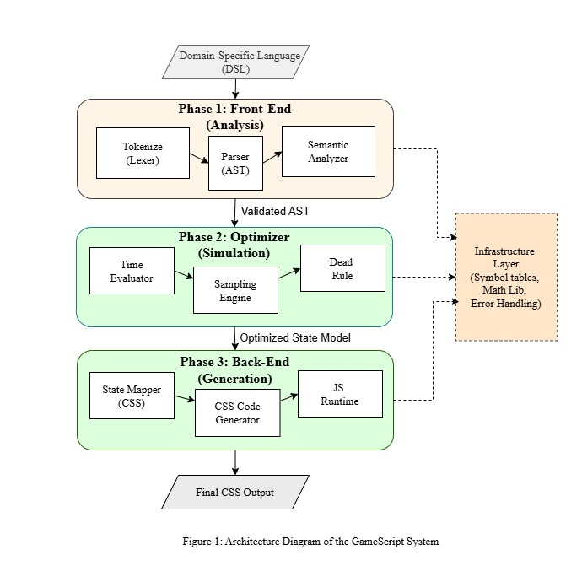
SYSTEM ARCHITECTURE

Slide 8
List of References
[1] Carlos Marín-Lora, Miguel Chover,
GameScript: A Simplified Scripting Language for Video Game Development,
Multimedia Systems, Springer Nature, 2025, Vol. 31, Article 70.
🔗 https://link.springer.com/article/10.1007/s00530-024-01574-8
[2] A. Kumar et al.,
Rule-Based Game Scripting Models for Modern Engines,
IEEE Access, 2024, Vol. 12.
[3] L. Zhang, M. Chen,
Declarative DSL for Game Behavior Design,
ACM Transactions on Graphics, 2023, Vol. 42.
[4] S. Romero et al.,
Lightweight Scripting Languages for Game AI,
Future Generation Computer Systems, Elsevier, 2022, Vol. 129.
[5] P. Martins, R. Silva,
Agent-Based Game Logic Representation,
Springer LNCS, 2021, Vol. 1280.
[6] J. Patel et al.,
Visual Tools for Game Scripting,
IEEE Computer Graphics and Applications, 2023, Vol. 43.
[7] K. Andersson,
Separation of Game State and Behavior Logic,
Journal of Visual Communication and Image Representation, Elsevier, 2020.
[8] Y. Tan, H. Wu,
Time-Based Behavior Modeling in Games,
IEEE Transactions on Games, 2024, Vol. 16.
[9] E. Brown et al.,
DSLs for Interactive Game Narratives,
Entertainment Computing, Springer, 2021, Vol. 38.
[10] D. Novak,
Model-Driven Game Development Approaches,
Wiley Publishing, 2022.

Slide 9
THANK YOU!..

