Slide 1
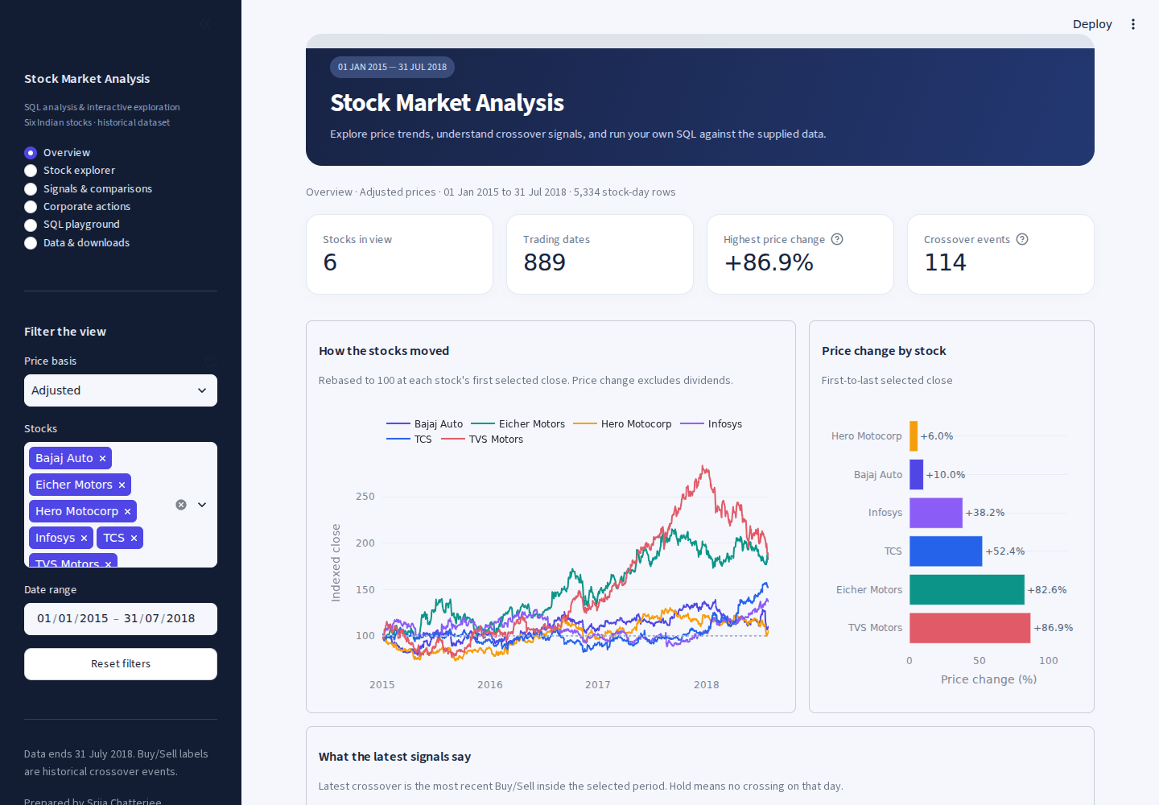
Stock Market
Analysis
My SQL analysis and
Streamlit dashboard
Srija Chatterjee
1 January 2015 to 31 July 2018
Submission: 10 October 2026
01 / 12
Notes:
I used the six supplied stock files to compare historical price trends and apply a 20/50-day moving-average crossover rule. My submission includes the MySQL analysis, an insights report and a walkthrough video. The Streamlit app lets me inspect the evidence and run SQL against the same records. The data is historical and ends on 31 July 2018. Price change here excludes dividend reinvestment.
Sources
Supplied student guide, page 2.
Original dashboard capture: 01_Overview.png.

Slide 2
What I set out to do
I wanted to compare the six stocks, explain the signals and check whether the price changes were fair comparisons.
ID | SQL analysis | Check or output
01 | History coverage | 889 trading dates
02 | Five highest Eicher closes | Peak: INR 32,786.40
03 | TCS average by year | 2018 partial year: INR 2,729.12
04 | Missing delivery records | Six rows kept as NULL
05 | Bajaj 20/50-day averages | Full windows only
06 | Join six closes by date | 889 master-table rows
07 | Create Bajaj signals | Buy, Sell and Hold
ID | SQL analysis | Check or output
08 | Count Bajaj signals | 12 Buy, 11 Sell, 866 Hold
09 | Bajaj signal function | 21 Jun 2018: Buy
10 | Six-stock signal summary | Raw: 56 Buy, 57 Sell
11 | Full-period raw change | 100 × (last / first − 1)
12 | Worst daily raw move | IT price cliffs near −50%
13 | Bonus-adjusted IT change | Infosys +38.17% TCS +52.36%
Required submission: MySQL SQL file, insights PDF and a short walkthrough video.
I also added adjusted signals, quick reversals, volatility, drawdown and an execution scenario.
Srija Chatterjee
02 / 12
Notes:
The thirteen rows map directly to the student guide. Task 1 finds coverage with COUNT, MIN and MAX. Task 2 orders Eicher closing prices from highest to lowest and returns five rows. The five peaks are INR 32,786.40 on 7 September 2017, 32,763.85 on 18 September, 32,628.70 on 8 September, 32,582.30 on 12 September, and 32,466.75 on 11 September. Task 3 groups TCS by year. Its raw annual averages are INR 2,537.39 for 2015, 2,419.00 for 2016, 2,475.36 for 2017 and 2,729.12 for the partial 2018 period. The 2018 mean mixes pre- and post-bonus price bases, so I do not treat it as proof of the best year.
Task 4 retains empty delivery fields as NULL. Tasks 5-7 create bajaj1, master_table and bajaj2. The script starts each created table with DROP TABLE IF EXISTS and embeds the source records, so it runs from top to bottom on a fresh database and can be rerun. Task 9 also defines bajaj_signal(d) in MySQL. The SQLite playground uses an equivalent SELECT lookup because SQLite has no stored SQL-function syntax. Tasks 10-13 compare all stocks and correct the two bonus events. Additional SQL tasks 14-17 calculate adjusted crossovers, changed events, quick reversals and risk. The playground also has preset 18 for selected dashboard rows.
The MySQL script ran twice on MySQL 8.0.46. The project has 17 passing automated test cases, including independent checks of the calculations.
Sources
Supplied student guide, tasks 1-13 and submission checklist, pages 2 and 19.
sql/Stock_Market_Analysis_MySQL.sql
reports/query_results/task_01.csv to task_17.csv

Slide 3
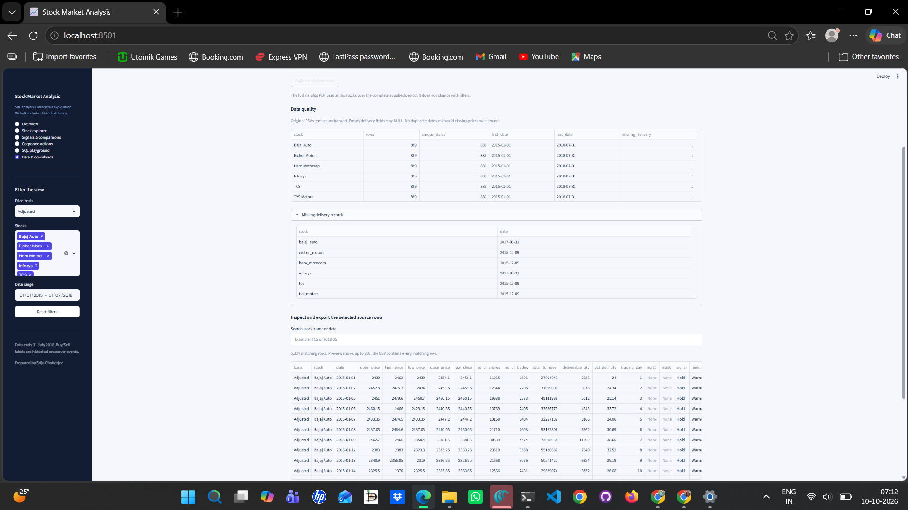
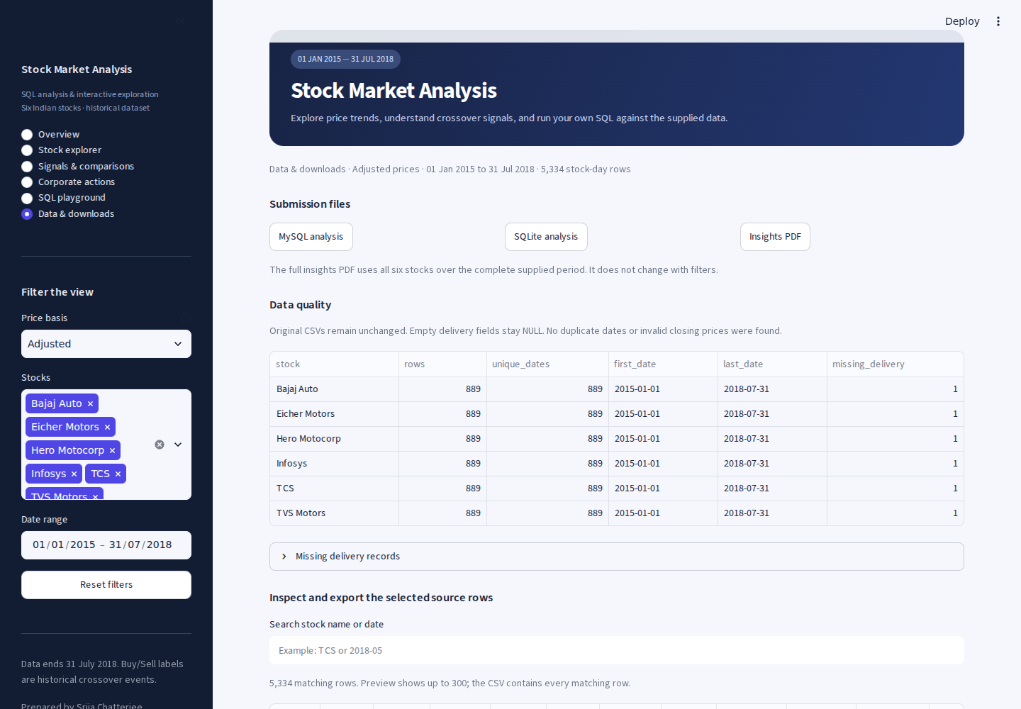
The data I worked with
Six original CSV files contain 5,334 stock-day records over the same 889 trading dates.
My data checks
I kept the original files and their missing values.
Dates are unique and closing prices are complete.
Each stock has one missing delivery record.
I can search rows and export the full selection.
Stocks: Bajaj Auto, Eicher Motors, Hero Motocorp, Infosys, TCS and TVS Motors.
Srija Chatterjee
03 / 12
Notes:
I loaded the six CSVs into typed tables, converted dates to ISO format and checked that all stocks have the same calendar. The original columns are date, open_price, high_price, low_price, close_price, wap, no_of_shares, no_of_trades, total_turnover, deliverable_qty, pct_deli_qty, spread_high_low and spread_close_open. I found no duplicate date keys, missing closing prices, non-positive closing prices or inconsistent OHLC ordering. Missing delivery quantities and their percentages occur on 31 August 2017 for Bajaj and Infosys, and on 9 December 2015 for Eicher, Hero, TCS and TVS. I kept those six records as NULL.
The data page includes missing-record inspection, a stock/date text search, a preview of up to 300 rows, a CSV with every matching row and a download of the SQLite database. It also links to the source documentation and downloadable submission files. The core stack is Python, MySQL 8, SQLite, Streamlit, pandas and Plotly. SQL produces the analysis, Python handles loading, the interface and the explicitly modeled execution scenario. source_rows validates the original CSVs, build_connection creates the database, and database_bytes caches the database using dataset_fingerprint as its cache key. build_project.py regenerates the SQL files, database and query exports.
Sources
reports/data_profile.json
engine.py: source_rows, build_connection and dataset_fingerprint
User screenshot 071235 and video screenshot 07_Data_Downloads

Slide 4
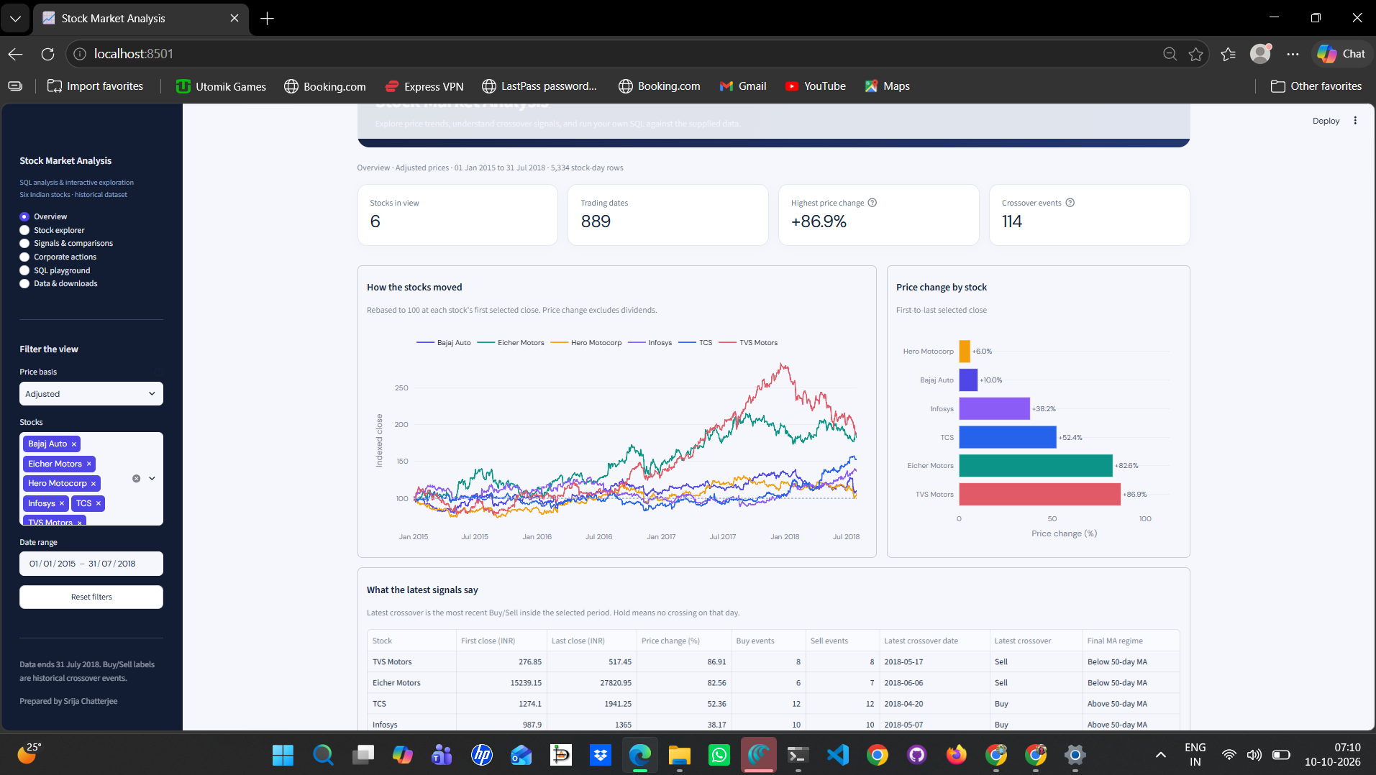
The dashboard at a glance
I can compare stocks on the same starting scale and inspect the latest crossover in the selected period.
Filters and overview
Choose stocks, dates and raw or adjusted prices.
Reset the filters in one click.
Rebased prices start at 100.
TVS gained 86.91%, the highest in this period.
Adjusted data has 114 crossover events.
The summary includes the latest crossing and final MA regime.
Srija Chatterjee
04 / 12
Notes:
The overview shows the number of selected stocks, trading dates, best first-to-last price change and the total number of crossover events. The line chart rebases each stock to 100 at its first selected close. The bar chart ranks first-to-last close changes for the selected period. The summary table includes first and last closes, change, Buy and Sell counts, latest crossover date and direction, and the final moving-average regime. I can download that summary as CSV.
The adjusted basis corrects the two known bonus issues. Raw prices remain available for the original assignment checks. The moving-average windows are calculated before filtering dates, so changing the visible range does not restart the averages. Drawdown also retains its full-history peak. An empty stock selection or a date interval without records displays an explanatory message. The latest crossover differs from the event on the final visible day. Each stock has Hold on the final dataset date, although its latest crossover can still be Buy or Sell.
Relevant functions: filtered_rows applies the selection after analytics, filtered_summary computes the selected endpoints and latest event, rebased_rows calculates the indexed close, reset_filters restores the default selection, and render_overview builds this page.
Sources
app.py: reset_filters and render_overview
engine.py: filtered_rows, filtered_summary and rebased_rows
reports/query_results/full_summary.csv
User screenshot 071015

Slide 5
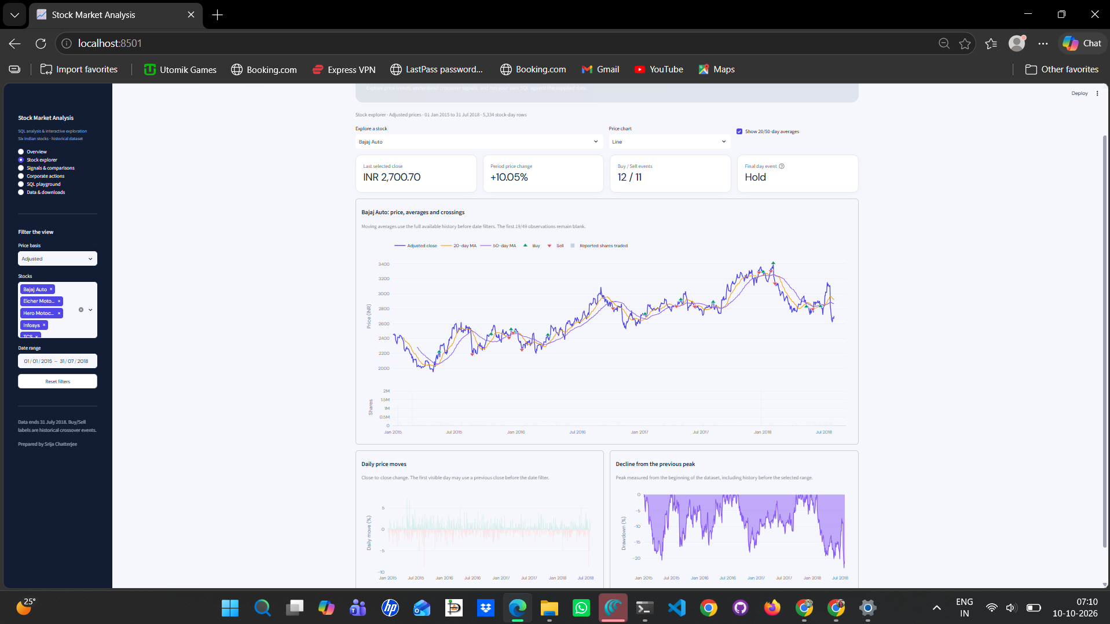
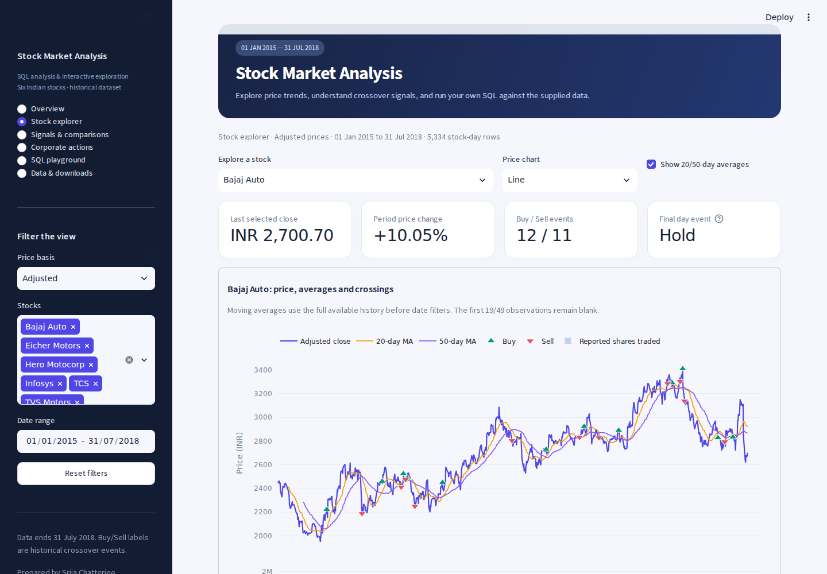
How I explored each stock
The explorer brings the price, moving averages, crossover markers and reported trading volume into one view.
My analysis rules
MA20: today plus 19 earlier trading rows.
MA50: today plus 49 earlier trading rows.
The first 19/49 averages stay NULL.
Line/candlestick switch and MA toggle.
Daily moves, drawdown and CSV export.
Bajaj checks: first MA20 = INR 2,415.53 on 29 Jan 2015. First MA50 = INR 2,283.80 on 13 Mar 2015.
Srija Chatterjee
05 / 12
Notes:
A twenty-day moving average is AVG(close_price) over ROWS BETWEEN 19 PRECEDING AND CURRENT ROW. The fifty-day window uses 49 PRECEDING. ROW_NUMBER ensures there are at least 20 or 50 observations before returning the result. That keeps the first 19/49 observations NULL. These are trading observations, so weekends do not consume a window row. The first complete Bajaj MA20 is INR 2,415.53 on 29 January 2015, its first MA50 is INR 2,283.80 on 13 March 2015, and the last MA20 is INR 2,918.51 on 31 July 2018.
The assignment Bajaj tables round averages to two decimals. The cross-stock and adjusted calculations retain full precision. I calculate all historical windows before applying the date filters. The price chart offers a line or OHLC candlesticks, an MA toggle, Buy and Sell markers, and a reported-shares subplot. The daily-move chart shows close-to-close percentage changes. The drawdown chart measures decline from the historical running close peak. The expanded trading-row table and CSV expose the plotted records.
Relevant functions and Plotly objects: render_explorer, chart, table, csv_button, make_subplots, go.Scatter, go.Candlestick, go.Bar, px.bar and px.area.
Sources
Student guide, task 5.
engine.py: setup_analysis_sql and analytics_select
app.py: render_explorer
User screenshot 071038 and video screenshot 02_Stock_Explorer

Slide 6
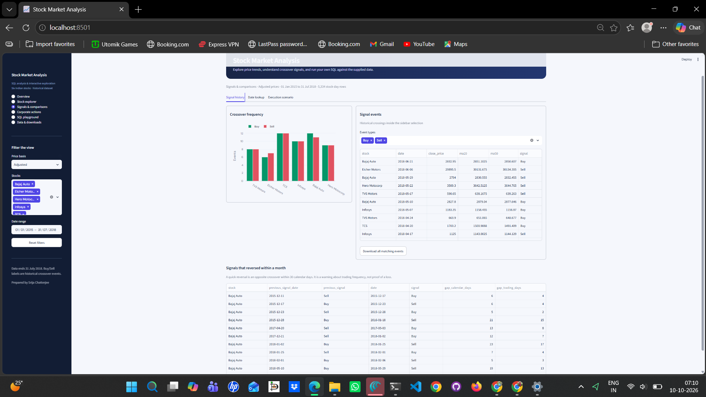
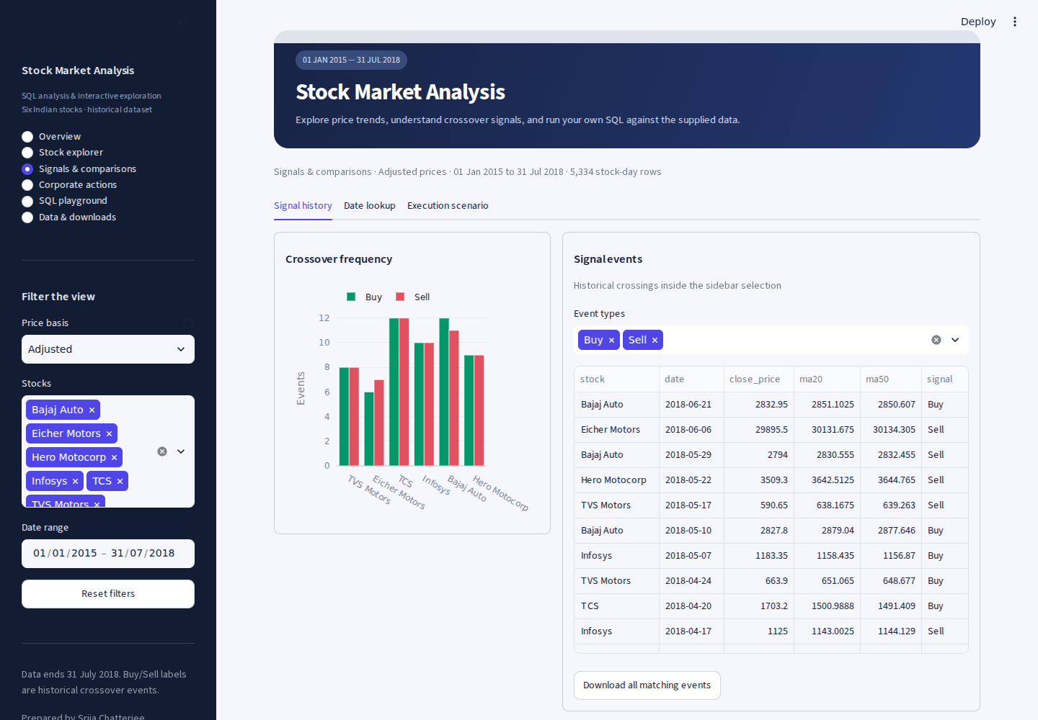
What Buy, Sell and Hold mean
I compare today’s 20/50-day relationship with yesterday’s relationship to identify a crossing.
The crossover rule
Buy: MA20 crosses above MA50.
Sell: MA20 crosses below MA50.
Hold: no new crossing.
Raw Bajaj: 12 Buy, 11 Sell.
Filter events; export CSV.
Quick reversal: opposite event within 30 days.
A Hold label describes a daily event. The latest crossover and final MA regime describe different parts of the history.
Srija Chatterjee
06 / 12
Notes:
The exact Buy rule is current MA20 > MA50 and previous MA20 <= MA50. Sell requires current MA20 < MA50 and previous MA20 >= MA50. I use LAG for the previous averages and CASE for the event label. If either current or previous average is NULL, I return Hold. Equality alone does not count as a crossing. Bajaj has 12 Buy, 11 Sell and 866 Hold days in the raw assignment table. Its first Buy is 18 May 2015 and its first Sell is 24 August 2015.
I can choose Buy, Sell and Hold in the event filter, inspect up to 300 events on screen and export every matching event. A quick reversal is an opposite crossing within 30 calendar days. The SQL table also reports the elapsed trading observations. Its previous crossing can precede the selected start date, while the new crossing must be inside the range. Adjusted counts are Bajaj 11, Eicher 1, Hero 4, Infosys 6, TCS 8 and TVS 4 quick reversals. Frequent crossings create more potential executions, but I cannot infer a loss from the count alone.
Relevant functions and SQL: render_signals, LAG, CASE, SUM with conditional cases, ROW_NUMBER, GROUP BY, ORDER BY and v_crossovers.
Sources
Student guide, tasks 7, 8 and 10.
reports/query_results/task_08.csv
reports/query_results/task_16.csv
User screenshot 071055 and video screenshot 03_Signal_History

Slide 7

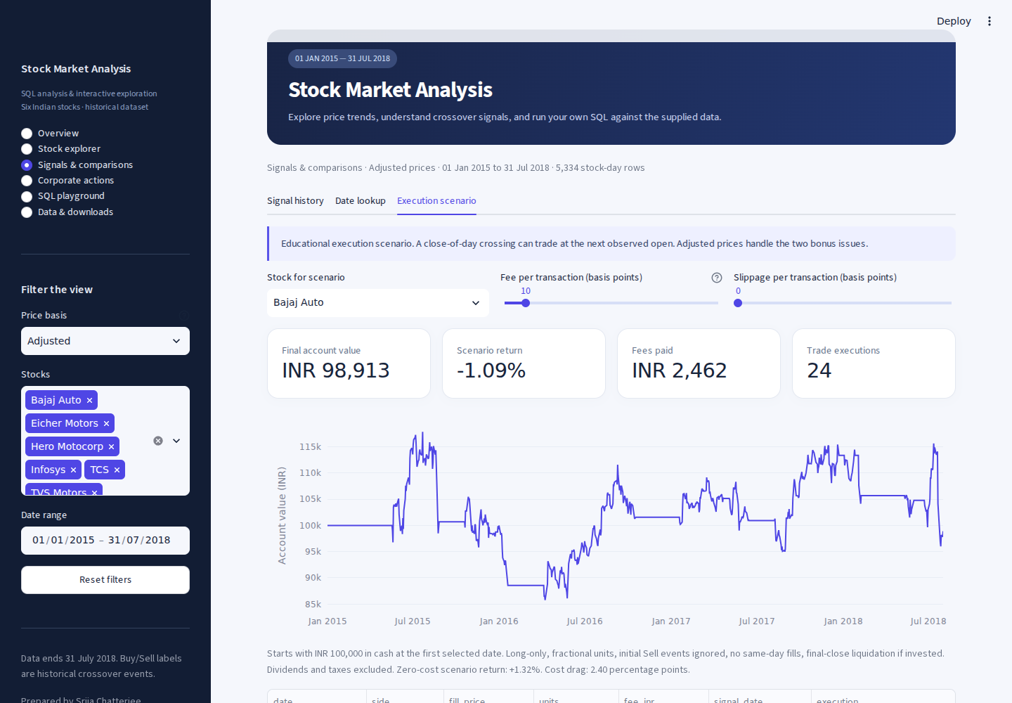
Date lookup and a trading-cost scenario
I can inspect a single trading date and test how execution timing and assumed costs affect the result.
Bajaj signal on a chosen date
A separate educational scenario
bajaj_signal('2018-06-21') returns Buy. A missing trading date returns no record or NULL.
INR 100,000 starting cash. Next observed open. Fee: 0.10% per transaction. Bajaj net return: −1.09%.
Srija Chatterjee
07 / 12
Notes:
The date-lookup control uses the selected stock and price basis but has its own date, independent of the sidebar interval. It returns Buy for Bajaj on 21 June 2018 and Hold for 4 January 2016. In MySQL, bajaj_signal(d) is a reusable function. Its missing-date result is NULL. The SQLite app displays that there is no trading record for an absent date.
The scenario is a Python model using SQL-generated adjusted prices and events. I start with INR 100,000 cash. A closing signal fills at the next observed open, which avoids using the signal before the close is known. The model is long-only, allows fractional units, ignores an initial Sell while in cash and liquidates any remaining investment at the final close. Fee and slippage sliders are explicit assumptions. With a fee of 10 basis points, or 0.10%, on each transaction and no slippage, Bajaj has a net result of −1.0872%, a final value of approximately INR 98,913, modeled fees of INR 2,461.56 and 24 executions. Its zero-cost scenario return is +1.3154%. These differ from the +10.0485% first-to-last price change because the entry/exit dates are different. The app shows an equity curve and an exportable trade log. Dividends, taxes, actual brokerage and market impact are absent.
Relevant functions: simulate, filtered_rows and render_signals. The simulation computes units, next-open fills, fee and slippage deductions, equity, final liquidation, and a complete trade log.
Sources
Student guide, task 9 and insight questions.
simulator.py: simulate
reports/query_results/execution_scenario.csv
Video screenshots 08_Date_Lookup and 09_Execution_Scenario

Slide 8
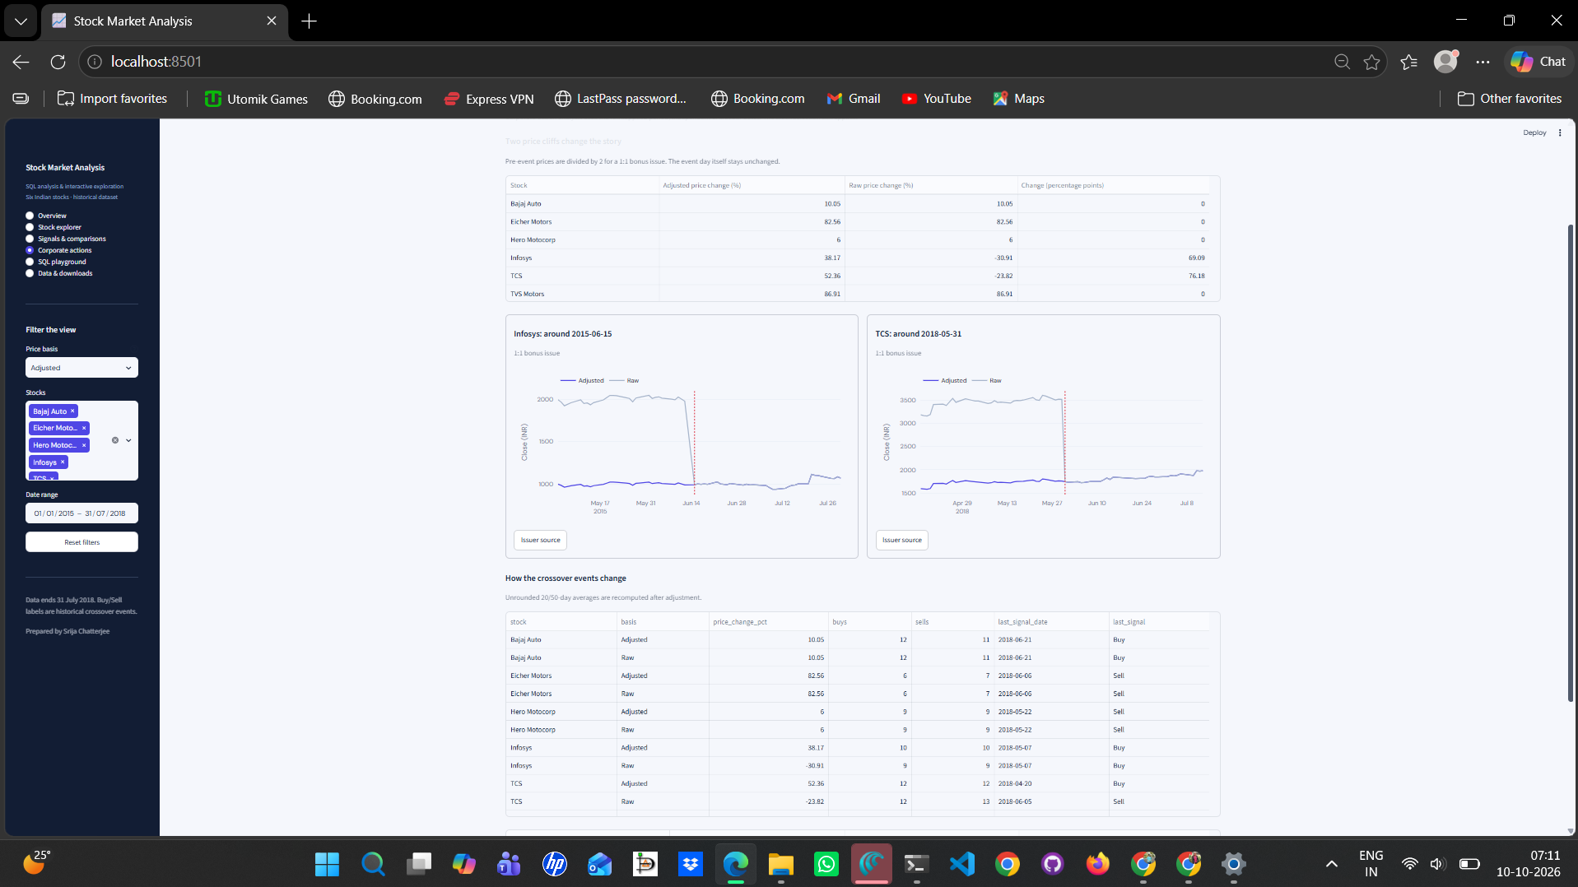

Why I adjusted Infosys and TCS
The two 1:1 bonus issues create raw price falls near 50%, which change the return comparison and some signals.
The corrected view
Infosys: 15 Jun 2015 ex-date.
TCS: 31 May 2018 ex-date.
Pre-event OHLC prices ÷ 2.
Infosys: −30.91% to +38.17%.
TCS: −23.82% to +52.36%.
Five signal dates change.
Issuer evidence: Infosys Q1 FY2016, page 5. TCS Annual Report 2018-19, printed page 89.
Srija Chatterjee
08 / 12
Notes:
I verified the two one-for-one bonus events against issuer documentation. The adjustment applies strictly before the ex-bonus trading date. The event day itself and later prices remain unchanged. I divide open, high, low and close by two and leave reported volume unchanged. The raw worst Infosys daily move on 15 June 2015 is −49.8596%, while the adjusted move is +0.2808%. The raw TCS move on 31 May 2018 is −50.4001%, while the adjusted move is −0.8002%.
Full-period Infosys change shifts from −30.9141% to +38.1719%, a difference of 69.0859 percentage points. TCS shifts from −23.8188% to +52.3625%, a difference of 76.1812 percentage points. The five signal differences are Infosys on 1 July, 8 July, 27 July and 18 August 2015, and TCS on 5 June 2018. TCS’s latest raw Sell on 5 June becomes an adjusted latest Buy on 20 April. I use the ex-bonus date rather than the later record/allotment date.
I also checked the supplied course slides. Infosys’s raw decline is 30.91%, rather than the stated 3%. TCS’s true raw endpoints are INR 2,548.20 and INR 1,941.25. Eicher’s +82.5623% rounds to +82.6% at one decimal. Only the two identified bonus events are adjusted. The return remains a price change excluding dividend reinvestment. Corporate actions use the full supplied period, independent of sidebar dates, and respect the stock selection. Relevant functions/views: render_actions, corporate_actions, v_price_basis and v_signal_changes.
Sources
https://www.infosys.com/investors/reports-filings/quarterly-results/2015-2016/q1/documents/q1-2016.pdf (page 5)
https://www.tcs.com/content/dam/tcs/pdf/discover-tcs/investor-relations/faq/annual-report-18-19-intimation-record-date-agm-24.pdf (printed page 89)
reports/query_results/task_12.csv, task_13.csv and task_15.csv
User screenshot 071121 and video screenshot 04_Corporate_Actions

Slide 9
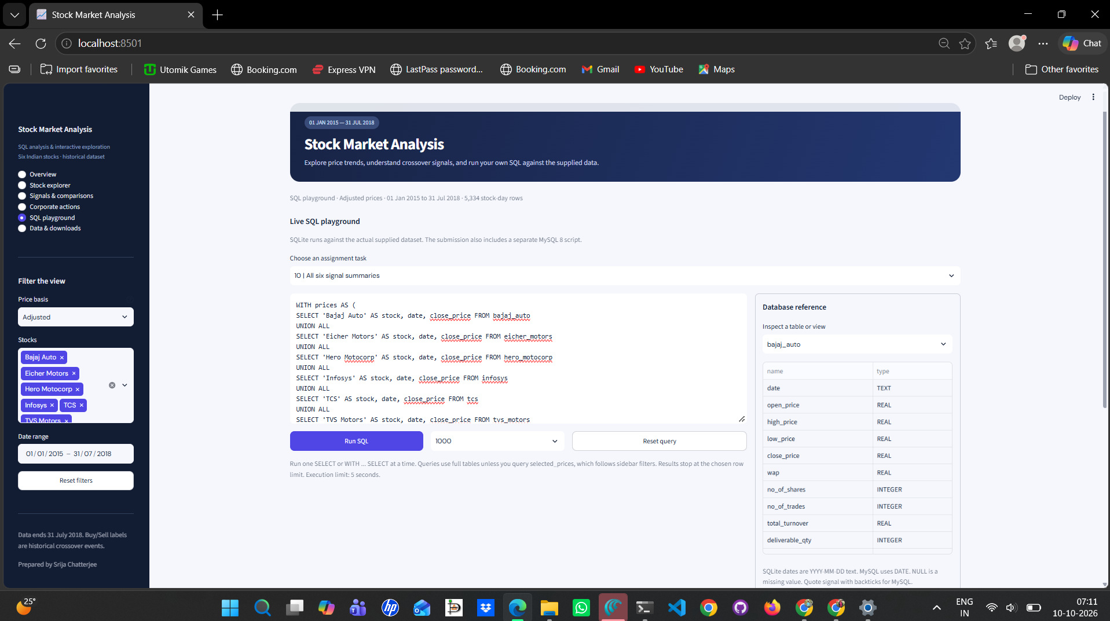
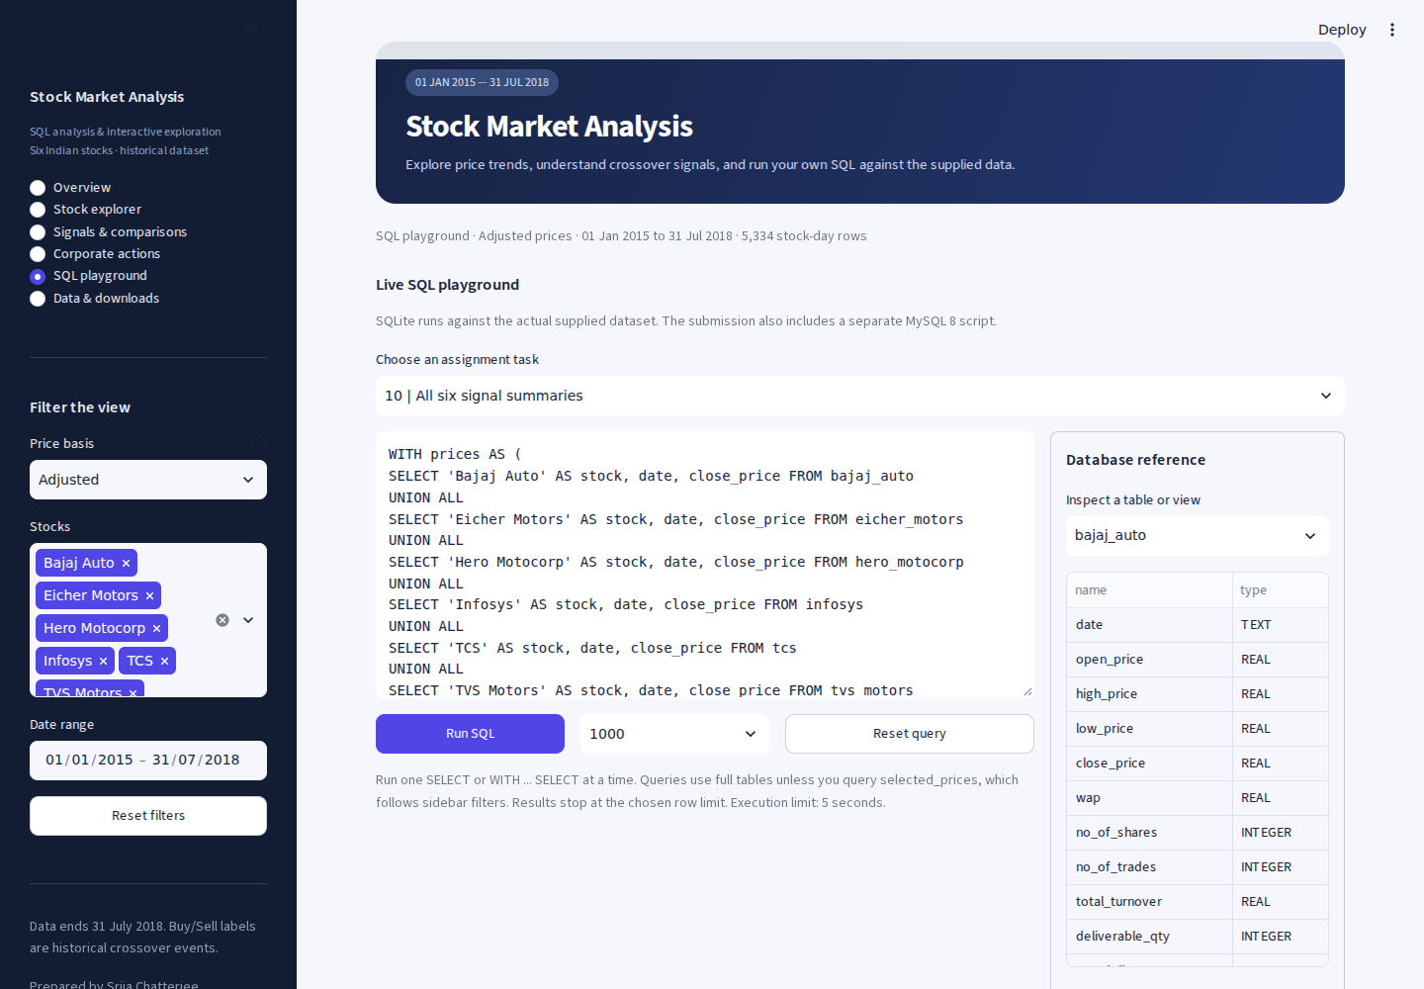
The SQL work behind the dashboard
I can edit a task query, inspect the schema and run it against the actual supplied data.
SQL I used
COUNT, MIN/MAX, AVG: coverage and means.
ROW_NUMBER, window AVG: complete MAs.
LAG and CASE: crossing labels.
JOIN, UNION ALL, CTEs: combine stocks.
SUM, ROUND, SQRT: counts and risk.
The playground runs one read-only SELECT or WITH … SELECT, with a result row cap and a five-second execution limit.
Srija Chatterjee
09 / 12
Notes:
The submission uses MySQL 8, while the interactive playground uses SQLite. Both scripts contain the same supplied records. MySQL extracts the year with YEAR(date), while SQLite uses strftime('%Y',date). I quote the signal column with backticks in MySQL. The SQL functions and clauses include COUNT, COUNT(DISTINCT), MIN, MAX, AVG, SUM, ROUND, SQRT, ROW_NUMBER, LAG, FIRST_VALUE, CASE, COALESCE, NULLIF, NULL checks, PARTITION BY, ORDER BY, ROWS windows, GROUP BY, JOIN, LEFT JOIN, UNION ALL, WITH CTEs, date and julianday in SQLite, and DATEDIFF in MySQL. Running MAX produces the close peak for drawdown, FIRST_VALUE rebases prices, and sample volatility uses daily changes with a sqrt(252) annualization factor.
The editor includes presets for tasks 1-18, a schema inspector, Run SQL, query reset and configurable limits of 100, 1,000, 6,000 or 20,000 displayed rows. Queries use complete database objects unless I choose selected_prices, which follows the stock, date and basis filters. A sidebar change does not silently rewrite a raw assignment preset. run_readonly_query permits one read-only SELECT or WITH SELECT, applies SQLite authorization rules, stops long statements through a progress handler and returns a truncation notice when needed. It blocks database mutations, file-access functions and extension loading. PRAGMA is used internally to inspect table definitions.
Relevant Python functions: task_queries, run_readonly_query, set_selected_view, new_connection, dataframe, render_sql and query_history. The SQL editor preserves its draft across page navigation and the app clearly labels a previously executed result if the editor or selection changes.
Sources
engine.py: task_queries, run_readonly_query and set_selected_view
app.py: new_connection, render_sql and query_history
sql/Stock_Market_Analysis_MySQL.sql
User screenshot 071138 and video screenshot 05_SQL_Playground

Slide 10
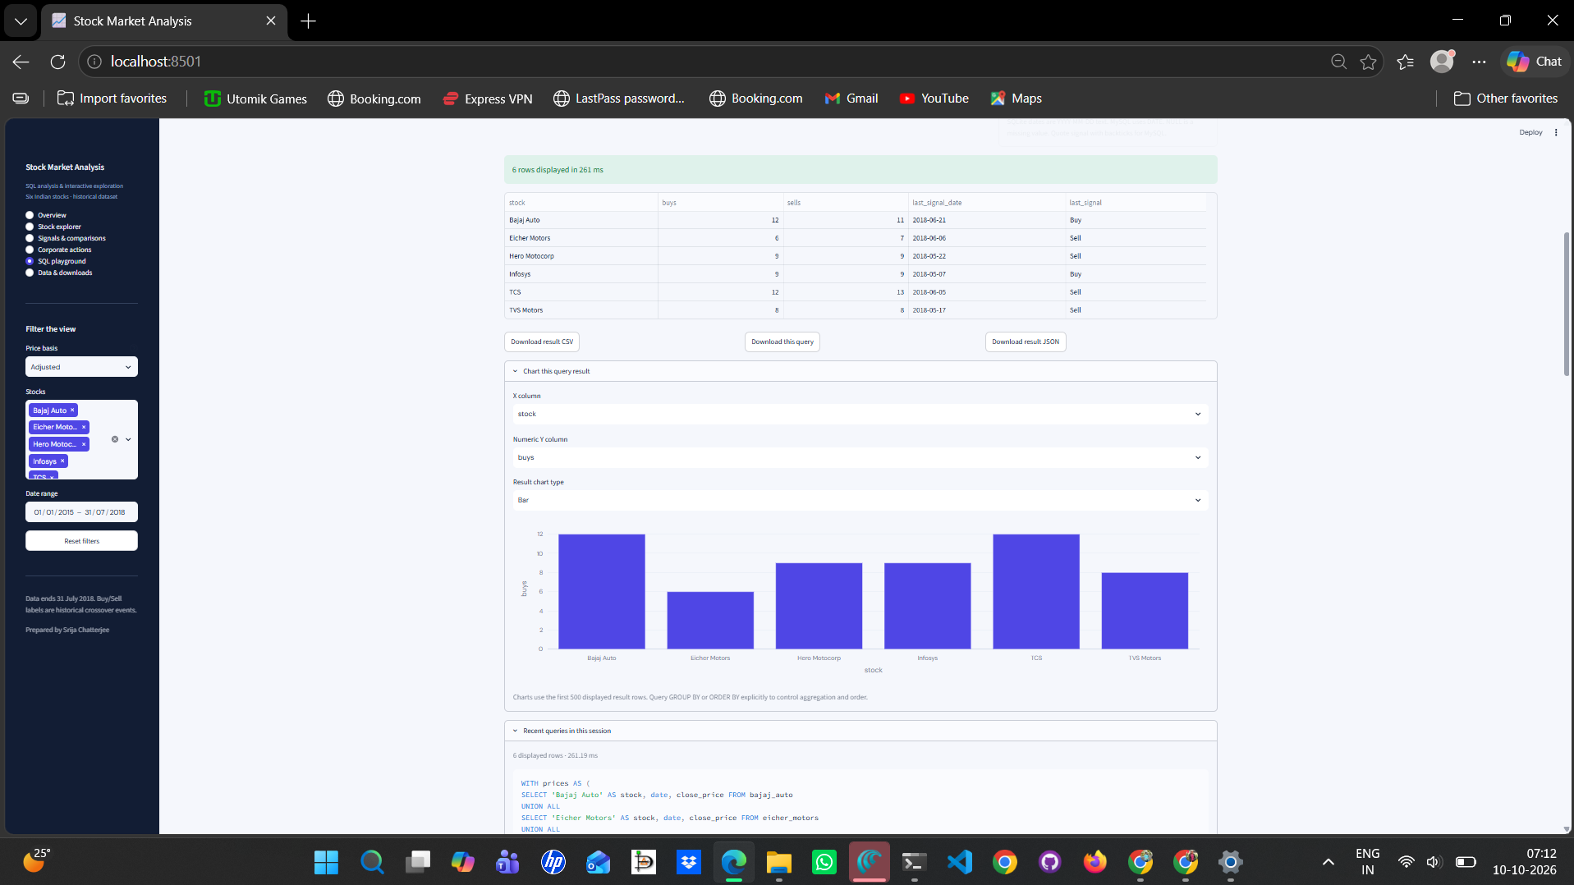
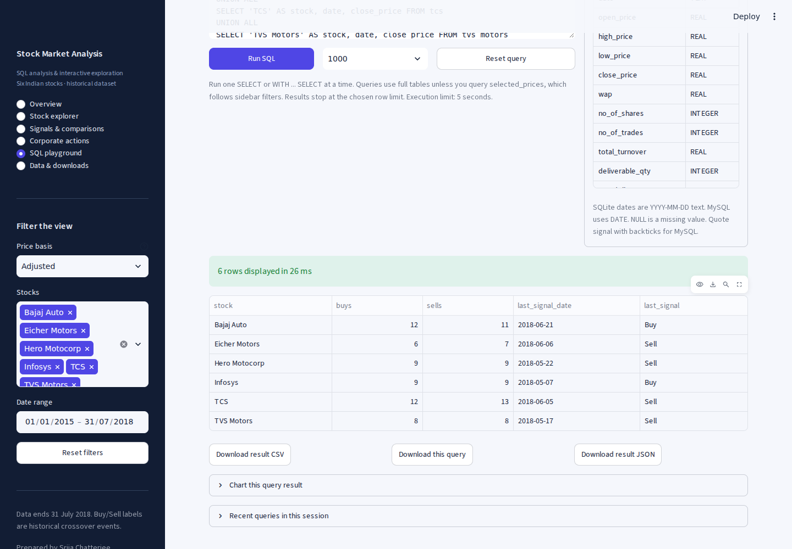
Query results I can inspect and share
The executed query returns a real result table, and I can make a chart from its numeric columns.
Results and exports
Raw task 10 returns six rows.
Total: 56 Buy and 57 Sell.
CSV, JSON and SQL downloads.
Choose X, Y and bar/line/scatter.
Ten recent queries per session.
Task 10 reads the raw assignment tables even when the sidebar says Adjusted. Use selected_prices to follow the sidebar.
Srija Chatterjee
10 / 12
Notes:
The result table displays actual executed rows and measured query time. The result downloads preserve the data as CSV or JSON, and a separate download preserves the exact SQL text. The result chart lets me select an X column, numeric Y column and a bar, line or scatter plot. It uses at most the first 500 displayed rows. I control aggregation and order in SQL with GROUP BY and ORDER BY rather than assuming the chart will aggregate for me. The session history keeps ten recently executed statements.
Raw task-10 counts are Bajaj 12/11, Eicher 6/7, Hero 9/9, Infosys 9/9, TCS 12/13 and TVS 8/8. They sum to 56 Buy and 57 Sell. Adjusted analytics sum to 57 of each. The task-10 preset explicitly queries the six original tables, so the sidebar label does not make that query adjusted. The selected_prices view is the explicit way to follow filters.
The shared display/export helpers are chart, table and csv_button. Streamlit functions include set_page_config, markdown, sidebar, radio, selectbox, multiselect, date_input, checkbox, slider, text_area, text_input, button, metric, tabs, columns, container, dataframe, plotly_chart, expander, download_button, link_button, caption, info, success, warning, error, cache_data, session_state and rerun. Plotly Express creates the result charts. render_downloads handles submission files, original data/database exports, quality inspection and sources. main manages page routing, selection validation and connection cleanup.
Sources
app.py: render_sql, query_history, chart, table, csv_button, render_downloads and main
reports/query_results/task_10.csv
User screenshot 071208 and video screenshot 06_SQL_Result

Slide 11
What I found across the six stocks
The adjusted results separate full-period price changes from the latest crossing and the cost scenario.
Stock | Price change | Buy / Sell | Latest adjusted crossover | Quick reversals | Net scenario return | Maximum drawdown
Bajaj Auto | +10.05% | 12 / 11 | Buy 21 Jun 2018 | 11 | -1.09% | -23.18%
Eicher Motors | +82.56% | 6 / 7 | Sell 06 Jun 2018 | 1 | +71.03% | -28.32%
Hero Motocorp | +6.00% | 9 / 9 | Sell 22 May 2018 | 4 | -18.68% | -26.90%
Infosys | +38.17% | 10 / 10 | Buy 07 May 2018 | 6 | +5.27% | -31.06%
TCS | +52.36% | 12 / 12 | Buy 20 Apr 2018 | 8 | -26.55% | -24.13%
TVS Motors | +86.91% | 8 / 8 | Sell 17 May 2018 | 4 | +90.89% | -34.59%
TVS and Eicher gained most overall. Their latest Sell crossings indicate later weakness.
TVS also had the deepest adjusted drawdown, −34.59%, and the highest annualized volatility, 30.80%.
Scenario: next observed open, INR 100,000 cash, 0.10% fee each transaction, zero slippage, final-close liquidation. Dividends and taxes excluded.
Srija Chatterjee
11 / 12
Notes:
Adjusted full-period price changes are Bajaj +10.0485%, Eicher +82.5623%, Hero +6.0020%, Infosys +38.1719%, TCS +52.3625% and TVS +86.9063%. The latest adjusted crossover is Buy for Bajaj, Infosys and TCS, and Sell for Eicher, Hero and TVS. Those directions also match their final MA20-versus-MA50 regimes. A positive full-period return can coexist with a later Sell because the two measurements answer different questions. I would check a benchmark, the trend at the end of the period and costs before relying on either measurement for a decision. All final-day event labels are Hold.
Annualized sample volatility is 23.29% for Bajaj, 29.12% for Eicher, 22.32% for Hero, 23.79% for Infosys, 21.61% for TCS and 30.80% for TVS. Maximum drawdowns are −23.18%, −28.32%, −26.90%, −31.06%, −24.13% and −34.59% respectively. The scenario return is a modeled strategy outcome, not the first-to-last price change. The modeled fees in INR are 2,461.56 for Bajaj, 1,580.85 for Eicher, 1,623.20 for Hero, 1,794.58 for Infosys, 1,857.46 for TCS and 1,958.65 for TVS. Costs and timing help explain why Bajaj, Hero and TCS scenarios finish below starting cash.
Limitations: the moving average lags prices, only six selected stocks are present, the dataset ends in July 2018, and dividend, benchmark, news, actual cost and tax data are missing. I cannot interpret this as current market guidance.
Sources
reports/query_results/full_summary.csv
reports/query_results/task_16.csv and task_17.csv
reports/query_results/execution_scenario.csv
Student guide, insight questions on page 19.

Slide 12
What I learned and what I would improve
The main lesson for me was to understand the calculation before drawing a conclusion from a chart.
What I learned
What I would improve next
I learned to use SQL windows and previous-day values without using future rows.
Keeping raw and adjusted prices separate helped me explain the bonus issues.
I learned to check dates, NULLs and crossing rules before trusting a result.
The cost scenario showed me why a Buy signal alone cannot establish profitability.
Connecting each chart to a query made the findings easier to explain.
I would add dividends and a broad market benchmark for a fairer comparison.
I would include a more complete corporate-action history.
I would test other MA windows on unseen periods and compare realistic costs.
I would connect fresh data and deploy the dashboard with scheduled updates.
I would add custom-file validation and more accessibility options.
For this version, my conclusions stay within the six supplied stocks and the 2015-2018 period.
Srija Chatterjee
12 / 12
Notes:
Through this project, I learned how SQL window functions connect individual trading records to a complete analysis. I learned that the same data can lead to a misleading conclusion if I ignore a bonus issue or confuse a daily event with a portfolio position. I also learned to preserve missing values, distinguish trading observations from calendar days and check my calculations before interpreting charts. The app made it easier for me to move between a visual result and the query behind it.
For future improvements, I would add dividend data and a broad market benchmark, include a more complete corporate-action history and test alternative moving-average windows on unseen periods. I would compare more realistic costs and execution assumptions. I would also connect refreshed data, host the dashboard with scheduled updates, improve accessibility and validate custom uploads. These are proposed next steps, not features already implemented. My current conclusions remain limited to the supplied six-stock dataset, ending on 31 July 2018.

